Slide 1
español, con Quique

Slide 2
Describing me and others
verde
- To be [state and trait]: estoy vs. soy; está vs. es
- SSC [e] [i]
Notes:
Artwork by Steve Clarke. All additional pictures selected are available under a Creative Commons license, no attribution required.
The frequency rankings for words that occur in this PowerPoint which have been previously introduced in the resources are given in the SOW (excel document) and in the resources that first introduced and formally re-visited those words.
For any other words that occur incidentally in this PowerPoint, frequency rankings will be provided in the notes field wherever possible.
Phonics:
Revisit SSC: [e] elefante [>5000] [i] idea [247]
Vocabulary (new words in bold): es [ser, 7] está [estar 21] amigo(a) [210] negativo [1804] perdido [1899] perfecto [1115] positivo [1188] preparado [2092] tranquilo [1093] mi [37] demasiado [494] hoy [167] normalmente [1696] pero [30]
Revisit 1: a menudo [958] en¹ [5] enero [1173] febrero [1419] marzo [1231] abril [1064] mayo [909] junio [1035] julio [659] agosto [931]septiembre [1150] octubre [1242] noviembre [1434] diciembre [1165] Revisit 2: crear [239] organizar [1053] preparar [570] aula [3501] lista [1189] fiesta [796] útil [3951]
Source: Davies, M. and Davies, K. (2018). A frequency dictionary of Spanish: Core vocabulary for learners (2nd ed.). Routledge: London

Slide 3
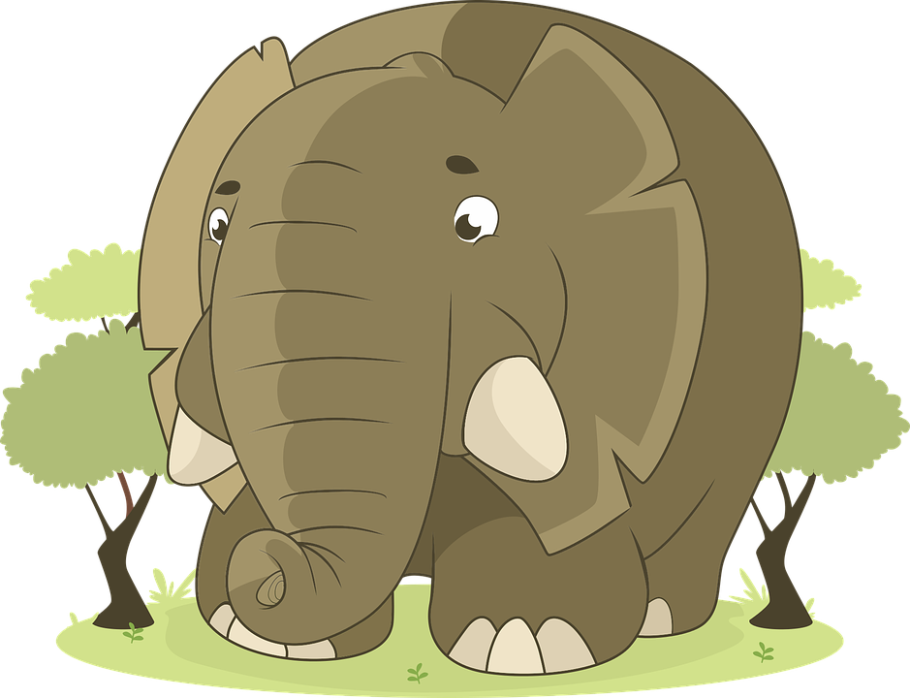
[e]
elefante
pronunciar
Notes:
Timing: 1 minute
Aim: to revisit SSC [e]
Procedure:
Click to present and elicit the pronunciation of the individual SSC [e] and then the source word ‘elefante’ (with gesture, if using).
Click to bring up the picture and get pupils to repeat (with gesture, if using).
Pupils to practise (for a few seconds) in pairs.
Gesture: the suggested gesture for ‘elefante’ is to raise the right arm as though an elephant is raising its trunk.

Slide 4
[i]
idea
pronunciar
Notes:
Timing: 1 minute
Aim: to revisit SSC [i]
Procedure:
Click to present and elicit the pronunciation of the individual SSC [i] and then the source word ‘idea’ (with gesture, if using).
Click to bring up the picture and get pupils to repeat (with gesture, if using).
Pupils to practise (for a few seconds) in pairs.
Gesture: the suggested gesture for ‘idea’ is to raise the index finger of the right hand in the air quickly as an exaggerated mime of someone having an idea.

Slide 5
pronunciar
[i]
idea
[e]
elefante
Notes:
Timing: 2 minutes
Aim: To practise SSC [e] [i]
Procedure:
Click to bring up SSC and elicit pronunciation of the SSC and the source word from pupils.
Click one more time to bring up the written form of the source word.
Next two clicks bring up picture of source words – elicit words again from pupils.
For further practice, pupils work in pairs. One pupils use a gesture, the partners elicits the source word.

Slide 6
Lee y escribe.
Persona A lee. Persona B escucha y escribe las letras.
pronunciar
Persona B ahora.
Persona A ahora.
1. Treinta días tiene noviembre,
1
1
1. Veintiocho solo hay uno
Thirty days has November
Twenty-eight there is only one
2
2
2. con abril, junio y septiembre.
2. y los demás treinta y uno.
with April, June and September
and the rest thirty-one.
Notes:
Timing: 6 minutes
Aim: to practise SSC [e] [i] in a paired dictation task; to practise written comprehension of revisited vocabulary.
Note: i) see final slide for a handout for this task. ii) for a higher level of challenge, pupils could transcribe the full sentences (in which case they will not need the handout). iii) pupils learnt the months in Y3/4 and revisited them briefly last week; however, they have not yet done numbers above 12.
Procedure:
Explain that pupil A will read two sentences out loud, and pupil B will listen and write the missing letters.
B turns away from the board with his/her handout.
Click to bring up the two sentences.
A reads each one clearly and slowly, repeating as necessary.
B writes in the missing letters.
B turns back to check his/her work on the board. Click each number to hear the sentence said by a native speaker.
Swap roles. A turns away. Repeat steps 3-6.
When all four sentences are on the board, elicit the English meanings from pupils. This revisits some of this week’s vocabulary from Y3/4.

Slide 7
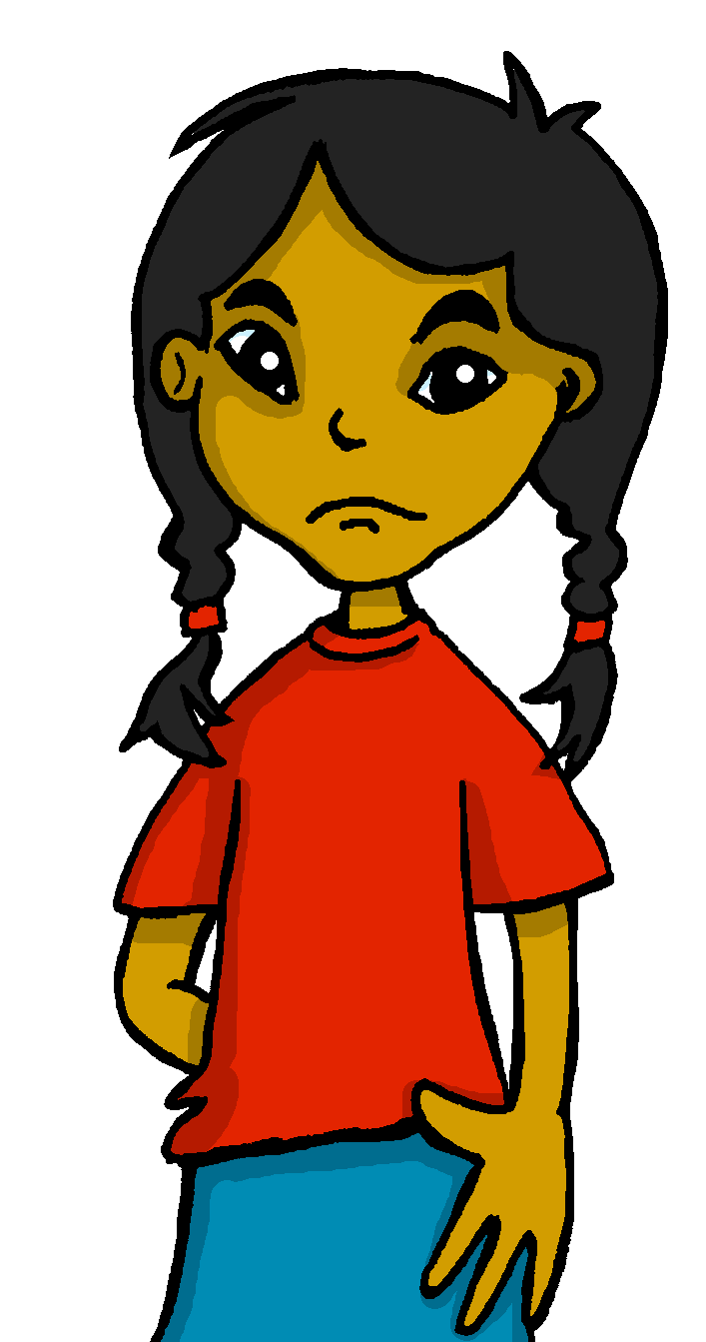
estar | ser: I am vs. s/he is
[to be, being]
To say where something or someone is and describe a temporary state use _______.
estar
To talk about permanent traits use_______.
ser
I am
s/he is
Estoy tranquilo.
Sofía está negativa.
I am (feeling) calm.
Sofía is (feeling) negative.
⚠ I am a positive person in general.
Soy positivo.
Sofía es divertida.
⚠ Sofía is a funny person.
I am positive.
Sofía is funny.
Notes:
Timing: 2 minutes
Aim: to revisit the two meanings of ‘to be’ (temporary states, permanent traits) in 1st and 3rd person singular
Procedure:
Use the animations to present the information about “estar” and “ser”.
Elicit English translations for the Spanish examples provided.
Note: we haven’t revisited [qui] yet so pupils might need help pronouncing this sound (use ‘key’ gesture).

Slide 8
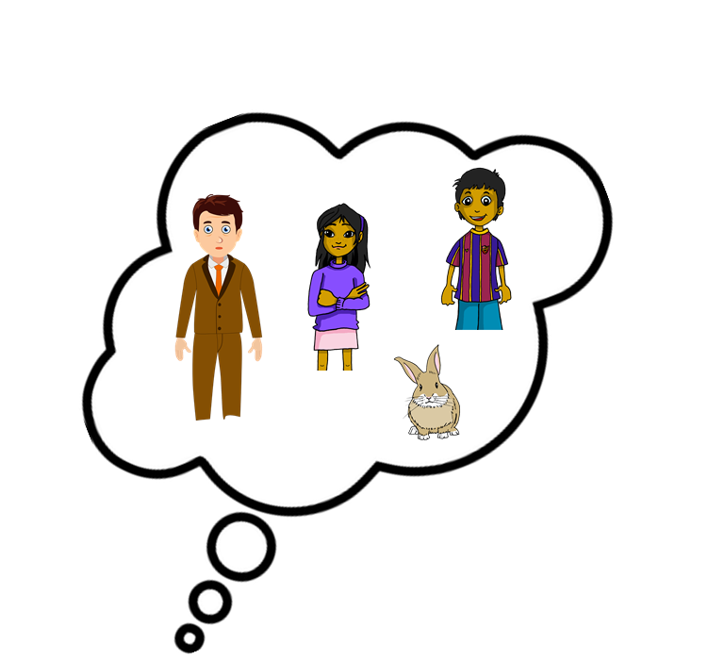
escuchar
Escucha a Quique. ¿A quién describe?
Marca
Escribe el verbo: ¿today / location or in general?
Quique | Someone else
verbo
today / location | in general
E
estoy
1
es
2
está
3
soy
4
estoy
5
es
6
soy
Notes:
Timing: 8 minutes
Aim: to practise listening out for the verbs ‘estoy’, ‘soy’, ‘está’, ‘es’ and connect the verb forms to the person they refer to. To then practise processing the meaning of the two verbs.
Procedure:
1. Ask pupils to write 1-6 in their books.
2. Read the instruction in Spanish from the board.
3. Tell them that they will hear Quique talking about himself or one of his friends (or his teacher). Tell them they need to pay attention to whether they hear “está”, “es”, “soy” or “estoy”. Encourage pupils to write the verb down for support, too.
4. Do the example with them, just Part 1 where they identify the person.
5. Do 1-6. The first time they listen, they should identify the person to whom Quique refers (herself – one of his friends) and tick the correct box.
Part 2
6. The second time they listen, if they haven’t already written the verb, they should do so now, then tick to identify the correct use of ser / estar.
7. Do the example with them.
8. Do 1-6.
Note: we omit adverbs here (e.g. hoy, siempre) to avoid giving additional clues about the meaning of the verb. Pupils are therefore compelled to connect soy/es and estoy/está with their meanings.
Transcript:
E. Estoy en el aula.
1. A menudo es muy tranquilo.
2. ¡Está perdido!
3. Soy muy positivo y divertido.
4. Estoy cansado.
5. ¡Es increíble!
6. Soy rápido en clase.

Slide 9
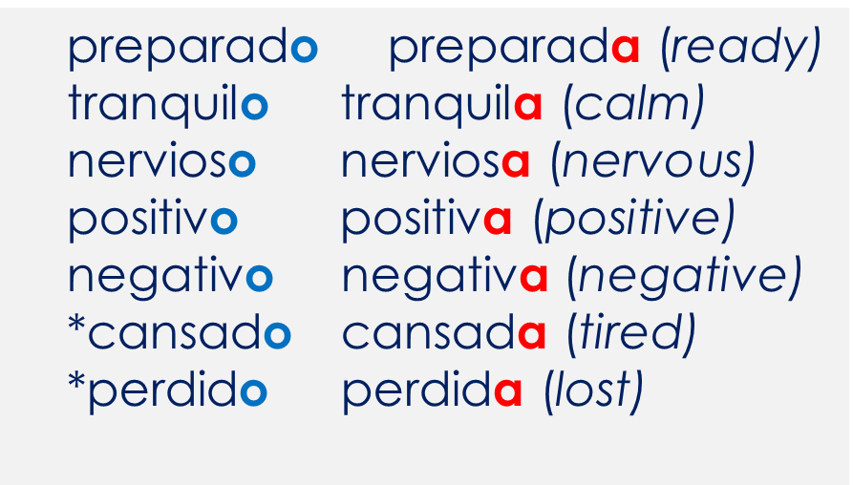
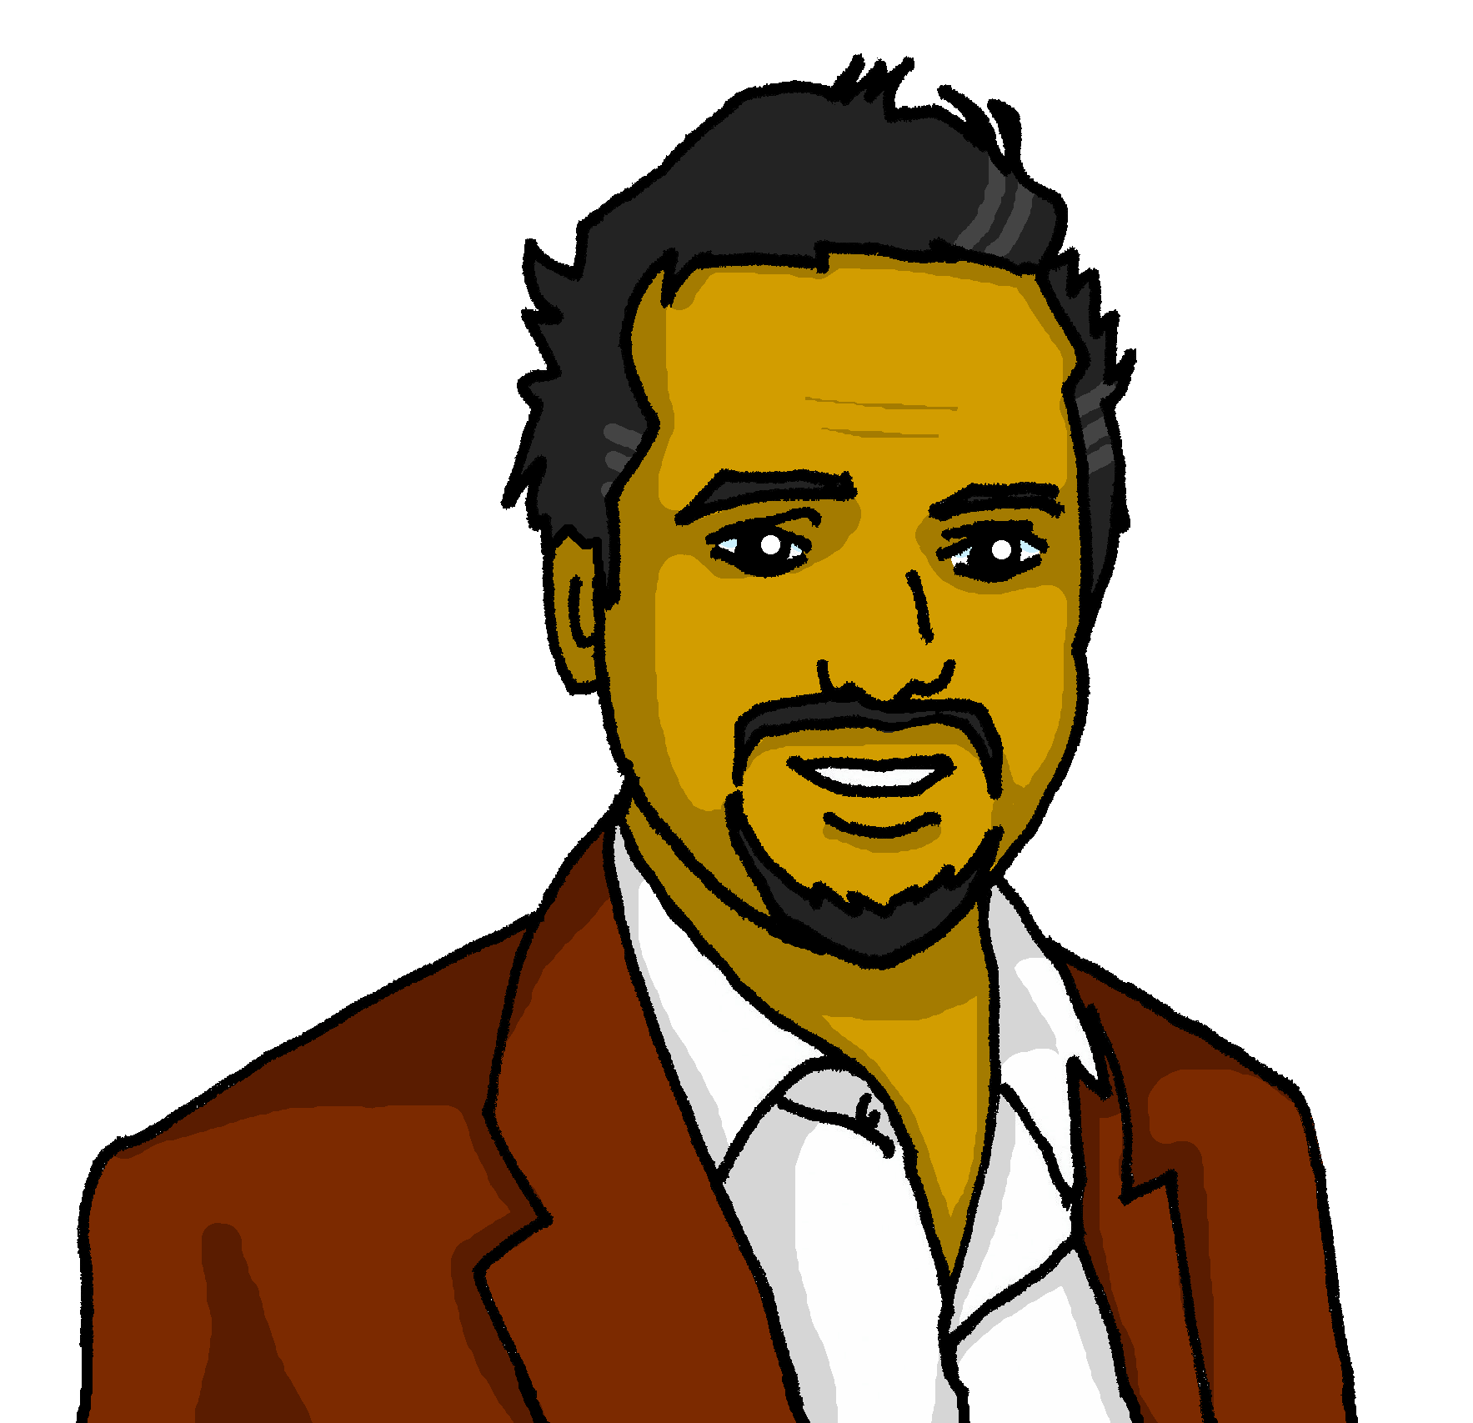
gender agreement
In Spanish, we already know that adjectives that end in ‘o’ change to end in ‘a’ when the noun being described is feminine.
*
⚠ *cansado, perdido and preparado can only be used with estar as they are temporary states.
cansado
perdida
Pedro está __________.
(tired)
Elena está _________.
(lost)
Notes:
Timing: 2 minutes
Aim: to revisit singular regular masculine and feminine adjectival agreement for nouns ending in –o.
Read the grammar explanation on agreeing adjectives with feminine / masculine nouns.
Elicit correct form of the adjective for “Pedro” and “Elena” from pupils, using the grey box.

Slide 10
leer
Escucha y lee: ¿Quién es?
pero
también
demasiado
but
also
too
4
Ángela
Rubén
Pedro
2
3
1
Elena
1. Es muy tranquilo pero hoy está nervioso. Es mi padre y es demasiado serio.
2. Está en mi clase de español. Es rápida pero hoy está cansada. Es mi amiga.
3. Es positivo y también es divertido cuando está en clase. Es mi amigo.
4. Normalmente está preparada y es divertida. Es perfecta y es mi madre.
i. __
1
ii. __
i. __
ii. __
2
i. __
ii. __
3
4
i. __
ii. __
Notes:
Timing: 8 minutes
Aim: to practise written comprehension of es / está + key adjectives for description in a longer context.
Procedure:
Read the instructions in Spanish.
Tell pupils Quique is going to describe Elena, Ángela, Rubén and Pedro.
First, pupils read sentence 1 and decide which verb (es or está) fills the gap. The clues are provided by the surrounding words (the adverbs and/or the adjectives).
Click to play sentence 1 to them to check their verb choices. Click to reveal the two written answers.
Next, draw pupils’ attention to the gender of the adjectives (masculine). This narrows down the options to two (Pedro/ Rubén). Then elicit English meaning of the adjectives (calm, nervous and serious). Recognising “padre” is key in order to be able to make the right choice.
6. Repeat steps 3-5 with sentences 2-4.
7. Elicit English translations of all sentences orally.
Note: Members of the family are revisited here (madre / padre – Y3/4). Ensure pupils are familiar with these.

Slide 11
¡adiós!
verde

Slide 12
Handout
pronunciar
Persona B
Persona A
1. Tr_inta d_as t_ _n_ nov_embr_,
1. V_int_ocho solo hay uno
2. con abr_l, jun_o y s_pt_ _mbr_.
2. y los demás tr_ _nta y uno.
Notes:
HANDOUT
Note: teachers may want to use this for students who need support with the pairwork task. Otherwise, pupils could be encouraged to write the full phrases.

