Slide 1
Describing me and others
verde
Follow ups 1-5
Notes:
Artwork by Steve Clarke. All additional pictures selected are available under a Creative Commons license, no attribution required.
The frequency rankings for words that occur in this PowerPoint which have been previously introduced in the resources are given in the SOW (excel document) and in the resources that first introduced and formally re-visited those words.
For any other words that occur incidentally in this PowerPoint, frequency rankings will be provided in the notes field wherever possible.
Phonics:
Revisit SSC [a] [o] [u] Source words: casa [106] dos [64] universo [1603]
Vocabulary (new words in bold): estar [21] estoy [21] estás [21] ser [7] soy [7] eres [7] quién [289] amigo(a) [210] profesor(a) [501] contento [1949] divertido [2465] elegante [2742] enfermo [1092] increíble [1642] inteligente [2167] lento [1569] perfecto [1115] pesado [2166] preparado [2092] rápido [870] serio [856] triste [1370] ¡Buenos días! [103/65] ¡Buenas tardes! [103/392] hola [1245]
Revisit 1: cumpleaños [3372] mes [288] enero [1173] febrero [1419] marzo [1231] abril [1064] mayo [909] junio [1035] julio [659] septiembre [1150] octubre [1242] noviembre [1434] diciembre [1165] cuándo [138] mi [37] tu [53] en [5] Revisit 2: cuento [853] deportista [>5000] naranja [>5000] rosa [>5000] después [115] muy [43] mí [17] (para [16])
Source: Davies, M. and Davies, K. (2018). A frequency dictionary of Spanish: Core vocabulary for learners (2nd ed.). Routledge: London

Slide 2
Follow up 1:
[a]
[o]
[u]
B Lee los meses en orden cronológico.
A Escucha. ¿Qué palabra es?
marzo
enero
pronunciar
abril
febrero
[EJ]
moro | mora
diciembre
marzo
60
[1]
cano | cuna
octubre
abril
[2]
julio
mayo
paso | pasa
agosto
junio
[3]
rosa | rusa
noviembre
julio
[4]
duda | dudo
enero
agosto
septiembre
septiembre
[5]
rima | rimo
febrero
octubre
0
junio
noviembre
mayo
diciembre
INICIO
Notes:
Timing: 5 minutes
Aim: to practise aural discrimination of the SSC [a] [o] [u].
Procedure:
Click to bring up the prompts.
Click on each audio symbol to listen to the words.
Click for the number answers. Pictures appear to clarify meaning.
Transcript: [E] mora
[1] cano
[2] paso [3] rusa
[4] duda
[5] rimo
Aim: to develop read aloud of words with SSC [a] [o] [u] and practise knowledge of alphabetical order.
Procedure:
Click to bring up the instruction.
Click to bring up the list of names.
Explain that pupils have one minute to pronounce the names, but in alphabetical order.
Start the timer. Pupils work in pairs, saying one each and alternating.
Teacher elicits answers one by one chorally from the class, and clicks to confirm.
Transcript: enero febrero marzo abril mayo junio julio
Agosto septiembre octubre noviembre diciembre

Slide 3
Follow up 2: estar | ser
estar
ser
[to be | being] (mood and temporary states)
[to be | being] (permanent traits)
You know there are two verbs ‘to be’ in Spanish.
Compare:
¿Cómo estás?
¿Cómo eres?
How are you (feeling)?
How are you (in general)? (What are you like?)
Estoy perfecto.
Soy perfecto.
I am (feeling) perfect.
I am perfect (in general).
Notes:
Timing: 7 minutes (two slides)
Aim: to recap knowledge of the two verbs ser and estar.
Procedure: Use the animations to present and elicit knowledge from pupils.

Slide 4
escuchar
Escucha.
La señora Cano has more questions for her new class.
Is she asking about feelings today (hoy) or characteristics in general (generalmente)?
Escribe el verbo (soy|estoy), marca hoy|generalmente, escribe el adjetivo en inglés.
verbo | hoy? | general- mente? | adjetivo (en inglés)
EJ
estoy
quick (f)
EJ
1
estoy
ill, sick (m)
1
2
soy
smart (m/f)
2
3
estoy
perfect (f)
3
4
soy
intelligent (m/f)
4
5
soy
very serious (m)
5
Notes:
Aim: to differentiate aurally between eres and estás, using the information to inform the correct choice of verb (soy | estoy) in the response, and the connection of both with meaning.
Procedure:
Model the task by doing the example. Pupils listen to the question and answer. The verb in the question informs their choice of verb in the answer (the verb is obscured by a beep). Pupils write the verb soy or estoy. They then tick today/now or in general, and write the adjective in English.
Click to play items 1-5. It is likely pupils will need to listen to each one twice.
Click to reveal the answers.
Transcript
E ¿Cómo estás? | [beep] rápida.
1. ¿Cómo estás? | [beep] enfermo.
2. ¿Cómo eres? | [beep] elegante.
3. ¿Cómo estás? | [beep] perfecta.
4. ¿Cómo eres? | [beep] inteligente.
5. ¿Cómo eres? | [beep] muy serio.
Transcript 2
E ¿Cómo estás? | Estoy rápida.
1. ¿Cómo estás? | Estoy enfermo.
2. ¿Cómo eres? | Soy elegante.
3. ¿Cómo estás? | Estoy perfecta.
4. ¿Cómo eres? | Soy inteligente.
5. ¿Cómo eres? | Soy muy serio.

Slide 5
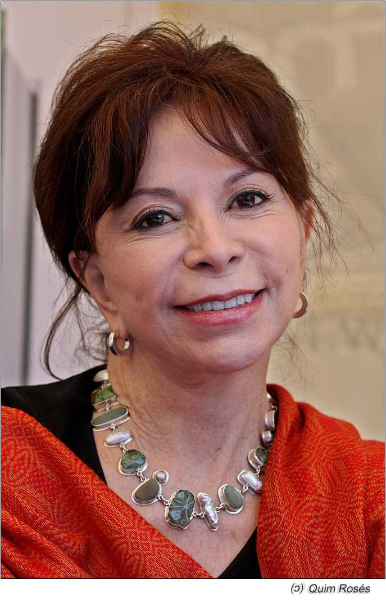
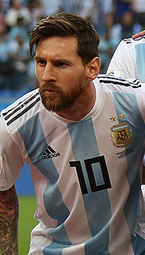
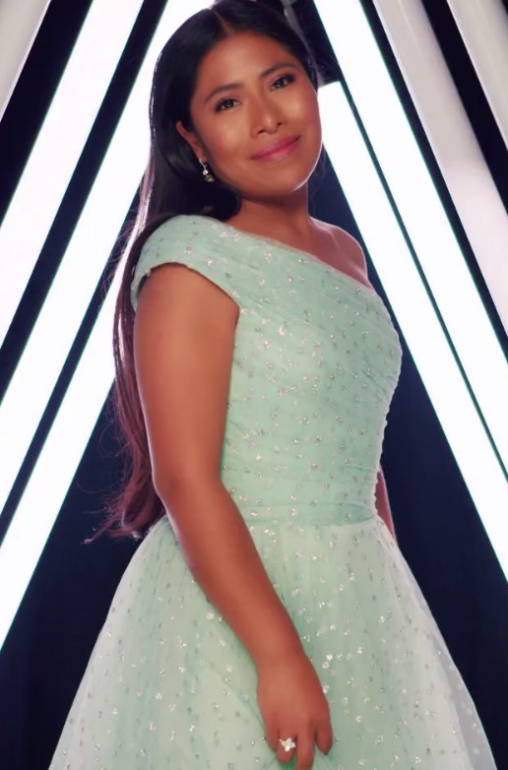
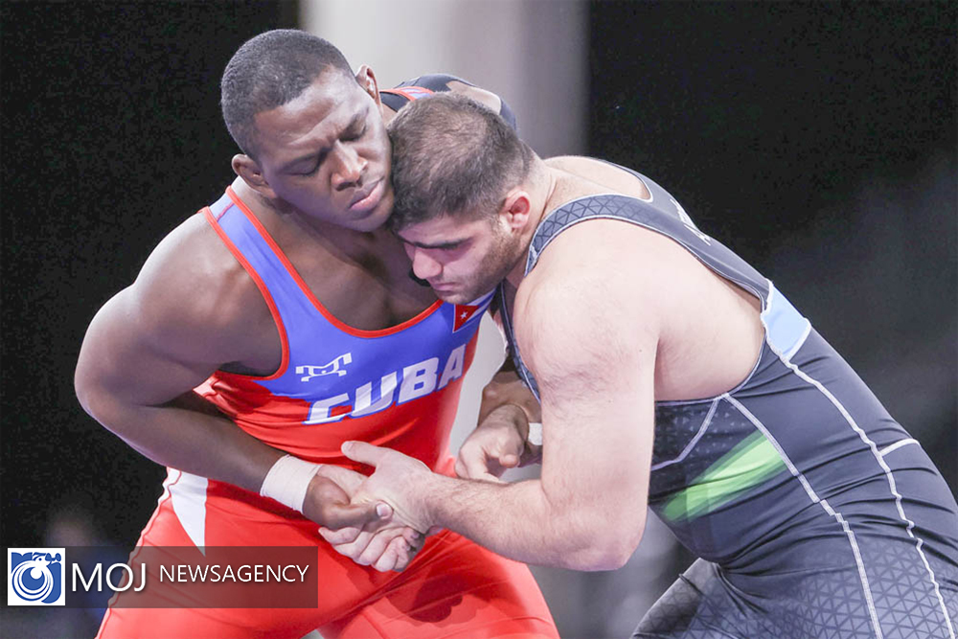
Follow up 3:
Lee el diálogo.
Escribe en español.
1
2
- ¿Quién eres?
- Soy Isabel Allende.
- ¿Cómo eres ?
- Soy inteligente y divertida.
- ¿Cómo estás?
- Estoy perfecta, gracias. Ah – soy de Perú y Chile.
- ¡Hola! ¿Cómo estás?
- Estoy preparado.
- ¿Quién eres?
- Soy Lionel Messi y soy
muy rápido.
- ¿De dónde eres?
- Soy de Argentina.
1 ___
1 __?
leer
escribir
2 ___
2 ___
3 ___
escuchar
3 ___
4 ___?
4 ___
3
4
- ¿Quién eres?
- Soy Yalitza Aparicio.
- ¿Cómo estás?
- Estoy muy contenta.
- ¿Cómo eres?
- Soy inteligente y elegante. Soy de Méjico.
- Buenas tardes. ¿Cómo estás?
- Estoy increíble.
- ¿Quién eres?
- Soy Mijaín López y soy serio y deportista. Soy de Cuba.
1 ___
1 ___
2 ___?
2 ___
3 ___
3 ___?
4 ___
4 ___
Notes:
Timing: 10 minutes
Aim: to practise recognition of the key vocabulary (adjectives and question words quién | cómo) linked to the correct translation of forms of estar | ser.
Procedure:
Do the example with them. Draw pupils’ attention to the words before and/or after the gap. For number 1 ask them ‘if we use “soy” + name to reply, which question word is missing?’ For number 2, pupils need to look at the words before and after the gap to work out which verb is missing. Guide them through 3 and 4 in a similar way. The click the number to hear the audio and pupils check their answers. Click to reveal the written answers.
Click to bring up text 2.
Give pupils time to complete items 1-4. Then click on the blue numbered buttons to listen and check and reveal the written answers.
Click to bring up texts 3 and 4 and complete, as previously.
Note: the texts are reused for comprehension tasks in follow up 4.
Attributions: Yalitza Aparicio: Cal Laird, CC BY 3.0, via Wikimedia Commons
Isabel Allende: Jroses, CC BY-SA 3.0, via Wikimedia Commons Mijaín López: MojNews, CC BY 4.0, via Wikimedia Commons
Lionel Messi: Кирилл Венедиктов, CC BY-SA 3.0 GFDL, via Wikimedia Commons

Slide 6
Follow up 4:
Ahora lee las frases.
How do they describe themselves?
leer
 |  | In general | today
1 | Soy Isabel Allende y soy inteligente y divertida. Estoy perfecta, gracias. Soy de Perú y Chile.
2 | Estoy preparado. Soy Lionel Messi y soy muy rápido. Soy de Argentina.
3 | Soy Yalitza Aparicio. Estoy muy contenta. Soy inteligente y elegante. Soy de Méjico.
4 | Estoy increíble. Soy Mijaín López y soy serio y deportista. Soy de Cuba.
intelligent
perfect
funny
fast
ready
intelligent
pleased
elegant
serious
incredible
sporty
Notes:
Timing: 5 minutes
Aim: to recognise the key vocabulary (adjectives) linked to the correct meaning of forms of estar | ser (to be / being).
Procedure:
1. Do the example with them. Draw their attention to the underlined adjectives and the verb that accompanies them (soy creativa y tranquila). Ask them if we use “soy” as “I am in general” or “I am (feeling) today”. Repeat with “estoy positiva”.
2. Ask pupils to write 1-4, and write down in general / today on top. pupils to write the English translation under the right category. 3. Click to reveal answers.

Slide 7
Follow up 5:
Prepara el diálogo.
hablar
- ¡Buenas tardes!
¿Cómo estás?
¡Hola! [I am (state)] contenta.
Estoy
- ¿Quién eres?
[I am (trait)] Sofía.
Soy
- ¿Cómo eres?
Soy [fast] y muy inteligente.
rápida
Notes:
Support slide to model a dialogue, if time allows.
Timing: 2 minutes
Aim: to model the key questions and answers using soy / estoy / eres / estás + correct adjectival agreement.
Procedure: Click through the animations to present and elicit the key language.

Slide 8
Follow up 5:
Con tu compañero/a, habla.
1
Good morning!
How are you (in general)?
hablar
4
Good afternoon!
I am … (in general)
Hello!
60
serio seria (serious)
pesado pesada (annoying)
perfecto perfecta (perfect)
divertido divertida (fun)
lento lenta (slow)
rápido rápida (fun)
elegante (elegant)
increíble (incredible)
enfermo* enferma (ill)
triste* (sad)
2
How are you (today)?
(Today) I am …
S
3
Who are you?
I’m (name).
0
muy
very
INICIO
Notes:
Timing: 5 minutes
Aim: to use the full range of new and revisited language from this week in spoken production.
Procedure:
Explain the format of the task. (teal writing = Pupil A, dark blue = Pupil B)
Pupils practise in pairs. They produce most of the language from memory but have a list of m/f adjectives to support this element of production.
Pupils swap roles so that they have the opportunity to both ask and answer questions.
Teacher circulates to support, as necessary.
Click on the buttons to hear the audio.

Slide 9
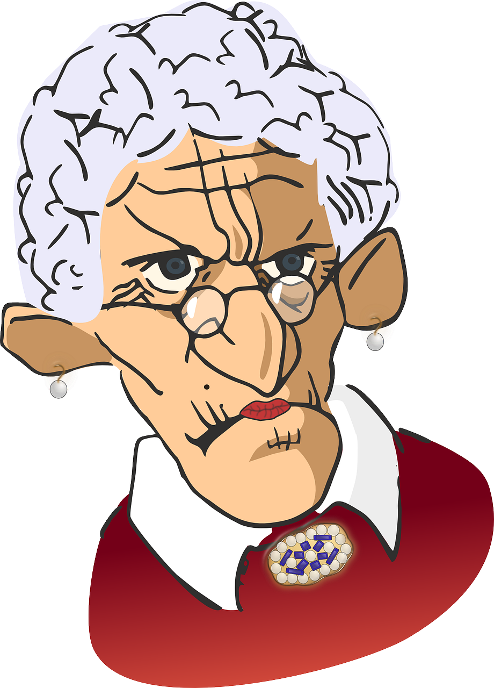
Follow up 5 :

Escribe la descripción en español.
escribir
I am Mrs Costa and I am from Spain. I am very annoying and slow every day. Today I am sad but I am prepared. I have a story for my class.
Soy la Señora Costa y soy de España. Soy muy pesada y lenta cada día. Hoy estoy triste pero estoy preparada. Tengo un cuento para mi clase.
a story – un cuento
Notes:
Additional follow up task
Timing: 10 minutes
Aim: to practise the key grammar features and key new and revisited vocabulary from this week.
Procedure: 1. Present the task. 2. Pupils write the four sentences in Spanish. 3. Click to provide a written answer.
Note: pupils should be encouraged to have a go at writing the words from memory. They should see this a practice task in which mistakes are expected and part of the process. Teachers should ensure that pupils understand the value of writing from memory as memory forming and strengthening – it is this practice itself which constitutes learning. Some of the vocabulary in the text have not been revisited for some considerable time, and pupils are likely to have forgotten some of it. They should just try their best, leaving gaps where they cannot remember, and not see this as a problem. They can add the words they didn’t remember during the feedback stage of the activity (perhaps in a different colour to highlight these words for additional attention later). Additional task suggestions: 1. If this is too challenging for pupils, it could be provided as a gapped writing. 2. Alternatively, reverse the animations and provide the Spanish text for translation into English as a reading comprehension task. 3. There is a further individual word revision text on the next, which could be used instead.

Slide 10
Follow up 5:
Escribe en español: Can you get at least 15 points?
 | big (m/f) | weak (m/f) | strong (m/f)
 | (the) boy | (the) girl | too much
 | famous (m) | typical (f) | (the) place
 | to accompany | to take place | music
 | friend (f) | perfect (m) | ill, sick (f)
 | How? | I am (state) | annoying (f)
 | Who? | you are (state) | teacher (m)
grande
débil
fuerte
x3
el chico
la chica
demasiado
famoso
típica
el lugar
x2
acompañar
tener lugar
la música
la amiga
perfecto
enferma
¿Cómo?
estoy
pesada
x1
¿Quién?
estás
el profesor
Notes:
Alternative additional follow up task
Timing: 6 minutes
Aim: to practise written production of vocabulary for this week and previous weeks.
Procedure:
1. Pupils need to write the Spanish for as many words as possible, aiming to get at least 15 points (but more if possible).
2. Click for Spanish answers.
Note: i) the most recently learnt and practised words are pink. As this is the first lesson in Y5/6, words in green / blue are from Y3/4 SOW thus more points are awarded for them, to recognise that memories fade and more effort (heavy lifting!) is needed to retrieve them. ii) if teachers want to hand out a blank grid they can print the following slide.

Slide 11
Follow up 5:
Escribe en español: Can you get at least 15 points?
 | big (m/f) | weak (m/f) | strong (m/f)
 | (the) boy | (the) girl | too much
 | famous (m) | typical (f) | (the) place
 | to accompany | to take place | music
 | friend (f) | perfect (m) | ill, sick (f)
 | How? | I am (state) | annoying (f)
 | Who? | you are (state) | teacher (m)
x3
x2
x1
Notes:
BLANK GRID FOR PRINTING

