Slide 1
español, con Sofía

Slide 2
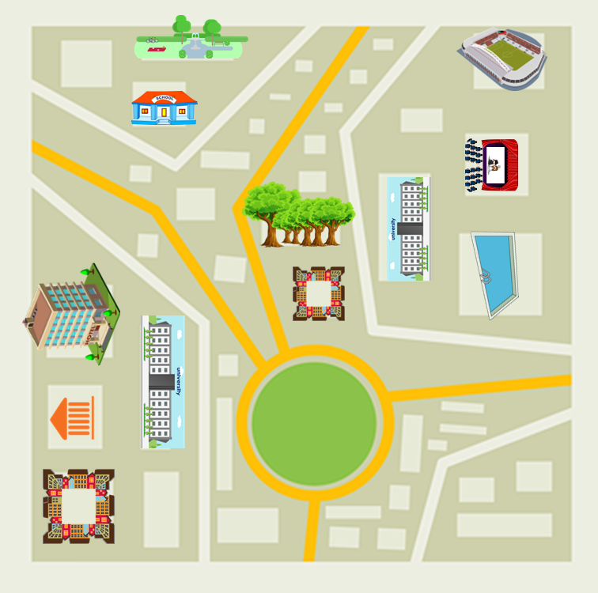
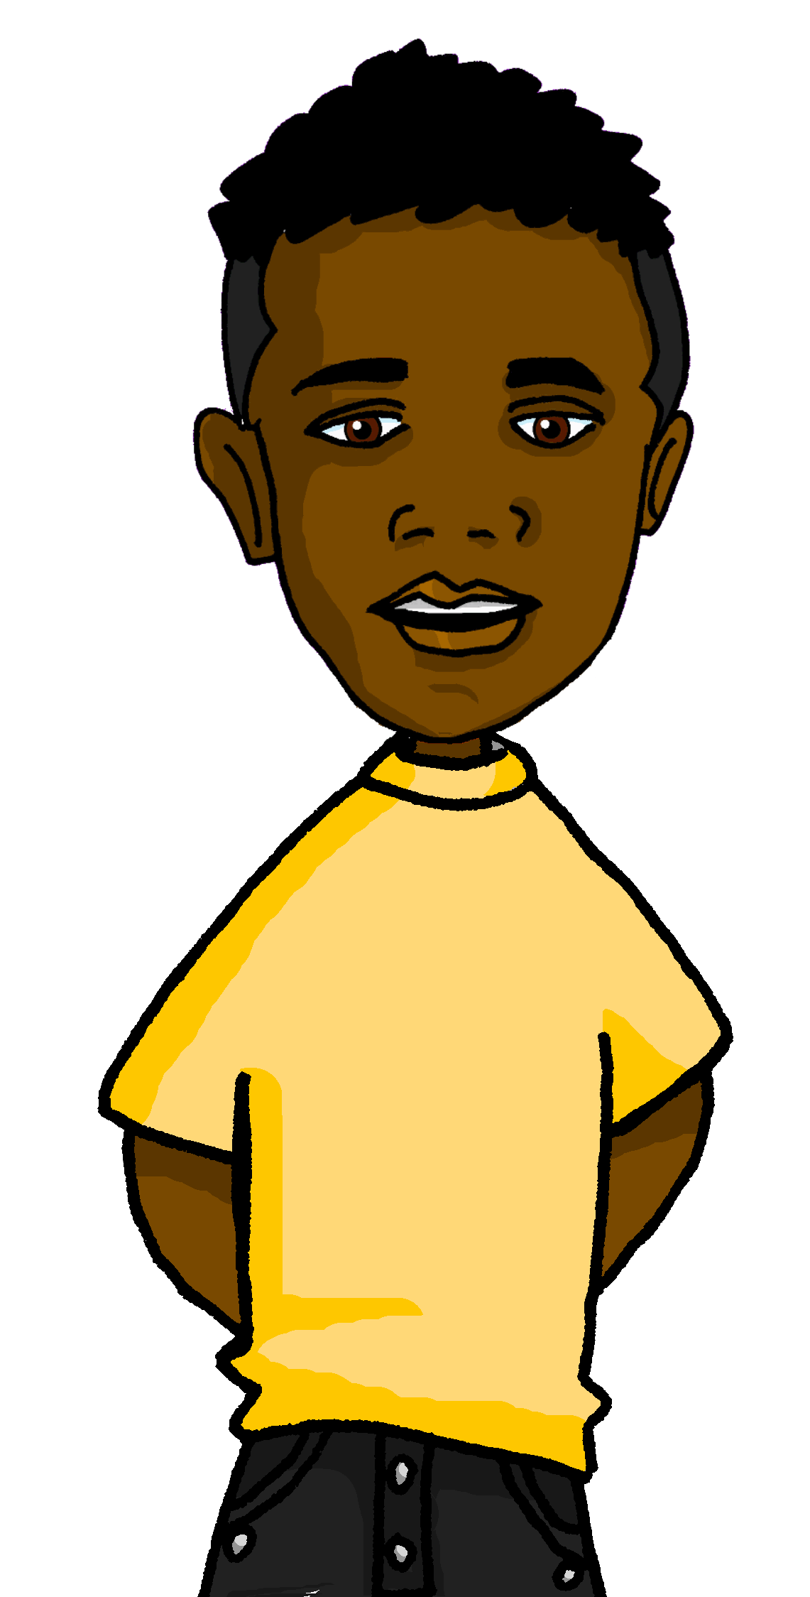
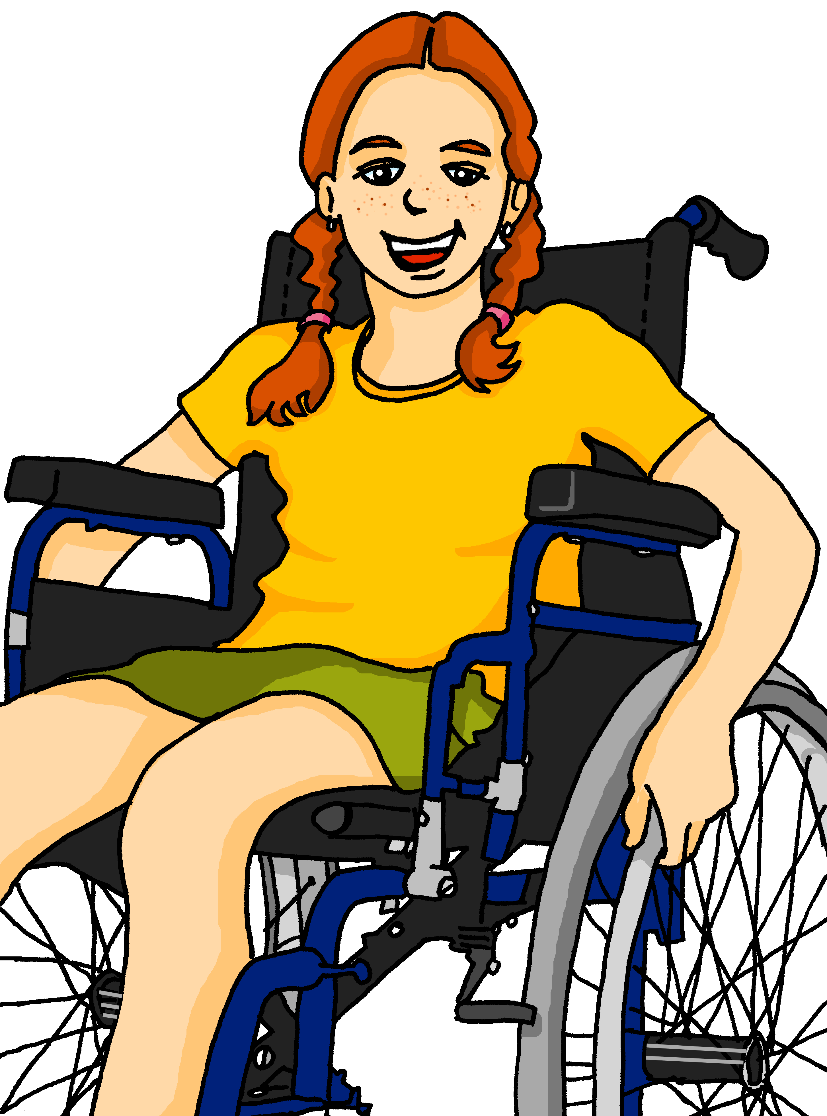
Saying what I and others have
lugares
verde
Tener: 1st & 3rd person plural
Postnominal adjectives
SSC: [z]
Notes:
Artwork by Steve Clarke. All additional pictures selected are available under a Creative Commons license, no attribution required.
The frequency rankings for words that occur in this PowerPoint which have been previously introduced in the resources are given in the SOW (excel document) and in the resources that first introduced and formally re-visited those words.
Phonics: zapato [1477]
Vocabulary: tienen [8] tenemos [8] edificio [857] aquí [130] de12 [2] delante [1742] detrás [2044] dónde [161] en1[6] entre [63]
Revisit 1: tener [19] tengo [tener 19] tiene [tener 19] compañero / compañera [551] escuela [424] hotel [1163] piscina [4604] puente [1715] feo [2373] muy [43] bastante [308]que [50] un [6] una [6] re-use adjectives: bonito [891] diferente [293] divertido [2465] fuerte [435] grande [66] importante [171] independiente [1177] inteligente [2167] lento [1569] normal [1000] pequeño [202] perfecto [1115] pesado [2166] serio [856]
Revisit 2: somos [ser, 7] estamos [estar, 21] amable [2707] curioso [1811] enfermo [1092] imposible [1418] nervioso [1521] sano [1961] y [4]
For any other words that occur incidentally in this PowerPoint, frequency rankings will be provided in the notes field wherever possible.
Source: Davies, M. & Davies, K. (2018). A frequency dictionary of Spanish: Core vocabulary for learners (2nd ed.). Routledge: London

Slide 3
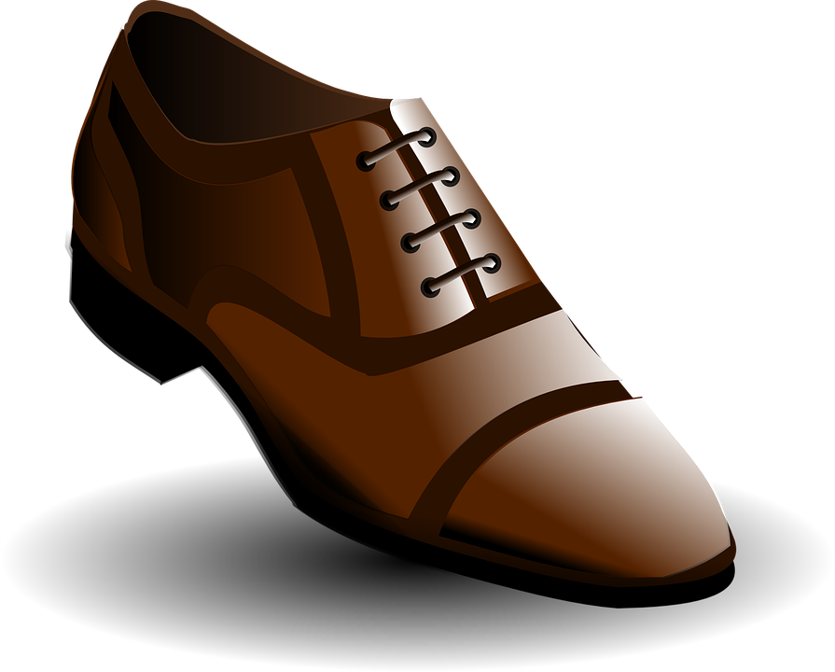
pronunciar
[z]
zapato
[Z] always comes before the sounds [a] [o] [u]
Notes:
Timing: 1 minute
Aim: To introduce SSC [z]
Procedure:
Introduce and elicit the pronunciation of the individual SSC [z] and then the source word ‘zapato’ (with gesture, if using).
Click to bring the picture & get students to repeat (with gesture, if using).

Slide 4
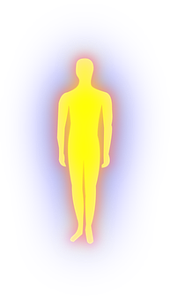
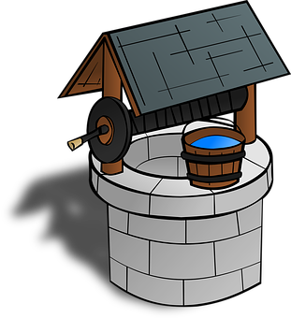
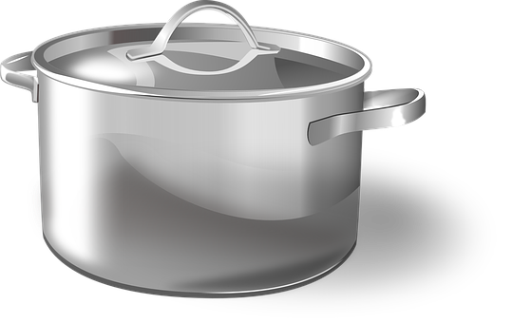
pronunciar
Escucha. ¿Se escribe con [z] o [c]? Luego, pronuncia.
20
pozo
maza
laca
cuerpo
lazo
contar
cazuela
marco
0
INICIO
Notes:
Timing: 5 minutes
Aim: to apply the spelling rule for SSC [z] (for ‘th’ sound before a, o, u) and [c] (for hard ‘c’ sound before a, o, u).
Procedure:
Click each picture to listen.
Pupils write 1-8 and either ‘z’ or ‘c’.
Click again to reveal the pictures and the answers.
Click inicio for pupils to pronounce all of the words. They can practise several times to speed up their production of the words.
Click on each image to hear it again, if desired.
Transcript: 1. pozo 2. maza 3. laca 4. cuerpo 5. lazo 6. contar 7. cazuela
8. marzo
Frequency of unknown words and cognates: pozo [2925] maza [>5000] laca [<5000] cuerpo [323] lazo [3396] contar [172] cazuela [>5000] marzo [1231]
Source: Davies, M. & Davies, K. (2018). A frequency dictionary of Spanish: Core vocabulary for learners (2nd ed.). Routledge: London

Slide 5
vocabulario
¿Cómo es en español?
una escuela
un árbol
un museo
una piscina
una universidad
un
edificio
una calle
una plaza
a building
a museum
a square
a school
a swimming pool
a street
a tree
a university
Notes:
Timing: 5 minutes
Aim: to revisit words from previous weeks and introduce six new nouns for this week.
Procedure: 1. Click for an English prompt.
2. Elicit the Spanish word from pupils. 3. Continue until all 8 items have been seen and heard.
Note: The new words are also illustrated with a picture; previously learnt words are not illustrated.

Slide 6
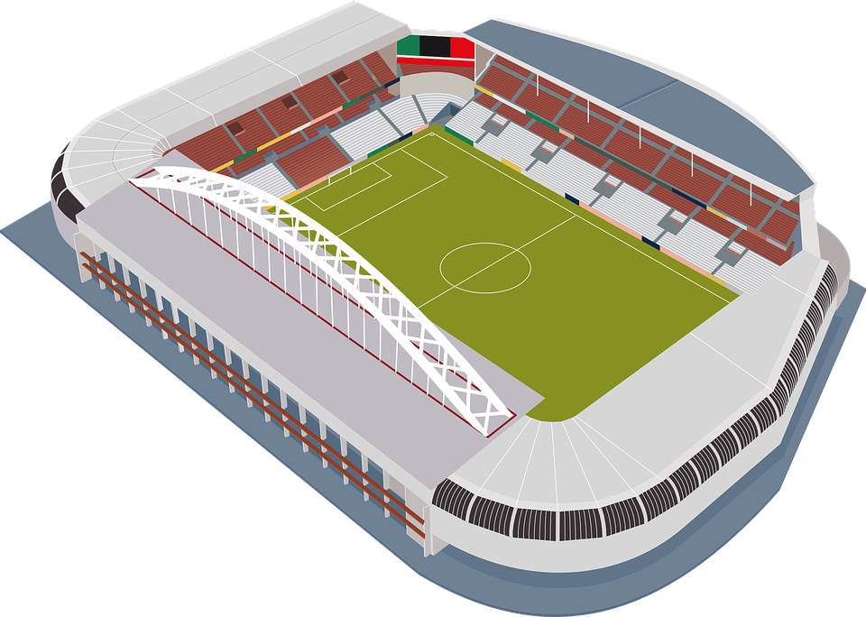
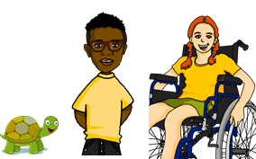
Tener: tenemos| tienen
[to have, having]
[we have | they have]
In Spanish the verb tener is irregular.
To say ‘they have’ we say ____________.
To say ‘we have’ we say _________.
tienen
tenemos
Tienen un estadio grande.
Tenemos dos museos importantes.
They have a big stadium.
We have two important museums.
Notes:
Timing: 2 minutes
Aim: to revisit ‘tienen’ and introduce ‘tenemos’
Procedure:
Click to present the information.
Elicit English translations for the Spanish examples provided.

Slide 7
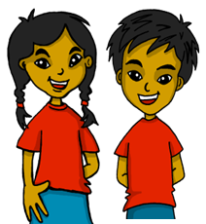
leer
El diario de Sofía.
¿Quién tiene qué?
Escribe dos listas en inglés.
E
Tienen un cine grande.
1
we have | they have
(only) a square | a big cinema
some historical bridges | some green parks
 | a famous university
 | some pretty buildings
Tenemos solo una plaza.
2
Tienen unos parques verdes.
3
Tienen una universidad famosa.
Tenemos unos puentes históricos.
4
5
Tienen unos edificios bonitos.
Notes:
Timing: 5 minutes
Aim: to practise written comprehension of tenemos, tienen and some new and revisited vocabulary.
Procedure:
Ensure that pupils understand the task. They need to identify and list in English the things that Sofía says Krina and Max have in Cambridge (they) and She and Quique have in Lugo (we).
2. Pupils write the words in English.
3. Click to reveal answers.

Slide 8
escuchar
Sofía habla con Quique sobre Krina y Max.
Escucha. ¿Quién es?
Remember: We use un or una with singular nouns and unos or unas with plural nouns.
Marca
Q&S (we) | K&M (they)
¿Cómo?
Escucha otra vez.
Escribe la palabra y el artículo en español.
Escribe ✍
árboles
Tenemos unos __________ enormes.
Tenemos una _________ histórica.
Tienen unos _________ importantes.
Tienen una ________ grande.
Tienen unas _________ bonitas.
Tenemos una _______ divertida.
E
enormous
E
iglesia
historical
1
1
2
museos
important
2
3
piscina
big
3
4
calles
pretty
4
5
fiesta
fun
5
Notes:
Timing: 7 minutes
Aim: to practise aural comprehension of ‘tenemos’ & ‘tienen’; to practise written transcription of known and new vocabulary; to practise connecting nouns and their adjectives with the correct indefinite article (un, una, unos, unas).
Procedure:
Read the title / context & instruction.
Click to bring up further instruction & clarify Q&S is for Quique and Sofía, and L&M is for Krina and Max, their English penfriends.
Explain to pupils Quique and Sofíá will be describing either what they have in their town/city (so they will be using the form “we”), or what Krina and Max have in their town/city (and therefore they will be using the form “they”).
Click to listen to the example.
Ask pupils to write 1-6 in their books.
Complete the task with items 1-5, listening out once for the correct verb form.
Click to reveal answers.
Click to bring up further instructions.
Listen again to transcribe the words. The article is ‘beeped out’ so that students have to consider the correct form according to the noun.
Click to reveal answers to the transcriptions, elicit correct article and translation of the adjective.
Click to listen again to the full sentences and elicit oral translations in English.
Transcript:
Ej. Tenemos [unos] árboles enormes. 1. Tenemos [una] iglesia histórica.
2. Tienen [unos] museos importantes.
3. Tienen [una] piscina grande.
4. Tienen [unas] calles bonitas.
5. Tenemos [una] fiesta divertida.
Transcript 2:
Ej. Tenemos unos árboles enormes. 1. Tenemos una iglesia histórica.
2. Tienen unos museos importantes.
3. Tienen una piscina grande.
4. Tienen unas calles bonitas.
5. Tenemos una fiesta divertida.

Slide 9
pronunciar
¿qué?
what?
¿Qué tienen?
[What do they have?]
Rachel Hawkes / Emma Marsden
Notes:
Timing: 1 minute
Aim: to revisit question word ¿qué?
Procedure:
Pupils listen and repeat the key question word (include gesture if possible).
Display the word and ask them to repeat one more time.
Elicit English meaning.
Reveal the sentence.

Slide 10
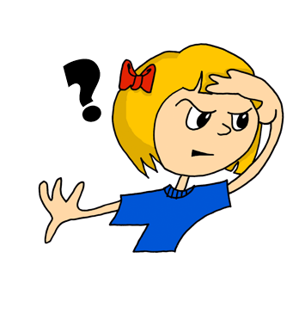
¿dónde?
pronunciar
where?
¿Dónde tienen un parque?
[Where do they have a park?]
Rachel Hawkes / Emma Marsden
Notes:
Timing: 1 minute
Aim: to revisit question word ¿dónde?
Procedure:
Pupils listen and repeat the key question word (include gesture if possible).
Display the word and get them to repeat one more time.
Elicit English meaning.
Reveal the sentence.

Slide 11
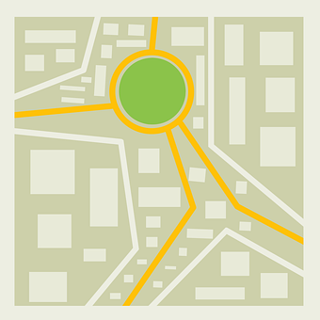
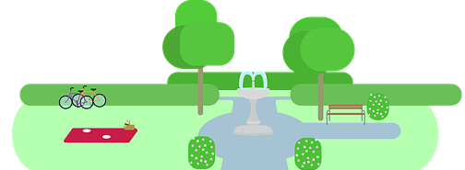
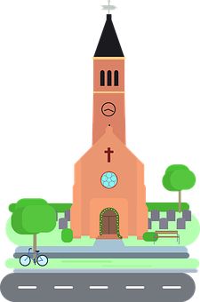
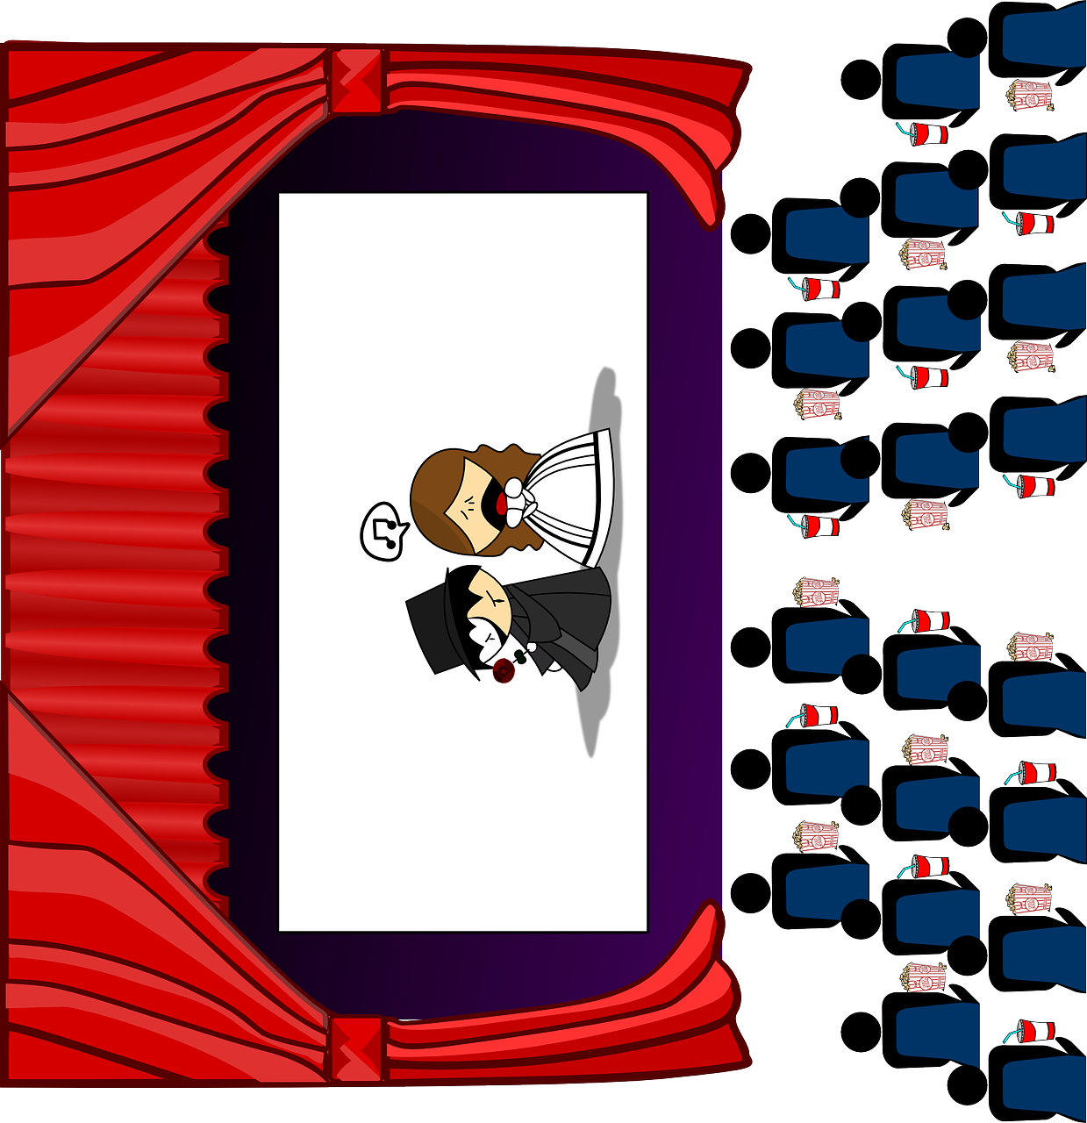
detrás, entre, delante
Note: we use de after detrás and delante but we don’t say of in English.
[behind, below, on]
To say something is behind, use detrás:
To say something is between, use entre:
To say something is opposite, use delante:
detrás
[behind]
Tienen un parque detrás de la iglesia.
entre
[between]
Tenemos un cine entre el museo y la plaza.
delante
[opposite]
Tenemos un museo delante de la escuela.
Notes:
Timing: 2 minutes
Aim: to introduce two new adverbs of position.
Procedure:
Click to present the information.
Elicit English translations for the Spanish examples provided.

Slide 12
leer
[1/6]
Lee. ¿Qué tienen en la ciudad?
¿Es verdad o mentira?
Tenemos un cine delante de la universidad.
Notes:
[1/6]
Timing: 6 minutes (6 slides)
Aim: to practise written recognition and comprehension of the new adverbs (detrás, debajo, entre).
Procedure:
1. Ensure that pupils understand the task. They need to read what Max and Krina have in their town decide whether the sentence is true or false, looking at their table.
2. Teachers elicit the response.
3. Click to reveal answers.

Slide 13
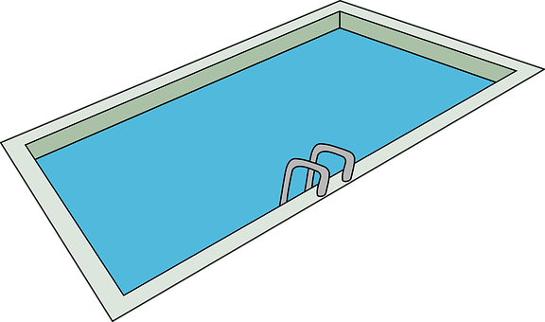
leer
[2/6]
Lee. ¿Qué tienen en la ciudad?
¿Es verdad o mentira?
Tenemos un puente entre un estadio y una piscina.
Notes:
[2/6]

Slide 14
leer
[3/6]
Lee. ¿Qué tienen en la ciudad?
¿Es verdad o mentira?
Tenemos un parque detrás de la escuela.
Notes:
[3/6]

Slide 15
leer
[4/6]
Lee. ¿Qué tienen en la ciudad?
¿Es verdad o mentira?
Tenemos una iglesia delante de la plaza.
Notes:
[4/6]

Slide 16
leer
[5/6]
Lee. ¿Qué tienen en la ciudad?
¿Es verdad o mentira?
Tenemos un árbol detrás de la universidad.
Notes:
[5/6]

Slide 17
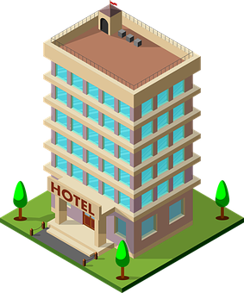
leer
[6/6]
Lee. ¿Qué tienen en la ciudad?
¿Es verdad o mentira?
Tenemos un museo entre la plaza y el hotel.
Notes:
[6/6]

Slide 18
¡adiós!
verde

