Slide 1
español, con Quique

Slide 2
Saying where you are going and what there is there
azul
ir [to go]: voy & vas
SSC: [r] [rr]
Notes:
Artwork by Steve Clarke. All additional pictures selected are available under a Creative Commons license, no attribution required.
The frequency rankings for words that occur in this PowerPoint which have been previously introduced in the resources are given in the SOW (excel document) and in the resources that first introduced and formally re-visited those words.
Phonics: [r] [rr] parar [706] correr [343] caro [2179] carro [1857] pera [>5000] perra [888]
Vocabulary (new words in bold): ir [33] voy vas va estar [21] estoy estás está mercado [487] teatro [605]
Revisit 1: armario [5000] cosa [69] habitación [1069] piso [889] radio [933] televisión [825] bicicleta [3684] cama [609] cuaderno [3301] gato [1728] idea [247] oso [4449] perro [888]
Revisit 2: bailar [1323] cocinar [3074] mandar [588] mirar [125] luz [278] pollo [3577] suéter [>5000] tarjeta [1958] común [742]
Glossed: el viaje [519]
Source: Davies, M. & Davies, K. (2018). A frequency dictionary of Spanish: Core vocabulary for learners (2nd ed.). Routledge: London
For any other words that occur incidentally in this PowerPoint, frequency rankings will be provided in the notes field wherever possible.

Slide 3
[r]
parar
pronunciar
Notes:
Timing: 1 minute
Aim: To revisit SSC [r]
Procedure:
To recap and elicit the pronunciation of the individual SSC [r]
Click to bring the picture & get students to repeat (with gesture, if using).
Gesture suggestion: hold one hand up, palm open and facing away, to signal ‘stop’.

Slide 4
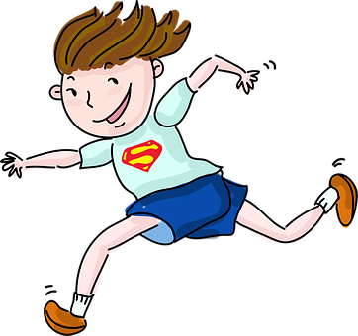
[rr]
correr
pronunciar
Notes:
Timing: 1 minute
Aim: To revisit SSC [rr]
Procedure:
To recap and elicit the pronunciation of the individual SSC [rr]
Click to bring the picture & get students to repeat (with gesture, if using).
Gesture suggestion: Using index and middle fingers to be ‘legs’ mime a fast running movement, moving the hand from right to left across the body.

Slide 5
pronunciar
¡A practicar!
In many countries in Latin America, carro means car. In those countries, this would be un carro caro!
pero
perro
caro
carro
🤔
45 segundos
expensive
pera
perra
INICIO
Notes:
Timing: 2 minutes
Aim: to practise reading aloud [r] [rr]
Procedure:
Pupils to apply SSC knowledge and pronounce the following minimal pairs (words differing by one phoneme only).
Click to bring up the first pair of words. Elicit choral repetition.
Click to bring up the 2nd pair of words. Elicit choral repetition.
Bring up the culture callout about the meaning of ‘carro’ in Latin America.
Click to bring up the 3rd pair of words.
Click on the timer (20 seconds) for pupils to practise saying the words again.
If required, click on individual words to hear them pronounced.

Slide 6
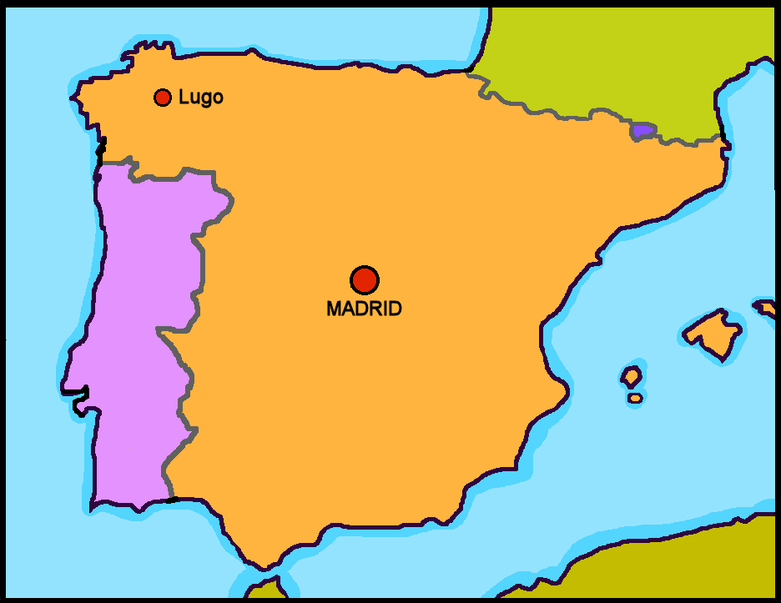
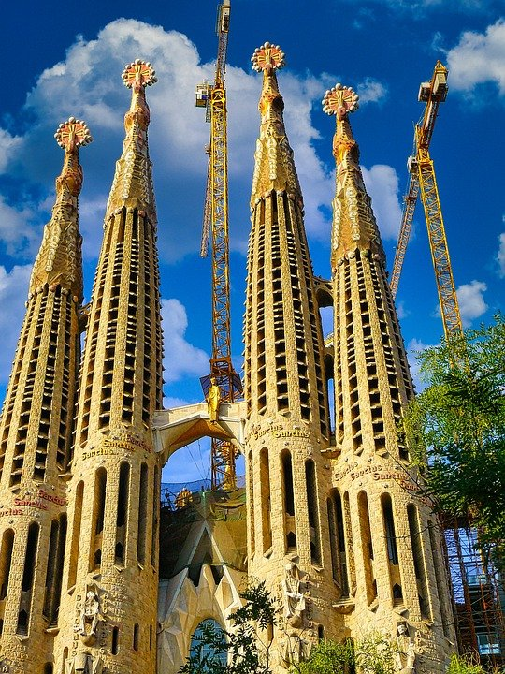
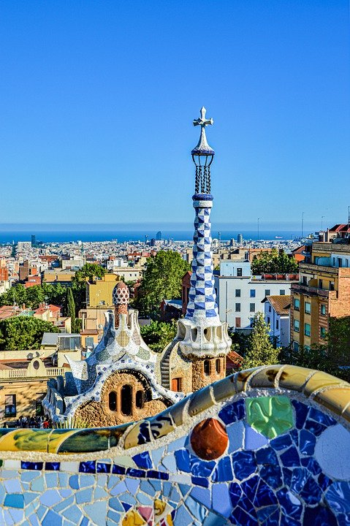
Leer y hablar
Barcelona
el viaje = trip / journey
El viaje a ______________
1
Voy al ______ de España con mi mamá, papá y Sofía.
La _________ es muy grande y moderna.
Está al ______.
escuchar
leer
norte
2
ciudad
este
3
Bilbao
Barcelona
Cáceres
Valencia
¿Qué ciudad es?
La Sagrada Familia
Sevilla
El Parque Güell
Notes:
Timing: 4 minutes
Aim: to introduce the context of the lesson (Barcelona) through transcription of 3 key items of vocabulary introduced in week 8.
Procedure: 1. Pupils write 1-3.
2. Click to listen to each sentence. Pupils write in the missing word.
3. Click to correct answers.
4. Click to bring up question ¿Qué ciudad es? Teachers can refer back to the sentences and the map… Está en el norte ¿Es Sevilla? No! No es Sevilla. Está en el este…. Etc.
5. Click to bring up ‘Barcelona’.
6. Click to bring up two pictures of 2 iconic places in Barcelona: La Sagrada Familia & Parc Güell (both designed by Gaudí).

Slide 7
vocabulario
Escucha y repite el vocabulario.
el cine
el teatro
[cinema]
[theatre]
el mercado
la costa
[market]
[coast]
Notes:
Timing: 4 minutes (one slides)
Aim: to introduce key vocabulary for the context of places in town
Procedure: 1.Teacher introduces items one by one (word, picture and English) and pupils practise pronunciation aloud.
Alternatively, pupils work in pairs, reading the Spanish words out loud and looking at the English meanings (1 minute). 2. Then the teacher removes the English words or pictures (one by one) and pupils try to recall the English orally (chorally), looking at the Spanish (1 minute). 3. Teacher removes Spanish word + picture and elicits Spanish from pupils.
NB. Further rounds of learning can be facilitated by one pupil turning away from the board, and his/her partner asking him/her the meanings (‘Cómo se dice X en español?’). This activity can work from L2 → L1 or L1 → L2.

Slide 8
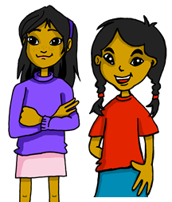
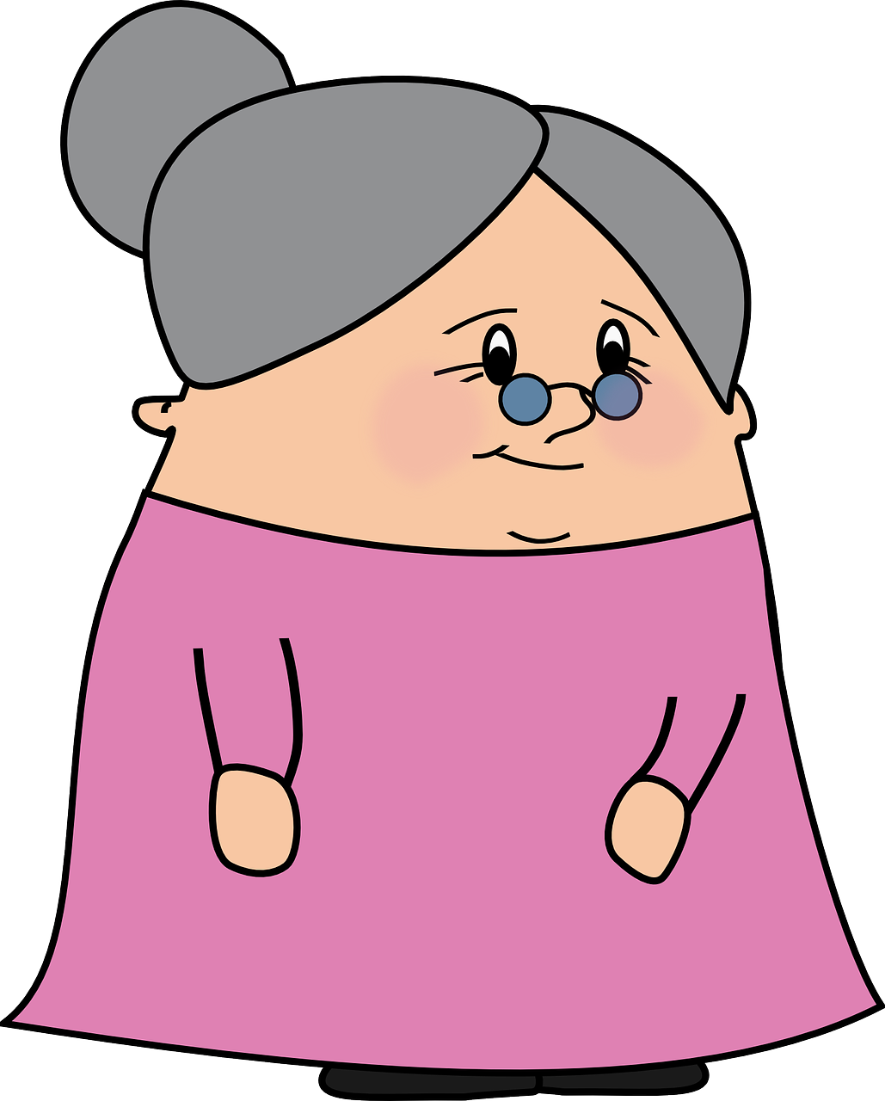
Using the verb ‘ir’
[ir: I go vs. you go]
We have learned that the verb ‘ir’ is irregular:
voy
To say ‘I go’, we use ‘_____’.
To say ‘you go’, we use ‘vas’.
I
you
Voy con papá.
Vas con la abuela.
I go with dad.
You go with grandma.
Notes:
Timing: 3 minutes
Aim: to introduce 1st and 2nd person singular of ‘ir’
Procedure:
Read the grammar explanation on irregular verb ir.
Elicit English translation for the Spanish examples provided.

Slide 9
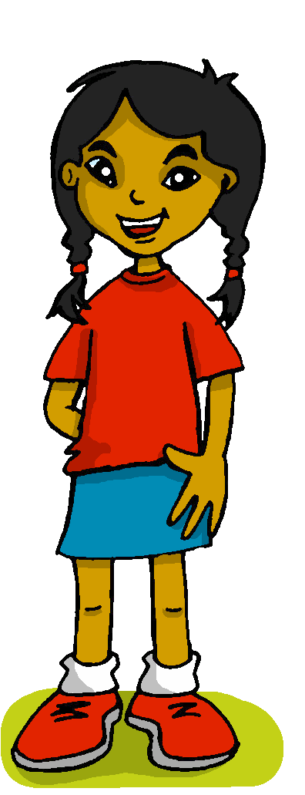
escuchar
Las actividades en Barcelona.
Quique habla con Sofía.
¿Quién es?
Marca
 | Quique (I) | Sofía (you)
¿dónde? ✍
E
al cine
1
a la costa
2
al mercado
3
al teatro
4
a la montaña
5
al cine
Notes:
Timing: 5 minutes
Aim: to practise aural identification of 1st and 2nd person singular of ‘ir’; transcription of key vocabulary (places in town).
Procedure:
1. Ensure pupils are clear about the task. Quique talks to Sofía about what he or she is going in Barcelona (and with whom).
2. Click to play the example. Ask pupils to tick Quique (I) or ‘Sofía’ (she)
3. Click to reveal the answer.
4. Play 1-5 and pupils to complete.
5. Click to reveal answers.
Transcript:
[E] Voy al cine con papá.
[1] Vas a la costa con mamá.
[2] Voy al mercado con papá.
[3] Voy al teatro con la abuela.
[4] Vas a la montaña con mamá.
[5] Vas al cine con mamá.

Slide 10
Using ir with al, a la [1/2]
[to go, going to the]
Remember, the verb ‘ir’ is often followed by ‘a’ (to) to say where someone goes.
Vas a la costa.
You go to the coast.
Remember that a + el becomes ‘al’.
Vas al cine.
You go to the cinema.
Notes:
Timing: 4 minutes [2 slides]
Aim: to recap ‘ir’ and to the (including the contraction ‘al’)
Procedure:
Read the grammar explanation on ir & ‘to the’
Elicit English translation for the Spanish examples provided.

Slide 11
Using ir & estar; en & al, a la [2/2]
[to go & to be (location)| in; to the]
The verb ‘estar’ means ‘to be’ when describing location.
Estás en el cine.
Estás en la costa.
You are at the cinema.
You are on the coast.
After estar, ‘en’ can mean ‘on’, ‘at’ or ‘in’.
Just choose the meaning that sounds right in each sentence.
ir
We generally use ‘a’ with the verb _______.
estar
We generally use ‘en’ with the verb ________.
Notes:
Timing: 4 minutes [slide 2/2]
Aim: to reintroduce ‘estar’ and ‘en’ to prepare for a contrast with ‘ir’ and ‘to the’
Procedure:
Read the grammar explanation about ‘estar’ and ‘en’.
Elicit English translations for the Spanish examples provided.

Slide 12
leer
Quique escribe mensajes a Sofía.
¿Es ‘en, “al” o “a la”?
¡Hay un problema con el teléfono!
E
3
Estoy en la habitación.
Vas al mercado
1
4
¿Estás en el cine?
Voy al teatro.
2
5
¿Vas a la montaña?
Estoy en la playa.
Notes:
Timing: 7 minutes (2 slides)
Aim: to practise identification of missing pronouns from the verbs they are used with.
Procedure:
Read the title and click to explain the context of the task.
Click to bring further instructions in Spanish. Teachers can ask further questions re the contraction “al”. Elicit examples of masculine nouns (cine, mercado, teatro).
Do [E] with them to model the task, drawing their attention to the verb (Está). Is it en, al or a la?
Pupils complete 1-5.
Click through the animations to make the ‘cracks’ disappear and show the correct preposition.
Teachers can play the texts for further listening practice, if they wish, or pupils can read the texts aloud in pairs.
NB: The next slide includes an activity to focus on comprehension.

Slide 13
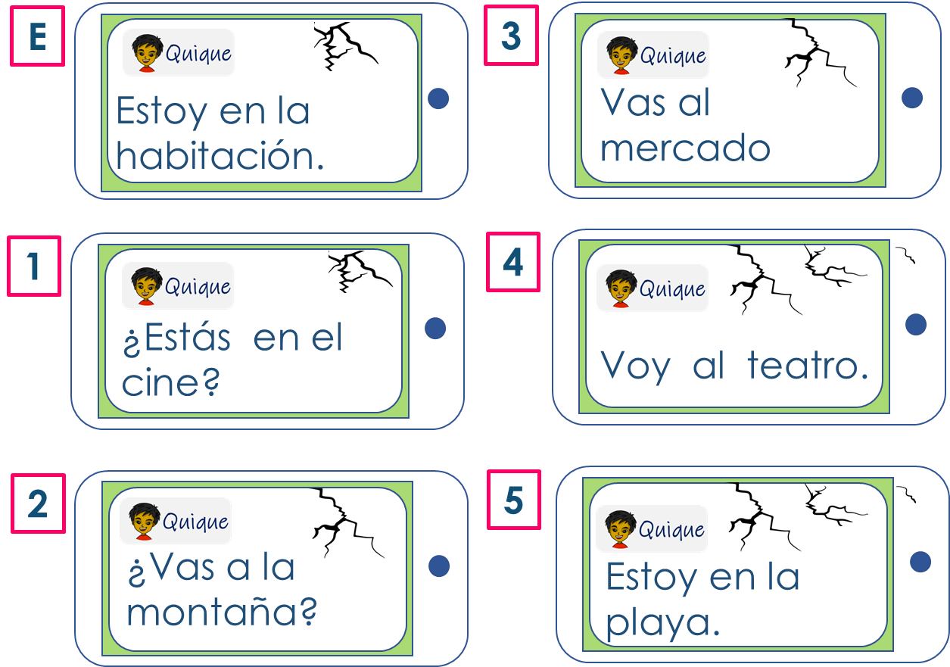
leer
Quique escribe mensajes a Sofía.
¿Qué mensaje es?
¿Qué persona es? ✍
¿Qué preposicion es?
[4]
 | You go | I go in | to the theatre.
 | I go | You go in | to the market.
 | I am | you are in | to the room.
 | Am I | Are you at | to the cinema?
 | You are | I am on | to the beach.
 | Do you go| Do I go in | to the mountain?
[3]
[E]
[1]
[5]
[2]
la preposición = preposition
Notes:
Timing: 7 minutes
Aim: to practise written comprehension of correct person of estar & ir, prepositions and places in town.
Procedure:
Read and clarify the instruction (pupils to match the sentences with the messages E-5 and decide the correct translation of the preposition.
Do the first sentence with them.
Pupils complete sentences 2-5.
Click to bring up answers and further instructions.
Next, pupils decide on the correct translation of the verb, identifying the person (subject) of the sentence.
Pupils to do E-5.
Elicit answers from pupils, click to bring up answers.

Slide 14
¡adiós!
azul

