Slide 1
español, con Quique

Slide 2
Saying what I and others do
Tener: 1st and 2nd persons singular
possessives (my, your)
SSC: [que] [qui]
azul
Notes:
Artwork by Steve Clarke. All additional pictures selected are available under a Creative Commons license, no attribution required.
The frequency rankings for words that occur in this PowerPoint which have been previously introduced in the resources are given in the SOW (excel document) and in the resources that first introduced and formally re-visited those words.
Phonics: revisit [que] [qui] paquete [2325] equipo [373]
Vocabulary (new words in bold): armario [5000] cosa [69] habitación [1069] piso [889] radio [933] televisión [825]
Revisit 1: aprender [428] beber [1085] comer [347] correr [343] hacer [26] leer [209] vender [528] ver [38] dinero [364] más [23]
Revisit 2: tienen [8] enorme [631] un poco [76] solo [181] bocadillo [>5000] clase [320] conejo [4728] cuaderno [3301] hermano [333] hermana [3409] lápiz [3740] libro [230] mochila [>5000] regla [1380] ventana [725] activo [1278] bonito [891] grande [66] nuevo [94] viejo [225] bastante [308] muy [43] de12 [2]
Source: Davies, M. & Davies, K. (2018). A frequency dictionary of Spanish: Core vocabulary for learners (2nd ed.). Routledge: London
For any other words that occur incidentally in this PowerPoint, frequency rankings will be provided in the notes field wherever possible.

Slide 3
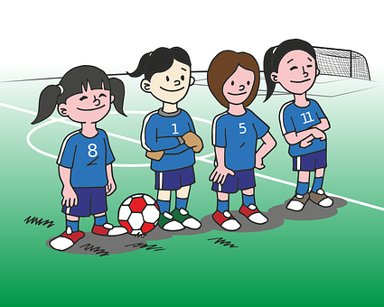
pronunciar
[qui]
equipo
[que]
paquete
Notes:
Timing: 1 minute
Aim: To revisit SSC [qui] [que]
Procedure:
To recap and elicit the pronunciation of the individual SSC [qui] [que]
Click to bring the picture & get students to repeat (with gesture, if using).
Gesture suggestion : handshake
Gesture suggestion : with both hands, draw the shape of a rectangle in 3 moves (top, sides, bottom).

Slide 4
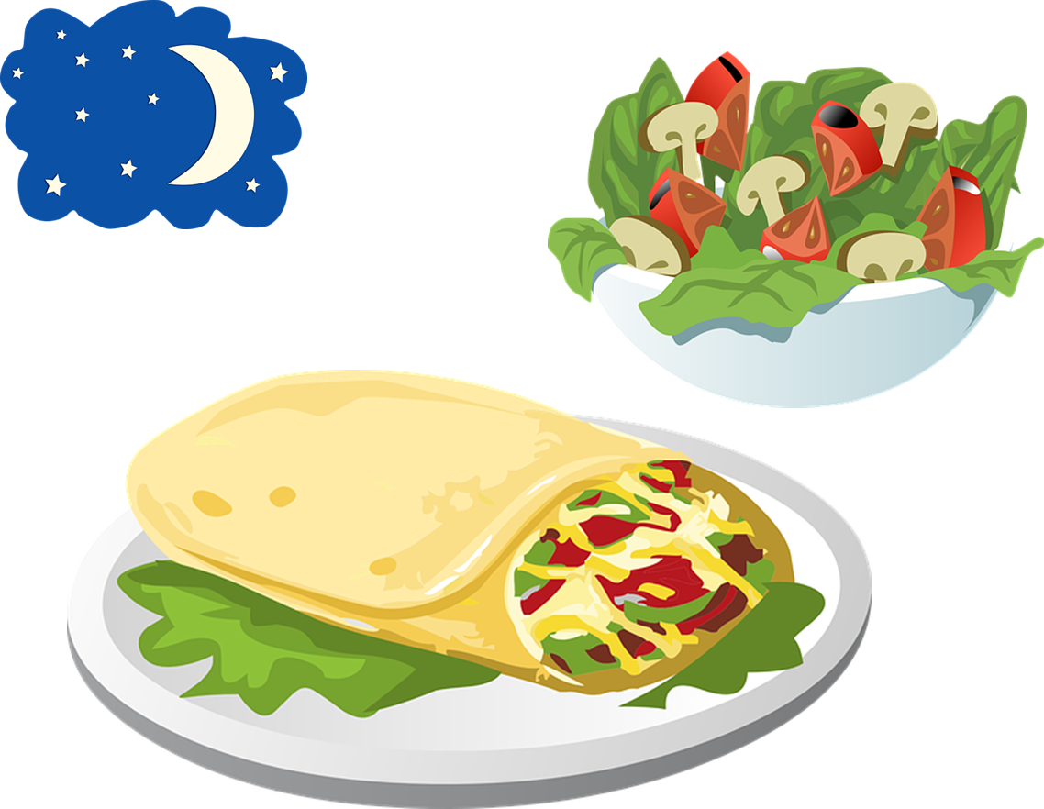
escuchar
Escucha. ¿Es ‘ce’, ‘ci’ o ‘que’ ‘qui’?
escuchar
[left]
E
1
iz____erda
qui
____so
que
3
4
2
que
ce
ra____ta
___na
____elo
ci
Notes:
Timing: 4 minutes
Aim: to recognise ‘qui’ ‘que’ with a previously learnt SSCs: ‘ci’, ‘ce’
Procedure:
Read the instruction and do the example [E] with pupils. Pupils to write the correct SSCs [ce], [ci] [qui] [que]
Do 1-4
Go through answers by eliciting the Spanish word from pupils, and click to bring up answers.
Give pupils 1 minute to work in pairs to practise pronunciation.
Transcript:
E izquierda
1 queso
2 cena
3 raqueta
4 cielo

Slide 5
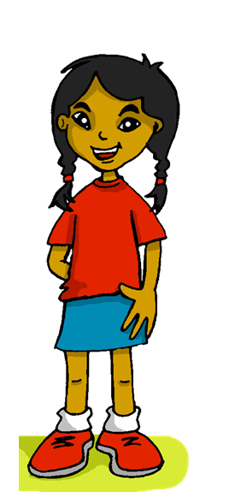
leer
your
things
wardrobe
radio
tu
las cosas
el armario
la radio
En mi casa, tengo muchas cosas pero soy muy organizada*. En mi habitación tengo mis libros, mi armario y mis osos. Mi bici no está en mi habitación, por supuesto*. Tengo mi bici en el jardín de la comunidad*. Vivo en un piso con mi madre y mi padre. En España es muy común. ¿Tienes una televisión en tu habitación? Yo*, no tengo una televisión en mi habitación pero sí tengo una radio.
flat
room
my
TV
el piso
la habitación
mi
la televisión
organizado = organised |por supuesto = of course | la comunidad = the community | yo = I
Notes:
Timing: 5 minutes
Aim: to set the scene for this week’s lesson; to practise written comprehension of previously taught vocabulary and this week’s new words.
Procedure:
Pupils read the text aloud with teacher support, as needed.
Click on Sofía to hear an audio version of the text, if desired.
3. Pupils focus on the English words and identify the Spanish words from the bold words in the text. Pupils can volunteer answers in any click – teacher clicks on the English word and the Spanish translation appears.
4. Teachers elicit an oral translation of the text from the class to establish the context of this week’s lesson.
organizado [2335] por supuesto [529] comunidad [523] yo [28]
Source: Davies, M. & Davies, K. (2018). A frequency dictionary of Spanish: Core vocabulary for learners (2nd ed.). Routledge: London

Slide 6
Talking about possessions in singular and plural
[my]
To say ‘my’ in Spanish before a singular or uncountable noun, use _____.
mi
⚠ It does not matter whether the nouns are masculine or feminine.
Tengo un oso en mi habitación.
I have a teddy bear in my room
mis
To say ‘my’ in Spanish before a plural noun, use _____.
En mi habitación tengo mis libros.
In my room I have my books.
Notes:
Timing: 2 minutes
Aim: to reintroduce s ‘mi/mis’.
Procedure:
Click to go through the explanation and examples.

Slide 7
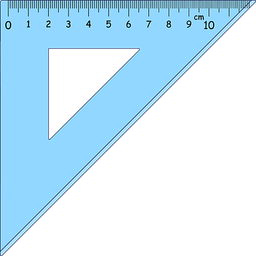
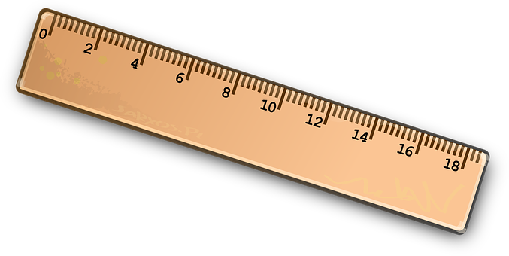
leer
¿Qué tiene Sofía en la habitación?
Lee las frases y marca. ¡Ojo! It could be both.
¿Se menciona? Marca o .
 | mi | cuaderno | osos
 | mis | lápices | bici
 | mi | cama | armario
 | mi | conejos | guitarra
 | mis | lámpara | reglas
 | mi | hermano | botellas
E
1
2
3
4
5
Notes:
Timing: 4 minutes
Aim: to practise written recognition of singular and plural nouns and connect them with the correct possessive adjective ‘mi’ or ‘mis’.
Part 1
Procedure:
Pupils write the noun that can follow the possessive adjective.
Click to correct OR click the audio button for a listen and check.
Part 2
Procedure:
Pupils decide for each picture shown whether the item was mentioned in Part 1 or not (i.e. in the list at all).
Click to correct.

Slide 8
Asking about possession: tener
[I have; you have; do you have?]
We have already seen the verb tener means ‘to have’.
⚠ To change a statement into a question, simply raise your voice at the end.
I
You (singular)
To mean ‘I have’, use ‘tengo’.
To mean ‘you have’, use ‘tienes’.
¿?
Tengo un conejo.
Tienes una pregunta, Elena.
I have a rabbit.
You have a question, Elena.
¿Tienes una pregunta, Elena?
Do you have a question, Elena?
Notes:
Timing: 2 minutes
Aim: to revisit 1st and 2nd person singsular of ‘tener’, including revisiting raised intonation for question formation.
Procedure:
Read the grammar explanation on tener (to have).
Elicit English translations for the Spanish examples provided.

Slide 9
escuchar
¿Dónde están las cosas de Sofía?
Sofía habla. Quique tiene las cosas de Sofía. ¡Qué desastre!
¿Quién es?
¿Qué es? Marca y escribe en inglés .
¿Es una pregunta o una respuesta?
Sofía | Quique
¿?
mi | mis | ¿Qué?
E
?
things
1
?
lamp
2
.
books
.
3
money
4
?
bears
5
.
dictionaries
Notes:
Timing: 6 minutes
Aim: listening activity to practise distinguishing between the meanings of the 1st and 2nd person singular of tener in the present, including statements and questions; mi and mis
Procedure:
Part 1
Click to bring instructions.
Pupils first idefintfiy the person of the verb ‘I’ / ‘you’, and then whether it’s a statement or a question.
Do [E] with them.
Part 2
Click to bring further instructions. Pupils to listen again and identify whether they hear ‘mi’ or ‘mis’ and write down the lexical item / object mentioned.
Transcript
E. ¿Tienes mis cosas?
¿Tienes mi lámpara?
Tengo mis libros.
¡Tienes mi dinero!
¿Tienes mis osos?
Tengo mis diccionarios.

Slide 10
Talking about possessions in singular and plural
[your]
To say ‘your’ in Spanish before a singular or uncountable noun, use _____.
tu
⚠ It does not matter whether the nouns are masculine or feminine.
¿Tienes un armario en tu habitación?
Do you have a wardrobe in your room?
tus
To say ‘your’ in Spanish before a plural noun, use _____.
¿Tienes tus libros en tu habitación?
Do you have your books in your room?
Notes:
Timing: 2 minutes
Aim: to reintroduce ’‘tu/tus’.
Procedure:
Click to go through the explanation and examples.

Slide 11
leer
En clase: Sofía escribe notas a Quique.
notas* = notes
¿Es ‘mi’, ‘mis’, ‘tu’ o ‘tus’?
1
E
Tengo mis cosas en mi piso.
radio
 | ____ have my ______ in your ______ .
 | ___ have my ______ in my _____ .
 | ___ ___ my ________ in my _____ .
 | ____ _____ have my ___________ in your ________________ ?
 | ____ _______ your ______ in my _______________ .
 | ____ _______ your ______ in your ______ .
Tienes mi
radio en tu habitación.
You
E
room
3
1
I
things
flat
¿Tienes mis bocadillos en tu mochila?
2
Tengo mis lápices en mi clase.
2
I have
pencils
class
Do you
sandwiches
3
school bag
5
Tienes tus libros en tu habitación.
I have
bottle
4
school bag
4
¡Tengo mi botella en tu mochila!
You have
books
5
room
Notes:
Timing: 6 minutes
Aim: to bring together various grammar features and vocabulary (tener: 1st and 2nd person singular; possessives ‘my’ and ‘your’)
Procedure:
Read the title & click to explain the context of the task
Click to bring further instructions in Spanish.
Pupils complete 1-5.
Click through the animations to bring up answers.
Transcript: E. Tienes mi radio en tu habitación. 1. Tengo mis cosas en mi piso. 2. Tengo mis lápices en mi clase. 3. ¿Tienes mis bocadillos en tu mochila?
4. ¡Tengo tu botella en mi mochila! 5. Tienes tus libros en tu habitación.

Slide 12
¡adiós!
azul

