Slide 1
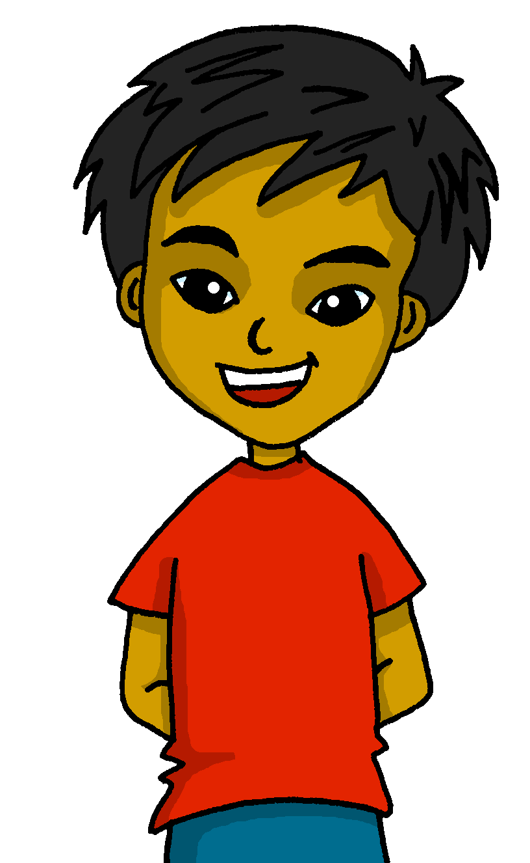
español, con Quique

Slide 2
Saying what I and others do
azul
-ER verbs: s/he, it vs. we
SSC: Stress 2
Notes:
Artwork by Steve Clarke. All additional pictures selected are available under a Creative Commons license, no attribution required.
The frequency rankings for words that occur in this PowerPoint which have been previously introduced in the resources are given in the SOW (excel document) and in the resources that first introduced and formally re-visited those words.
Phonics: pasado [932] nunca [158] orden [421] sacapuntas [>5000]
Vocabulary (new words in bold): patio [1197] recreo [>5000] revisit: aprender [428] beber [1085] comer [37] correr [343] hacer [26] leer [209] chocolate [3408] semana [301] a menudo [958] a veces [vez 59] siempre [96]
Revisit 1: bailar [1323] cocinar [3074] mandar [588] mirar [125] luz [278] pollo [3577] suéter [>5000] tarjeta [1958] común [742]
Revisit 2: tener [19] tengo [tener 19] tiene [tener 19] casa [106] familia [233] habitación [1069] jardín [1195] libro [230] madre [226] padre [162] problema [145] profesor / profesora [501] silla [1271] estricto [3155] feo [2373] terrible [1246] muy [43] un [6] una [6]
Re-use adjectives: bonito [891]cómodo [2237] diferente [293] divertido [2465] feliz [908] elegante [2742] grande [66] importante [171] independiente [1177] negativo [1804] normal [1000] pequeño [202] tranquilo [1093]
Source: Davies, M. & Davies, K. (2018). A frequency dictionary of Spanish: Core vocabulary for learners (2nd ed.). Routledge: London
For any other words that occur incidentally in this PowerPoint, frequency rankings will be provided in the notes field wherever possible.
Corregir [2351]

Slide 3
pronunciar
Stress 2
Where there is no written accent, stress the penultimate (second to last) syllable for any word ending in a vowel, ‘n’ or ‘s’.
pasado
[past]
nunca
[never]
orden
[order]
sabemos
[we know]
Notes:
Timing: 3 minutes
Aim: to explain the rule of stress and written accents: 2. Where there is no written accent, stress the penultimate (second to last) syllable for any word ending in a vowel, ‘n’ or ‘s’.
Procedure:
Read the explanation.
Introduce the example words to exemplify the rule.

Slide 4
pronunciar
Pronuncia en parejas.
tartas
peces
banco
tarjeta
estamos
60
fecha
pollo
tonta
dinero
perfecta
madre
sobre
eco
trece
frase
bonito
estricto
0
problema
elegante
grande
INICIO
Notes:
Timing: 3 minutes
Aim: to practise Stress rule 2
Procedure:
Pupils work in pairs to pronounce as many words as they can in 60 seconds.
Click on ‘inicio’ to start timer.
NB. Most of these words have been encountered in Rojo materials, as well as Azul (Autumn SOW).

Slide 5
Knowing who does what
[–er verbs: ‘S/he,it’ vs. ‘we’]
To mean ‘S/he, it’ with a verb, we remove –er and add -e.
To mean ‘we’ with a verb, we remove –er and add –emos.
we
S/he, it
Bebe en el recreo.
Bebemos en el patio.
S/he drinks at break time.
We drink in the playground.
Notes:
Timing: 3 minutes
Aim: to reintroduce 3rd person singular for–er verbs and introduce 1st plural.
Procedure:
Click through the animations to present the new information.
Elicit English translations for the Spanish examples provided.

Slide 6
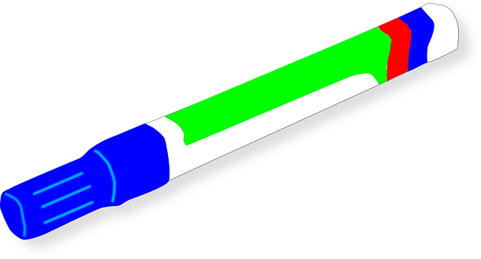
leer
Quique escribe en la pizarra [1/5]
el zumo = juice
Is he talking about what he does with Rubén or what someone else does?
Bebe zumo* en el recreo.
Quiqué & Rubén (we) | Someone else (s/he, it)
Notes:
Timing: 8 minutes (part 1 – 5 minutes / part 2 – 3 minutes)
Aim: to practise written comprehension of 1st person plural and 3rd person singular.
[Part 1] [1/5]
Procedure:
Read the title and click to explain the context of the task.
Click to bring up further instructions in Spanish.
Do [1/5] with them to model the task and draw their attention to the verb (bebe). Does it refer to Quique & Rubén (we) or someone else (s/he)?
Click to bring up the answer.
Repeat with items 2-5.
NB. Meaning will be checked in Part 2 of this task.

Slide 7
leer
Quique escribe en la pizarra [2/5]
Is he talking about what he does with Rubén or what someone else does?
Corremos en el patio.
Quiqué & Rubén (we) | Someone else (s/he, it)
Notes:
[2/5]

Slide 8
leer
Quique escribe en la pizarra [3/5]
Is he talking about what he does with Rubén or what someone else does?
Leemos un libro sobre cultura.
Quiqué & Rubén (we) | Someone else (s/he, it)
Notes:
[3/5]

Slide 9
leer
Quique escribe en la pizarra [4/5]
Is he talking about what he does with Rubén or what someone else does?
Come un bocadillo grande.
Quiqué & Rubén (we) | Someone else (s/he, it)
Notes:
[4/5]

Slide 10
leer
Quique escribe en la pizarra [4/5]
Is he talking about what he does with Rubén or what someone else does?
Hacemos una actividad en clase.
Quiqué & Rubén (we) | Someone else (s/he, it)
Notes:
[5/5]

Slide 11
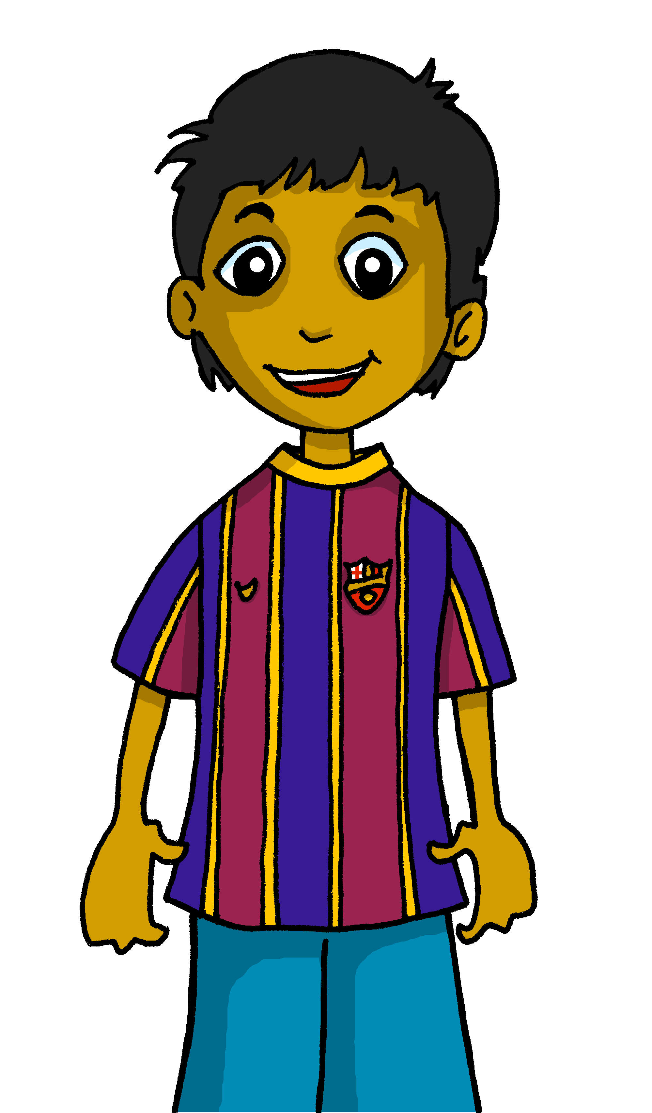
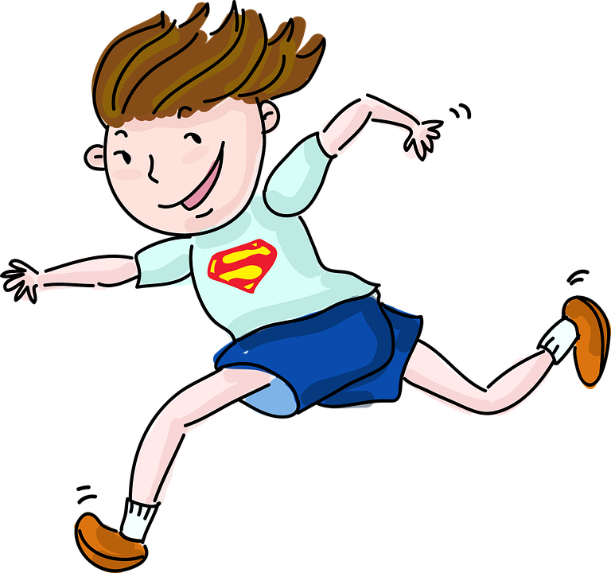
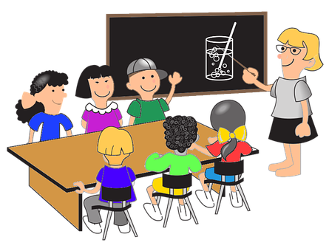
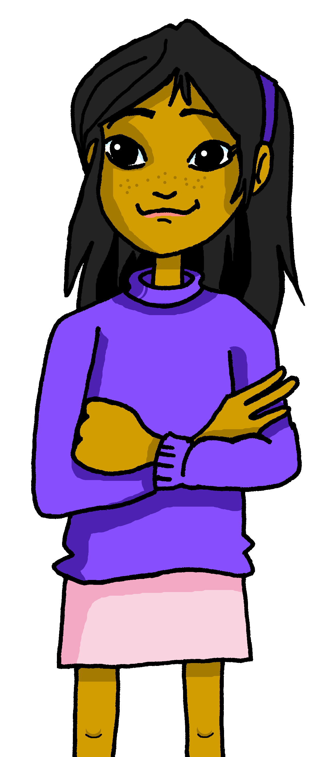
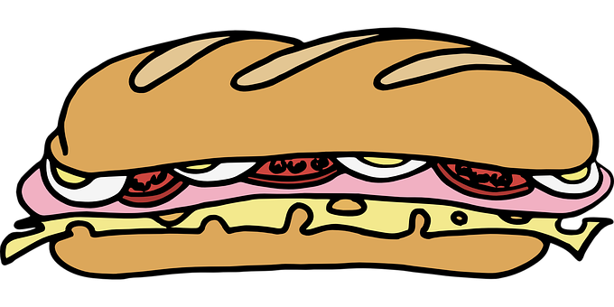
leer
¿Qué imagen es?
Lee otra vez y decide.
[c]
[a]
[b]
[1] Bebe zumo en el recreo.
[2] Corremos en el patio.
[3] Leemos un libro sobre cultura.
[4] Come un bocadillo grande.
[5] Hacemos una actividad en clase.
[a]
[e]
[we run]
[we do]
[d]
[b]
[c]
[d]
[e]
[she drinks]
[he eats]
[we read]
Notes:
Timing: 3 minutes
Aim: to practise written comprehension of 1st person plural and 3rd person singular.
[Part 2]
Procedure:
Read the title and click to explain the context of the task.
Do [1] to model the task.
Click to bring up the answer.
Repeat with 2-5.
When going through the answers, encourage pupils to translate the whole sentence.
Translation of these sentences should reinforce understanding of 1st person plural, 3rd person singular and new/revisited vocabulary.

Slide 12
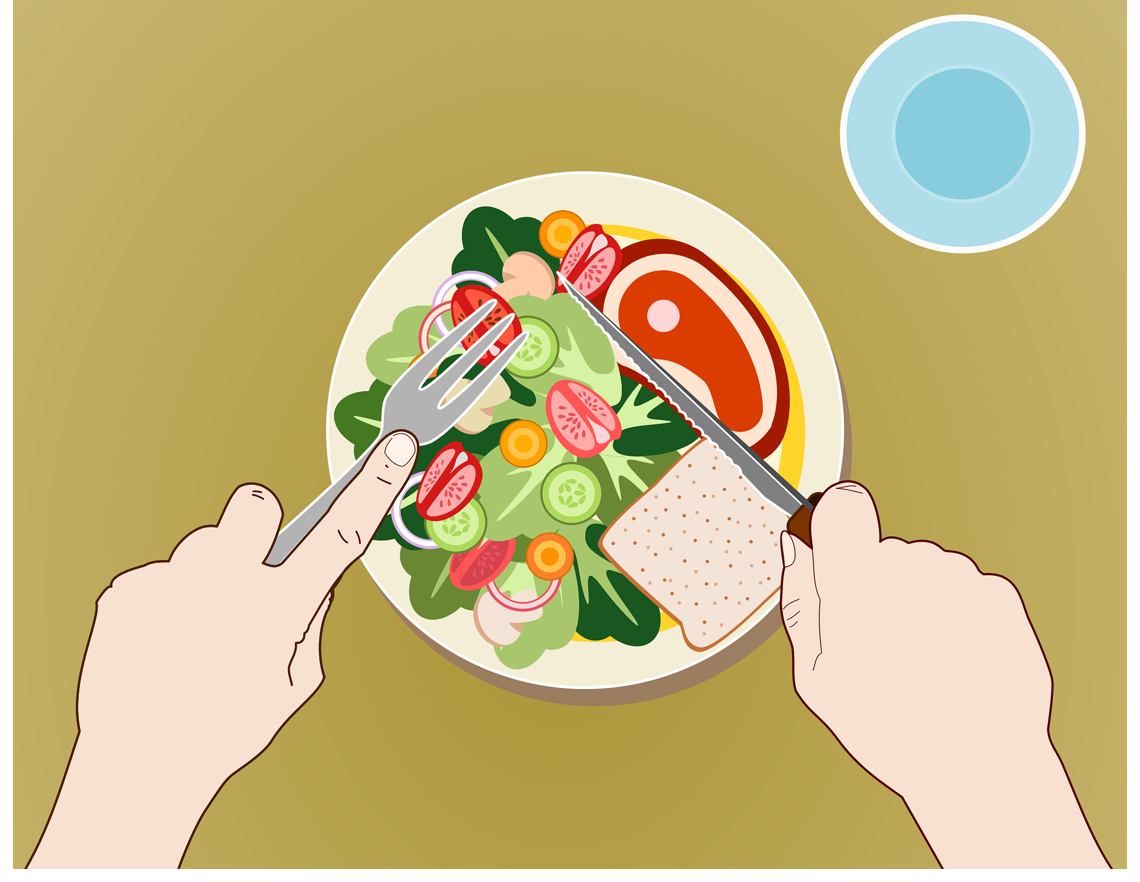
Using the negative ‘no’
[no]
In Spanish, to say what you or others don’t do, put ‘no’ before the verb. This makes a negative.
No come en el patio.
No comemos en el recreo.
S/he doesn’t eat in the playground.
We don’t eat in the break.
This works for any verb and any person (e.g., I, you, s/he, we).
Notes:
Timing: 3 minutes
Aim: to introduce the negative ‘no’, drawing on pupils’ knowledge of 1st person plural and 3rd person singular.
Procedure:
Click through the animations to present the new information.
Elicit English translations for the Spanish examples provided.

Slide 13
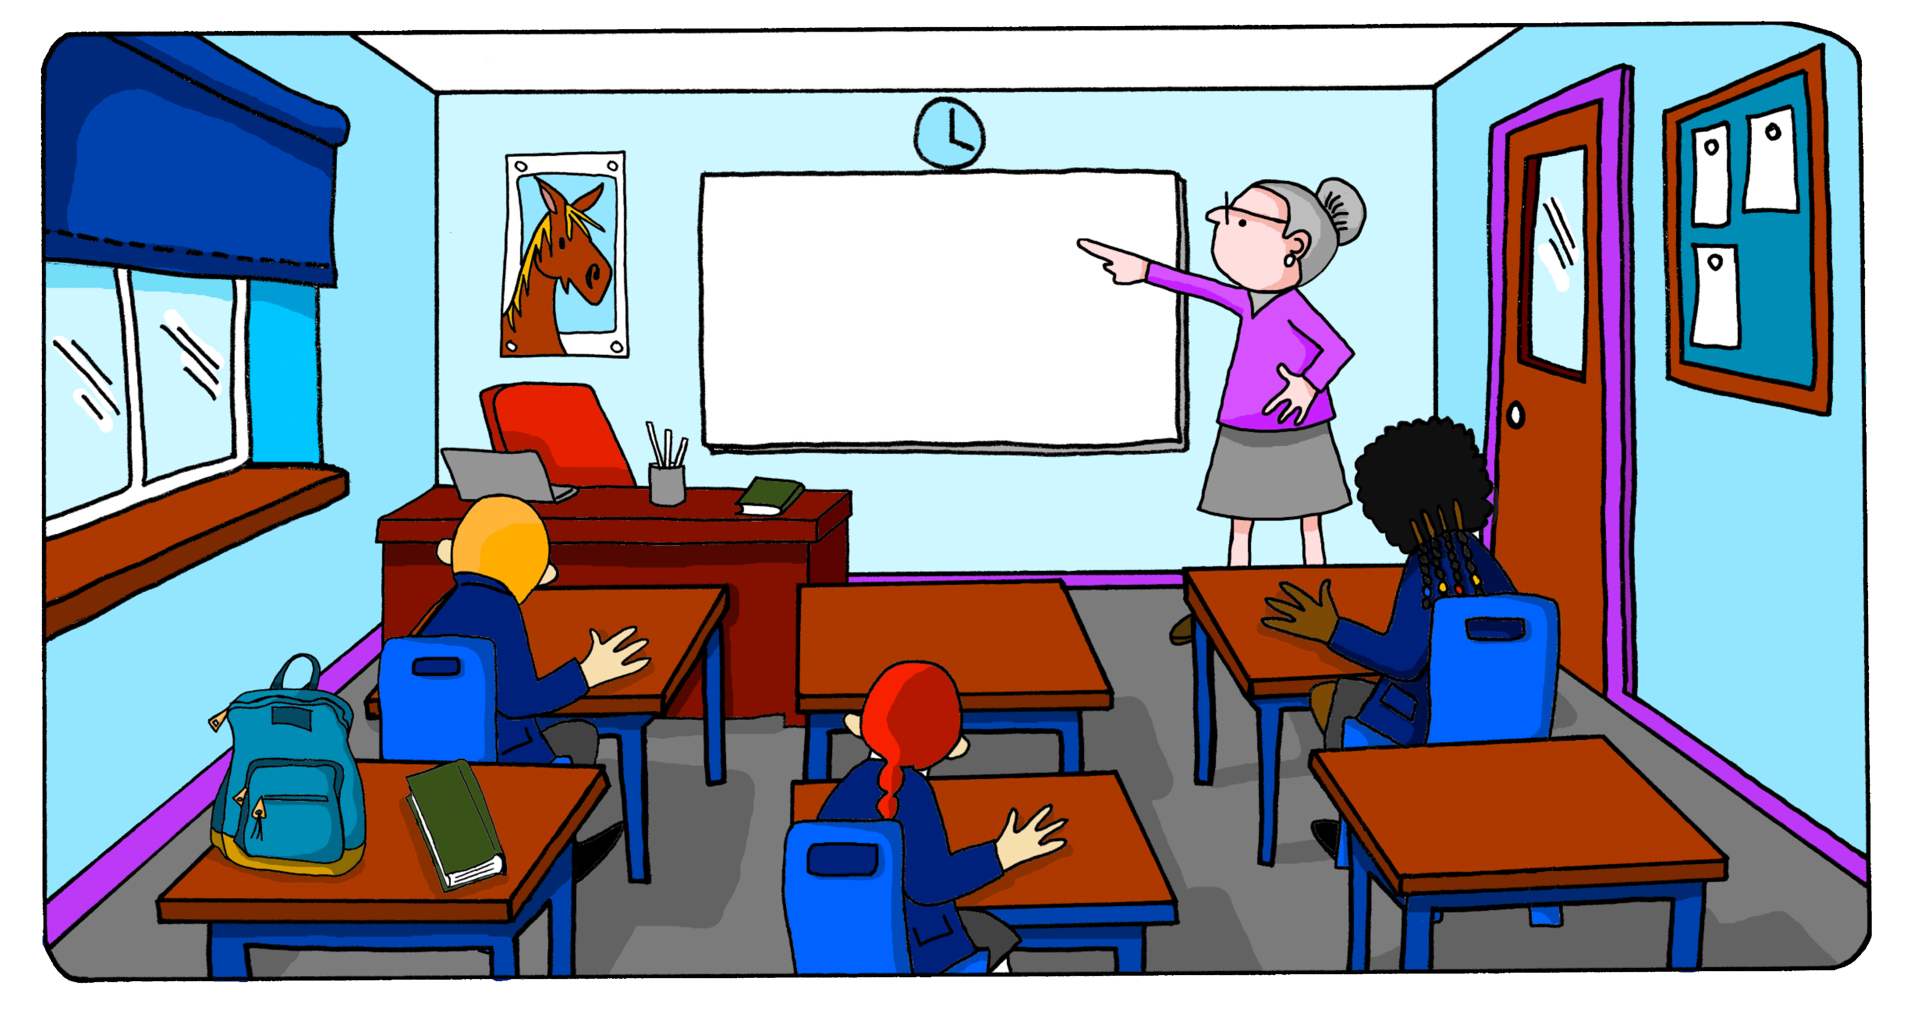
escuchar
En clase
Escucha: ¿La frase es positiva o negativa?
Marca
¿Quién es?
positiva | negativa
verbo | s/he | we
información extra
aprendemos
E
culture
1
compre
game
2
lee
a magazine
3
hacemos
vocab test
4
hace
a cake
5
corre
fast
Notes:
Timing: 7 minutes
Aim: listening activity to practise distinguishing between negative and positive statements, and 3rd person singular and 1st person plural forms of ‘-er’ verbs in the present.
Procedure:
Click to bring instructions.
Pupils first identify whether it’s a negative or affirmative statement and then the person of the verb ‘she’ / ‘you’.
Do [E] with them to model the task.
Complete items 1-5 and then click to correct.
Transcript
E. Aprendemos sobre cultura.
No comprende el juego.
Lee una revista
Hacemos una prueba de vocabulario.
No hace una tarta.
No corre rápido.

Slide 14
hablar
¡Habla! Say the Spanish sentence. [1/4]
She overcomes the fear in class.
15
Vence el miedo en clase.
S
el
en
miedo
clase
vence
0
INICIO
Notes:
Time: 3 minutes
(Slide 1/4)
Aim: to practise oral translation, building sentences from individual words. Targeted features: 1st person plural and 3rd person singular; the negative ‘no’ Procedure:
1. Click for English sentence and Spanish prompt words. 2. Click inicio to start the timer.
3. Pupils select from the words given to create and say the sentence out loud before the time elapses. 4. Click for the Spanish sentence to appear.

Slide 15
hablar
¡Habla! Say the Spanish sentence. [2/4]
He doesn’t drink at break time.
15
No bebe en el recreo.
S
bebe
en
no
el
recreo
0
INICIO
Notes:
[2/4]

Slide 16
hablar
¡Habla! Say the Spanish sentence. [3/4]
We read a book every week.
15
Leemos un libro cada semana.
S
libro
leemos
cada
un
semana
0
INICIO
Notes:
[3/4]

Slide 17
hablar
el kilómetro = kilometre
¡Habla! Say the Spanish sentence. [4/4]
We don’t run 5km every day.
15
No corremos 5k cada día.
S
corremos
día
5km
no
cada
0
INICIO
Notes:
[4/4]

Slide 18
¡adiós!
azul

