Slide 1
español, con Quique

Slide 2
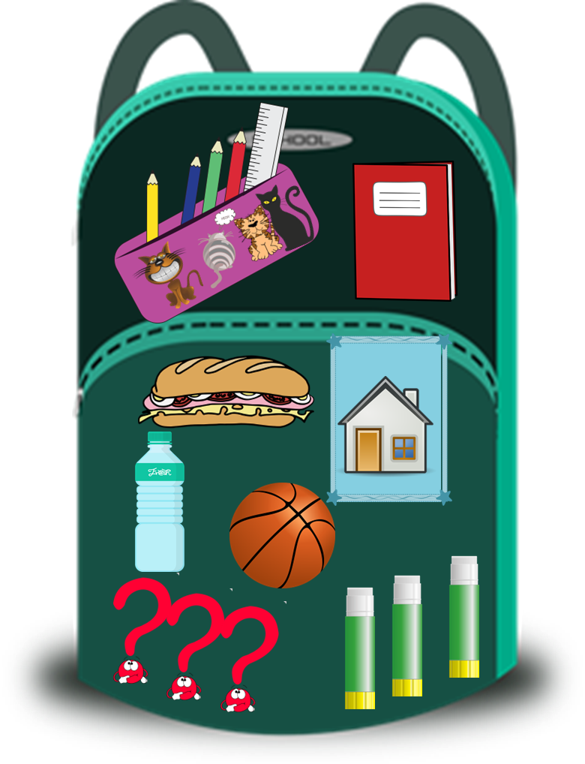
Saying what I and others have
¿Qué tienes en tu mochila?
azul
tener: 1st, 2nd and 3rd person singular
Plural indefinite articles
SSC: [ca] [co] [cu]
Notes:
Artwork by Steve Clarke. All additional pictures selected are available under a Creative Commons license, no attribution required.
The frequency rankings for words that occur in this PowerPoint which have been previously introduced in the resources are given in the SOW (excel document) and in the resources that first introduced and formally re-visited those words.
Phonics: Revisit: [ca] [co] [cu] cama [609] cosa [69] cucaracha [>5000]
Vocabulary (new words in bold): tiene [tener 19] tienes [tener 19] bocadillo [>5000] botella [1878] casa [106] cuaderno [3301] gato [1728] libro [230] mentira [1673] mochila [>5000] pegamento [>5000] pelota [2270] pregunta [507] verdad [176] nuevo [94] viejo [225] pero [30] también [49] y [4] unos, unas [6]
Revisit 1: están [21] son [7] demasiado [494] hoy [167] normalmente [1696] Revisit 2: estar [21] estoy [21] estás [21] ser [7] soy [7] eres [7] es [7] cómo [151] quién [289] señor [201] señora [509] activo [1279] cansado [1818] creativo [2945] negativo [1804] nervioso [1521] perdido [1899] positivo [1188] preparado [2092] raro [1005] serio [856] tonto [2379] tranquilo [1093] muy [43] ¡Buenos días! [103/65] ¡Buenas tardes! [103/392] hola [1245]
Frequency of unknown words:
pareja [893]
Source: Davies, M. and Davies, K. (2018). A frequency dictionary of Spanish: Core vocabulary for learners (2nd ed.). Routledge: London
For any other words that occur incidentally in this PowerPoint, frequency rankings will be provided in the notes field wherever possible.

Slide 3
pronunciar
[ca]
cama
[co]
contar
[cu]
cucaracha
Notes:
Timing: 2 minutes
Aim: to revisit SSC [a] [o] [u] in combination with [c]
Procedure:
Click to trigger [ca] and get pupils to repeat. Click to bring up the image. Say the word again together.
Bring up [co] and [cu] and elicit the the SSC, and the source words.

Slide 4
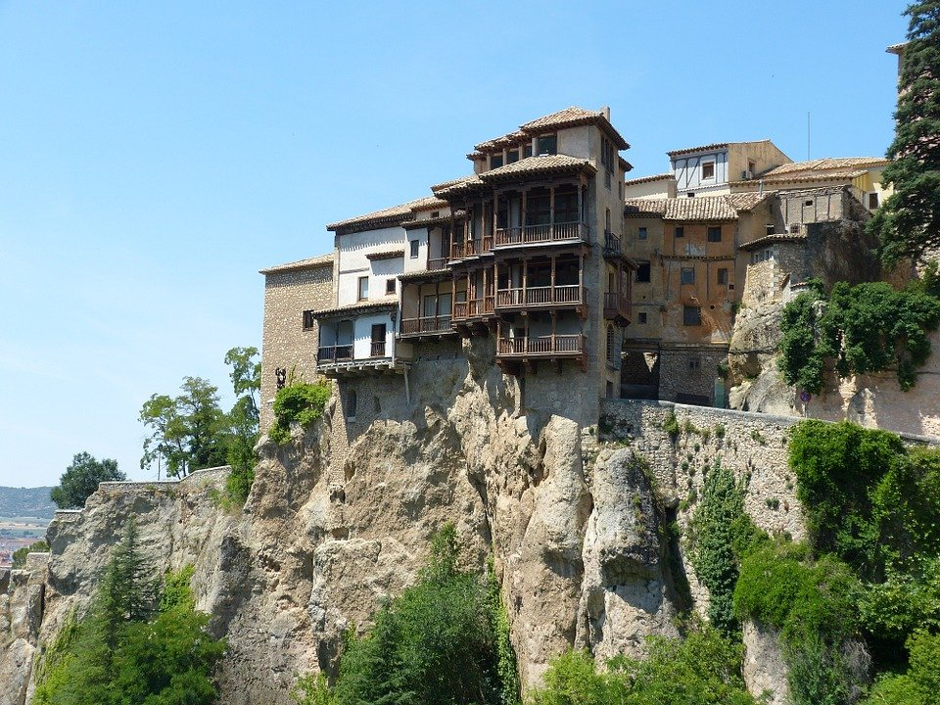
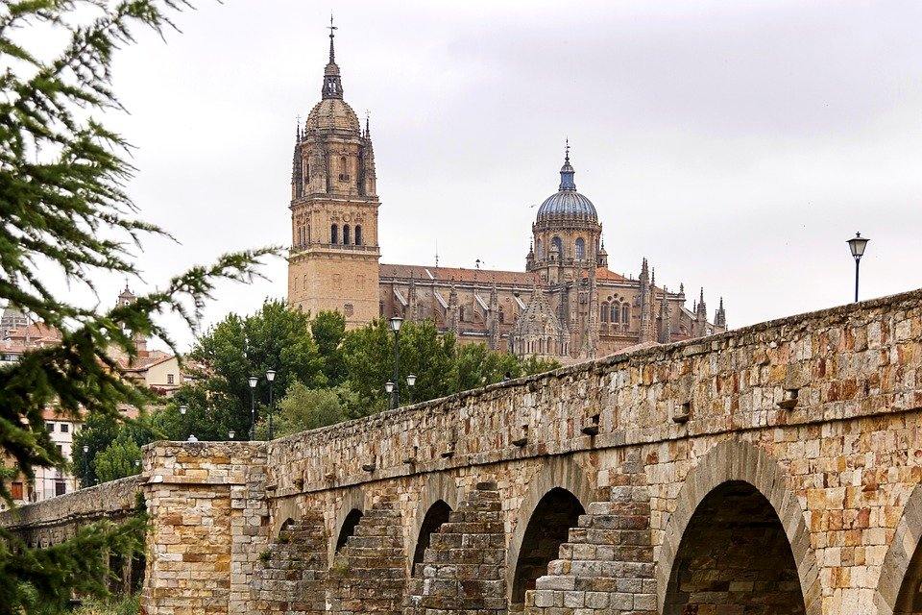
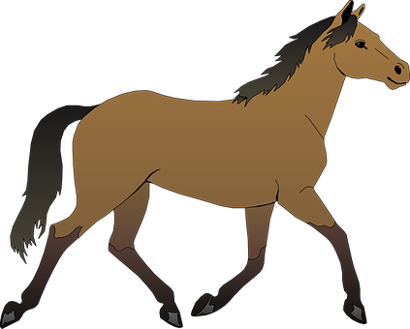
pronunciar
Pronuncia en parejas.
5
cuaderno
1
¿Cómo?
1 minuto
10
contar
6
cansado
2
Cuenca
7
Paco
11
contento
3
cucaracha
8
cámara
12
Salamanca
0
4
caballo
9
cama
parejas = pairs
INICIO
Notes:
Timing: 3 minutes
Aim: to apply SSC [a] [o] [u] in combination with [c]
Procedure:
Pupils work in pairs to pronounce as many words as they can in 60 seconds.
Click on ‘inicio’ to start timer.
Click to bring up animations (image covering syllables [co] [co] and [cu] and give pupils 60 more seconds to pronounce these words, using [co] [co] and [cu] when it corresponds. NB. The majority of these words are revisited from rojo / amarillo; we have also included proper nouns (Cuenca, Salamanca and Paco).
Click on the pictures to hear the audio, if required.
Frequency of unknown words:
pareja [893]
Source: Davies, M. and Davies, K. (2018). A frequency dictionary of Spanish: Core vocabulary for learners (2nd ed.). Routledge: London

Slide 5
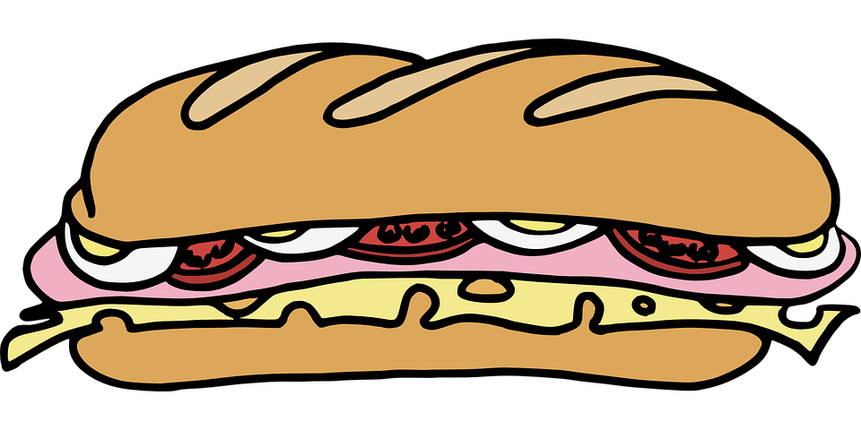
vocabulario
a b ñ
Escucha y repite.
el bocadillo
la casa
[sandwich]
[house]
la pelota
el pegamento
[ball]
[glue]
Notes:
Timing: 3 minutes (two slides)
Aim: to revisit six previously taught nouns and introduce two new nouns for this week. These nouns will feature in the lesson this week.
Procedure: 1. Pupils either work in pairs, reading the Spanish words out loud and looking at the English meanings (1 minute). 2. Then the teacher removes the English words or pictures (one by one) and pupils try to recall the English orally (chorally), looking at the Spanish (1 minute). 3. Then the Spanish meanings are removed (one by one) and pupils try to recall them orally (again, chorally), looking at the English (1 minute) 4. Further rounds of learning can be facilitated by one pupil turning away from the board, and his/her partner asking him/her the meanings (‘Cómo se dice X en español?’). This activity can work from L2 → L1 or L1 → L2.

Slide 6
vocabulario
a b ñ
Escucha y repite.
la pregunta
el cuaderno
[question]
[exercise book]
el gato
la botella
[cat]
[bottle]
Notes:
[2/2]

Slide 7
Talking about things in the plural:
Plural nouns and indefinite articles (unos/unas)
Remember! To talk about more than one thing (plural), Spanish often adds ‘s’ to the end of the noun.
Tengo un libro.
I have a book.
Tengo dos libros.
I have two books.
To say ‘some’ before a plural noun, use unos or unas.
Tengo unos amigos.
Tengo unas camas.
I have some (male) friends.
I have some beds.
unos
unas
For plural masculine nouns, use _____. For plural feminine nouns, use ______.
Notes:
Timing: 2 minutes
Aim: to recap plural ‘s’ on nouns and to introduce plural indefinite articles.
Procedure:
1. Click to bring up each new part of the explanation.
2. Interactive elicitation: Try to elicit the English meaning in each of the example sentences.
3. After showing the examples (and before showing the final line of text), ask pupils why it’s ‘unos amigos’ but ‘unas amigas’ to elicit: 1) nouns have gender 2) amigo is masculine and cama is feminine.
4. Ask pupils if they can think of any other words that could take ‘unos’ or ‘unas
Last week’s vocabulary: unos (libros, padres, animals, profesores, jardines); unas (camas, casas, sillas, madres, profesoras)

Slide 8
escuchar
Quique habla. ¿Cuántos tiene? ¿Qué tiene?
Marca I (singular) o II (plural).
escuchar
I (singular) | II+ (plural) | ¿Qué tiene Quique?
E
un pegamento
1
una botella
2
unos cuadernos
3
unas casas
4
unos gatos
5
un bocadillo
6
una pregunta
Notes:
Timing: 7 minutes
Aim: to practise aural comprehension of singular and plural nouns.
Procedure:
Pupils write 1-6 in their books and I (singular) and II+ (plural).
Click to listen to the example. Pupils decide whether the noun is ‘one’ or ‘more than one’.
Click to listen again. Pupils transcribe the word in Spanish. (Note: a follow up comprehension activity is on the next slide).
Complete the task with items 1-6, listening once for number.
Click to correct for number.
Listen again to transcribe.
Click to reveal answers to the transcriptions.
Transcript:
Ej. Tengo un pegamento. 1. Tengo una botella.
2. Tengo unos cuadernos. 3. Tengo unas casas. 4. Tengo unos gatos. 5. Tengo un bocadillo. 6. Tengo una pregunta.

Slide 9
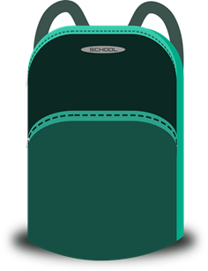
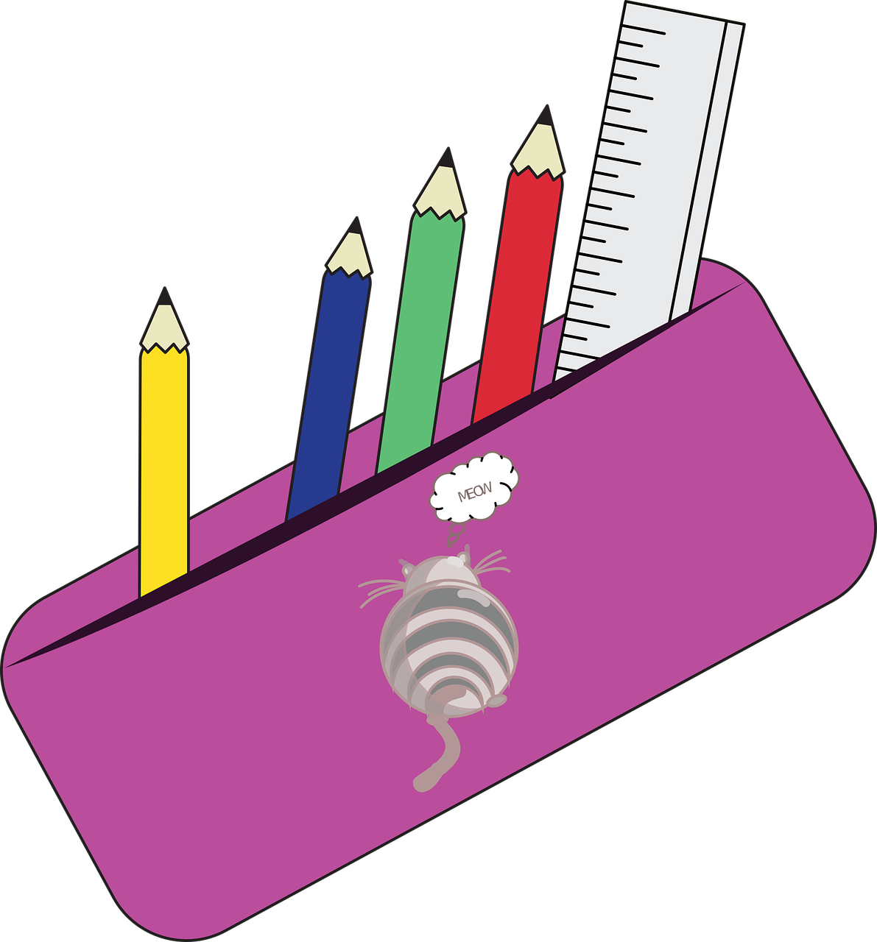
leer
¿Es verdad [V] o mentira [M] ?
Escribe 1 – 7 y [V] o [M].
1
Tengo un pegamento.
Tengo una botella.
Tengo unos cuadernos.
Tengo unas casas.
Tengo unos gatos.
Tengo un bocadillo.
Tengo una pregunta.
[M]
2
[V]
3
[M]
4
[M]
5
[V]
6
[V]
7
[M]
Notes:
Timing: 5 minutes
Aim: to practise written comprehension of singular and plural nouns based on the connection to the singular or plural indefinite articles.
Procedure:
Read the title – ‘¿Es verdad o mentira?’ Ensure that pupils understand the title. These two words are new for this week.
Explain that this is a list of what Quique says he has in his bag, but is he telling the truth or has he forgotten what he has, and it’s a lie? Tell them they need to pay attention to whether there is one or more than one of the item to decide.
Do [1] with them to model the task.
Paying attention to the indefinite article and comparing it to what they can see is in the bag, pupils write [V] or [M].
Note: the end of the nouns is obscured to focus all of pupils’ attention on the indefinite article.

Slide 10
Asking yes/no questions
Remember! Turn a statement into a yes/no question by making
your voice go up at the end.
Tengo un libro.
I have a book.
¿Tengo un libro?
Do I have a book?
Remember how to say ‘you have’:
Tienes unos libros.
You have some books.
Ask someone else ‘do you have?’ using tienes and making your voice go up.
¿Tienes unos libros?
Do you have some books?
Notes:
Timing: 2 minutes
Aim: to recap tienes and raised intonation questions.
Procedure:
1. Click to bring up each new part of the explanation.
2. Elicit the English for the Spanish examples.

Slide 11
escuchar
Quique habla. Escucha.
Marca I o you .
Is he asking himself or Sofía?
escuchar
Do I have…? | Do you have…? | en inglés
E
some exercise books
1
a ball
2
some questions
3
some sandwiches
4
a bottle
5
some things
6
some pens
Notes:
Timing: 6 minutes
Aim: to practise aural comprehension of singular and plural nouns and differentiate between tengo and tienes, connecting these with their meanings in yes/no questions.
Procedure:
Pupils write 1-6 in their books and I and you.
Click to listen to the example. Pupils decide whether question means do I have or do you have.
Click to listen again. Pupils write the meaning of the noun in English, paying careful attention to whether it is singular or plural.
Complete the task with items 1-6, listening once for the verb
Click to correct.
Listen again to understand the nouns.
Click to reveal noun answers.
Transcript:
Ej. ¿Tengo unos cuadernos? 1. ¿Tengo una pelota?
2. ¿Tienes unas preguntas?
3. ¿Tienes unos bocadillos?
4. ¿Tengo una botella?
5. ¿Tienes unas cosas?
6. ¿Tienes unos bolígrafos?

Slide 12
hablar
Habla con Quique.
Tell him what he has in his school bag.
‘You have…’
1. __________ bocadillos.
¿Qué tengo en mi mochila?
¡Tengo muchas cosas!
2. __________ frutas.
3. __________ cuadernos.
4. __________ cámara.
Ej. __________ pegamento
5. __________ bolígrafos.
a (m)
a (f)
some (mpl)
some (fpl)
un pegamento
una cámara
unos bocadillos
unas frutas
unos cuadernos
unos bolígrafos
Notes:
Timing: 2 minutes
Aim: to practise oral production of indefinite articles and their connection to matching noun forms.
Procedure:
Do the example with the class. Elicit ‘Tienes un pegamento.’ and click twice for the noun to appear under the correct article.
Continue with items 1 – 5.

Slide 13
¡adiós!
azul

