Slide 1
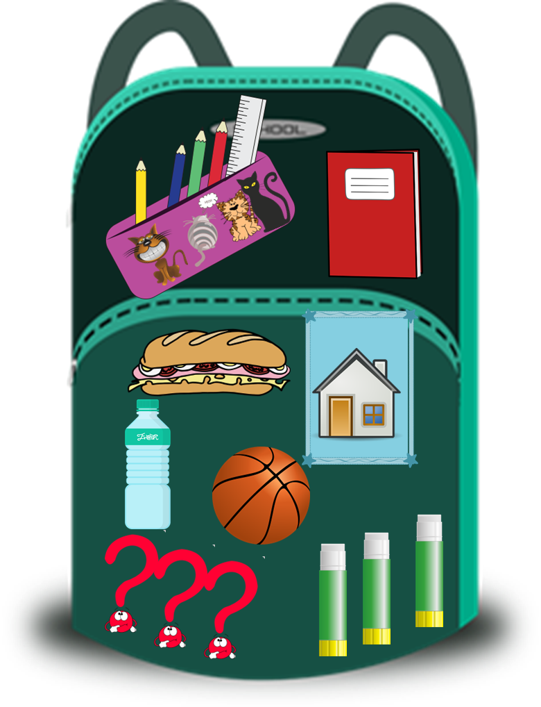
Saying what I and others have
¿Qué tienes en tu mochila?
azul
Follow ups 1-5
Notes:
Artwork by Steve Clarke. All additional pictures selected are available under a Creative Commons license, no attribution required.
The frequency rankings for words that occur in this PowerPoint which have been previously introduced in the resources are given in the SOW (excel document) and in the resources that first introduced and formally re-visited those words.
Phonics: Revisit: [ca] [co] [cu] cama [609] cosa [69] cucaracha [>5000]
Vocabulary (new words in bold): tiene [tener 19] tienes [tener 19] bocadillo [>5000] botella [1878] casa [106] cuaderno [3301] gato [1728] libro [230] mentira [1673] mochila [>5000] pegamento [>5000] pelota [2270] pregunta [507] verdad [176] nuevo [94] viejo [225] pero [30] también [49] y [4] unos, unas [6]
Revisit 1: están [21] son [7] demasiado [494] hoy [167] normalmente [1696] Revisit 2: estar [21] estoy [21] estás [21] ser [7] soy [7] eres [7] es [7] cómo [151] quién [289] señor [201] señora [509] activo [1279] cansado [1818] creativo [2945] negativo [1804] nervioso [1521] perdido [1899] positivo [1188] preparado [2092] raro [1005] serio [856] tonto [2379] tranquilo [1093] muy [43] ¡Buenos días! [103/65] ¡Buenas tardes! [103/392] hola [1245]
Frequency of unknown words and cognates: advinar [2201] banco [728] calcular [1947] capital [582] color [358] completar [2003] contexto [1977] correcto [1467] costo [1707] cultura [469] curiosidad [1830] dificultad [1153] documento [996] eco [2461] frecuente [2066] local [734] música [341]
Source: Davies, M. & Davies, K. (2018). A frequency dictionary of Spanish: Core vocabulary for learners (2nd ed.). Routledge: London
For any other words that occur incidentally in this PowerPoint, frequency rankings will be provided in the notes field wherever possible.

Slide 2
Follow up 1:
[ca]
[co]
[cu]
Escribe 5 palabras. Es un secreto.
pronunciar
Tu compañero/a, adivina.
¿Qué significa en inglés?
1 minuto
correcto
local
dificultad
banco
música
cultura
documento
color
completar
capital
calcular
costo
eco
frecuente
contexto
0
curiosidad
adivina = guess
INICIO
Notes:
Timing: 5 minutes
Aim: to apply knowledge of the SSC [ca] [co] and [cu] to the oral production of mostly unknown words.
Procedure:
Each pupils secretly writes down 5 of the words.
Start the timer. Pupil A tries to say all of Pupil B’s words within the 30 seconds.
Swap roles and start the timer again.
Several rounds of the activity can be completed.
Teacher clicks to bring up the prompt for English meanings. pupils have not been taught these words but they share several letters in common with highly frequent English words. Many pupils will be able to anticipate the meanings.
Frequency of unknown words and cognates: advinar [2201] banco [728] calcular [1947] capital [582] color [358] completar [2003] contexto [1977] correcto [1467] costo [1707] cultura [469] curiosidad [1830] dificultad [1153] documento [996] eco [2461] frecuente [2066] local [734] música [341]
Source: Davies, M. & Davies, K. (2018). A frequency dictionary of Spanish: Core vocabulary for learners (2nd ed.). Routledge: London

Slide 3
Follow up 2:
Escucha. ¿Es ‘tengo, tienes o tiene’?
Identifica las preguntas.
escuchar
Marca
escuchar
I have
Escucha otra vez: ¿Cómo es? ¿Cómo son?
You have
She has
Quique | Sofía | Úrsula
?
objeto
descripción
E
E
questions
strange
1
1
sandwiches
ready
2
2
(male) teacher
creative
3
3
bottles
small
4
school bag
lost
4
5
pens
pretty
5
Notes:
Timing: 7 minutes
Aim: to practise differentiating aurally between ‘tengo’, ‘tienes’ & ‘tiene’ and connect the verbs forms with their meaning. In addition, to recognise questions and statements from the intonation. Finally, pupils will practise aural comprehension of nouns and adjectives from this and previous weeks.
Procedure:
Part 1
Read the instruction in Spanish from the board.
Click to bring up speech bubbles and elicit translations from pupils. This will provide support when doing the activity.
Click to bring up further instruction (Marca).
Tell them that they will hear Quique talking about what he has, talking to Sofía or talking about Úrsula. Tell pupils they need to pay attention to whether they hear “tengo”, ‘tienes’ or “tiene”. They can write the verb down for support or tick directly.
5. Click to bring up further instructions and clarify. They need to pay attention to whether it’s a statement or a question.
6. Do the example with them.
7. Ask pupils to write 1-5 in their books.
8. Do 1-5 and click to provide feedback.
Part 2
9. Click x3 to bring up the instructions and the table. Pupils need now to concentrate understanding the vocabulary.
10. Play all items again.
11. Go through answers 1-6.
Transcript 1:
Ej. Tiene unas preguntas.
Tengo unos bocadillos.
¿Tienes un profesor?
Tiene unas botellas.
¿Tiene una mochila?
Tienes unos bolígrafos.
Transcript 2:
Ej. Tiene unas preguntas. Son raras.
Tengo unos bocadillos. Están preparados.
¿Tienes un profesor? ¿Es creativo?
Tiene unas botellas. Son pequeñas.
¿Tiene una mochila? ¿Está perdida?
Tienes unos bolígrafos. Son bonitos.

Slide 4
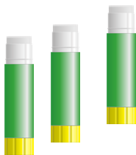
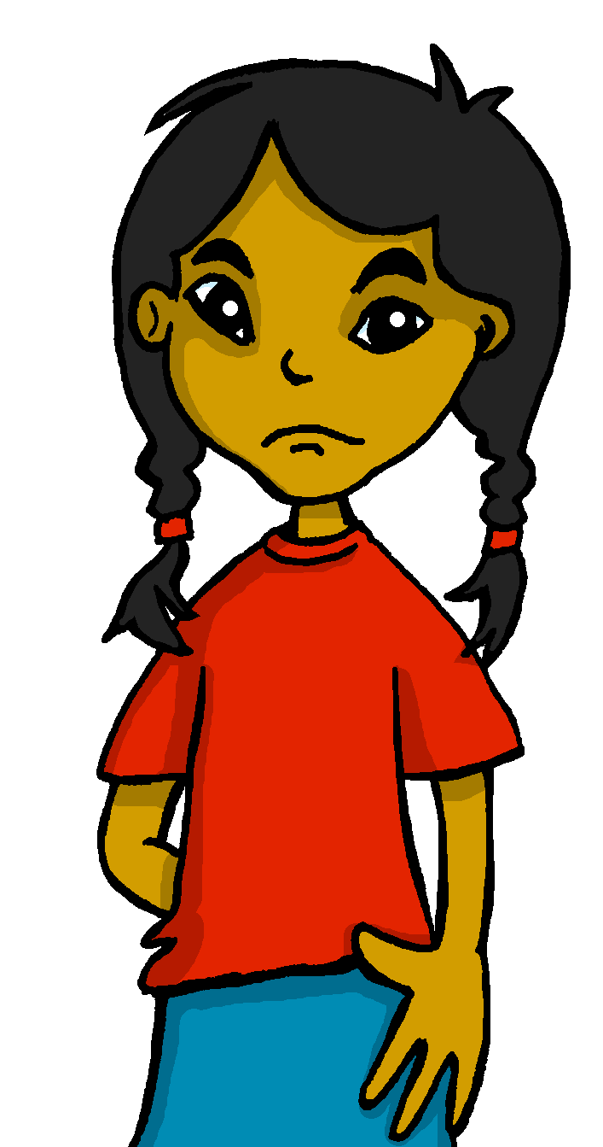
Gender & number agreement on adjectives
Remember that in Spanish all nouns are either masculine or feminine.
💡 Don’t forget! This is grammatical, not biological gender. Preguntas (questions) are feminine, not female!
We also know that:
when we describe more than one masculine noun, the adjective ends in –os.
when we describe more than one feminine noun, the adjective ends in –as.
Tengo unos pegamentos. Son nuevos.
Tengo unas pelotas, pero son muy viejas.
I have some glue sticks. They are new.
I have some balls but they are very old.
Notes:
Use before Follow up 3 and/or 4. Timing: 1 minute
Aim: to revisit regular adjectival agreement (gender and number) in order use the masculine and feminine plural form of regular adjectives ending in –o, when describing any noun.
Procedure:
Click to present the information in stages.
Elicit English translation for the Spanish examples provided.

Slide 5
Follow up 3:
💡 ’foto’ is a feminine noun!
Quique escribe una lista de cosas. ¿Qué tiene Quique? ¿Qué tiene Señora Cano? Y ¿cómo es? o ¿cómo son?
leer
1
Tiene una botella. Es azul.
¿Quién? | ¿Qué? | ¿Cómo?
Señora Cano (she) | botella bolígrafo | azul (blue)
Quique (I) | cuadernos frutas | ---
Señora Cano (she) | pelotas pegamentos | viejos (old)
Señora Cano (she) | fotos diccionarios | bonitas (pretty)
Quique (I) | cuadernos cuaderno | rojo (red)
Quique (I) | libros frutas | nuevos (new)
2
Tengo unas frutas y un bocadillo.
3
Tiene unos pegamentos. Son viejos.
4
Tiene unas fotos. Son bonitas.
5
Tengo un cuaderno. Es rojo.
6
Tengo unos libros. Son nuevos.
Notes:
Timing: 4 minutes
Aim: to identify nouns from the indefinite articles; to understand new and previously taught nouns and adjectives (in singular and plural forms). To practise written comprehension of two parts of the verb tener (tengo, tiene) and connect these to their meaning.
Procedure:
Read the scenario with pupils. They should understand that Quique is writing a list of what he sees on his own table (tengo – I have) and what his teacher has on her desk (tiene – she has). He has smudged some of his writing, though. Can they still work out who has what, and what it is like?
Do the first one with pupils. They work out ‘quién’ by looking at the part of tener, they work out ‘qué’ by looking at the article, they work out ‘cómo’ by understanding the adjective. Click to work through the task in small steps, highlighting in pink the relevant parts of the sentence.
Pupils write 1 – 6 and complete the tasks.
Click to correct.

Slide 6
Follow up 4:
¿Qué frase es? Decide y escribe en español.

1a I have some (male) teachers.
Son tranquilas.
escribir
1b You have some (female) teachers.
Tienes unas profesoras.
2a She has some (male) friends.

Tiene unos amigos.
Son demasiado activos.
2b I have some (female) friends.
3a You have some questions.

Tienes unas preguntas.
💡 ’problema’ is a masculine noun!
Pero son tontas.
3b He has some (male) teachers.

4a Does she have some problems?
¿Tiene unos problemas?
Sí, y son serios.
4b Do you have some ideas?

5a Do you have some (male) friends?
Sí, pero están cansadas hoy.
¿Tengo unas hermanas?
5b Do I have some sisters?
Notes:
Timing: 10 minutes
Aim: to use knowledge of plural adjective agreement to identify which of two sentences is the target for translation; to practise written production of the singular forms of tener, plural indefinite articles unos and unas, and familiar plural nouns.
Procedure:
Model the first item with pupils, asking questions to help them understand the task. E.g., how do we know which sentence/noun the description / adjective is referring to? (Yes, -as on the adjective means it must be describing a plural feminine noun.) Which sentence is it, then a or b?
Pupils write the sentence. Teacher asks prompt questions. ¿Cómo se dice ‘you have’? ¿Cómo se dice ‘some’ en femenino? ¿Cómo se dice ‘female teachers’?
Click to reveal the answer to item 1.
Give pupils time to write items 2 – 5. Teachers may want to give feedback after each item or at the end of five items. Teachers circulate to offer support, where needed.
Finally, click to bring up the question ¿Es positivo o negativo? and elicit a response from pupils for each description. This prompts pupils to consider the meaning of the adjectives and also revisits two further adjectives for this week (positivo / negativo).
Note: this task revisits previously taught vocabulary that is in this week’s revisiting sets.

Slide 7
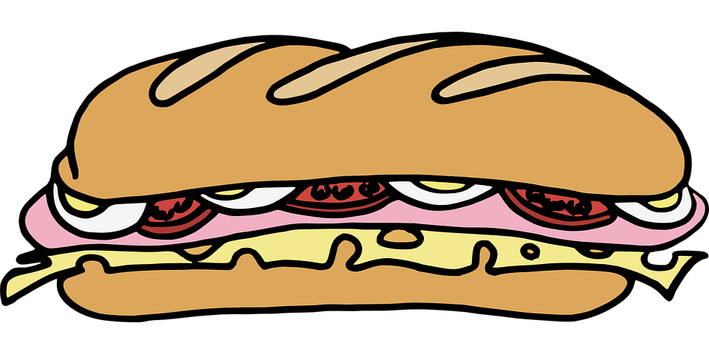
Follow up 5:
Describe tu tarjeta a tu compañero/a.
Persona A
Persona B
hablar
Persona C
Persona D
Notes:
Timing: 5 minutes (two slides, if desired)
Aim: to practise oral production of ‘tienes, unos, unas and plural forms of familiar nouns’ connecting them to meaning.
The aim of both activities is to identify a character (Persona A, B, C, D), but with slight differences.
Pupil B chooses one of the Personas but doesn’t tell his/her partner which one.
Pupil A asks questions to determine which person B has chosen. E.g. ¿Tienes unos gatos?
Pupil A makes notes and after several questions can ask ¿Eres persona X?
When A has correctly identified the person, they swap roles.
Notes:
pupils A and B will both see this set of cards (so the slide can be projected for the whole group, so no printing needed).
There is a 2nd set of cards for a further round of activity, if time allows.

Slide 8
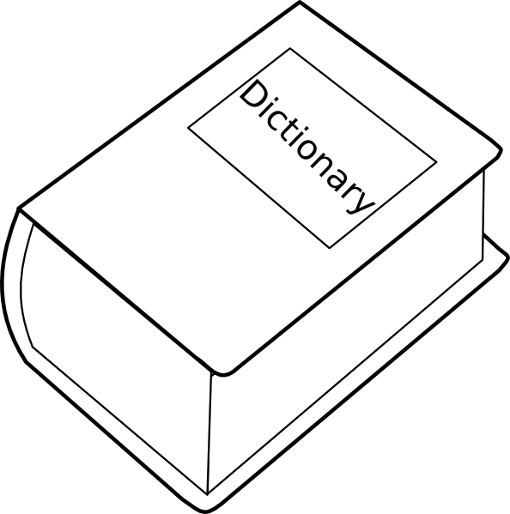
Follow up 5:
Describe tu tarjeta a tu compañero/a.
Persona A
Persona B
hablar
Persona C
Persona D
Notes:
[2/2]

Slide 9
Follow up extra 2:
Escribe en español 📝.
a b ñ
vocabulario
Can you get at least15 points?
 | you are (trait) | I am (state) | to be (state)
 | I am (trait) | to be (trait) | you are (state)
 | how? | today | too
 | Mrs, Miss (teacher) | Mr, Sir (teacher) | normally
 | some (f) | new (f) | old (m)
 | glue | lie | some (m)
 | sandwich | old (f, pl) | new (m, pl)
eres
estoy
estar
x3
soy
ser
estás
¿cómo?
hoy
demasiado
x2
Señora
Señor
normalmente
unas
nueva
viejo
el pegamento
la mentira
unos
x1
el bocadillo
viejas
nuevos
Notes:
Aim: to practise written production of vocabulary for this week and previous weeks.
Procedure:
Pupils need to write the Spanish for as many words as possible, aiming to get at least 15 points (but more if possible).
Tell pupils to write the correct word for ‘the’ with all the nouns.
3. Click for Spanish answers.

