Slide 1
español, con Quique
¡Feliz Navidad!

Slide 2
Saying what I and others have
azul
Phonics quiz
Christmas tradition: la lotería
Notes:
Artwork by Steve Clarke. Pronoun pictures from NCELP (www.ncelp.org). All additional pictures selected from Pixabay and are
available under a Creative Commons license, no attribution required.
This lesson contains a phonics assessment to check progress in SSC practised in the first 12 weeks of this year’s course.
For any other words that occur incidentally in this PowerPoint, frequency rankings will be provided in the notes field wherever possible.
Source: Davies, M. & Davies, K. (2018). A frequency dictionary of Spanish: Core vocabulary for learners (2nd ed.). Routledge: London

Slide 3
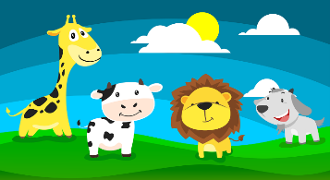
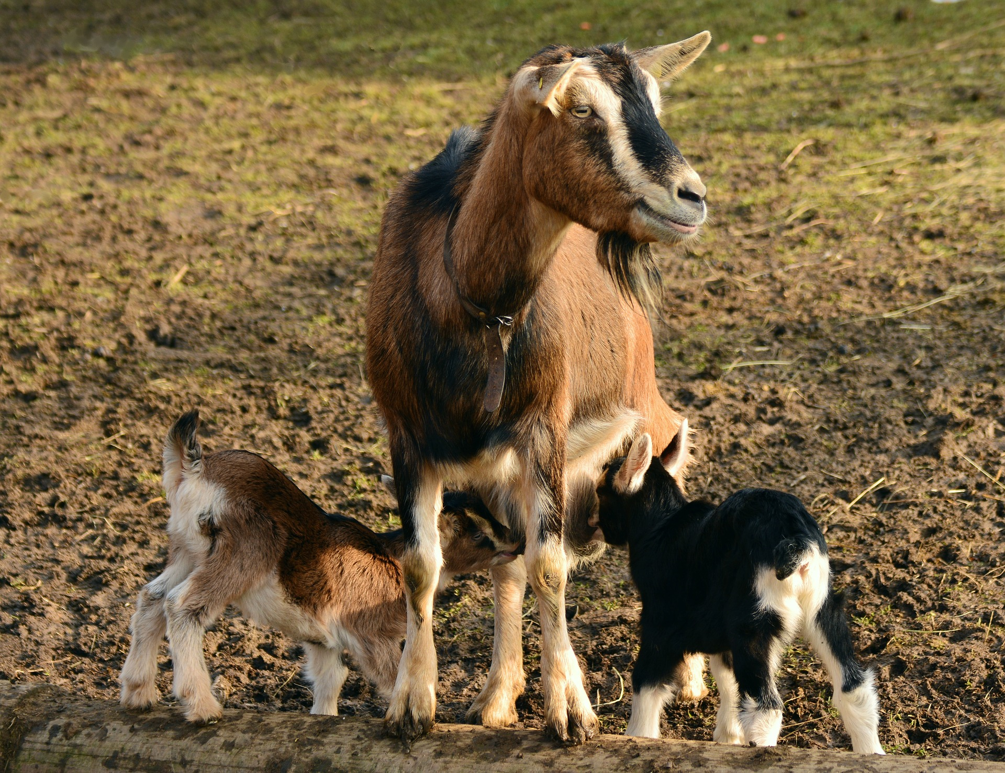
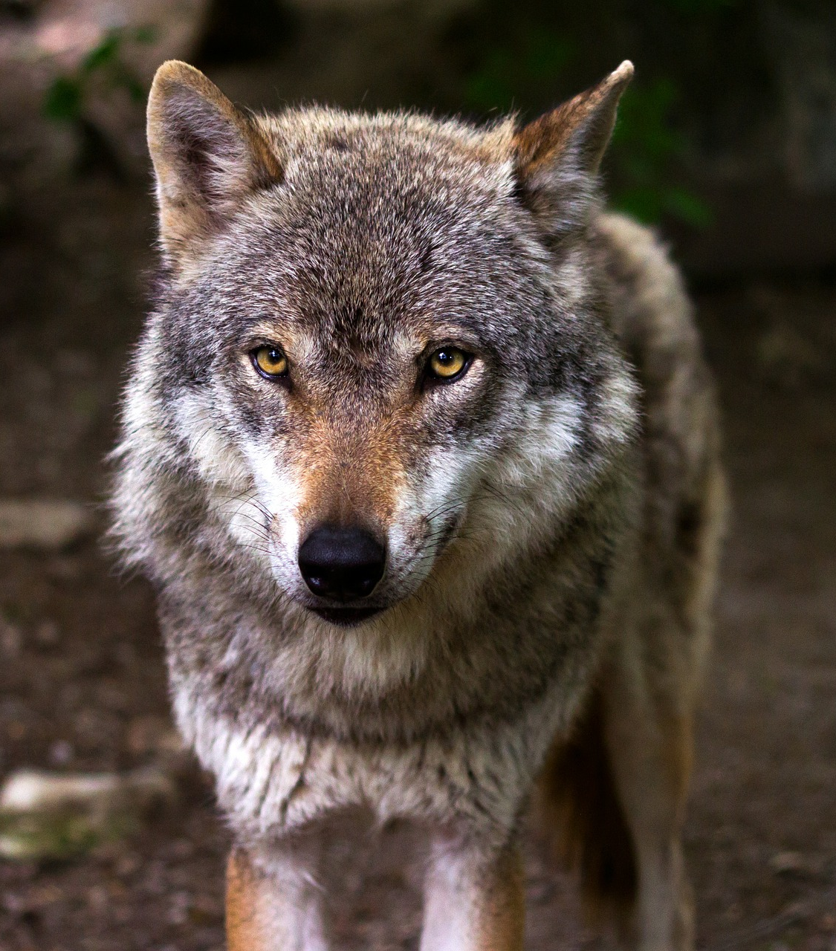
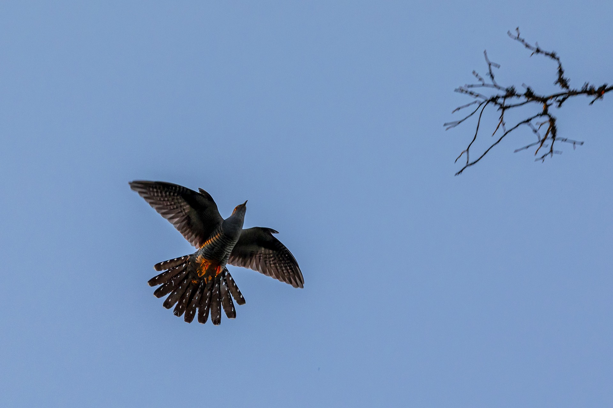
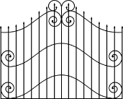
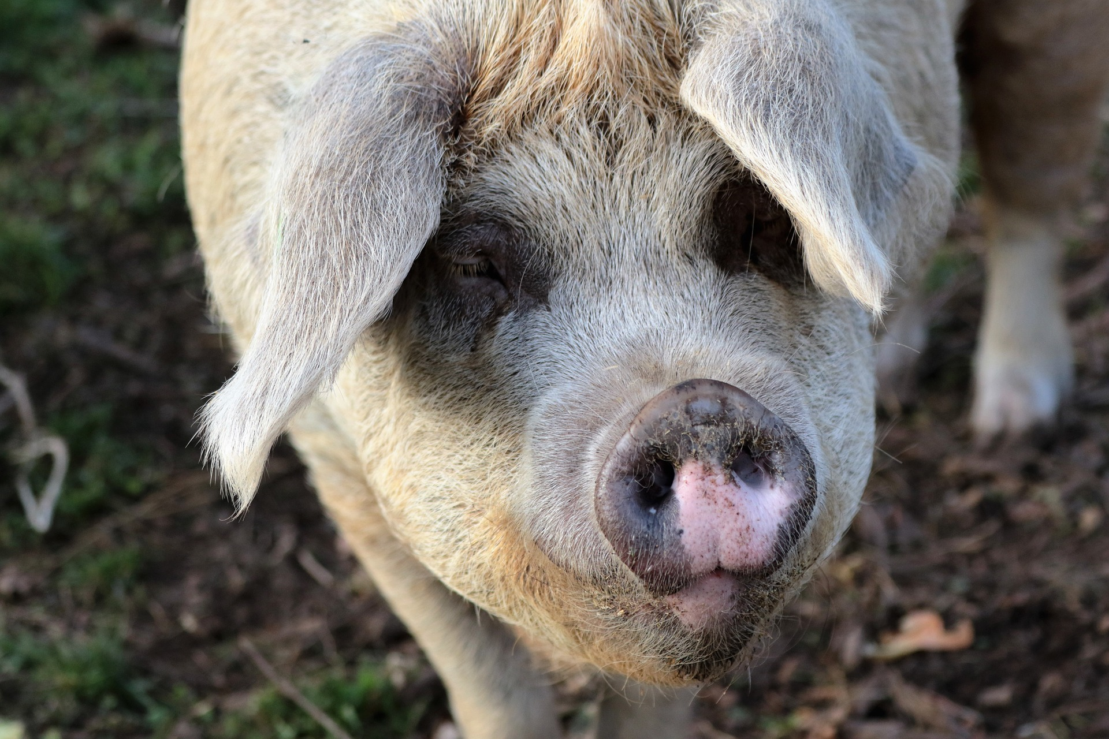
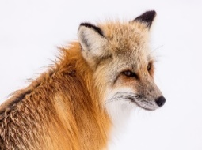
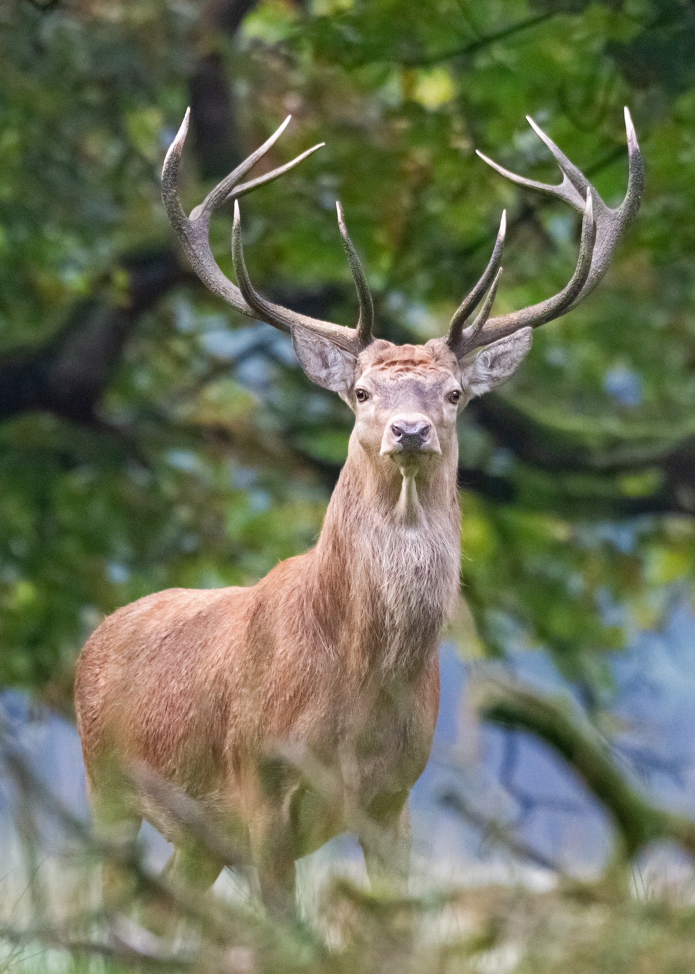
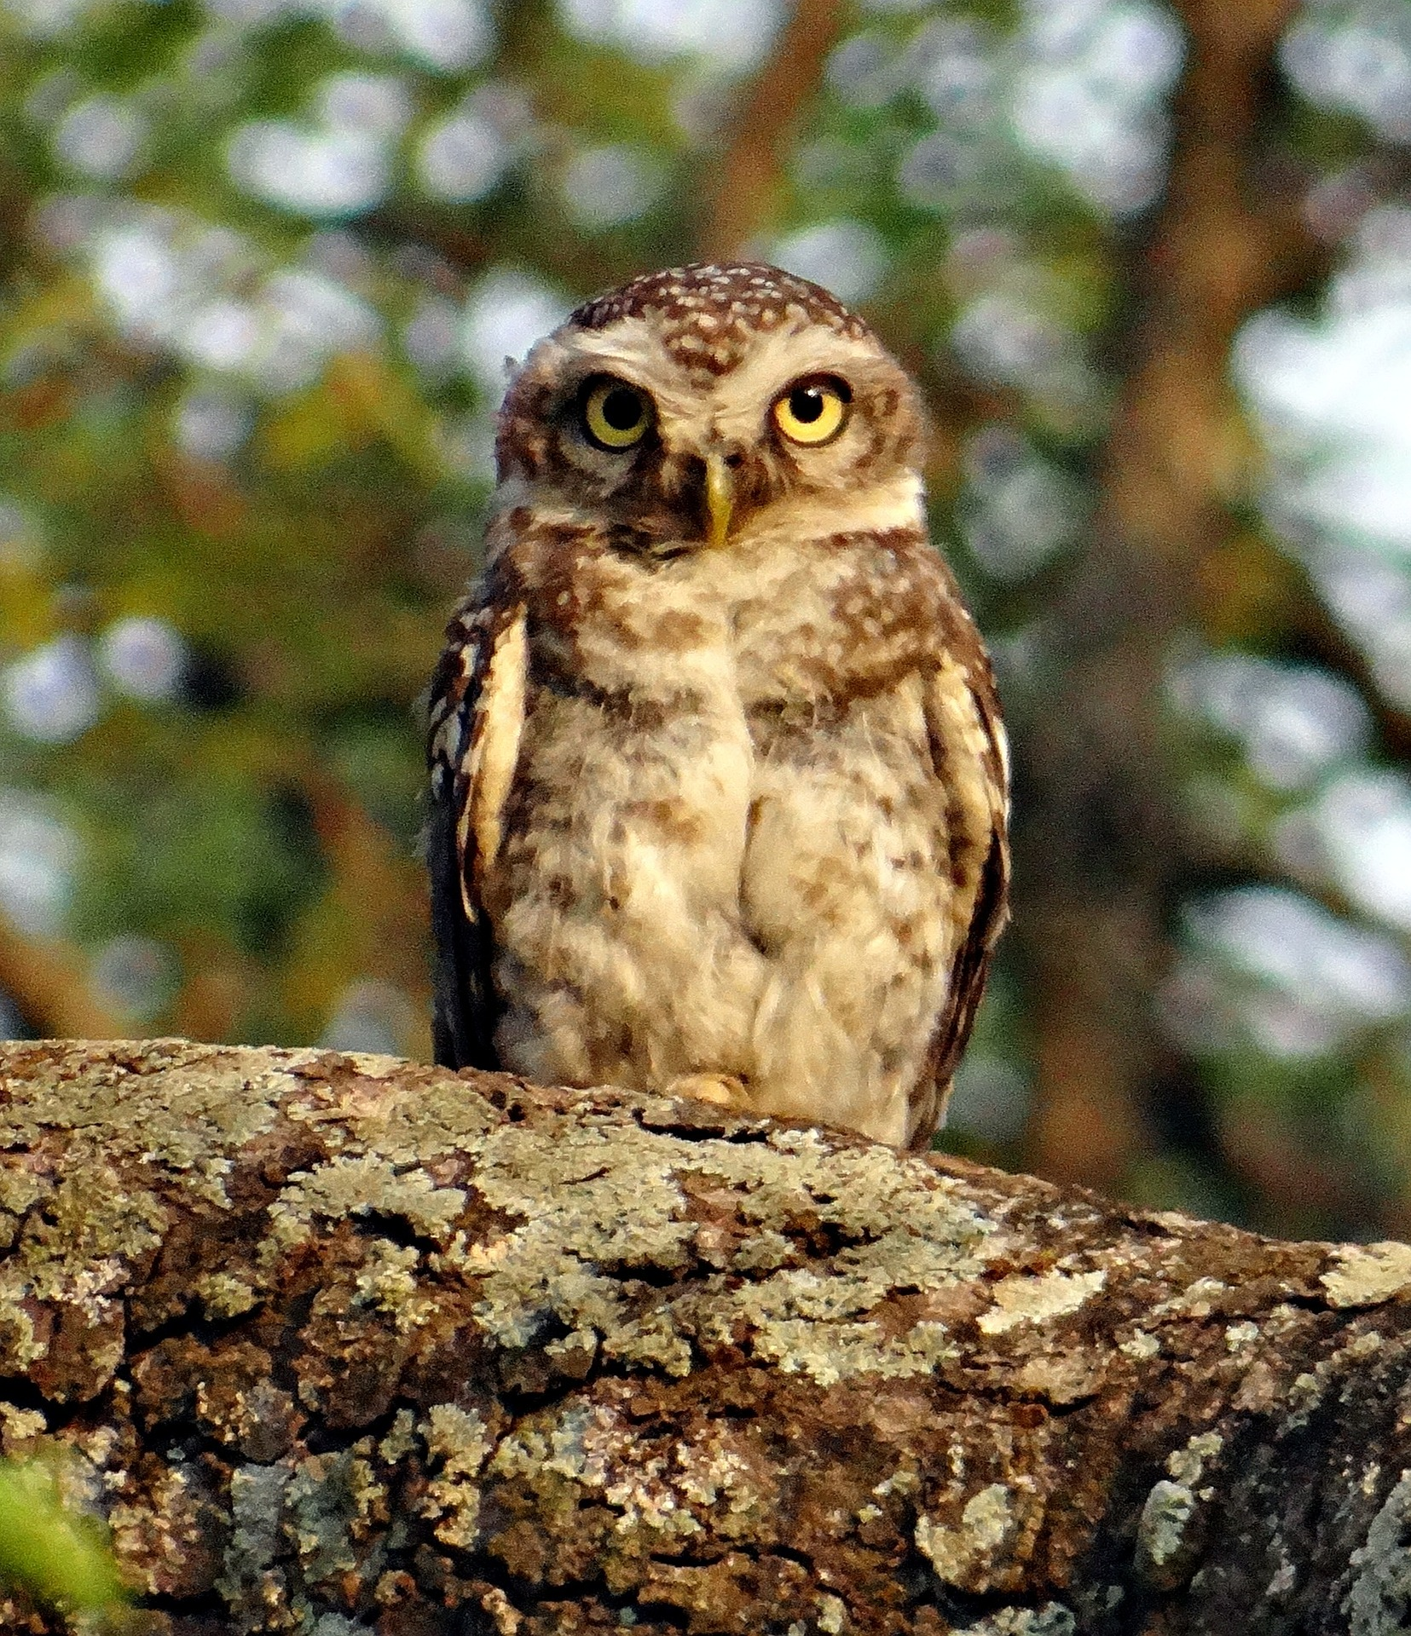
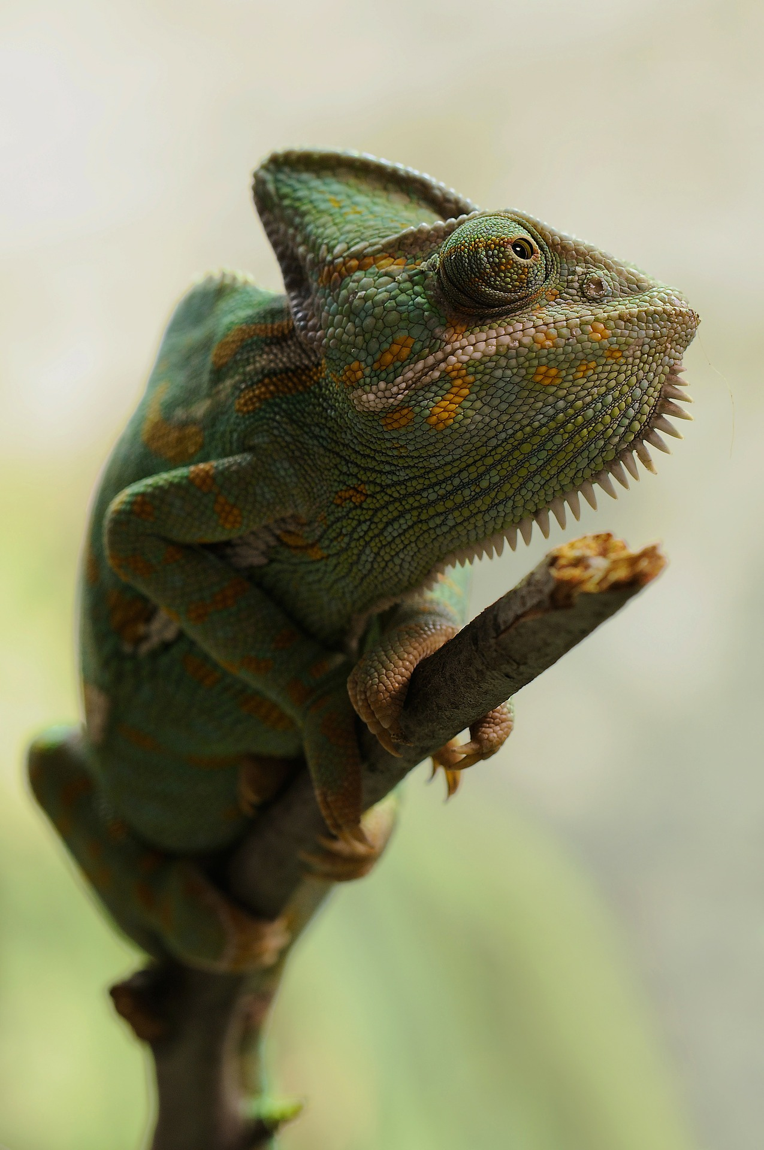
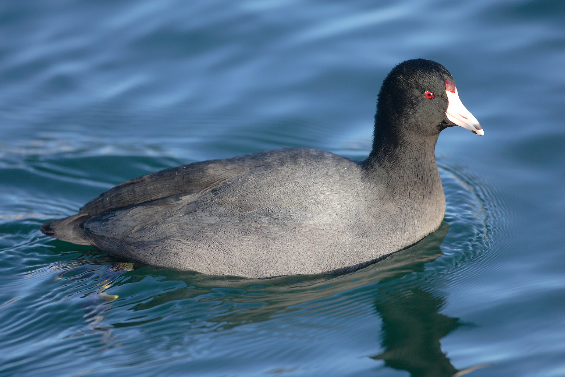
pronunciar
El zoo Read aloud the Spanish name of each animal.
ZOO
1 | 2 | 3
4 | 5 | 6
la cabra
el lobo ibérico
el cuco
You have not learnt these words so just use what you know about how to pronounce Spanish. ☺
Concentrate on the underlined letters.
el lince
el porcino
el zorro
7 | 8 | 9 | 10
la focha
el ciervo
el mochuelo
el camaleón
For numbers 8, 9 and 10 write the number of syllables in each word here: 8. [___] 9. [___] 10. [___]
Notes:
Timing: 1 minute per pupil
Aim: to assess pupils’ ability to read aloud the SSC practised this term. Procedure: 1. Use this slide to explain the phonics task. Tell pupils that you will give them the handout just before you hear each pupil so that the preparation time is the same for all.
2. Then give out the independent task activity sheets (and if desired, nominate a pupil monitor to be i/c of the PPT during the lesson). 3. Whilst pupils work on the independent tasks, listen to individual pupils reading the ten words aloud. Mark in real time, using the grid on the teacher version.
Note:
there are no follow up lessons this week, so it would be possible to continue the speaking assessments in the follow up time during this week, as needed.
if preferred, and the resources are available, pupils could record their answers (e.g. on computer or ipad) though this would involve the teacher listening back to assess them.

Slide 4
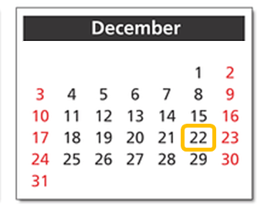
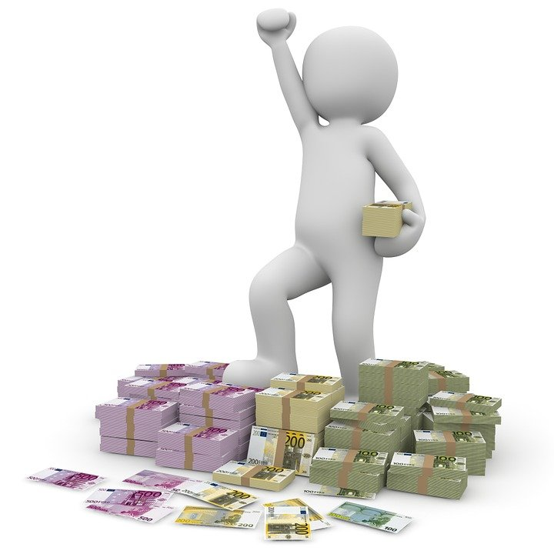
leer
el sorteo = draw la lotería = lottery
la gente = people cantan = they sing
primer = first el premio = prize
La lotería de Navidad: El Gordo
escuchar
A Escucha la información sobre la celebración.
[1] En España, el 22 de diciembre hay un sorteo de lotería.
[2] La gente ve y escucha el sorteo en la televisión y en la radio.
[3] En la tradición, los niños del Colegio de San Ildefonso cantan los premios.
[4] El primer premio es ‘El Gordo’ porque es muy grande. ¡Es mucho dinero!
[A]
[2]
[B]
[3]
[C]
[1]
B Ordena las imágenes en el orden del texto.
[D]
[4]
Notes:
Overall timing will be 20-30 minutes.
Timing: 8 minutes
Aim: to listen to and read a short text introducing knowledge about the national Christmas lottery in Spain.
Procedure:
1. Click to play the recording. (Note that if it isn’t possible for a pupil or TA to be i/c of the laptop and to play the listening, students could complete this task without the audio). 2. Pupils put the pictures in order of the text.
3. Click to correct answers.
Notes:
Later in the week, teachers could show the following video of the Spanish Christmas lottery. El Gordo 2019: https://www.youtube.com/watch?v=YhYjOkr8yFU&ab_channel=RTVE
Frequencies of unknown words: billete [2992] gente [137] lotería [>5000] premio [1090] primero [82] sorteo [>5000]

Slide 5
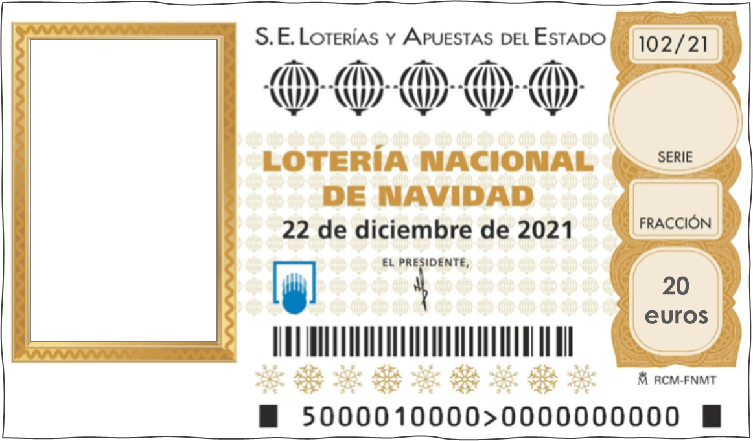
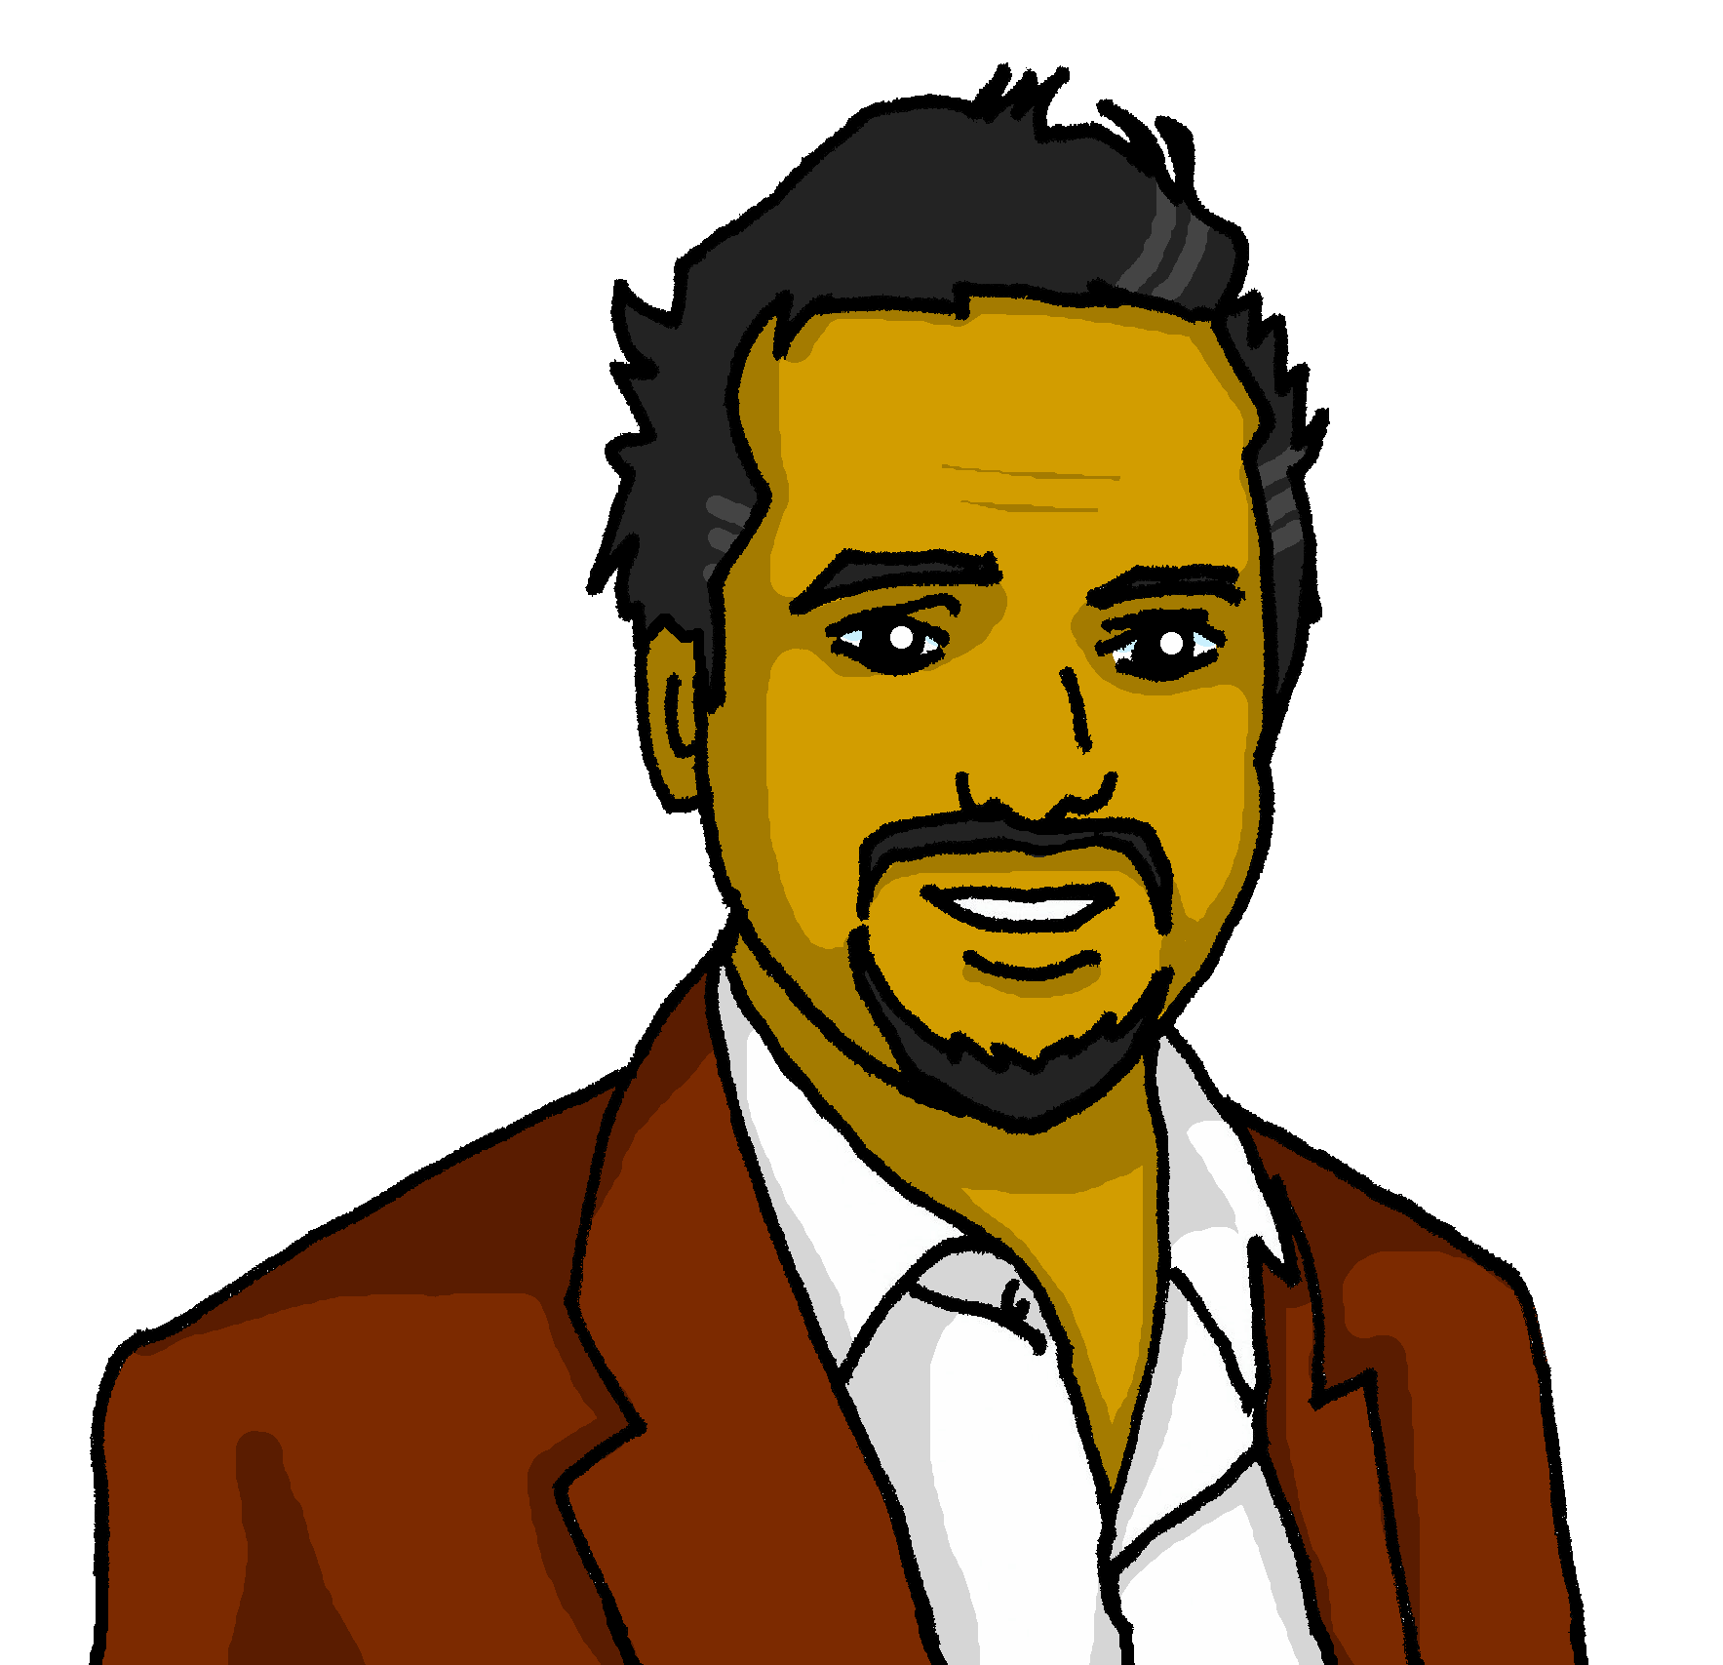
escuchar
El billete de lotería
el billete -ticket
It is traditional for families and close friends to buy the same numbers (often numbers they like!). Some families and friends buy the same number every year!
Mamá Elena tiene un billete. Papa Pedro también.
Escucha y escribe los números.
9
8
3
4
5
2
1
6
_ _ _ _
_ _ _ _
Mi billete tiene mis números favoritos.
Tengo un billete para mi hermana Valentina también.
Notes:
Timing: 3-4 minutes
Aim: to listen and understand individual numbers up to 10; to learn a bit more about the tradition of the Christmas lottery.
Procedure:
Click to play the number sequences i) and ii).
Pupils write down the sets of numbers.
Click to check these.
Click to bring up Sofía and Quique’s mum’s and dad’s speech bubbles.
Elicit their meaning.
Click to bring up the final callout.
Transcript:
i) 9 8 3 4
ii) 5 2 1 6

Slide 6
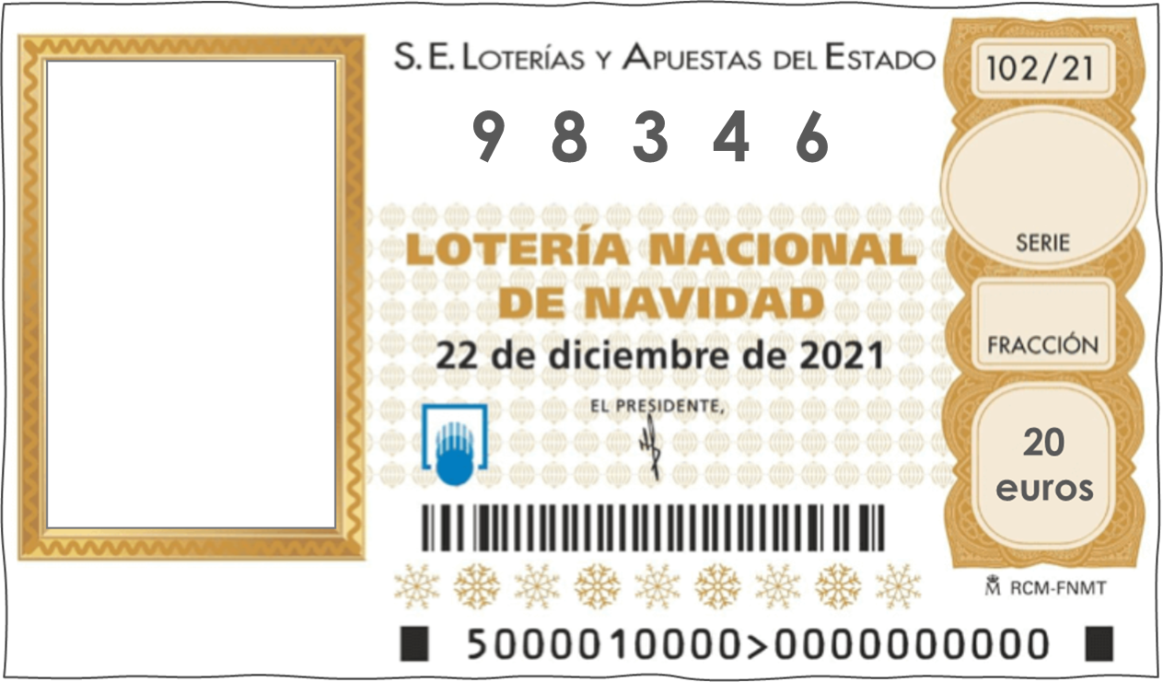
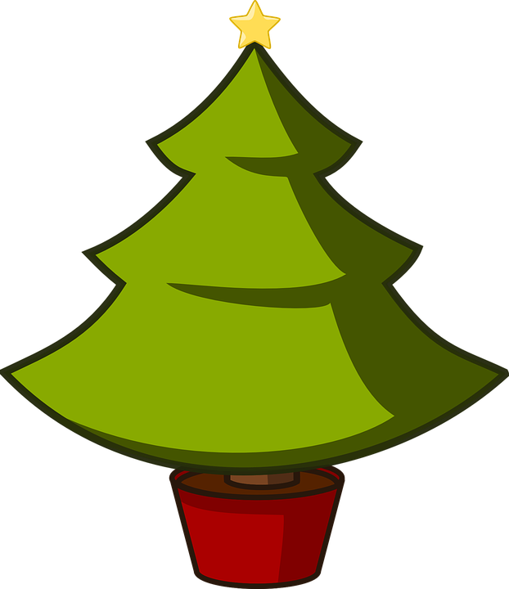
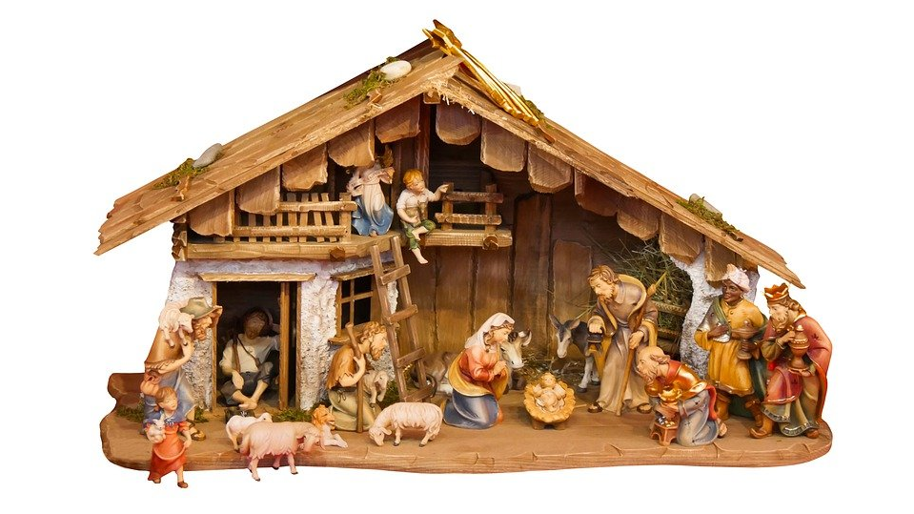
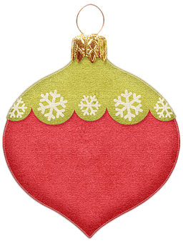
escuchar
El billete de lotería
El diseño es diferente cada año, con decoración de Navidad.
un árbol
un ángel
una estrella
una bola de Navidad
un portal de Belén
Notes:
Timing: 5 minutes
Aim: to learn a little more about the Spanish lottery tradition.
Procedure:
1. Click to present the five new vocabulary items. 2. Pupils write them down.
Frequencies of unknown words: ángel [1300] árbol [748] bola [2817] decoración [3879] diseño [1389] estrella [974] Navidad [3513] portal [3333]

Slide 7
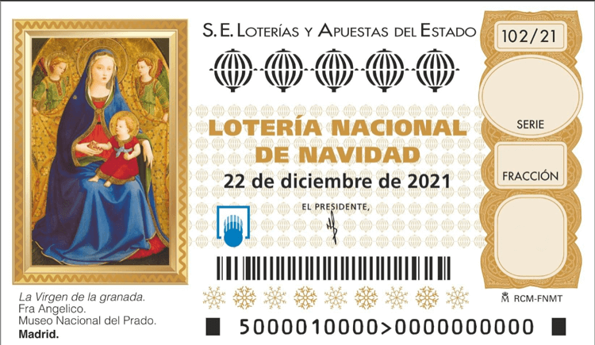
escribir
El billete de lotería
A ¿Cómo es el billete?
Completa el texto.
leer
B Dibuja el diseño ✍.
El billete [has] el número [seven], [eight], [three],
[and] [six] .
El diseño [has] [a tree] pequeño, [two] [baubles] rojas y [a star] amarilla.
tiene
siete
ocho
tres
_ _ _ _
7
8
3
6
y
seis
20
euros
tiene
un árbol
dos
bolas
una estrella
Notes:
Timing: 6 minutes
Aim: to practise known and new vocabulary in the context of a short text about the lottery.
Procedure:
Complete the written text, translating English words into Spanish.
Click to check the answers.
Pupils then draw the design, including writing the numbers in.
Click to bring up the numbers and reveal the ticket design pictures.

Slide 8
escribir
El billete de lotería
When adding extra details to your description, remember:
adjectives come after nouns in Spanish.
adjectives agree in number and gender with the noun they describe
A ¡Tu turno! Diseña tu billete de lotería.
B Describe tu billete.
Mi billete [has] el número [______], [______], [______] and [______] .
Mi diseño [has] …
_ _ _ _
objetos | una bola de Navidad un árbol una estrella un portal de Belén un niño una flor
adjetivos | verde azul amarillo rojo dorado (golden) plateado (silver)
20
euros
Notes:
Display on the board, whilst pupils are doing their own design and written description.
Frequencies of unknown words: árbol [748] bola [2817] diseño [1389] dorado [2541] estrella [974] Navidad [3513] niño [173] plateado [>5000] portal [3333]

Slide 9
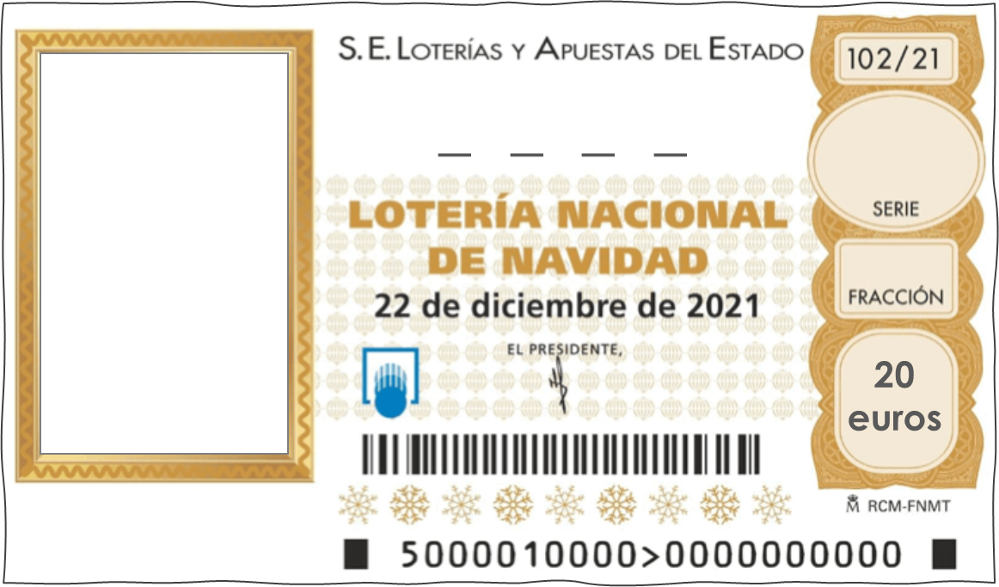
handout
Mi billete ________ el número ________, ________, ________ y ________. Mi diseño ________ __________________________________________________________________
_____________________________________________________________________________________
Notes:
Handout Note: the idea is that pupils would draw on their design and then write their description of it.

Slide 10
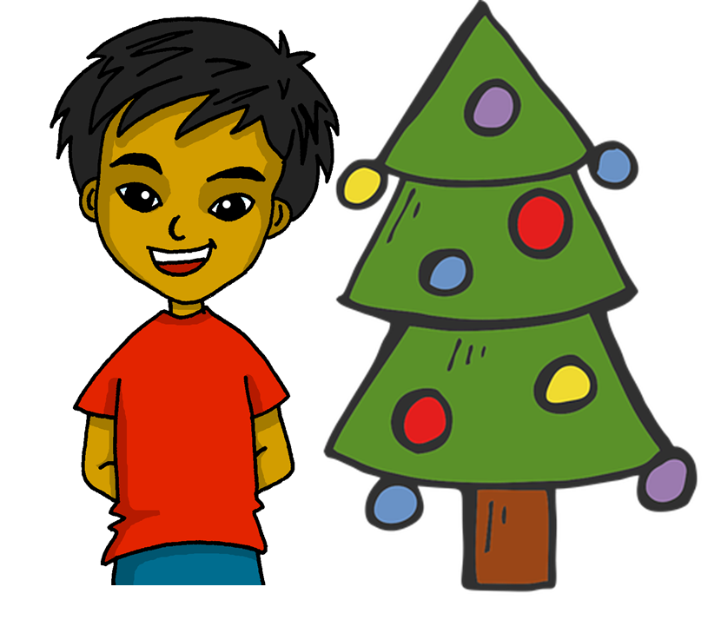
¡Feliz Navidad !
azul

Slide 11
pupil phonics
El zoo Read aloud the Spanish name of each animal.
El zoo Read aloud the Spanish name of each animal.
You have not learnt these words so just use what you know about how to pronounce Spanish. ☺
Concentrate on the underlined letters.
ZOO
You have not learnt these words so just use what you know about how to pronounce Spanish. ☺
Concentrate on the underlined letters.
ZOO
1 | 2 | 3
4 | 5 | 6
1 | 2 | 3
4 | 5 | 6
la cabra
el lobo ibérico
el cuco
la cabra
el lobo ibérico
el cuco
el lince
el porcino
el zorro
el lince
el porcino
el zorro
7 | 8 | 9 | 10
7 | 8 | 9 | 10
la focha
el ciervo
el mochuelo
el camaleón
la focha
el ciervo
el mochuelo
el camaleón
For numbers 8, 9 and 10 write the number of syllables in each word here: 8. [___] 9. [___] 10. [___]
For numbers 8, 9 and 10 write the number of syllables in each word here: 8. [___] 9. [___] 10. [___]
Notes:
Pupil handout To copy and cut in half
Attribution: Focha - No machine-readable author provided. Mdf assumed (based on copyright claims)., CC BY-SA 3.0 via Wikimedia Commons

Slide 12
El zoo Read aloud the Spanish name of each animal.
Teacher phonics
Pupil name: ___________________________________
Total score: _____ / 10
You have not learnt these words so just use what you know about how to pronounce Spanish. ☺
Concentrate on the underlined letters.
ZOO
 | Animal | SSC [sound-symbol correspondence] | p/ x
1 | la cabra | [ca]
2 | el lobo ibérico | [co]
3 | el cuco | [cu]
4 | el lince | [ce]
5 | el porcino | [ci]
6 | el zorro | [z]
7 | la focha | [ch]
8 | el ciervo | weak + strong [ie]
9 | el mochuelo | weak + strong [ue]
10 | el camaleón | strong + strong [eo]
1 | 2 | 3
4 | 5 | 6
la cabra
el lobo ibérico
el cuco
el lince
el porcino
el zorro
7 | 8 | 9 | 10
Notes:
i) Teachers award one point for each SSC. ii) There are no points for the number of syllables questions, but these are designed to prompt pupils to think about the pronunciation of these three words.
la focha
el ciervo
el mochuelo
el camaleón
For numbers 8, 9 and 10 write the number of syllables in each word here: 8. [___] 9. [___] 10. [___]
Notes:
Teacher handout

