Slide 1
español, con Quique

Slide 2
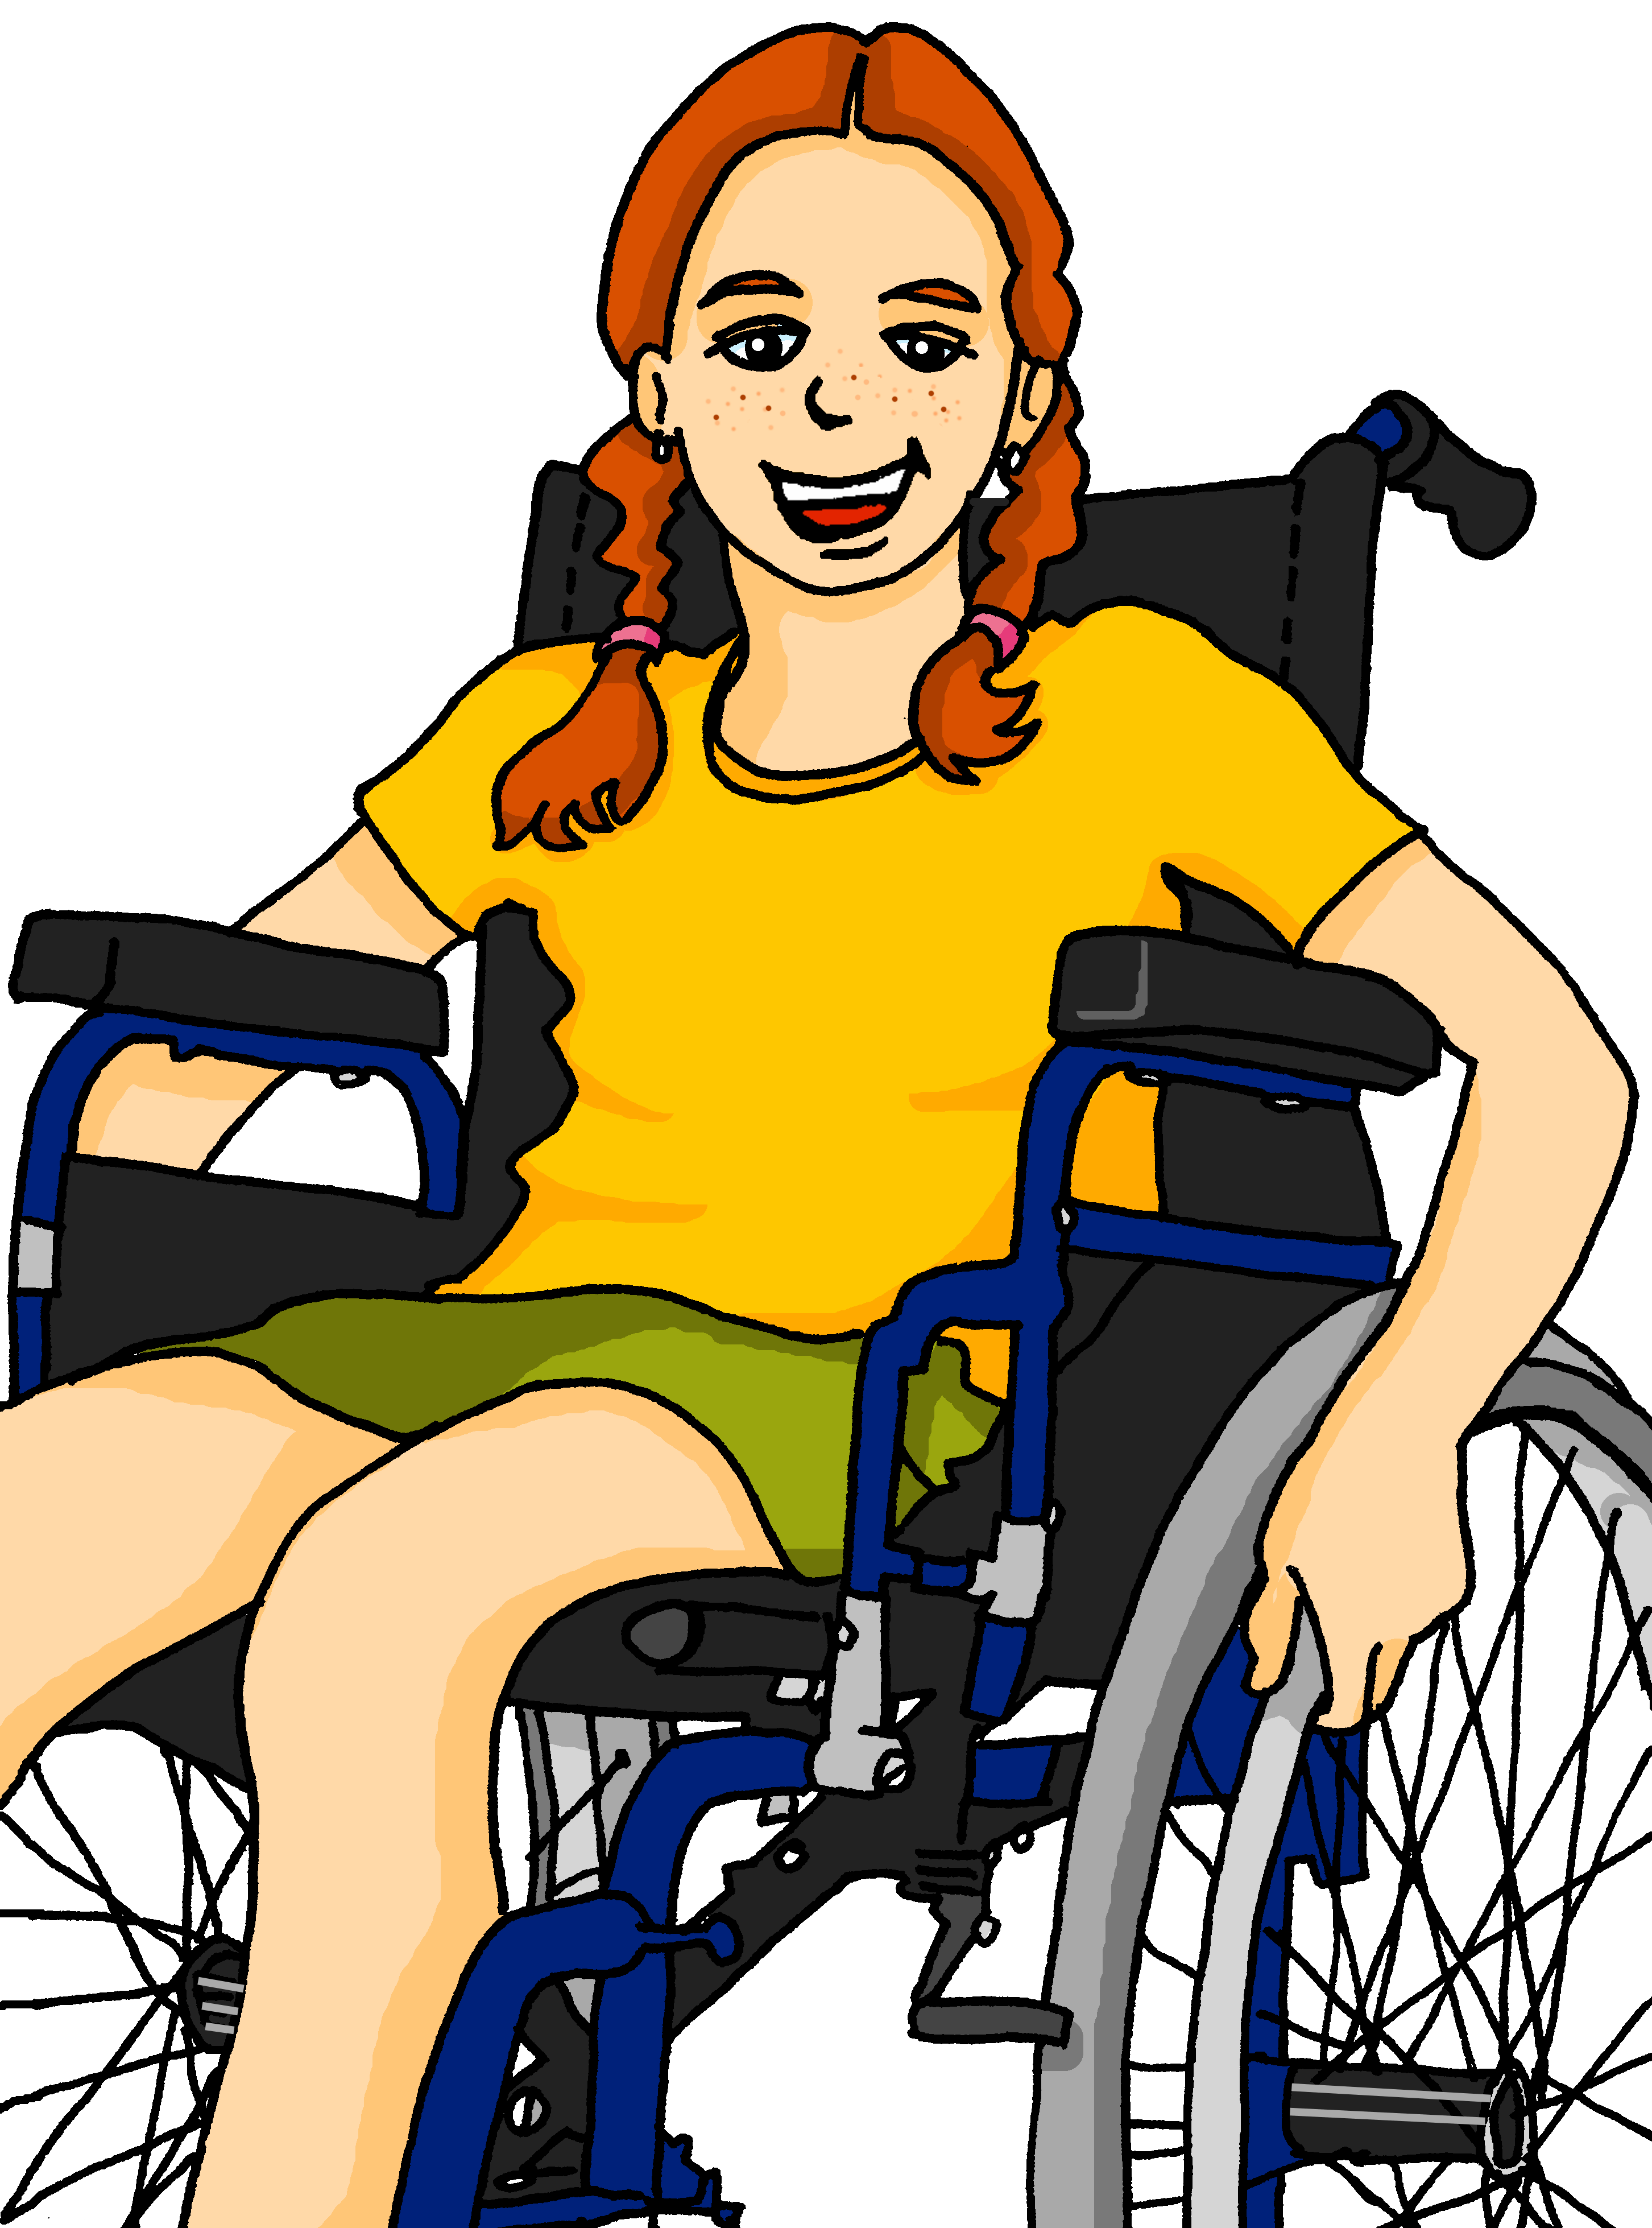
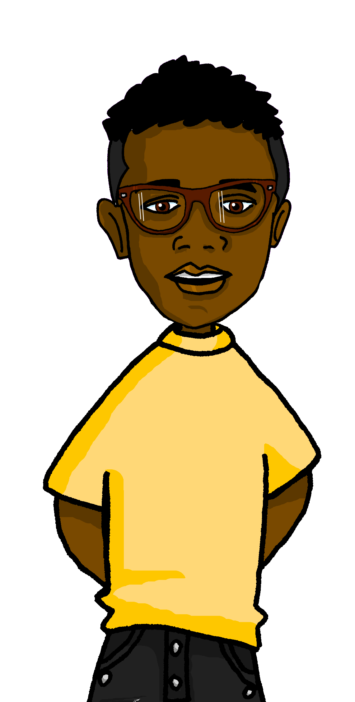
Saying what I and others have
¿Qué tienen?
azul
tener: 3rd person singular & plural
negation
SSC: [ce] [ci]
Notes:
Artwork by Steve Clarke. All additional pictures selected are available under a Creative Commons license, no attribution required.
The frequency rankings for words that occur in this PowerPoint which have been previously introduced in the resources are given in the SOW (excel document) and in the resources that first introduced and formally re-visited those words.
Phonics: [ce] centro [317] [ci] decir [32] cluster: cerca [1042] celebrar [886] dulce [1861] cero [1731] cocina [1214]
Vocabulary (new words in bold): tienen [8] enorme [631] un poco [76] solo [181] bocadillo [] clase [320] conejo [] cuaderno [3301] hermano [333] hermana [3409] lápiz [3740] libro [230] mochila [>5000] regla [1380] ventana [725] activo [1278] bonito [891] grande [66] nuevo [94] viejo [225] bastante [308] muy [43] de12 [2]
Revisit 1: hay [13] cuántos/cuántas [580] diccionario [3844] flor [739] foto [882] regalo [1986] blanco [372] especial [436] feliz [908] grande [66] importante [171] normal [1000] pequeño [202] rojo [534] útil [3951]
Revisit 2: es [ser, 7] está [estar 21] amigo [210] profesor [510] divertido [2465] lento [1569] rápido [870] serio [856] tranquilo [1093] pesado [2166] también [49] hoy [167] siempre [96] y [4]
Source: Davies, M. & Davies, K. (2018). A frequency dictionary of Spanish: Core vocabulary for learners (2nd ed.). Routledge: London
For any other words that occur incidentally in this PowerPoint, frequency rankings will be provided in the notes field wherever possible.
Corregir [2351] rodear [912]

Slide 3
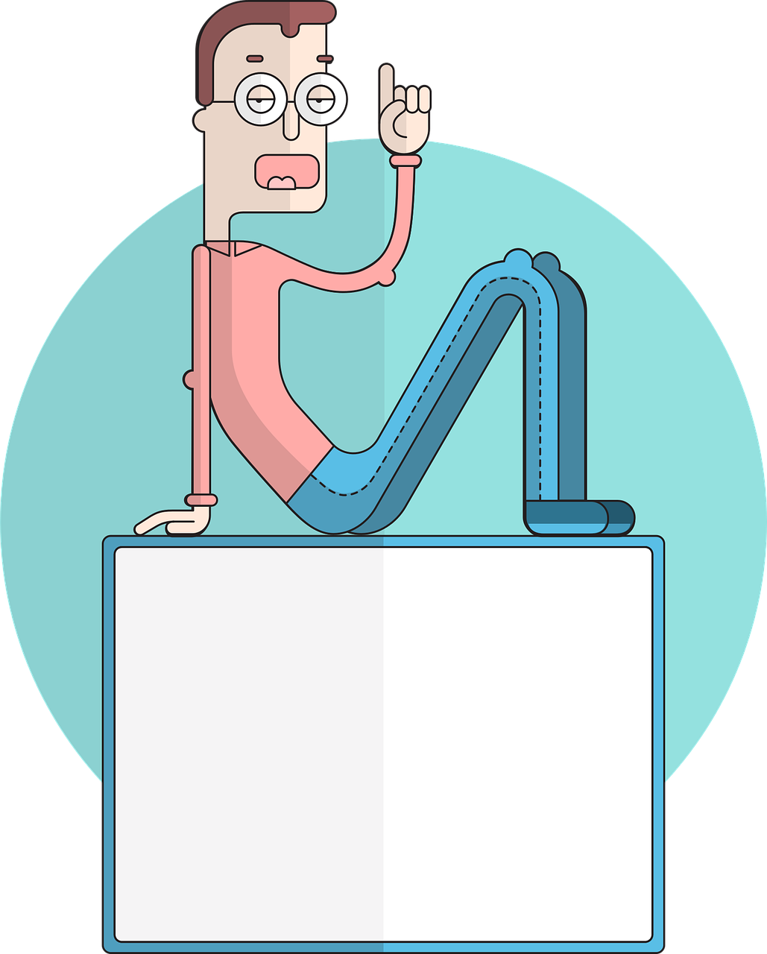
pronunciar
[ci]
decir
[to say, tell]
[ce]
centro
Notes:
Timing: 1 minute
Aim: to revisit SSC [ce] and [ci]
Procedure:
Present and elicit the pronunciation of the individual SSC [ci] and then the source word ‘decir’ (with gesture, if using).
Click to bring up the picture and get pupils to repeat (with gesture, if using).
Present and elicit the pronunciation of the individual SSC [ce] and then the source word ‘centro’ (with gesture, if using).
Click to bring up the picture and get pupils to repeat (with gesture, if using).
Suggested gestures: i) For ‘centre’, pupils can bring their two index fingers together to touch as per the image where arrows converge in a central point.
ii) British sign language for ‘say’ is to lift the right index finger to mouth and then direct it quickly away from the body (as though tracing the trajectory of a string of words coming out of the mouth towards a listener in front). For a video, see here: https://www.signbsl.com/sign/say

Slide 4
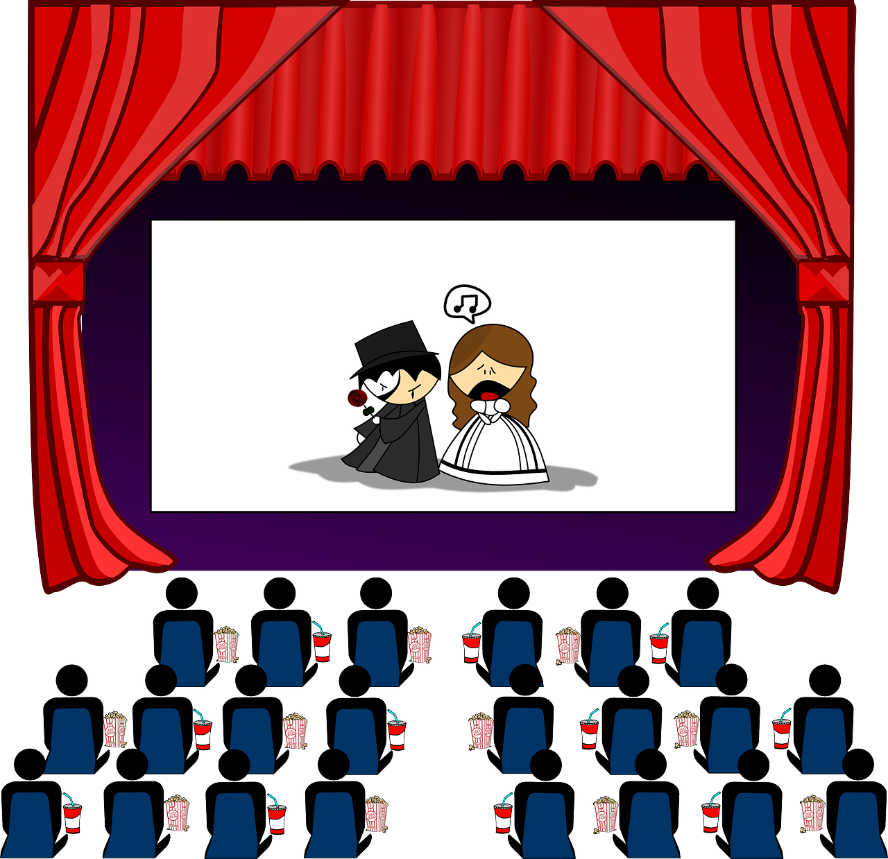
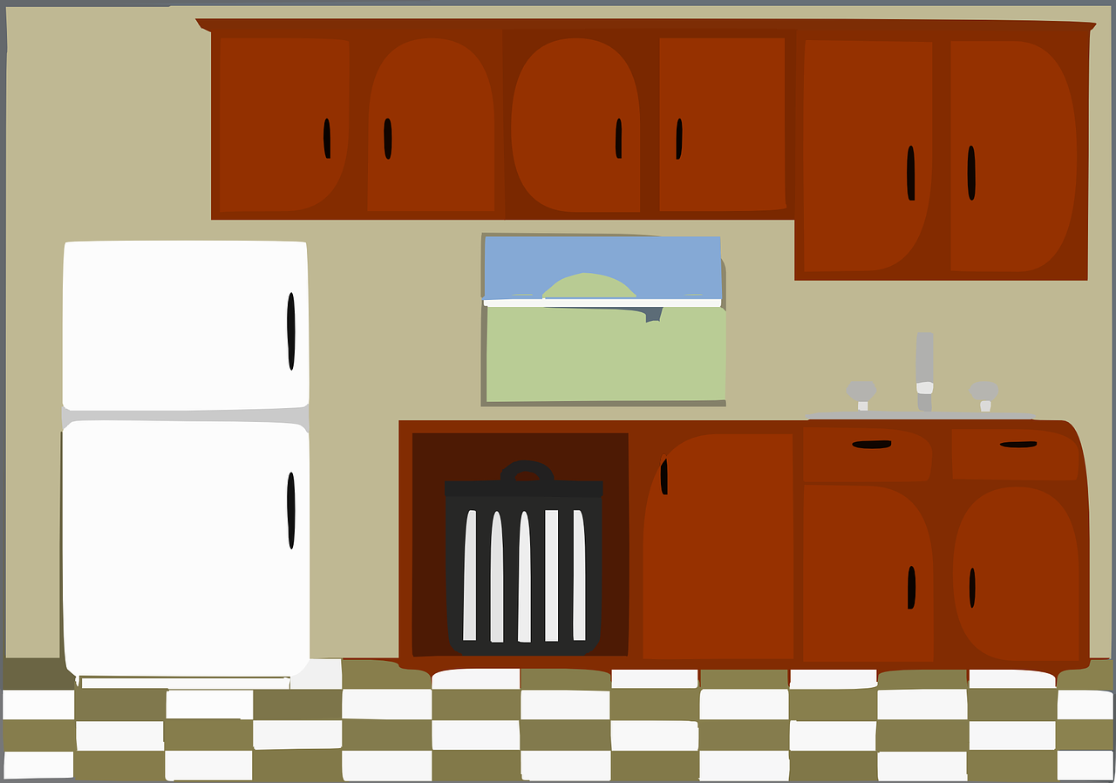
pronunciar
Con un compañero/a, pronuncia.
cerca
cocina
cine
[near]
cero
edificio
[kitchen]
[building]
0
especial
[special]
oficina
dulces
celebrar
[office]
[sweets]
[to celebrate]
Notes:
Timing: 2 minutes (two slides)
Aim: to develop phonological awareness of [ce] [ci]
Procedure:
In pairs, pupils pronounce the words themselves and apply their SSC knowledge of [ci].
Teacher gives feedback and pupils listen and repeat.
Frequency of unknown words and cognates:
cine [952] cocina [1214] edificio [857] oficina [1072]
Source: Davies, M. & Davies, K. (2018). A frequency dictionary of Spanish: Core vocabulary for learners (2nd ed.). Routledge: London
Note: all these words, though unknown, are very high frequency and most will be explicitly taught later in the SOW.

Slide 5
vocabulario
a b ñ
¿Cómo se dice en español?
vocabulario
¡Excelente! 🤗
nuevo
unos
viejas
una
bonitas
unas
a/an (f, sg.)
red (m./pl.)
pretty (f/pl.)
some (f, pl.)
some (m)
exercise book
(the) male friend
new
old (f/pl)
books
(the) class
ruler
(el) cuaderno
(la) clase
(la) regla
(los) libros
rojos
(el) amigo
Notes:
Timing: 5 minutes
Aim: to practise written comprehension and spoken pronunciation of vocabulary for this week and the revisited weeks.
Procedure:
1. Click for English prompt. Pupils need to locate the correct Spanish word and pronounce it, chorally.
2. Click for target word to be highlighted. 3. Repeat for all 12 items.

Slide 6
Tener: s/he, it has | they have
[to have, having]
[3rd person singular & plural]
In Spanish the verb tener is irregular.
To say ‘s/he, it has’ we say ______.
To say ‘they have’ we say ____________.
tiene
tienen
Sofía tiene un conejo activo.
Tienen dos conejos activos.
Sofía has an active rabbit.
They have two active rabbits.
She has an active rabbit .
Notes:
Timing: 2 minutes
Aim: to revisit 1st and 3rd person singular of ‘tener’.
Procedure:
Click to present the information.
Elicit English translations for the Spanish examples provided.

Slide 7
escuchar
Escucha a Quique.
¿Es la clase de Sofía o la clase de Krina y Max?
escuchar
Sofía
Krina y Max
💡 Remember: We use unos or unas with plural nouns.
E
1
2
3
4
5
Notes:
Timing: 7 minutes
Aim: to practise aural comprehension of ‘tienen’ and ‘tiene’.
Procedure:
Pupils write 1-6 in their books and Sofía, Krina & Max as headings.
Click to listen to the example. Pupils decide whether Quique is talking about Sofia (she), or Krina and Max (they).
Click to listen again. Pupils transcribe the noun and article in Spanish.
Complete the task with items 1-6, listening once for person of the verb (she or they).
Click to correct.
Next slide - Listen again - Pupils transcribe the noun.
They then select the correct form of the adjective (reading task) based on their knowledge of number and gender agreement.
Click to bring up a new set of audio buttons. Listen to the full sentences (Transcript 2) to check, and reveal written answers.
Transcript 1:
Ej. Tienen unos cuadernos. 1. Tiene una mochila.
2. Tienen unos profesores.
3. Tienen una planta. 4. Tiene una clase. 5. Tiene unos libros.
Transcript 2:
Ej. Tienen unos cuadernos rojos. 1. Tiene una mochila muy grande.
2. Tienen unos profesores nuevos.
3. Tienen una planta bonita. 4. Tiene una clase enorme. 5. Tiene unos libros viejos.

Slide 8
escuchar
Esucha otra vez y escribe las cosas.
Rodea el adjetivo correcto.
rodea = circle
escuchar
Sofía
Las cosas | ¿cómo es / son?
 | rojo / rojos / roja / rojas
 | grande / grandes
 | nuevo / nueva /nuevas / nuevos
 | bonito / bonita / bonitos / bonitas
 | enorme / enormes
 | viejos / viejas / viejo / vieja
Krina y Max
E
unos cuadernos
1
una mochila
2
unos profesores
3
una planta
4
una clase
5
unos libros
Notes:
Listen again. Pupils transcribe the noun.
They then select the correct form of the adjective (reading task) based on their knowledge of number and gender agreement.
Click to bring up a new set of audio buttons. Listen to the full sentences (Transcript 2) to check, and reveal written answers.
Transcript 1:
Ej. Tienen unos cuadernos. 1. Tiene una mochila.
2. Tienen unos profesores.
3. Tienen una planta. 4. Tiene una clase. 5. Tiene unos libros.
Transcript 2:
Ej. Tienen unos cuadernos rojos. 1. Tiene una mochila muy grande.
2. Tienen unos profesores nuevos.
3. Tienen una planta bonita. 4. Tiene una clase enorme. 5. Tiene unos libros viejos.
Frequency of unknown words and cognates:
rodear [912]
Source: Davies, M. & Davies, K. (2018). A frequency dictionary of Spanish: Core vocabulary for learners (2nd ed.). Routledge: London

Slide 9
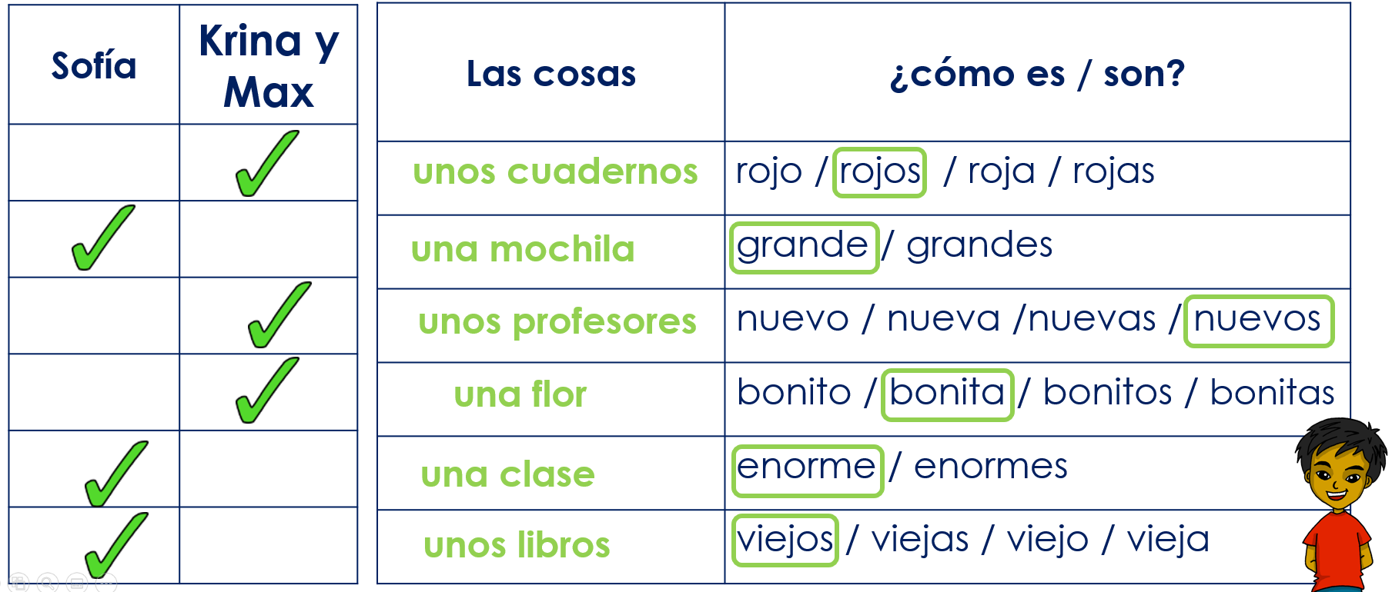
leer
¿Qué es incorrecto? Corrige el error.
Ej. They have a red exercise book. 1. She has a big pencil case.
2. They have old teachers.
3. They have some pretty flowers. 4. She has a new classroom. 5. She has an old book.
some
s.
school bag.
new
a
.
an enormous
some
s.
corrige = correct
Notes:
Timing: 5 minutes
Aim: to practise written comprehension of singular and plural nouns based on the connection to the singular or plural indefinite articles as well as revisited vocabulary.
Procedure:
Read the title – ‘¿Qué es incorrecto? Ensure that pupils understand the title & instruction.
Explain that this is the list Quique has read aloud in the previous task. They need to work out the mistakes in the sentences.
Do [EJ] with them to model the task.
pupils correct the mistake in each of these translations.
Frequency of unknown words and cognates:
corregir [2351]
Source: Davies, M. & Davies, K. (2018). A frequency dictionary of Spanish: Core vocabulary for learners (2nd ed.). Routledge: London

Slide 10
Using the negative ‘no’
In Spanish, to say what you or others don’t have, put ‘no’ before the verb. This makes a negative.
Quique no tiene un hermano.
Sofía no tiene una hermana.
Quique does not have a brother.
Sofía does not have a sister.
He does not have a brother.
She does not have a sister.
This works for any verb and any person (e.g., I, s/he, they).
Max y Krina no tienen hermanos.
Max and Krina do not have siblings (brothers and sisters).
They do not have siblings (brothers and sisters).
Notes:
Timing: 2 minutes
Aim: to introduce negation with ‘no’
Procedure:
1. Click to bring up each new part of the explanation.
2. Interactive elicitation: Try to elicit the English meaning in each of the example sentences.

Slide 11
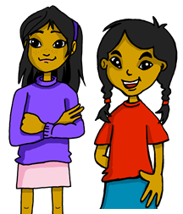
escuchar
Escucha la frase. ¿Es positiva o negativa?
[1/4]
1
leer
escuchar
????
Tiene unos diccionarios viejos.
s/he
they
[positiva]
[negativa]
Notes:
4/4
Transcript:
Tiene unos diccionarios viejos
Note: pupils may query this one! They may say that it’s not a positive thing to have old dictionaries. This is a useful opportunity to clarify sentences that are negative (i.e. containing negation) and affirmative/positive, where there is no negation of the verb, vs. sentences that carry a negative/positive message for us.
Here we are listening out for negation, so using negative in the grammatical sense.

Slide 12
escuchar
2
leer
escuchar
????
Tienen unas mochilas diferentes.
s/he
they
[positiva]
[negativa]
Notes:
Timing: 5 minutes (4 slides)
Aim: to practise aural comprehension of negative ‘no’ in combination; to practise written comprehension of ‘tiene’ & ‘tienen’
Procedure:
Explain to pupils that they need to identify whether the statement is positive or negative
Click to play the sentence.
Elicit the response from pupils
Click to show the sentence, with the callout pointing towards the speakers.
Click to bring up the possible persons of the verb
Elicit the correct meaning from pupils.
Click to confirm with a tick.
Repeat steps 2-7 with the next three slides.
Transcript:
Tienen unas mochilas diferentes.

Slide 13
escuchar
3
leer
escuchar
????
No tienen unos cuadernos.
s/he
they
[positiva]
[negativa]
Notes:
Transcript:
No tienen unos cuadernos.

Slide 14
escuchar
4
leer
escuchar
????
No tiene un bocadillo en la mochila.
s/he
they
[positiva]
[negativa]
Notes:
Transcript:
No tiene un bocadillo en la mochila.

Slide 15
¡adiós!
azul

