Slide 1
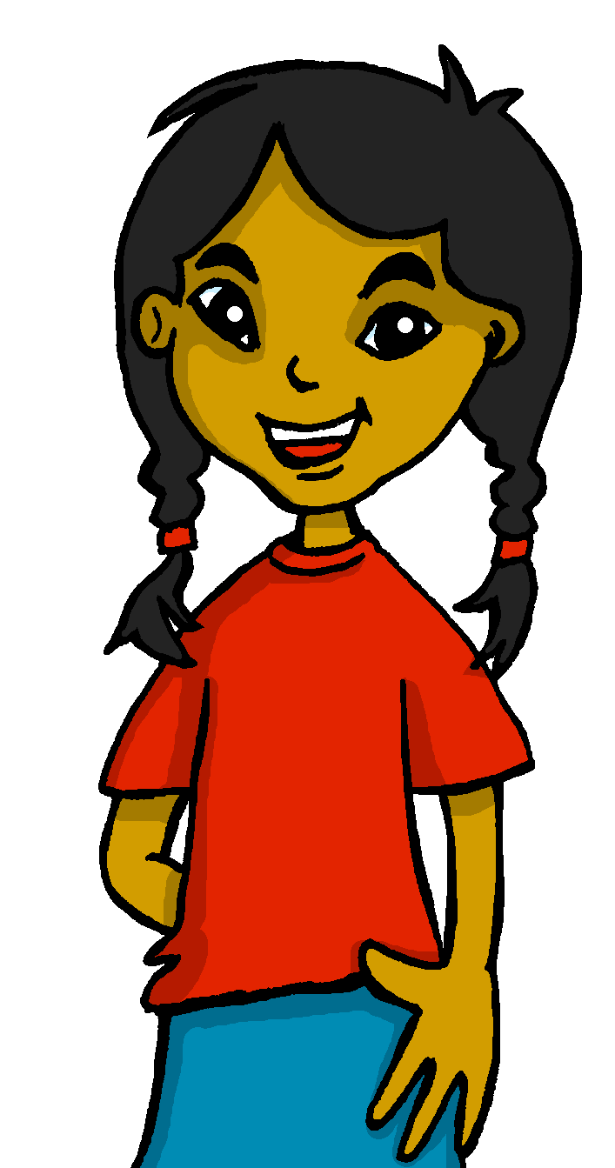
español, con Sofía

Slide 2
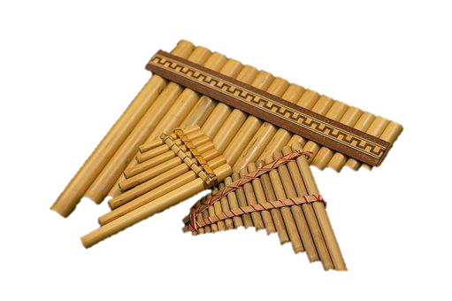
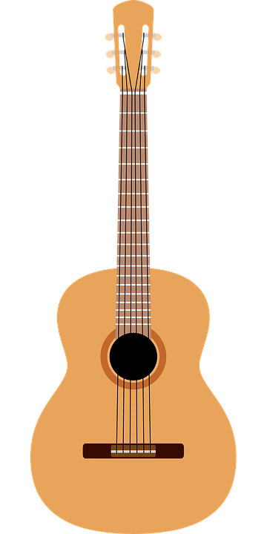
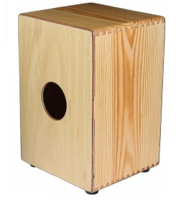
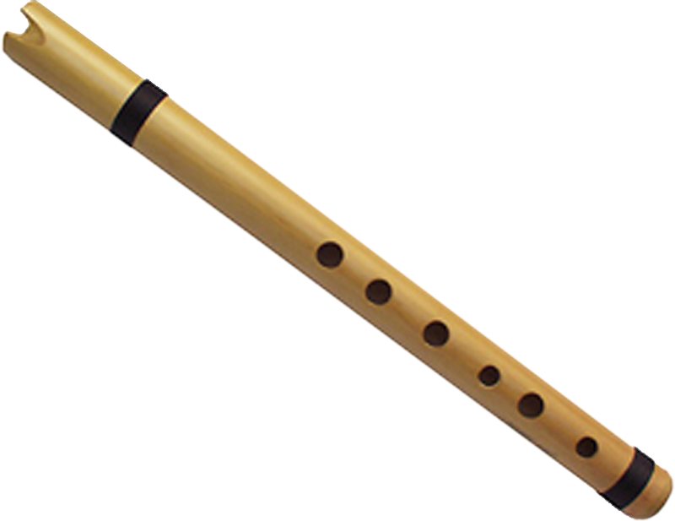
Expressing likes and saying what I and others do
rojo
-ar & -er verbs: I, you, s/he
SSC [h]
NB: AUDIO TO BE ADDED TO THIS LESSON
Notes:
Artwork by Steve Clarke. All additional pictures selected are available under a Creative Commons license, no attribution required.
The frequency rankings for words that occur in this PowerPoint which have been previously introduced in the resources are given in the SOW (excel document) and in the resources that first introduced and formally re-visited those words.
For any other words that occur incidentally in this PowerPoint, frequency rankings will be provided in the notes field wherever possible.
Phonics: Source: helado [3024]
Vocabulary: cuidar [751] enseñar [610] participar [593] practicar [1595] guitarra [2705] niño, niña [173] trabajo [152]
Revisit 1: año [46] hambre [1262] razón [306] sed [2214]
Revisit 2: fruta [1925] globo [3765] pelota [2270] queso [3187] sombrero [2289] tarta [>5000] (cognates: pizza [>5000] yoyó [>5000]
Glossed:
tocar [327] traducir [2037] tarjeta [1958] verano [1139] verbo [3443]
Source: Davies, M. & Davies, K. (2018). A frequency dictionary of Spanish: Core vocabulary for learners (2nd ed.). Routledge: London

Slide 3
[h]
helado
pronunciar
Notes:
Timing: 1 minute
Aim: To introduce SSC [h]
Procedure:
To practise and elicit the pronunciation of the individual SSC [h]
Click to bring the picture & get students to repeat (with gesture, if using).
Gesture suggestion: mime holding an ice cream cone and bringing it towards your mouth.

Slide 4
pronunciar
a
↓
z
Lee las palabras en orden alfabético.
hola
ahora
ahora
almohada
60
búho
a
↓
z
búho
hospital
cohete
hermano
hablar
hermano
hablar
cohete
hola
humano
hospital
0
almohada
humano
INICIO
Notes:
Timing: 3 minutes
Aim: to apply SSC knowledge for [h]
Procedure:
Read the instruction in Spanish.
Ensure meaning of ‘orden alfabético’ is clear and elicit first word from a volunteer.
3. Click on ‘inicio’ to start the timer.
4. Elicit responses from students. Answers are animated (X2 clicks per word – one for disappearance effect, one for entrance).
Frequency of unknown words and cognates:
ahora [81] almohada [4267] búho [>5000] cohete [>5000] hospital [1050] humano [243]
Source: Davies, M. & Davies, K. (2018). A frequency dictionary of Spanish: Core vocabulary for learners (2nd ed.). Routledge: London

Slide 5
vocabulario
Escucha y repite 🗣 [1/2]
to participate
to practise
cuidar
participar
practicar
c _ _ d _ _
enseñar
p _ rt _ c_ p_r
pr_ct_c_r
cuidar
e _ s _ ñ _ _
participar
practicar
enseñar
[to look after, looking after]
[to teach, show; teaching, showing]
Notes:
Timing: 5 minutes (2 slides)
Aim: to introduce key vocabulary for this week.
Procedure: 1.Teacher introduces items one by one (word, picture, English) & pupils practise pronunciation aloud.
Alternatively, pupils work in pairs, reading the Spanish words out loud and looking at the English meanings (1 minute). 2. Then the teacher removes the English words or pictures, and pupils try to recall the English orally (chorally), looking at the Spanish (1 minute). 3. Teacher brings up hints – pupils work in pairs trying to recall the Spanish.
4. Elicit answers from pupils (from left to right).
NB. Further rounds of learning can be facilitated by one pupil turning away from the board, and his/her partner asking him/her the meanings (‘Cómo se dice X en español?’). This activity can work from L2 → L1 or L1 → L2.

Slide 6
vocabulario
Escucha y repite 🗣 [2/2]
la guitarra
l_ n _ ñ _
_l n _ _ _
l_ gui _ _ rr_
la niña
el niño
_l t _ _ b_j_
la guitarra
la niña
el niño
el trabajo
el trabajo
[guitar]
[girl]
[boy]
[work(place)]
[job]
Notes:
Timing: 5 minutes (2 slides)
Aim: to introduce key vocabulary for this week.
Procedure: 1.Teacher introduces items one by one (word, picture, English) & pupils practise pronunciation aloud.
Alternatively, pupils work in pairs, reading the Spanish words out loud and looking at the English meanings (1 minute). 2. Then the teacher removes the English words or pictures, and pupils try to recall the English orally (chorally), looking at the Spanish (1 minute). 3. Teacher brings up hints – pupils work in pairs trying to recall the Spanish.
4. Elicit answers from pupils (from left to right).
NB. Further rounds of learning can be facilitated by one pupil turning away from the board, and his/her partner asking him/her the meanings (‘Cómo se dice X en español?’). This activity can work from L2 → L1 or L1 → L2.

Slide 7
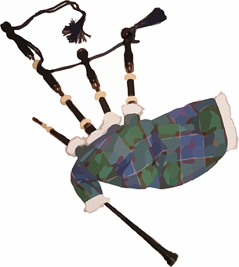
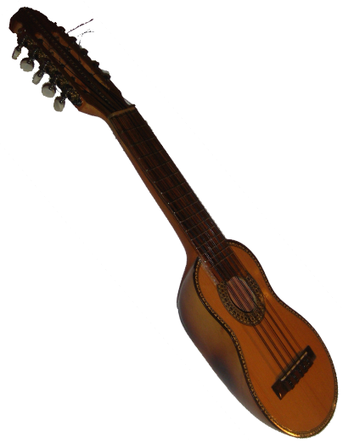
¿Qué instrumentos toca Pedro?
toca = s/he plays
hablar
la zampoña
la gaita
la guitarra
el charango
el cajón
la quena
las castañuelas
Notes:
Timing: 3 minutes
Aim: to introduce pupils to the most popular instruments in Perú and Spain; to practise the pronunciation of different instruments.
Procedure:
Click to hear or read the title question:
Elicit answer from pupils.
Ask further questions, for example: ¿La zampoña es de Perú o de España?
Pupils respond, pronouncing the instruments. Click on the picture to hear the audio, as required.
https://www.intelikidsperu.pe/tienda/instrumentos-musicales-para-ninos/cajon-peruano-para-ninos/#&gid=1&pid=2 Joel Takv, CC BY-SA 2.5 <https://creativecommons.org/licenses/by-sa/2.5>, via Wikimedia Commons

Slide 8
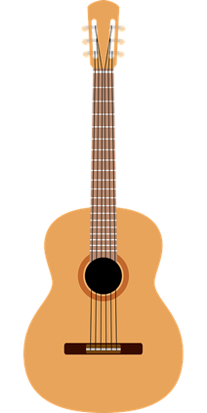
leer
El trabajo de papá [1/3]
(el) verano = summer su = his
toca = s/he plays (instrument)
leer
Lee el texto ¿Qué es en inglés?
En verano* voy con papá a su* trabajo. Él es profesor de música y toca* la guitarra.
He
work
teacher
I go
él
trabajo
profesor
voy
Notes:
Timing: 7 minutes (3 slides)
Aim: to introduce the context of the lesson through reading practice of 3 key items of vocabulary introduced in week 9 & 1st and 3rd person singular of –ar and –er verbs.
Procedure:
Give pupils 2-3 minutes with a partner to find the Spanish meanings for the four English words.
Elicit Spanish responses chorally, prompting with the English, e.g., ‘papá?’ ‘dad’, muy bien. ☺ Note: click on each English word to reveal the Spanish translation.
Pupils could be asked to read the text aloud in pairs, taking it in turns to read alternate sentences. There are a few unknown words in the text, and a variety of words that were taught some time ago.
Click the audio player to hear the full text, if desired.
tocar [327] verano [1139]

Slide 9
leer
El trabajo de papá [2/3]
leer
Lee el texto ¿Qué es en inglés?
Por la mañana, participo en las clases y practico con mi guitarra.
lessons
morning
I participate
with
I practise
las clases
la mañana
participo
con
practico
Notes:
[2/3]

Slide 10
leer
El trabajo de papá [3/3]
leer
Lee el texto ¿Qué es en inglés?
Después, cuando tengo hambre, como un bocadillo de queso y papá come fruta. ¡Ama la fruta!
he loves
when
I’m hungry
cheese
I eat
he eats
after
ama
cuando
tengo hambre
queso
como
come
después
Notes:
[3/3]

Slide 11
Saying who does what
[-ar & -er verbs: I, you, s/he]
In Spanish, the words for ‘I’ and ‘s/he’ (pronouns) are often _____________ and the verb ending __________ to indicate the _____________ who the verb refers to.
unnecessary
changes
person
To mean ‘I’ with –ar or -er verbs, the verb ending is ___.
-o
-as
To mean ‘you’, the verb ending is ____ with –ar verbs and ____ with –er verbs.
-es
To mean ‘s/he, it’, the verb ending is ___ with –ar verbs and to ___ with –er verbs.
-a
-e
changes -a -es unnecessary -e person -as -o
Notes:
Timing: 4 minutes
Aim: to revisit singular persons of –ar and –er verbs.
Procedure:
Click through the animations to present the information.
Elicit answers from pupils (1-3).
Give pupils 1-2 minutes with a partner to retrieve the different endings for –ar/-er verbs.
Elicit answers from pupils and click to bring up animations.

Slide 12
Escucha y traduce para completar el dominó.
Persona 1 lee la tarjeta.
leer
hablar
Persona 2 lee la tarjeta.
Persona 3 lee la tarjeta.
¿Tienes el verbo en inglés?
¿Tienes ‘enseña’ en inglés?
traduce – translate
(la) tarjeta – card
(el) verbo - verb
Notes:
Timing: 5-7 minutes
Aim: aural comprehension of singular persons of key –ar and –er verbs.
Procedure:
Click through the animations to explain the task in Spanish.
Give one domino to each student (if there are more dominoes than students give more able students two dominoes). The students with the domino that starts with inicio' begins by saying the Spanish verb. The student with the matching verb in English says it and then the Spanish verb that forms the other side of their domino. Keep going until the class reaches the final domino.
NB. Teachers can add a competitive element by challenging pupils to get through the whole domino set in less than 3 minutes.
NB. The dominoes last longer if laminated before being used! They can be reused for pair work activity.
traducir [2037] tarjeta [1958] verbo [3443]

Slide 13
¡adiós!
rojo

Slide 14
I look after
s/he shows, teaches
You spend, pass
s/he eats
You swim
You see, watch
inicio
I learn
cuido
enseña
pasas
come
aprendo
ves
nadas
compra
s/he looks after
s/he buys
s/he understands
You need
I read
s/he walks
You practise
I play
comprende
necesitas
juego
leo
camina
practicas
cuida
aprendes
You learn
s/he sees, watches
I show, teach
You love
You eat
s/he reads
s/he participates
I hate
ve
enseño
amas
comes
odio
lee
participa
fin

