Slide 1
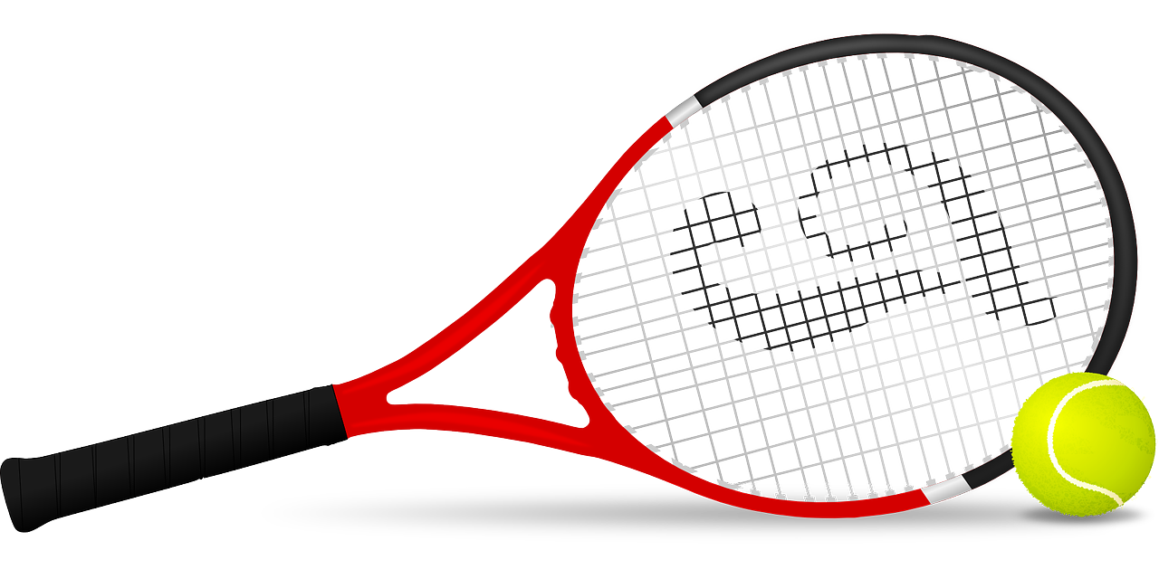
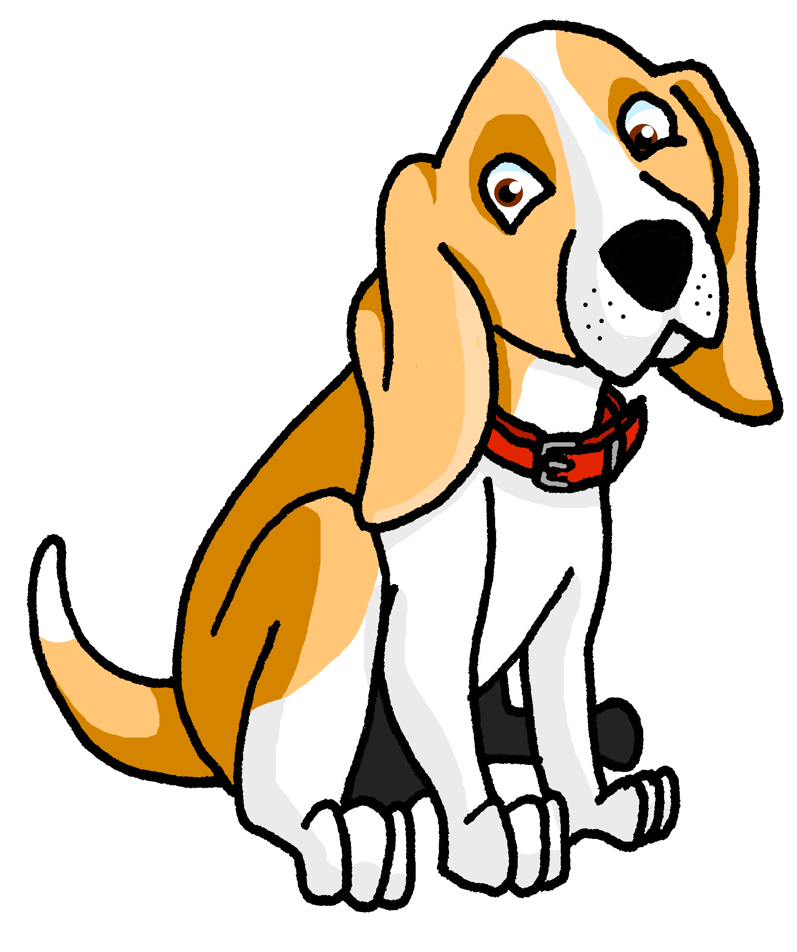
Describing things and people
Audio still to be added to these follow up activities.
rojo
Follow ups 1-5
Notes:
Artwork by Steve Clarke. All additional pictures selected are available under a Creative Commons license, no attribution required.
The frequency rankings for words that occur in this PowerPoint which have been previously introduced in the resources are given in the SOW (excel document) and in the resources that first introduced and formally re-visited those words.
For any other words that occur incidentally in this PowerPoint, frequency rankings will be provided in the notes field wherever possible.
Artwork by Steve Clarke. All additional pictures selected are available under a Creative Commons license, no attribution required.
The frequency rankings for words that occur in this PowerPoint which have been previously introduced in the resources are given in the SOW (excel document) and in the resources that first introduced and formally re-visited those words.
For any other words that occur incidentally in this PowerPoint, frequency rankings will be provided in the notes field wherever possible.
Phonics: Source: ver [38] abuela [783] Cluster: banco [728] bolsa [1581] vela [2247] viento [814]
Vocabulary: comer [347] jugar [356] llevar² [101] ] preparar [570] canción [982] profesor, profesora [501] después [115]
Revisit 1: grupo [200] favorito [2630] mi [37] tu [53] muy [43] también [49] y [4]
Revisit 2: hay [haber 13] unos [6] unas [6] cuántos [580] cuántas [580]
Glossed:
traducir [2037] baile [2040] sonido [1040] último [188]
Source: Davies, M. & Davies, K. (2018). A frequency dictionary of Spanish: Core vocabulary for learners (2nd ed.). Routledge: London

Slide 2
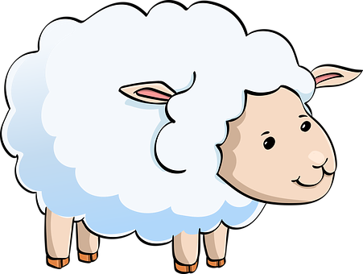
Follow up 1:
[v] [b]
¿b o v? Completa la rima y practica.
hablar
uve
b = be
v = uve
dos
Vas y va tienen ____
Baja
15
del bus tiene _____
be
Oveja tiene ______
uve
Bancos
dos
y viento tienen las ______.
0
tienen – they have
START
Notes:
Timing: 5 minutes
Aim: to practise knowledge of [b] [v] to known and unknown words.
Procedure: Click to bring up the instruction.
Pupils practice reading the rhyme aloud, filling the gaps with b, v or dos accordingly.

Slide 3
follow up 2 :

Escribe en inglés: can you get at least 15 points?
 | hay | unas | cuántas
 | unos | cuántos | la comida
 | el grupo | favorito | mi
 | también | tu | muy
 | comer | jugar | llevar
 | la canción | después | preparar
vocabulario
There is/are
some (f)
How many (f)
x3
some (m)
How many (m)
(the) food
(the) group
favourite
my(singular)
x2
also,too
your (singular)
very
to eat, eating
to play, playing
to take, wear
x1
(the) song
after(wards)
to prepare, preparing
Notes:
Timing: 5 minutes
Aim: to practise written production of vocabulary from this week and this week’s revisited sets.
Procedure: 1. Give pupils a blank grid. They fill in the English meanings of any of the words they know, trying to reach 15 points in total.
Note: The most recently learnt and practised words are pink, words from the first revisit are green and those from the second revisit are blue, thus more points are awarded for them, to recognise that memories fade and more effort (heavy lifting!) is needed to retrieve them.

Slide 4
Using the verb ‘jugar’
[to play: I, you & s/he; -ar verb]
Some verbs do not follow the general rules.
The verb ‘jugar’ is an example of this.
‘jug’ changes to ‘jueg’
☺ Use the same endings as for all –ar verb.s
I
you
S/he
Juego
Juegas
Juega
I play
You play
S/he plays
Notes:
Timing: 3 minutes
Aim: to introduce 1st , 2nd , 3rd person singular of jugar’
Procedure:
Read the grammar explanation about the spelling change in ‘jugar’.
Elicit English translation for the Spanish examples provided.

Slide 5
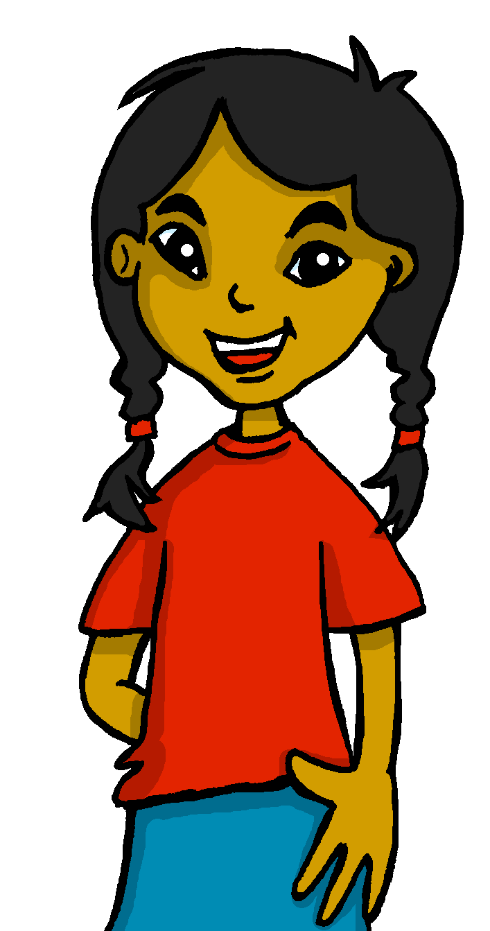
Follow up 3 :
El festival de fin de curso 🎉
Lee las frases y traduce.
leer
 | ____take Spanish ______.
 | ____ play _____ Quique.
 | ____ read a ____________ poem.
 | ____ prepare ____ ______.
 | ___ wear a __ ________ hat.
 | ____ sing with ___ _______.
 | ___ play in the __________.
E
He
s
food
[E] Lleva comida española.
1
You
with
[1] Juegas con Quique.
S/he
s
beautiful
[2] Lee un poema bonito.
2
‘jugar’ changes
[3] Preparas una canción.
3
a song
You
[4] Llevo un sombrero muy grande.
4
I
very
big
[5] Cantas con el profesor.
5
You
the teacher
[6] Juego en el patio.
6
I
playground
Notes:
Timing: 7 minutes
Aim: to practise written recognition of definite articles and their connection with corresponding nouns; to practise comprehension of new and previously taught vocabulary
Procedure:
Ensure that the context is clear. Sofía has written these notes to Quique.
Pupils read the sentence and select the appropriate noun based on the definite article.
They then translate the sentence (this can be done orally with the whole class or written, and then checked).
Click to reveal answers.

Slide 6
Follow up 4:
B Escucha otra vez.
Use the correct words to
translate what you hear.
There are some extra ones!
A Escucha. ¿Qué palabra es?
escuchar
c | with| of| the teacher (f)| the teacher (m)
 | a sport| a game| to class | to the playground
 | grandma | grandad
 | the beach | the mountain | the village
 | a book | a newspaper
 | Spanish| a language |
I play | s/he plays | you play
I take | you take | s/he takes
I visit | s/he visits | you visit
I see | s/he learns | s/he sees
s/he read | I read | I see
You play | I play | you learn
E
She plays with the teacher (f)
E
. . . . . . . . . . . . . . . . . . . . . . . . . . . . . . . . . . . . . .
1
1
Llevas un juego a clase.
. . . . . . . . . . . . . . . . . . . . . . . . . . . . . . . . . . . . . .
2
2
I visit grandad.
. . . . . . . . . . . . . . . . . . . . . . . . . . . . . . . . . . . . . ...
3
3
I see the mountain.
. . . . . . . . . . . . . . . . . . . . . . . . . . . . . . . . . . . . . .
4
4
S/he reads a magazine.
. . . . . . . . . . . . . . . . . . . . . . . . . . . . . . . . . . . . . .
5
5
You learn a language.
. . . . . . . . . . . . . . . . . . . . . . . . . . . . . . . . . . . . . .
Notes:
Timing: 10 minutes
Aim: to practise aural comprehension of singular persons o –ar and –er verbs and previously introduced vocabulary. Connecting sound with meaning.
Procedure:
(Part A)
Read the instruction in Spanish & click to bring further instruction.
Do [E] with them. Click to listen. Pupils circle the correct words & write ? Or . According to whether it’s a statement or a question NB. Some puplis would benefit from working on a handout. Alternatively, they can use numbers 1,2,3.
Click for answers
(Part B)
1. Pupils listen to 1-5 and write the sentences, selecting from the options given (there are additional words that are not needed).
Click to reveal answers.
Transcript 1:
[E] Juega con la profesora.
[1] Llevas un juego a clase.
[2] Visito a el abuelo.
[3] Veo la montaña.
[4] Lee una revista.
[5] Aprendes un idioma.

Slide 7
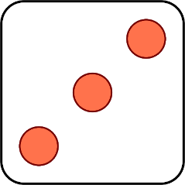
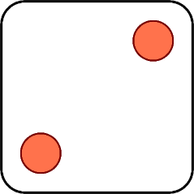
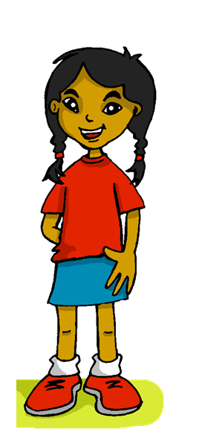
Follow up 5:
Habla en español.
Remember to use ‘a’ after verbs such as ‘ver’ ‘escuchar’ and ‘llevar’ if what we see, listen or take is a person or an animal we are fond of.
__________________.
veo
hablar
Prepara
Canta
Lees
Llevo
Escuchas
a song
food
a film
a game
[the] teacher (f)
[the] teacher (m)
[a] texto
[a] película
Manchita
1 | S/he
2 | You
3 | I
4 | S/he
5 | You
6 | I
1 | sing
2 | listen
3 | prepare
4 | read
5 | watch
6 | take
Notes:
Timing: 5 minutes
Aim: to practise oral production of singular persons of –ar and –er verbs;
Procedure: 1. Click to ‘roll’ the dice.
2. Pupils translate the verbs and nouns whose numbers correspond to the respective dice to make a short sentence. They say the answer chorally & use one of the options from ‘información extra’ to form a logical sentence.
3. Click to reveal the correct sentence.
4. Repeat until all six combinations have been said.

Slide 8
follow up extra:

Escribe en español: can you get at least 15 points?
 | (the) food | there is / are | some (m)
 | how many (m) | some (f) | how many (f)
 | my (singular) | very | (the) group
 | favourite | your (singular) | also, too
 | to prepare, preparing | (the) song | to play, playing
 | after(wards) | to take, wear | to eat, eating
vocabulario
la comida
hay
unos
x3
cuántos
unas
cuántas
mi
muy
el grupo
x2
favorito
tu
también
preparar
la canción
jugar
x1
después
llevar
comer
Notes:
Timing: 5 minutes
Aim: to practise written production of vocabulary from this week and this week’s revisited sets.
Procedure: 1. Give pupils a blank grid. They fill in the Spanish meanings of any of the words they know, trying to reach 15 points in total.
Note: The most recently learnt and practised words are pink, words from the first revisit are green and those from the second revisit are blue, thus more points are awarded for them, to recognise that memories fade and more effort (heavy lifting!) is needed to retrieve them.

Slide 9
¡adiós!
rojo

Slide 10
follow up 2b:

Handout 5
Escribe en inglés: can you get at least 15 points?
 | cinco | cuatro | doce
 | nueve | diez | once
 | tres | él | yo
 | ella | pero | un
 | odiar | la abuela | los
 | amar | la comida | las
vocabulario
x3
x2
x1
Notes:
HANDOUT 5

Slide 11
follow up 2b:

Handout 5
Escribe en español: can you get at least 15 points?
 | 9 | 10 | 4
 | 11 | 5 | 12
 | a/an, one | but | she
 | I | 3 | he
 | food | the (m., pl.) | the (f., pl.)
 | to hate, hating | to love, loving | grandma
vocabulario
x3
x2
x1
Notes:
HANDOUT 5

