Slide 1
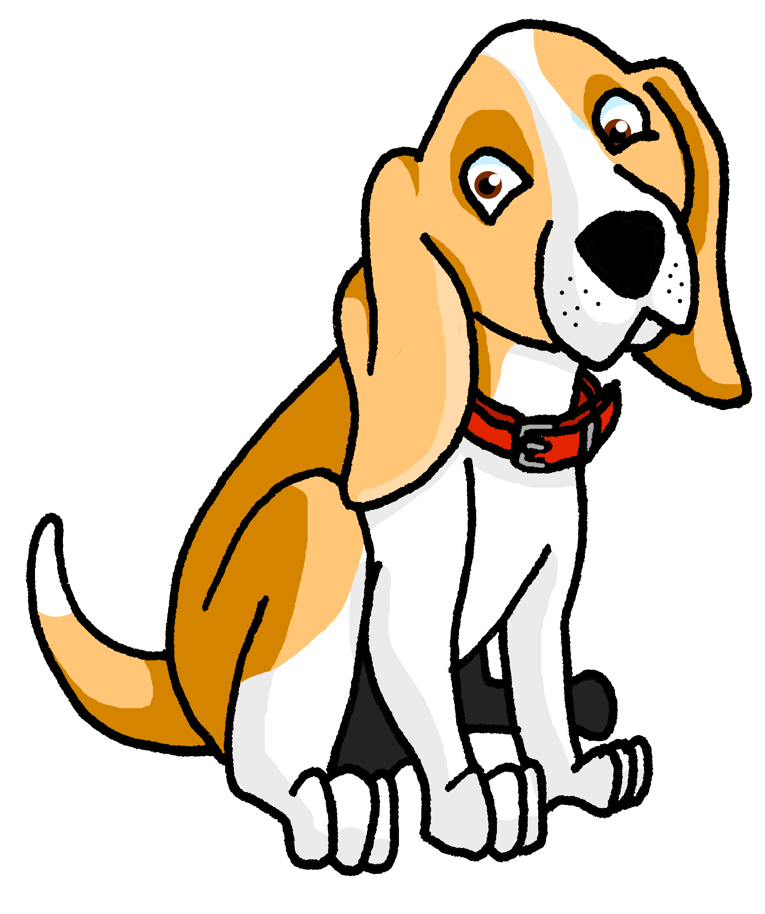
Describing things and people
rojo
Follow ups 1-5
NB: AUDIO TO BE ADDED TO THIS LESSON
Notes:
Artwork by Steve Clarke. All additional pictures selected are available under a Creative Commons license, no attribution required.
The frequency rankings for words that occur in this PowerPoint which have been previously introduced in the resources are given in the SOW (excel document) and in the resources that first introduced and formally re-visited those words.
For any other words that occur incidentally in this PowerPoint, frequency rankings will be provided in the notes field wherever possible.
Phonics: [r]|[rr]
Source: parar [706] correr [343] Cluster: caro [2179] carro [1857] pera [>5000] perra [888]
Vocabulary: amar [700] odiar [2211] abuela [783] abuelo [4796] comida [906] las [1] los [1]
Revisit 1: él [9] ella [72] tú [184] yo [28] pero [30]
Revisit 2: un [6] dos [64] tres [134] cuatro [241] cinco [284] seis [438] siete [603] ocho [641] nueve [991] diez [449] once [1701] doce [1138]
Source: Davies, M. & Davies, K. (2018). A frequency dictionary of Spanish: Core vocabulary for learners (2nd ed.). Routledge: London
dar [42] su [12] decir [31] receta [3104]

Slide 2
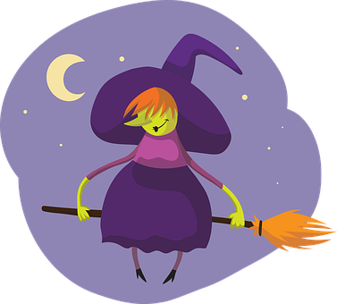
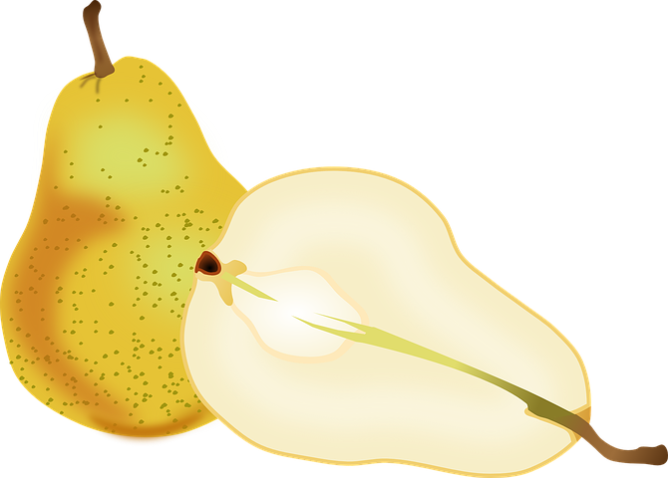
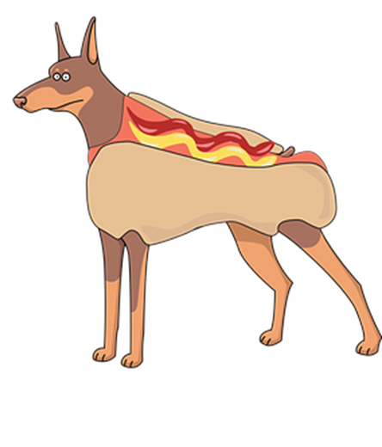
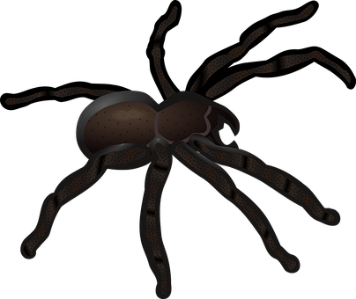
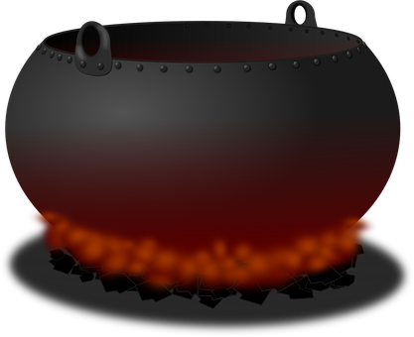
Follow up 1:
La receta* de la bruja Piruja
[r] [rr]
Escribe la(s) letra(s). ✍
escuchar
¿Qué ingredientes hay?
 | pe __ a
 | a __ oz
 | pe __ o
 | a _ aña
 | co __ azón
 | ma __ ón
E
r
15
1
rr
Practica la receta.
2
rr
Una pera y arroz
3
r
una araña y un perro
4
r
y un corazón marrón.
0
5
rr
(la) receta - recipe
START
Notes:
Timing: 5 minutes
Aim: to practise applying knowledge of [n] [ñ] to known and unknown words.
Procedure: Click to bring up the instruction.
Click to bring table and do example together (E).
Students write the correct sound [r] [rr]
Part B
Procedure:
Read the instruction in Spanish.
3. Click on ‘inicio’ to start the timer.
4. Pupils work in pairs to read the recipe. NB. Pupils can read the recipe several tunes with different voices (as a witch, as a monster, as an ant…)
receta [3104]

Slide 3
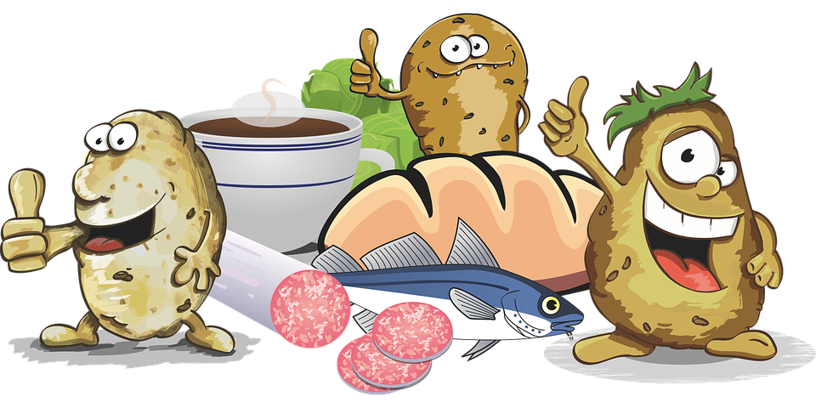
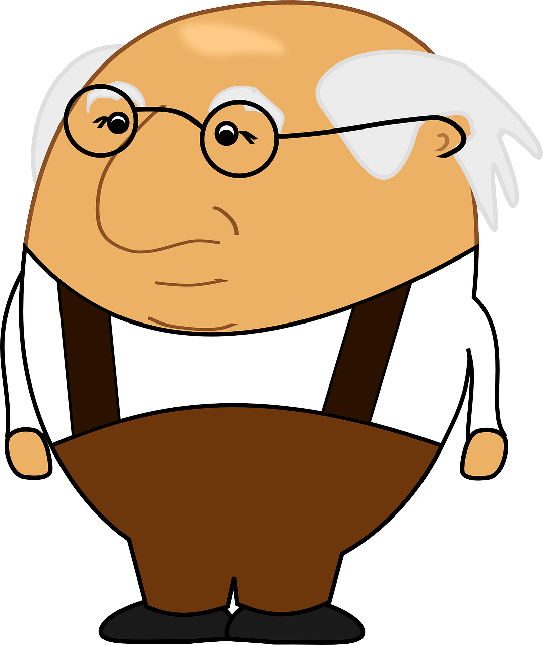
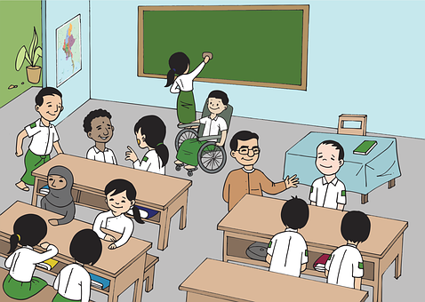
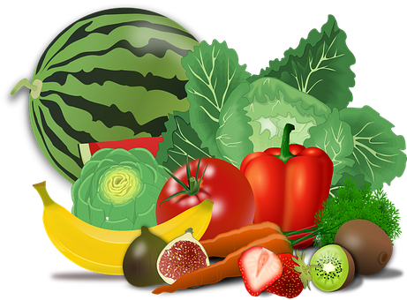
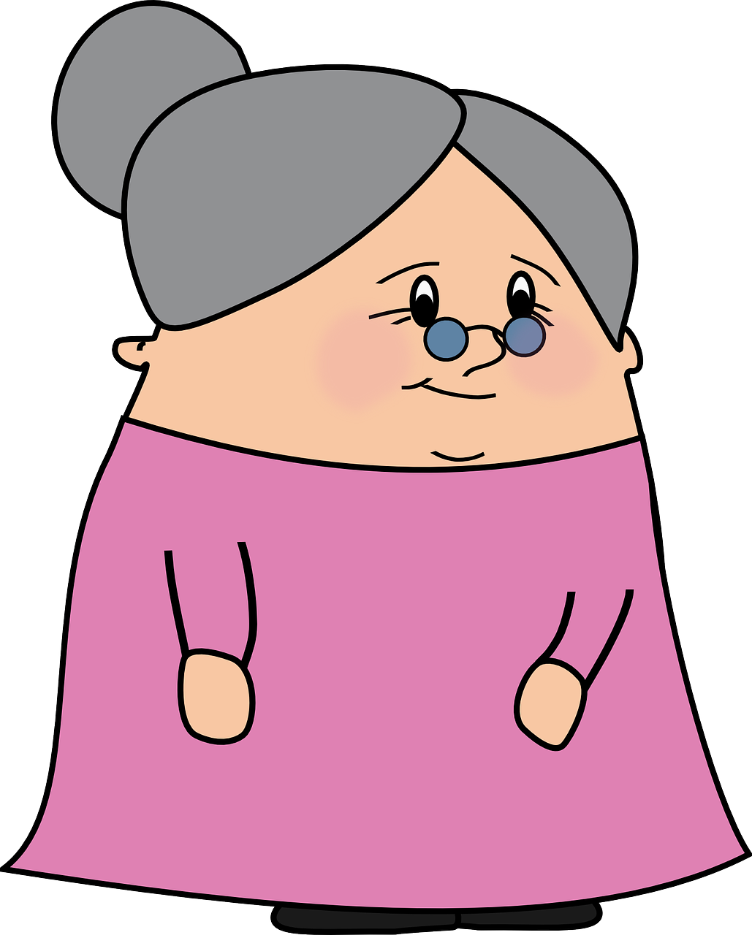
Follow up 2a
Lee la palabra.
¿el, la, los o las?
hablar
palabras
Luego, escribe en inglés.
____ comida
____ mañanas
____ abuelos
____ clase
____ abuela
____ idioma ⚠
amar
odiar
____ idioma ⚠
Notes:
Timing: 5 minutes (There is a faster version of the same activity on the next slide)
Aim: to practise spoken production of the Spanish words (including the article) within a limited time; to practise written comprehension of the vocabulary (by replaying the slide).
Procedure:
Explain to pupils that they need to say all the Spanish words with the correct word for the before they are covered.
Click to start the animation sequence (but don’t click again until it is finished).
Go back and replay the slide. This time, pupils write down the English translations of each word before they are covered.
Use slide 5 to check answers.

Slide 4
Follow up 2b
Súper rápido
Lee la palabra.
¿el, la, los o las?
hablar
palabras
Luego, escribe en inglés.
____ comida
____ mañanas
____ abuelos
____ clase
____ abuela
____ idioma ⚠
amar
odiar
____ idioma ⚠
Notes:
Timing: 5 minutes [A faster version of the previous task]
Aim: to practise spoken production of the Spanish words (including the article) within a limited time; to practise written comprehension of the vocabulary (by replaying the slide).
Procedure:
Explain to pupils that they need to say all the Spanish words with the correct word for the before they are covered.
Click to start the animation sequence (but don’t click again until it is finished).
Go back and replay the slide. This time, pupils write down the English translations of each word before they are covered.
Use slide 5 to check answers.

Slide 5
Follow up 2:
Respuestas
¿Qué es en español?
hablar
palabras
la comida
las mañanas
los abuelos
la clase
(the) food
(the) mornings
(the) grandads
(the) class(room)
la abuela
amar
odiar
el idioma⚠
(the) grandma
to love
to hate
(the) language
Notes:
ANSWERS
Procedure:
Click to reveal the English for pupils to check.
After each, elicit the Spanish orally from pupils for additional practice.
Click to reveal.

Slide 6
Follow up 3:
Knowing whose opinion it is
[amar | odiar: ‘I’,‘you’ & ‘she’]
Remember, to mean ‘I’, ‘s/he,it’ or ‘you’ with a verb, the verb ending changes.
I
S/he, it
you
Amo el español.
Ama el español.
Amas el español.
I love Spanish.
S/he loves Spanish.
You love Spanish.
Remember! In English we often don’t need an article (the) after opinion verbs. In Spanish we always do.
Notes:
Timing: 10 minutes in total (2 slides) Grammar info (3 minutes) + reading task (7 minutes)
Aim: to revisit singular persons in the present tense for –ar verbs using amar and odiar.
Procedure:
Click through the animations to present the new information.
Elicit English translations for the Spanish examples provided.

Slide 7
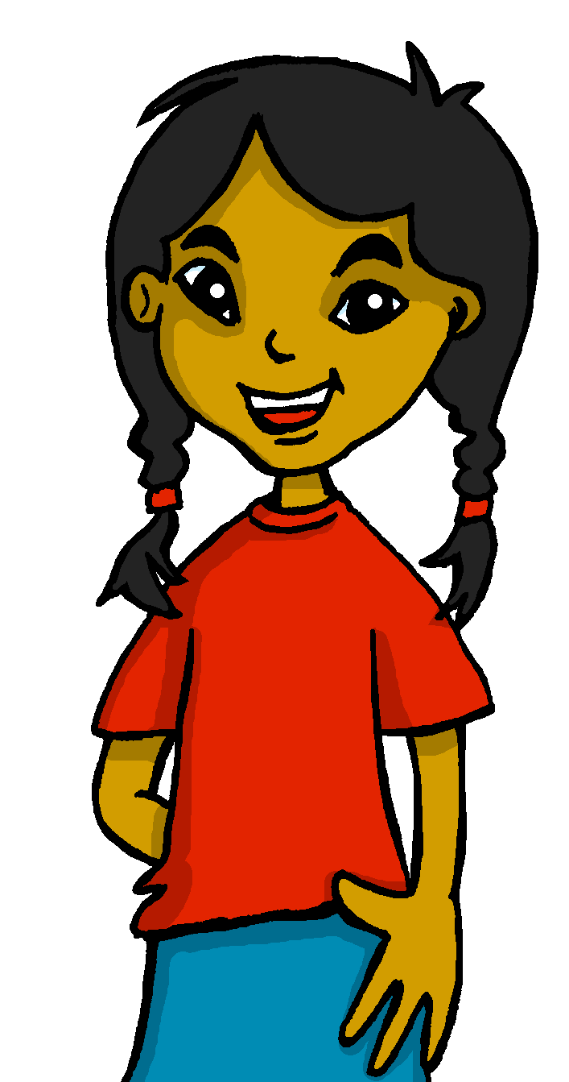
Follow up 3
Lee los mensajes. ¿Qué persona es?
Remember! We use ‘a’ after the verb with a person or an animal we are fond of.
I
leer
E
Ama las tartas.
you
s/he
I
3
I
1
Odias las clases de inglés.
Amas a tu abuelo.
you
you
s/he
s/he
2
I
4
I
Odia la comida de conejo.
Odio las sillas.
you
you
s/he
s/he
Notes:
Timing: 5 minutes
Aim: to recognise singular persons in the present tense for –ar verbs using amar and odiar.
Procedure:
Read the context. Tell students Sofía is receiving messages from different friends.
Read the first message. Ask pupils to identify amar (is it to hate or to love?). Then they need to identify the person it refers to.
Click to reveal the answer.
Continue with items 2 – 4.
Teachers can also elicit Engilsh translation to reinforce the absence of article in some of the English sentences.

Slide 8
Follow up 4:
Sofía da su opinión [1/6]
da – s/he gives
su - her
dice – s/he says
escribir
¿Qué dice? Lee la frase en español.
1
Amo la clase.
Notes:
Timing: 5 minutes
Aim: to practise spoken production of amar / odiar in the singular persons.
Procedure:
Do number 1 with pupils to model the task.
Click to reveal the answer.
Give pupils 30 seconds to say / practise the next sentence with a partner.
Elicit the sentence from the whole class chorally, then click to confirm.
Repeat steps 3-4 for the remaining sentences.
dar [42] su [12] decir [31]

Slide 9
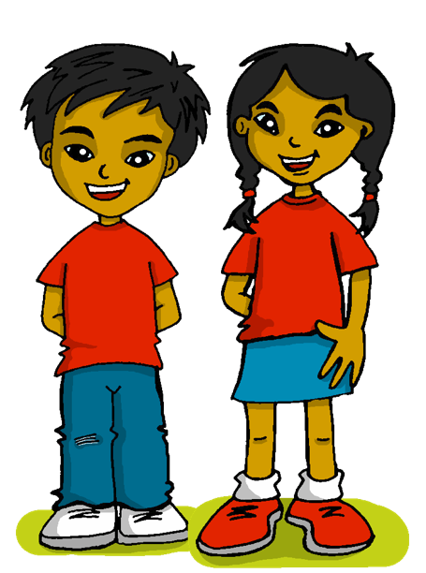
Follow up 4:
Sofía da su opinión [2/6]
da – s/he gives
su - her
dice – s/he says
escribir
2
Ama la comida.

Slide 10
Follow up 4:
Sofía da su opinión [3/6]
da – s/he gives
su - her
dice – s/he says
escribir
3
mornings
you
Odias las mañanas.

Slide 11
Follow up 4:
Sofía da su opinión [4/6]
da – s/he gives
su - her
dice – s/he says
escribir
4
games
Odia los juegos.

Slide 12
Follow up 4:
Sofía da su opinión [5/6]
da – s/he gives
su - her
dice – s/he says
escribir
5
your grandma.
you
Amas a tu abuela.

Slide 13
Follow up 4:
Sofía da su opinión [6/6]
da – s/he gives
su - her
dice – s/he says
escribir
6
languages
you
Amas los idiomas.

Slide 14
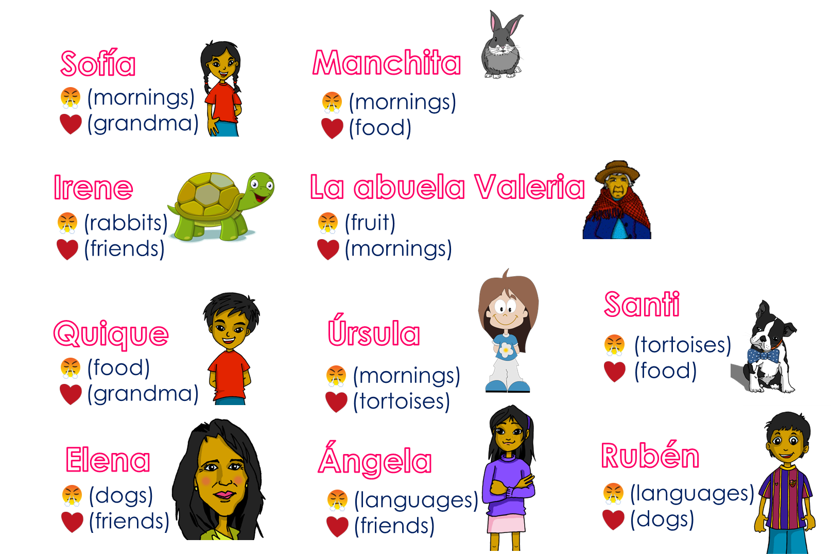
Follow up 5
Ask and guess!
Ask your partner questions to guess their secret character.
hablar
60
¿Amas [las tortugas] ?
¿Amas [la comida] ?
¿Odias [las mañanas] ?
¿Eres Manchita?
S
No …
¡Sí! Amo la comida.
Sí, odio [las mañanas].
¡Sí! 😊
0
INICIO
Notes:
Time: 8-10 minutes
Aim: To use raised intonation and adjectival agreement in oral production to guess their partner’s characters.
Read the title in Spanish and click to bring a brief explanation of the instructions.
Tell students they are going to work in pairs. Partners take it in turns to ask yes/no questions to try to figure out the other player’s character. The partner guessing needs to use amar and odiar in the 2nd person singular and the correct definite article and noun to narrow down their options correctly! Explain this to the pupils - they have to pronounce the adjective correctly, with the correct ending, otherwise their partner cannot guess who they are.
Click x2 to bring the speech bubbles to make sure students are clear about what the exchange should look like (¿Odias ..? / Sí / No).
Click x2 to model an example of how correct adjective ending is key for the task. – read the speech bubbles (“¿Odias las mañanas?” / ¡Sí!). Show students on the board how that narrows down their options and click to bring X shape to cover up. Click x2 to trigger the next question now with the adjective in the male form. The response is “Yes” so we now know it’s “Manchita”.
2. Teachers can model another round with the whole class (getting students to ask the questions) before getting them started in pairs.
3. Give students 30 seconds to write down 4 names (mixture of male/female). Click on “Inicio” to trigger timer.
4. The aim is to work with your partner, to identify all 8 people as quickly as possible.
NB. Print the template slide (slide 20) in A5 so that students can cross out as they play.
Nouns used in the task:
las mañanas
La abuela
La comida
Los conejos
La fruta
Las tortugas
Los amigos
Los idiomas
Los perros

Slide 15
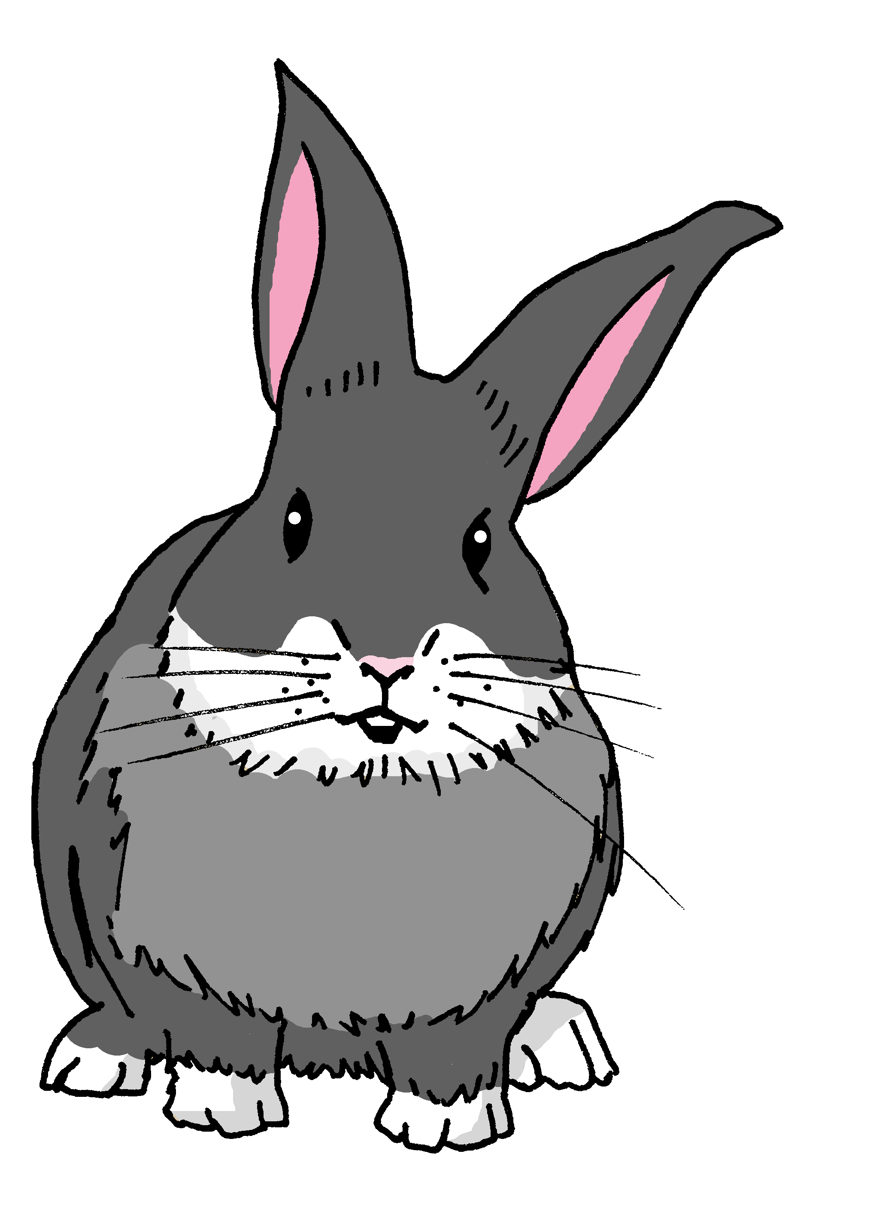
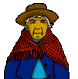
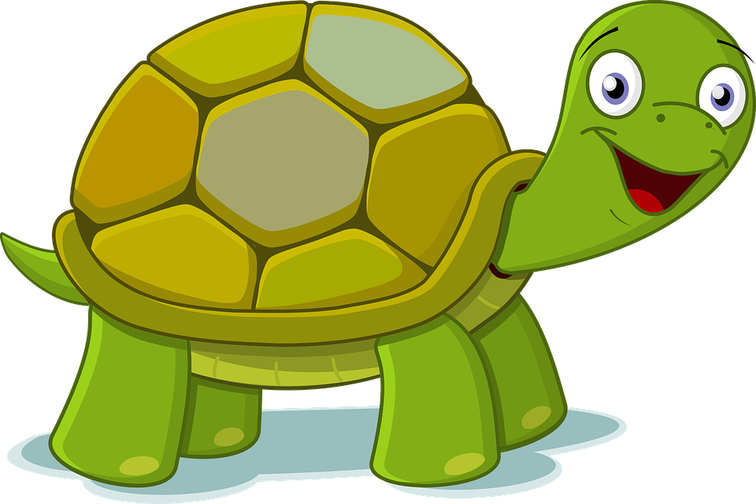
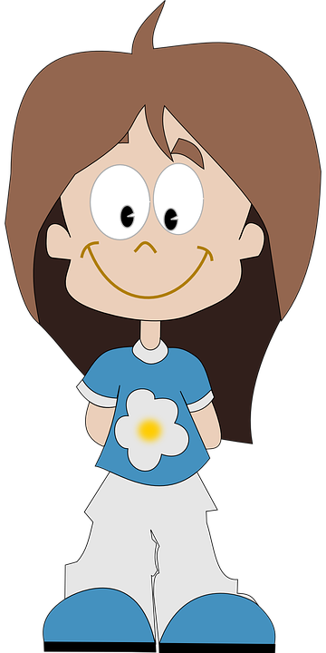
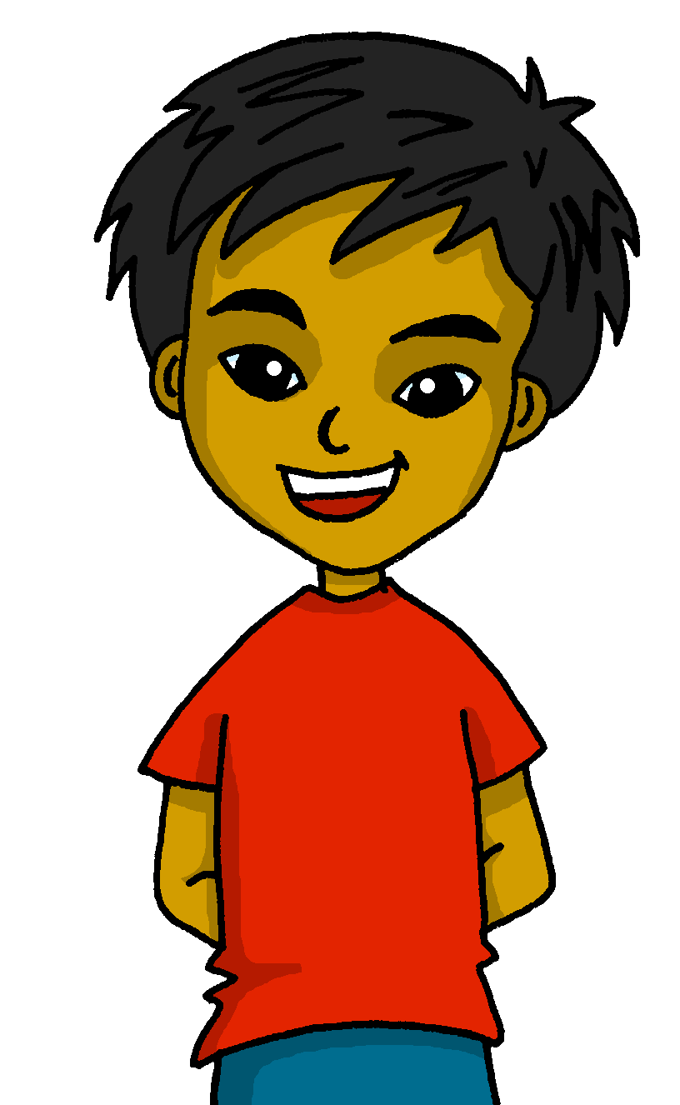
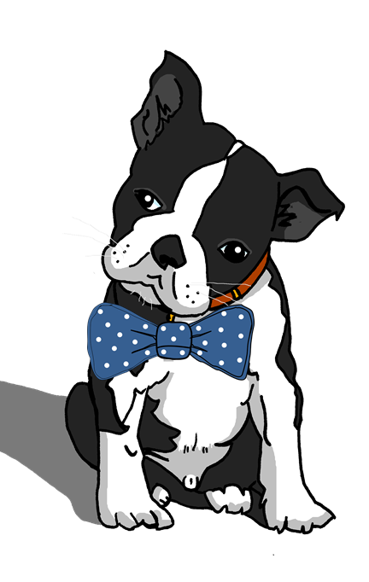
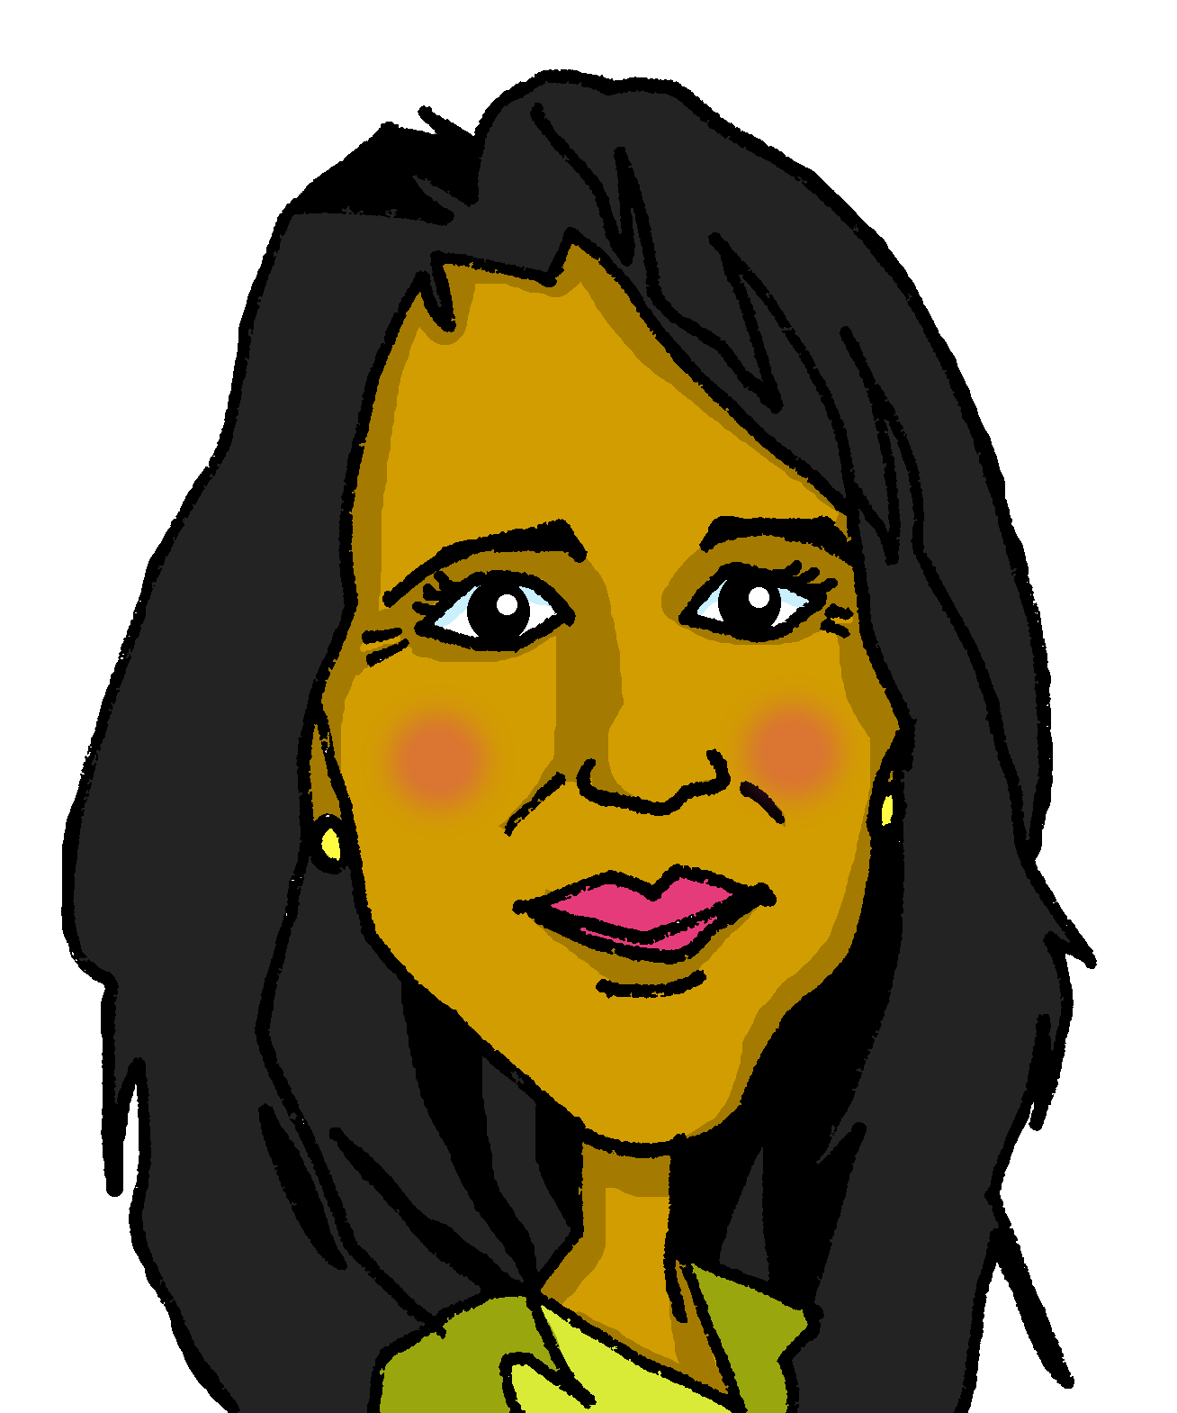
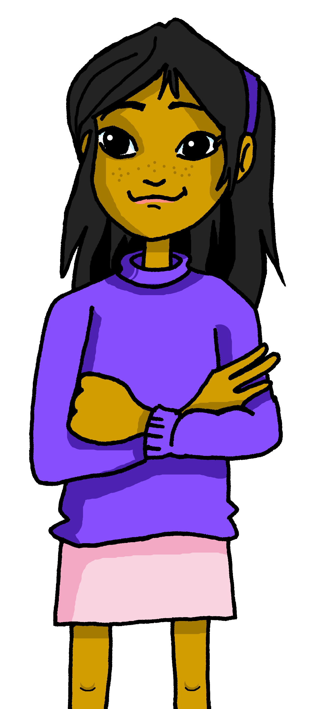
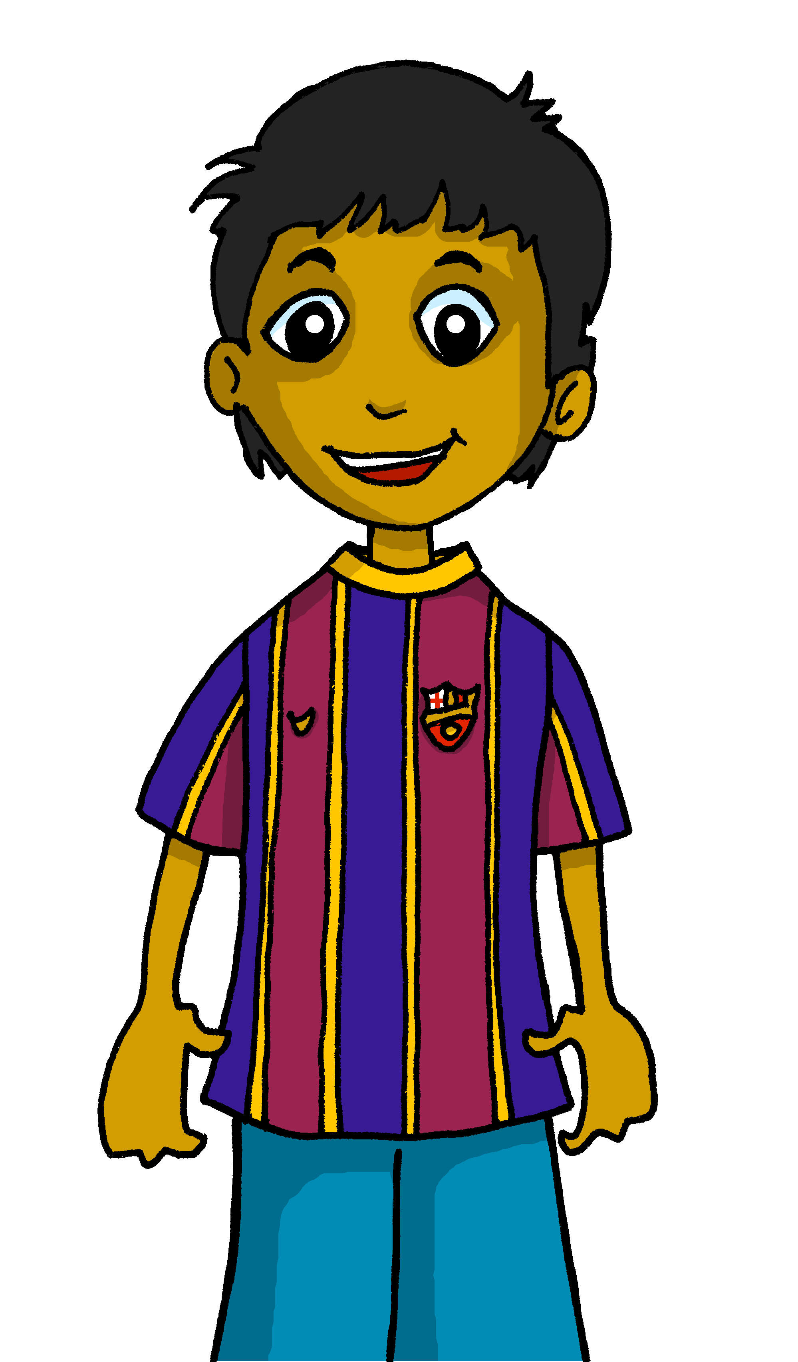
Follow up 5
¿Amas…?
¿Odias…?
Sofía
Manchita
(mornings)
(grandma)
(mornings)
(food)
Irene
La abuela Valeria
(rabbits)
(friends)
(fruit)
(mornings)
¡Sí! ¡No!
Odio…
Amo..
Santi
Quique
Úrsula
(tortoises)
(food)
(food)
(grandma)
(mornings)
(tortoises)
Elena
Ángela
Rubén
⚠ Remember the article (el, la, los, las).
(dogs)
(friends)
(languages)
(friends)
(languages)
(dogs)
Notes:
Master slide for guess who game. Print the template slide in A5 so that students can cross out as they play.

Slide 16
follow up extra:

Escribe en inglés: can you get at least 15 points?
 | cinco | cuatro | doce
 | nueve | diez | once
 | tres | él | yo
 | ella | pero | un
 | odiar | la abuela | los
 | amar | la comida | las
vocabulario
5
4
12
x3
9
10
11
3
He
I
x2
She
but
a/an, one
to hate, hating
grandma
the (m., pl.)
x1
to love, loving
food
the (f., pl.)
Notes:
Timing: 5 minutes
Aim: to practise written production of vocabulary from this week and this week’s revisited sets.
Procedure: 1. Give pupils a blank grid. They fill in the English meanings of any of the words they know, trying to reach 15 points in total.
Note: The most recently learnt and practised words are pink, words from the first revisit are green and those from the second revisit are blue, thus more points are awarded for them, to recognise that memories fade and more effort (heavy lifting!) is needed to retrieve them.

Slide 17
follow up extra:

Escribe en español: can you get at least 15 points?
 | 9 | 10 | 4
 | 11 | 5 | 12
 | a/an, one | but | she
 | I | 3 | he
 | food | the (m., pl.) | the (f., pl.)
 | to hate, hating | to love, loving | grandma
vocabulario
nueve
diez
cuatro
x3
once
cinco
doce
un
pero
ella
x2
yo
tres
él
la comida
los
las
x1
odiar
amar
la abuela
Notes:
Timing: 5 minutes
Aim: to practise written production of vocabulary from this week and this week’s revisited sets.
Procedure: 1. Give pupils a blank grid. They fill in the Spanish meanings of any of the words they know, trying to reach 15 points in total.
Note: The most recently learnt and practised words are pink, words from the first revisit are green and those from the second revisit are blue, thus more points are awarded for them, to recognise that memories fade and more effort (heavy lifting!) is needed to retrieve them.

Slide 18
¡adiós!
rojo

Slide 19
follow up 2b:

Handout 5
Escribe en inglés: can you get at least 15 points?
 | cinco | cuatro | doce
 | nueve | diez | once
 | tres | él | yo
 | ella | pero | un
 | odiar | la abuela | los
 | amar | la comida | las
vocabulario
x3
x2
x1
Notes:
HANDOUT 5

Slide 20
follow up 2b:

Handout 5
Escribe en español: can you get at least 15 points?
 | 9 | 10 | 4
 | 11 | 5 | 12
 | a/an, one | but | she
 | I | 3 | he
 | food | the (m., pl.) | the (f., pl.)
 | to hate, hating | to love, loving | grandma
vocabulario
x3
x2
x1
Notes:
HANDOUT 5

