Slide 1
Describing things and people
¡Tengo ocho años!
rojo
Follow ups 1-5
Notes:
Artwork by Steve Clarke. All additional pictures selected are available under a Creative Commons license, no attribution required.
The frequency rankings for words that occur in this PowerPoint which have been previously introduced in the resources are given in the SOW (excel document) and in the resources that first introduced and formally re-visited those words.
For any other words that occur incidentally in this PowerPoint, frequency rankings will be provided in the notes field wherever possible.
Phonics: Revisit [ñ] [n] Source: español [262] mano [135]
Cluster: niña [622] novio [1322] nube [1499] pañuelo [3063]
Vocabulary: año [46] hambre [1262] razón [306] sed [2214]
Revisit 1: conejo [4728] tortuga [>5000] amable [2707] diferente [293] divertido [2465] inteligente [2167] demasiado [494]
Revisit 2: comprender [434] información [326] instrucción [2158] texto [753]
Source: Davies, M. & Davies, K. (2018). A frequency dictionary of Spanish: Core vocabulary for learners (2nd ed.). Routledge: London

Slide 2
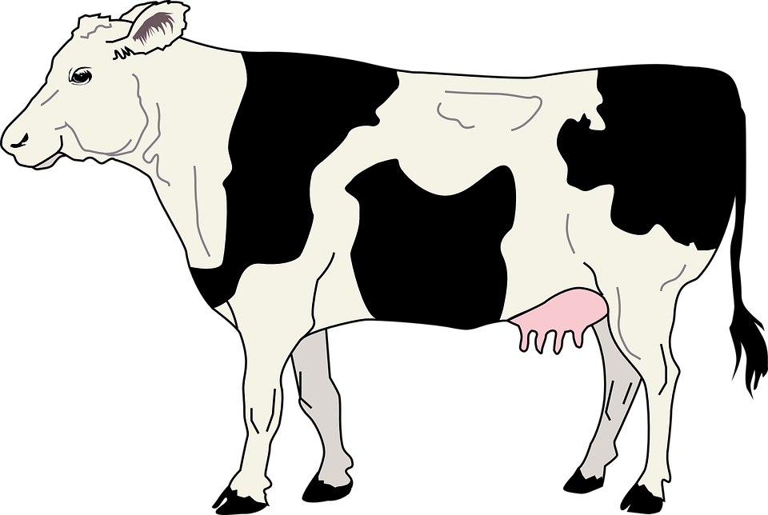
Follow up 1
[n] [ñ]
Escucha bien. Es [ñ] o [n]?
araña [spider]
moño [bun]
plátano [banana]
uña |  | araña | moño | mano |  | plátano
pena |  | Nina |  | montaña |  | pañal
puño | campana | ordeñar |  | leña | panal | paño
uña
[nail]
mano
[hand]
60
pena
[sadness]
Nina [girl’s name]
montaña
[mountain]
panal [nappy]
S
puño
[fist]
campana
[bell]
ordeñar [to milk]
leña
[wood]
panal
[honey-comb]
paño [cloth]
0
START
Notes:
Timing: 5 minutes
Aim: to practise applying knowledge of [n] [ñ] to known and unknown words.
Procedure: 1. Start the timer. Pupil A tries to read aloud all of the words pronouncing n / ñ correctly, within the 60 seconds allowed.
2. Pupil B listens. If Pupil A mispronounces n or ñ by mistake, Pupil B can direct him/her to start again from the beginning. 3. They swap roles and repeat the task.
4. Teacher then uses animations to elicit pronunciations chorally.
uña [2578] araña [4427] moño [>5000] pena [743] pañal [>5000] puño [3060] campana [3374] ordeñar [>5000] leña [4785] panal [>5000] paño [>5000]

Slide 3
Follow up 2:
Escucha la canción. Después, canta.
hablar
palabras
Notes:
Timing: 5 minutes
Aim: to revisit the numbers 1-10.
Procedure:
Play the video clip.
Encourage all pupils to join in and sing the short song several times through.
Video source:
https://youtu.be/QdUyBfsp3l8
© 2015 - 2022 by Super Tree LLC

Slide 4
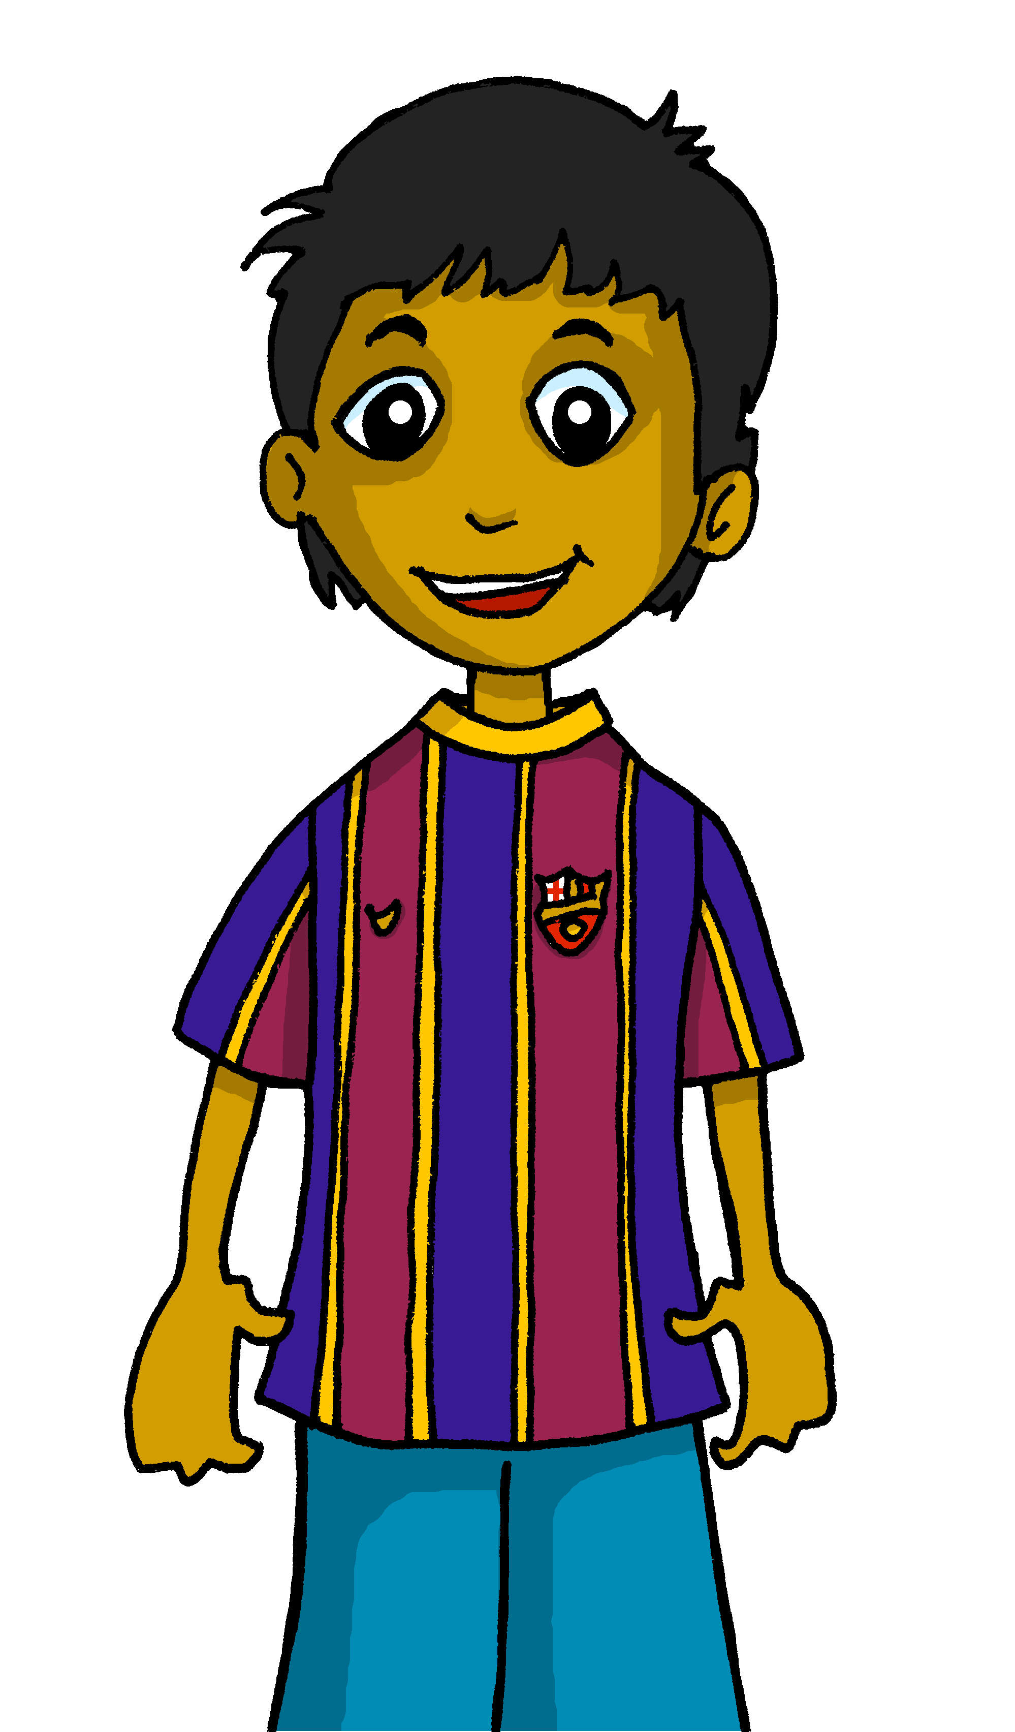
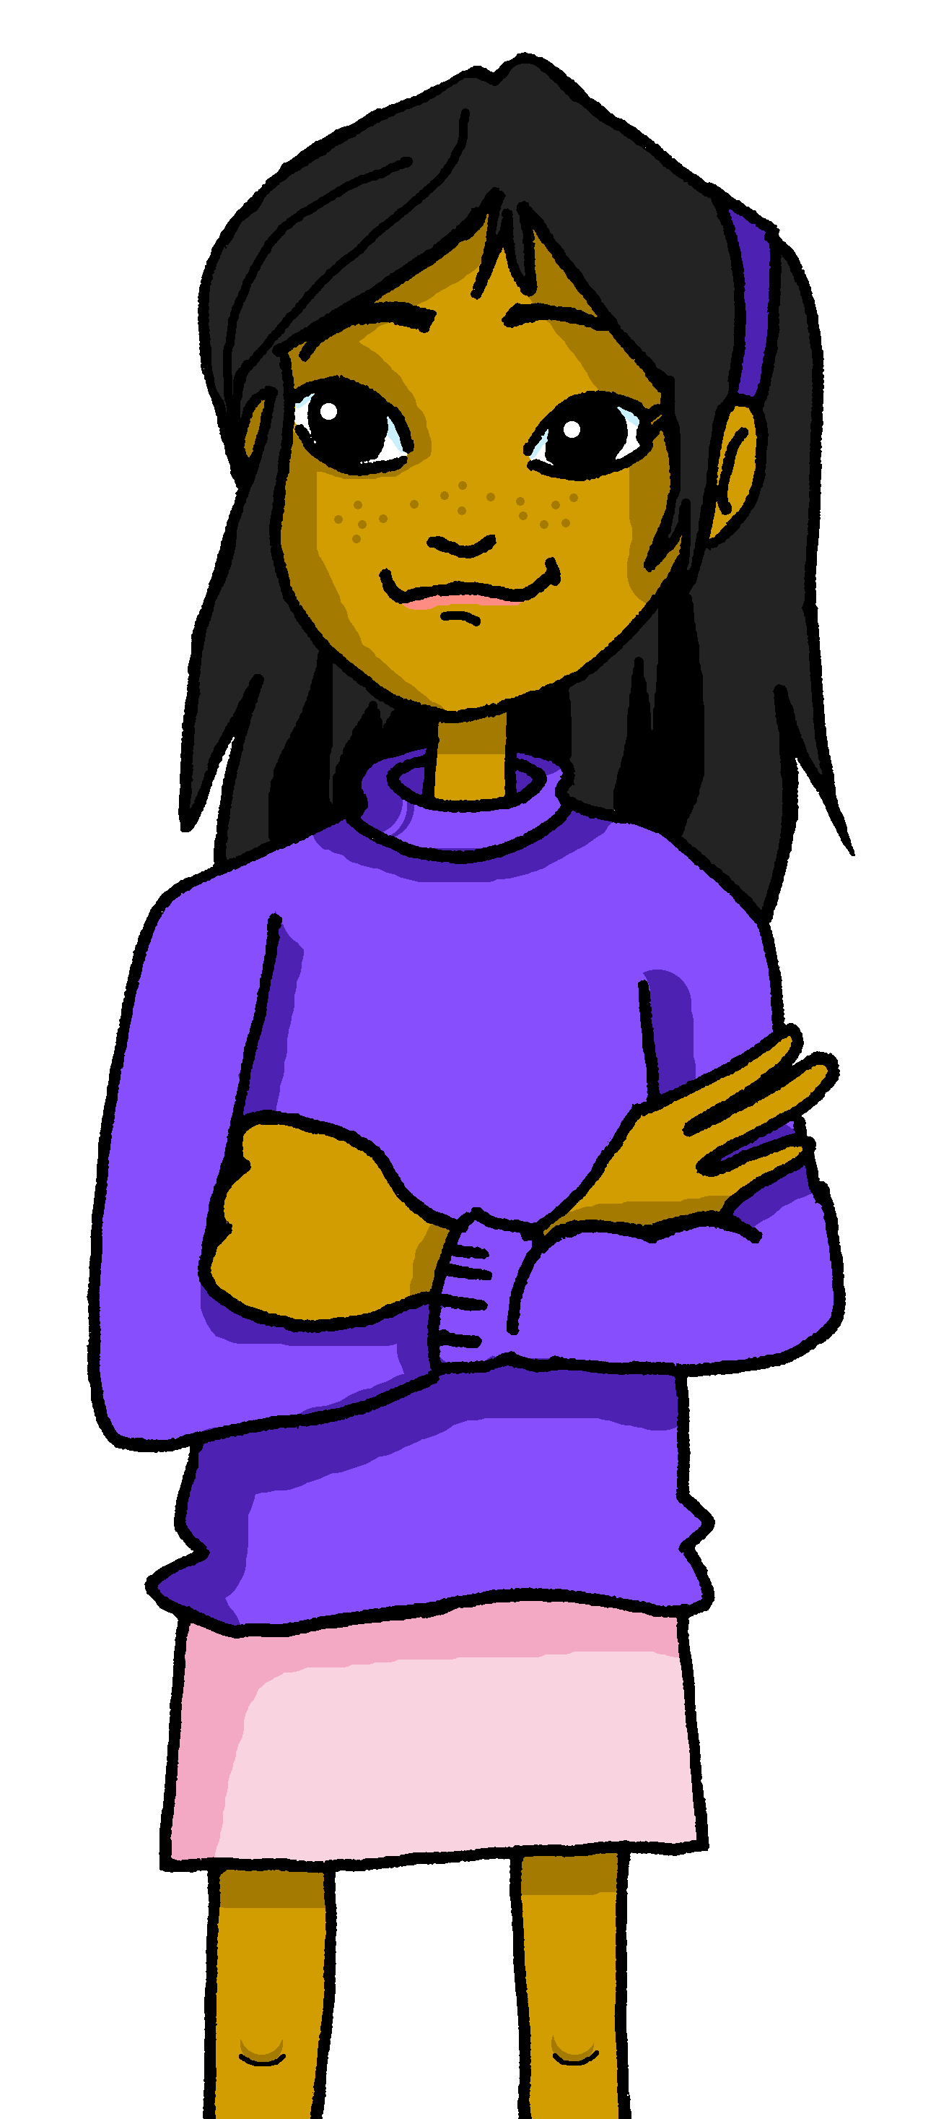
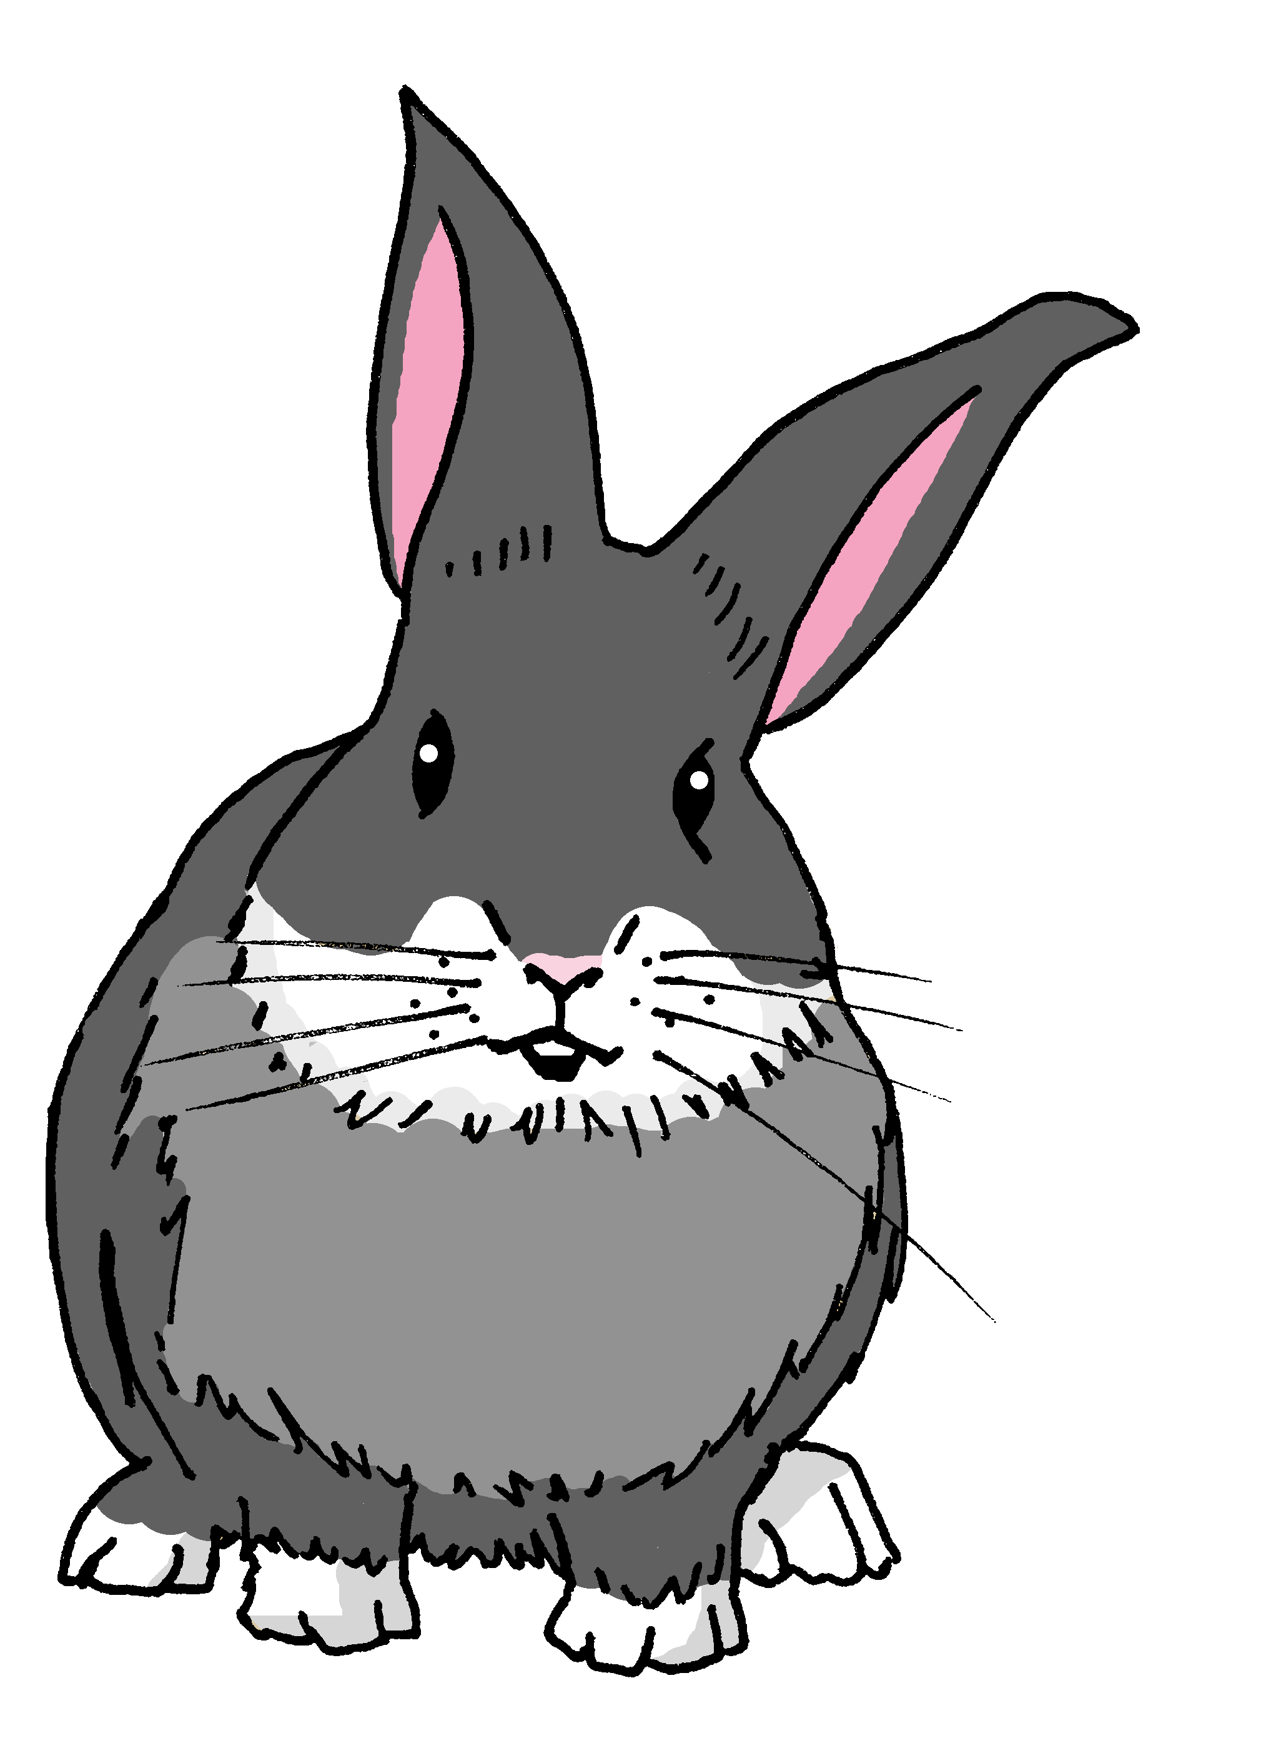
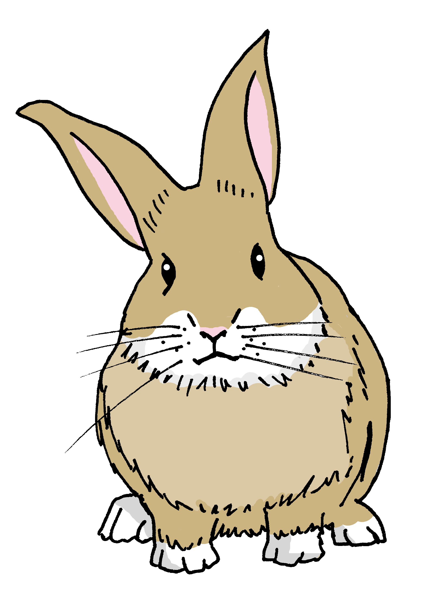
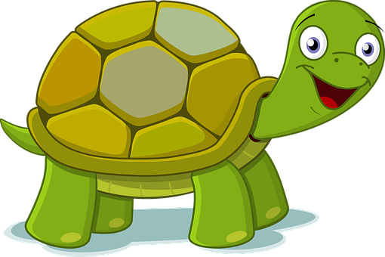
Follow up 3:
2
3
4
5
6
7
8
1
Escucha. ¿Sofía tiene razón o no?
escuchar
3
5
8
1
7
9
12
10
Notes:
Timing: 5 minutes
Aim: to practise aural comprehension of numbers 1-12 in sentences giving ages.
Procedure:
Pupils look at the image for item 1.
Click buttons to play audio.
Pupils respond by saying ‘ella/Sofía tiene razón’ or ‘ella/Sofía no tiene razón.
Click to confirm the answer.
Repeat steps 1-4 with items 2-8.
Transcript: Rubén tiene siete años Santi tiene cinco años.
Ángela tiene ocho años.
Manchita tiene cuatro años.
La tortuga Irene tiene diez años.
Pancho tiene dos años.
Quique tiene siete años.
Y yo, yo tengo siete años.

Slide 5
Follow up 4
Habla con tu compañero/a
Soy Quique. Tengo siete años.
Soy Ángela. Tengo ocho años.
Soy Irene. Tengo diez años.
Soy Manchita. Tengo cuatro años.
Soy Santi. Tengo cinco años.
Soy Rubén. Tengo ocho años.
Soy Pancho. Tengo dos años.
Soy Sofía. Tengo siete años.
hablar
8
5
2
7
10
8
7
4
Notes:
Timing: 5 minutes
Aim: to practise spoken production of the new structure ‘tener’ + number + an(s) for age.
Procedure:
Do number 1 with pupils to model the task.
Click to reveal the answer.
Give pupils 30 seconds to say / practise the next sentence with a partner.
Elicit the sentence from the whole class chorally, then click to confirm.
Repeat steps 3-4 for the remaining sentences.

Slide 6
Follow up 5:
1 Escribe el número correcto.
escribir
leer
uno
A | nueve | + | ______ | = | diez
B | ocho | + | ______ | = | diez
C | nueve | + | ______ | = | doce
D | tres | + | ______ | = | diez
E | cinco | + | ______ | = | once
F | dos | + | ______ | = | diez
dos
tres
siete
seis
2 Escribe el número correcto.
ocho
ocho
1. seis + dos = __________________
2. cuatro + siete = _________________
3. tres + nueve = _________________
4. nueve – tres = _________________
5. tres + dos – uno = ______________
6. ocho – tres + dos + cuatro – cinco + seis – tres =_________
once
doce
seis
cuatro
nueve
Notes:
Timing: 5 minutes
Aim: To practise written production of numbers.
Procedure:
Teachers read the instruction and clarify the meaning.
Pupils write the answers in words to activities 1 and 2.
Click to elicit from pupils and correct.

Slide 7
follow up extra:

Escribe en inglés: can you get at least 15 points?
 | ella | pero | gris
 | comprender | la información | la instrucción
 | el texto | inteligente | demasiado
 | divertido | amable | diferente
 | el año | la tortuga | el conejo
 | el hambre (f) | la sed | la razón
vocabulario
she
but
grey
x3
to understand, understanding
information
instruction
text
intelligent
too (much)
x2
fun
kind, nice
different
year
tortoise
rabbit
x1
hunger
thirst
right
Notes:
Timing: 5 minutes
Aim: to practise written production of vocabulary from this week and this week’s revisited sets.
Procedure: 1. Give pupils a blank grid. They fill in the English meanings of any of the words they know, trying to reach 15 points in total.
Note: The most recently learnt and practised words are pink, words from the first revisit are green and those from the second revisit are blue, thus more points are awarded for them, to recognise that memories fade and more effort (heavy lifting!) is needed to retrieve them.

Slide 8
follow up extra:

Escribe en español: can you get at least 15 points?
 | but | she | information
 | instruction | to understand, understanding | grey
 | kind, nice | text | fun
 | different | too (much | intelligent
 | rabbit | year | tortoise
 | right | thirst | hunger
vocabulario
pero
ella
la información
x3
la instrucción
comprender
gris
amable
el texto
divertido
x2
diferente
demasiado
inteligente
el conejo
el año
la tortuga
x1
la razón
la sed
el hambre
Notes:
Timing: 5 minutes
Aim: to practise written production of vocabulary from this week and this week’s revisited sets.
Procedure: 1. Give pupils a blank grid. They fill in the Spanish meanings of any of the words they know, trying to reach 15 points in total.
Note: The most recently learnt and practised words are pink, words from the first revisit are green and those from the second revisit are blue, thus more points are awarded for them, to recognise that memories fade and more effort (heavy lifting!) is needed to retrieve them.

Slide 9
¡adiós!
rojo

Slide 10
follow up 2b:

Handout 5
Escribe en inglés: can you get at least 15 points?
 | ella | pero | gris
 | comprender | la información | la instrucción
 | el texto | inteligente | demasiado
 | divertido | amable | diferente
 | el año | la tortuga | el conejo
 | el hambre (f) | la sed | la razón
vocabulario
x3
x2
x1
Notes:
HANDOUT 5

Slide 11
follow up 2b:

Handout 5
Escribe en español: can you get at least 15 points?
 | but | she | information
 | instruction | to understand, understanding | grey
 | kind, nice | text | fun
 | different | too (much | intelligent
 | rabbit | year | tortoise
 | right | thirst | hunger
vocabulario
x3
x2
x1
Notes:
HANDOUT 5

