Slide 1
Describing things and people
rojo
Follow ups 1-5
Notes:
Artwork by Steve Clarke. All additional pictures selected are available under a Creative Commons license, no attribution required.
The frequency rankings for words that occur in this PowerPoint which have been previously introduced in the resources are given in the SOW (excel document) and in the resources that first introduced and formally re-visited those words.
For any other words that occur incidentally in this PowerPoint, frequency rankings will be provided in the notes field wherever possible.
Phonics: gue | gui Source: juguete [3163] guitarra [2706] Cluster: guerra [283] hoguera [>5000] seguir [99] guiso [>5000]
Vocabulary: él [9] ella [72] tú [184] yo [28] pero [30]
Revisit 1: cielo [620] medio [395] sol [383] arriba [690] abajo [788]
Revisit 2: pasar [68] visitar [792] mamá [675] mañana [402] papá [865] semana [301] tiempo [80] por² [15]
Source: Davies, M. & Davies, K. (2018). A frequency dictionary of Spanish: Core vocabulary for learners (2nd ed.). Routledge: London

Slide 2
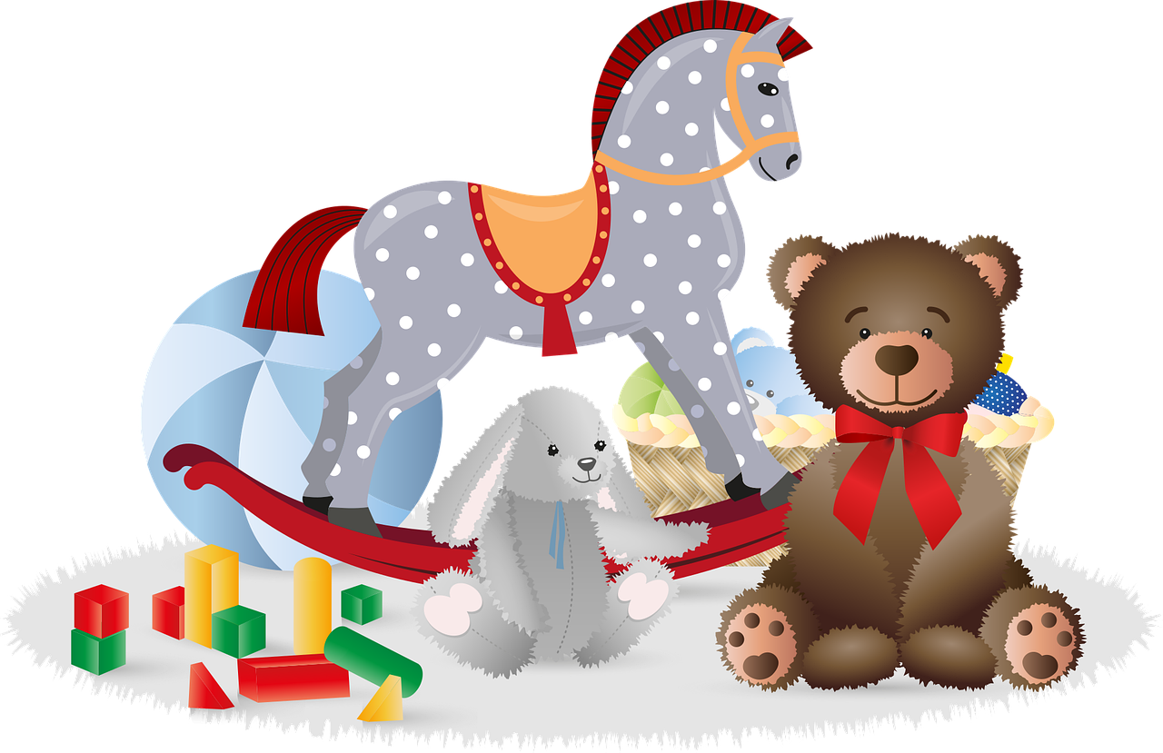
[gue]
pronunciar
[toy]
juguete
Notes:
Timing: 1 minute
Aim: To introduce SSC [gue].
Procedure:
Introduce and elicit the pronunciation of the individual SSC [gue] and then the source word ‘juguete’ (with gesture, if using).
Click to bring up the picture and get pupils to repeat (with gesture, if using).
Pupils to practise in pairs.
Gesture suggestion: put hands out in front (as though holding a toy) and do three short movements with the shoulders (right-left-right) to match the number of syllables as you say the word ‘ju-gue-te’.

Slide 3
[gui]
pronunciar
guitarra
Notes:
Timing: 1 minute
Aim: To introduce SSC [gui].
Procedure:
Introduce and elicit the pronunciation of the individual SSC [gui] and then the source word ‘guitarra’ (with gesture, if using).
Click to bring up the picture and get pupils to repeat (with gesture, if using).
Pupils to practise in pairs.
Gesture suggestion: mime playing a guitar.

Slide 4
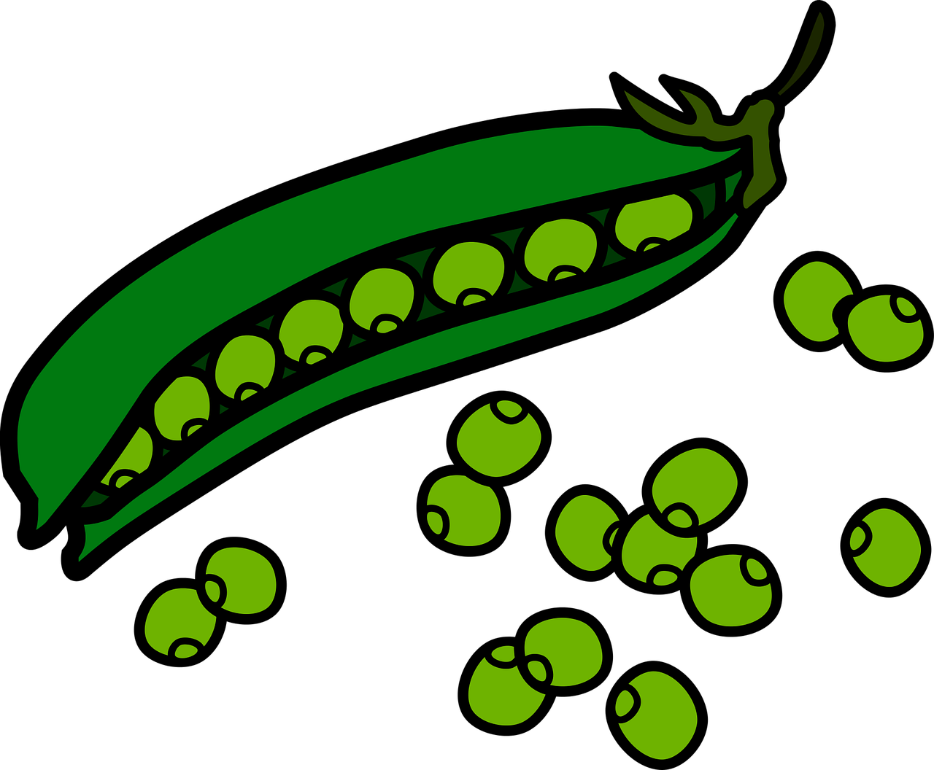
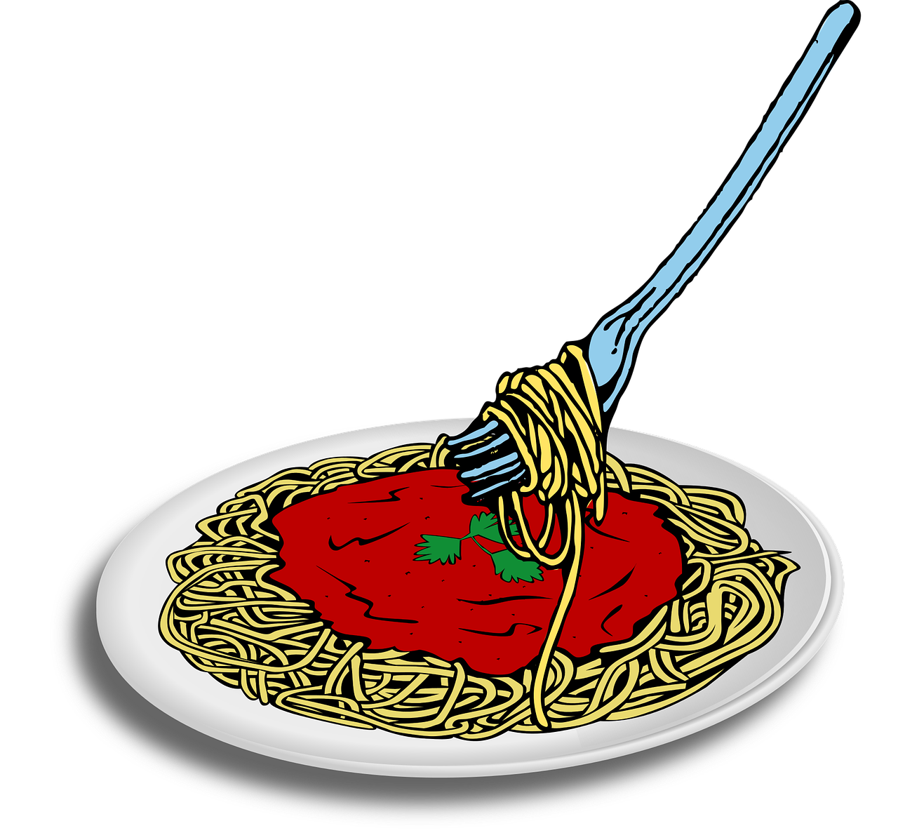
Follow up 1:
Escucha. ¿[gue/gui] o [ge/gi]?
¡A practicar!
pronunciar
gue gui
ge gi
gue gui
ge gi
guisantes
geografía
hamburguesa
guiar
gimnasia
gesto
espaguetis
girar
1
5
2
6
7
3
4
8
Notes:
Timing: 5 minutes
Aim: to practise aural distinction between [gue/gui] and [ge/gi] in mainly unknown words (pictures provided to support meaning).
Procedure:
Read the explanation and ensure pupils understand the task.
Click to listen. Pupils note either gue/gui or ge/gi.
Click to reveal the words.
Click to bring up next prompt – to practise. Pupils do whole-class choral practice, i.e. all speaking simultaneously.
Transcript: guisantes geografía hamburguesa guiar gimnasia gesto espaguetis girar

Slide 5
SER | ESTAR
Remember that in Spanish there are two ways to say ‘you are’:
estás
Use ______ for location or temporary state.
eres
Use ______ for permanent traits.
¿Cómo estás?
Estoy contento.
How are you?
I am (feeling) pleased.
¿Cómo eres?
What are you like?
Soy muy tranquilo.
I am (a) very calm (person).
Notes:
DO BEFORE FOLLOW UP 2
Timing: 2 minutes
Aim: to revisit estoy/estás and soy/eres and the two questions.
Procedure:
Click through the animations to present the information.
Elicit English translations for the Spanish examples provided.

Slide 6
Follow up 2: Dos niños* en la clase de Luis
Escucha. ¿Es hoy o siempre? ¿Niño o niña o ?
escuchar
el niño = boy | la niña = girl | los niños = children
 | hoy | siempre | niño | niña | | ¿Cómo estás? | ¿Cómo eres?
E
1
2
3
4
5
Notes:
Timing: 5 minutes
Aim: to practise aural comprehension of estoy/soy and previously taught adjectives.
Procedure:
Explain the context: there are new pupils in Luis’ class. They answer questions about themselves. What do they say about themselves? And which question are they answering?
Do the example for part 1 of the task. Click to listen. Pupils listen for estoy/soy and note either ‘hoy’ or ‘siempre’. Click to reveal the answer.
Click to listen again – part 2. Is the new pupil a boy or girl or is it impossible to tell? Click to reveal.
Click to listen again – part 3. Which question would have been asked? ¿Cómo estás (how are you) or ¿Cómo eres? (what are you like) Click to reveal.
Repeat all three steps with items 1-5.
Transcript:
E. Soy tranquila.
Estoy nervioso.
Soy amable.
Estoy curiosa.
Estoy serio.
Soy inteligente.

Slide 7
Follow up 3: ¿Cómo estás? ¿Cómo eres?
A: Ask the questions on your card in order 1-5. Write B’s answer down.
B: Answer according to your cards 1-5.
hablar
¿Cómo estás?
Estoy serio/a.
hoy
normalmente
Ask:
serious
calm
‘How are you (today)?
serio/a
Notes:
Timing: 8-10 minutes
Aim: to practise oral production from memory of ser/estar in 1st and 2nd persons singular; to develop understanding of the differences between ‘ser’ and ‘estar’.
Procedure: 1. Pupil A asks the questions on his/her card in the given order. (See end of PPT for handouts). 2. Pupil B answers by selecting the correct response.
3. After 5 questions/answers, swap roles and repeat the task.

Slide 8
Follow up 3: Round 1- A
Follow up 3: Round 1 B
hoy
normalmente
Ask:
‘How are you (usually)?
Soy tranquilo/a.
tranquilo/a
serious
calm
hoy
Estoy nervioso/a.
‘How are you (today)?
normalmente
Ask:
nervioso/a
nervous
happy
hoy
Estoy curioso/a.
‘How are you (today)?
normalmente
Ask:
curioso/a
curious
fast
‘How are you (usually)?
hoy
normalmente
Ask:
Soy elegante.
elegante
slow
smart
hoy
Estoy inteligente.
‘How are you (today)?
normalmente
Ask:
inteligente
intelligent
kind, friendly
Notes:
ROUND 1 ANSWERS: DO NOT DISPLAY
Click on the pencil to hear the correct question each time.

Slide 9
Follow up 3: Round 2 B
Follow up 3: Round 2 A
hoy
Estoy triste.
Ask:
‘How are you (today)?
normalmente
triste
sad
happy
Soy divertido/a.
Ask:
‘How are you (usually)?
hoy
normalmente
divertido/a
nervous
fun, funny
hoy
Estoy diferente.
‘How are you (today)?
normalmente
Ask:
diferente
different
calm
Soy amable.
Ask:
‘How are you (usually)?
hoy
normalmente
amable
slow
kind, friendly
Soy fantástico/a.
Ask:
‘How are you (usually)?
hoy
normalmente
fantástico/a
tired
fantastic
Notes:
ROUND 2 ANSWERS: DO NOT DISPLAY

Slide 10
Subject pronouns (I, you)
The verb (or verb ending) often tells us who the sentence refers to:
Estoy feliz.
I am (feeling) happy.
Estás divertido.
You are (in a) funny (mood).
Sometimes, when comparing, we use subject pronouns to emphasise the difference:
Yo soy nervioso pero tú eres tranquila.
I am nervous but you are calm.
In English we stress the contrast with our voice.
Yo estoy triste pero tú estás feliz.
I am (feeling) sad but you are (feeling) happy.
Notes:
DO BEFORE FOLLOW UP 4
Timing: 2 minutes
Aim: to introduce a second reason for using the subject pronouns with examples using yo and tú.
Procedure:
Click through the animations to present the information.
Elicit English translations for the Spanish examples provided.

Slide 11
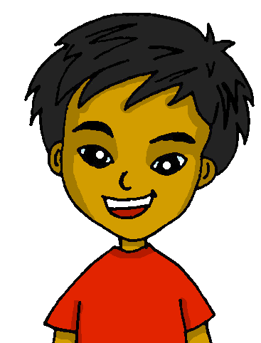
Follow up 4:
Luis se compara* con Quique.
se compara = compares himself
Lee los mensajes. ¿Es yo o tú?
leer
Hoy yo estoy cansado pero tú estás rápido.
Tú caminas 1km a la escuela pero yo camino 3km.
Luis (I)
Quique (you)
E
1
E | am tired | are fast
1 | walk 3km to school | walk 1km to school
2 | have English class | have Spanish class
3 | spending the morning at home | are in class
4 | swim in pool | swim in sea
5 | visit a friend | visit grandma
Tú tienes una clase de español pero yo tengo una clase de inglés.
Yo paso la mañana en casa pero ¡tú estás en clase!
2
3
Hoy yo nado en la piscina pero tú nadas en el mar.
Tú visitas a la abuela pero yo visito a mi amigo.
4
5
Notes:
Timing: 7 minutes
Aim: to practise written comprehension of 1st and 2nd person singular (previously taught) verbs; to understand the use of subject pronouns for emphasising a comparison.
Procedure:
Remind pupils that in Spanish we can often just use verb endings/forms on their own without pronouns (especially I/you forms as they are always different, but that when comparing two people (or things) we often use subject pronouns for emphasis.
Introduce the context – Luis is comparing himself with Quique in these messages so for emphasis he used pronouns but the phone screen has smudges on it and we can’t see them.
Do the example. Pupils read the message and work out which pronoun is missing (yo/tú) by looking at the verb that follows the gap.
Teacher elicits the pronoun from pupils, encouraging them to read the whole message aloud, with the pronouns included.
Click to reveal the answer.
Then elicit the key information in English and click to reveal it in the table.
Pupils complete items 1-5 and teacher gives feedback on each item, as above.

Slide 12
follow up 5:

Escribe en inglés: can you get at least 15 points?
 | la mamá | la semana | el tiempo
 | la mañana | por | el papá
 | el medio | pasar | el cielo
 | abajo | visitar | el sol
 | él | tú | arriba
 | yo | ella | pero
vocabulario
(the) mum
(the) week
(the) time
x3
through, around, along, in (time of day)
(the) morning
(the) dad
to spend, spending (time)
(the) middle
(the) sky
x2
down, below
to visit, visiting
(the) sun
he
you
up, above
x1
I
she
but
Notes:
Timing: 5 minutes
Aim: to practise written production of vocabulary from this week and this week’s revisited sets.
Procedure: 1. Give pupils a blank grid. They fill in the English meanings of any of the words they know, trying to reach 15 points in total.
Note: The most recently learnt and practised words are pink, words from the first revisit are green and those from the second revisit are blue, thus more points are awarded for them, to recognise that memories fade and more effort (heavy lifting!) is needed to retrieve them.

Slide 13
follow up 5:

Escribe en español: can you get at least 15 points?
 | (the) time | through, around, along, in (times of day) | (the) morning
 | (the) mum | (the) dad | (the) week
 | (the) sun | to spend, spending (time) | to visit, visiting
 | down, below | (the) middle | (the) sky
 | you | but | up, above
 | he | she | I
vocabulario
el tiempo
por
la mañana
x3
la mamá
el papá
la semana
el sol
pasar
visitar
x2
abajo
el medio
el cielo
tú
pero
arriba
x1
él
ella
yo
Notes:
Timing: 5 minutes
Aim: to practise written production of vocabulary from this week and this week’s revisited sets.
Procedure: 1. Give pupils a blank grid. They fill in the Spanish meanings of any of the words they know, trying to reach 15 points in total.
Note: The most recently learnt and practised words are pink, words from the first revisit are green and those from the second revisit are blue, thus more points are awarded for them, to recognise that memories fade and more effort (heavy lifting!) is needed to retrieve them.

Slide 14
¡adiós!
rojo

Slide 15
follow up 2b:

Handout 5
Escribe en inglés: can you get at least 15 points?
 | la mamá | la semana | el tiempo
 | la mañana | por | el papá
 | el medio | pasar | el cielo
 | abajo | visitar | el sol
 | él | tú | arriba
 | yo | ella | pero
vocabulario
x3
x2
x1
Notes:
HANDOUT 5

Slide 16
Follow up 3: Round 1 A
Follow up 3: Round 2 A
Ask:
‘How are you (usually)?
hoy
normalmente
sad
happy
‘How are you (today)?
hoy
normalmente
Ask:
nervous
fun, funny
‘How are you (today)?
hoy
normalmente
Ask:
different
calm
Ask:
‘How are you (usually)?
hoy
normalmente
slow
kind, friendly
‘How are you (today)?
hoy
normalmente
Ask:
tired
fantastic
Notes:
HANDOUT A

Slide 17
Follow up 3: Round 1 B
Follow up 3: Round 2 B
hoy
normalmente
Ask:
‘How are you (usually)?
serious
calm
‘How are you (today)?
hoy
normalmente
Ask:
serious
calm
‘How are you (today)?
hoy
normalmente
Ask:
serious
calm
hoy
normalmente
Ask:
‘How are you (usually)?
serious
calm
‘How are you (today)?
hoy
normalmente
Ask:
serious
calm
Notes:
HANDOUT B

Slide 18
follow up 2b:

Handout 5
Escribe en español: can you get at least 15 points?
 | (the) time | through, around, along, in (times of day) | (the) morning
 | (the) mum | (the) dad | (the) week
 | (the) sun | to spend, spending (time) | to visit, visiting
 | down, below | (the) middle | (the) sky
 | you | but | up, above
 | he | she | I
vocabulario
x3
x2
x1
Notes:
HANDOUT 5

