Slide 1
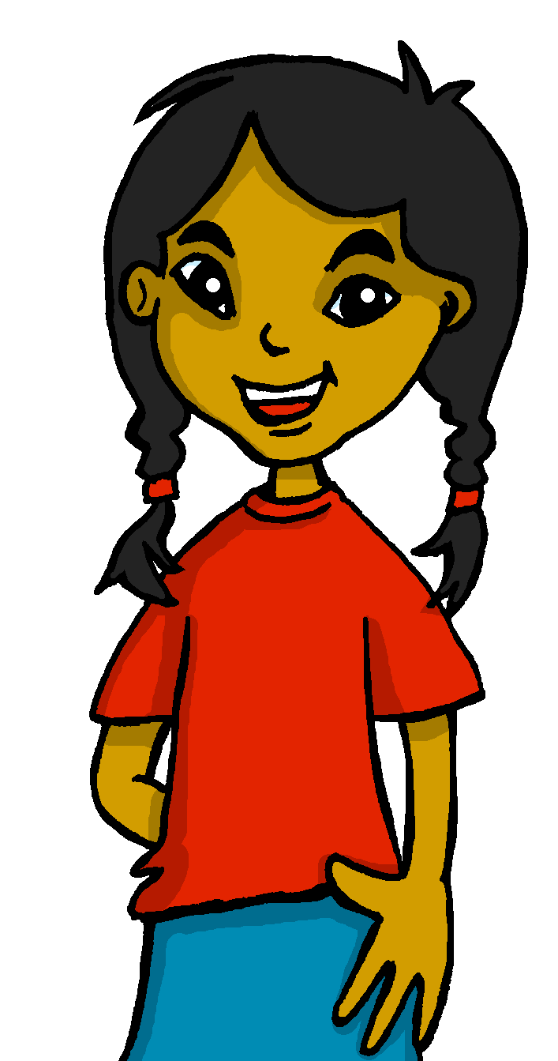
español, con Sofía

Slide 2
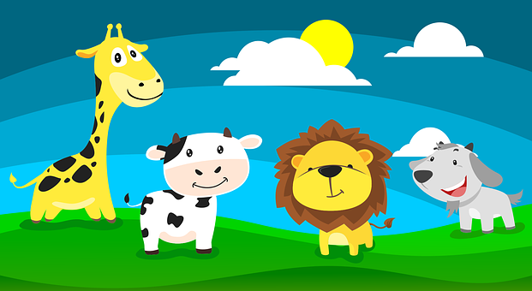
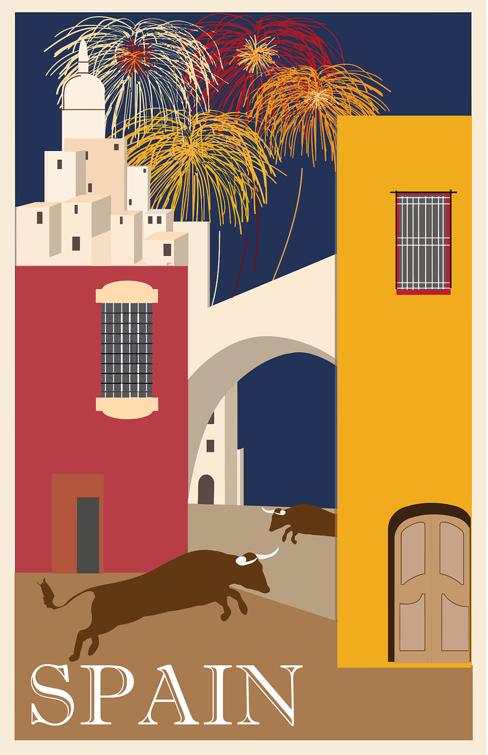
Describing things and people
rojo
¿Cómo es?
adjective agreement
SSC [ga] [go] [gu] [ge] [gi]
Notes:
Artwork by Steve Clarke. All additional pictures selected are available under a Creative Commons license, no attribution required.
The frequency rankings for words that occur in this PowerPoint which have been previously introduced in the resources are given in the SOW (excel document) and in the resources that first introduced and formally re-visited those words.
For any other words that occur incidentally in this PowerPoint, frequency rankings will be provided in the notes field wherever possible.
Phonics: revisit SSC [ga] [go] [gu] [ge] [gi]
Vocabulary: conejo [4728] tortuga [>5000] amable [2707] diferente [293] divertido [2465] inteligente [2167] demasiado [494] Revisit 1: fruta [1925] globo [3765] pelota [2270] queso [3187] sombrero [2289] tarta [>5000]
Revisit 2: caminar [514] nadar [3604] mar [480] montaña [1464] playa [1475] pueblo [244] el [1] la [1] de² [2] por¹ [15]
Source: Davies, M. & Davies, K. (2018). A frequency dictionary of Spanish: Core vocabulary for learners (2nd ed.). Routledge: London

Slide 3
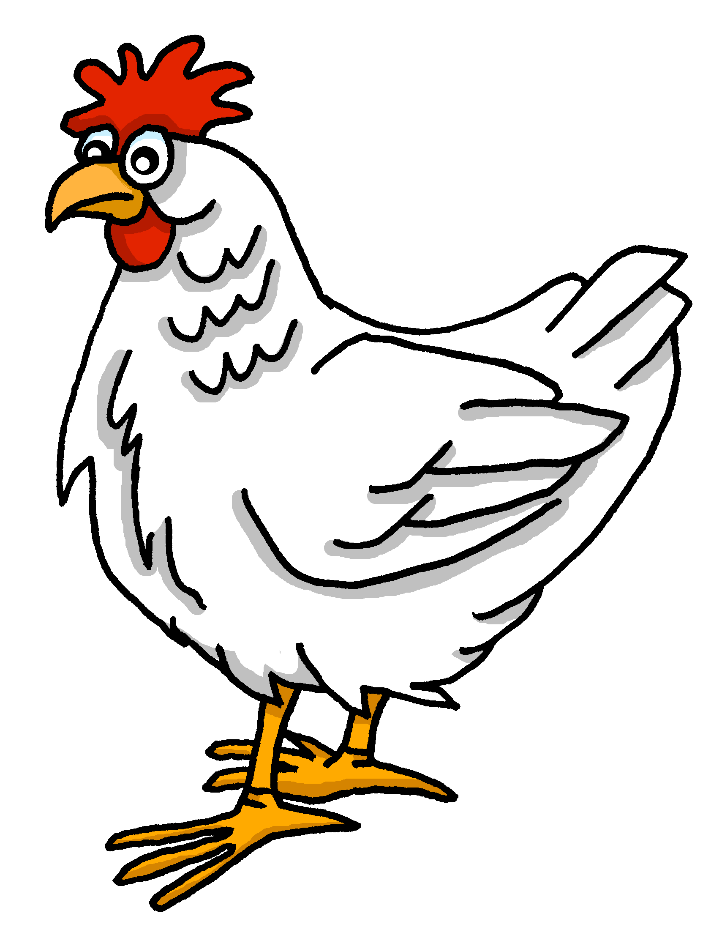
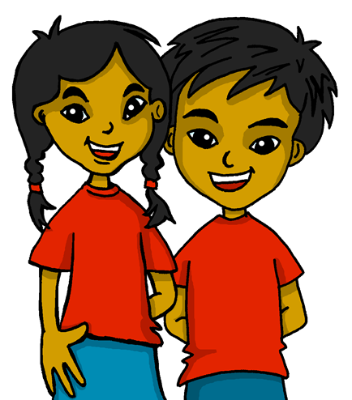
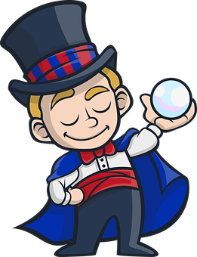
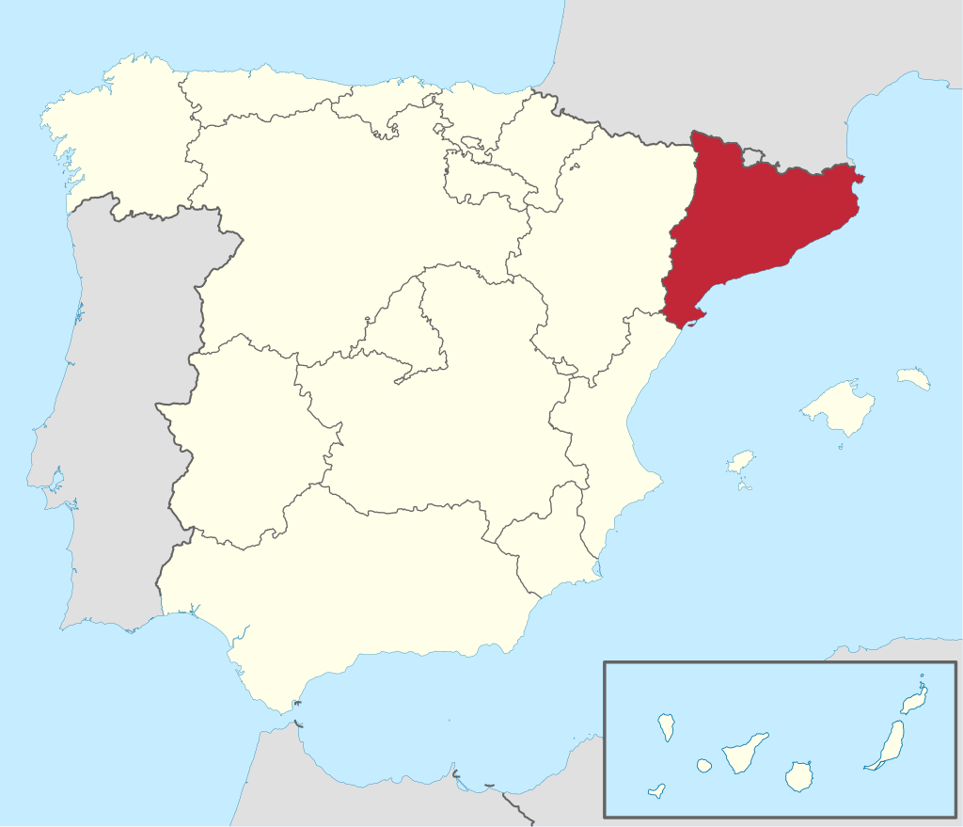
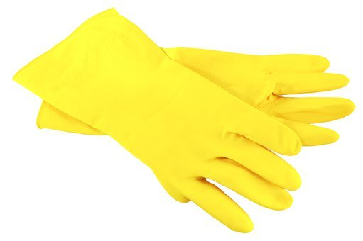
[A] Escucha y escribe.
[ga] [go] [gu] [ge] [gi]
pronunciar
45
gallina
gema
algo
gemelos
vigilante
guantes
mago
región
0
[B] Practica con tu compañero/a.
INICIO
Notes:
Timing: 5 minutes
Aim: To revisit SSC [ga] [go] [gu] [ge] [gi]
Procedure:
Pupils write 1-8 and either [ga] [go] [gu] [ge] [gi]
Click on the pictures to listen.
Click again to reveal the answers.
Click inicio for pupils to pronounce all of the words.
Click on each image again to hear the word, if desired.
Transcript: gallina
gema
algo
gemelos
vigilante
guantes
mago
región
Frequency of unknown words:
algo [110] gallina [3153] gema [>5000] gemelo [>5000] guantes [4008] mago [4573] región [545] vigilante [>5000]

Slide 4
vocabulario
¡A practicar!
nervioso
inteligente
rápida
amable
demasiado
diferente
tranquilo
elegante
divertido
seria
fun, funny (m)
too (much)
different (m, f)
elegant (m, f)
serious (f)
calm, quiet (m)
intelligent (m, f)
nervous (m)
fast (f)
kind, nice (m, f)
Notes:
Timing: 5 minutes
Aim: to revisit adjectives from previous weeks (and the four introduced this week).
Procedure: 1. Click for an English prompt.
2. Elicit the Spanish word from pupils. 3. Continue until all 10 items have been seen and heard. Note: the newest words that are not cognates are left until last. Teachers can pause to practise the pronunciations of the new words here, too.
Note: The new words are also illustrated with a picture; previously learnt words are not illustrated.

Slide 5
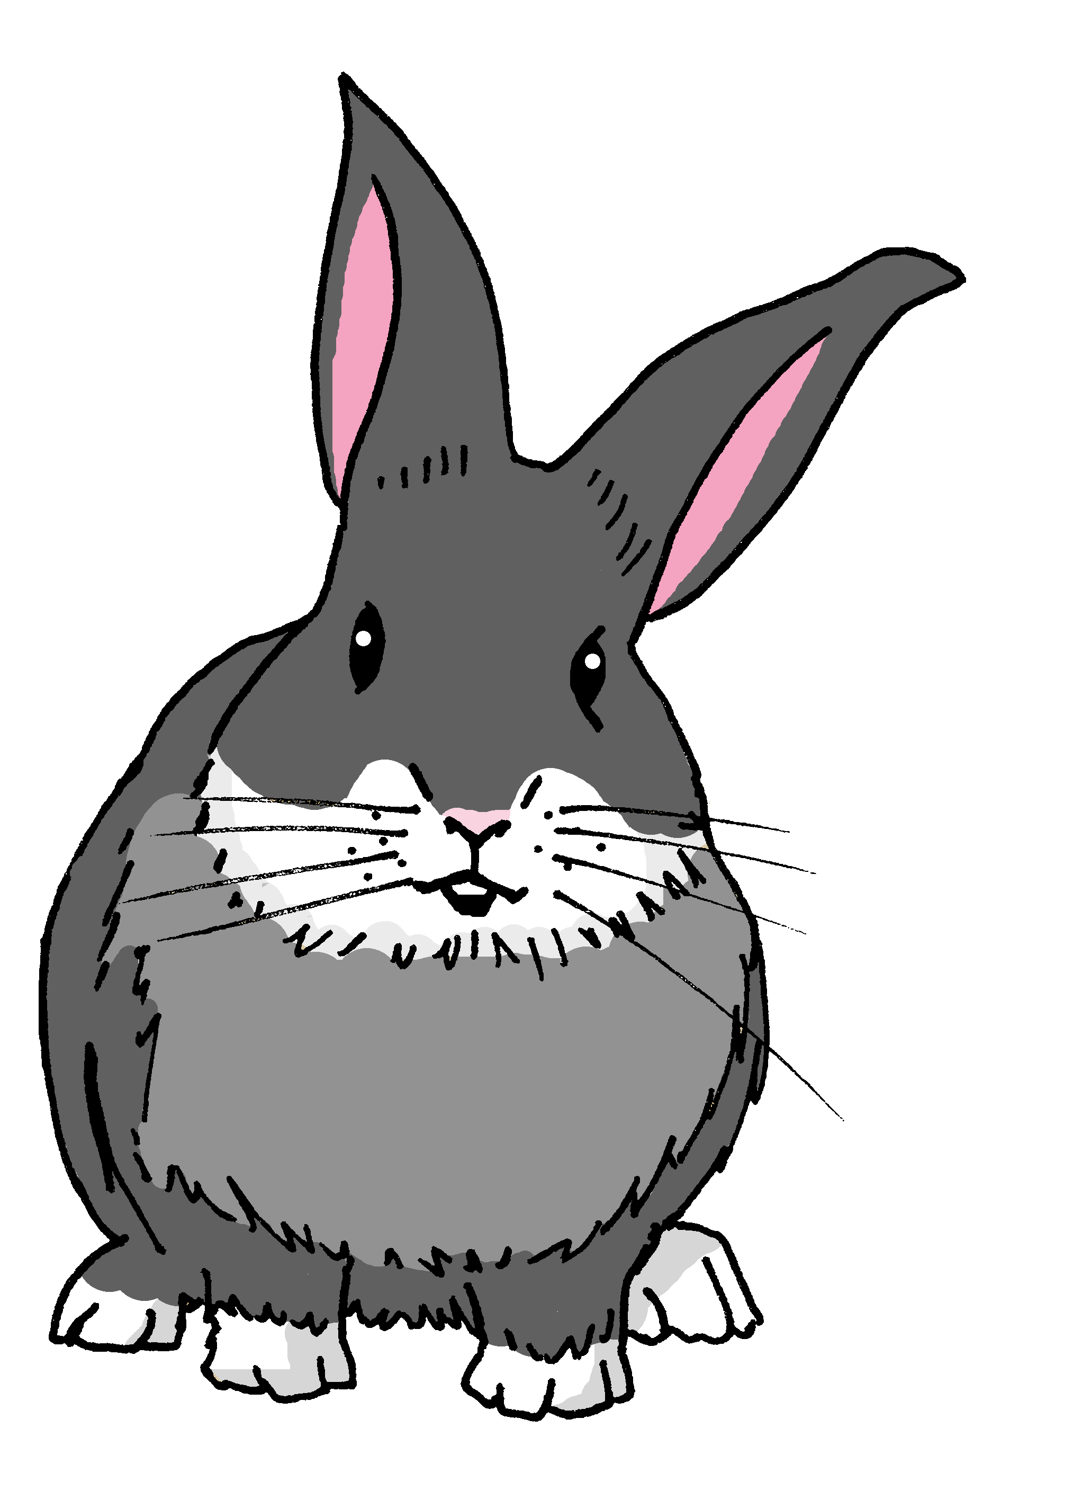
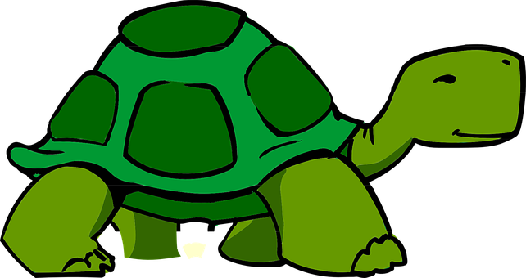
Adjectives following the noun
Remember, adjectives change depending on whether the noun they describe is masculine or feminine.
When an adjective ends in –e or consonant, it can describe a masculine or feminine noun.
El conejo es rápido.
The rabbit is fast.
El conejo es elegante.
La tortuga es lenta.
The rabbit is elegant.
La tortuga es elegante.
The tortoise is slow.
The tortoise is elegant.
Notes:
Timing: 2 minutes
Aim: to revisit adjective agreement.
Procedure:
Click through the animations to present the information.
Elicit English translations for the Spanish examples provided.

Slide 6
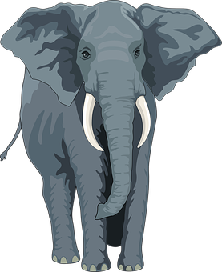
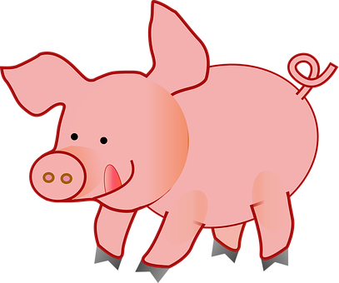
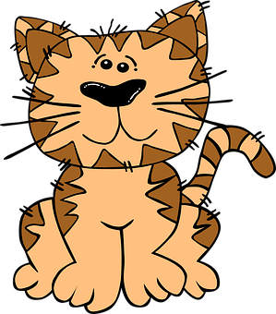
Lee: ¿Qué forma es correcta?
descripción | imagen | adjetivo en inglés
El gato | la gata es tranquilo.
El conejo | la coneja es amable.
La gata | el gato es diferente.
El elefante | la elefanta es seria.
El conejo | la coneja es inteligente.
El cerdo | la cerda es lento.
leer
E
[d]
calm/quiet
[c]
kind
1
2
[d]
different
3
[a]
serious
4
[c]
intelligent
5
[a]
slow
Female animals in Spanish often change their spelling too, like adjectives: el gato (male cat) la gata (female cat)
[a]
[b]
[c]
[d]
Notes:
Timing: 6 minutes
Aim: to practise written understanding of regular adjectival agreement.
Procedure:
Read the Spanish instruction.
Click to bring up the callout about females versions of Spanish animals.
Complete the example to model part 1 of the task; pupils look at the adjective form to work out which animal is being described.
Teacher elicits response for item 1.
Pupils complete part 1 for the remaining items 1-5.
Teacher elicits answers and provides feedback.
Part 2: pupils select the correct picture and write the English meaning of the adjective.
Click to reveal answers.

Slide 7
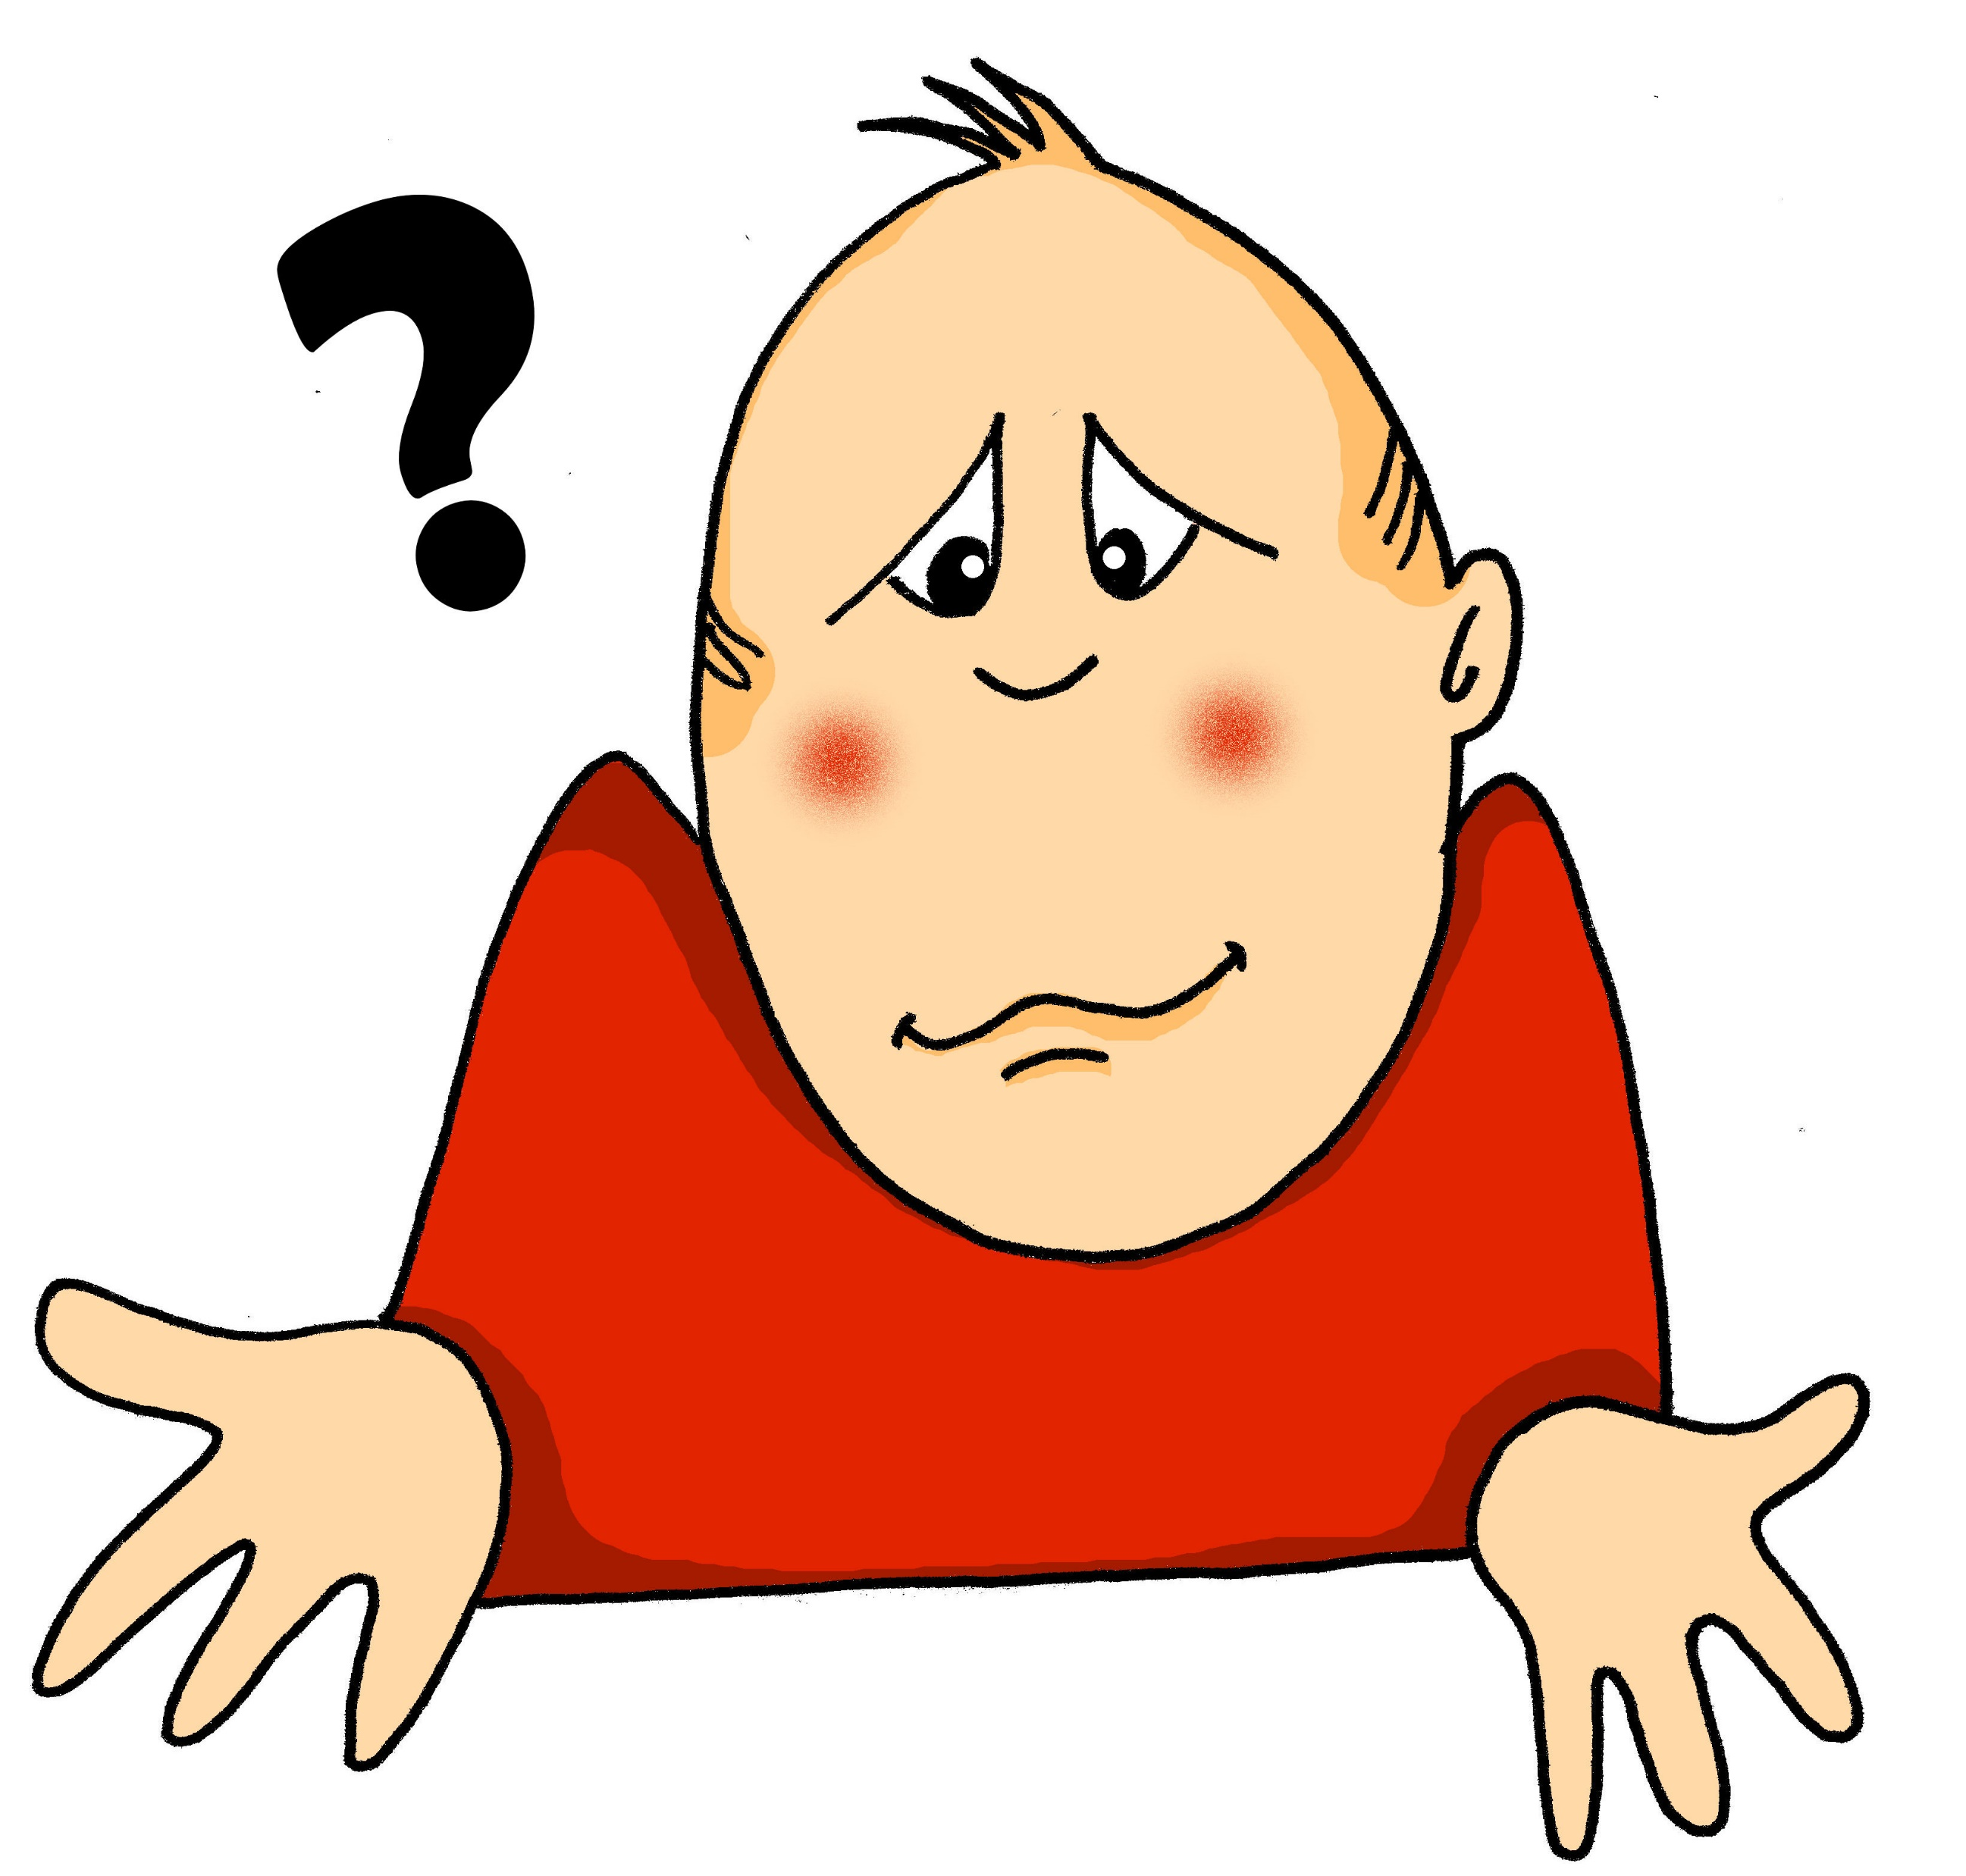
¿Cómo es? What is it like?
You know that ¿cómo? means ‘how’:
¿Cómo está hoy?
How is s/he, it today?
We also use ¿cómo? to ask what something is like, generally:
¿Cómo es?
Es elegante.
What is s/he, it like?
It is elegant.
Notes:
Timing: 2 minutes
Aim: to present a new use/meaning of ¿cómo?
Procedure:
Click through the animations to present the new information.
Elicit English translations for the Spanish examples provided.

Slide 8
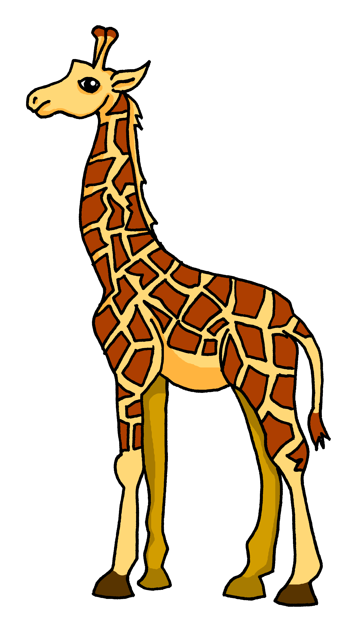
Leer y hablar
¿Cómo es?
el mensaje = message
Luis está en el zoo. Manda unos Whatsapp a Sofía y Quique pero hay un problema con los mensajes*.
leer
Lee los mensajes y escribe el adjetivo correcto.
¡Hola! Estoy en el zoo. Veo una jirafa pero ¡es demasiado tranquila para mí!
amarillo | tranquila
1
Notes:
Slide 1 of 8 slides
Timing: 10 minutes
Aim: to consolidate written recognition of the connection between subject pronoun and noun gender, and adjective ending and word gender.
Procedure:
Pupils read the message and work out the missing adjective from the gender of the noun it refers to.
Click on whatsapp audio icon to hear the full message, and reveal the written answer.
Teachers can elicit the English for the Whatsapp message, orally from all students.
Repeat steps 1-3 for the remaining slides.

Slide 9
Leer y hablar
¿Cómo es?
el mensaje = message
Lee los mensajes y escribe el adjetivo correcto.
leer
Veo una tortuga pero ¡es demasiado seria para mí!
seria | lento
2
Notes:
[2/8]
Procedure:
Pupils read the message and work out the missing adjective from the gender of the noun it refers to.
Click on whatsapp audio icon to hear the full message, and reveal the written answer.
Teachers can elicit the English for the Whatsapp message, orally from all students.

Slide 10
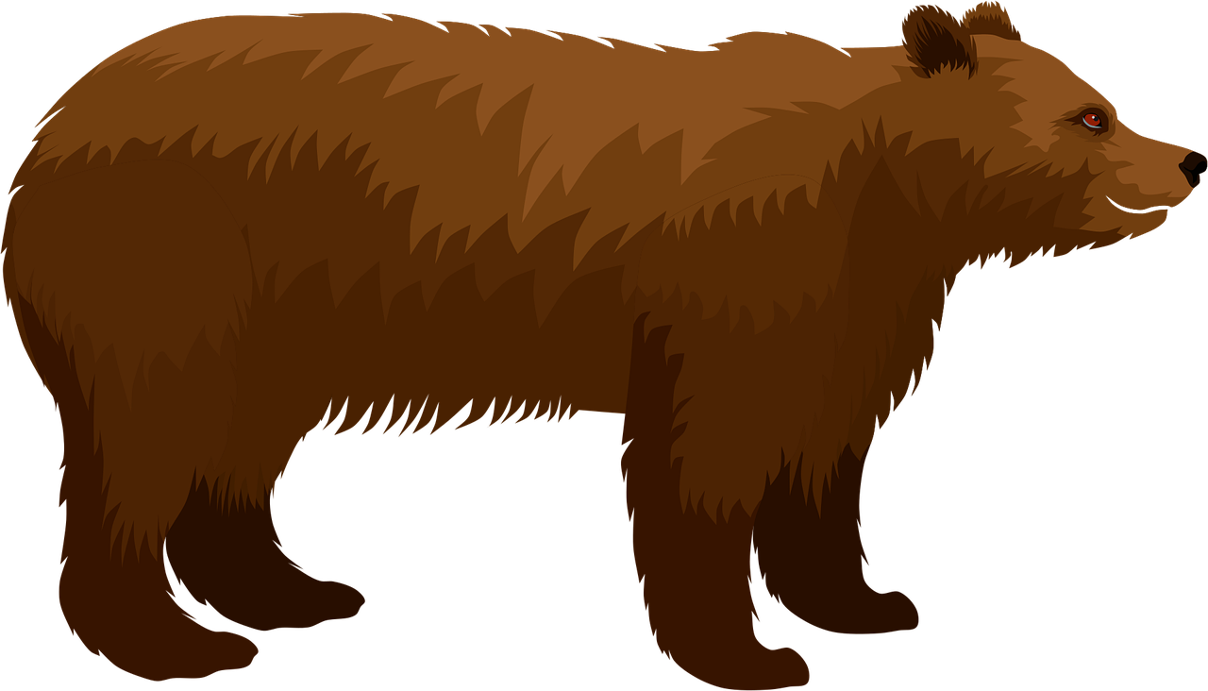
Leer y hablar
¿Cómo es?
el mensaje = message
Lee los mensajes y escribe el adjetivo correcto.
leer
Veo un oso pero ¡es demasiado curioso para mí!
curioso | nerviosa
3
Notes:
[3/8]
Procedure:
Pupils read the message and work out the missing adjective from the gender of the noun it refers to.
Click on whatsapp audio icon to hear the full message, and reveal the written answer.
Teachers can elicit the English for the Whatsapp message, orally from all students.

Slide 11
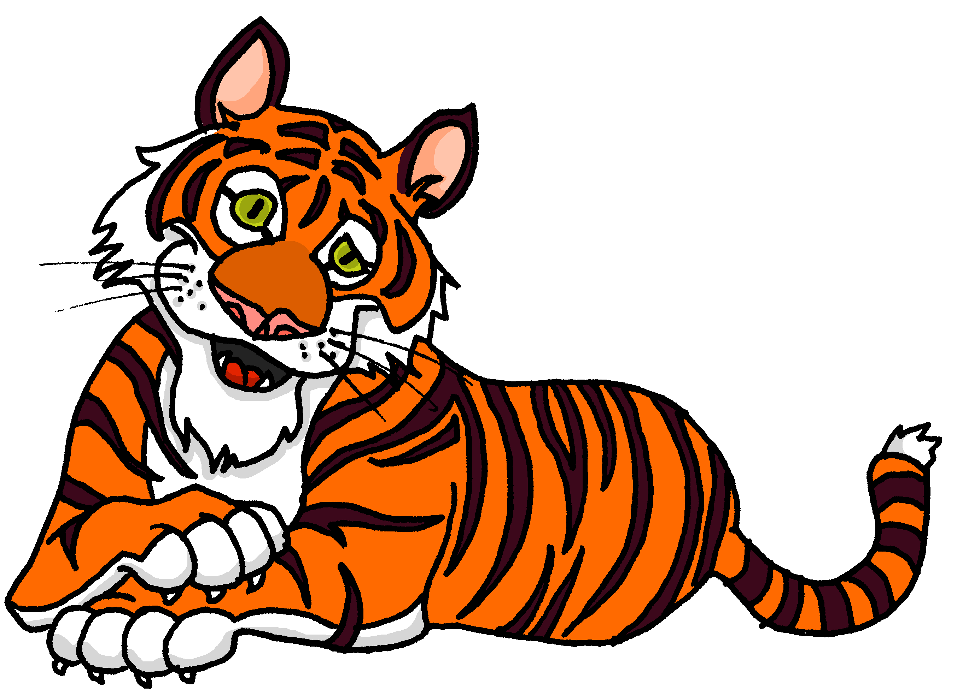
Leer y hablar
¿Cómo es?
el mensaje = message
Lee los mensajes y escribe el adjetivo correcto.
leer
Veo un tigre. Es divertido pero ¡es demasiado
rápido y grande!
rápido | grande
4
Notes:
[4/8]
Procedure:
Pupils read the message and work out the missing adjective from the gender of the noun it refers to.
Click on whatsapp audio icon to hear the full message, and reveal the written answer.
Teachers can elicit the English for the Whatsapp message, orally from all students.

Slide 12
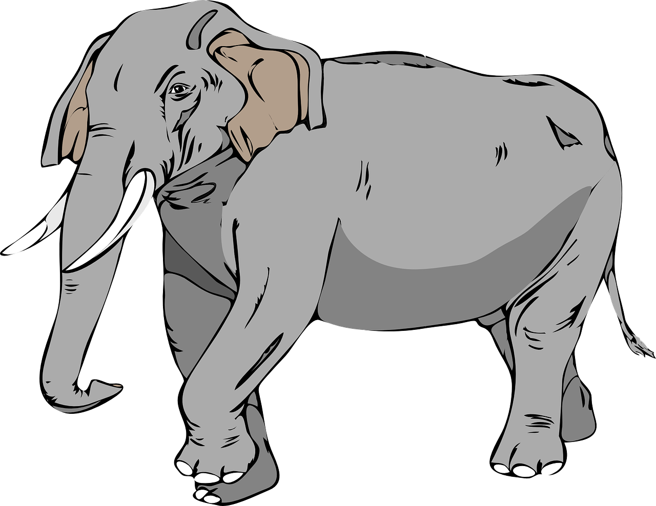
Leer y hablar
¿Cómo es?
el mensaje = message
Lee los mensajes y escribe el adjetivo correcto.
leer
Veo un elefante. Es inteligente pero ¡es demasiado lento !
seria | lento
5
Notes:
[5/8]
Procedure:
Pupils read the message and work out the missing adjective from the gender of the noun it refers to.
Click on whatsapp audio icon to hear the full message, and reveal the written answer.
Teachers can elicit the English for the Whatsapp message, orally from all students.

Slide 13
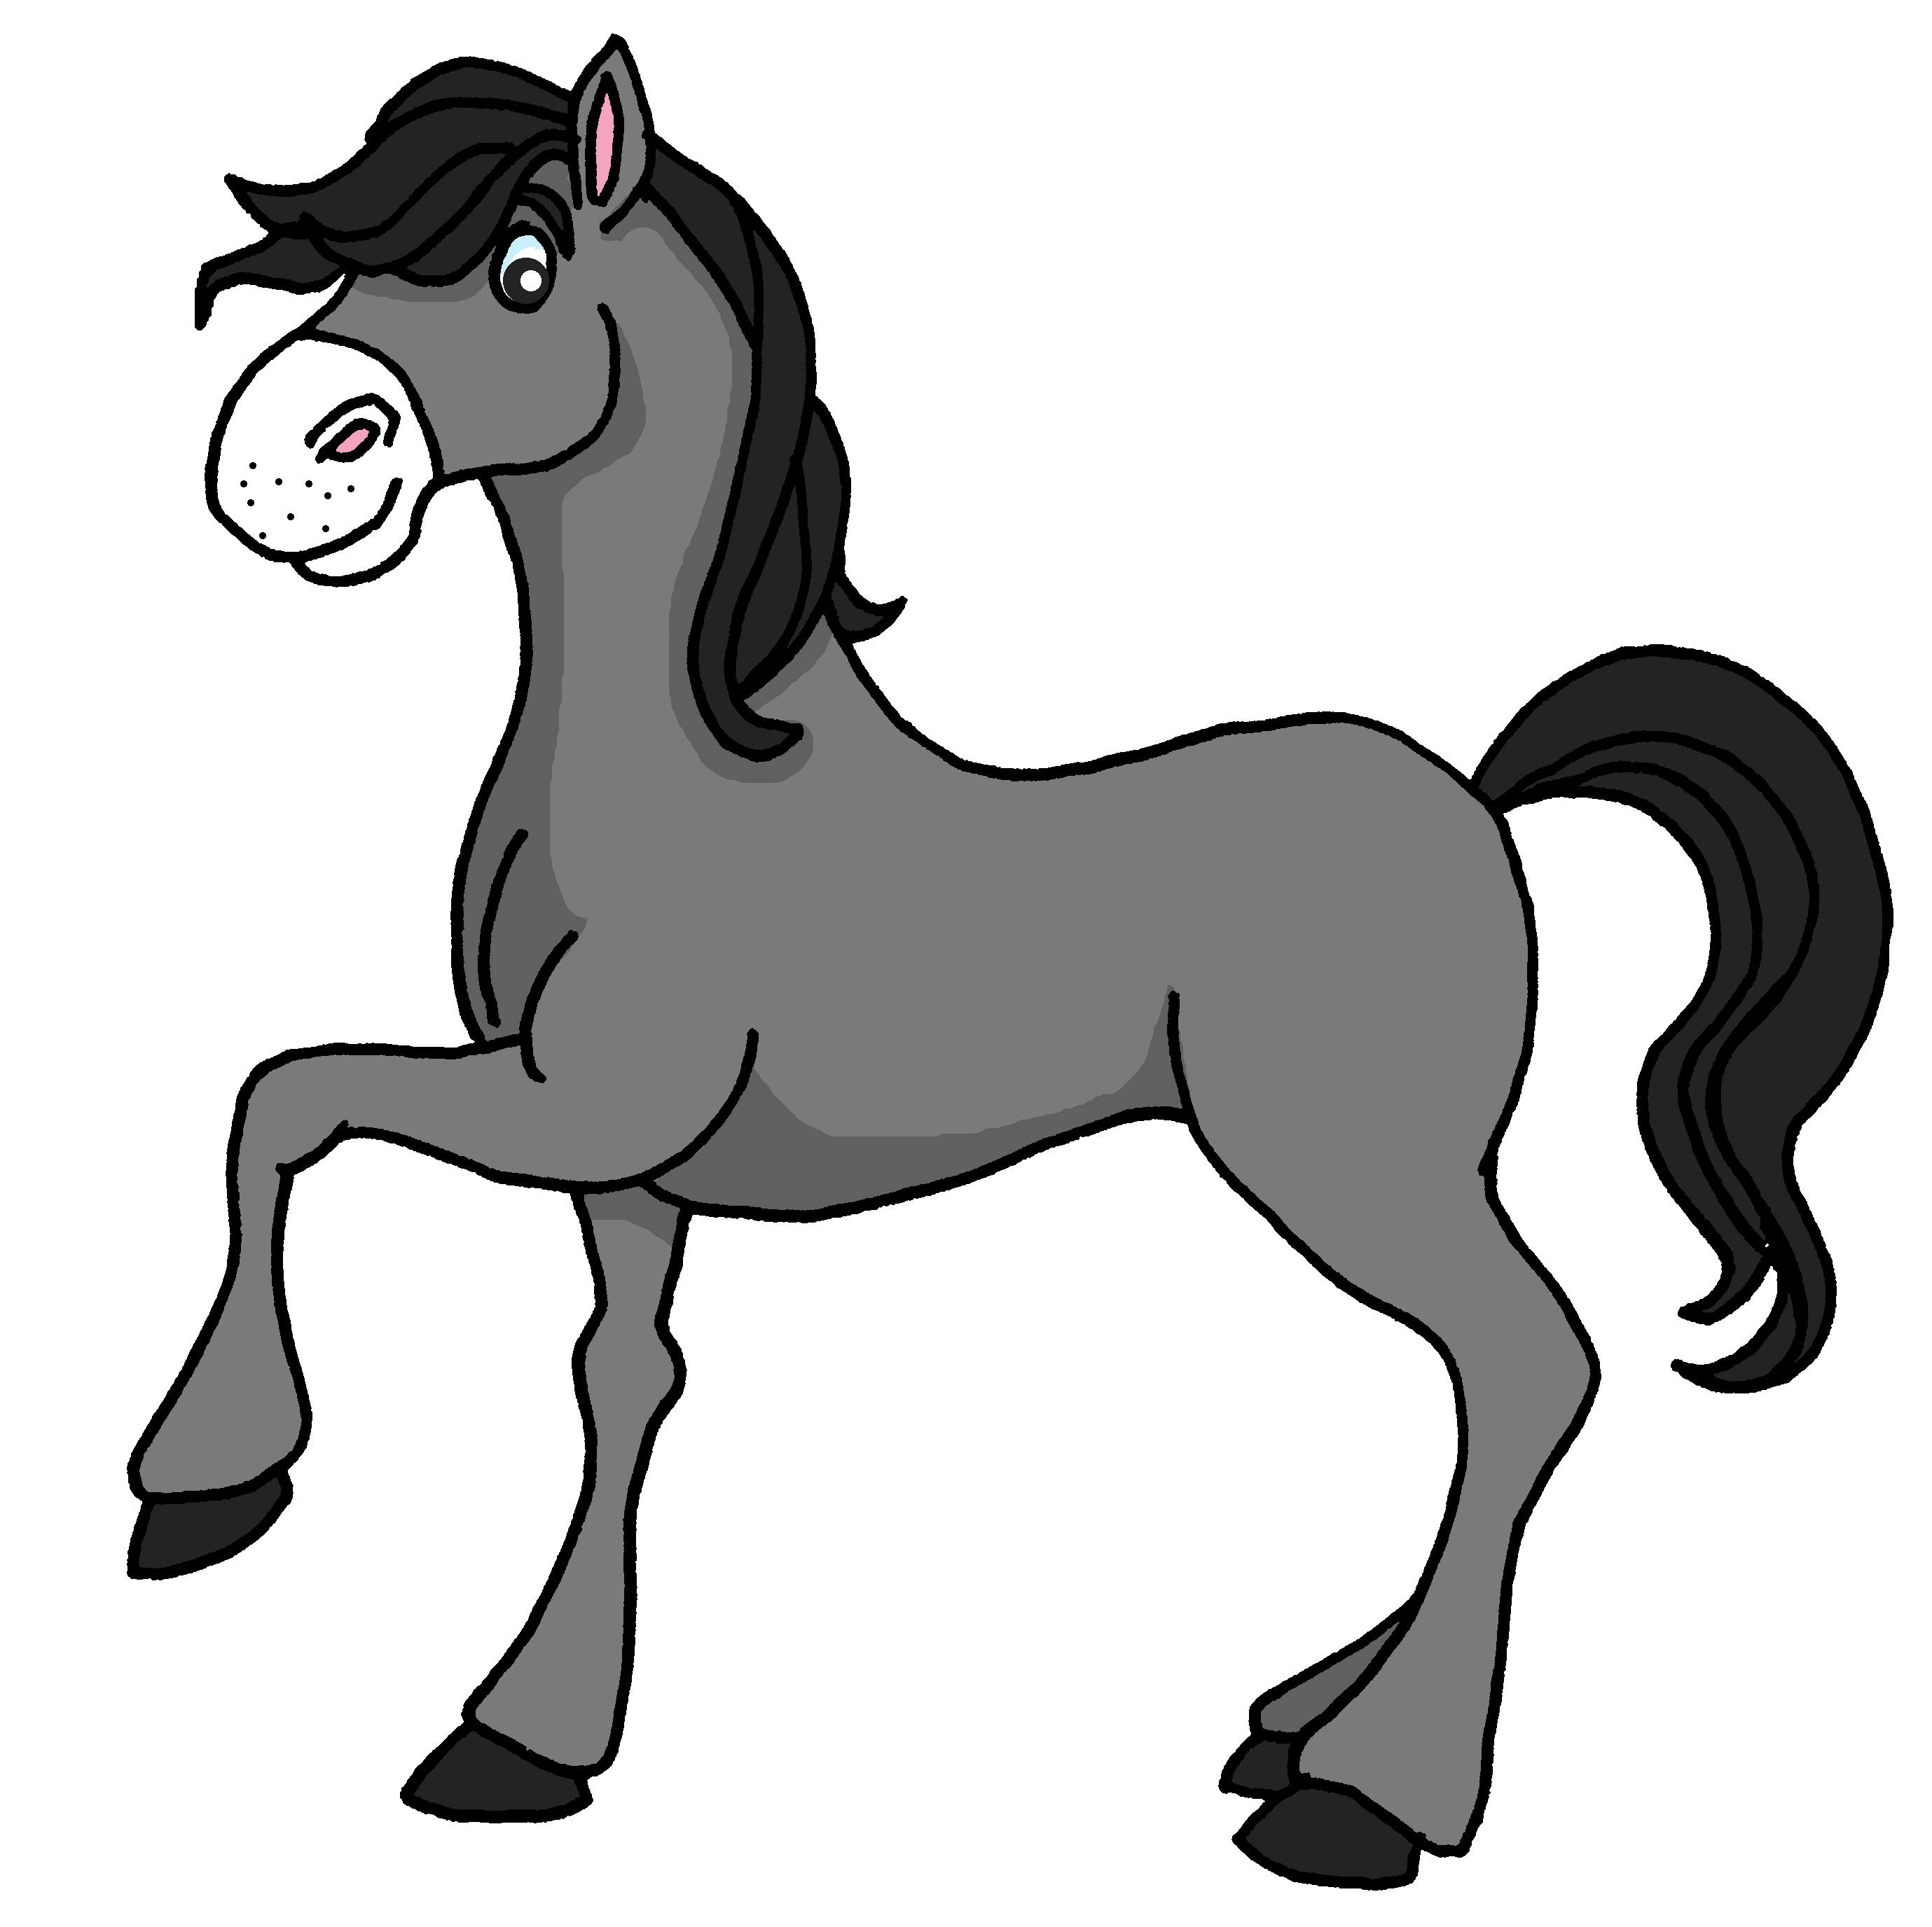
Leer y hablar
¿Cómo es?
el mensaje = message
Lee los mensajes y escribe el adjetivo correcto.
leer
Veo un caballo. Es amable pero ¡es demasiado nervioso !
rápida | nervioso
6
Notes:
[6/8]
Procedure:
Pupils read the message and work out the missing adjective from the gender of the noun it refers to.
Click on whatsapp audio icon to hear the full message, and reveal the written answer.
Teachers can elicit the English for the Whatsapp message, orally from all students.

Slide 14
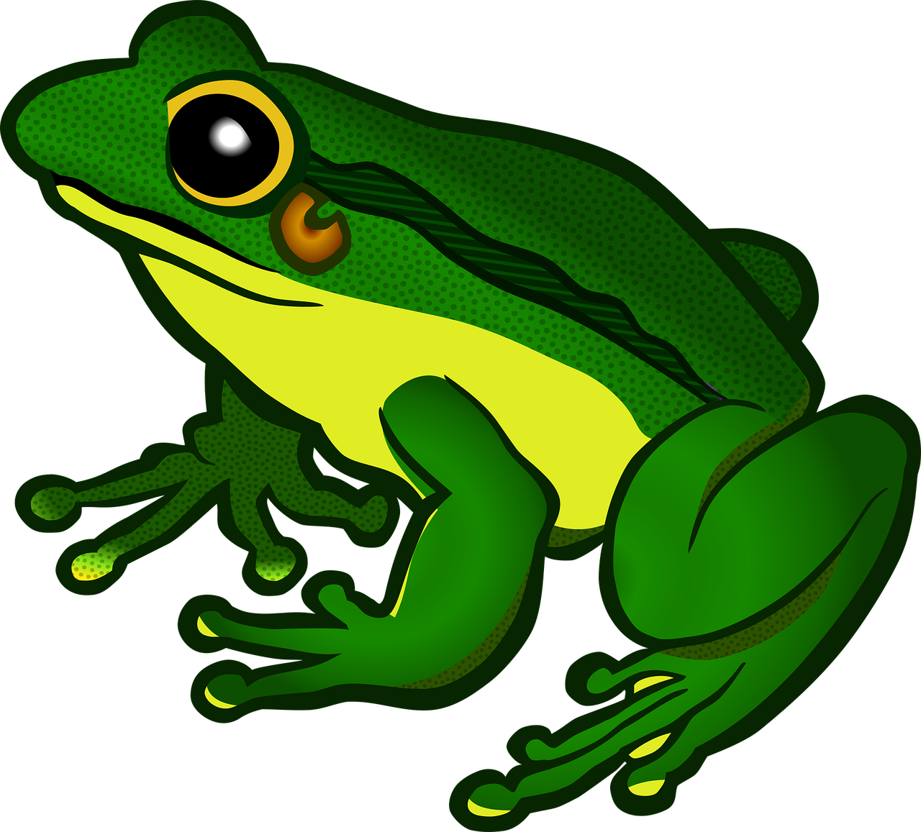
Leer y hablar
¿Cómo es?
el mensaje = message
Lee los mensajes y escribe el adjetivo correcto.
leer
Veo una rana. Es diferente pero ¡es demasiado curiosa para mí!
curiosa | pequeño
7
Notes:
[7/8]
Procedure:
Pupils read the message and work out the missing adjective from the gender of the noun it refers to.
Click on whatsapp audio icon to hear the full message, and reveal the written answer.
Teachers can elicit the English for the Whatsapp message, orally from all students.

Slide 15
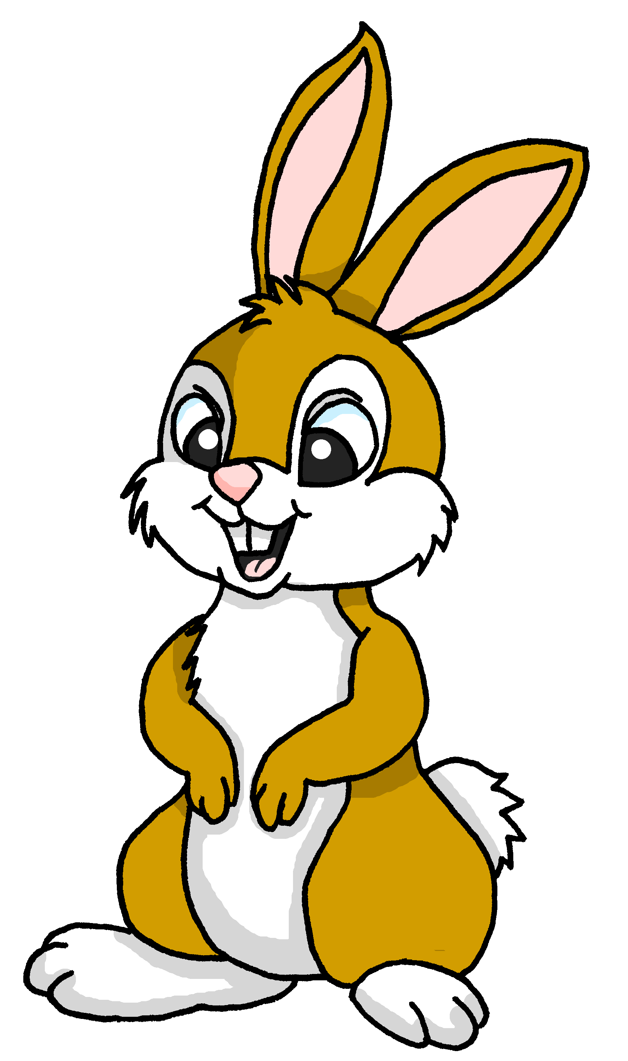
Leer y hablar
¿Cómo es?
el mensaje = message todavía = still
Lee los mensajes y escribe el adjetivo correcto.
leer
¡Hola! Estoy todavía* en el zoo. Veo un conejo. ¡Es perfecto para mí! El conejo es mi animal favorito.
perfecto | perfecta
8
Notes:
[8/8]
Procedure:
Pupils read the message and work out the missing adjective from the gender of the noun it refers to.
Click on whatsapp audio icon to hear the full message, and reveal the written answer.
Teachers can elicit the English for the Whatsapp message, orally from all students.

Slide 16
¡adiós!
rojo

