Slide 1
Describing things and people
rojo
Follow ups 1-5
Notes:
Artwork by Steve Clarke. All additional pictures selected are available under a Creative Commons license, no attribution required.
The frequency rankings for words that occur in this PowerPoint which have been previously introduced in the resources are given in the SOW (excel document) and in the resources that first introduced and formally re-visited those words.
For any other words that occur incidentally in this PowerPoint, frequency rankings will be provided in the notes field wherever possible.
SSC: [j] ojo [169] rojo [534] pájaro [1607] jueves [1650] jirafa [>5000]
Vocabulary: cielo [620] medio [395] sol [383] arriba [690] abajo [788]
Revisit 1: un [6] dos [64] tres [134] cuatro [241] cinco [284] seis [438] siete [603] ocho [641] nueve [991] diez [449] once [1701] doce [1138]
Revisit 2: cantar [717] escuchar [281] hablar [90] necesitar [276] español [262] frase [1037] inglés [583] fantástico [2501] importante [171] normal [1000]
Glossed: empezar [175] completar [2003] poema [1430] propio [183]
Source: Davies, M. & Davies, K. (2018). A frequency dictionary of Spanish: Core vocabulary for learners (2nd ed.). Routledge: London
Marta Altés, ‘El libro de Gloria Fuertes para niñas y niños’, Blackie Books. https://blackiebooks.org/catalogo/el-libro-de-gloria-fuertes-para-ninas-y-ninos/

Slide 2
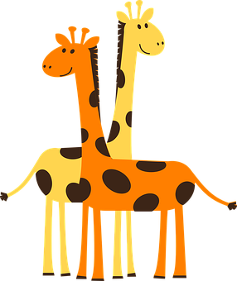
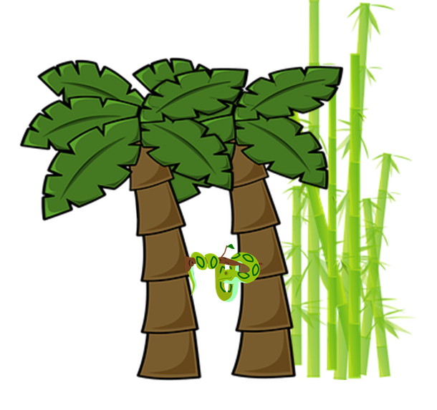
Follow up 1
[j] ojo
A Escucha. ¿Qué sonido es?
Marca
 | ja | je | ji | jo | ju
B ¡Practica la frase!
E
45 segundos
La jirafa
juega al ajedrez
con el pájaro Juanjo
en la jungla
1
[the giraffe]
2
[plays chess]
3
4
[with Juanjo the bird]
5
[in the jungle]
INICIO
Notes:
Timing: 5 minutes
Aim: to develop phonological awareness of [j]
Procedure:
1. Click to bring up the instruction.
2. Click to bring table and do example together (E).
3. Students tick and/or write the correct sound [ja] [je] [ji] [jo] [ju]
4. Click to bring up Part B and read instructions.
5. Practise as a whole class and then allow students to work in pairs.
6. In Part B, click on the pictures to hear each line.
Transcript 1 [EJ] jirafa
[1] juega
[2] ajedrez
[3] pájaro
[4] Juanjo
[5] jungla
Transcript 2
La jirafa juega al ajedrez con el pájaro Juanjo en la jungla

Slide 3
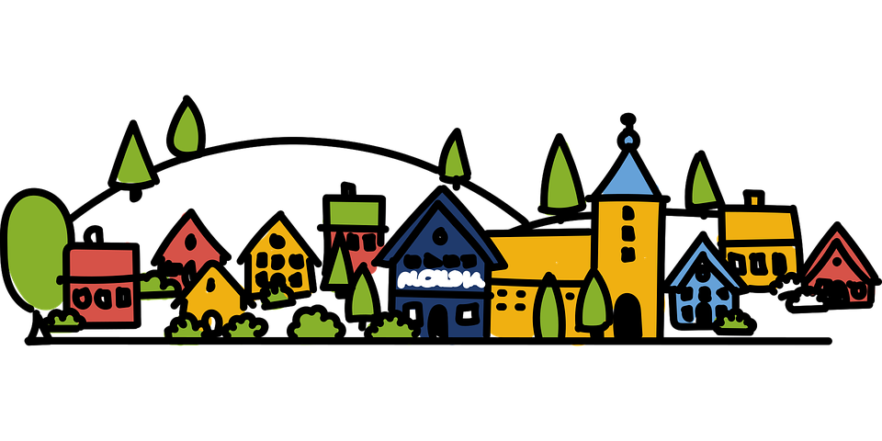
Follow up 2.1a
sol
hablar
palabras
ols
botella
tebolla
globo
boglo
[above]
mar
ram
arriba
barria
[below]
abajo
playa
baajo
yapla
cielo
locie
[middle]
regalo
medio
garelo
diome
montaña
pueblo
ñatamon
blopue
Notes:
Timing: 5 minutes (two slides – there are two levels of challenge for slide 1)
Aim: to practise key vocabulary (newly introduced this week and from previous weeks).
Procedure: [Part 1 / slide 1 and/or 2]
1. Pupils work in pairs to put the syllables in the correct order.
2. Teacher elicits answers from pupils. Answers appear on clicking the picture.
For a more challenging version see next slide.

Slide 4
Follow up 2.1b
sol
botella
hablar
palabras
_ _ _
_ _ _ _ _ _ _
globo
_ _ _ _ _
[above]
mar
_ _ _
arriba
_ _ _ _ _ _
[below]
playa
abajo
_ _ _ _ _
_ _ _ _ _
cielo
_ _ _ _ _
[middle]
medio
regalo
montaña
_ _ _ _ _
_ _ _ _ _ _
pueblo
_ _ _ _ _ _ _
_ _ _ _ _ _
Notes:
A more challenging version of Part 1
Procedure: 1. Pupils work in pairs to recall the words orally.
2. Teacher elicits Spanish words from pupils. Answers appear on clicking the picture.

Slide 5
Follow up 2.2
empieza = it starts
_ _ _
Veo veo
palabras
_ _ _ _ _
_ _ _
¿Qué ves?
[below]
[above]
_ _ _ _ _
_ _ _ _ _
_ _ _ _ _ _
Una cosita
_ _ _ _ _ _ _
¿Qué cosita es?
_ _ _ _ _
[middle]
_ _ _ _ _
¿Qué es, qué es, qué es?
_ _ _ _ _ _ _
Empieza con la letra…
_ _ _ _ _ _
_ _ _ _ _ _
Notes:
Aim: to practise key vocabulary (newly introduced this week and from previous weeks).
Procedure: [Part 2]
Tell students they need to guess the word the teacher is thinking of (s/he might write it down unseen on a mini whiteboard as part of the process)
Teacher models the game by reading the first (pink) speech bubble and pupils respond (green speech bubble).
Pupils suggest different words in Spanish (from the prompts shown on the left) until they guess the word and the teacher reveals it.
Do a couple of rounds, then pupils can work in pairs to guess each other’s word.
Note: this is the ‘I spy’ game; the meaning of the spoken routine is as follows: - Veo, veo. (I see, I see or I spy, I spy) - ¿Qué ves? (What do you see?) - Una cosita (a little thing)
- ¿Qué cosita es? (what little thing is it?)
- Empieza con la letra… (it starts with the letter…)
empezar [175] Source: Davies, M. & Davies, K. (2018). A frequency dictionary of Spanish: Core vocabulary for learners (2nd ed.). Routledge: London

Slide 6
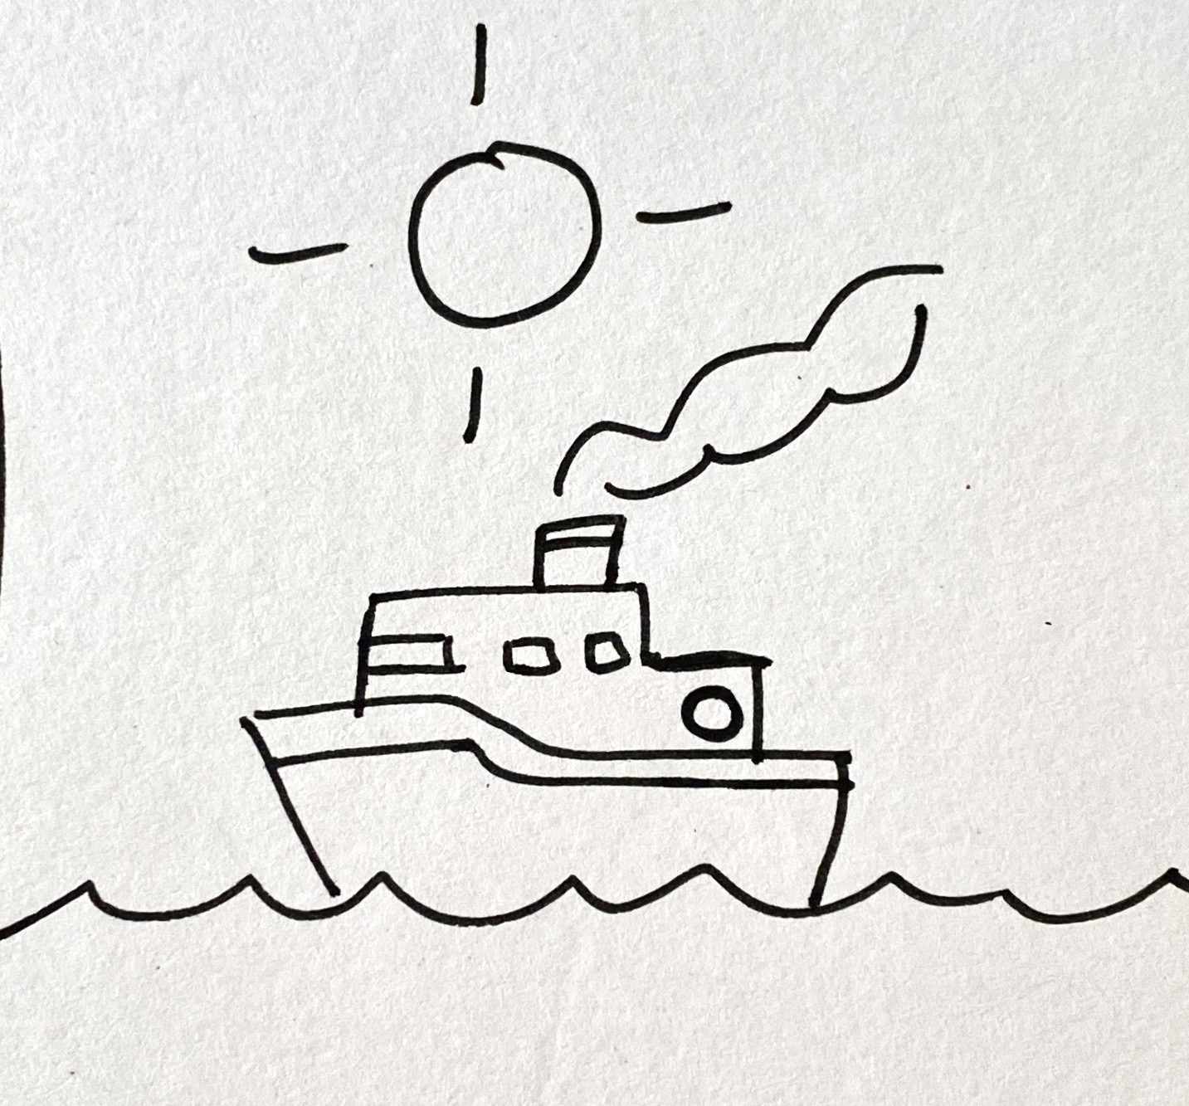
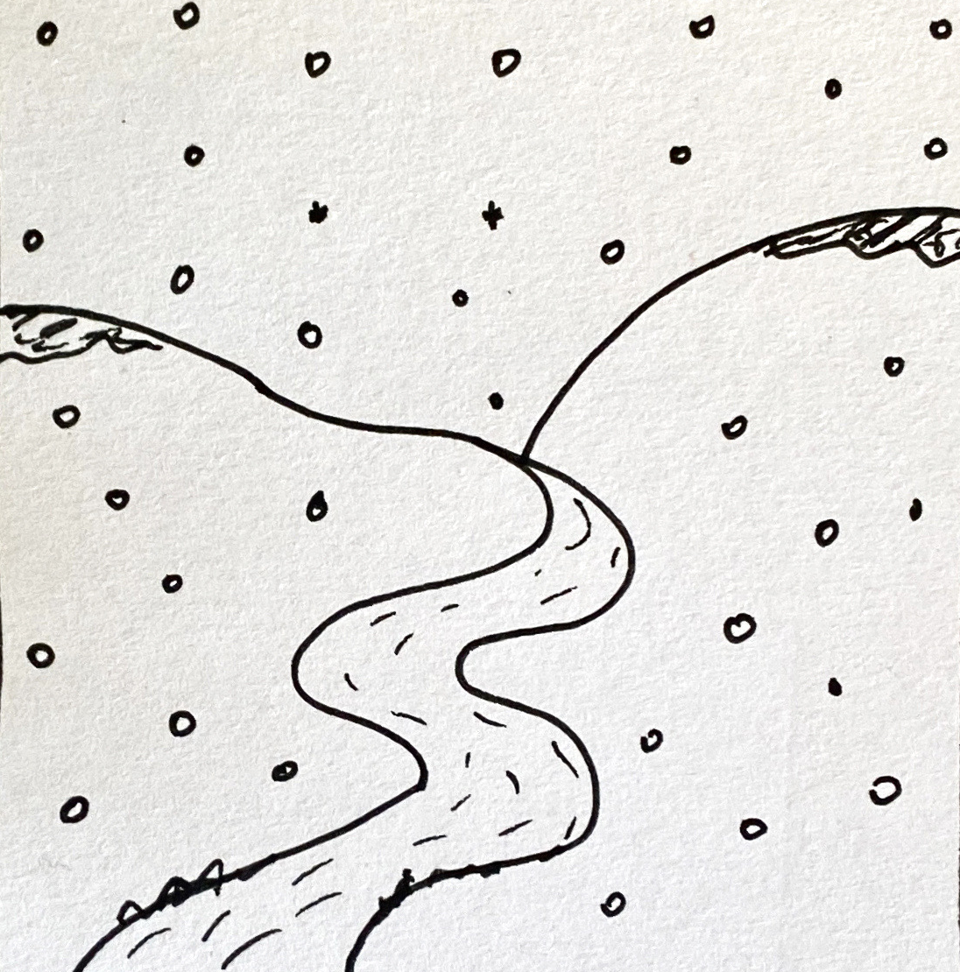
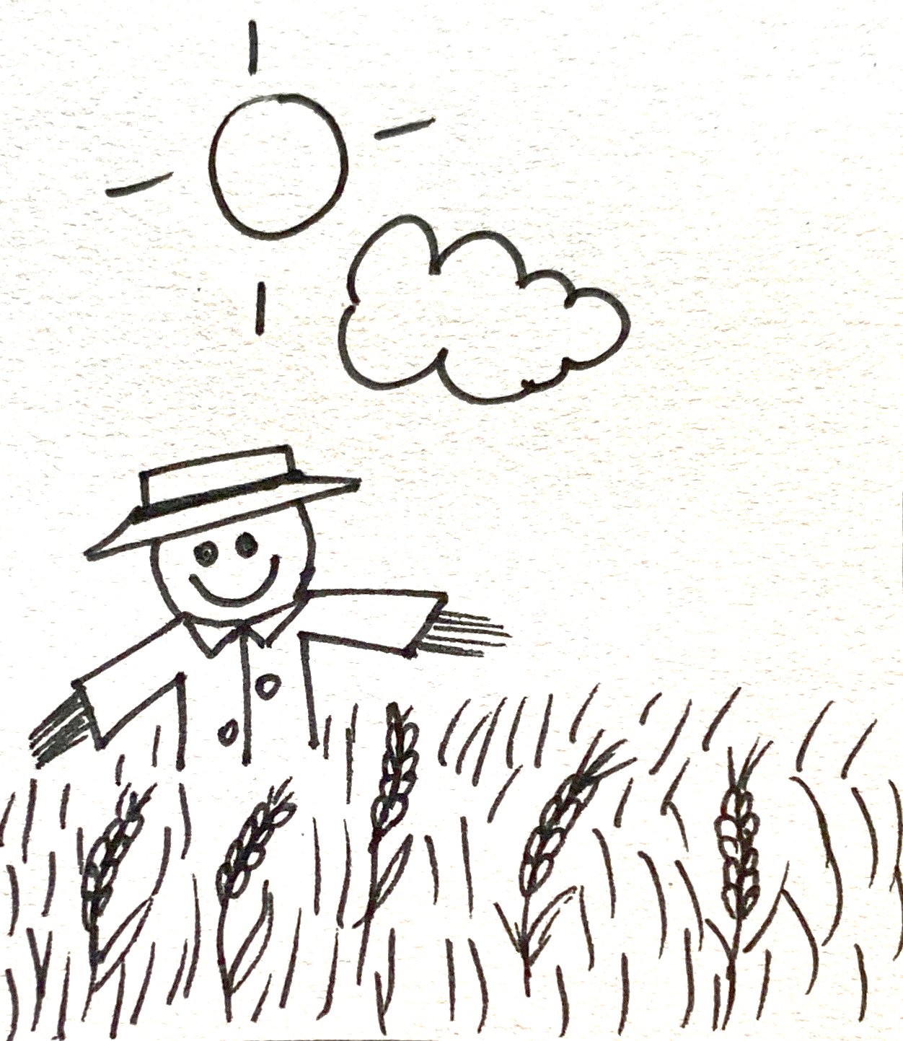
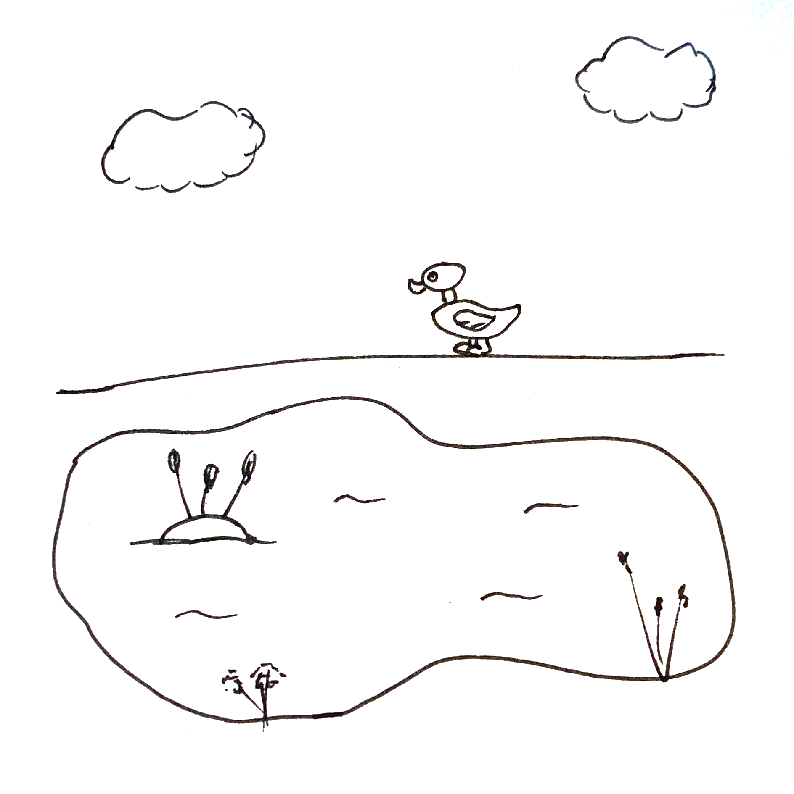
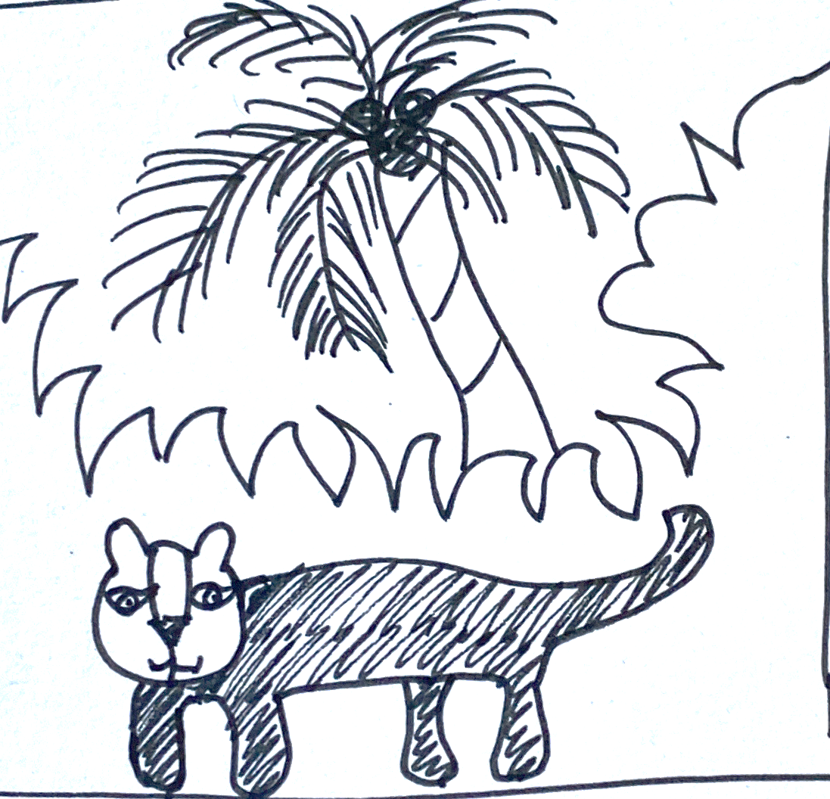
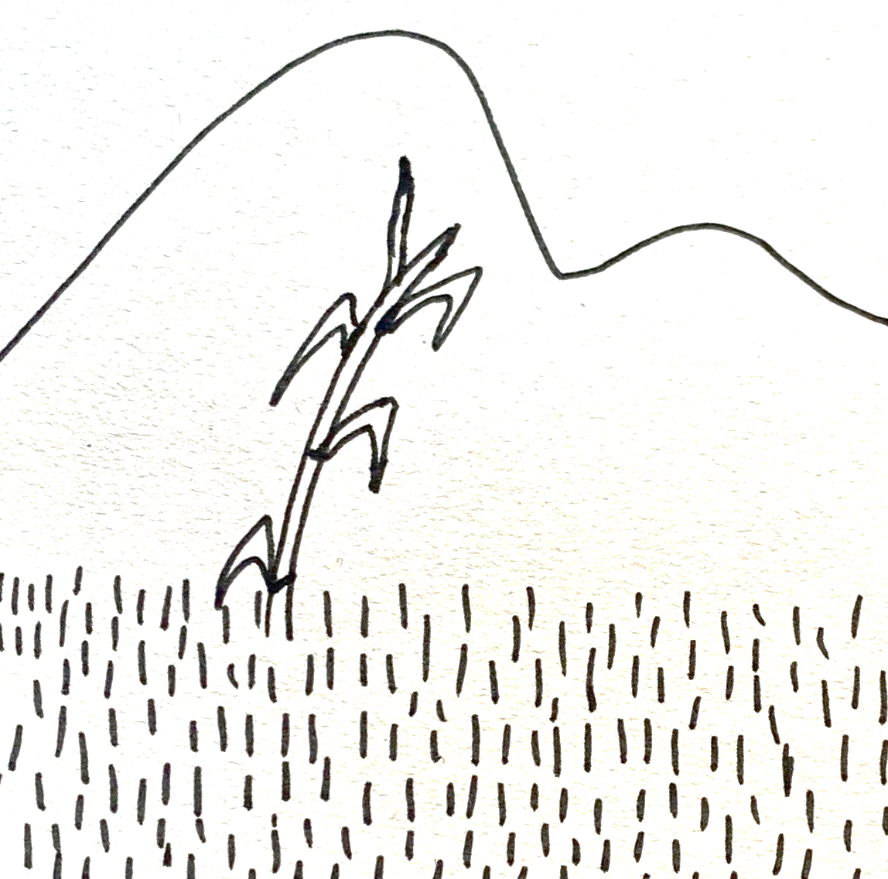
Follow up 3:
Lee: ¿Qué imagen es?
1
2
3
leer
3
a
El sol arriba,
la nube abajo,
y, en el medio, el trigo
y un espantapájaros.
4
5
6
c
El sol arriba
el mar abajo
y, en el medio,
un barco.
1
La nieve,
el frío,
y, en el medio, un río.
2
b
6
d
El prado,
la montaña,
y, en el medio, una caña.
Notes:
Timing: 5 minutes
Aim: to practise key vocabulary from this week.
Procedure: 1. Pupils read the texts and identify the pictures that match each of the four poems. (Two pictures are not needed).
2. To bring up answers, click on the pink letter next to each poem.
3. Click on the number that appears next to each poem to hear the full audio.

Slide 7
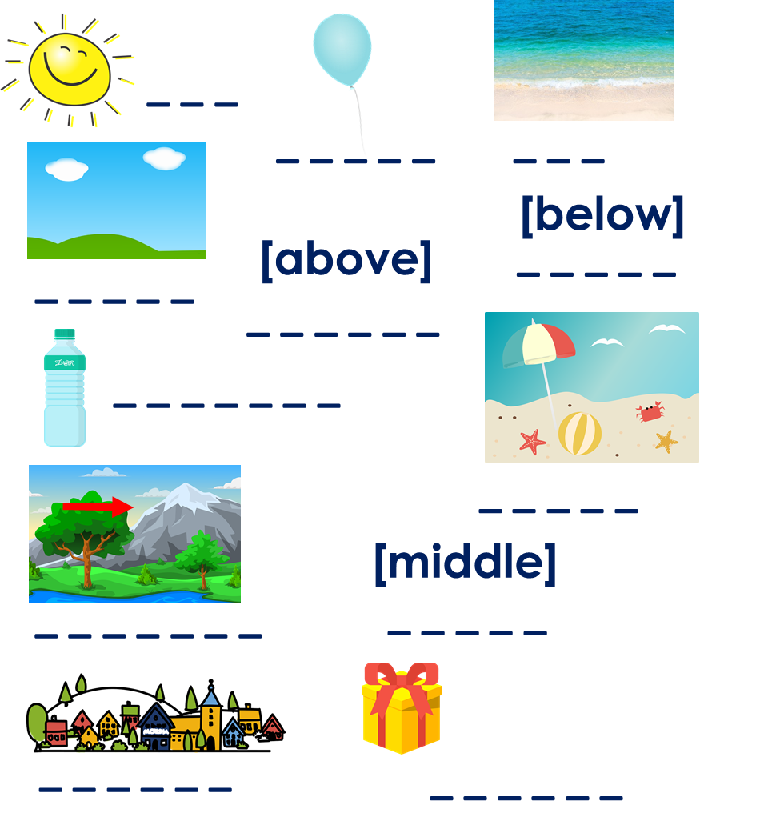
Follow up 4:
completar = to complete
(el) poema = poem
propio = own (m)
Parte 1: Completa el poema con una palabra correcta.
escribir
El _________ [position],
la _________ [position],
y, en el medio, un _________
Parte 2: Crea tu propio poema.
_________ [position],
_________ [position],
y, [position], un _________
Other masculine nouns:
sombrero, uniforme, juego, pelota, queso, globo, estuche, amigo
Other feminine nouns:
fruta, pelota, película, tarta, botella, amiga, bicicleta, cámara
Parte 3: Dibuja tu poema.
Notes:
Timing: 10 minutes
Aim: to practise supported creative writing.
Procedure:
For part 1, pupils are prompted to use nouns of a specific gender. Point at the vocabulary we are practising this week as well as the suggested masculine / feminine nouns.
For part 2, pupils can use the frame provided (or the poems used in the lessons) to write their own poem.
Pupils to draw their poem. This would make a very nice display!
completar [2003] poema [1430] propio [183]
Source: Davies, M. & Davies, K. (2018). A frequency dictionary of Spanish: Core vocabulary for learners (2nd ed.). Routledge: London

Slide 8
Follow up 5:
Escribe en español: Can you get at least 15 points?
 | fantastic (m) | important (m/f) | normal (m/f)
 | to need, needing | (the) phrase | (the) English
 | to sing, singing | to listen, listening | to speak, speaking
 | twelve | eight | nine
 | four | seven | ten
 | the middle | up, above | down, below
 | the (m, f) | the sun | the sky
fantástico
importante
normal
vocabulario
necesitar
la frase
el inglés
x3
cantar
escuchar
hablar
doce
ocho
nueve
x2
cuatro
siete
diez
el medio
una mochila
una pelota
x1
el, la
el sol
el cielo
Notes:
Timing: 6 minutes
Aim: to practise written production of vocabulary for this week and previous weeks.
Procedure:
1. Pupils need to write the Spanish for as many words as possible, aiming to get at least 15 points (but more if possible).
2. Click for Spanish answers.

Slide 9
¡adiós!
rojo

Slide 10
Handout (follow up 5)
Parte 1: Completa el poema con una palabra correcta.
Parte 1: Completa el poema con una palabra correcta.
El _________ [position],
la _________ [position],
y, en el medio, un _________
El _________ [position],
la _________ [position],
y, en el medio, un _________
Parte 2: Crea tu propio poema.
Parte 2: Crea tu propio poema.
_________ [position],
_________ [position],
y, [position], un _________
_________ [position],
_________ [position],
y, [position], un _________
Notes:
Handout

Slide 11
Follow up 5: handout
 | fantastic (m) | important (m/f) | normal (m/f)
 | to need, needing | (the) phrase | (the) English
 | to sing, singing | to listen, listening | to speak, speaking
 | twelve | eight | nine
 | four | seven | ten
 | the middle | up, above | down, below
 | the (m, f) | the sun | the sky
vocabulario
x3
x2
x1
Notes:
HANDOUT

