Slide 1
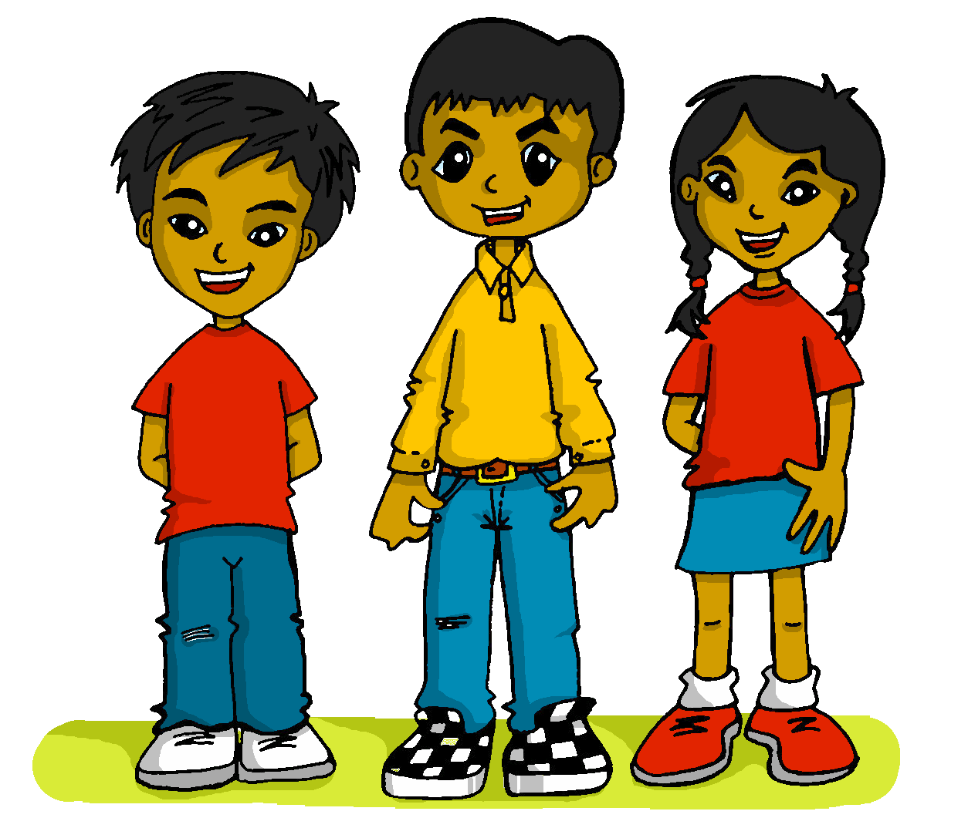
español, con Sofía
¡Felices vacaciones!

Slide 2
QUIZ
rojo
Knowledge quiz
Notes:
Artwork by Steve Clarke. All additional pictures selected are available under a Creative Commons license, no attribution required.
The frequency rankings for words that occur in this PowerPoint which have been previously introduced in the resources are given in the SOW (excel document) and in the resources that first introduced and formally re-visited those words.
For any other words that occur incidentally in this PowerPoint, frequency rankings will be provided in the notes field wherever possible.
This lesson includes an assessment of the vocabulary and grammar knowledge from the first two terms of this year’s course. There is a phonics assessment in Week 11. Note: there are no follow up activities this week, but there is an Easter activity at the end of the quiz. This could be used in a follow up slot, more than once, during this week, as appropriate. The quiz can be completed on paper with pupils writing numbered answers. Alternatively there is a word document for printing. There is an answer sheet for teachers. Alternatively, answers are provided on slides for pupils to correct their own or a partner’s.
Source: Davies, M. & Davies, K. (2018). A frequency dictionary of Spanish: Core vocabulary for learners (2nd ed.). Routledge: London

Slide 3
escuchar
Vocabulary
At home, Nina speaks Aymara, a language spoken by Aymara people of Peru and Bolivia. She is learning Spanish at school, like you. Help Nina by answering the questions in this quiz.
A For each question, put a cross (x) under the English meaning that matches what you hear.
You will hear each Spanish word twice. Choose one correct answer only.
 | A | B | C | D
1. | language | middle | Sunday | sea
 | ☐ | ☐ | ☐ | ☐
2. | to eat | bed | camera | food
 | ☐ | ☐ | ☐ | ☐
3. | short | pretty | slow | tired
 | ☐ | ☐ | ☐ | ☐
1
2
3
Notes:
Timing: 20-25 minutes (all assessment slides)
Aim: to practise aural comprehension of vocabulary taught in this year’s course.
Procedure:
1. Click the audio buttons to play each item. (The words are recorded twice with a pause to allow pupils to process the information).
2. Pupils can either write 1C, etc.. or if they have the assessment on a print out they can put a X in the correct box.
3. After items 1-3, continue to the next slide to complete the remainder of the task.
Transcript:
1. medio…..medio
2. comida…..comida
3. bajo…..bajo
4. demasiado…..demasiado
5. arriba…..arriba
6. trabajo…..trabajo

Slide 4
escuchar
Vocabulary
A For each question, put a cross (x) under the English meaning that matches what you hear.
You will hear each Spanish word twice. Choose one correct answer only.
 | A | B | C | D
4. | after(wards) | fun, funny | two | too (much)
 | ☐ | ☐ | ☐ | ☐
5. | nice, friendly | up, above | year | down, below
 | ☐ | ☐ | ☐ | ☐
6. | too, also | your | work | text
 | ☐ | ☐ | ☐ | ☐
4
5
6
Notes:
[Continued]
Transcript:
1. medio…..medio
2. comida…..comida
3. bajo…..bajo
4. demasiado…..demasiado
5. arriba…..arriba
6. trabajo…..trabajo

Slide 5
escuchar
Vocabulary
B For each question, put a cross (x) under the type of word you hear. You will hear each Spanish word twice. Choose one correct answer only.
This word is a good example of …
 | A | B | C | D
Ej. | an object ☐ | a mood or character ☐ | an activity ☐ | a number ☐
1. | a question ☐ | a day of the week ☐ | a person ☐ | a location ☐
2. | a number ☐ | a location ☐ | a question ☐ | an object ☐
3. | a mood or character ☐ | a question ☐ | a number ☐ | an activity ☐
4. | a person ☐ | a feeling or state ☐ | an object ☐ | a location ☐
 | a number ☐ | a person ☐ | an activity ☐ | a feeling or state ☐
1
2
3
4
5
6
Notes:
Procedure:
1. Click the audio buttons to play each item. (The words are recorded twice with a pause to allow pupils to process the information).
2. Pupils can either write 1C, etc.. or if they have the assessment on a print out they can put a X in the correct box.
3. When complete, continue to the next task.
Transcript:
amable…..amable
profesor…..profesor
abajo…..abajo
cómo…..cómo
familiar…..familiar
tengo sed…..tengo sed

Slide 6
escuchar
Grammar
C Put a cross (x) next to the person or people that the sentence is about. You will hear each Spanish sentence twice.
1. | I | ☐ | you | ☐ | he/she | ☐
2. | I | ☐ | you | ☐ | he/she | ☐
3. | I | ☐ | you | ☐ | he/she | ☐
4. | I | ☐ | you | ☐ | he/she | ☐
5. | I | ☐ | you | ☐ | he/she | ☐
 | I | ☐ | you | ☐ | he/she | ☐
1
2
3
4
5
6
Notes:
Procedure:
1. Click the audio buttons to play each item. (The words are recorded twice with a pause to allow pupils to process the information).
2. Pupils can either write 1C, etc.. or if they have the assessment on a print out they can put a X in the correct box.
3. When complete, continue to the reading.
Transcript:
1. Escucho a la profesora.
2. Practica el deporte.
3. Visitas a tu abuelo.
4. Aprendes inglés.
5. Estoy en la montaña.
6. Camina por la mañana.

Slide 7
leer
A Translate the underlined Spanish word to complete each English sentence.
1. ¿Llevas un sombrero? Are you _____________ a hat?
2. Prepara tu mochila. S/he ___ ______________ _________ bag.
3. Jugar es fantástico. _______________is fantastic.
4. Hay siete bolígrafos. _________ _________ __________ pens.
5. Veo el cielo y es azul. I see the _________ and it is __________.
6. Tiene razón. S/he is _____________ .
7. Estás muy divertido hoy. You are _________ __________today.
8. Odio el gris. I ____________ __________.
9. ¡Buenas tardes, profe! __________ _____________, Sir/Miss!
10. Después, cuido a mi perro. __________, I________________ my dog.
Notes:
Aim: to practise written recall of previously taught vocabulary.
Procedure:
Ensure that the task is clear.
Pupils could write 1 – 10 and the individual English word meanings (or they could fill in if they have printed assessment sheets).

Slide 8
escribir
B Translate the underlined English words to complete the Spanish sentence.
1. I understand Spanish. Comprendo el ______________. (write one word)
2. You are from Spain. Eres _____ _______________. (write two words)
3. I play the guitar. Toco _____ _______________. (write two words)
4. I watch a film. Veo una _____________. (write one word)
5. I am hungry, too. Tengo __________, ___________. (write two words)
6. It is my favourite song. Es ______ ____________ favorita. (write two words)
7. There are ten phrases. Hay ________ frases. (write one word)
8. I love the sun. Amo _____ ______ . (write two words)
9. Participating is important. _____________ es importante. (write one word)
10. It is tall and yellow. Es __________ _____ amarillo. (write two words)
Total marks available for vocabulary: 38
Notes:
Aim: to practise written production of previously taught vocabulary.
Procedure:
Ensure that the task is clear.
Pupils could write 1 – 10 and the individual English word meanings (or they could fill in if they have printed assessment sheets).

Slide 9
leer
Grammar
Aymara grammar is very different from Spanish. Help Nina with her Spanish grammar by answering the questions in this part of the quiz.
A
i) Put a [X] next to the person each sentence refers to. ii) Write the Spanish pronoun for I or you or he, she for each sentence, too.
Pronoun
Pronoun
1 | ☐ I ☐ you _{[singular]} ☐ she, he, it | Compra una silla. |  |  | 4 | ☐ I ☐ you _{[singular]} ☐ she, he, it | Lee un libro.
2 | ☐ I ☐ you _{[singular]} ☐ she, he, it | Paso el sábado con mi amiga. |  |  | 5 | ☐ I ☐ you _{[singular]} ☐ she, he, it | Comes una tarta.
3 | ☐ I ☐ you _{[singular]} ☐ she, he, it | Tienes una bicicleta amarilla. |  |  | 6 | ☐ I ☐ you _{[singular]} ☐ she, he, it | Soy importante.
Notes:
Aim: to practise written recall of previously taught grammar.
Procedure:
Ensure that the task is clear.
Pupils could write the correct English pronouns (or they could fill in if they have printed assessment sheets).

Slide 10
leer
Grammar
B Put a (X) next to the word that completes the sentence.
1. | _________ una tortuga en clase. There is a tortoise in class. | ☐ hay | ☐ es | ☐ está | ☐ tiene
2. | El niño _________ diferente hoy. The boy is different today. | ☐ hay | ☐ es | ☐ está | ☐ tiene
3. | _________ once años. He is eleven years old. | ☐ hay | ☐ es | ☐ está | ☐ tiene
4. | El conejo __________ un animal inteligente. The rabbit is an intelligent animal. | ☐ hay | ☐ es | ☐ está | ☐ tiene

Slide 11
leer
Grammar
C Write the words in each box in the correct order.
1. | grupo un rápido | Correct order:_________________________________________
2. | mañana fantástica una | Correct order:_________________________________________
D Put a (X) next to the words that could finish this sentence. Remember the personal ‘a’.
1. Enseña a... | a) la información. | ☐
 | b) la niña. | ☐
2. Amo... | a) mi abuela. | ☐
 | b) la playa. | ☐
Notes:
Aim: to practise written recall of previously taught grammar.
Procedure:
Ensure that the task is clear.
Pupils could write the correct English pronouns (or they could fill in if they have printed assessment sheets).

Slide 12
escribir
E Write the Spanish word for ‘a’ or ‘some’. 1. _______ estuche (m) 2. _______ fruta (f) 3. _______ teléfonos (mpl) 4. _______ botellas (fpl)
F Write the Spanish word for ‘the’.
1. ________ semana. (f) 2. ________ idioma. (m) 3. ¿ ________ mamás? (fpl) 4. ¿ ________ pueblos? (mpl)
Total marks available for grammar: 28
Notes:
Aim: to practise written production of previously taught grammar
Procedure:
Ensure that the task is clear.
Pupils could write the answers only (or they could fill in if they have printed assessment sheets).

Slide 13
¡adiós!
rojo

Slide 14
escuchar
Vocabulary
At home, Nina speaks Aymara, a language spoken by Aymara people of Peru and Bolivia. She is learning Spanish at school, like you. Help Nina by answering the questions in this quiz.
A For each question, put a cross (x) under the English meaning that matches what you hear.
You will hear each Spanish word twice. Choose one correct answer only.
 | A | B | C | D
1. | language | middle | Sunday | sea
 | ☐ | ☐ | ☐ | ☐
2. | to eat | bed | camera | food
 | ☐ | ☐ | ☐ | ☐
3. | short | pretty | slow | tired
 | ☐ | ☐ | ☐ | ☐
1
2
3
Notes:
Timing: 20-25 minutes (all assessment slides)
Aim: to practise aural comprehension of vocabulary taught in this year’s course.
Procedure:
1. Click the audio buttons to play each item. (The words are recorded twice with a pause to allow pupils to process the information).
2. Pupils can either write 1C, etc.. or if they have the assessment on a print out they can put a X in the correct box.
3. After items 1-3, continue to the next slide to complete the remainder of the task.
Transcript:
1. medio…..medio
2. comida…..comida
3. bajo…..bajo
4. demasiado…..demasiado
5. arriba…..arriba
6. trabajo…..trabajo

Slide 15
escuchar
Vocabulary
A For each question, put a cross (x) under the English meaning that matches what you hear.
You will hear each Spanish word twice. Choose one correct answer only.
 | A | B | C | D
4. | after(wards) | fun, funny | two | too (much)
 | ☐ | ☐ | ☐ | ☐
5. | nice, friendly | up, above | year | down, below
 | ☐ | ☐ | ☐ | ☐
6. | too, also | your | work | text
 | ☐ | ☐ | ☐ | ☐
4
5
6
Notes:
[Continued]
Transcript:
1. medio…..medio
2. comida…..comida
3. bajo…..bajo
4. demasiado…..demasiado
5. arriba…..arriba
6. trabajo…..trabajo

Slide 16
escuchar
Vocabulary
B For each question, put a cross (x) under the type of word you hear. You will hear each Spanish word twice. Choose one correct answer only.
This word is a good example of …
 | A | B | C | D
Ej. | an object ☐ | a mood or character ☐ | an activity ☐ | a number ☐
1. | a question ☐ | a day of the week ☐ | a person ☐ | a location ☐
2. | a number ☐ | a location ☐ | a question ☐ | an object ☐
3. | a mood or character ☐ | a question ☐ | a number ☐ | an activity ☐
4. | a person ☐ | a feeling or state ☐ | an object ☐ | a location ☐
 | a number ☐ | a person ☐ | an activity ☐ | a feeling or state ☐
1
2
3
4
5
6
Notes:
Procedure:
1. Click the audio buttons to play each item. (The words are recorded twice with a pause to allow pupils to process the information).
2. Pupils can either write 1C, etc.. or if they have the assessment on a print out they can put a X in the correct box.
3. When complete, continue to the next task.
Transcript:
amable…..amable
profesor…..profesor
abajo…..abajo
cómo…..cómo
familiar…..familiar
tengo sed…..tengo sed

Slide 17
escuchar
Grammar
C Put a cross (x) next to the person or people that the sentence is about. You will hear each Spanish sentence twice.
1. | I | ☐ | you | ☐ | he/she | ☐
2. | I | ☐ | you | ☐ | he/she | ☐
3. | I | ☐ | you | ☐ | he/she | ☐
4. | I | ☐ | you | ☐ | he/she | ☐
5. | I | ☐ | you | ☐ | he/she | ☐
 | I | ☐ | you | ☐ | he/she | ☐
1
2
3
4
5
6
Notes:
Procedure:
1. Click the audio buttons to play each item. (The words are recorded twice with a pause to allow pupils to process the information).
2. Pupils can either write 1C, etc.. or if they have the assessment on a print out they can put a X in the correct box.
3. When complete, continue to the reading.
Transcript:
1. Escucho a la profesora.
2. Practica el deporte.
3. Visitas a tu abuelo.
4. Aprendes inglés.
5. Estoy en la montaña.
6. Camina por la mañana.

Slide 18
leer
A Translate the underlined Spanish word to complete each English sentence.
1. ¿Llevas un sombrero? Are you _____________ a hat?
2. Prepara tu mochila. S/he ___ ______________ _________ bag.
3. Jugar es fantástico. _______________is fantastic.
4. Hay siete bolígrafos. _________ _________ __________ pens.
5. Veo el cielo y es azul. I see the _________ and it is __________.
6. Tiene razón. S/he is _____________ .
7. Estás muy divertido hoy. You are _________ __________today.
8. Odio el gris. I ____________ __________.
9. ¡Buenas tardes, profe! __________ _____________, Sir/Miss!
10. Después, cuido a mi perro. __________, I________________ my dog.
wearing
(taking, carrying)
is preparing your
Playing
There are seven
sky
blue
right
very fun, funny
hate grey
Good afternoon
After(wards)
look after
Notes:
Aim: to practise written recall of previously taught vocabulary.
Procedure:
Ensure that the task is clear.
Pupils could write 1 – 10 and the individual English word meanings (or they could fill in if they have printed assessment sheets).

Slide 19
escribir
B Translate the underlined English words to complete the Spanish sentence.
1. I understand Spanish. Comprendo el ______________. (write one word)
2. You are from Spain. Eres _____ _______________. (write two words)
3. I play the guitar. Toco _____ _______________. (write two words)
4. I watch a film. Veo una _____________. (write one word)
5. I am hungry, too. Tengo __________, ___________. (write two words)
6. It is my favourite song. Es ______ ____________ favorita. (write two words)
7. There are ten phrases. Hay ________ frases. (write one word)
8. I love the sun. Amo _____ ______ . (write two words)
9. Participating is important. _____________ es importante. (write one word)
10. It is tall and yellow. Es __________ _____ amarillo. (write two words)
español
de España
la guitarra
película
hambre, también
mi canción
diez
el sol
Participar
alto y
Total marks available for vocabulary: 38
Notes:
Aim: to practise written production of previously taught vocabulary.
Procedure:
Ensure that the task is clear.
Pupils could write 1 – 10 and the individual English word meanings (or they could fill in if they have printed assessment sheets).

Slide 20
leer
Grammar
Aymara grammar is very different from Spanish. Help Nina with her Spanish grammar by answering the questions in this part of the quiz.
A
i) Put a [X] next to the person each sentence refers to. ii) Write the Spanish pronoun for I or you or he, she for each sentence, too.
Pronoun
Pronoun
1 | ☐ I ☐ you _{[singular]} ☐ she, he, it | Compra una silla. |  |  | 4 | ☐ I ☐ you _{[singular]} ☐ she, he, it | Lee un libro.
2 | ☐ I ☐ you _{[singular]} ☐ she, he, it | Paso el sábado con mi amiga. |  |  | 5 | ☐ I ☐ you _{[singular]} ☐ she, he, it | Comes una tarta.
3 | ☐ I ☐ you _{[singular]} ☐ she, he, it | Tienes una bicicleta amarilla. |  |  | 6 | ☐ I ☐ you _{[singular]} ☐ she, he, it | Soy importante.
Notes:
Aim: to practise written recall of previously taught grammar.
Procedure:
Ensure that the task is clear.
Pupils could write the correct English pronouns (or they could fill in if they have printed assessment sheets).

Slide 21
leer
Grammar
B Put a (X) next to the word that completes the sentence.
1. | _________ una tortuga en clase. There is a tortoise in class. | ☐ hay | ☐ es | ☐ está | ☐ tiene
2. | El niño _________ diferente hoy. The boy is different today. | ☐ hay | ☐ es | ☐ está | ☐ tiene
3. | _________ once años. He is eleven years old. | ☐ hay | ☐ es | ☐ está | ☐ tiene
4. | El conejo __________ un animal inteligente. The rabbit is an intelligent animal. | ☐ hay | ☐ es | ☐ está | ☐ tiene

Slide 22
leer
Grammar
C Write the words in each box in the correct order.
1. | grupo un rápido | Correct order:_________________________________________
2. | mañana fantástica una | Correct order:_________________________________________
un grupo rápido
una mañana fantástica
D Put a (X) next to the words that could finish this sentence. Remember the personal ‘a’.
1. Enseña a... | a) la información. | ☐
 | b) la niña. | ☐
2. Amo... | a) mi abuela. | ☐
 | b) la playa. | ☐
Notes:
Aim: to practise written recall of previously taught grammar.
Procedure:
Ensure that the task is clear.
Pupils could write the correct English pronouns (or they could fill in if they have printed assessment sheets).

Slide 23
escribir
E Write the Spanish word for ‘a’ or ‘some’. 1. _______ estuche (m) 2. _______ fruta (f) 3. _______ teléfonos (mpl) 4. _______ botellas (fpl)
F Write the Spanish word for ‘the’.
1. ________ semana. (f) 2. ________ idioma. (m) 3. ¿ ________ mamás? (fpl) 4. ¿ ________ pueblos? (mpl)
un
una
unos
unas
la
el
las
los
Total marks available for grammar: 28
Notes:
Aim: to practise written production of previously taught grammar
Procedure:
Ensure that the task is clear.
Pupils could write the answers only (or they could fill in if they have printed assessment sheets).

