Slide 1
Saying how many and describing things
rojo
Follow ups 1-5
Notes:
Artwork by Steve Clarke. All additional pictures selected are available under a Creative Commons license, no attribution required.
The frequency rankings for words that occur in this PowerPoint which have been previously introduced in the resources are given in the SOW (excel document) and in the resources that first introduced and formally re-visited those words.
For any other words that occur incidentally in this PowerPoint, frequency rankings will be provided in the notes field wherever possible.
Phonics: Revisit SSC [qui] [que] [ce] [ci]
Vocabulary: hay [haber 13] unos [6] unas [6] cuántos [580] cuántas [580]
Revisit 1: aprender [428] leer [209] ver [38] deporte [1489] idioma [1159] juego [409] de² [2]
Revisit 2: tienes [19] botella [1878] estuche [>5000] libro [230] pregunta [507] respuesta [488] sacapuntas [>5000]
Source: Davies, M. & Davies, K. (2018). A frequency dictionary of Spanish: Core vocabulary for learners (2nd ed.). Routledge: London

Slide 2
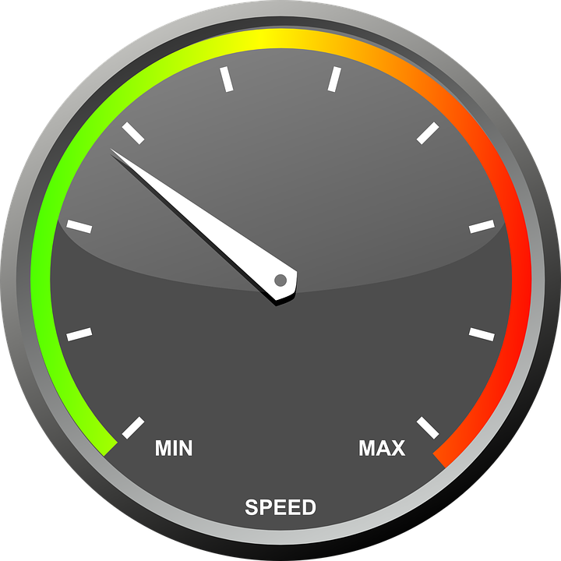
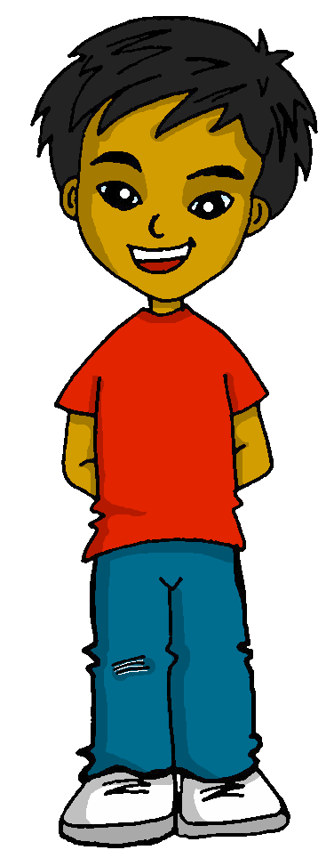
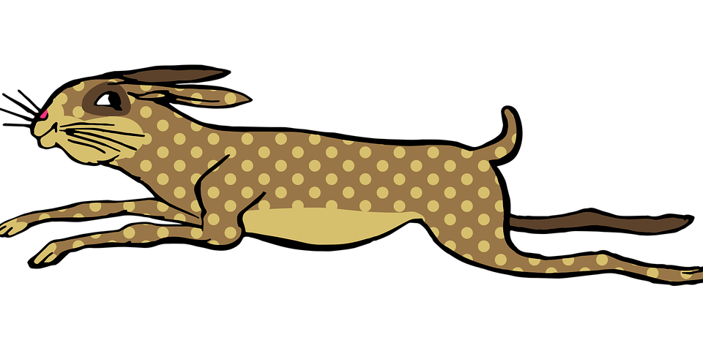
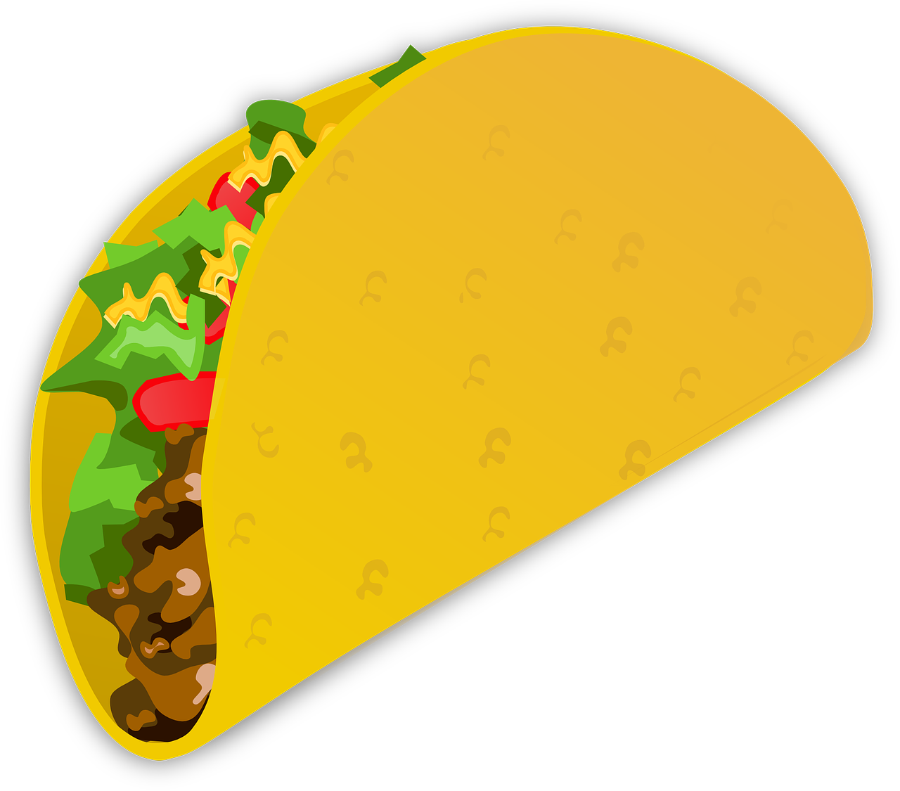
Follow up 1
[que] [qui]
A Escucha las palabras y clasifica.
B Practica el trabalenguas.
pronunciar
E
1
2
3
Lento
Quique quiere cinco quesos y quince taquitos chiquitos.
4
5
¡Escribe la palabra!
Normal
Quique quiere cinco quesos y quince taquitos chiquitos.
[que] | [qui] | [ce] [ci]
tanque
1
cinco
2
Quito
E
Rápido
Quique quiere cinco quesos y quince taquitos chiquitos.
4
bosque
3
once
Arequipa
5
Quique wants five cheeses and fifteen tiny tacos.
Arequipa
___________ es una ciudad* de Perú.
Quito
______ es la capital* de Ecuador.
la ciudad = city | la capital = capital
Notes:
Timing: 5 min.
Aim: to practise listening out [que] [qui] in contrast with [ce] [ci]; to apply SSC [que] [qui] to read a tongue twister with unknown words.
Procedure:
Part A
Pupils write [que] [qui] & [ce] [ci] in their books
Teacher plays click on the individual play buttons (E-5) and pupils write down the number in the column that corresponds with the correct SSC they have heard. Encourage pupils to write the entire word if they feel confident.
Click to bring up answers. Ask pupils to produce SSC for each number. Número 1, ¿qué sonido es? ¿qué palabra es?
Click to bring up further info.
Part B
Encourage pupils to practise the tongue twister in pairs, at different speeds.
Click on the pictures to hear the tongue twister at different speeds.
Transcript 1:
Ej. Quito
Tanque
cinco
Arequipa
bosque
once
Transcript 2:
Quique quiere cinco quesos y quince taquitos chiquitos.

Slide 3
Follow up 2:
Sofía has mixed up all her flashcards.
Ordena el vocabulario de Sofía.
palabras
leer
⚠ ‘idioma’ is a masculine noun
__ uniformes some unirforms
00
00
unos
__ sombreros some hats
___ caballos some horses
unas
00
___ películas some films
00
__ clases some classes
00
00
__ bicicletas some bicycles
00
__ teléfonos
some phones
00
__ idiomas some languages
00
___ playas
some beaches
Notes:
Timing: 3 minutes
Aim: to practise connecting and producing (orally) plural indefinite articles with previously taught nouns.
Procedure: 1. Pupils either work in pairs or chorally as a class, reading the Spanish words out loud, including the correct article.
2. Click to start the animation sequence.
3. Pupils call out the Spanish (e.g. unos uniformes) before the flashcard appears on the desk.
Note: Each flashcard animation sequence is started on a mouse click.

Slide 4
Follow up 3a
leer
[A] Lee las sumas y escribe el resultado.
 | La suma | El resultado ✍
 | dos + cinco
 | cuatro + seis
 | uno + siete
 | nueve + tres
 | once - dos
 | ocho + cuatro
E
siete
1
diez
2
ocho
3
doce
4
nueve
5
doce
la suma = sum más = plus menos = minus igual a = equals
Notes:
Timing: 5 minutes
Aim: to practise written comprehension and production of numbers 1-12.
Procedure:
Clarify Spanish instruction.
Model the example [E] with pupils.
Pupils to write the totals in words for sums 1-5
Click on the audio buttons to hear the full sums spoken and click to reveal written answers.
Transcript: Ejemplo: dos más cinco igual a siete.
1. cuatro más seis igual a diez. 2. uno más siete igual a ocho. 3. nueve más tres igual a doce. 4. once menos dos igual a nueve. 5. ocho más cuatro igual a doce.

Slide 5
Follow up 3b
[B] Continúa la serie.
hablar
 | 1, 2, 3, 4, 5, ___ ___ ___ ___
 | 10, 9, 8, 7, ___ ___ ___ ___
 | 2, 1, 3, 1, 4, 1 ___ ___ ___ ___ ___ ___
 | 2, ___, 6, ___, 10
 | 12, 11, 10, ___ ___ ___ ___
 | 1, 3, 5, ___ ___ ___
 | 11, 9, 7, ___ ___ ___
E
6
7
8
9
1
6
5
4
3
2
5
1
6
1
7
1
3
4
8
4
9
8
7
6
5
7
9
11
6
5
3
1
continuar = to continue, continuing
Notes:
Timing: 5 minutes
Aim: to practise oral production of numbers 1-12.
Procedure:
Clarify Spanish instruction.
Model the example [E] with pupils
Pupils work in pairs to follow the different series of numbers.
Click on the audio buttons to hear the full sequences.
Encourage pupils to join in to increase fluency in production.

Slide 6
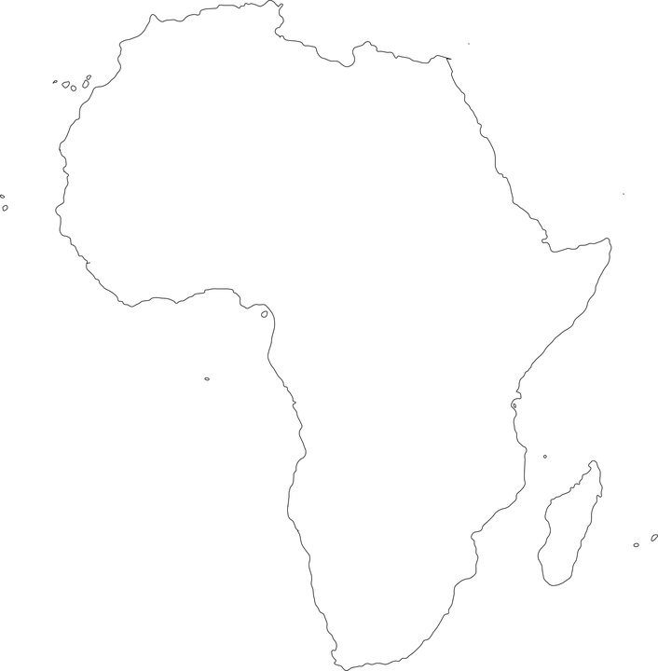
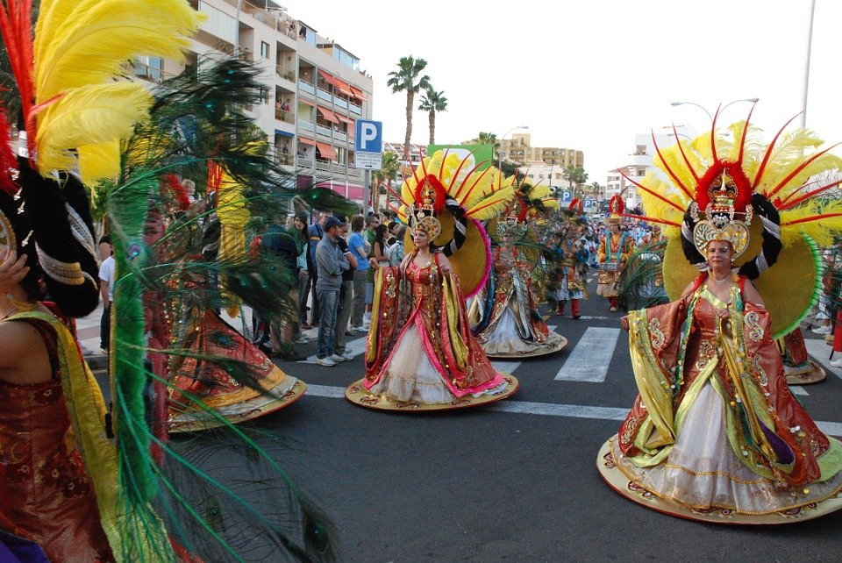
Follow up 4a:
Busca el vocabulario.
las = the (fem., pl.)
1
Las Islas Canarias es un grupo de islas al oeste de África.
Hay siete islas en total.
En Tenerife hay un carnaval muy importante en febrero.
leer
2
3
West
February
there are
group
important
islands
carnival
oeste
febrero
hay
grupo
importante
islas
carnaval
Tenerife
El carnaval
Notes:
Aim: to practise written comprehension of some previously taught vocabulary within a longer text; to introduce carnaval de Tenerife and locate Tenerife on a map.
Procedure:
Give pupils 2-3 minutes with a partner to find the Spanish meanings for the 7 English words.
Elicit Spanish responses chorally, prompting with the English, e.g., ‘group?’ ‘grupos’, muy bien. ☺ Note: click on each English word to reveal the Spanish translation.
Pupils could be asked to read the text aloud in pairs, taking it in turns to read alternate sentences. There are a few unknown words in the text.
Click the audio player to hear the full text for each sentece, if desired.
Frequency of unknown words and cognates: grupo [200] isla [810] carnaval [4114]
Source: Davies, M. & Davies, K. (2018). A frequency dictionary of Spanish: Core vocabulary for learners (2nd ed.). Routledge: London

Slide 7
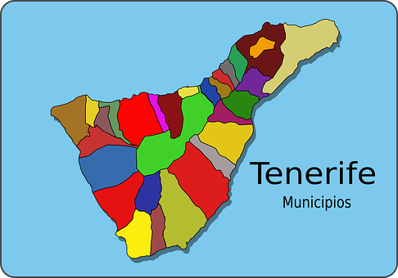
Follow up 4b:
Escucha y escribe en inglés.
escuchar
 | In Tenerife _________________________.
 | In Carnaval _________more than ____________.
 | In Tenerife _________________________.
 | In Tenerife ________________________.
 | In Tenerife __________ more than ______________.
 | In Tenerife ____________________________.
E
there are some beaches.
1
there are
nine balloons
2
there is a sea.
El carnaval
3
there are some villages
4
there are
eleven mountains
5
there is a carnival.
más de = more than (with numbers)
Notes:
Timing: 5 minutes
Aim: to aural comprehension of hay, indefinite article & previously introduced vocabulary.
Procedure:
Transcript
[E] En Tenerife hay unas playas.
[1] En Carnaval hay más de nueve globos.
[2] En Tenereife hay un mar.
[3] En Tenerife hay unos pueblos.
[4] En Tenerife hay más de once montañas.
[5] En Tenerife hay un carnaval.

Slide 8
Follow up 5:
Escribe en español.
una
hay
?
?
montañas
pelotas
unas
¿
escribir
There is a question.______________________
2. There are some answers. _____________________
3. There are 11 mountains . ______________________
4. How many balls are there? ______________________________________________.
5. How many games are there? ______________________________________________.
Hay una pregunta.
once
Hay unas respuestas.
Don’t forget punctuation: capital letters, full stops and question marks.
Hay once montañas.
pregunta
¿Cuántas pelotas hay?
hay
¿Cuántos juegos hay?
hay
cuántas
respuestas
hay
¿
cuántos
hay
juegos
Notes:
Timing: 8 minutes
Aim: guided production of there is, there are, indefinite articles and cuántos & cuántas
Procedure:
Students to translate the sentences using the vocabulary from the lesson. They can use the words in the frame to support their writing.
Remind students about punctuation & use of question marks in Spanish.

Slide 9
Follow up 5:
Escribe en inglés: Can you get at least 15 points?
 | la pregunta | la respuesta | el sacapuntas
 | tienes | la botella | el estuche
 | el idioma | el juego | de
 | leer | ver | el deporte
 | cuántos | cuántas | aprender
 | hay | unas | unos
(the) question
(the) answer
(the) pencil sharpener
vocabulario
vocabulario
x3
you have
(the) bottle
(the) pencil case
(the) language
(the) game
of, from
x2
to read, reading
to see, seeing
(the) sport
how many (mpl)
how many (fpl)
to learn, learning
x1
there is, there are
some (fpl)
some (mpl)
Notes:
Timing: 6 minutes
Aim: to practise written comprehension of vocabulary for this week and previous weeks.
Procedure:
1. Pupils need to write the English for as many words as possible, aiming to get at least 15 points (but more if possible).
2. Click for Spanish answers.

Slide 10
Follow up 5:
Escribe en español: Can you get at least 15 points?
 | (the) question | (the) answer | (the) pencil sharpener
 | you have | (the) bottle | (the) pencil case
 | (the) language | (the) sport | of, from
 | to read, reading | to see, seeing | (the) sport
 | how many (mpl) | how many (fpl) | to learn, learning
 | there is, there are | some (fpl) | some (mpl)
vocabulario
la pregunta
la respuesta
el sacapuntas
vocabulario
x3
tienes
la botella
el estuche
el idioma
el juego
de
x2
leer
ver
el deporte
cuántos
cuántas
aprender
x1
hay
unas
unos
Notes:
Timing: 6 minutes
Aim: to practise written production of vocabulary for this week and previous weeks.
Procedure:
1. Pupils need to write the Spanish for as many words as possible, aiming to get at least 15 points (but more if possible).
2. Click for Spanish answers.

Slide 11
Follow up 5:
Escribe en inglés: Can you get at least 15 points?
 | la pregunta | la respuesta | el sacapuntas
 | tienes | la botella | el estuche
 | el idioma | el juego | de
 | leer | ver | el deporte
 | cuántos | cuántas | aprender
 | hay | unas | unos
vocabulario
vocabulario
x3
x2
x1
Notes:
HANDOUT

Slide 12
Follow up 5:
Escribe en español: Can you get at least 15 points?
 | (the) question | (the) answer | (the) pencil sharpener
 | you have | (the) bottle | (the) pencil case
 | (the) language | (the) sport | of, from
 | to read, reading | to see, seeing | (the) sport
 | how many (mpl) | how many (fpl) | to learn, learning
 | there is, there are | some (fpl) | some (mpl)
vocabulario
vocabulario
x3
x2
x1
Notes:
HANDOUT

Slide 13
¡adiós!
rojo

