Slide 1
Saying what I and others do
rojo
Follow ups 1-5
Notes:
Artwork by Steve Clarke. All additional pictures selected are available under a Creative Commons license, no attribution required.
The frequency rankings for words that occur in this PowerPoint which have been previously introduced in the resources are given in the SOW (excel document) and in the resources that first introduced and formally re-visited those words.
For any other words that occur incidentally in this PowerPoint, frequency rankings will be provided in the notes field wherever possible.
Vocabulary: comprender [434] información [326] instrucción [2158] texto [753]
SSC: paquete [2325] queso [3187]
Glossed words: ella [72] abuela [783]
Source: Davies, M. & Davies, K. (2018). A frequency dictionary of Spanish: Core vocabulary for learners (2nd ed.). Routledge: London

Slide 2
Follow up 1:
pronunciar
[que]
paquete
They all sound like ‘k’ ☺.
[ca]
cama
[co]
contar
⚠ This is a different sound: ‘th’
[ce]
cento
Notes:
Timing: 5 minutes [2 slide]
Aim: To practise the pronunciation of Spanish words with the SSC [que] in contrast with [ce] and [ca] [co] [cu].

Slide 3
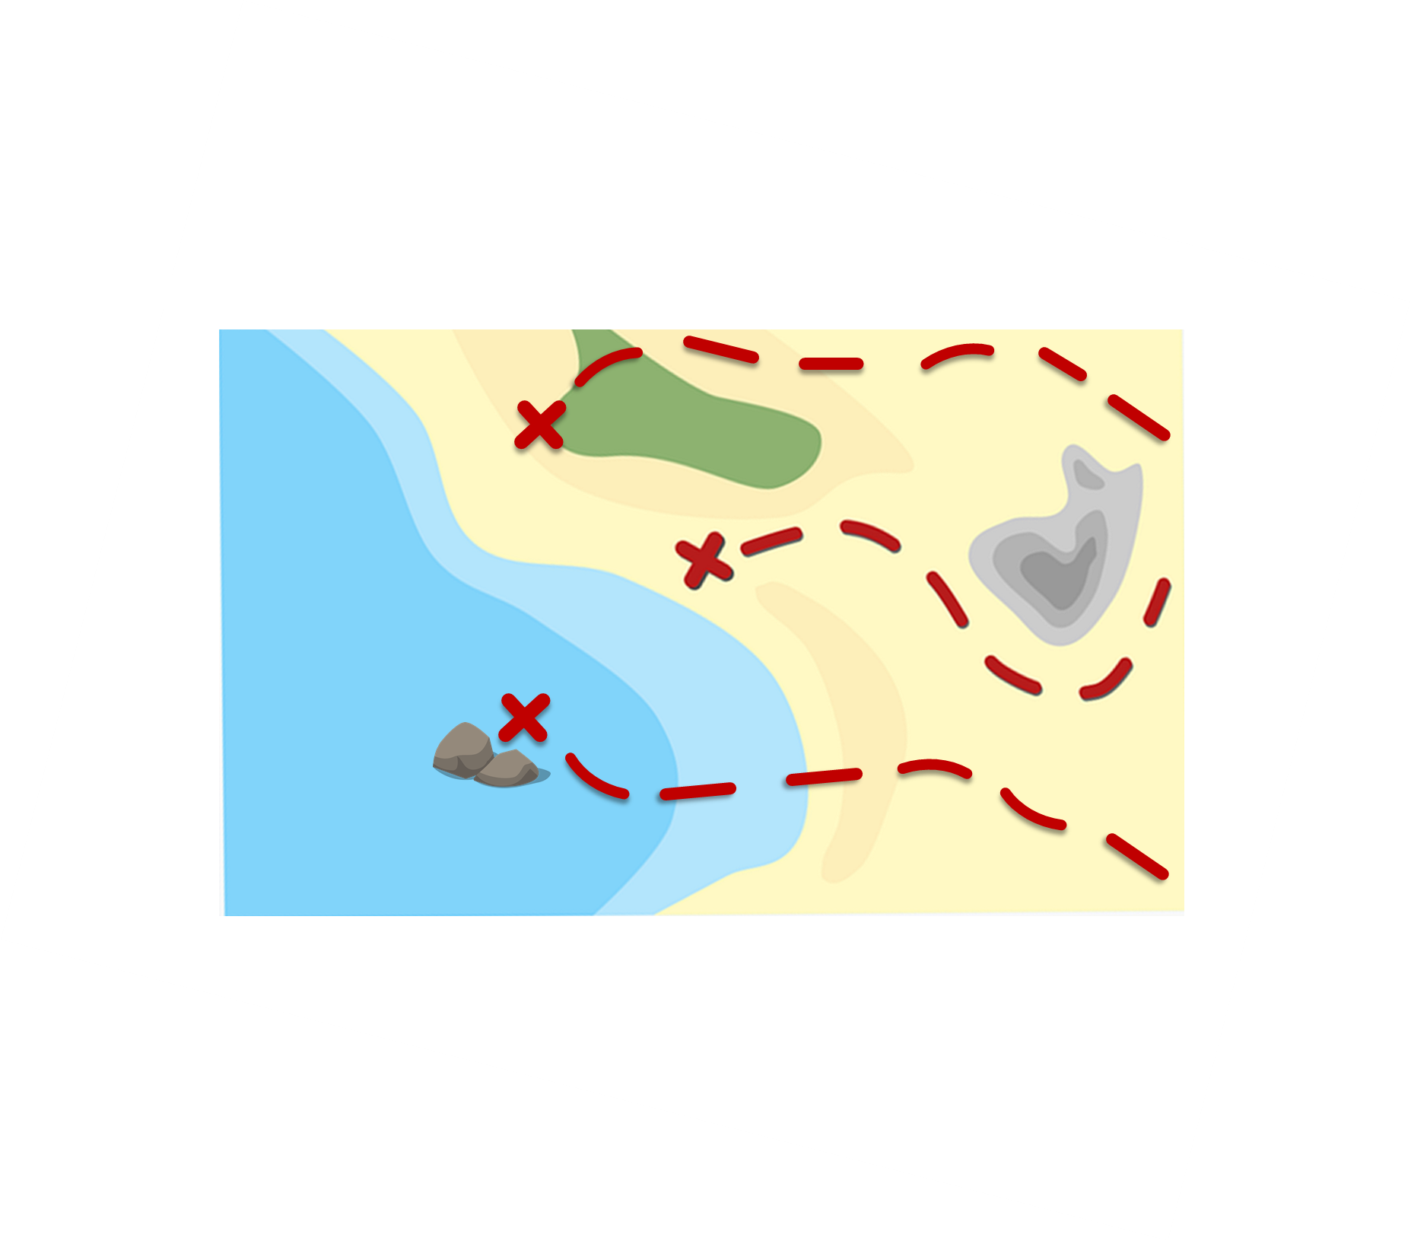
Follow up 1:
La ruta de las monedas
Pronuncia las palabras y colecciona monedas.
Turno 1: Persona A
Turno 2: Persona B
cena
paquete
pequeño
caminar
cantar
celebrar
cerca
quemar
dulce
cero
camisa
parque
con
color
peces
cama
queso
INICIO
Notes:
Timing: 5 minutes [2 slides]
Aim: To practise the pronunciation of Spanish words with the SSC [que] and [ce].
Procedure:
Pupils work in pairs to practise pronunciation. They can choose where to start and have one minute to collect as many coins as possible.
Divide the class in A & B and click to indicate it’s ‘persona A’’s turn.
Pupil A starts from either ‘cantar, ‘dulce’ or ‘queso’, and follows the path to pronounce the words and collect the corresponding coins. Pupil B listens and notes down the number of coins for his/her partner.
Click to bring up Persona B’s turn.
Click on each word to hear it pronounced, as required.

Slide 4
Follow up 2
A Escucha. ¿Qué palabra es?
B Escribe las palabras.
escuchar
E
a | the
village | ball
the | a/an
___ ________ | una pelota
el boli | ___ ________
___ ________ | un teléfono
___ ________ | una pregunta
el gato | ___ ________
___ ________ | una botella
la pelota
1
a | the
pen | balloon
un boli
2
a | the
phone | sea
el teléfono
3
a | the
question | text
la pregunta
a | the
fruit | cat
un gato
4
la botella
5
a | the
bike | bottle
Notes:
Timing: 10 minutes
Aim: to practise aural comprehension of this week’s new vocabulary and revisit definite and indefinite articles; connect sound with meaning.
Procedure:
(Part A)
Read the instruction in Spanish.
Do [E] with them. Click to listen. Pupils circle the correct article.
Click for answer.
Complete items 1-5 and click to correct with the class.
(Part B)
1. Write the word with the correct article.
2. Click to correct.
Transcript 1:
[E] una pelota.
[1] el bolígrafo
[2] un teléfono
[3] una pregunta
[4] el gato
[5] una botella

Slide 5
Follow up 3:
Knowing who does what
[–er verbs: ‘I’,‘you’ & ‘she’]
Remember, to mean ‘I’, ‘s/he,it’ or ‘you’ with a verb, the verb ending changes.
I
you
S/he, it
Leo información.
Lees información.
Lee información.
I read information.
You read information.
S/he reads information.
Notice that in English, the verb also changes when referring to s/he, it ☺.
Notes:
Timing: 10 minutes in total (2 slides) Grammar info (3 minutes) + reading task (7 minutes)
Aim: to revisit singular persons in the present tense for –er verbs.
Procedure:
Click through the animations to present the new information.
Elicit English translations for the Spanish examples provided.

Slide 6
Follow up 3 :
Sofía escribe a Quique.
¿Quién es? Es Sofía (I), Quique (you) o la abuela* (she)?
leer
1 | Lees un libro en la cama.
Escribe el verbo y clasifica las frases.
You read a book in (the) bed.
2 | Aprendo el vocabulario con mamá.
I learn the vocabulary with mum.
la abuela
[I]
[you]
[she]
3 | Ve la playa de casa.
2
aprendo
1 lees
3 ve
She sees the beach from home.
4
comprendes
4 | Comprendes el texto en inglés.
You understand the text in English.
5 ves
5 | Ves la información en clase.
You see the information in class.
ella = she/her
la abuela = grandma
Notes:
Timing: 7 minutes
Aim: to practise written recognition of definite articles and their connection with corresponding nouns; to practise comprehension of new and previously taught vocabulary.
Procedure:
Ensure that the context is clear. Sofía has written these notes to Quique.
Pupils read the sentence and record the verb under the appropriate heading: I, you or she.
They then translate the sentence (this can be done orally with the whole class or written, and then checked).
Click to reveal answers.

Slide 7
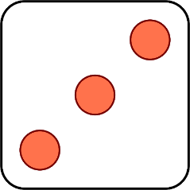
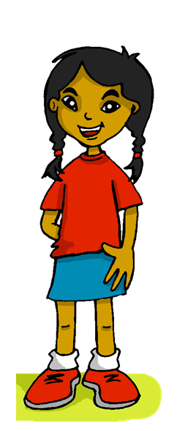
Follow up 4:
Habla en español.
Remember to use ‘a’ after verbs such as ‘ver’ if what we see or visit is a person or an animal we are fond of.
Leo
hablar
ve
Aprendes
Comprendo
Comprende
Lees
[the] playa
[the] la montaña
[the] instrucción
[a] book
[a] idioma
[the] texto
mamá
[a] película
Manchita
1 | S/he
2 | You
3 | I
4 | S/he
5 | You
6 | I
1 | understand
2 | learn
3 | see/watch
4 | read
5 | understand
6 | read
Notes:
Timing: 5 minutes
Aim: to practise oral production of singular persons of 4 –ER verbs; definite and indefinite articles.
Procedure: 1. Click to ‘roll’ the dice.
2. Pupils translate the verbs and nouns whose numbers correspond to the respective dice to make a short sentence. They say the answer chorally and use one of the options from ‘información extra’ to form a logical sentence.
3. Click to reveal the correct verb phrase.
4. Repeat until all six combinations have been said.

Slide 8
Follow up 5:
Escribe en inglés: Can you get at least 15 points?
 | el teléfono | un | una
 | tengo | la fruta | la pelota
 | de | por | tener
 | el pueblo | el | la
 | el mar | la montaña | la playa
 | el texto | caminar | nadar
 | comprender | la información | la instrucción
(the) telephone
a/an (m)
a/an (f)
vocabulario
vocabulario
x3
I have
(the) fruit
(the) ball
from, of
through, along,
to have, having
x2
(the) village
the (m)
the (f)
(the) sea
(the) mountain
(the) beach
(the) text
to walk, walking
to swim, swimming
x1
to understand, understanding
(the) information
(the) instruction
Notes:
Timing: 6 minutes
Aim: to practise written production of vocabulary for this week and previous weeks.
Procedure:
1. Pupils need to write the English for as many words as possible, aiming to get at least 15 points (but more if possible).
2. Click for English answers.

Slide 9
Follow up:
Escribe en español: Can you get at least 15 points?
 | (the) phone | a/an (m) | a/an (f)
 | I have | (the) fruit | (the) ball
 | from, of | through, along | to have, having
 | (the) village | the (m) | the (f)
 | (the) sea | (the) mountain | (the) beach
 | (the) text | to walk, walking | to swim, swimming
 | to understand | (the) information | (the) instruction
el teléfono
un
una
vocabulario
vocabulario
x3
tengo
la fruta
la pelota
de
por
tener
x2
el pueblo
el
la
el mar
la montaña
la playa
el texto
caminar
nadar
x1
comprender
la información
la instrucción
Notes:
Timing: 6 minutes
Aim: to practise written production of vocabulary for this week and previous weeks.
Procedure:
1. Pupils need to write the Spanish for as many words as possible, aiming to get at least 15 points (but more if possible).
2. Click for Spanish answers.

Slide 10
Saying what I and others have
rojo
Follow ups 1-5

Slide 11
Follow up 5:
Escribe en inglés: Can you get at least 15 points?
 | el teléfono | un | una
 | tengo | la fruta | la pelota
 | de | por | tener
 | el pueblo | el | la
 | el mar | la montaña | la playa
 | el texto | caminar | nadar
 | comprender | la información | la instrucción
vocabulario
vocabulario
x3
x2
x1
Notes:
HANDOUT

Slide 12
Follow up:
Escribe en español: Can you get at least 15 points?
 | (the) phone | a/an (m) | a/an (f)
 | I have | (the) fruit | (the) ball
 | from, of | through, along | to have, having
 | (the) village | the (m) | the (f)
 | (the) sea | (the) mountain | (the) beach
 | (the) text | to walk, walking | to swim, swimming
 | to understand | (the) information | (the) instruction
vocabulario
vocabulario
x3
x2
x1
Notes:
Timing: 6 minutes
Aim: to practise written production of vocabulary for this week and previous weeks.
Procedure:
1. Pupils need to write the Spanish for as many words as possible, aiming to get at least 15 points (but more if possible).
2. Click for Spanish answers.

