Slide 1
español, con Sofía

Slide 2
Describing me and others do
rojo
-er verbs: I vs. s/he
SSC [ga] [go] [gu] [ca] [co] [cu]
Notes:
Artwork by Steve Clarke. All additional pictures selected are available under a Creative Commons license, no attribution required.
The frequency rankings for words that occur in this PowerPoint which have been previously introduced in the resources are given in the SOW (excel document) and in the resources that first introduced and formally re-visited those words.
For any other words that occur incidentally in this PowerPoint, frequency rankings will be provided in the notes field wherever possible.
SSC: Revisit [ca] [co] [cu] [ga] [go] [gu]
Vocabulary: aprender [428] leer [209] ver [38] deporte [1489] idioma [1159] juego [409] de² [2] Revisit 1: llevar [101] comprar [361] película [944] sombrero [2290] uniforme [2796] con [14]
Revisit 2: qué [50] día [65] lunes [1370] martes [3101] miércoles [1816] jueves [1650] viernes [1259] sábado [1179] domingo [693]
Glossed words: ella [72]
Source: Davies, M. & Davies, K. (2018). A frequency dictionary of Spanish: Core vocabulary for learners (2nd ed.). Routledge: London

Slide 3
pronunciar
[ca]
cama
[co]
contar
[cu]
cucaracha
Notes:
Timing: 2 minutes
Aim: to revisit SSC [ca] [co] [cu]
Procedure:
Click to trigger [ca] and get pupils to repeat.
Click to bring up the word. Click to bring up the image too.
Encourage pupils to do the gesture, if using.
Bring [co] and [cu] and repeat steps 1-3.
Gestures:
[ca] Both hands stretch down to pull up an imaginary duvet as pupils mime gently reclining backwards.
[co] Pupils hold up one hand and put each finger down one by one to denote ‘counting’. [cu] With fingers of their right hand, pupils mime a cockroach crawling up their left arm.

Slide 4
[ga]
ganar
pronunciar
[go]
lago
[gu]
gusano
Notes:
Timing: 1 minute
Aim: To revisit SSC [ga] [go] [gu]
Procedure:
To recap and elicit the pronunciation of the individual SSC [ga] [go] [gu]
Click to bring the picture & get students to repeat (with gesture, if using).
Gesture suggestion for ganar: lift your fist up in two goes.
Gesture suggestion for lago: rowing – two movements
Gesture suggestion for gusano: with index finger, lift up and down three times.

Slide 5
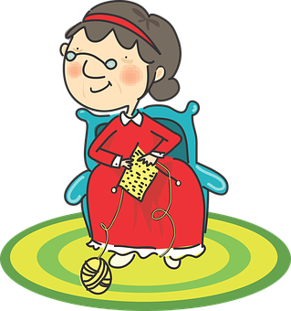
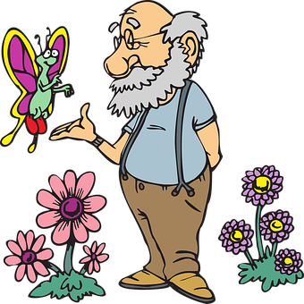
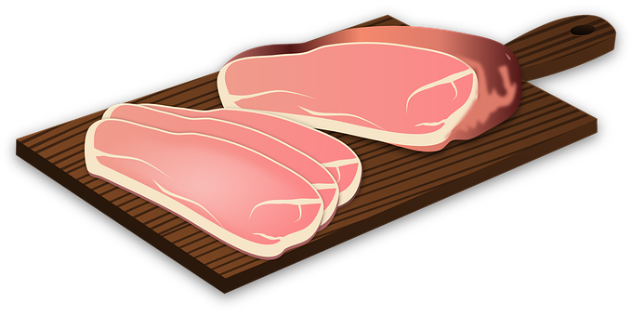
[ca] [co] [cu] [ga] [go] [gu]
[A] Escucha y escribe.
pronunciar
[something]
45
algas
Paca
algo
Pascua
[with me]
Paco
segundo
carne
conmigo
0
[B] Practica con tu compañero/a.
INICIO
Notes:
Timing: 3 minutes
Aim: To revisit SSC [ga] [go] [gu] [ca] [co] [cu]
Procedure:
Pupils write 1-8 and either [ga] [go] [gu] [ca] [co] [cu]
Click to listen.
Click again to reveal the pictures and the answers.
Click inicio for pupils to pronounce all of the words.
Click on each image to hear it, if desired.
Transcript: algas
Paca
algo
Pascua
Paco
segundo
carne
conmigo
Frequency of unknown words:
alga [>5000] algo [110] carne [860] segundo [223] Conmigo [1256]

Slide 6
vocabulario
Practica el vocabulario:
¡Excelente!
3. la mañana
8. el juego
5. la cama
6. ver
1. visitar
10. aprender
9. el deporte
2. una película
4. el idioma
7. el libro
to visit, visiting
bed
to learn, learning
a film
language
to see watch; seeing, watching
morning
book
sport
game
Notes:
Timing: 5 minutes Aim: to practise written comprehension and spoken pronunciation of vocabulary.
Procedure: 1. Students write 1-10 in books.
2. Ask students to say the Spanish word and write down the English translation before the word has faded away (5 sec per word)
3. Click for English translation to be highlighted. 4. Repeat for all 11 items.
5. Check answers by eliciting the Spanish from students, (i.e. so that they are translating back from their written English into spoken Spanish).
Note: Students have not yet done numbers but will be taught them explicitly in Week 7. However, in the next few weeks, certain activities will prime for them. Here the teacher can say the number when eliciting the answers, but support understanding by holding up the appropriate number of fingers each time. Obviously, the items proceed in number order in any case, so the finger gesture is more to draw learners attention to the sound – meaning connection of the number with the Spanish word for that number.

Slide 7
Knowing who does what
⚠ We don’t need pronouns because the verb ending tells us who is doing the action.
[–er verbs: ‘I’ versus ‘s/he, it’]
Some Spanish infinitives end in –er
We know to mean ‘I’ & ‘s/he, it’ with a verb, the verb ending changes.
To mean ‘I’ with a verb, we remove –er and add -o.
To mean ‘s/he, it’ with a verb, we remove –ar and add –e.
Ejemplo:
aprender
I
s/he, it
Aprendo español en clase.
Aprende español en clase.
I learn Spanish in class.
S/he learns Spanish in class.
Notes:
Timing: 3 minutes
Aim: to introduce 1st person singular for –er verbs, building on the concept of the infinitive.
Procedure:
Click through the animations to present the new information.
Elicit English translations for the Spanish examples provided.

Slide 8
escuchar
Mi amiga es diferente: Sofía habla de ella* y Ángela.
¿Quién es?
ella = she/her
Marca
 | Sofía (I) | Ángela (she)
Información extra
with… a friend | mum | dad
a game | a sport | a question
at home | in class | in bed
a film | a present | a friend
in the mountain| in the morning
an answer | a language | a book
E
1
2
3
4
5
Notes:
Timing: 7 minutes
Aim: to practise aural recognition of 1st and 3rd person of –er verbs (singular)
Procedure:
Read the title and click to bring up the instructions in Spanish. Pupils need to identify to which person each statement refers to (I / SHE)
Do the example (E).
Click to bring up the answers.
Pupils to listen out to understand more information form each sentences. Pupils can either write 1A/B.C, etc.. or if they have the print out they can put a X in the correct box. Some pupils can also write the word in English.
Click to bring up answers (tick and English words) and get pupils check their answers.
Transcript:
[E] Aprendo con papá
[1] Veo un deporte
[2] Lee en la cama
[3] Veo una película
[4] Lee por la mañana
[5] Aprende un idioma

Slide 9
Personal ‘a’
In Spanish, after verbs such as ‘ver’ [to see, seeing] and ‘visitar’ [to visit, visiting], we need to use ‘a’ if what we see or visit is a person or a pet.
This does not happen in English!
Compara
place or object
person or pet
Visito el pueblo.
Visito a un amigo.
I visit the village.
I visit a friend.
Notes:
Timing: 2 minutes
Aim: to introduce the notion of personal ‘a’ with two key infinitive verbs.
Procedure:
Read the grammar explanation on gender in Spanish.
Click to bring up examples of singular masculine and feminine nouns.

Slide 10
leer
¡Mi gemelo es diferente!
Sofía habla de ella* y Quique.
el gemelo = male twin ella = she/her
Lee: ¿Quién es?
Marca
¿Necesita ‘a’o no?
 | Sofía | Quique
[E] Veo a mi profesora en clase.
[1] Leo el libro de Ángela.
[2] Aprende un deporte.
E
1
2
[3] Ve una película con mamá.
3
[4] Ve a Manchita de la cama..
4
[5] Aprendo con un juego de vocabulario.
5
Notes:
Timing: 10 minutes (2 slides)
Aim: to practise written comprehension of t 1st & 3rd person singular verb endings with a range of regular –er verbs; persona ‘a’
Procedure:
Read the title & click to explain the context of the task. In part 1 of this task, pupils aim to identify the correct person of the verb (I/she).
Do [E] with them. Draw their attention to the verb and the ending (veo). Is it Sofía talking about herself or is she talking about something Quique does?
Click to bring up the answer.
Pupils to complete 1-5.
Click through the animations to bring up answers.
NB: This is a reading task, but audio is provided to assist the teacher, if needed.
NNB: Please note – meaning is checked in the next slide.
Part 2 [translation task – next slide]
Pupils to complete the translation task.
Click through the animations to bring up answers.
Glossed words: ella [72]

Slide 11
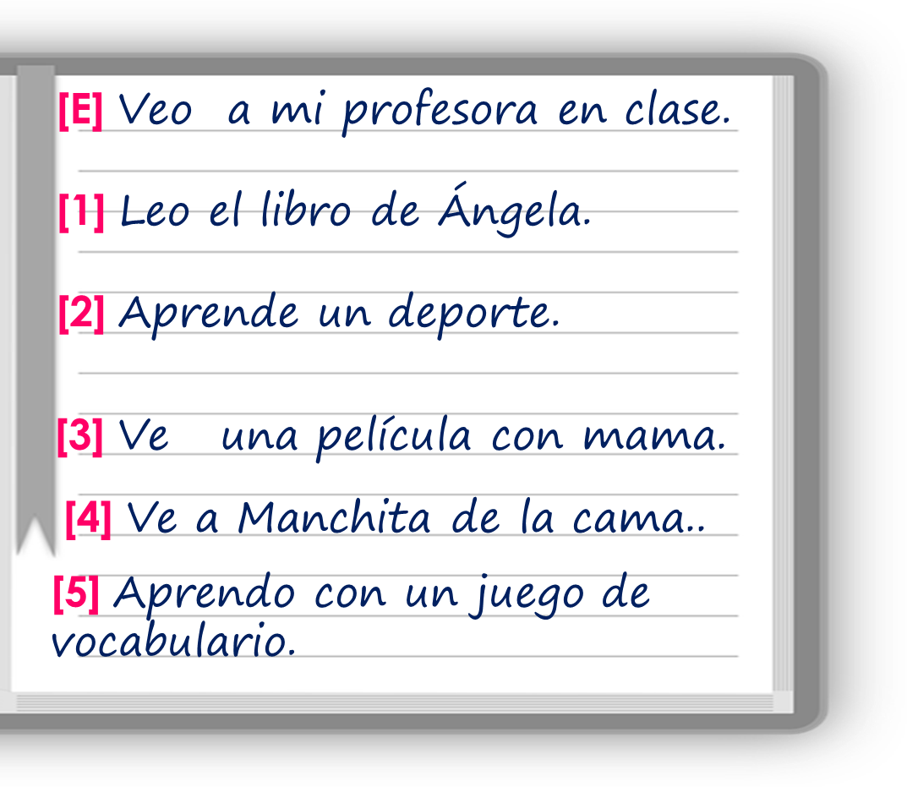
leer
Traduce las frases al inglés.
⚠ In English, it’s more natural to say ‘Angela’s book’
 | I ____ my (female) __________ in class.
 | I ______ the ________ of Ángela.
 | He ________ a _______.
 | He _________ a _______ ____ mum.
 | He ______ Manchita from ____ ______.
 | I ______ with a _______ _____ vocabulary.
E
see
teacher
1
read
book
2
learns
sport
3
watches
film
with
4
sees
the
bed
learn
game
of
5
Notes:
Aim: to practise written comprehension of t 1st & 3rd person singular verb endings with a range of regular –er verbs
Procedure:
(slide 2). Read the instruction (traduce las frases al inglés).
Pupils to complete the translation task.
Click through the animations to bring up answers.

Slide 12
¡adiós!
rojo

