Slide 1
Saying what I and others do
rojo
Follow ups 1-5
Notes:
Artwork by Steve Clarke. All additional pictures selected are available under a Creative Commons license, no attribution required.
The frequency rankings for words that occur in this PowerPoint which have been previously introduced in the resources are given in the SOW (excel document) and in the resources that first introduced and formally re-visited those words.
For any other words that occur incidentally in this PowerPoint, frequency rankings will be provided in the notes field wherever possible.
SSC: Revisit [ca] [co] [cu] [ga] [go] [gu]
Vocabulary: aprender [428] leer [209] ver [38] deporte [1489] idioma [1159] juego [409] de² [2] Revisit 1: llevar [101] comprar [361] película [944] sombrero [2290] uniforme [2796] con [14]
Revisit 2: qué [50] día [65] lunes [1370] martes [3101] miércoles [1816] jueves [1650] viernes [1259] sábado [1179] domingo [693]
Glossed words: personaje [595]
Source: Davies, M. & Davies, K. (2018). A frequency dictionary of Spanish: Core vocabulary for learners (2nd ed.). Routledge: London

Slide 2
Follow up 1
adivinar = to guess
[ga][go][gu] [ca][co][cu]
¡A practicar!
Escribe cinco palabras en secreto. Tu compañero/a adivina*.
45 segundos
domingo
gusano
cámara
pegar
cultura
plástico
película
algo
ganar
miércoles
caminar
juego
INICIO
Notes:
Timing: 5 minutes
Aim: to practise reading aloud [ga] [go] [gu] [ca] [co] [cu] in previously taught vocabulary (including one cognate – plástico)
Procedure:
Read the explanation and ensure pupils understand the task.
Start the timer.
Pupils try to guess their partner’s 5 words by saying them aloud, before the 45 seconds is up.
Swap roles and repeat the game.
pegar1 [1135] algo [110]

Slide 3
Follow up 2 :
Escribe en inglés.
leer
una pregunta
el idioma
aprender
el deporte
5
de
4
el juego
ver
el mar
3
2
la película
leer
1
Notes:
Timing: 5 minutes (two slides)
Aim: to practise written comprehension of vocabulary.
Procedure:
Tell pupils to be ready to write the English meanings of key vocabulary There will be 10 altogether and they should prepare to work from the bottom of the slide, left to right.
Explain the scenario – it’s raining and the raindrops will splash down and cover the words. They need to write the Spanish (but also be prepared to translate). Tell them they will have 5 seconds to get a headstart on the rain.
Click to start number animation.
Click once more to start raindrops. The timing has been carefully set! Don’t click again or all the raindrops will appear at once.
When finished move to the next slide to check answers.

Slide 4
Follow up 2 :
Respuestas
leer
una pregunta
el idioma
a question
language
aprender
el deporte
de
to learn, learning
sport
of
el juego
ver
el mar
game
to see, seeing
sea
la película
leer
film
to read, reading
Notes:
Procedure:
Elicit responses from the bottom, left to right, from pupils.
Click to bring up a written version of the answer.

Slide 5
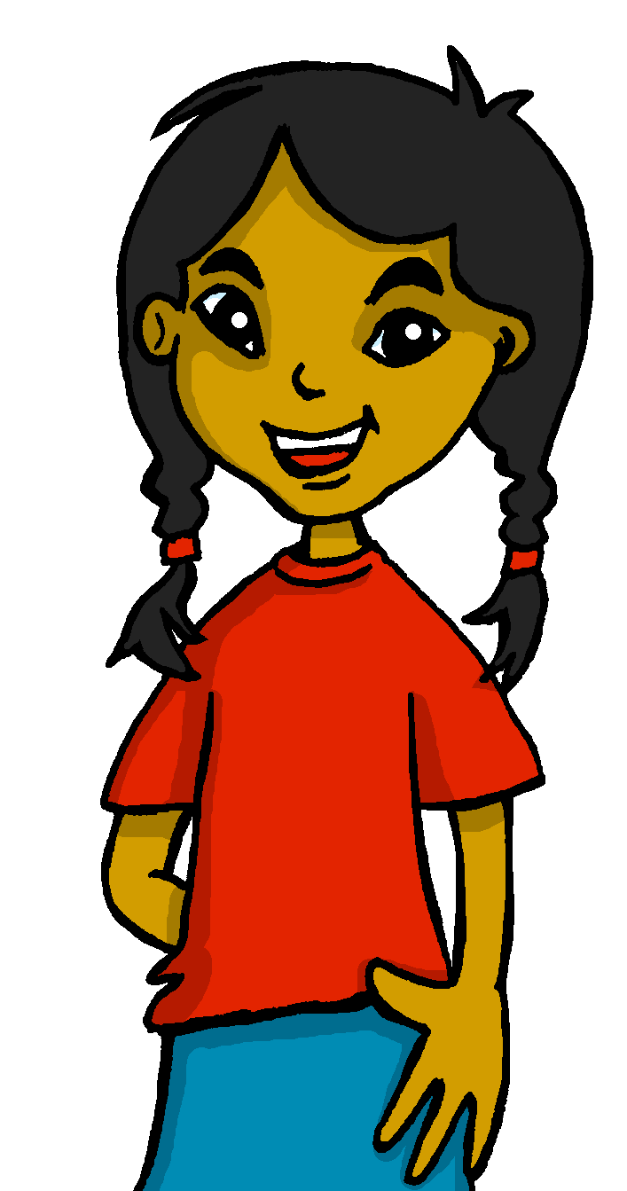
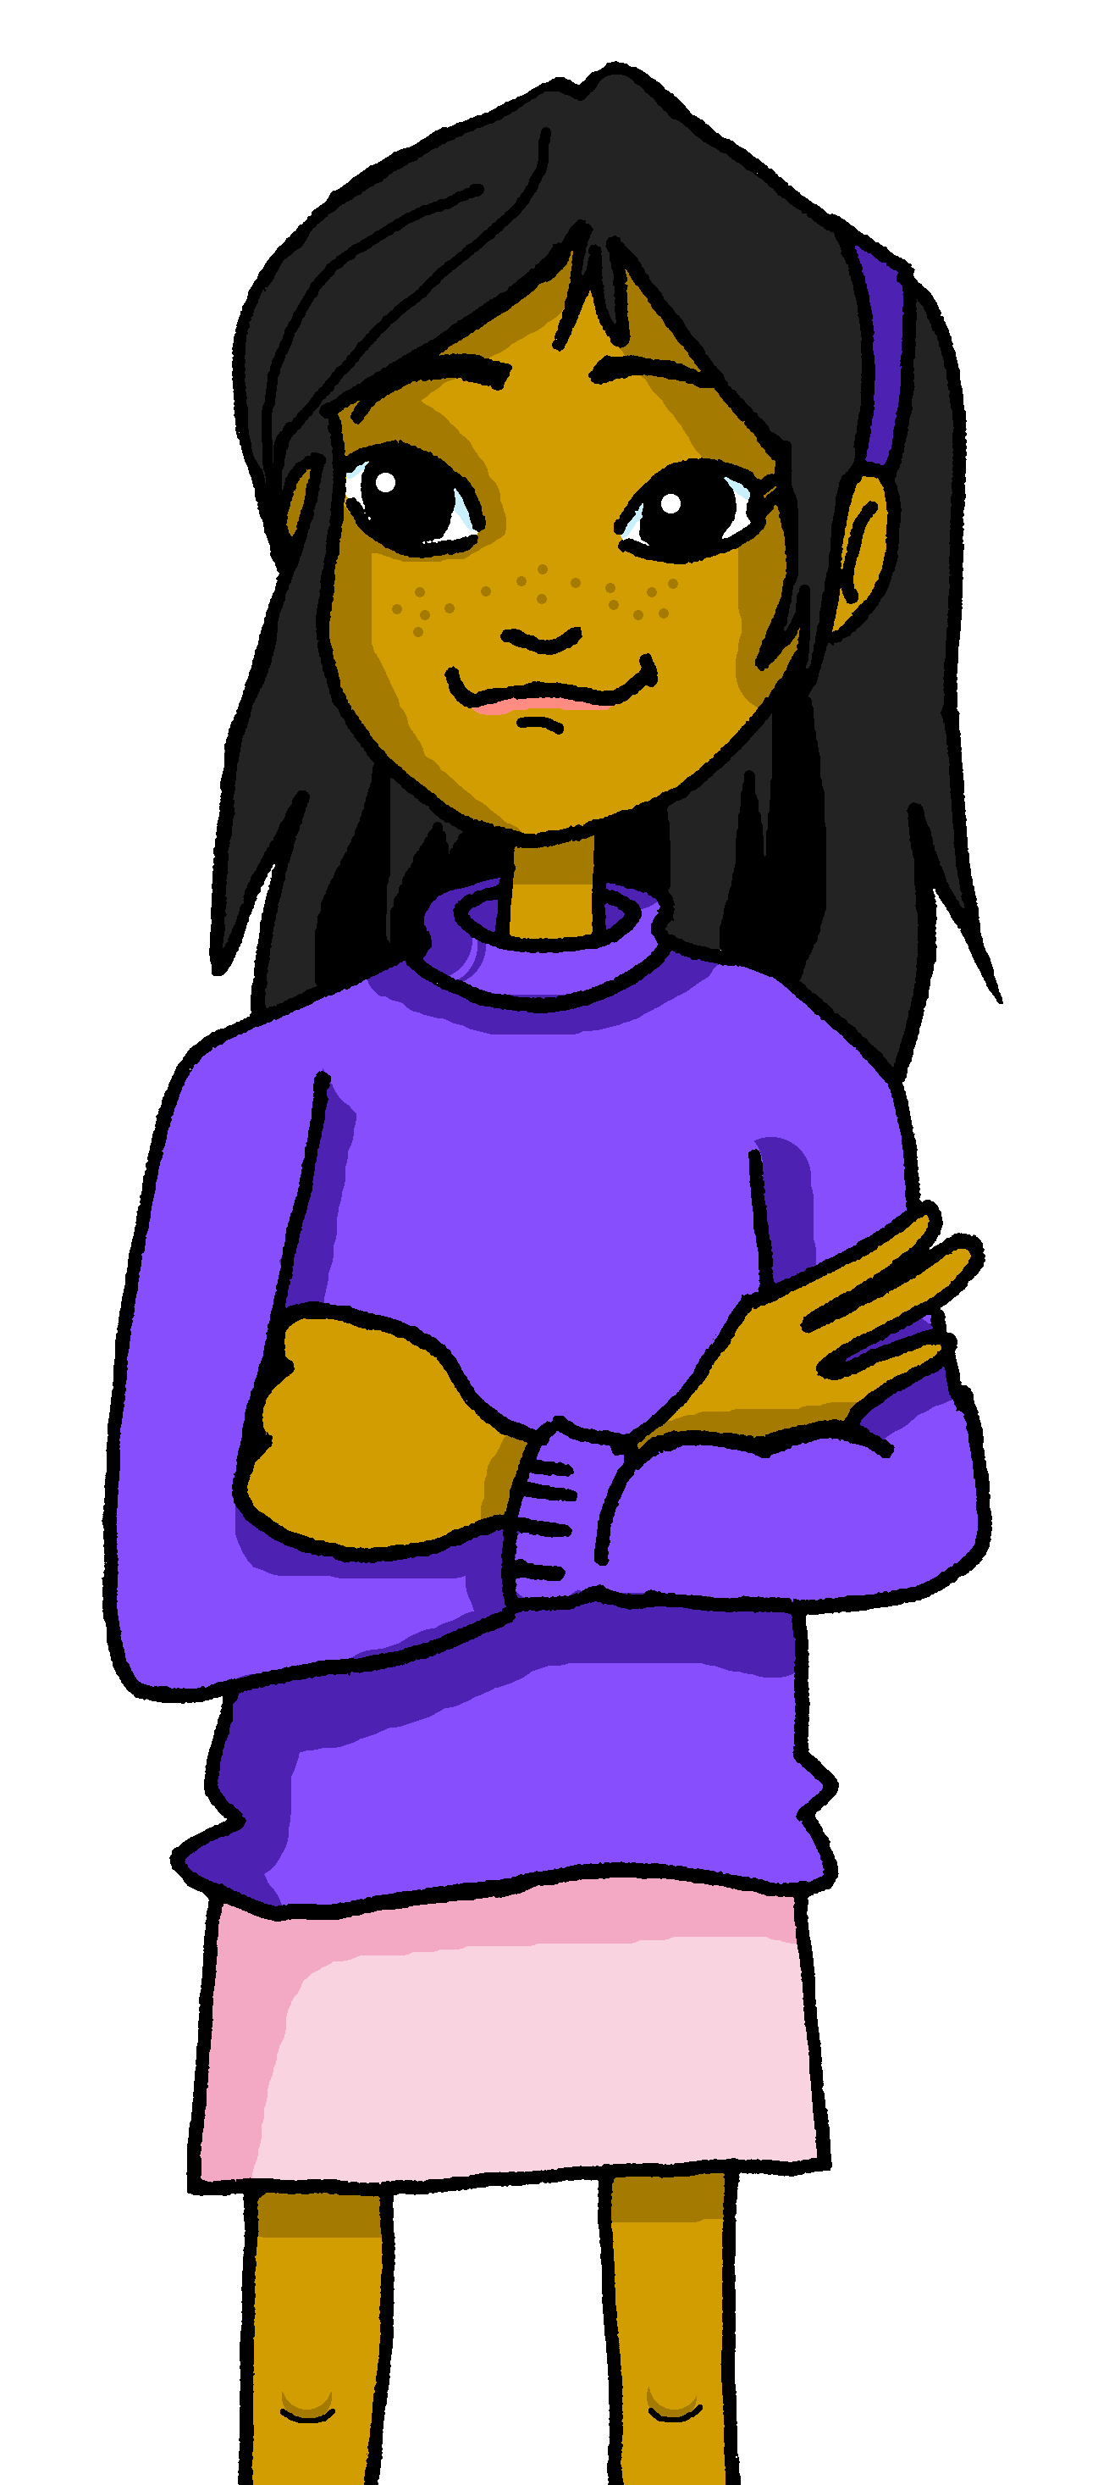
Follow up 3:
Yes/no questions
[–er verbs: ’I’ & ‘s/he, it’]
Remember! Turn a statement into a yes/no question by making
your voice go up at the end.
Leo un libro.
I read a book.
¿Leo un libro?
Do I read a book?
This works for any verb and any person (e.g., I, you, s/he).
¿Lee una revista?
Does she read a magazine?
la revista = magazine
Notes:
Timing: 10 minutes
Aim: to revisit 1st & 3rd person singular of –er verbs & raised intonation
Procedure:
1. Click to bring up each new part of the explanation.
2. Elicit the English for the Spanish examples after each animated question mark.
Frequency of unknown words and cognates:
revista [920] Source: Davies, M. & Davies, K. (2018). A frequency dictionary of Spanish: Core vocabulary for learners (2nd ed.). Routledge: London

Slide 6
Follow up 3:
la revista = magazine
B Escucha otra vez.
A Escucha. ¿Qué palabra es?
Use the correct words to
translate what you hear.
There are some extra ones!
escuchar
¿Es una pregunta? Escribe ¿? o .
E
I learn | s/he learns | I read
c | a game | a sport| at home | in class
 | an answer| a question| in Spanish | in English
 | a language| a sport|with mum| with dad
 | the mountain| the beach | the sea | and
 | a book | a newspaper | of | sport | culture
 | a concert| the| in | morning | a film
E
I learn
1
s/he sees | s/he reads | I read
a game
at home.
. . . . . . . . . . . . . . . . . . . . . . . . . . . . . . . . . . . . . .
2
s/he learns | I learn | I see
1
I read
a question
in English.
. . . . . . . . . . . . . . . . . . . . . . . . . . . . . . . . . . . . . .
3
I see | s/he learns | s/he sees
2
S/he learns
a language
with dad.
. . . . . . . . . . . . . . . . . . . . . . . . . . . . . . . . . . . . . ...
4
I learn | s/he reads | I see
3
I see
the mountain
and the sea.
I read | I watch | s/he watches
. . . . . . . . . . . . . . . . . . . . . . . . . . . . . . . . . . . . . .
5
4
S/he reads
a magzine
of sport.
In English, it’s more natural to say ‘a sports magazine’.
. . . . . . . . . . . . . . . . . . . . . . . . . . . . . . . . . . . . . .
E | 1 | 2 | 3 | 4 | 5
?
.
.
.
?
?
5
S/he watches
a film
in the morning.
. . . . . . . . . . . . . . . . . . . . . . . . . . . . . . . . . . . . . .
Notes:
Timing: 10 minutes
Aim: to practise aural comprehension of this week’s new vocabulary and revisiting adjectives from week 2-6. Connecting sound with meaning.
Procedure:
(Part A)
Read the instruction in Spanish & click to bring further instruction.
Do [E] with them. Click to listen. Pupils circle the correct words & write ? Or . According to whether it’s a statement or a question NB. Some puplis would benefit from working on a handout. Alternatively, they can use numbers 1,2,3.
Click for answers
(Part B)
1. Pupils listen to 1-5 and write the sentences, selecting from the options given (there are additional words that are not needed).
Click to reveal answers.
Transcript for parts A and B:
[E] Aprendo un juego en casa.
[1] Leo una pregunta en inglés.
[2] Aprende un idioma con papá.
[3] Veo la montaña y el mar.
[4] Lee una revista de deporte.
[5] Ve una película por la mañana

Slide 7
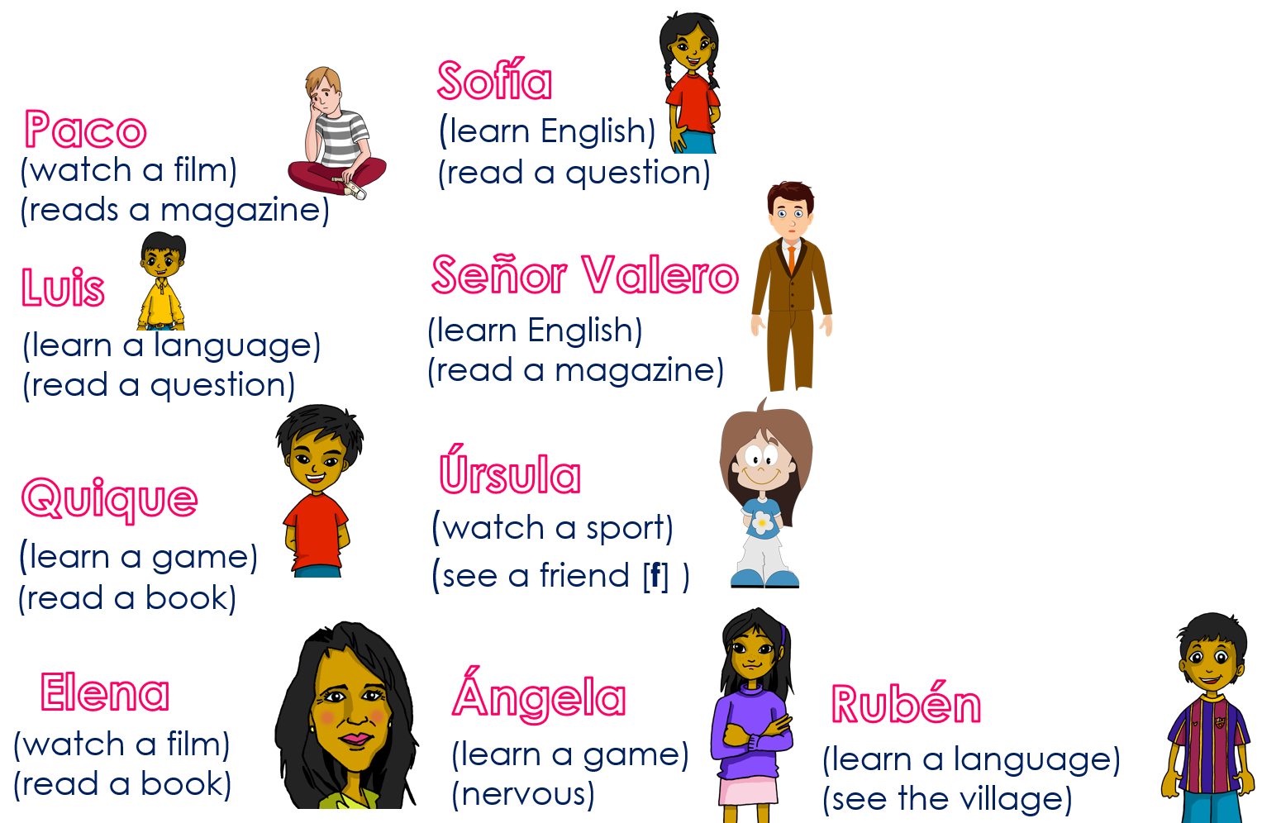
Follow up 4:
El personaje* secreto
el personaje = character
la revista = magazine
Escribe el nombre de un personaje* ✍ (i.e Paco).
hablar
With your partner, ask questions to guess each other’s secret character.
Does s/he…. read/see/learn?
¿Lee un libro?
¿Lee una revista?
¿Lee?
¡Es Paco ☺!
¿Aprende?
¡Sí, es Paco ☺!
¡No!
¡Sí!
¡Sí!
¡No!
Notes:
Time: 8-10 minutes
Aim: To use raised intonation and adjectival agreement in oral production to guess their partner’s characters.
Read the title in Spanish and click to bring a brief explanation of the instructions.
Tell students they are going to work in pairs. Partners take it in turns to ask yes/no questions to try to figure out the other player’s character. The partner guessing needs to use raised question intonation and the correct verb and noun to narrow down their options correctly!
Click to bring the speech bubbles to make sure students are clear about what the exchange should look like (¿Aprende? / Sí / No). When the answer is ‘no’ all those who do not have ‘learn’ as an activity are eliminated.
Click to bring up the question ¿Lee? When the answer is ‘Sí’ this eliminates Úrsula who doesn’t read.
Click to bring up a more specific question: ¿Lee un libro? The answer is ‘no’ and eliminates Elena, meaning the answer is Paco.
2. Teachers can model another round with the whole class (getting students to ask the questions) before getting them started in pairs.
3. Give students 30 seconds to write down 4 names (mixture of male/female).
4. The aim is to work with your partner, to identify all 8 people as quickly as possible.
NB. Print the template slide at the end of this PPT, in A5 so that students can cross out as they play.
personaje [595]

Slide 8
Follow 5:
Escribe 5 frases lógicas en español.
I | learn(s) | a film | with my teacher (f)
 |  | a friend (m) | on the beach
 |  | an answer | in class
He | read(s) | a question | of Spain
 |  | a book | of Perú
 |  | a magazine | in the morning
She | see(s) | a game | every day
 |  | a language | every week
 |  | a sport | in English
escribir
lógicas = logical
Remember to add ‘a’ when what you see is a ‘person‘ or an ‘animal’
Aprende un juego en inglés.
Veo a un amigo en la playa.
Ve una película de España.
Lee una pregunta cada día.
la revista = magazine
Notes:
Timing: 10 minutes
Aim: to create 4 sentences with –er verbs in 1st and 3rd person singular based on the prompts.
Procedure:
Bring up each combination of sentence parts.
Ask students to volunteer the answer orally. Alternatively they could just to write the Spanish on mini-whiteboards or in their books.
Students then create 5 of their own sentences, using new combinations of words in the grid.
Teachers could encourage an oral simultaneous translation task, where students say a sentence and their partner translates it. Some may find this challenging to do on the spot, so this oral component could be done by some students, while other students continue to practise writing.
Sentences:
1) Aprende un juego en inglés. 2) Lee una pregunta cada día.
3) Veo a un amigo en la playa. 4) Ve una película en España.

Slide 9
Follow up:
Escribe en inglés: Can you get at least 15 points?
 | viernes | sábado | domingo
 | martes | miércoles | jueves
 | el día | ¿qué? | lunes
 | comprar | el sombrero | con
 | de | la película | llevar
 | el deporte | el idioma | el juego
 | aprender | leer | ver
Saturday
Sunday
vocabulario
Friday
vocabulario
x3
Wednesday
Thursday
Tuesday
(the) day
what?
Monday
x2
to buy, buying
(the) hat
with
of, from
(the) film
to wear, carry
(the) sport
(the) language
(the) game
x1
to learn, learning
to read, reading
to see, seeing
Notes:
Timing: 6 minutes
Aim: to practise written production of vocabulary for this week and previous weeks.
Procedure:
1. Pupils need to write the English for as many words as possible, aiming to get at least 15 points (but more if possible).
2. Click for Spanish answers.

Slide 10
Follow up:
Escribe en español: Can you get at least 15 points?
 | Friday | Saturday | Sunday
 | Tuesday | Wednesday | Thursday
 | (the) day | What? | Monday
 | to buy, buying | (the) hat | with
 | of, from | (the) film | to wear, carry
 | (the) sport | (the) language | (the) game
 | to learn, learning | to read, reading | to see, seeing
sábado
domingo
vocabulario
viernes
vocabulario
x3
miércoles
jueves
martes
el día
¿Qué?
lunes
x2
comprar
el sombrero
con
de
la película
llevar
el deporte
el idioma
el juego
x1
aprender
leer
ver
Notes:
Timing: 6 minutes
Aim: to practise written production of vocabulary for this week and previous weeks.
Procedure:
1. Pupils need to write the Spanish for as many words as possible, aiming to get at least 15 points (but more if possible).
2. Click for Spanish answers.

Slide 11
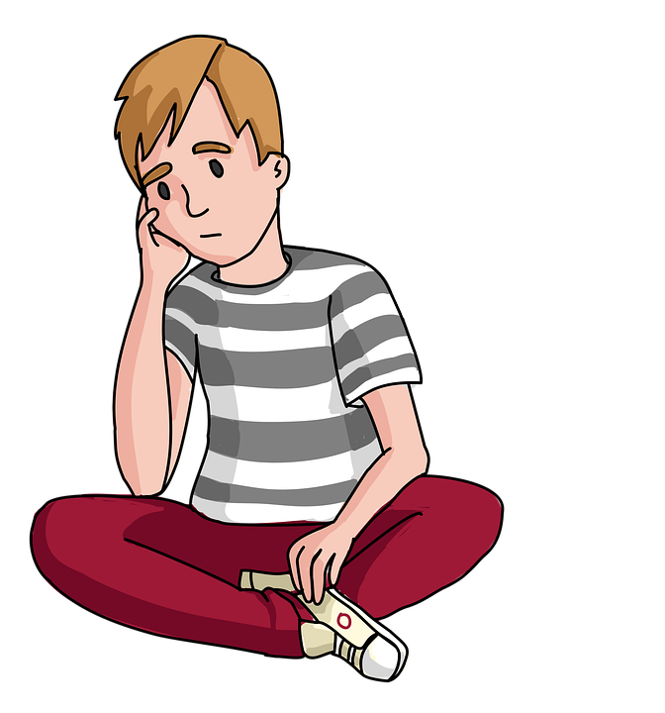
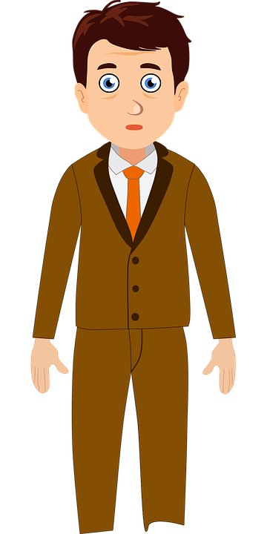
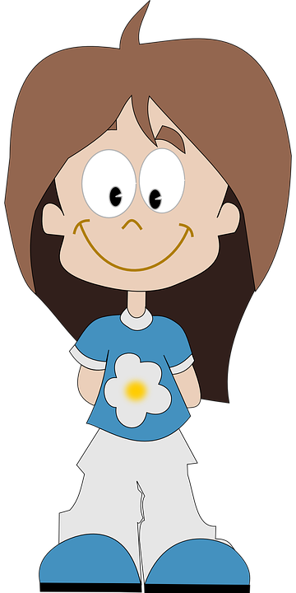
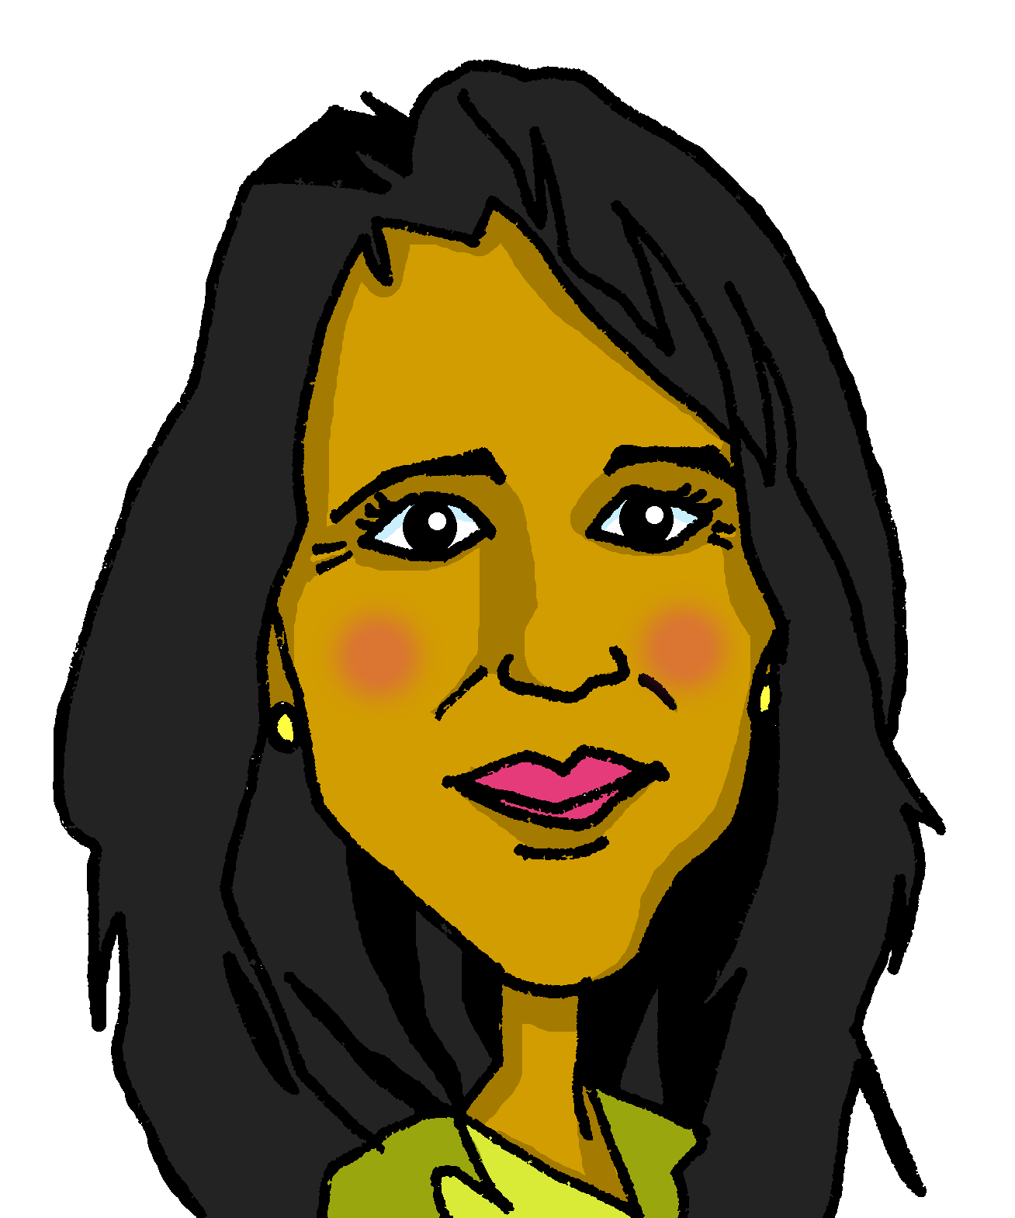
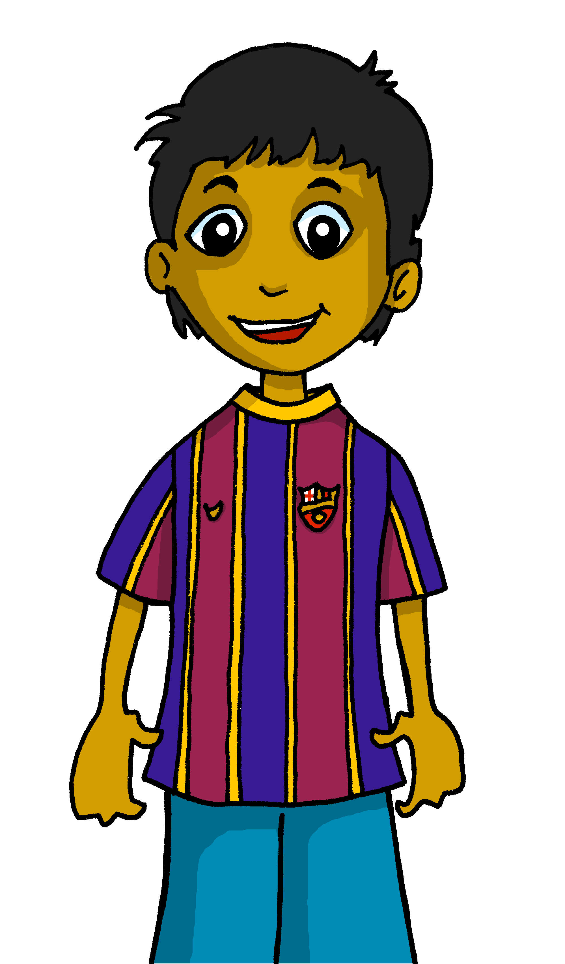
Handout
Follow up 4
la revista = magazine
¿Does s/he…?
Sofía
Paco
(learn English)
(read a question)
(watch a film)
(reads a magazine)
Señor Valero
¡Sí! / ¡No!
Luis
(learn a language)
(read a question)
(learn English)
(read a magazine)
Úrsula
Quique
(watch a sport)
(see a friend [f] )
(learn a game)
(read a book)
Elena
Ángela
Rubén
(watch a film)
(read a book)
(learn a game)
(nervous)
(learn a language)
(see the village)
Notes:
Master slide for guess who game. Print the template slide in A5 so that students can cross out as they play.

Slide 12
Saying what I and others have
rojo
Follow ups 1-5
Notes:
Artwork by Steve Clarke. All additional pictures selected are available under a Creative Commons license, no attribution required.
The frequency rankings for words that occur in this PowerPoint which have been previously introduced in the resources are given in the SOW (excel document) and in the resources that first introduced and formally re-visited those words.
For any other words that occur incidentally in this PowerPoint, frequency rankings will be provided in the notes field wherever possible.
- Vocabulary: cantar [717] escuchar [281] hablar [90] necesitar [276] español [262] fantástico [2501] importante [171] inglés [583] normal [1000]
- SSC: libro [1477]
Glossed words: volcán [4254] el/la [1] su [12] primo [1451]
Source: Davies, M. & Davies, K. (2018). A frequency dictionary of Spanish: Core vocabulary for learners (2nd ed.). Routledge: London

