Slide 1
español, con Sofía

Slide 2
Describing me and others do
Actividades
rojo
Definite article: words for ‘the’ – el, la
Infinitives: -ar verbs
SSC [ga] [go]
Notes:
Artwork by Steve Clarke. All additional pictures selected are available under a Creative Commons license, no attribution required.
The frequency rankings for words that occur in this PowerPoint which have been previously introduced in the resources are given in the SOW (excel document) and in the resources that first introduced and formally re-visited those words.
For any other words that occur incidentally in this PowerPoint, frequency rankings will be provided in the notes field wherever possible.
Phonics: SSC [ga] and [go] - ganar [295] lago [2151]
Vocabulary: caminar [514] nadar [3604] mar [480] montaña [1464] playa [1475] pueblo [244] el [1] la [1] por¹ [15] de² [2]
Revisit 1: familiar [1922] globo [3765] silla [1271] tarta [>5000] regalo [1986] bonito [891] pequeño [202] rojo [534] amarillo [1381] Revisit 2: ser [7] soy [7] es [7] siempre [96] normalmente [1696] (recycle adjectives)
Glossed words: ella [72] sobre [62]
Source: Davies, M. & Davies, K. (2018). A frequency dictionary of Spanish: Core vocabulary for learners (2nd ed.). Routledge: London

Slide 3
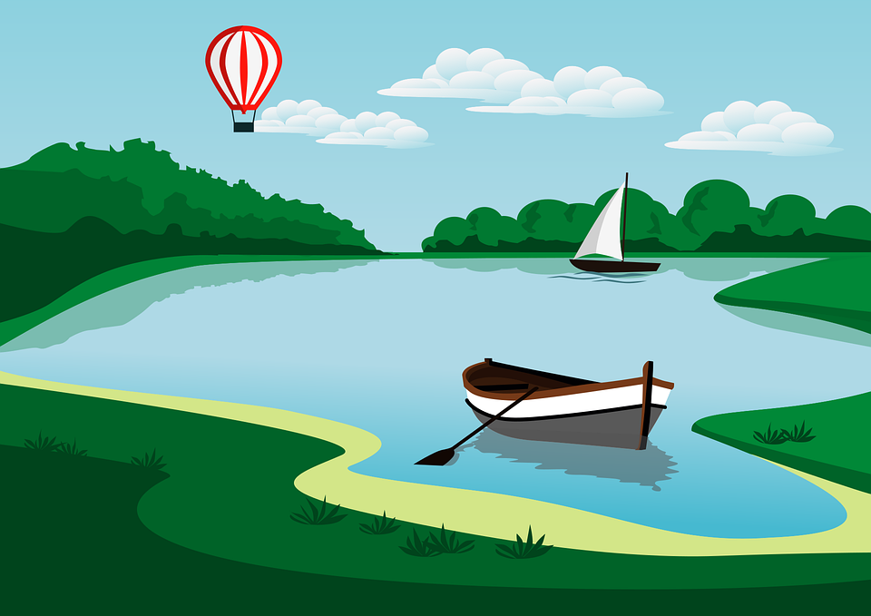
pronunciar
[ga]
ganar
[go]
lago
Notes:
Timing: 1 minute
Aim: to introduce SSC [ga] [go]
Procedure:
To recap and elicit the pronunciation of the individual SSC [ga] [go]
Click to bring the picture & get students to repeat (with gesture, if using).
Gesture suggestion for ganar: lift your fist up in two goes.
Gesture suggestion for lago: rowing – two movements

Slide 4
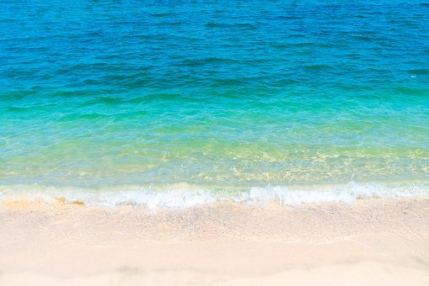
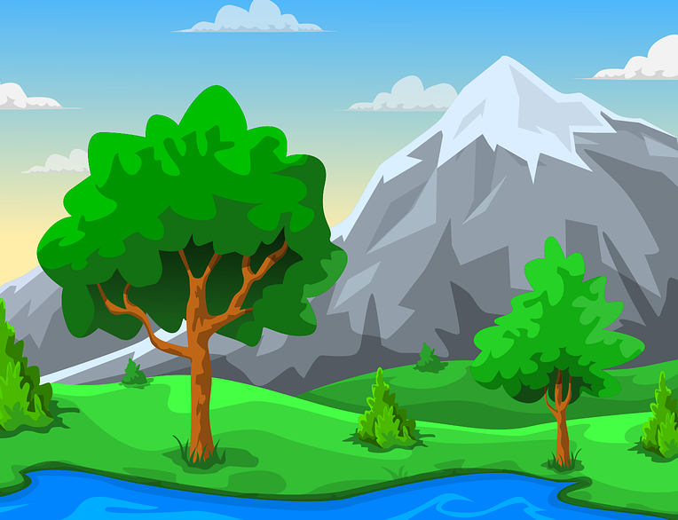
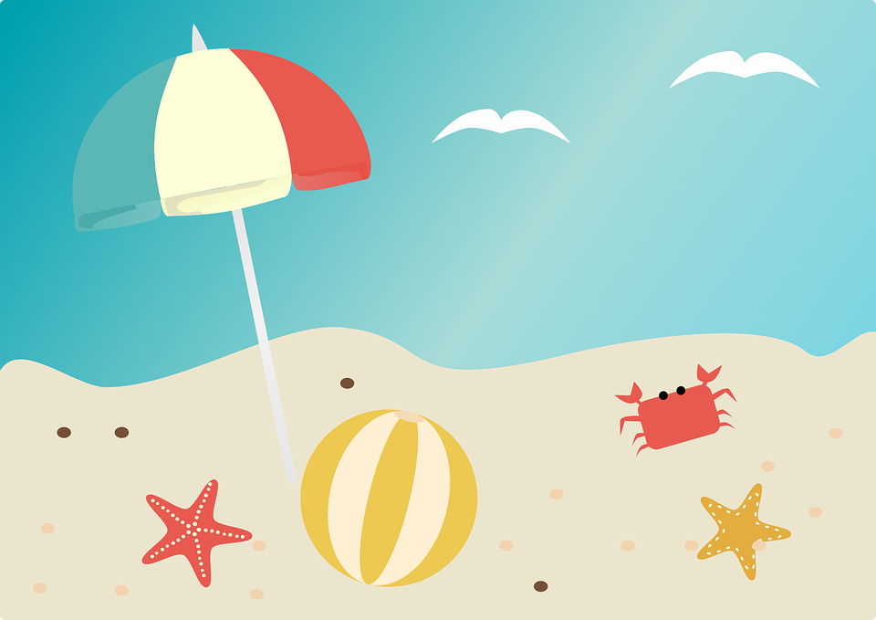
Vocabulario
¿Es un o una?
⚠ Nouns that end in –r are masculine.
escuchar
[un]
[una]
__ clase de inglés an English class
__ mar a sea
__ sombrero a hat
__ pueblo a village
__ playa a beach
__ casa a house
__ regalo a gift
__ montaña a mountain
__ botella a bottle
__ globo a balloon
Notes:
Timing: 5 minutes
Aim: to practise aural distinction between un and una; to present the new vocabulary (and some revisited vocabulary for this week in sound and writing, and with English meanings.
Procedure:
Click for each word to appear with audio (without article).
Pupils say ‘un’ or ‘una’, depending on the noun ending.
Click again for it to disappear into the corresponding pacperson’s mouth.
Transcript: un globo una botella una montaña un regalo un sombrero una playa un pueblo una casa
una clase de inglés
un mar

Slide 5
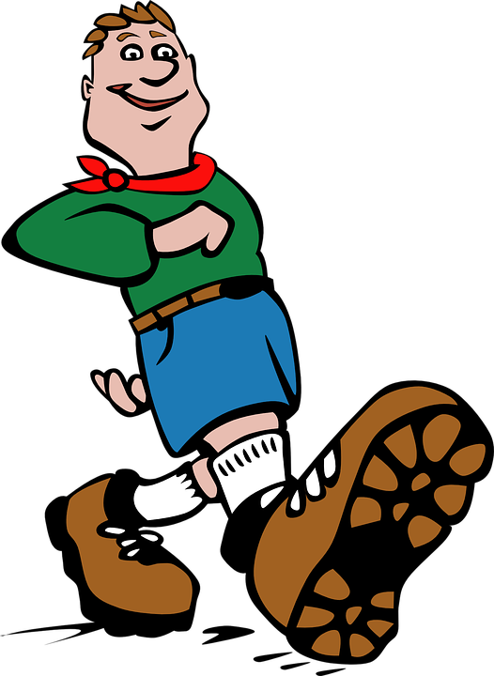
vocabulario
[from, of]
de
[to walk, walking]
[to swim, swimming]
⚠ You know de means from. E.g. Soy de España. It can also mean ‘of’:
caminar
nadar
⚠ In English, we use more than one word for por:
La clase de Sofía. The class of Sofía or Sofía’s class.
[through, around, along]
Camino por la montaña. I walk through the mountain(s).
La clase de español. The class of Spanish or The Spanish class.
Camino por el pueblo. I walk around the village.
por
Just use the English meaning that sounds right to you.
Camino por la playa. I walk along the beach.
Notes:
Timing: 3 minutes
Aim: to introduce key vocabulary for this week.
Procedure: 1. Teacher clicks through animations to present and elicit practice of the new words.
Note: there is additional information for the prepositions ‘de’ and ‘por’.

Slide 6
Definite articles: singular & plural
This is grammatical, not biological gender! A house (una casa) is not female, it is a feminine noun.
[the]
Remember! In Spanish, things, as well as people and animals, are either masculine or feminine. We say that they have gender.
To say a (or an) in Spanish use un before a masculine noun and una before a feminine noun.
To say the before a singular noun, you use ‘el’ or ‘la’.
Masculine
Feminine
la
el
una
un
the uniform
___ playa
a beach
___ uniforme
a uniform
the beach
el
la
una
a mountain
___ pueblo
the village
___ montaña
the mountain
un
a village
el
la
un
___ museo
a museum
a fruit
the museum
___ fruta
una
the fruit
Notes:
Timing: 3 minutes
Aim: to revisit grammatical gender and singular indefinite articles; to introduce singular definite articles (el, la)
Procedure:
Read the grammar explanation on gender in Spanish & indefinite articles.
Click to bring up examples of singular masculine and feminine nouns.
Elicit the indefinite article from pupils and the English meaning of each noun.
Click each time to reveal the answer.
Click to make examples of nouns with singular definite article disappear.
Click to bring up the explanation for “the” in the singular form.
Repeat as in steps 2-5.

Slide 7
leer
El diario de Sofía:
Sofía habla de actividades al aire libre*.
¿Es ‘I’ (Sofía) o ‘she’ (Ángela)? Y, ¿dónde?
[E] Lleva una mochila en la pueblo. | montaña.
Sofía (I) | Ángela (she) | Where?
E
[1] Camino por el pueblo. | playa.
mountain
1
beach
[2] Nada en el escuela. | mar.
2
sea
3
[3] Canto en el clase de música. | pueblo.
village
4
[4] Escucha la radio en el mar. | casa.
sea
el aire libre – the open air
Notes:
Timing: 7 minutes
Aim: to practise written comprehension of definite and indefinite articles & key vocabulary for this week; to revisit 1st & 3rd person singular verb endings with a range of regular –ar verbs.
Procedure:
Read the title and instructions.
Pupils write I or she for each verb and decide the location, connecting the definite article ‘the’ with the correctly-gendered noun.
Click through the animations to bring up answers, eliciting whole sentence meanings at the same time.
If desired, click on the audio buttons to hear the full sentences as part of the feedback process.
Transcript: Ejemplo. Lleva una mochila en la montaña.
1. Camino por el pueblo.
2. Nada en el mar. 3. Canto en el pueblo. 4. Escucha la radio en el mar.

Slide 8
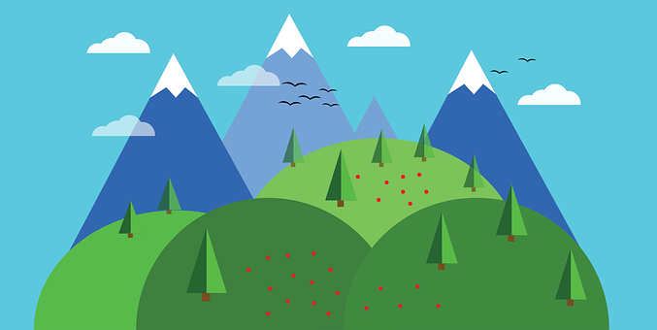
escuchar
Sofía habla de actividades al aire libre.
Escucha otra vez.
¿ Quién es? ¿Es al aire libre?
Escucha:
¿Menciona el o la?
Marca
¿dónde?
S (I), Á (she)
al aire libre
 | el | la
 | el | la
 | el | la
 | el | la
 | el | la
 | el | la
E
playa | mar
E
Sofía (I)
1
clase de inglés | pueblo
1
Sofía (I)
2
mar | playa
2
Ángela (I)
3
3
Sofía (I)
casa de Ángela | pueblo
4
montaña | lago
4
Ángela (I)
5
playa | pueblo
5
Ángela (I)
Notes:
Timing: 5 minutes
Aim: to practise aural recognition of el / la and its connection with an appropriate noun; to practise understanding of 1st and 3rd person present tense –AR verbs and overall comprehension of sentences mad up of this week and previous weeks’ vocabulary.
Procedure:
Read the title and the instructions in Spanish.
Do the example (E). (Note: some learners will benefit from being able to circle the words on the sheet).
Click to bring up the answers.
Pupils write (or circle) the correct article, and identify the place.
Pupils check their answers.
Click to bring up a 2nd set of audio buttons to hear the whole sentence. This time pupils need to identify who is doing the ac tivity and whether the activity takes places outdoors (al aire libre) or indoors.
Click to confirm the answers. Note that ‘buys a present in the village’ could be understood as an indoor (in the shop) or outdoor (at a market) activity.
Transcript:
E. Camino por la [playa].
Llevo un sombrero en el [pueblo].
Nada en el [mar].
Canto en la [casa de Ángela]
Camina por la [montaña].
Compra un regalo en el [pueblo].

Slide 9
¡adiós!
rojo

