Slide 1
Saying what I and others have
rojo
Follow ups 1-5
Notes:
Artwork by Steve Clarke. All additional pictures selected are available under a Creative Commons license, no attribution required.
The frequency rankings for words that occur in this PowerPoint which have been previously introduced in the resources are given in the SOW (excel document) and in the resources that first introduced and formally re-visited those words.
For any other words that occur incidentally in this PowerPoint, frequency rankings will be provided in the notes field wherever possible.
SSC: [l] and [ll]
Vocabulary (new words in bold): llevar [101] comprar [361] película [944] sombrero [2290] uniforme [2796] con [14]
Revisit 1: tienes [19] botella [1878] estuche [>5000] libro [230] pregunta [507] respuesta [488] sacapuntas [>5000] Revisit 2: elegante [2742] feliz [908] triste [1371] ¿dónde? [161]
Source: Davies, M. & Davies, K. (2018). A frequency dictionary of Spanish: Core vocabulary for learners (2nd ed.). Routledge: London

Slide 2
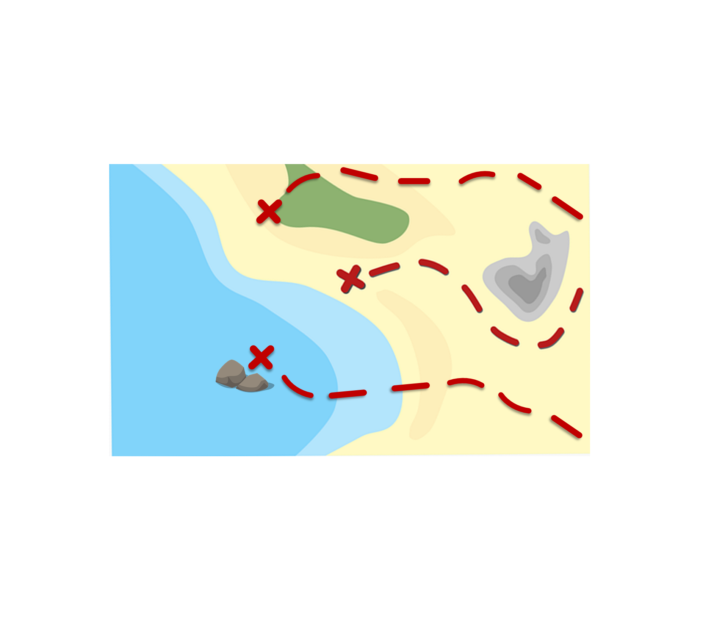
Follow up 1:
[l] libro
La ruta de las monedas
[ll] llamar
Pronuncia las palabras y colecciona monedas.
Turno 1: Persona A
Turno 2: Persona B
libro
lobo
collar
grillo
llamar
amarillo
llama
color
ballena
camello
lavar
llave
llave
calle
loro
llover
sol
collar
INICIO
Notes:
Timing: 5 minutes
Aim: To practise the pronunciation of Spanish words with the SSC [l] and [ll].
Procedure:
Pupils work in pairs to practise pronunciation. They can choose where to start and have one minute to collect as many coins as possible.
Divide the class in A & B and click to indicate it’s ‘persona A’’s turn.
Pupil A starts from either ‘Amarillo, ‘camello’ or ‘collar’, and follows the path to pronounce the words and collect the corresponding coins.
Click to bring up Persona B’s turn.

Slide 3
Follow up 2:
Knowing who does what
⚠ We don’t need pronouns because the verb ending tells us who is doing the action.
[–ar verbs: ‘I’ versus ‘s/he, it’]
In Spanish, the words for ‘I’ and ‘s/he’ (pronouns) are often unnecessary.
To mean ‘I’ with a verb, we remove –ar and add -o.
To mean ‘s/he, it’ with a verb, we remove –ar and add –a.
Ejemplo: llevar
I
s/he, it
Llevo uniforme en clase.
LLeva un sombrero en casa.
I wear uniform in class.
S/he wears a hat at home.
Notes:
Timing: 8 minutes (two slides)
Aim: to recap 1st and 3rd person singular forms of –ar verbs.
Procedure:
Click through the animations to present the new information.
Elicit English translations for the Spanish examples provided.

Slide 4
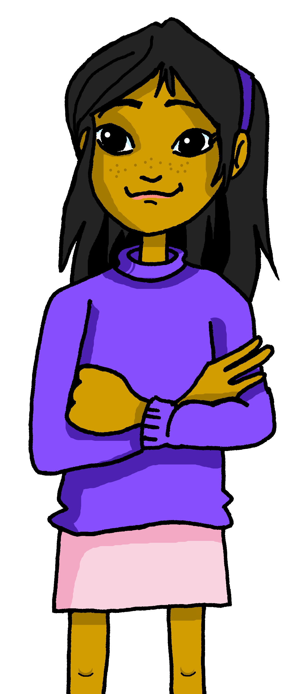
Follow up 2: Sofía escribe.
A Lee las frases.
leer
Marca la opción correcta para el verbo.
¿La respuesta es normal o rara?
Sofía (I) | Ángela (she)
Llevo un sombrero en clase.
Necesita uniforme en clase.
Hablo inglés con una amiga de Perú.
Llevo una mochila a clase.
Habla español en casa.
Canto en clase.
Escucha vocabulario en clase.
[R]
1
2
[R]
[R]
3
4
[N]
5
[N]
6
[N/R]
7
[N]
Notes:
Aim: to practise written comprehension of 1st and 3rd persons singular of –AR verbs and vocabulary from this week.
Procedure:
Read the instructions in Spanish. Clarify meaning.
Model the task using the first item.
Pupils decide which each of the sentences refers to (Sofía talking about herself (I) or about Ángela (she).
Click to correct the answers. If desired, click the green buttons to hear the sentence audio.
Click again to bring up a supplementary comprehension task. The aim of the activity is to prompt pupils to think about the meaning of the sentences. Pupils read the sentences again and decide which are expected and which are strange or unexpected answers. Item 2 requires pupils to know that in Spain pupils don’t wear school uniform (except in private schools, which are uncommon). Items 3 and 5 require pupils to consider the languages spoken by people generally in Peru and by Ángela at home.
Click to bring up the answers.

Slide 5
Follow up 3:
Escucha y escribe.
escuchar y escribir
Habla
1. _______ con una amiga de Inglaterra.
3
I
s/he
2
1
¡escribe!
Notes:
[1/5] Timing: 5 minutes (5 slides)
Aim: to practise aural comprehension of this week’s new language, connecting sound with meaning.
Procedure:
Click to play the audio.
Click to count down 3 -2 – 1. When the word ‘escribe’ appears bottom right, pupils can try to write the missing verb.
Note: pupils can be challenged to write the full sentence from memory by turning away from the board.
Click to reveal the missing verb.
Click again to bring up two pronoun options.
Elicit the answer from pupils and click to reveal the answer tick.
Transcript:
Habla con una amiga de Inglaterra.

Slide 6
Follow up 3:
Escucha y escribe.
escuchar y escribir
Llevo
2. _______ uniforme ahora.
3
I
s/he
2
1
¡escribe!
Notes:
[2/5]
Transcript:
Llevo uniforme ahora.

Slide 7
Follow up 3:
Escucha y escribe.
escuchar y escribir
Neccesita
3. ___________ un estuche en clase.
3
I
s/he
2
1
¡escribe!
Notes:
[3/5]
Transcript:
Necesita un estuche en clase.

Slide 8
Follow up 3:
Escucha y escribe.
escuchar y escribir
Compro
4. ___________ una película en Internet.
3
I
s/he
2
1
¡escribe!
Notes:
[4/5]
Transcript:
Compro una película en Internet.

Slide 9
Follow up 3:
Escucha y escribe.
escuchar y escribir
Compra
5. ___________ una tarta para un amigo.
3
I
s/he
2
1
¡escribe!
Notes:
[5/5]
Transcript:
Compra una tarta para un amigo.

Slide 10
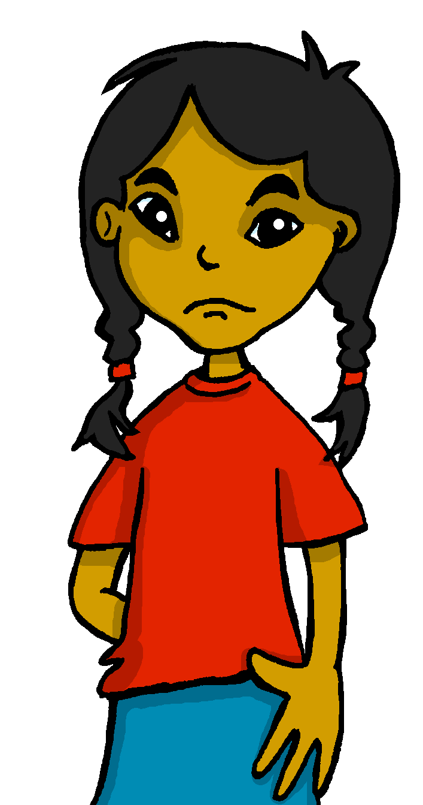
Follow up 4:
¡No tengo voz!
Sofía habla [1/5]
leer
hablar
Lee la frase en español. ¡Usa las palabras!
Sofía has lost her voice but wants to send a voice message to Luis, saying what she does on the weekend, but also what Quique does. Can you help her?
¡Ojo⚠! Una palabra es extra.
1 [I buy (a piece of) fruit.]
Luis
compra
fruta
una
compro
?
Sofía
compro
una
fruta
INICIO
Notes:
Timing: 5 mins [5 slides in total] [1/5]
Aim: to practise scaffolded spoken production of this week’s key language.
Procedure:
Teacher reads the title of the task and elicits English translation from students.
Click to bring up Spanish instructions and read out loud. Ensure that meanings are clear.
Click to start the timer.
Pupils work in pairs to translate orally and say the sentence aloud in Spanish within the five-second time limit.
Elicit answers from students (either chorally or from individuals).
Click on the blue speaker icon on the phone to bring up the answer.

Slide 11
Follow up 4:
¡No tengo voz!
Sofía habla [2/5]
leer
hablar
Lee la frase en español. ¡Usa las palabras!
¡Ojo⚠! Una palabra es extra.
2 [She speaks in Spanish]
Luis
hablo
español
habla
en
?
Sofía
habla
en
español
INICIO
Notes:
[2/5]

Slide 12
Follow up 4:
¡No tengo voz!
Sofía habla [3/5]
leer
hablar
Lee la frase en español. ¡Usa las palabras!
¡Ojo⚠! Una palabra es extra.
3 [She buys a film]
Luis
película
compro
compra
una
?
Sofía
compra
una
película
INICIO
Notes:
[3/5]

Slide 13
Follow up 4:
¡No tengo voz!
Sofía habla [4/5]
leer
hablar
Lee la frase en español. ¡Usa las palabras!
¡Ojo⚠! Una palabra es extra.
4 [she needs help now]
Luis
necesitar
ahora
necesita
ayuda
?
Sofía
necesita
ayuda
ahora
INICIO
Notes:
[4/5]

Slide 14
Follow up 4:
¡No tengo voz!
Sofía habla [5/5]
Lee la frase en español. ¡Usa las palabras!
leer
hablar
¡Ojo⚠! Una palabra es extra.
5 [I listen to vocabulary in Spanish]
Luis
en
escuchar
español
vocabulario
?
escucho
Sofía
escucho
vocabulario
en
español
INICIO
Notes:
[5/5]

Slide 15
Follow up 5:
Escribe 5 frases en español.
un cuaderno
un lápiz
una palabra
una frase
en español
en inglés
una pregunta
una respuesta (un) uniforme ayuda vocabulario un sombrero una película
escribir
[I need] [S/he needs] [I listen to] [S/he listens to] [I buy] [S/he buys] [I speak] S/he speaks] [I wear, carry] [S/he wears, carries]
Notes:
Timing: 8 minutes
Aim: to practise written production of new 1st and 3rd person verb forms and written comprehension of previously taught vocabulary.
Procedure: 1. Pupils write five sentences using five different verb forms, translating from English into Spanish, and then selecting appropriate sentence endings from the Spanish items in the yellow box on the right. 2. Pupils read each other their sentences and the listening partners interprets into English.

Slide 16
Follow up:
Escribe en español: Can you get at least 15 points?
 | sad | where? | Do you have?
 | a pencil sharpener | smart | happy
 | a book | a question | an answer
 | you have | a bottle | a pencil case
 | a uniform | a film | with
 | to wear, carry | to buy, buying | a hat
vocabulario
triste
¿dónde?
¿tienes?
vocabulario
x3
un sacapuntas
elegante
feliz
un libro
una pregunta
una respuesta
x2
tienes
una botella
un estuche
un uniforme
una película
con
x1
llevar
comprar
un sombrero
Notes:
Timing: 6 minutes
Aim: to practise written production of vocabulary for this week and previous weeks.
Procedure:
1. Pupils need to write the Spanish for as many words as possible, aiming to get at least 15 points (but more if possible).
2. Click for Spanish answers.

Slide 17
Follow up:
Escribe en español: Can you get at least 15 points?
 | sad | where? | Do you have?
 | a pencil sharpener | smart | happy
 | a book | a question | an answer
 | you have | a bottle | a pencil case
 | a uniform | a film | with
 | to wear, carry | to buy, buying | a hat
vocabulario
vocabulario
x3
x2
x1
Notes:
HANDOUT

