Slide 1
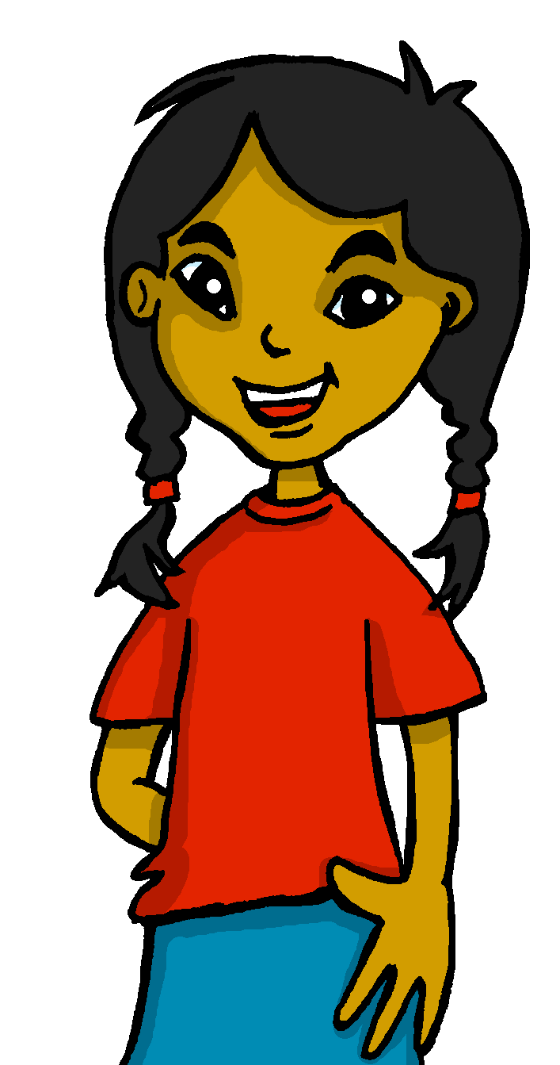
español, con Sofía

Slide 2
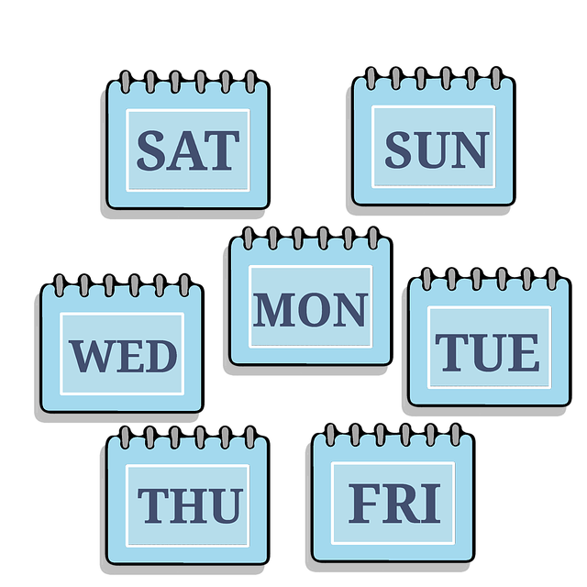
Describing me and others
¿Qué día es?
lun
mar
mié
jue
vier
rojo
sáb
dom
‘to be’: ‘es’ for dates, estar + temporary states
SSC [ca] [co] [cu]
Notes:
Artwork by Steve Clarke. All additional pictures selected are available under a Creative Commons license, no attribution required.
The frequency rankings for words that occur in this PowerPoint which have been previously introduced in the resources are given in the SOW (excel document) and in the resources that first introduced and formally re-visited those words.
For any other words that occur incidentally in this PowerPoint, frequency rankings will be provided in the notes field wherever possible.
Frequency of new vocabulary and phonics:
- Vocabulary: qué [50] día [65] lunes [1370] martes [3101] miércoles [1816] jueves [1650] viernes [1259] sábado [1179] domingo [693]
- Phonics: casa [106] dos [64] elefante [>5000] idea [247] universo [1603] + cluster: cama [609] contar [172] cucaracha [>5000]
Frequency of unknown words:
orden [421] correcto [1467]
Source: Davies, M. and Davies, K. (2018). A frequency dictionary of Spanish: Core vocabulary for learners (2nd ed.). Routledge: London

Slide 3
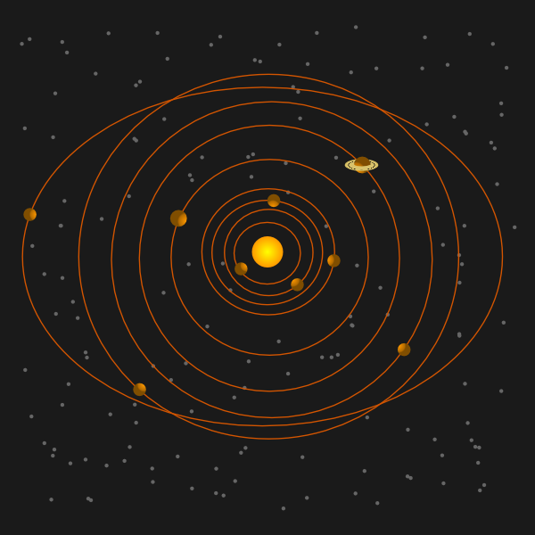
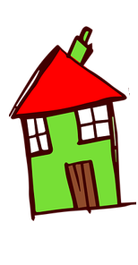
pronunciar
2
[a]
casa
1
5
[o]
dos
4
[u]
universo
3
Notes:
Timing: 2 minutes
Aim: to practise SSC [a] [e] [i] [o] [u]
Procedure:
1. Click to trigger the SSC [a] and get pupils to repeat – this is also a great opportunity to check whether they remember the source words.
2. Click to trigger the word [casa] and pupils repeat.
3. Repeat the process with [o] [u].
4. Once all the source words are on display, click to trigger first picture [universo] – ask pupils to pronounce the word that matches the picture. Teachers to model numbers (uno, dos, tres, cuatro, cinco) as these have not been introduced yet. Repeat 2 more times to go through all the source words.
For further practice, pupils work in pairs. One pupil uses a gesture, the partners elicits the source word.

Slide 4
pronunciar
[ca]
cama
[co]
contar
[cu]
cucaracha
Notes:
Timing: 2 minutes
Aim: to apply SSC [a] [o] [u] in combination with [c] → [ca] [co] [cu]
Procedure:
Click to trigger [ca] and get pupils to repeat.
Click to bring up the word. Click to bring up the image too.
Encourage pupils to do the gesture, if using.
Bring [co] and [cu] and repeat steps 1-3.
Gestures:
[ca] Both hands stretch down to pull up an imaginary duvet as pupils mime gently reclining backwards.
[co] Pupils hold up one hand and put each finger down one by one to denote ‘counting’. [cu] With fingers of their right hand, pupils mime a cockroach crawling up their left arm.

Slide 5
pronunciar
¿Qué?
What?
¿Qué día es hoy?
[What day is it today]
Rachel Hawkes / Emma Marsden
Notes:
Timing: 1 minute
Aim: to introduce question word ¿qué?
Procedure:
Pupils listen and repeat the key question word (include gesture if possible)
Display the word & get them to repeat one more time.
Elicit English meaning.
Reveal the sentence + elicit English meaning from pupils.

Slide 6
Using ‘es’ with days of the week
[ser]
We use ser when talking about what day it is.
To say ‘it is’ and ‘is’ + day of the week, we use es.
Por ejemplo:
Hoy es jueves.
Es jueves.
Today is Thursday.
It is Thursday.
Thursday
Notes:
Time: 2 minutes Aim: to learn about the use of ‘ser’ when taking about what day it is.
Note: this is a specific use of ser that doesn’t follow the rules learnt so far for using ser (traits, origin). However, it is congruent with the notion of essential characteristic or trait in the sense that Tuesday is always Tuesday (for the length of the 24 hour period of one day). It doesn’t unexpectedly change its mood or state and become Wednesday.
Procedure: 1. Teachers present the new information. It is animated to allow for a paced, interactive delivery. 2. Elicit the English translation for the examples.

Slide 7
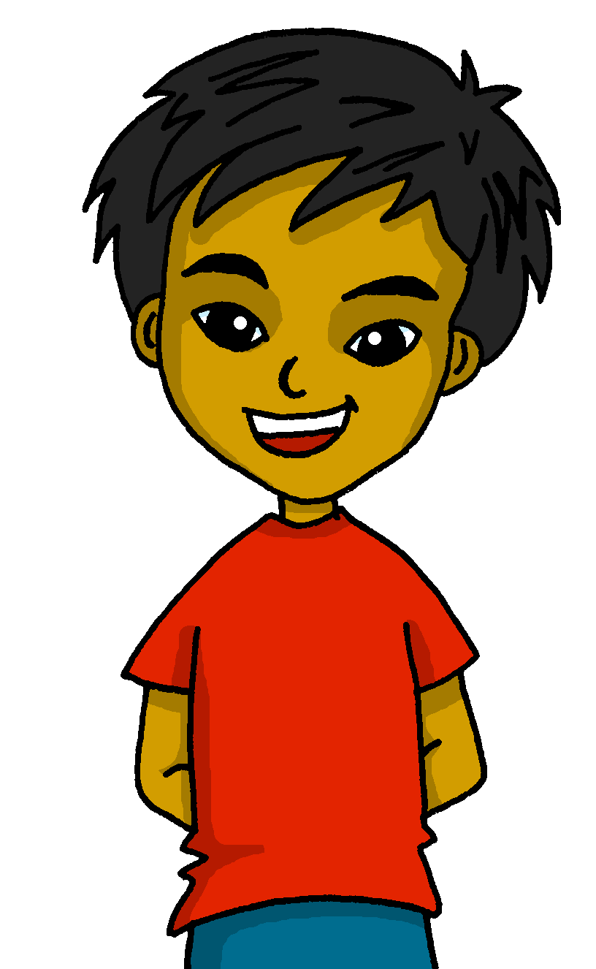
hablar
Quique, ¿Qué día es hoy?
Es lunes.
Monday
Notes:
Timing: 3 minutes (four slides)
Aim: to introduce four new vocabulary items for this lesson.
Procedure:
Read Sofía’s question & ensure pupils are clear about the meaning.
Click to bring up Quique’s response.
Click to bring up the translation.
Ensure correct pronunciation – get pupils to practise out loud.

Slide 8
hablar
Sofía, ¿Qué día es hoy?
Es martes.
Tuesday

Slide 9
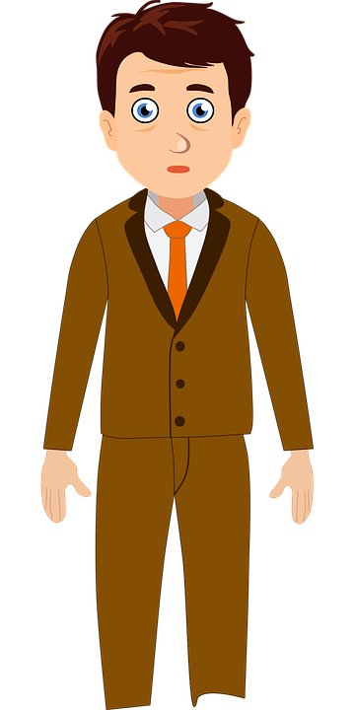
hablar
Señor Valero, ¿Qué día es hoy?
Es miércoles.
Wednesday

Slide 10
hablar
Quique, ¿Qué día es hoy?
Es jueves.
Thursday

Slide 11
hablar
¿Qué día es hoy, clase?
miércoles
lunes
martes
Tuesday
Notes:
Timing: 3 minutes (four slides)
Aim: to recap the four new vocabulary items learnt so far this lesson.
Procedure:
Click to bring up the question.
Read the 3 options & elicit correct translation from pupils.

Slide 12
hablar
¿Qué día es hoy, clase?
jueves
lunes
martes
Monday

Slide 13
hablar
¿Qué día es hoy, clase?
miércoles
lunes
jueves
Thursday

Slide 14
hablar
¿Qué día es hoy, clase?
lunes
jueves
miércoles
Wednesday

Slide 15
hablar
Sofía, ¿Qué día es hoy?
Es viernes.
Friday
Notes:
Timing: 2 minutes (three slides)
Aim: to introduce three new vocabulary items for this lesson.
Procedure:
Read Quique’s question & ensure pupils are clear about the meaning.
Click to bring up Sofía’s response.
Click to bring up the translation.
Ensure correct pronunciation – get pupils to practise out loud.

Slide 16
hablar
Señor Valero, ¿Qué día es hoy?
Es sábado.
Saturday

Slide 17
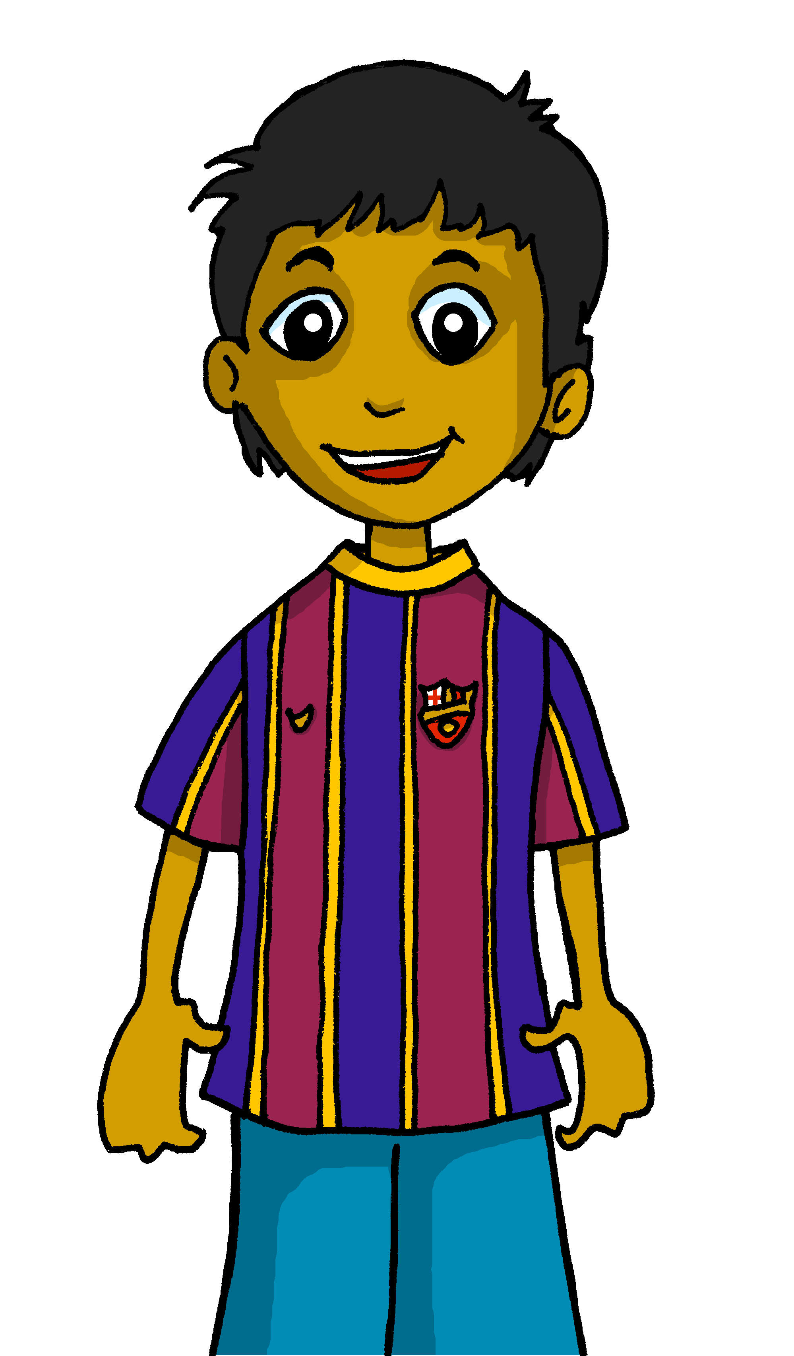
hablar
Rubén, ¿Qué día es hoy?
Es domingo.
Sunday

Slide 18
hablar
¿Qué día es hoy, clase?
jueves
martes
sábado
viernes
Saturday
Notes:
Timing: 2 minutes (three slides)
Aim: to recap four of the new vocabulary items for this lesson.
Procedure:
Click to bring up the question.
Read the 3 options & elicit correct translation from pupils.

Slide 19
hablar
¿Qué día es hoy, clase?
domingo
martes
sábado
lunes
Sunday

Slide 20
hablar
¿Qué día es hoy, clase?
miércoles
domingo
sábado
viernes
lunes
💡In Spanish, days of the week are not capitalised.
Friday

Slide 21
escuchar
La señora Cano habla.
¿Qué día es?
escuchar
escuchar
 | Tuesday | Wednesday | Monday | Thursday
 | Wednesday | Friday | Thursday | Saturday
 | Tuesday | Sunday | Wednesday | Thursday
 | Friday | Saturday | Monday | Wednesday
 | Thursday | Friday | Sunday | Tuesday
 | Sunday | Monday | Tuesday | Saturday
E
1
2
3
4
5
Which day is not mentioned?
Friday
____________
____________
viernes
Notes:
Timing: 4 minutes
Aim: to practise aural comprehension of the vocabulary (days of the week) in sentence context. Note: this activity does not practise the grammar as the 3rd person ‘es’ is used throughout. Irregular verb forms (such as es) are learnt as individual vocabulary items, and the intention is not to focus on a pattern of verb endings in this lesson, but rather to teach and learn the combination of ‘es’ with days of the week.
Procedure:
Read the title & click to bring up the instructions in Spanish.
Do the example (E) with them and read the options. (Note: some learners will benefit from being able to circle the words on the sheet).
Click to bring up answers and, to extend the more proficient learners, elicit the Spanish meanings from pupils in whole class feedback.
Transcript:
Hoy es jueves.
Hoy es miércoles.
Hoy es martes.
Hoy es sábado.
Hoy es domingo.
Hoy es lunes.

Slide 22
pronunciar
lunes
Notes:
Timing: 3 minutes (7 slides)
Aim: to consolidate pronunciation & 7 new items of vocabulary and use hand gestures to embed meaning.
Procedure:
Use hand gesture and (1-7 for days of the week) in combination with oral production of day of the week & get pupils to repeat.

Slide 23
pronunciar
martes

Slide 24
pronunciar
miércoles

Slide 25
pronunciar
jueves

Slide 26
pronunciar
viernes

Slide 27
pronunciar
sábado

Slide 28
pronunciar
domingo

Slide 29
hablar
Lee en el orden* correcto*.
martes
miércoles
sábado
30 segundos
viernes
lunes
jueves
orden = order
correcto = correct
domingo
INICIO
Notes:
Timing: 2 minutes
Aim: to consolidate days of the week (in combination with hand gestures to embed meaning).
Procedure:
Read the instruction in Spanish.
In pairs, ask pupils to read the days of the week in the correct order.
Click “inicio” to trigger 30-second timer.
Go to next slide for answers.
Frequency of unknown words:
orden [421] correcto [1467]
Source: Davies, M. and Davies, K. (2018). A frequency dictionary of Spanish: Core vocabulary for learners (2nd ed.). Routledge: London

Slide 30
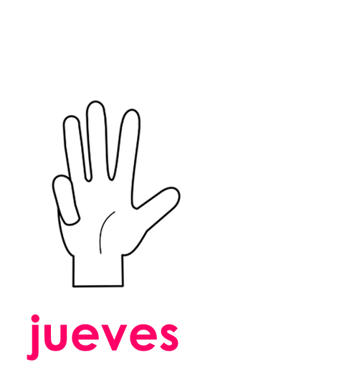
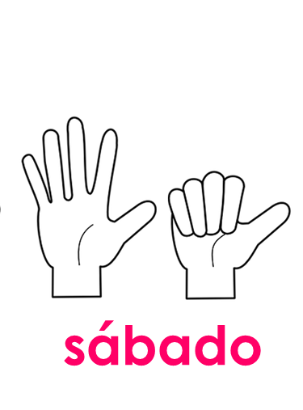
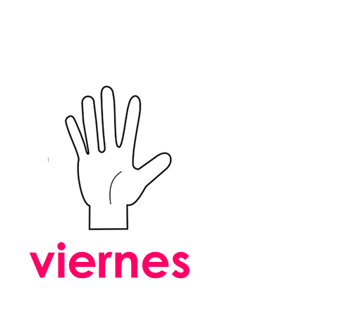
hablar
Lee en el orden* correcto*.
martes
viernes
sábado
jueves
lunes
miércoles
domingo
30 segundos
orden = order
correcto = correct
INICIO
Notes:
ANSWERS Procedure:
Click to make the days disappear in the correct order and click again to bring up the correct answer with image.
Click again to make all of the answers disappear and bring back the jumbled days.
Click “inicio” to trigger 30-second timer. Pupils practise one more time saying all of the days in the correct order.
Frequency of unknown words:
orden [421] correcto [1467]
Source: Davies, M. and Davies, K. (2018). A frequency dictionary of Spanish: Core vocabulary for learners (2nd ed.). Routledge: London

Slide 31
vocabulario
Escribe en inglés 📝.
Can you get at least15 points?
a b ñ
vocabulario
 | estás | aquí | ¿Dónde?
 | soy | ahora | eres
 | triste | feliz | perdido
 | ¿Cómo? | estoy | hoy
 | día | viernes | domingo
 | jueves | ¿Qué? | es
 | lunes | martes | miércoles
vocabulario
vocabulario
vocabulario
vocabulario
vocabulario
you are (state)
here
Where?
x3
I am (trait)
now
you are (trait)
sad
happy
lost
x2
How?
I am (state)
today
day
Friday
Sunday
Thursday
What?
it is (trait)
x1
Monday
Tuesday
Wednesday
Notes:
Timing: 6 minutes
Aim: to practise written comprehension of vocabulary from last week and this week.
Procedure: 1. Give pupils a blank grid. They fill in the English meanings of any of the words they know, trying to reach 15 points in total.
Note: The most recently learnt and practised words are pink, words from the previous week are green and those from two weeks ago are blue, thus more points are awarded for them, to recognise that memories fade and more effort (heavy lifting!) is needed to retrieve them.

Slide 32
¡adiós!
rojo

