Slide 1
Describing me and others
¿Cómo es?
rojo
Follow ups 1-5
Notes:
Artwork by Steve Clarke. Pronoun pictures from NCELP (www.ncelp.org). All additional pictures selected from Pixabay and are available under a Creative Commons license, no attribution required.
Vocabulary: ser [7] soy [7] es [7] siempre [96] normalmente [1696] Revisit: cansado [1818] contento [1949] nervioso [1521] serio [856] tranquilo [1073] ahora [81] ¿cómo? [151]
Source: Davies, M. and Davies, K. (2018). A frequency dictionary of Spanish: Core vocabulary for learners (2nd ed.). Routledge: London
The frequency rankings for words that occur in this PowerPoint which have been previously introduced in these resources are given in the SOW and in the resources that first introduced and formally re-visited those words.
For any other words that occur incidentally in this PowerPoint, frequency rankings will be provided in the notes field wherever possible.

Slide 2
Follow up 1
a b ñ
Say each word in Spanish when you see the English.
vocabulario
vocabulario
vocabulario
vocabulario
seria
tranquilo
es
contenta
ahora
siempre
calm (m.)
nervous (m.)
tired (f.)
pleased (f.)
serious (f.)
¡Excelente!
now
I am
how?
always
normally
s/he, it is
where?
nervioso
¿cómo?
cansada
¿dónde?
normalmente
soy
Notes:
Timing: 5 minutes
Aim: to practise written comprehension and spoken pronunciation of vocabulary for this week and the revisited week.
Procedure:
1. Click for English prompt. Pupils need to locate the correct Spanish word and pronounce it, chorally.
2. Click for target word to be highlighted. 3. Repeat for all 12 items.

Slide 3
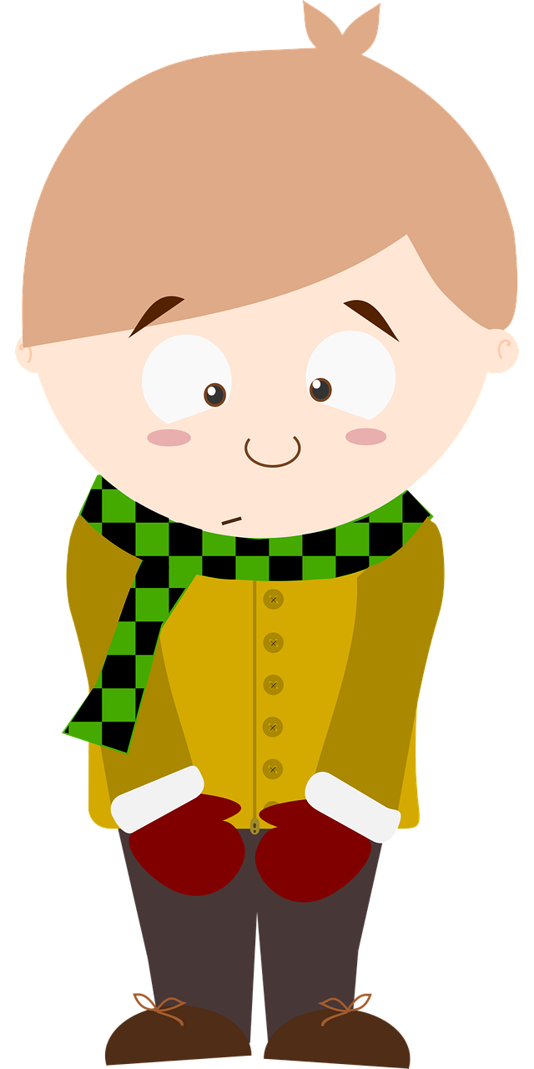
Follow up 2:
Sometimes we refer to people by name in a sentence:
Emilio is always serious.
In Spanish, we often don’t need to use the pronoun.
Emilio es serio siempre.
Here we use the pronoun he because we don’t need to repeat Emilio.
He is (generally) nervous.
⚠ This means that es can mean is and he is, she is, it is.
Es nervioso.
[is]
[He is]
Notes:
Timing: 5 minutes (two slides)
Aim: to draw attention to pronouns in English and Spanish and the multiple meanings of ‘es’ (is, he is, she is, it is).
Procedure:
Click to present the information.
Ensure pupils’ understanding of the key term ‘pronoun’.

Slide 4
Follow up 2:
Lee las frases.
Write the English meaning of es for each sentence, and the meaning of the whole sentence, if you can:
leer
Iker es tranquilo siempre.
Normalmente Irene es feliz.
¿Es Isabel curiosa? No, es seria.
¿Cómo es Quique? Siempre es feliz.
¿ Es nerviosa? No, Eva es seria.
Iker is always calm.
Irene is usually happy.
Is Isabel curious? No, she is serious.
How is Quique (generally)? He is always happy.
Is she (generally) nervous? No, Eva is serious.
Notes:
Procedure:
Pupils write 1 – 5 and the English translation of es as best fits each sentence.
Click to trigger answers.
Note: Pupils have already practised a similar task with está sentences. This time they are asked to translate the full sentences to practise additional vocabulary, too.

Slide 5
Follow up 3
Say the Spanish sentence.
hablar
You do not need all of the words!
hablar
Normally she is serious.
15 segundos
Normalmente es seria.
serio
es
curiosa
soy
siempre
seria
normalmente
0
INICIO
Notes:
Time: 6-8 minutes (8 slides)
Aim: to practise oral sentence building, deciding between the target features of soy | es and masculine | feminine adjective forms. Procedure:
1. Click for English sentence and Spanish prompt words. 2. Click inicio to start the timer.
3. Pupils select from the words given to create and say the sentence out loud before the time elapses. 4. Click for the Spanish sentence to appear.

Slide 6
Follow up 3
Say the Spanish sentence.
hablar
You do not need all of the words!
hablar
I (a boy) am always calm.
15 segundos
Soy tranquilo siempre.
feliz
es
tranquila
soy
siempre
tranquilo
normalmente
0
INICIO
Notes:
[2/8]

Slide 7
Follow up 3
💡 In Spanish put siempre and normalmente at the start OR at the end but not in the middle of the sentence.
Say the Spanish sentence.
hablar
You do not need all of the words!
hablar
He is normally happy.
15 segundos
Es feliz normalmente.
feliz
es
elegante
soy
siempre
normalmente
rápido
0
INICIO
Notes:
[3/8]

Slide 8
Follow up 3
💡 In Spanish put siempre and normalmente at the start OR at the end but not in the middle of the sentence.
Say the Spanish sentence.
hablar
You do not need all of the words!
hablar
I (a girl) am generally fast.
15 segundos
Soy rápida normalmente.
es
soy
normalmente
rápida
rápido
lenta
siempre
0
INICIO
Notes:
[4/8]

Slide 9
Follow up 3
💡 In Spanish put siempre and normalmente at the start OR at the end but not in the middle of the sentence.
Say the Spanish sentence.
hablar
You do not need all of the words!
hablar
She is always smart.
15 segundos
Siempre es elegante.
es
soy
normalmente
nerviosa
curiosa
elegante
siempre
0
INICIO
Notes:
[5/8]

Slide 10
Follow up 3
Say the Spanish sentence.
hablar
You do not need all of the words!
hablar
Normally he is curious.
15 segundos
Normalmente es curioso.
normalmente
curiosa
lento
es
curioso
soy
siempre
0
INICIO
Notes:
[6/8]

Slide 11
Follow up 3
Say the Spanish sentence.
hablar
You do not need all of the words!
hablar
I (a boy) am always nervous.
15 segundos
Siempre soy nervioso.
normalmente
curiosa
nervioso
es
curioso
soy
siempre
0
INICIO
Notes:
[7/8]

Slide 12
Follow up 3
Say the Spanish sentence.
hablar
You do not need all of the words!
hablar
He is always fast.
15 segundos
Es rápido siempre.
normalmente
lento
rápida
es
rápido
soy
siempre
0
INICIO
Notes:
[8/8]

Slide 13
Follow up 4
Pupil A reads six sentences. Pupil B listens and writes M (male), F (female) or M/F (male/female) if it could be either.
hablar
hablar
15 segundos
Persona B lee 💬
Persona A lee 💬
Pupil A
1 | Es tranquilo.
2 | Es feliz.
3 | Es lenta.
4 | Es elegante.
5 | Es seria.
6 | Es curioso.
Pupil B
1 | Es tranquila.
2 | Es elegante.
3 | Es lento.
4 | Es feliz.
5 | Es serio.
6 | Es curiosa.
M
F
M/F
M/F
F
M
M/F
M/F
F
M
M
0
F
INICIO
Notes:
Time: 5 minutes
Aim: to practise aural comprehension of masculine and feminine adjectives.
Pupil B turns away from the board. S/he needs something to write on.
Click for Pupil A’s six sentences to appear. Pupil A reads each sentence to his/her partner.
3.Pupil B listens and writes M (male), F (female), M/F (male/female) if it could be either. 4. Pupils swap roles and repeat the task with the 2nd set of prompts.

Slide 14
Follow up 5:
Escribe en español 📝.
a b ñ
Can you get at least15 points?
vocabulario
 | tired (m) | serious (m) | pleased (f)
 | nervous (f) | calm (m) | now
 | how? | quick (f) | in class
 | today | curious (m) | slow (m)
 | elegant | sad | happy
 | always | normally | to be, being
 | I am (trait) | S/he, it is (trait) | where?
cansado
serio
contenta
x3
nerviosa
tranquilo
ahora
¿cómo?
rápida
en clase
x2
hoy
curioso
lento
elegante
triste
feliz
siempre
normalmente
ser
x1
es
¿dónde?
soy
Notes:
Timing: 5 minutes
Aim: to practise written production of vocabulary for this week and previous weeks.
Procedure:
1. Pupils need to write the Spanish for as many words as possible, aiming to get at least 15 points (but more if possible).
2. Click for Spanish answers.

