Slide 1
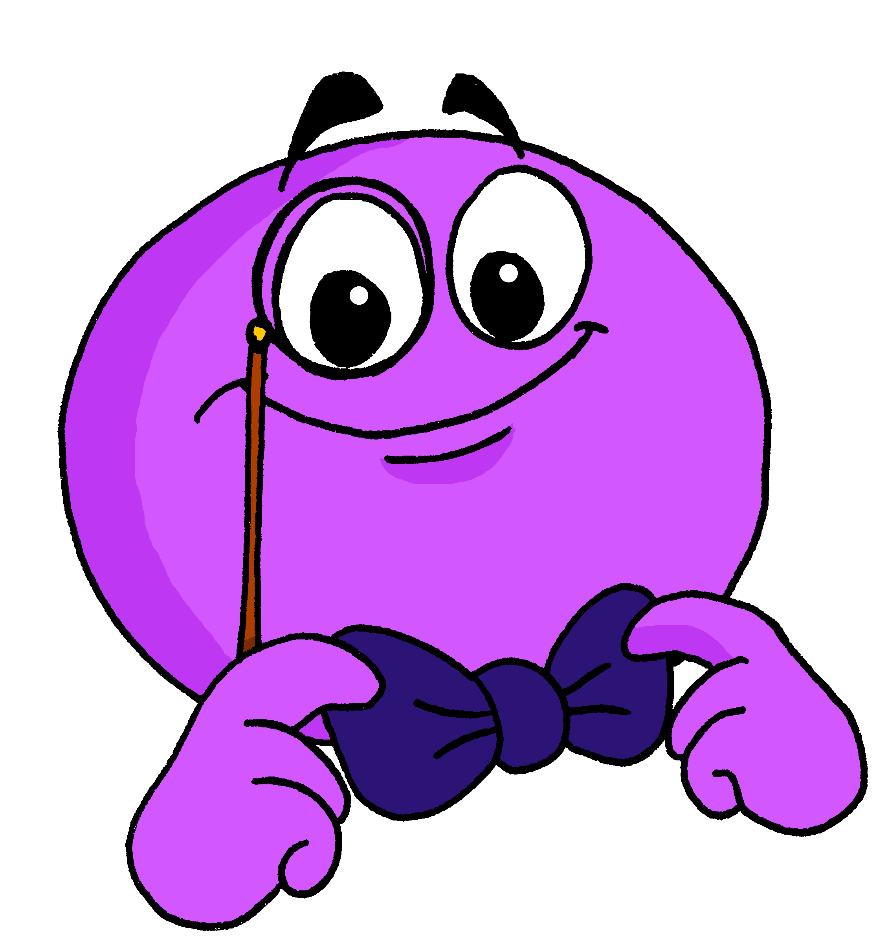
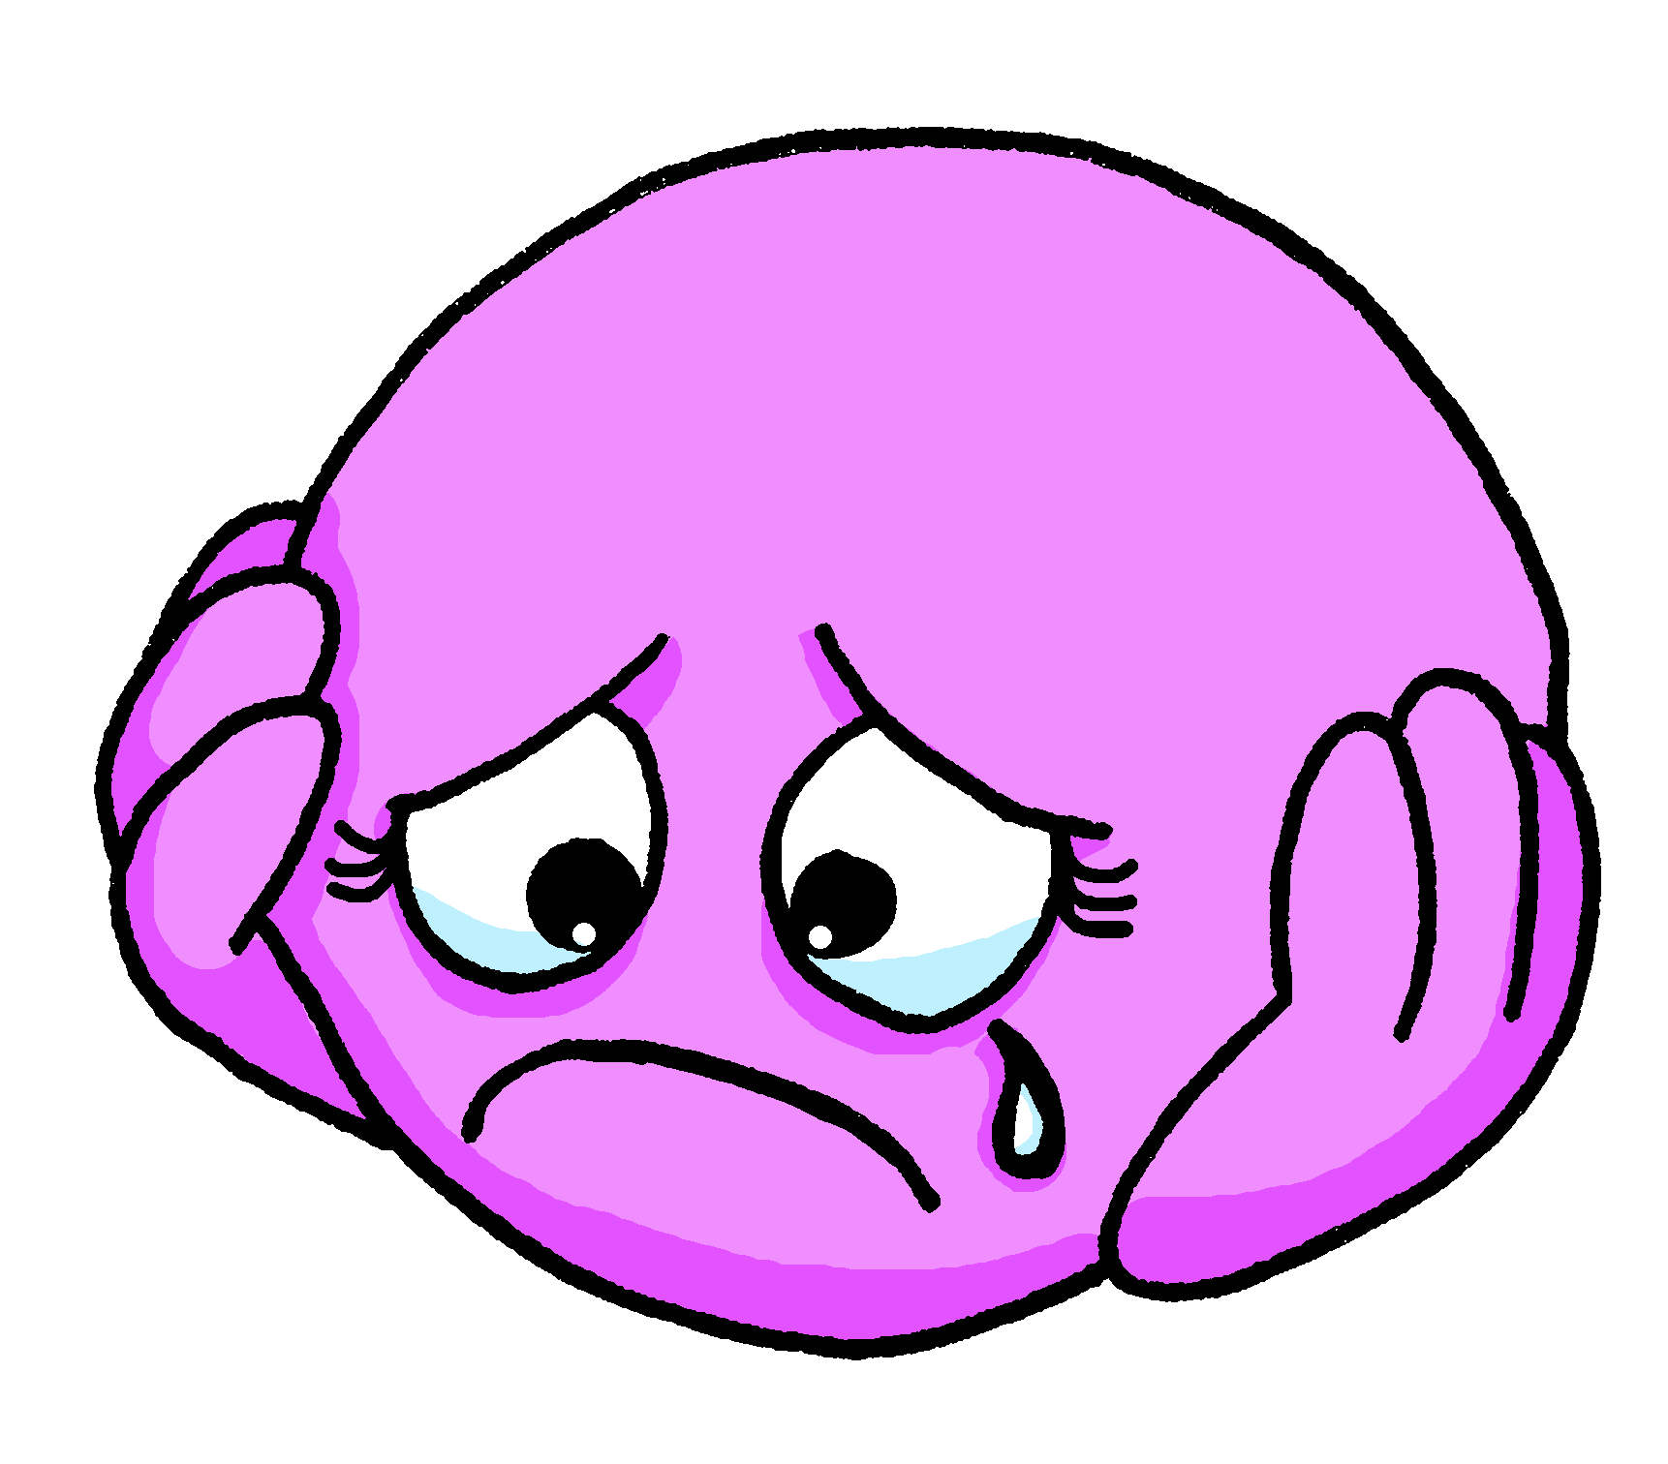
Describing me and others
¿Cómo está?
rojo
Follow ups 1-5
Notes:
Artwork by Steve Clarke. Pronoun pictures from NCELP (www.ncelp.org). All additional pictures selected from Pixabay and are available under a Creative Commons license, no attribution required.
Frequency of new vocabulary:
elegante [2742] feliz [908] triste [1371] dónde [161] + revisiting week 2-4 adjectives
Source: Davies, M. and Davies, K. (2018). A frequency dictionary of Spanish: Core vocabulary for learners (2nd ed.). Routledge: London
The frequency rankings for words that occur in this PowerPoint which have been previously introduced in these resources are given in the SOW and in the resources that first introduced and formally re-visited those words.
For any other words that occur incidentally in this PowerPoint, frequency rankings will be provided in the notes field wherever possible.

Slide 2
Follow up 1:
Escribe en inglés 📝.
a b ñ
vocabulario
Can you get at least15 points?
 | estoy | allí | contenta
 | buenos días | ¿cómo? | buenas tardes
 | clase | lento | curiosa
 | sí | hoy | rápido
 | elegante | estás | ahora
 | está | feliz | lenta
 | tranquilo | ¿dónde? | triste
I am (state)
there
pleased (f)
x3
good morning
how?
good afternoon
class
slow (m)
curious (f)
x2
yes
today
fast (m)
elegant, smart
you are (state)
now
s/he, it is (state)
happy
slow (f)
x1
calm (m)
where?
sad
Notes:
Timing: 5 minutes
Aim: to practise written comprehension of vocabulary for this week and previous weeks.
Procedure:
1. Pupils need to write the English for as many words as possible, aiming to get at least 15 points (but more if possible).
2. Click for English answers.

Slide 3
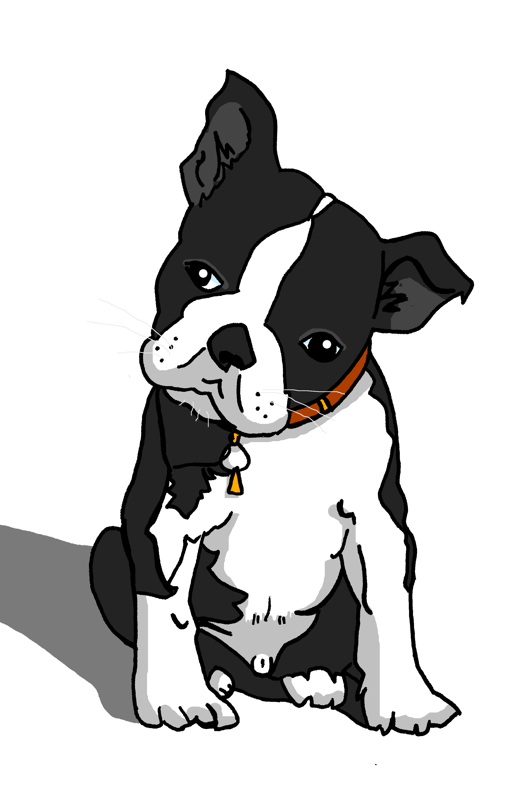
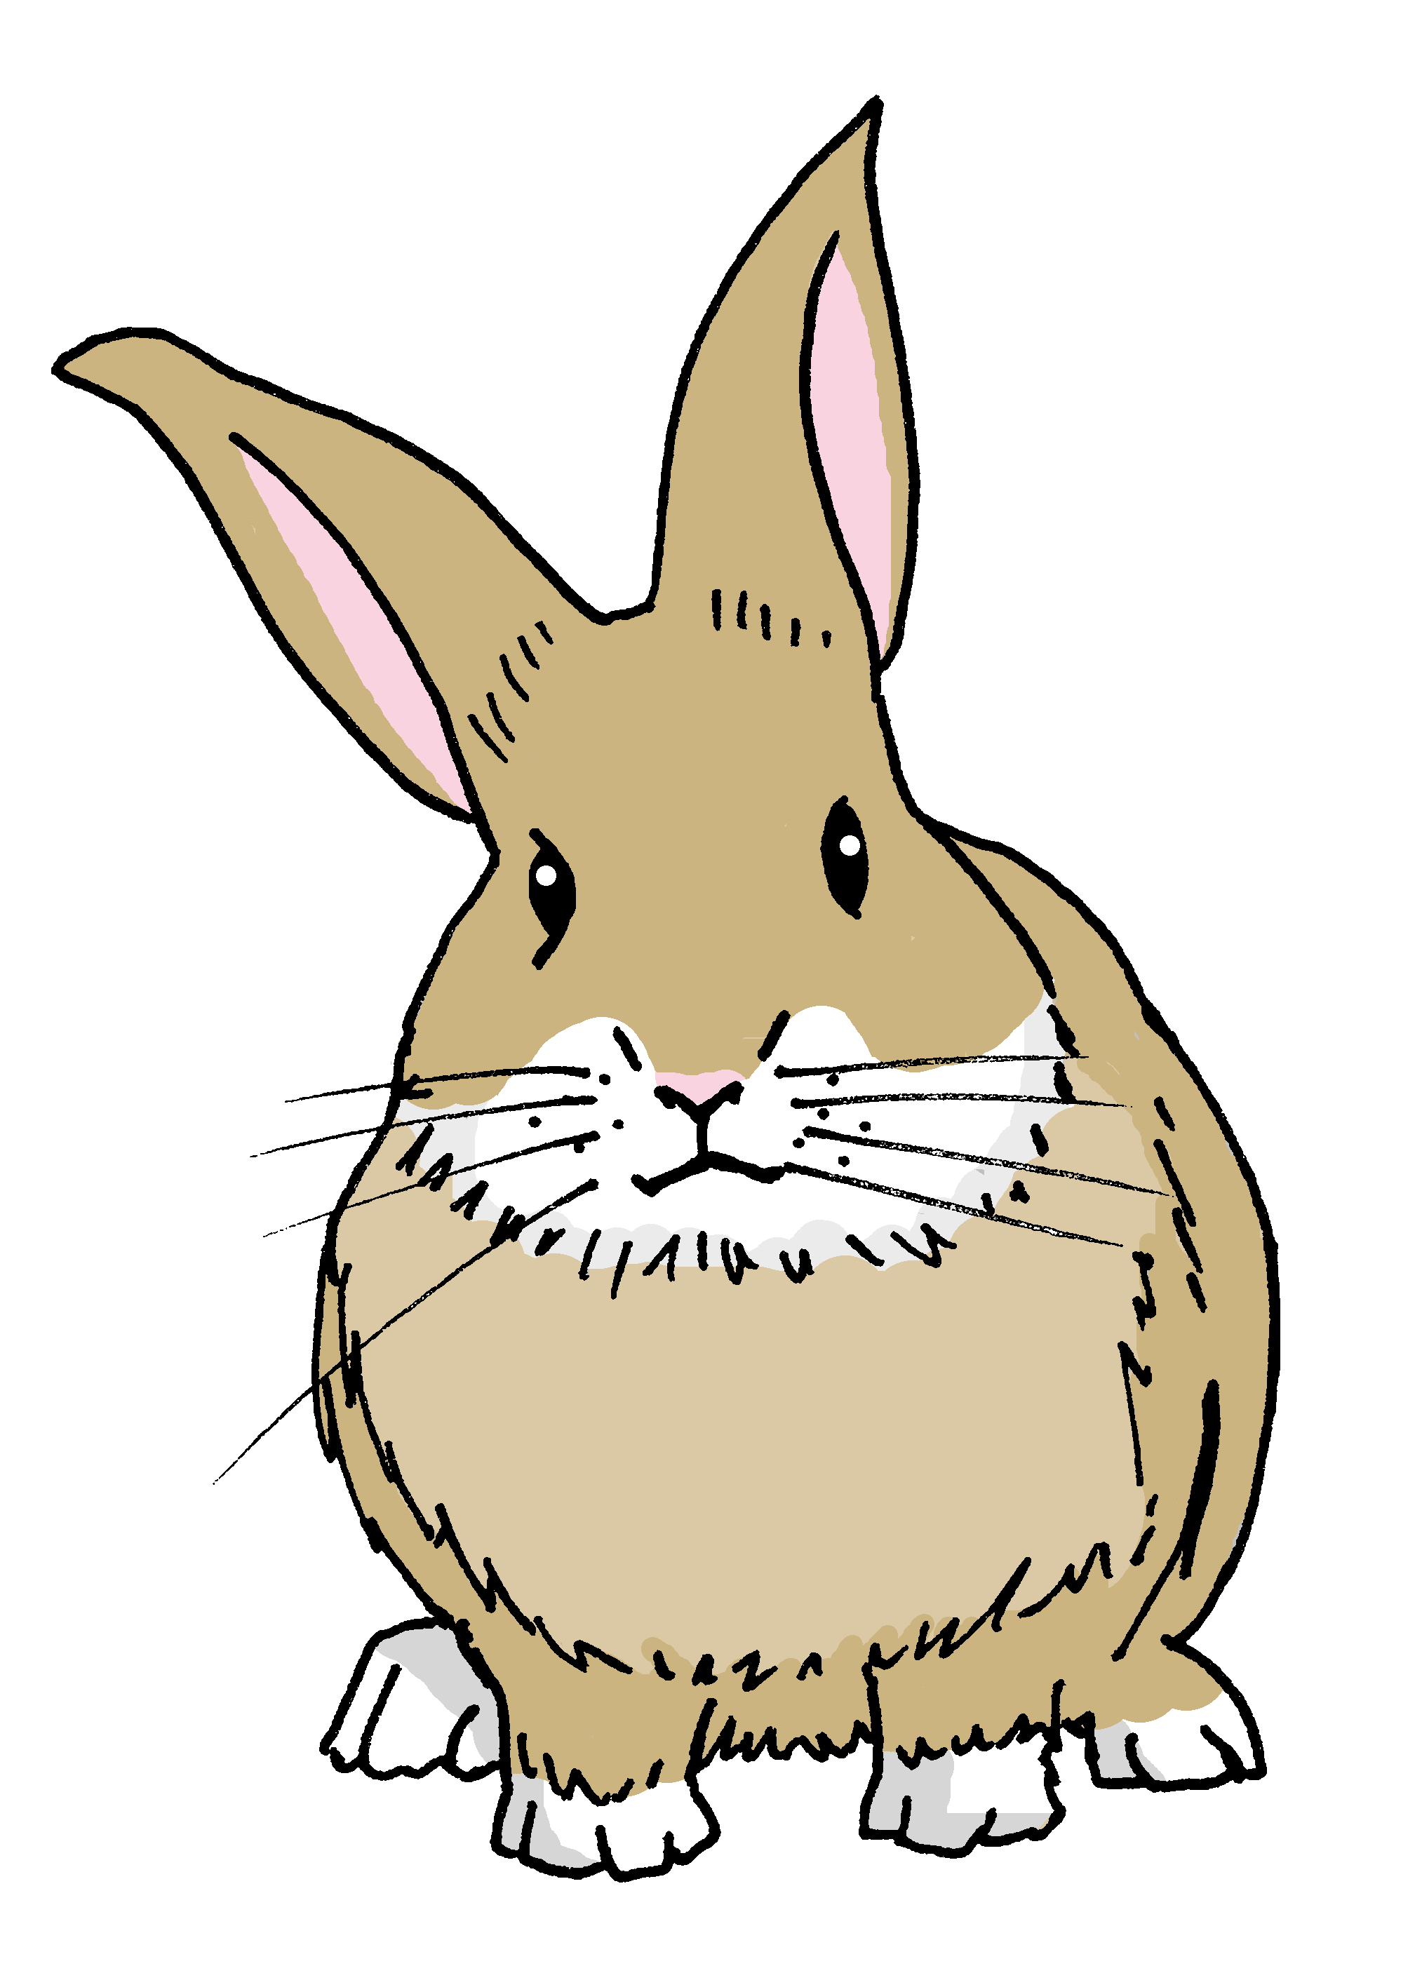
Follow up 2
Yes/no questions
Remember! In Spanish, change a statement into a question by raising your voice at the end:
Statement
You are sad.
Estás triste.
⚠ Spanish uses two question marks – the one at the front is upside down!
Question
¿Estás triste?
Are you sad?
Notes:
Timing: 2 minutes
Aim: to formally introduce yes / no questions = raising intonation to form questions.
Procedure:
Read the grammar explanation.
Elicit English translation for the Spanish examples provided.

Slide 4
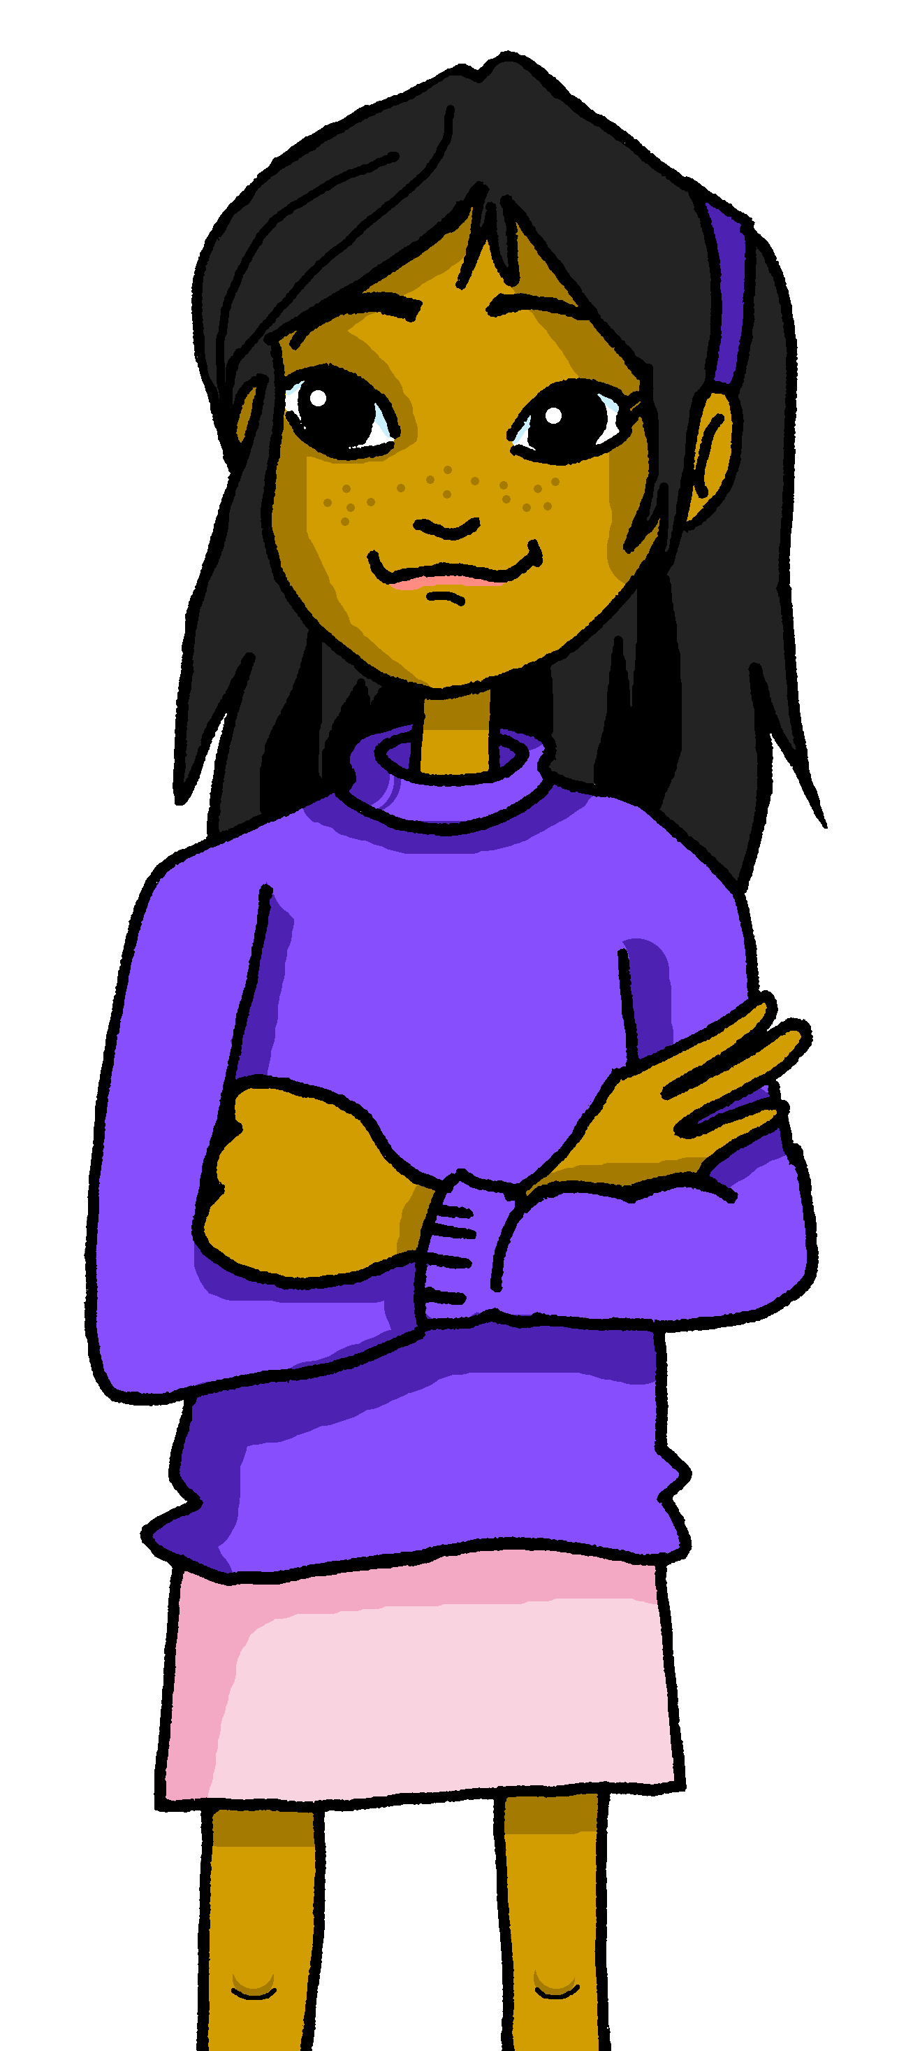
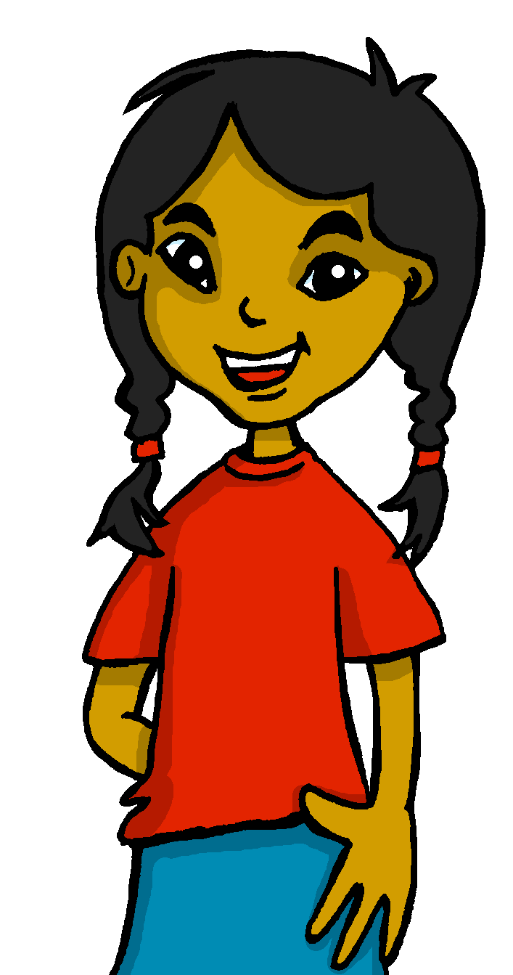
Follow up 2:
Sofía is playing Guess Who in class.
Her friend Ángela is asking the questions.
escuchar
Who is talking each time?
Escucha y marca .
Escribe la frase 📝.
Ángela [?] | Sofía [.]
Ej
¿Está feliz?
1
Está elegante.
2
Está serio.
3
¿Está tranquila?
Está triste.
4
¿Está nerviosa?
5
Notes:
Time: 5 minutes
Aim: to practise aural comprehension of questions and statements by paying attention to raised intonation.
Procedure:
1. Read the title and instructions.
2. Click to trigger the Spanish instructions. (!) Remind pupils that when giving a statement, the intonation will be flat and when asking a question they will hear a raised intonation.
4. pupils could be asked to write what they hear during the second listening. The challenge icon appears on second click.
5. Answers are animated – first click brings up the tick and second click brings up what was said.
Transcript
¿Está feliz?
Está elegante
Está serio
¿Está tranquila?
Está triste
¿Está nerviosa?

Slide 5
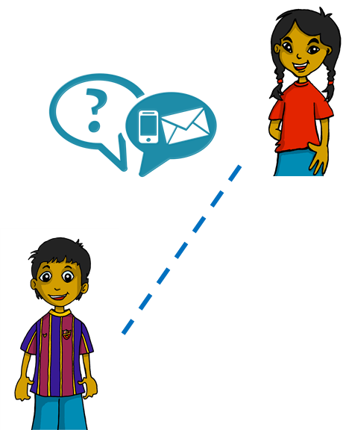
Follow up 3:
Sofía sends messages to Rubén.
Lee y marca .
leer
1
Ángela
Está feliz. ☺
Quique
los dos
Rubén
Ángela
Ángela
4
Quique
2
Está tranquilo.
Está contenta. ☺
Quique
Ángela
los dos
los dos
5
los dos
Ángela
3
¿Está triste?. ☺
Está elegante. ☺
los dos
Quique
Quique
Ángela
Notes:
Timing: 5 minutes
Aim: to practise written comprehension of adjective agreement.
Procedure:
Read the context. Tell pupils Sofía is receiving messages from and about different friends.
Read the first message. Ask pupils to tell you if the message could be from or about Quique (a boy), Ángela (girl) or either of them.
Click to reveal the answer.
Continue with items 2 – 5.

Slide 6
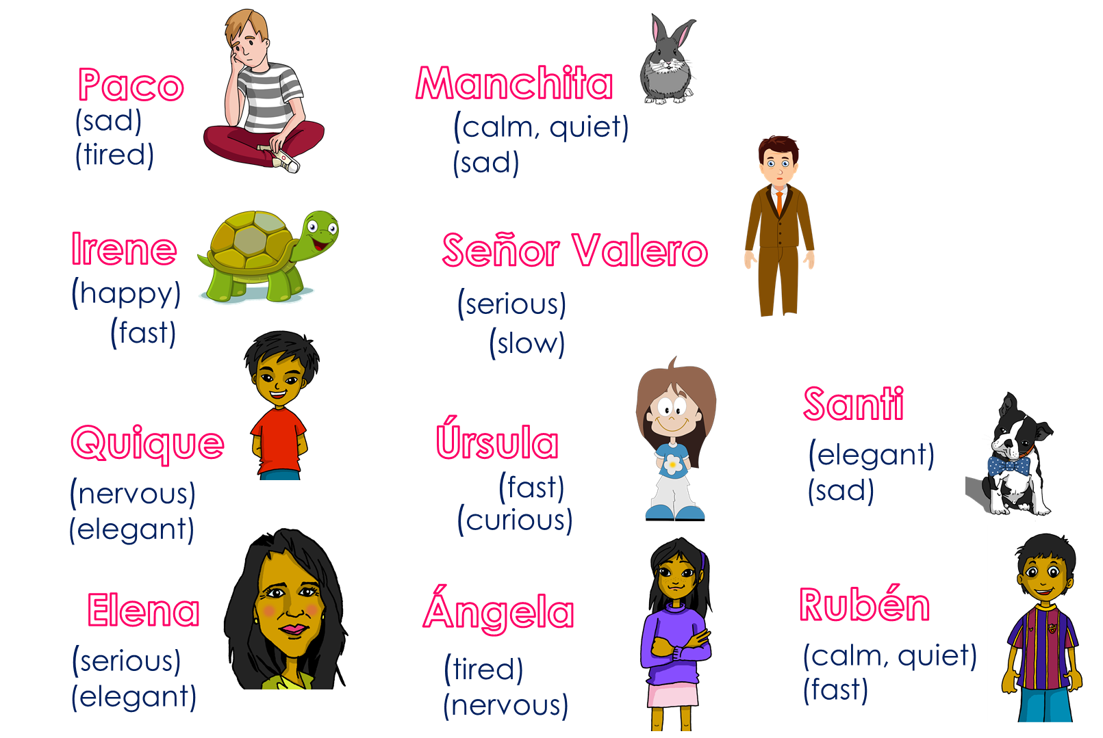
Follow up 4
Ask and guess!
hablar
hablar
Ask your partner questions to guess their secret character.
1 minuto
¿Estás cansado?
¿Estás cansada?
¿Paco?
¿Estás…?
Sí / No…
¡Sí!
¡Sí!
No…
0
INICIO
Notes:
Time: 8-10 minutes
Aim: To use raised intonation and adjectival agreement in oral production to guess their partner’s characters.
Read the title in Spanish and click to bring a brief explanation of the instructions.
Tell pupils they are going to work in pairs. Partners take it in turns to ask yes/no questions to try to figure out the other player’s character. The partner guessing needs to use raised question intonation and the correct adjectival agreement to narrow down their options correctly! Explain this to the pupils - they have to pronounce the adjective correctly, with the correct ending, otherwise their partner cannot guess who they are.
Click x2 to bring the speech bubbles to make sure pupils are clear about what the exchange should look like (¿Estás ..? / Sí / No).
Click x2 to model an example of how correct adjective ending is key for the task. – read the speech bubbles (“¿Estás cansada?” / ¡No!). Show pupils on the board how that means Ángela is not the secret character & click to bring X shape to cover her. Click x2 to trigger the next question now with the adjective in the male form. The response is “Yes” so we now know it’s “Paco”.
2. Teachers can model another round with the whole class (getting pupils to ask the questions) before getting them started in pairs.
3. Give pupils 30 seconds to write down 4 names (mixture of male/female). Click on “Inicio” to trigger timer.
4. The aim is to work with your partner, to identify all 8 people as quickly as possible.
NB. Print the template slide (slide 20) in A5 so that pupils can cross out as they play.
At the end of the game, point out to them that grammar features (in this case masc/fem adjective endings) often help us to pinpoint the correct meaning more quickly, but not always!
Adjectives used in the task:
regular a/o: cansado, rápido, lento, nervioso, serio, tranquilo
Regular e/z: triste, feliz, eleganteTiming: xxx minutes

Slide 7
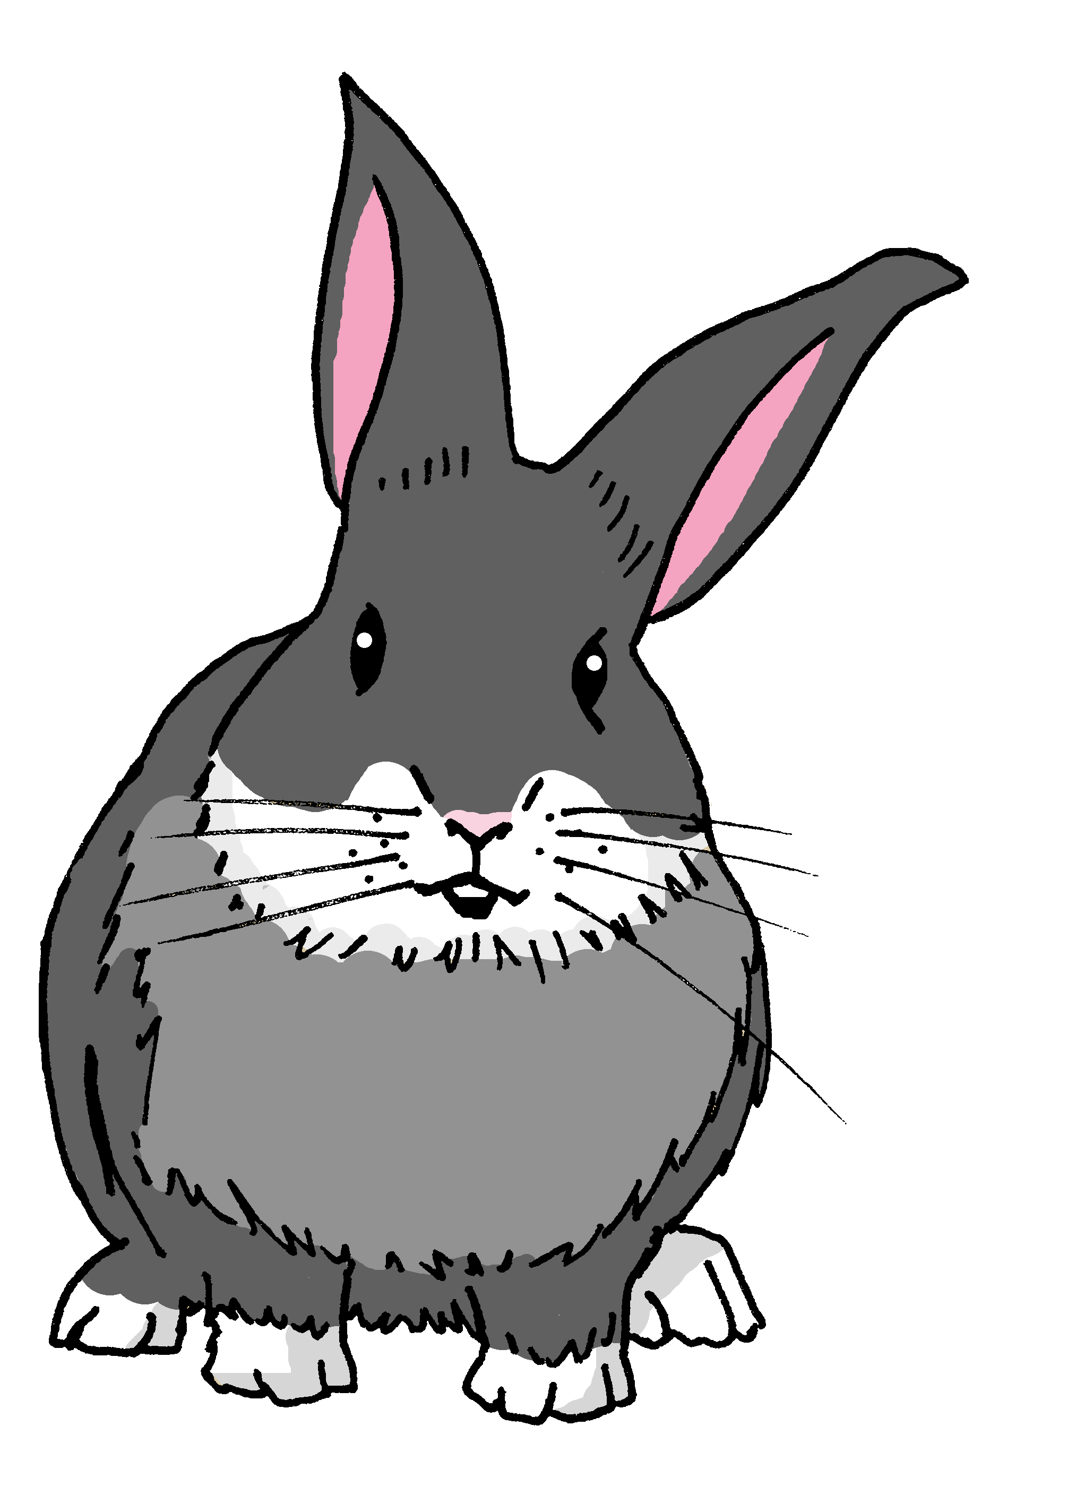
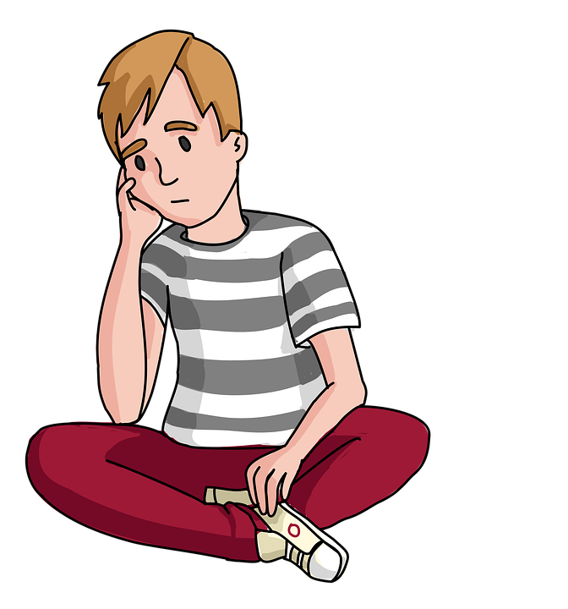
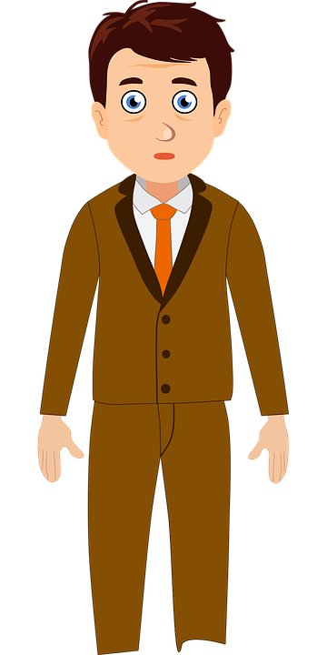
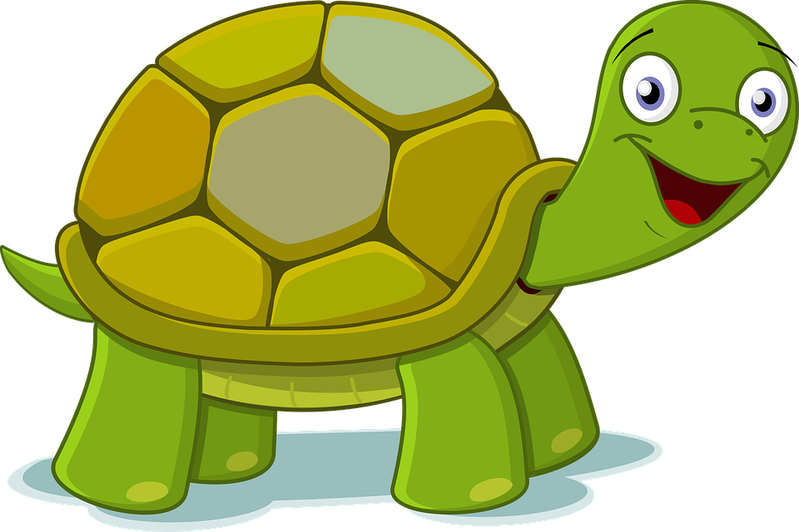
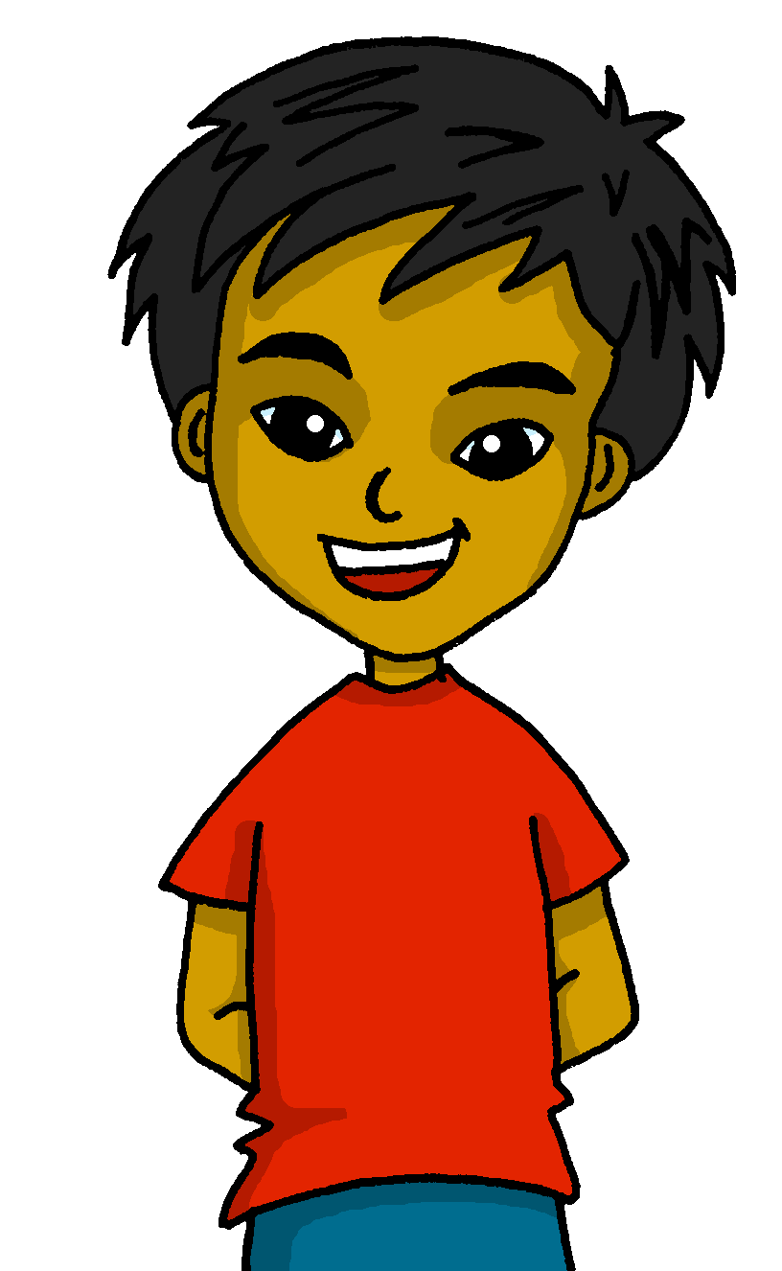
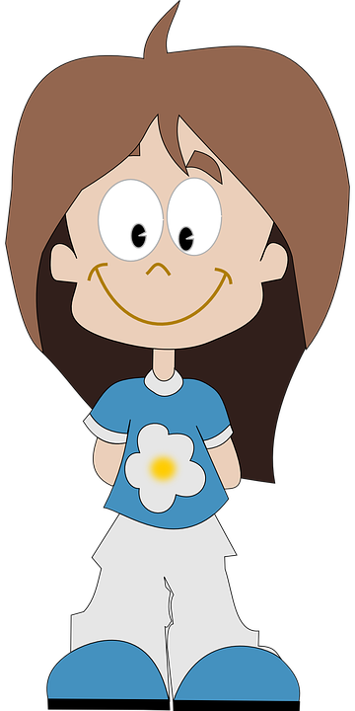
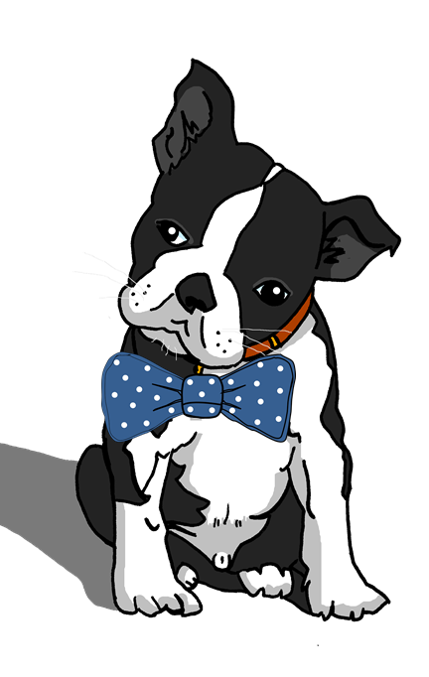
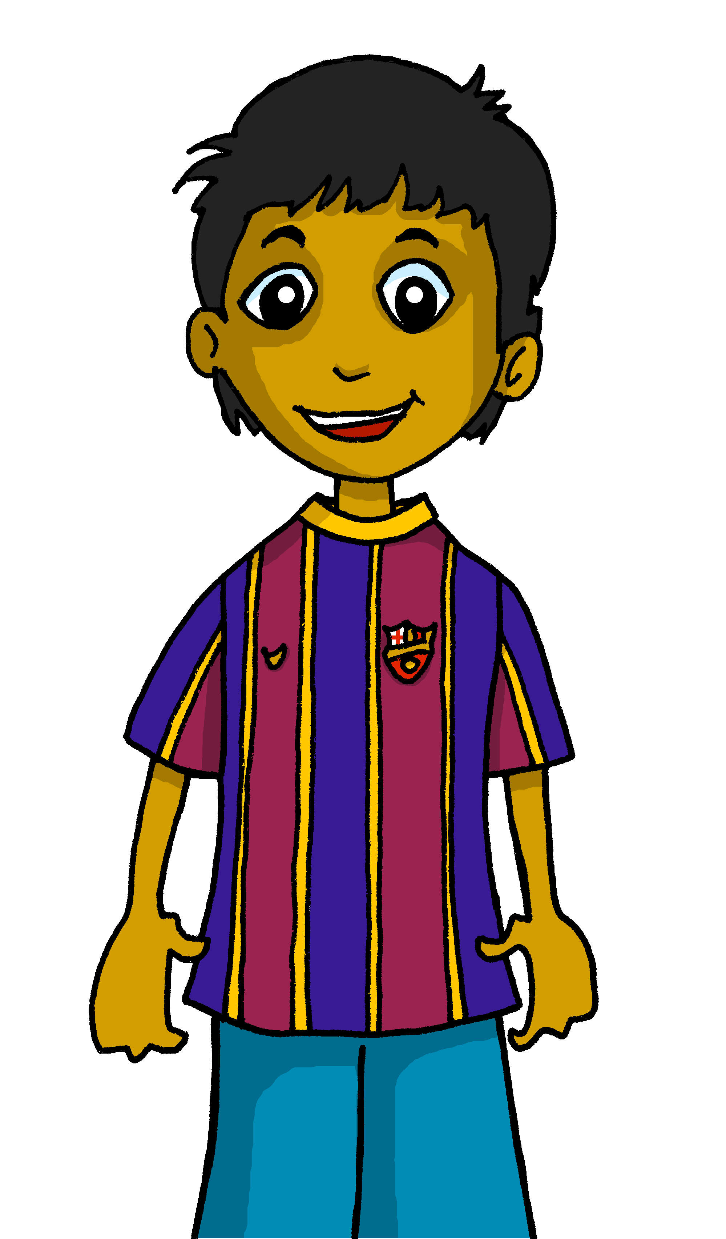
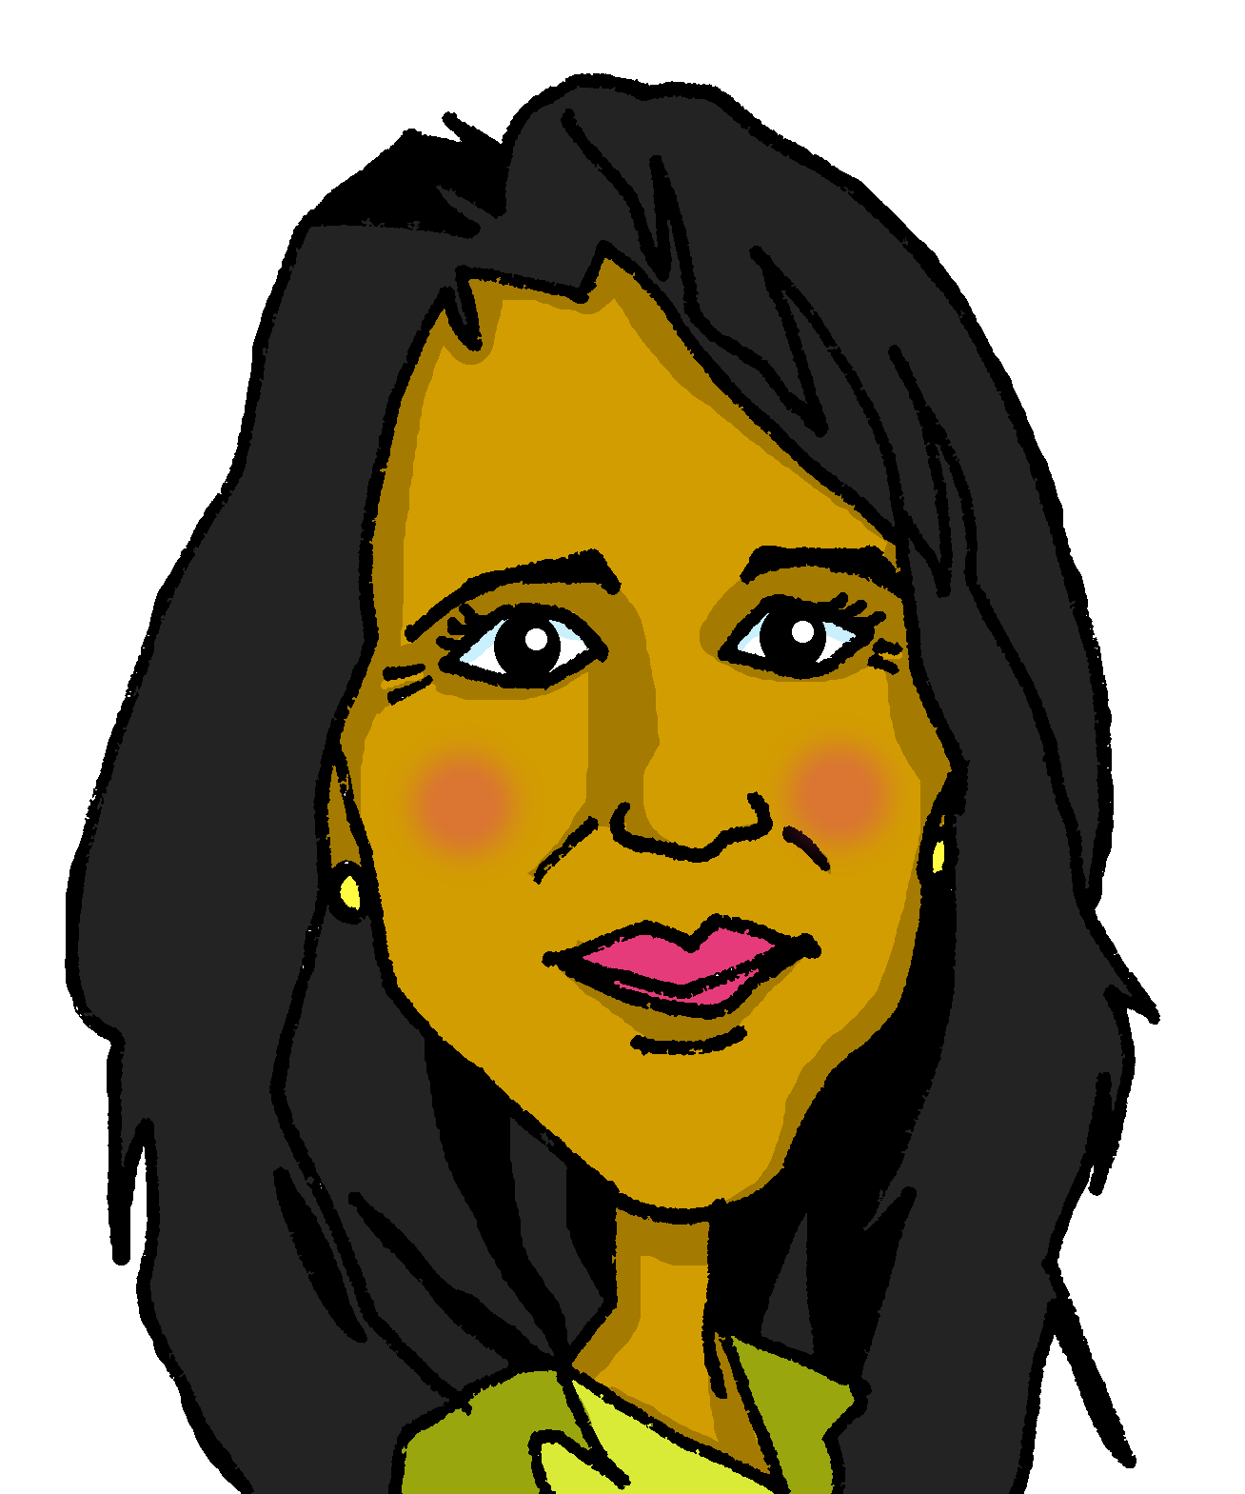
Follow up 4
¿Estás…?
Paco
Manchita
(sad)
(tired)
(calm, quiet)
(sad)
Irene
Señor Valero
(happy)
(serious)
(fast)
(slow)
Santi
¡Sí! / ¡No!
Quique
Úrsula
(elegant)
(sad)
(nervous)
(elegant)
(fast)
(curious)
Elena
Ángela
Rubén
(serious)
(elegant)
(tired)
(nervous)
(calm, quiet)
(fast)
Notes:
Master slide for guess who game. Print the template slide in A5 so that pupils can cross out as they play.

Slide 8
Follow up 5
Escribe en español 📝.
a b ñ
Can you get at least15 points?
vocabulario
vocabulario
 | Good morning | I am (state) | Good afternoon
 | there | here | how?
 | curious (m) | pleased (f) | in class
 | fast (m) | today | yes
 | slow (m) | sad | happy
 | you are (state) | elegant | s/he is (state)
 | calm/quiet (f) | now | where?
vocabulario
Buenos días
estoy
Buenas tardes
x3
allí
aquí
¿cómo?
curioso
contenta
en clase
x2
rápido
hoy
sí
lento
triste
feliz
estás
elegante
está
x1
tranquila
ahora
¿dónde?
Notes:
Timing: 5 minutes
Aim: to practise written production of vocabulary for this week and previous weeks.
Procedure:
1. Pupils need to write the Spanish for as many words as possible, aiming to get at least 15 points (but more if possible).
2. Click for Spanish answers.

Slide 9
Handout Follow up 1:
Follow up 1:
Escribe en inglés 📝.
a b ñ
vocabulario
Can you get at least15 points?
 | estoy | allí | contenta
 | buenos días | ¿cómo? | buenas tardes
 | clase | lento | curiosa
 | sí | hoy | rápido
 | elegante | estás | ahora
 | está | feliz | lenta
 | tranquilo | ¿dónde? | triste
x3
x2
x1
Notes:
Timing: 5 minutes
Aim: to practise written comprehension of vocabulary for this week and previous weeks.
Procedure:
1. Pupils need to write the English for as many words as possible, aiming to get at least 15 points (but more if possible).
2. Click for English answers.

