Slide 1
español, con Sofía
¡Feliz Navidad!

Slide 2
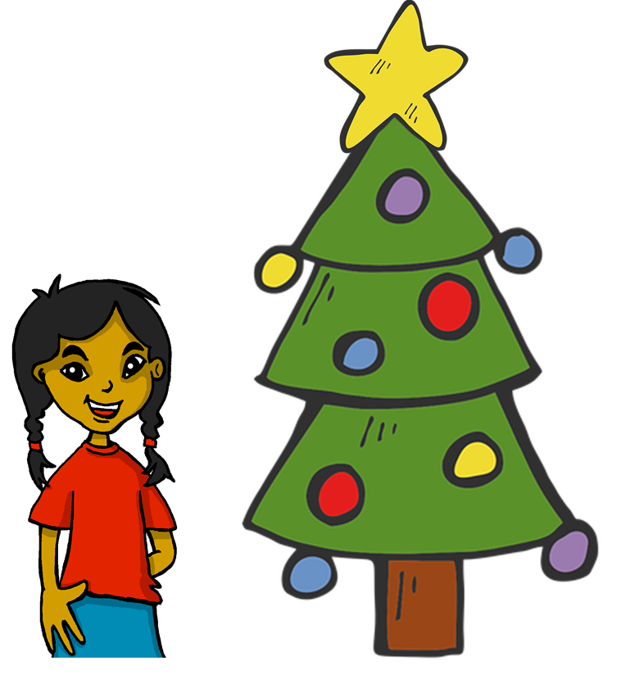
Describing me and others
rojo
Phonics
Christmas: The Three Wise Men
Term 1 Week 14
Notes:
Artwork by Steve Clarke. All additional pictures selected are available under a Creative Commons license, no attribution required.
The frequency rankings for words that occur in this PowerPoint which have been previously introduced in the resources are given in the SOW (excel document) and in the resources that first introduced and formally re-visited those words.
For any other words that occur incidentally in this PowerPoint, frequency rankings will be provided in the notes field wherever possible.
This week starts with the transcription part of the phonics assessment. Note that all remaining activities for this week are included within this PPT. Activities have been designed so that pupils complete them independently and then a nominated pupil can click to provide the answers. The tasks can be used flexibly throughout the week, to allow the teacher to listen to individual pupils completing the read aloud part of the phonics assessment.
Glossed words: haba [>5000] juguete [>5000] adivinar [2201]
Source: Davies, M. & Davies, K. (2018). A frequency dictionary of Spanish: Core vocabulary for learners (2nd ed.). Routledge: London

Slide 3
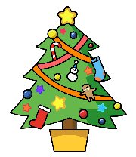
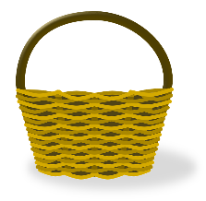
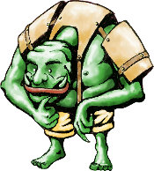
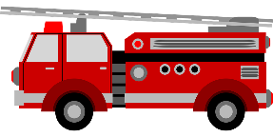
escuchar
¡Feliz Navidad!
Listen and fill the gaps with the correct letter or letters.
 | Names
1 | __ mada
2 | __ nzo
3 | __ __ ncha
4 | __ __ ntia
5 | __ rina
6 | __ ara
7 | __ riol
8 | __ __ ta
9 | __ ma
10 | __ __ sar
una cesta
un imán
un cisne
un zafiro
Read aloud the Spanish name and the Christmas present with the same initial sound. You have not learnt these words so use what you know about how to pronounce Spanish.
un unicornio
un ogro
un camión
un avión
una cometa
un enano
Notes:
Timing: 5 minutes
Aim: to assess knowledge of the phonics that pupils have been taught in weeks 1-12 in a listen and transcribe and then a read aloud task.
Procedure:
1. Explain that pupils will first listen and fill the gaps with the letters they hear to complete the list of 10 Spanish names. 2. Complete this stage with pupils. Click on each audio button once to hear the names. They are recorded twice with a pause in between for processing. 3. Then click to bring up the list of 10 presents and the instruction for these.
4. Explain to pupils that you will listen to each pupil individually during the lessen (during the week) and that during this time, the class will do some other Christmas activities.
Transcript:
1. Amada | Amada 2. Enzo | Enzo 3. Concha | Concha 4. César | César 5. Irina | Irina 6. Zara | Zara 7. Oriol | Oriol 8. Cintia | Cintia 9. Uma | Uma 10. Cata | Cata

Slide 4
prononciar
[a]
[e]
prononciar
un avión
un enano
Amada
Enzo
Notes:
These are flashcard versions of each SSC item that teachers may find it useful to print and use, after the dictation of the names part has been collected in.
Note:
there are no follow up lessons this week, so it would be possible to continue the speaking assessments in the follow up time during this week, as needed.
if preferred, and the resources are available, pupils could record their answers (e.g. on computer or ipad) though this would involve the teacher listening back to assess them.
Frequency of unknown words: avión [1399] enano [>5000]
Source: Davies, M. & Davies, K. (2018). A frequency dictionary of Spanish: Core vocabulary for learners (2nd ed.). Routledge: London
4

Slide 5
prononcer
[co]
[ce]
prononcer
cometa
una cesta
Concha
César
Notes:
Frequency of unknown words: cesta [>5000] cometa [>5000]
Source: Davies, M. & Davies, K. (2018). A frequency dictionary of Spanish: Core vocabulary for learners (2nd ed.). Routledge: London
5

Slide 6
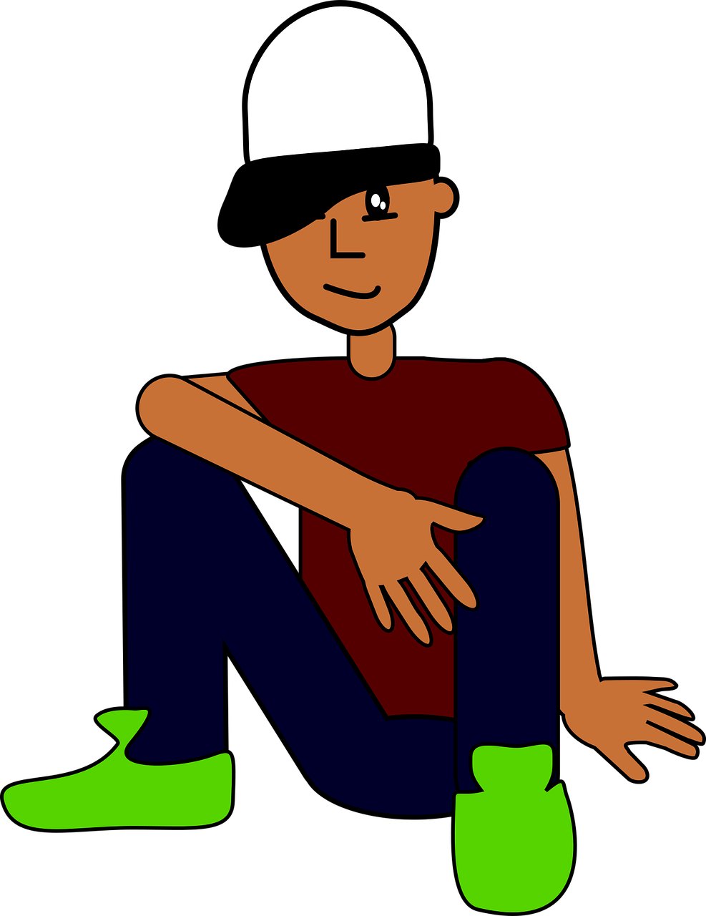
prononcer
[i]
[z]
prononcer
imán
zafiro
Irina
Zara
Notes:
Frequency of unknown words: imán [>5000] zafiro [>5000]
Source: Davies, M. & Davies, K. (2018). A frequency dictionary of Spanish: Core vocabulary for learners (2nd ed.). Routledge: London
6

Slide 7
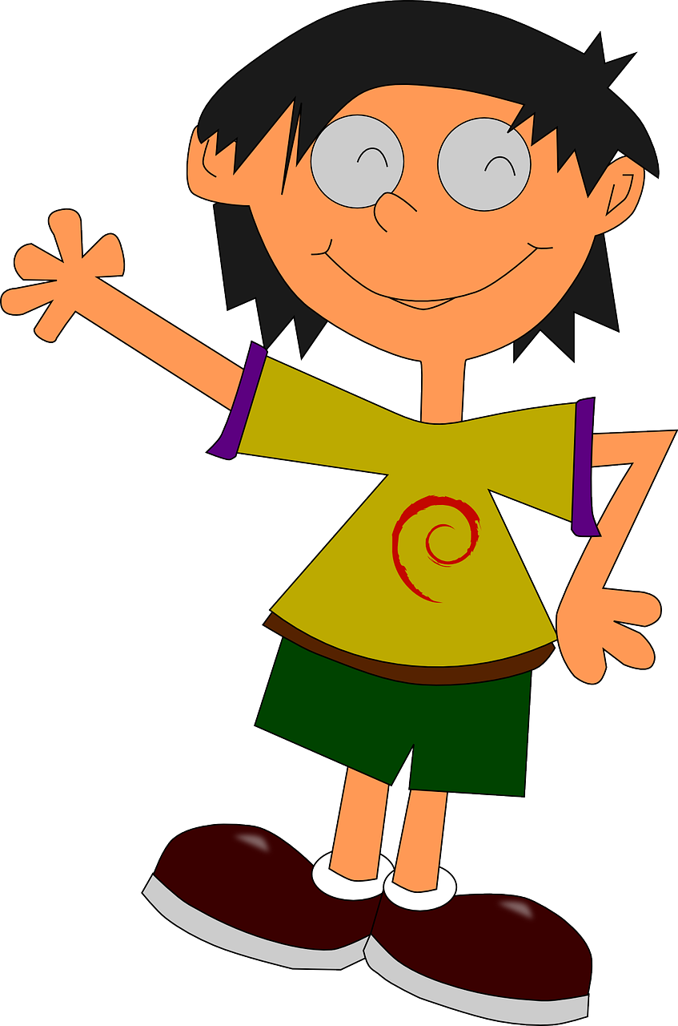
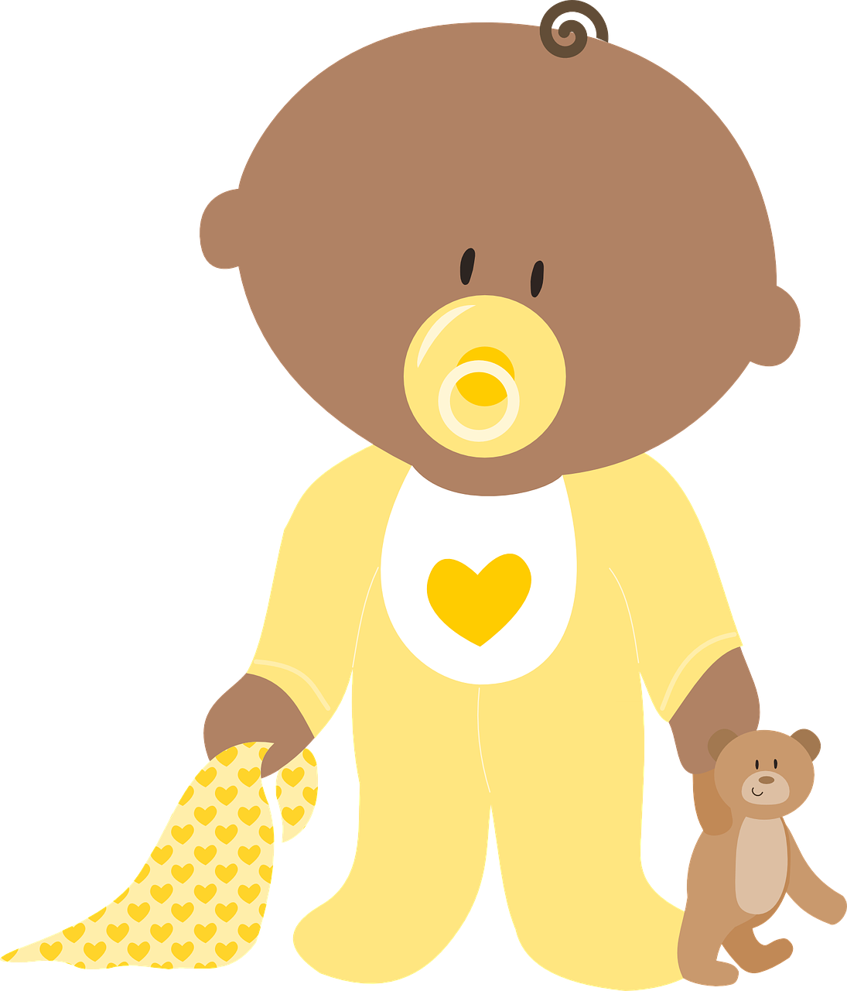
prononcer
[o]
[ci]
prononcer
ogro
cisne
Oriol
Cintia
Notes:
Frequency of unknown words: cisne [>5000] ogro [>5000]
Source: Davies, M. & Davies, K. (2018). A frequency dictionary of Spanish: Core vocabulary for learners (2nd ed.). Routledge: London
7

Slide 8
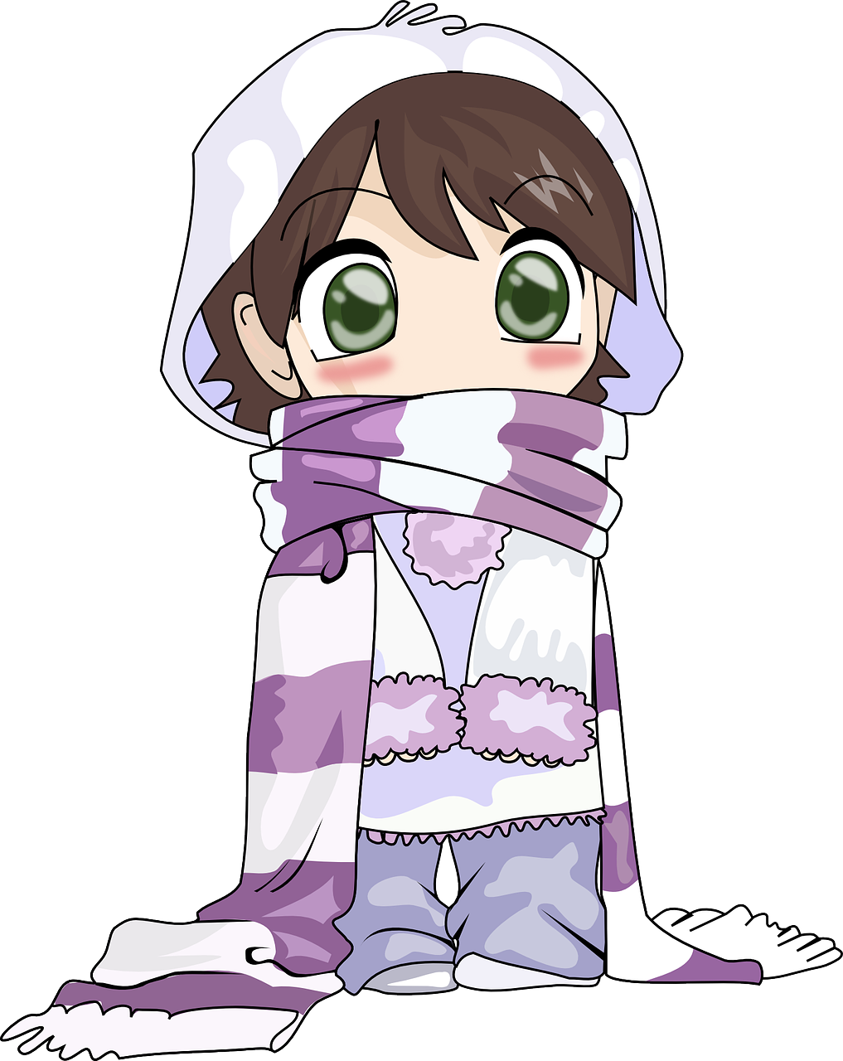
prononcer
[u]
[ca]
prononcer
unicornio
camión
Uma
Cata
Notes:
Frequency of unknown words: camión [2327] unicornio [>5000]
Source: Davies, M. & Davies, K. (2018). A frequency dictionary of Spanish: Core vocabulary for learners (2nd ed.). Routledge: London
8

Slide 9
¡Feliz Navidad!
¡Feliz Navidad!
Listen and fill the gaps with the correct letter or letters.
Listen and fill the gaps with the correct letter or letters.
 | Palabras
1 | __ mada
2 | __ nzo
3 | __ __ ncha
4 | __ __ ntia
5 | __ rina
6 | __ ara
7 | __ riol
8 | __ __ ta
9 | __ ma
10 | __ __ sar
 | Palabras
1 | __ mada
2 | __ nzo
3 | __ __ ncha
4 | __ __ ntia
5 | __ rina
6 | __ ara
7 | __ riol
8 | __ __ ta
9 | __ ma
10 | __ __ sar
una cesta
un imán
una cesta
un imán
un cisne
un zafiro
un cisne
un zafiro
un unicornio
un ogro
un unicornio
un ogro
un camión
un avión
un camión
un avión
un enano
una cometa
un enano
una cometa
Read aloud the Spanish name and the Christmas present with the same initial sound. You have not learnt these words so use what you know about how to pronounce Spanish.
Read aloud the Spanish name and the Christmas present with the same initial sound. You have not learnt these words so use what you know about how to pronounce Spanish.

Slide 10
¡Feliz Navidad!
Pupil name: ___________________________________
Total score: _____ / 20
Listen and fill the gaps with the correct letter or letters.
 | Name | Present | SSC [sound-symbol correspondence] | p/ x
1 | Amada | un avión | a
2 | Enzo | un enano | e
3 | Concha | una cometa | co
4 | César | una cesta | ce
5 | Irina | un imán | i
6 | Zara | un zafiro | z
7 | Oriol | un ogro | o
8 | Cintia | un cisne | ci
9 | Uma | un unicornio | u
10 | Cata | un camión | ca
 | Palabras
1 | __ mada
2 | __ nzo
3 | __ __ ncha
4 | __ __ ntia
5 | __ rina
6 | __ ara
7 | __ riol
8 | __ __ ta
9 | __ ma
10 | __ __ sar
una cesta
un imán
un cisne
un zafiro
un unicornio
un ogro
un camión
un avión
Note: 1] Each item offers two opportunities to assess the same SSC, but only one SSC is assessed per item (e.g. ‘avión’ only assesses for ‘a’, not for ‘v’. 2] Teachers award one point for the SSC in each word (max. 2 points per item).
un enano
una cometa
Read aloud the Spanish name and the Christmas present with the same initial sound. You have not learnt these words so use what you know about how to pronounce Spanish.
Notes:
This is a teacher reference version with audio.

Slide 11
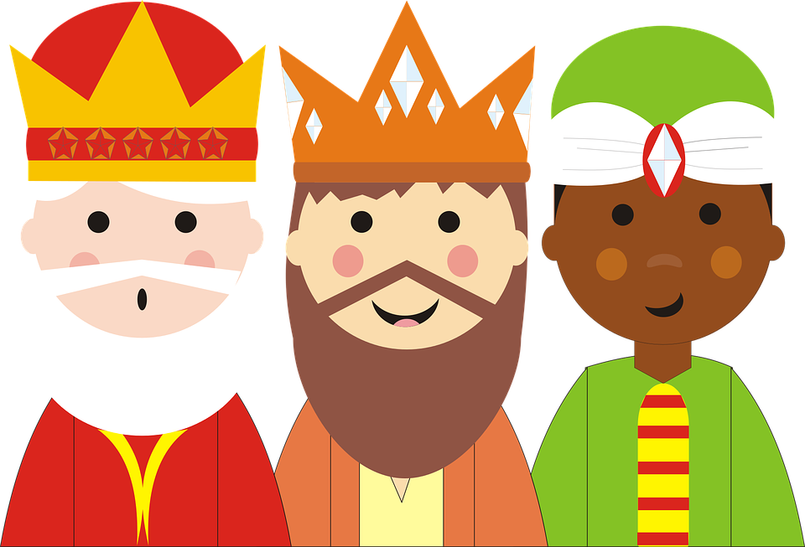
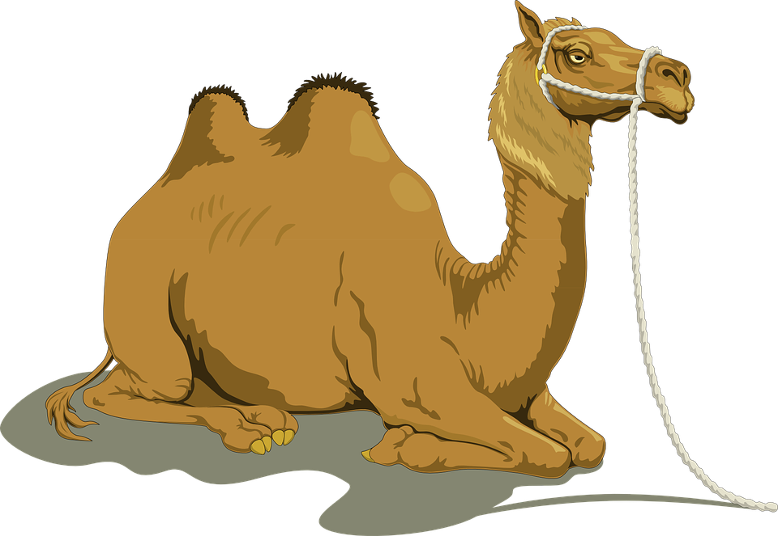
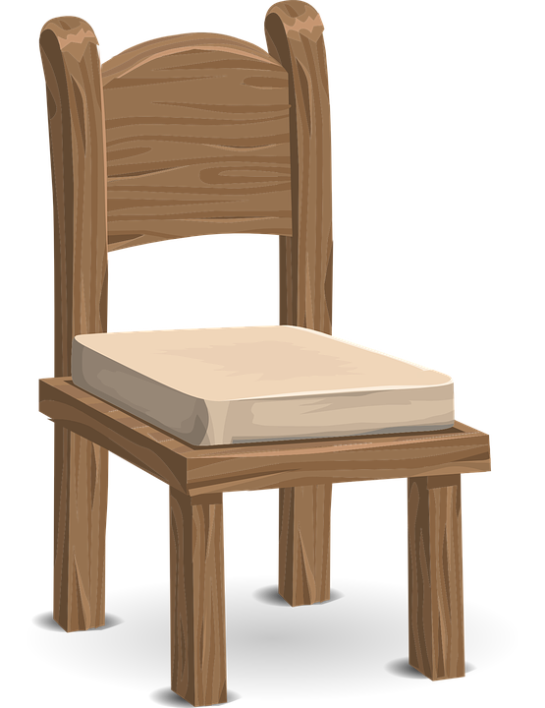
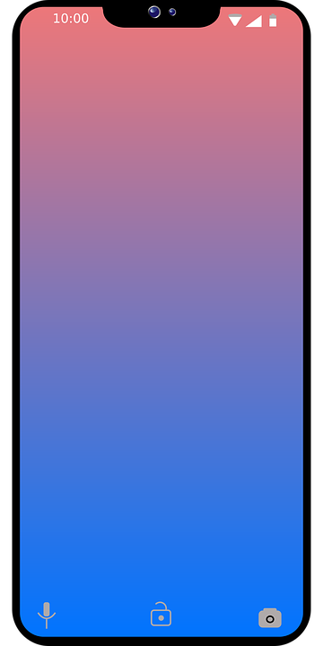
escuchar
Los regalos de Navidad:
‘para’ means ‘for’ when referring to the intended recipient.
The Three Wise men prepare themselves to deliver presents to Spanish children.
escuchar
Escucha y escribe el regalo.
¿Qué Rey Mago es?
____ __________ para Ángela.
____ __________ para Elena.
____ __________ para Rubén.
____ __________ para Sol.
____ __________ para Quique.
____ __________ para Asunción.
Una cámara
Baltasar
Spanish kids usually address their
letters to one of the three Wise Men who is the one in charge of bringing the desired presents on 6th January.
Who was it in this case?
Un teléfono
Gaspar
Un estuche
Melchor
Una flor
Baltasar
Una silla
Gaspar
Una canción
Melchor
The Three Wise men travel by camel!
Melchor
Gaspar
Baltasar
Notes:
Timing: 5 minutes
Aim: to practise written transcription of previously taught words; to practise written comprehension of the same words.
Procedure:
1. Click on the audio buttons to hear each present. Each word is said twice with a short pause between. 2. Click to reveal the Spanish words for the six presents. 3. Pupils then use the visual prompts to identify the name of the wise man who receives the letter about each present.
4. Click to reveal the names.
Transcript:
Una cámara | una cámara
Un teléfono | un teléfono
Un estuche | un estuche
Una flor | una flor
Una silla | una silla
Una canción | una canción

Slide 12
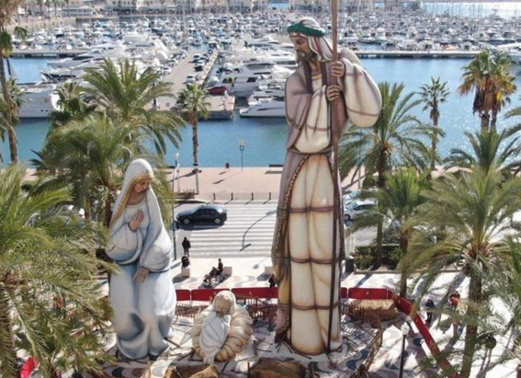
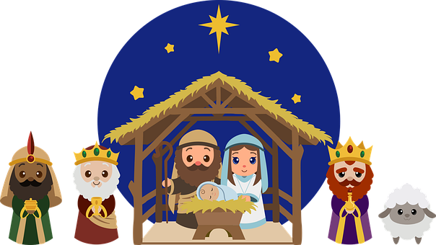
cultura
El Portal de Belén
El ‘Belén’ más grande del
mundo 🌍 está en Alicante.
En el porta del Belén está….
grande = big, large
la estrella
José
el niño Jesús
el establo
Gaspar
Melchor
María
Gaspar
la oveja
Notes:
Timing: 5 minutes
Aim: to introduce pupils the tradition of ‘Belenes’.
Procedure:
The name of each character is introduced on an individual click. Tell pupils one of the main features of Christmas in Spain is the belén, the nativity scene which appears in the windows of houses as well as the living room. There are also larger versions commissioned by the town hall in large spaces across towns and villages. Although decorated trees are starting to appear in town squares and houses in Spain, the inauguration of the nativity scene is one of the most anticipated events in the run-up to the festive period and has traditionally been something that the whole family comes together to create.
Elicit meaning of the ‘cultura’ box. You can ask additional questions such as ‘¿Dónde está Alicante? ¿En España o en Perú? There is a video you can play in the lesson so that they get a better idea of how big it is.
Frequencies of unknown words: grande [66]
Alicante – Guiness World records:
https://www.youtube.com/watch?v=ZVprVBCqKbk&ab_channel=Danny356
Photo from https://www.eldebate.com/religion/20211213/belen-mas-grande-mundo-encuentra-alicante.html

Slide 13
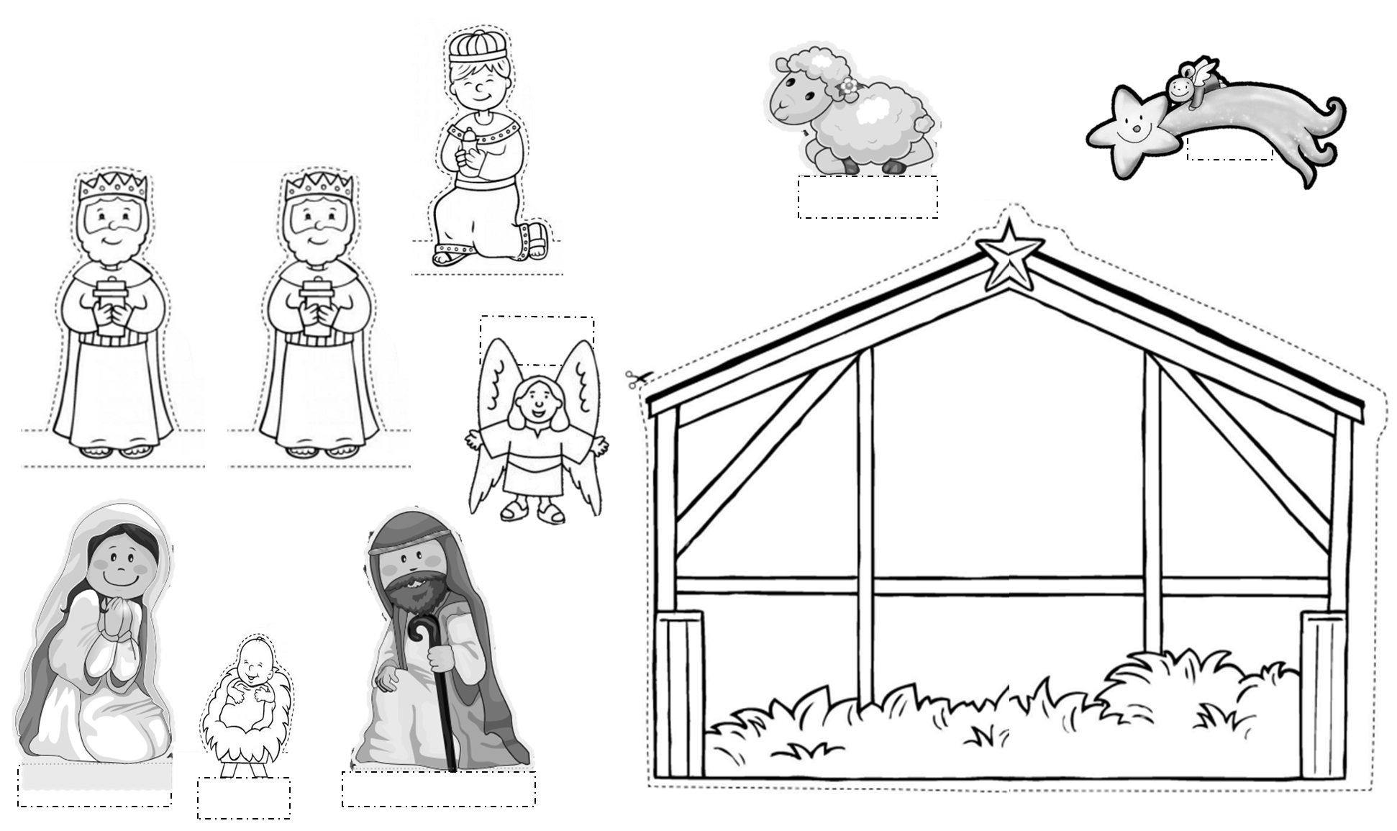
escribir
Una tarjeta de Navidad con el Portal de Belén
1 Dobla el papel
2 Corta y colorea
3 Escribe ‘Feliz Navidad’
doblar = to fold, folding
cortar = to cut out
colorear = to colour
escribir = to write
Notes:
Timing: 15-20 minutes
Aim: to create their own Christmas card with a traditional Christmas scene – el portal de Belén.
Procedure:
Pupils fold an A4 piece of paper / card to make a card (Dobla el papel)
Handout out the sheet of paper with the main characters of the Nativity scene. Pupils to colour in the pictures and cut out the pictures, following the dotted lines.
Pupils to arrange and stick the pictures onto the card.
Write “¡ Feliz Navidad !”
Frequencies of unknown words: doblar [2451] cortar [755] colorear [>5000] escribir [198]
Pictures adapted from:
https://www.diocesismalaga.es/pagina-de-inicio/2014043456/descarga-aqui-el-belen-recortable-de-pachi/
https://juegosinfantiles.bosquedefantasias.com/blog/figuras-imprimibles-para-el-belen-de-Navidad
https://www.plazanorte2.com/blog/11340-belen-recortable

Slide 14
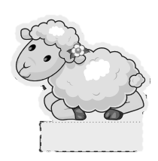
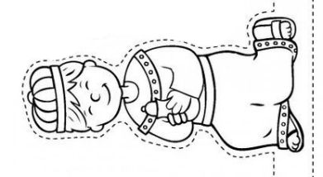
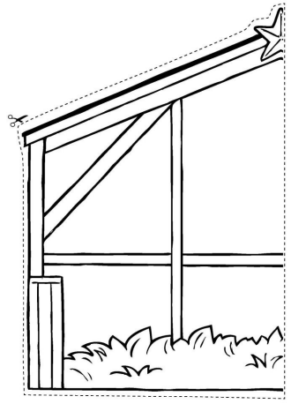
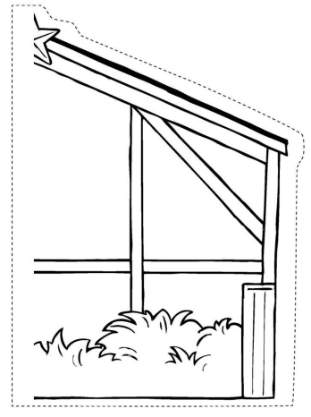
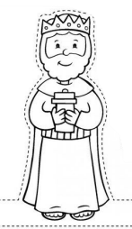
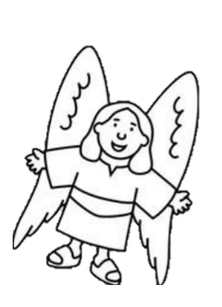
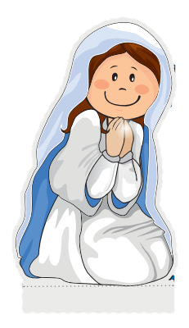
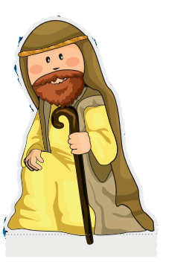
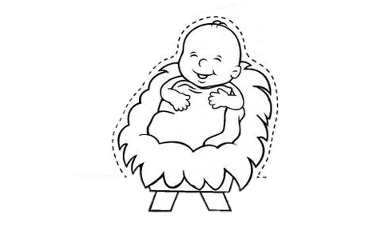
handout
v
00
Notes:
Pictures adapted from:
https://www.diocesismalaga.es/pagina-de-inicio/2014043456/descarga-aqui-el-belen-recortable-de-pachi/
https://juegosinfantiles.bosquedefantasias.com/blog/figuras-imprimibles-para-el-belen-de-Navidad
https://www.plazanorte2.com/blog/11340-belen-recortable

Slide 15
leer
El Roscón de Reyes
¡Es un donut gigante 😮!
A ‘Roscón de Reyes’ is a traditional Spanish brioche-like sweet bread eaten the night before or morning of Reyes or King’s Day (6th January).
Hidden inside, there are a small toy and a small dried kidney bean. The person who finds the small toy will be crowned king for the day and the lucky person who finds the bean has the honour of paying for the whole cake!
el haba
el juguete
Notes:
Timing: 10 minutes
Aim: to learn about a typical food eaten to celebrate el día de los Reyes Magos; to practise spoken recall of singular persons of tener and nouns from weeks 9, 10, 11 and 12.
Procedure: 1. Read the text in English explaining what the Roscón de Reyes is. 2. Tell pupils that they are going to have the chance to practise hiding and finding the bean and the toy.
Image attribution: https://www.hornazart.com/roscones.html

Slide 16
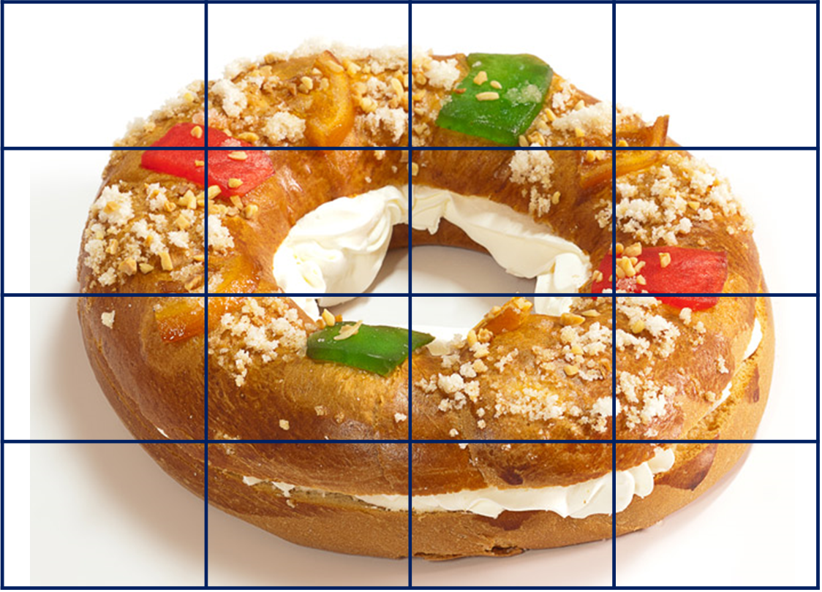
hablar
El Roscón de Reyes
En tu roscón, dibuja ✍ y esconde* el haba y el juguete.
a
b
c
d
1
2
3
el haba
el juguete
4
*esconde = hide
Notes:
Procedure: 1. Display this slide. 2. Pupils collect their handout and secretly draw their bean and toy in their selected cells.
Image attribution: https://www.hornazart.com/roscones.html

Slide 17
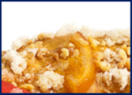
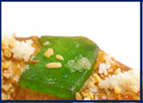
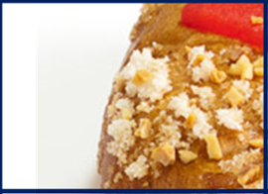
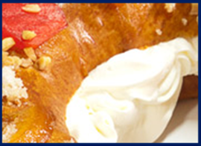
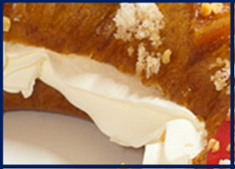
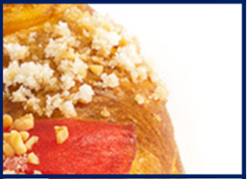
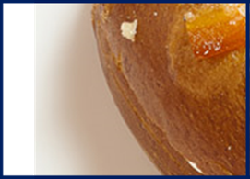
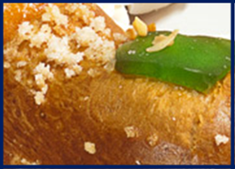
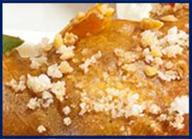
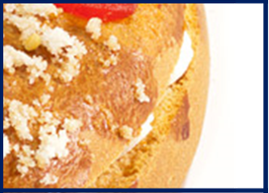
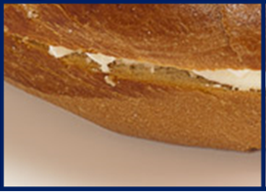
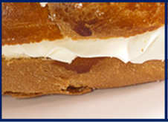
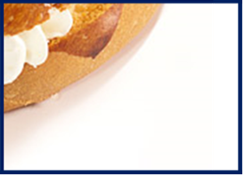
hablar
El Roscón de Reyes [1]
an exercise book
a female friend
a present
a question
Do you have…?
s/he, it has
you have
I have
Notes:
You have + exercise book = bean [tienes un cuaderno]
You have + a present = king [tengo un regalo]
A= nouns from week 9
B = nouns from week 10
C = nouns from week 11
D = nouns from week 12
Image attribution: https://www.hornazart.com/roscones.html

Slide 18
hablar
El Roscón de Reyes [2]
an exercise book
a female friend
a present
a question
Do you have…?
s/he, it has
you have
I have
Notes:
I have have + a question = bean [tengo una pregunta]
S/he has + a female friend = king [tiene una amiga]
A= nouns from week 9
B = nouns from week 10
C = nouns from week 11
D = nouns from week 12
Image attribution: https://www.hornazart.com/roscones.html

Slide 19
¡adiós!
rojo

Slide 20
a |  | b |  | c |  | d
English | Spanish | English | Spanish | English | Spanish | English | Spanish
a pen | un bolígrafo | a (male) friend | un amigo | a bottle | una botella | a relative | un familiar
a camera | una cámara | a (female) friend | una amiga | a pencil case | un estuche | a balloon | un globo
an exercise book | un cuaderno | a bicycle | una bicicleta | a book | un libro | a chair | una silla
a (piece of) fruit | una fruta | a bed | una cama | a question | una pregunta | a cake | una tarta
a school bag | una mochila | a cat | un gato | an answer | una respuesta | a present | un regalo
a ball | una pelota |  |  | a pencil sharpener | un sacapuntas | a flower | una flor
a telephone | un teléfono |  |  |  |  | a song | una canción
Notes:
A list of the Spanish and English vocabulary for additional support, if needed.

