Slide 1
español, con Sofía
¡Feliz Navidad!

Slide 2
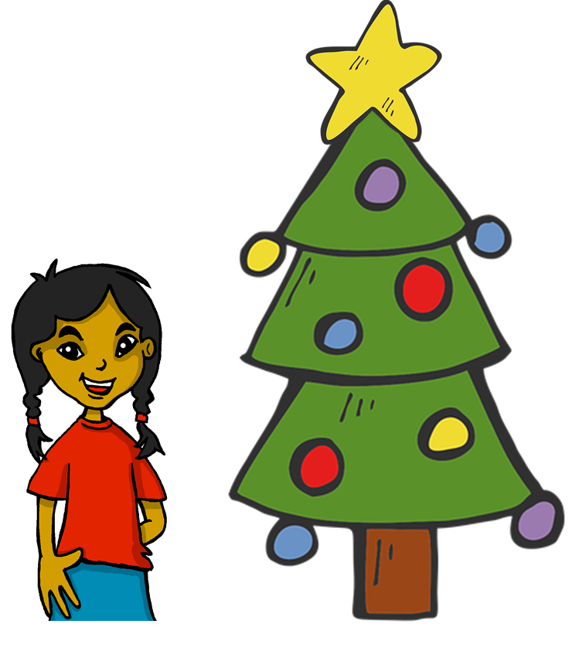
Describing me and others
rojo
Knowledge quiz
A Christmas carol
Term 1 Week 13
Notes:
Artwork by Steve Clarke. All additional pictures selected are available under a Creative Commons license, no attribution required.
The frequency rankings for words that occur in this PowerPoint which have been previously introduced in the resources are given in the SOW (excel document) and in the resources that first introduced and formally re-visited those words.
For any other words that occur incidentally in this PowerPoint, frequency rankings will be provided in the notes field wherever possible.
This lesson includes an assessment of the vocabulary and grammar knowledge from the first 12 weeks of the course. There is a phonics assessment in Week 14. Note: there are no follow up activities this week, but there is a Christmas carol at the end of the quiz. This could be used in a follow up slot, more than once, during this week, as appropriate. The quiz can be completed on paper with pupils writing numbered answers. Alternatively there is a word document for printing. There is an answer sheet for teachers. Alternatively, answers are provided on slides for pupils to correct their own or a partner’s.
Glossed words: el villancico [>5000]
= Christmas carol
Source: Davies, M. & Davies, K. (2018). A frequency dictionary of Spanish: Core vocabulary for learners (2nd ed.). Routledge: London

Slide 3
escuchar
Vocabulary
At home, Nina speaks Aymara, a language spoken by Aymara people of Peru and Bolivia. She is learning Spanish at school, like you. Help Nina by answering the questions in this quiz.
A For each question, put a cross (x) under the English meaning that matches what you hear.
You will hear each Spanish word twice. Choose one correct answer only.
 | A | B | C | D
Ej. | slow | sad | happy | fast
 | ☐ | ☐ | ☐ | ☐
1. | to be (trait) | to have | to be (state) | am (state)
 | ☐ | ☐ | ☐ | ☐
2. | Wednesday | Monday | Friday | Tuesday
 | ☐ | ☐ | ☐ | ☐
3. | exercise book | bed | school bag | pencil case
 | ☐ | ☐ | ☐ | ☐
Ej.
1
2
3
Notes:
Timing: 20-25 minutes (all assessment slides)
Aim: to practise aural comprehension of vocabulary taught in weeks 1-12 of the course.
Procedure:
1. Click the audio buttons to play each item. (The words are recorded twice with a pause to allow pupils to process the information).
2. Pupils can either write 1C, etc.. or if they have the assessment on a print out they can put a X in the correct box.
3. Note that the first item can be completed, with support from the teacher, as an example. It is NOT included in the overall total marks.
3. After items 1-4, continue to the next slide to complete the remainder of the task.
Transcript:
Ejemplo. feliz
1. ser
2. martes
3. estuche
4. ahora
5. bolígrafo
6. allí

Slide 4
escuchar
Vocabulary
A For each question, put a cross (x) under the English meaning that matches what you hear.
You will hear each Spanish word twice. Choose one correct answer only.
 | A | B | C | D
4. | today | always | now | usually
 | ☐ | ☐ | ☐ | ☐
5. | balloon | pen | bottle | present
 | ☐ | ☐ | ☐ | ☐
6. | here | there | yes | how
 | ☐ | ☐ | ☐ | ☐
4
5
6
Notes:
Timing: 20-25 minutes (all assessment slides)
Aim: to practise aural comprehension of vocabulary taught in weeks 1-12 of the course.
Procedure:
1. Click the audio buttons to play each item. (The words are recorded twice with a pause to allow pupils to process the information).
2. Pupils can either write 1C, etc.. or if they have the assessment on a print out they can put a X in the correct box.
3. Note that the first item can be completed, with support from the teacher, as an example. It is NOT included in the overall total marks.
3. After items 1-4, continue to the next slide to complete the remainder of the task.
Transcript:
Ejemplo. feliz
1. ser
2. martes
3. estuche
4. ahora
5. bolígrafo
6. allí

Slide 5
escuchar
Vocabulary
B For each question, put a cross (x) under the type of word you hear. You will hear each Spanish word twice. Choose one correct answer only.
This word is a good example of …
 | A | B | C | D
Ej. | an object ☐ | food ☐ | a day of the week ☐ | a country ☐
1. | a greeting ☐ | furniture ☐ | a question word ☐ | mood or character ☐
2. | a country ☐ | a day of the week ☐ | a greeting ☐ | a colour ☐
3. | mood or character ☐ | an object ☐ | furniture ☐ | a greeting ☐
4. | food ☐ | an object ☐ | a colour ☐ | a question word ☐
Ej.
1
2
3
4
Notes:
Procedure:
1. Click the audio buttons to play each item. (The words are recorded twice with a pause to allow pupils to process the information).
2. Pupils can either write 1C, etc.. or if they have the assessment on a print out they can put a X in the correct box.
3. Note that the first item can be completed, with support from the teacher, as an example. It is NOT included in the overall total marks.
4. When complete, continue to the reading.
Transcript:
Ejemplo. jueves
1. una silla
2. Buenas tardes !
3. tranquilo
4. dónde

Slide 6
escuchar
Grammar
C Put a cross (x) next to the person or people that the sentence is about. You will hear each Spanish sentence twice.
1. | I | ☐ | you | ☐ | he/she | ☐
2. | I | ☐ | you | ☐ | he/she | ☐
3. | I | ☐ | you | ☐ | he/she | ☐
4. | I | ☐ | you | ☐ | he/she | ☐
5. | I | ☐ | you | ☐ | he/she | ☐
1
2
3
4
5
Notes:
Procedure:
1. Click the audio buttons to play each item. (The words are recorded twice with a pause to allow pupils to process the information).
2. Pupils can either write 1C, etc.. or if they have the assessment on a print out they can put a X in the correct box.
3. Note that the first item can be completed, with support from the teacher, as an example. It is NOT included in the overall total marks.
4. When complete, continue to the reading.
Transcript:
1. Eres elegante.
2. Tengo una respuesta.
3. Estoy nerviosa hoy.
4. Siempre es serio.
5. Tienes una cámara bonita

Slide 7
leer
A Translate the underlined Spanish word to complete each English sentence.
1. Tengo un regalo. I have a _____________ .
2. Rafa está aquí. Rafa is _____________ .
3. Tienes un gato. You have a _____________ .
4. Está ausente? ______ she absent?
5. Es domingo? Is it _____________ ?
6. Estoy cansado. I am _____________ .
7. ¿Cómo estás? ___________ are you?
8. Chaska tiene una pelota. Chaska has a _____________ .
9. Hoy es miércoles. _____________ it’s Wednesday.
10. Señor Valero tiene un libro. Mr Valero has a _____________ .
Notes:
Aim: to practise written recall of previously taught vocabulary.
Procedure:
Ensure that the task is clear.
Pupils could write 1 – 10 and the individual English word meanings (or they could fill in if they have printed assessment sheets).

Slide 8
escribir
B Translate the underlined English words to complete the Spanish sentence.
1. It’s a school bag. Es _____ __________. (write two words)
2. Sofía is pleased. Sofía está _____________. (write one word)
3. To be in class is importante. _________ en clase es importante. (write one word)
4. Good morning! ¡ ___________ _______! (write two words)
5. Friday is a day. El viernes es un ________. (write one word)
6. What? In Peru? ¿__________? ¿En Perú? (write one word)
7. To have a camera is excellent. ___________ una cámara es excelente. (write one word)
8. It’s an exercise book. Es un _______________. (write one word)
Notes:
Aim: to practise written production of previously taught vocabulary.
Procedure:
Ensure that the task is clear.
Pupils could write 1 – 10 and the individual English word meanings (or they could fill in if they have printed assessment sheets).

Slide 9
escribir
C Write the opposite word in Spanish.
1. lento - ________________ 2. tranquilo - _____________ 3. feliz - __________________
4. ausente - ______________
5. no - ________
Notes:
Aim: to practise written production of previously taught vocabulary.
Procedure:
Ensure that the task is clear.
Pupils could write the answers only (or they could fill in if they have printed assessment sheets).

Slide 10
leer
Grammar
Like English, Aymara doesn’t have grammatical gender and adjectives go before the noun. Verb forms are different, too. Help Nina with her Spanish grammar by answering the questions in this part of the quiz.
1 | ☐ I ☐ you _{[singular]} ☐ she, he, it | Tengo un gato. |  | 4 | ☐ I ☐ you _{[singular]} ☐ she, he, it | Tienes una tarta.
2 | ☐ I ☐ you _{[singular]} ☐ she, he, it | Eres curioso. |  | 5 | ☐ I ☐ you _{[singular]} ☐ she, he, it | Tiene una botella.
3 | ☐ I ☐ you _{[singular]} ☐ she, he, it | Está en Inglaterra. |  | 6 | ☐ I ☐ you _{[singular]} ☐ she, he, it | Estoy en casa.
Notes:
Aim: to practise written recall of previously taught grammar.
Procedure:
Ensure that the task is clear.
Pupils could write the correct English pronouns (or they could fill in if they have printed assessment sheets).

Slide 11
leer
Grammar
B Put a (X) next to two words that could finish this sentence about Carlos (a boy).
 | Tick two boxes.
1. Carlos es _______. | a) elegante | ☐
 | b) pequeña | ☐
 | c) tranquila | ☐
 | d) contento | ☐
 | e) curiosa | ☐
Put a (X) next to two words that could finish this sentence about Elena (a girl).
 | Tick two boxes.
2. Elena es _______. | a) serio | ☐
 | b) triste | ☐
 | c) curiosa | ☐
 | d) bonito | ☐
 | e) lento | ☐
Notes:
Aim: to practise written recall of previously taught grammar.
Procedure:
Ensure that the task is clear.
Pupils could write the correct English pronouns (or they could fill in if they have printed assessment sheets).

Slide 12
leer
Grammar
C Write the words in each box in the correct order.
1. | un amarillo globo | Correct order:_________________________________________
2. | amiga cansada una | Correct order:_________________________________________
3. | roja una bicicleta | Correct order:_________________________________________
4. | sacapuntas un pequeño | Correct order:_________________________________________
Notes:
Aim: to practise written recall of previously taught grammar.

Slide 13
escribir
D Write the Spanish word for ‘a’. 1. _______ teléfono (m) 2. _______ fruta (f)
E Write the Spanish for the English given in brackets.
1. ________ una pregunta. (I have) 2. ________ lunes. (it is) 3. ¿________ nervioso ahora? (you are) 4. ________ seria siempre. (I am)
Notes:
Aim: to practise written production of previously taught vocabulary.
Procedure:
Ensure that the task is clear.
Pupils could write the answers only (or they could fill in if they have printed assessment sheets).

Slide 14
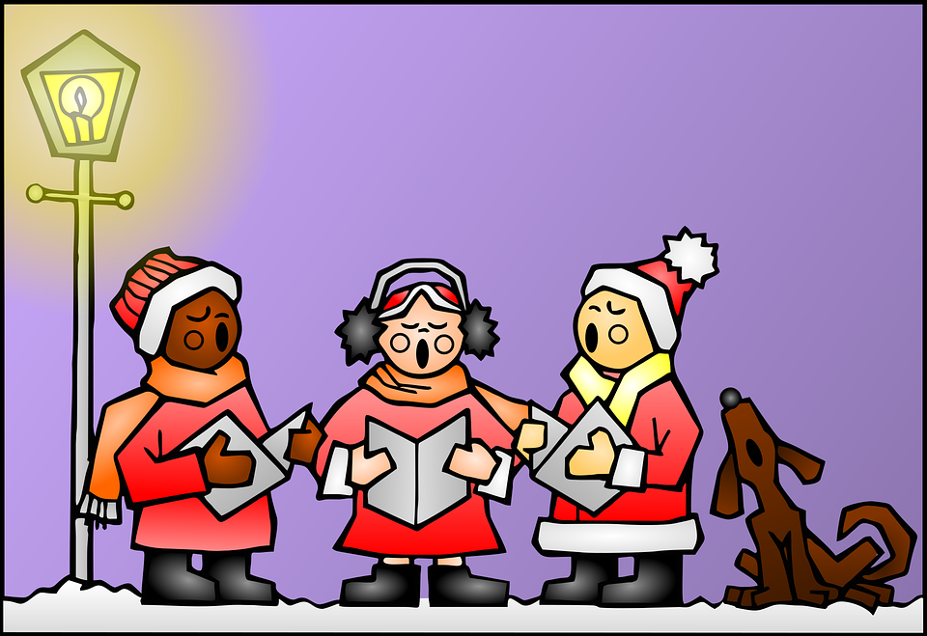
escuchar
Un villancico: Hoy es Navidad
Escucha y completa el villancico.
_________________ (1) por doquier resuenan sin cesar proclaman con placer que hoy es Navidad. Los _________ (2) que aquí están no dejan de __________ (3) En este día de amor y buena voluntad. (¡ey!)
campanas
[Estribillo] (chorus)
_______________ (4), Navidad, __________ (5) es Navidad Es un día de alegría y felicidad. (¡ey!) x2
Navidad
Hoy
niños
cantar
la campana = bell por doquier = everywhere
resuenan = they ring con placer = with pleasure
sin cesar = non-stop proclaman = they announce
los niños = children (m) están = they are (location)
el amor = love buena voluntad = good will
la alegría = joy la felicidad = happiness
Canta el villancico 🎤.
el villancico = Christmas carol
Notes:
Tune:
https://www.youtube.com/watch?v=3xymP1HmQgk&ab_channel=DiaKariMoLan
Timing: 15-20 mins
Aim:
Procedure:
Transcript: Campanas (1) por doquier resuenan sin cesar proclaman con placer que hoy es Navidad. Los niños (2) que aquí están no dejan de cantar (3) En este día de amor y buena voluntad. (¡ey!)
[Estribillo] (chorus)
Navidad (4), Navidad, Hoy (5) es Navidad Es un día de alegría y felicidad. (¡ey!) x2

Slide 15
¡adiós!
rojo

Slide 16
escuchar
Vocabulary
At home, Nina speaks Aymara, a language spoken by Aymara people of Peru and Bolivia. She is learning Spanish at school, like you. Help Nina by answering the questions in this quiz.
A For each question, put a cross (x) under the English meaning that matches what you hear.
You will hear each Spanish word twice. Choose one correct answer only.
 | A | B | C | D
Ej. | slow | sad | happy | fast
 | ☐ | ☐ | ☐ | ☐
1. | to be (trait) | to have | to be (state) | am (state)
 | ☐ | ☐ | ☐ | ☐
2. | Wednesday | Monday | Friday | Tuesday
 | ☐ | ☐ | ☐ | ☐
3. | exercise book | bed | school bag | pencil case
 | ☐ | ☐ | ☐ | ☐
Ej.
1
2
3
Notes:
Timing: 20-25 minutes (all assessment slides)
Aim: to practise aural comprehension of vocabulary taught in weeks 1-12 of the course.
Procedure:
1. Click the audio buttons to play each item. (The words are recorded twice with a pause to allow pupils to process the information).
2. Pupils can either write 1C, etc.. or if they have the assessment on a print out they can put a X in the correct box.
3. Note that the first item can be completed, with support from the teacher, as an example. It is NOT included in the overall total marks.
3. After items 1-4, continue to the next slide to complete the remainder of the task.
Transcript:
Ejemplo. feliz
1. ser
2. martes
3. estuche
4. ahora
5. bolígrafo
6. allí

Slide 17
escuchar
Vocabulary
A For each question, put a cross (x) under the English meaning that matches what you hear.
You will hear each Spanish word twice. Choose one correct answer only.
 | A | B | C | D
4. | today | always | now | usually
 | ☐ | ☐ | ☐ | ☐
5. | balloon | pen | bottle | present
 | ☐ | ☐ | ☐ | ☐
6. | here | there | yes | how
 | ☐ | ☐ | ☐ | ☐
4
5
6
Notes:
Timing: 20-25 minutes (all assessment slides)
Aim: to practise aural comprehension of vocabulary taught in weeks 1-12 of the course.
Procedure:
1. Click the audio buttons to play each item. (The words are recorded twice with a pause to allow pupils to process the information).
2. Pupils can either write 1C, etc.. or if they have the assessment on a print out they can put a X in the correct box.
3. Note that the first item can be completed, with support from the teacher, as an example. It is NOT included in the overall total marks.
3. After items 1-4, continue to the next slide to complete the remainder of the task.
Transcript:
Ejemplo. feliz
1. ser
2. martes
3. estuche
4. ahora
5. bolígrafo
6. allí

Slide 18
escuchar
Vocabulary
B For each question, put a cross (x) under the type of word you hear. You will hear each Spanish word twice. Choose one correct answer only.
This word is a good example of …
 | A | B | C | D
Ej. | an object ☐ | food ☐ | a day of the week ☐ | a country ☐
1. | a greeting ☐ | furniture ☐ | a question word ☐ | mood or character ☐
2. | a country ☐ | a day of the week ☐ | a greeting ☐ | a colour ☐
3. | mood or character ☐ | an object ☐ | furniture ☐ | a greeting ☐
4. | food ☐ | an object ☐ | a colour ☐ | a question word ☐
Ej.
1
2
3
4
Notes:
Procedure:
1. Click the audio buttons to play each item. (The words are recorded twice with a pause to allow pupils to process the information).
2. Pupils can either write 1C, etc.. or if they have the assessment on a print out they can put a X in the correct box.
3. Note that the first item can be completed, with support from the teacher, as an example. It is NOT included in the overall total marks.
4. When complete, continue to the reading.
Transcript:
Ejemplo. jueves
1. una silla
2. Buenas tardes !
3. tranquilo
4. dónde

Slide 19
escuchar
Grammar
C Put a cross (x) next to the person or people that the sentence is about. You will hear each Spanish sentence twice.
1. | I | ☐ | you | ☐ | he/she | ☐
2. | I | ☐ | you | ☐ | he/she | ☐
3. | I | ☐ | you | ☐ | he/she | ☐
4. | I | ☐ | you | ☐ | he/she | ☐
5. | I | ☐ | you | ☐ | he/she | ☐
1
2
3
4
5
Notes:
Procedure:
1. Click the audio buttons to play each item. (The words are recorded twice with a pause to allow pupils to process the information).
2. Pupils can either write 1C, etc.. or if they have the assessment on a print out they can put a X in the correct box.
3. Note that the first item can be completed, with support from the teacher, as an example. It is NOT included in the overall total marks.
4. When complete, continue to the reading.
Transcript:
1. Eres elegante.
2. Tengo una respuesta.
3. Estoy nerviosa hoy.
4. Siempre es serio.
5. Tienes una cámara bonita

Slide 20
leer
A Translate the underlined Spanish word to complete each English sentence.
1. Tengo un regalo. I have a _____________ .
2. Rafa está aquí. Rafa is _____________ .
3. Tienes un gato. You have a _____________ .
4. Está ausente? ______ she absent?
5. Es domingo? Is it _____________ ?
6. Estoy cansado. I am _____________ .
7. ¿Cómo estás? ___________ are you?
8. Chaska tiene una pelota. Chaska has a _____________ .
9. Hoy es miércoles. _____________ it’s Wednesday.
10. Señor Valero tiene un libro. Mr Valero has a _____________ .
present
here
cat
Is
Sunday
tired
How
ball
Today
book
Notes:
Aim: to practise written recall of previously taught vocabulary.
Procedure:
Ensure that the task is clear.
Pupils could write 1 – 10 and the individual English word meanings (or they could fill in if they have printed assessment sheets).

Slide 21
escribir
B Translate the underlined English words to complete the Spanish sentence.
1. It’s a school bag. Es _____ __________. (write two words)
2. Sofía is pleased. Sofía está _____________. (write one word)
3. To be in class is importante. _________ en clase es importante. (write one word)
4. Good morning! ¡ ___________ _______! (write two words)
5. Friday is a day. El viernes es un ________. (write one word)
6. What? In Peru? ¿__________? ¿En Perú? (write one word)
7. To have a camera is excellent. ___________ una cámara es excelente. (write one word)
8. It’s an exercise book. Es un _______________. (write one word)
una mochila
contenta
Estar
Buenos días
día
Qué
Tener
cuaderno
Notes:
Aim: to practise written production of previously taught vocabulary.
Procedure:
Ensure that the task is clear.
Pupils could write 1 – 10 and the individual English word meanings (or they could fill in if they have printed assessment sheets).

Slide 22
escribir
C Write the opposite word in Spanish.
1. lento - ________________ 2. tranquilo - _____________ 3. feliz - __________________
4. ausente - ______________
5. no - ________
rápido
nervioso
triste
presente
sí
Notes:
Aim: to practise written production of previously taught vocabulary.
Procedure:
Ensure that the task is clear.
Pupils could write the answers only (or they could fill in if they have printed assessment sheets).

Slide 23
leer
Grammar
Like English, Aymara doesn’t have grammatical gender and adjectives go before the noun. Verb forms are different, too. Help Nina with her Spanish grammar by answering the questions in this part of the quiz.
1 | ☐ I ☐ you _{[singular]} ☐ she, he, it | Tengo un gato. |  | 4 | ☐ I ☐ you _{[singular]} ☐ she, he, it | Tienes una tarta.
2 | ☐ I ☐ you _{[singular]} ☐ she, he, it | Eres curioso. |  | 5 | ☐ I ☐ you _{[singular]} ☐ she, he, it | Tiene una botella.
3 | ☐ I ☐ you _{[singular]} ☐ she, he, it | Está en Inglaterra. |  | 6 | ☐ I ☐ you _{[singular]} ☐ she, he, it | Estoy en casa.
Notes:
Aim: to practise written recall of previously taught grammar.
Procedure:
Ensure that the task is clear.
Pupils could write the correct English pronouns (or they could fill in if they have printed assessment sheets).

Slide 24
leer
Grammar
B Put a (X) next to two words that could finish this sentence about Carlos (a boy).
 | Tick two boxes.
1. Carlos es _______. | a) elegante | ☐
 | b) pequeña | ☐
 | c) tranquila | ☐
 | d) contento | ☐
 | e) curiosa | ☐
Put a (X) next to two words that could finish this sentence about Elena (a girl).
 | Tick two boxes.
2. Elena es _______. | a) serio | ☐
 | b) triste | ☐
 | c) curiosa | ☐
 | d) bonito | ☐
 | e) lento | ☐
Notes:
Aim: to practise written recall of previously taught grammar.
Procedure:
Ensure that the task is clear.
Pupils could write the correct English pronouns (or they could fill in if they have printed assessment sheets).

Slide 25
leer
Grammar
C Write the words in each box in the correct order.
1. | un amarillo globo | Correct order:_________________________________________
2. | amiga cansada una | Correct order:_________________________________________
3. | roja una bicicleta | Correct order:_________________________________________
4. | sacapuntas un pequeño | Correct order:_________________________________________
un globo amarillo
una amiga cansada
una bicicleta roja
un sacapuntas pequeño
Notes:
Aim: to practise written recall of previously taught grammar.

Slide 26
escribir
D Write the Spanish word for ‘a’. 1. _______ teléfono (m) 2. _______ fruta (f)
E Write the Spanish for the English given in brackets.
1. ________ una pregunta. (I have) 2. ________ lunes. (it is) 3. ¿________ nervioso ahora? (you are) 4. ________ seria siempre. (I am)
un
una
Tengo
Es
Estás
Soy
Notes:
Aim: to practise written production of previously taught vocabulary.
Procedure:
Ensure that the task is clear.
Pupils could write the answers only (or they could fill in if they have printed assessment sheets).

