Slide 1
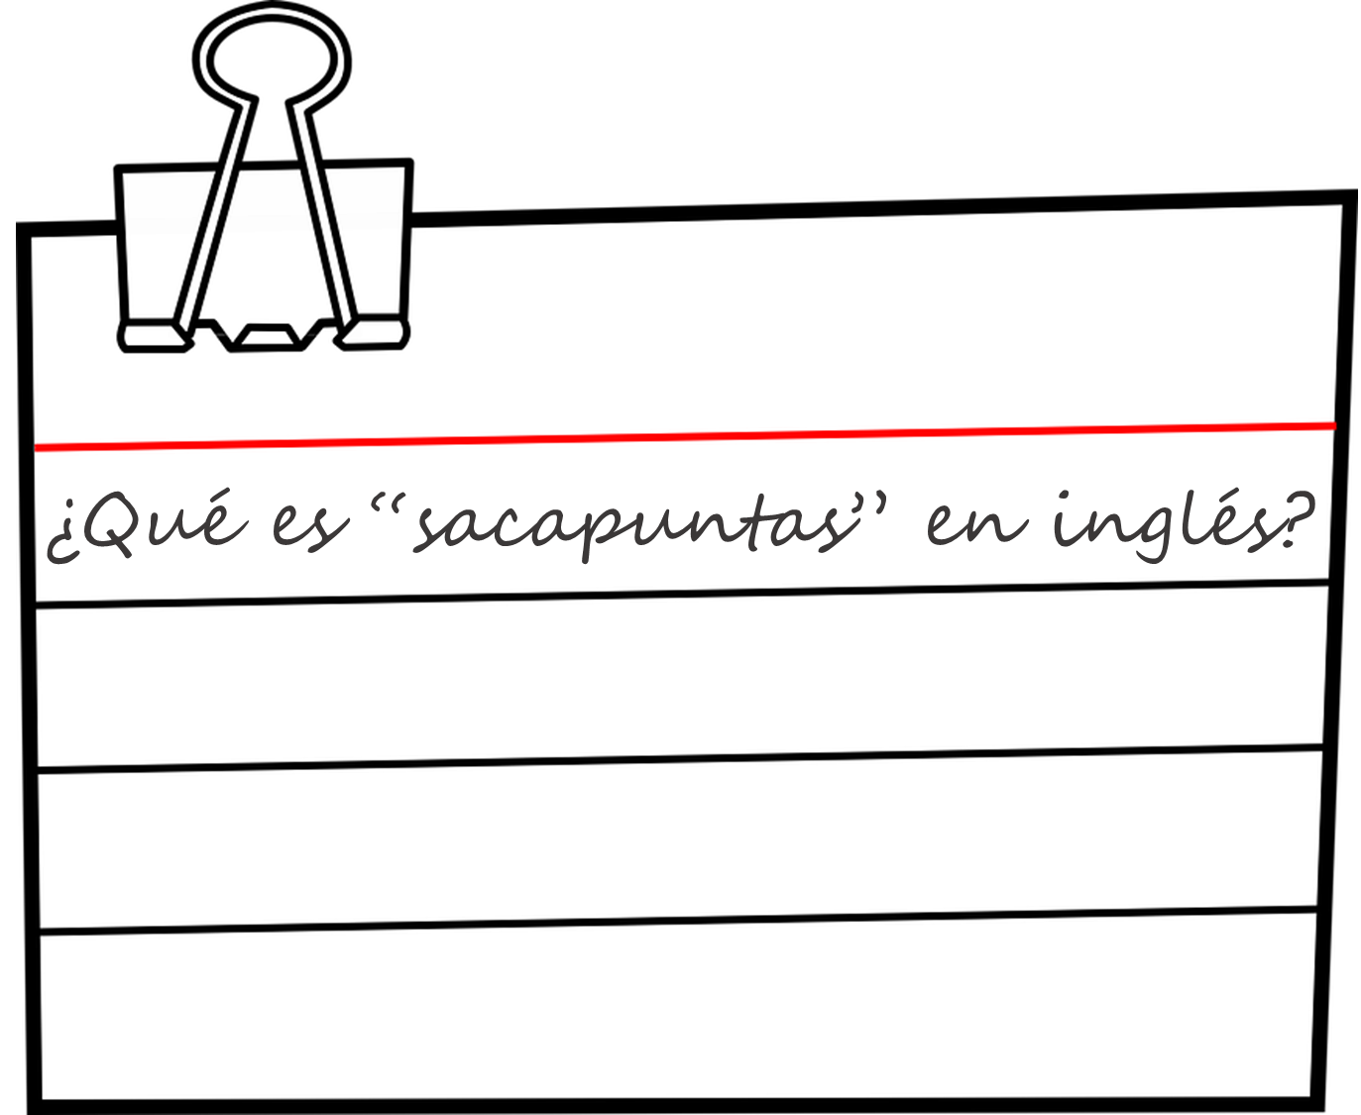
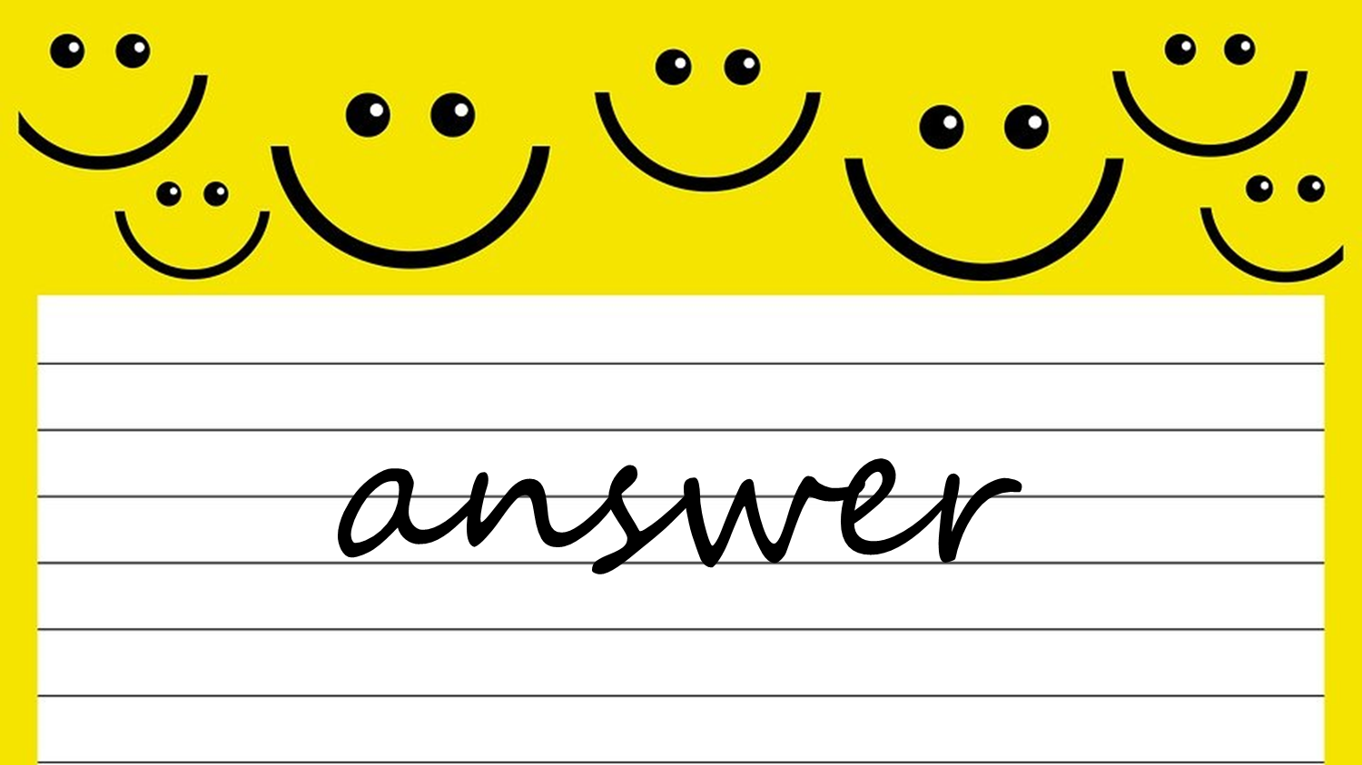
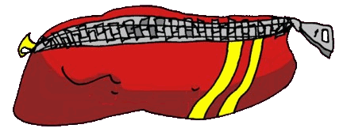
Saying what I and others have
¿Qué tienes?
rojo
Follow ups 1-5
Notes:
Artwork by Steve Clarke. All additional pictures selected are available under a Creative Commons license, no attribution required.
The frequency rankings for words that occur in this PowerPoint which have been previously introduced in the resources are given in the SOW (excel document) and in the resources that first introduced and formally re-visited those words.
For any other words that occur incidentally in this PowerPoint, frequency rankings will be provided in the notes field wherever possible.
Phonics: decir [32] centro [317] cluster: cerca [1042] celebrar [886] dulce [1861] cero [1731] cocina [1214]
Vocabulary: tienes [19] amigo [210] bolígrafo [>5000] botella [1878] gato [1728] libro [230] pregunta [507] respuesta [488] sacapuntas [>5000] estuche [>5000]
Revisit 1: qué [50] día [65] lunes [1370] martes [3101] miércoles [1816] jueves [1650] viernes [1259] sábado [1179] domingo [693] Revisit 2: estás [21] sí [45] no [11] en1 [5] ¡Buenos días! [103/65] ¡Buenas tardes! [103/392]
Frequency of unknown words and cognates: adivinar [2201] compañero [551] ciudad [178] letra [977] la [1]
Source: Davies, M. & Davies, K. (2018). A frequency dictionary of Spanish: Core vocabulary for learners (2nd ed.). Routledge: London

Slide 2
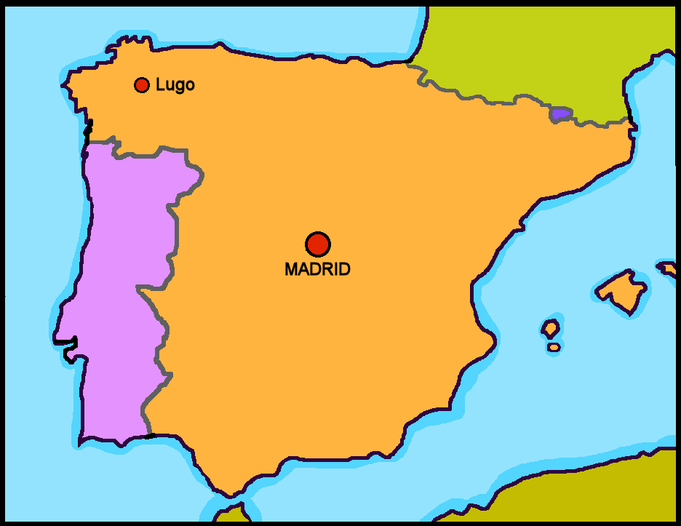
Follow up 1
Escucha. ¿Es [ce] o [ci]?
Escribe la ciudad 📝.
Cervo
1
_ _ _ v _
2
Palencia
P _ _ _ _ _ _ _
3
Madrid
Barcelona
B _ _ _ _ l _ _ a
Cáceres
C _ _ _ _ _ _
5
Valencia
6
V _ _ _ _ _ _ _
4
Albacete
A _ _ _ _ _ _ _
7
Murcia
M _ _ _ _ _
8
Ceuta
_ _ _ t a
la = the (fem, sing.)
ciudad = city, town
Notes:
Timing: 5 minutes
Aim: to develop phonological awareness of [ci] and [ce] in a transcription task; to develop familiarity with the location of some Spanish cities and the shape of Spain on a map.
Procedure:
Click to bring up the instruction.
Complete number 1 together. Click to hear the city name. Pupils write the city. Click to reveal the written answer.
Continue with items 1-8.
Click to correct them.
Ask pupils which cities they have heard of and anything they might know about them.
Transcript Cervo Palencia Barcelona Cáceres Valencia Albacete Murcia Ceuta
Frequency of unknown words:
la [1] ciudad [178]
Source: Davies, M. and Davies, K. (2018). A frequency dictionary of Spanish: Core vocabulary for learners (2nd ed.). Routledge: London

Slide 3
Follow up 2:
Escribe 1 – 10 y las palabras en inglés.
leer
libro | respuesta | botella | estuche | sacapuntas | pregunta | amiga | cama | bici | boli
word for ‘a/an’
word for ‘a/an’
en inglés
en inglés
1
2
3
4
5
question
una
book
un
6
7
8
9
10
answer
una
(female) friend
una
bottle
una
bed
una
pencil case
un
bike
una
sharpener
un
pen
un
las palabras = the words
Notes:
Timing: 5 minutes
Aim: to practise written comprehension of new vocabulary and its correct association with the appropriate indefinite article (word for ‘a/an’).
Procedure:
1. Read the instruction in Spanish.
2. Pupils are to write down the English meanings of the nouns (in order as they appear from the left on the ‘tickertape’). Note: the tickertape is set to repeat until the next mouse click. Pupils may need to see as many as 3 – 4 repetitions to get all of the words.
3. Pupils can volunteer the answers orally. Written answers appear on clicks. 4. Teacher clicks to bring up the 2nd prompt ‘word for ‘a/an’’.
5. Pupils write in the indefinite articles.
6. Elicit and click to reveal answers.

Slide 4
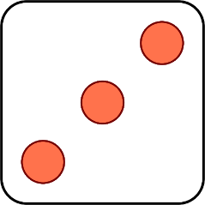
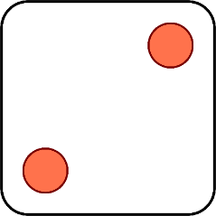
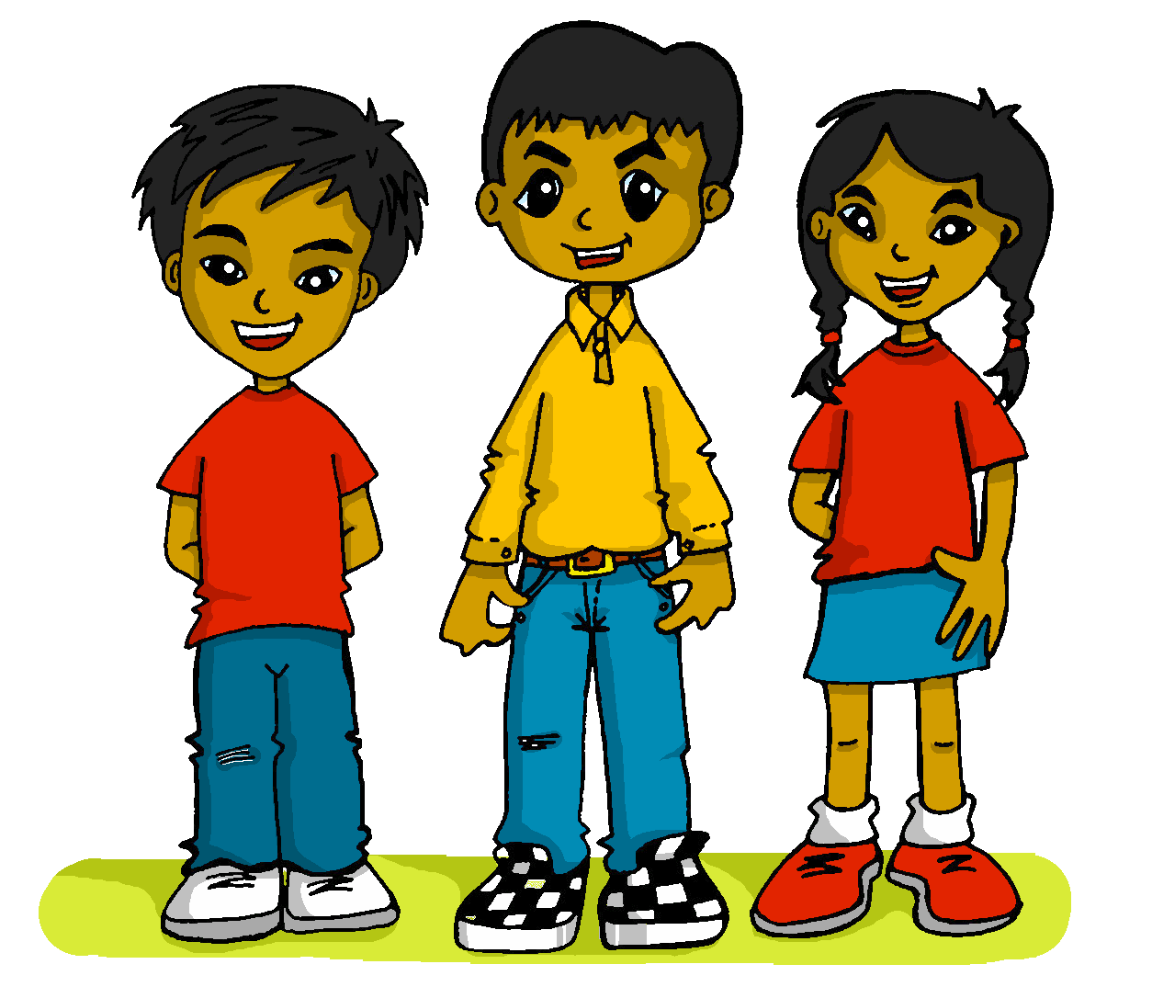
Follow up 3:
¿Qué es en español? Habla 📝.
Quique, Luis and Sofía are playing a game.
What do they have to say each time in Spanish?
hablar
Tengo una respuesta.
Tienes un estuche.
Tiene un libro.
¿Tengo una pregunta?
¿Tienes un sacapuntas?
¿Tiene una botella?
1 | I have…
2 | You have…
3 | She has…
4 | Do I have…?
5 | Do you have…?
6 | Does he have…?
1 | a question
2 | a pencil case
3 | an answer
4 | a sharpener
5 | a book
6 | a bottle
Notes:
Timing: 5 minutes
Aim: to practise oral production of three parts of tener (question and answer) and the six new nouns from this week.
Procedure: 1. Click to ‘roll’ the dice.
2. Pupils translate the verbs and nouns whose numbers correspond to the respective dice to make a short sentence. They say the answer chorally.
3. Click to reveal the correct sentence.
4. Repeat until all six combinations have been said.

Slide 5
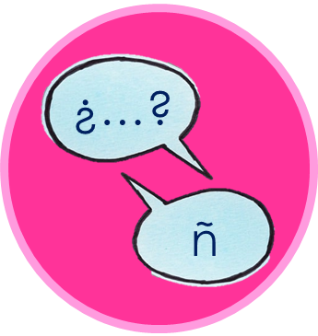
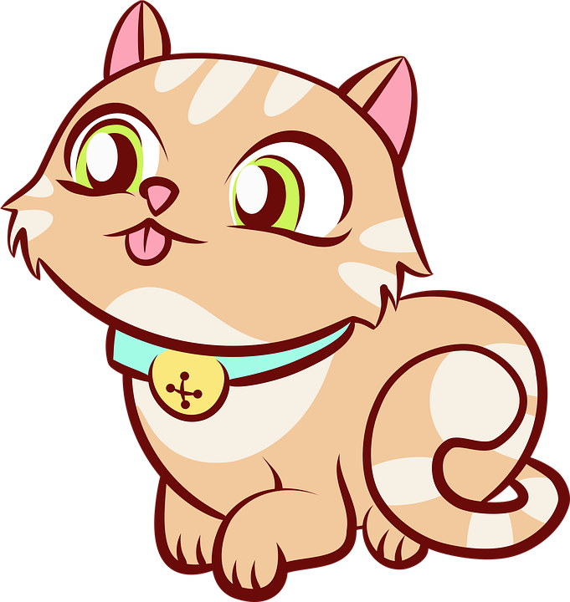
Follow up 4
Escribe la letra* de un estuche (A-B).
Un compañero* adivina*.
‘Do you have…..?’
hablar
Estuche A
Estuche B
un | sacapuntas
 | boli
 | libro
 | gato
 | elefante
 | cuaderno
una | botella
 | pregunta
 | respuesta
 | pelota
 | fruta
Estuche C
Estuche D
la letra = the letra
compañero = partner
adivina = guess
Notes:
Timing: 5 minutes
Aim: to practise oral production tengo, tienes, the six new nouns from this week and previously taught nouns.
Procedure: 1. Pupil A chooses (in secret) a pencil case. 2. Pupil B asks questions to guess which pencil case A has chosen. 3. When B correctly guesses, pupils swap and repeat the task. Note: for more able groups / pupils, teachers could remove or partially obscure the vocabulary support, either before the first round, or for subsequent rounds, to increase the challenge.
Frequency of unknown words:
adivinar [2201] compañero [551] la [1] letra [977]
Source: Davies, M. and Davies, K. (2018). A frequency dictionary of Spanish: Core vocabulary for learners (2nd ed.). Routledge: London

Slide 6
Follow up 5a:
Escribe en inglés 📝.
a b ñ
Can you get at least15 points?
vocabulario
 | ¿qué? | lunes | miércoles
 | un día | jueves | viernes
 | estás | ¡Buenos días! | sí
 | no | tiene | ¡Buenas tardes!
 | una pregunta | un estuche | tengo
 | una botella | un sacapuntas | un libro
 | tienes | una respuesta | una
what?
Monday
Wednesday
x3
a day
Thursday
Friday
you are (state)
Good morning!
yes
x2
no
S/he, it has
Good afternoon!
a question
a pencil case
I have
a bottle
a pencil sharpener
a book
x1
you have
an answer
a / an (feminine)
Notes:
Timing: 6 minutes
Aim: to practise written production of vocabulary for this week and previous weeks.
Procedure:
1. Pupils need to write the Spanish for as many words as possible, aiming to get at least 15 points (but more if possible).
2. Click for Spanish answers.
Note: The most recently learnt and practised words are pink, words from the previous week are green and those from two weeks ago are blue, thus more points are awarded for them, to recognise that memories fade and more effort (heavy lifting!) is needed to retrieve them.

Slide 7
Follow up 5b:
Escribe en español 📝.
a b ñ
vocabulario
Can you get at least15 points?
 | What? | Tuesday | Wednesday
 | a day | Saturday | Sunday
 | you are (state) | Good morning | yes
 | no | s/he, it has | Good afternoon!
 | a question | a pencil case | I have
 | a bottle | a sharpener | a book
 | you have | an answer | a / an (feminine)
¿qué?
martes
miércoles
x3
un día
sábado
domingo
estás
¡Buenos días!
sí
x2
no
Tiene
¡Buenas tardes!
una pregunta
un estuche
Tengo
una botella
un sacapuntas
un libro
x1
tienes
una respuesta
una
Notes:
Timing: 6 minutes
Aim: to practise written comprehension of vocabulary from last week and this week.
Procedure:
1. Pupils need to write the Spanish for as many words as possible, aiming to get at least 15 points (but more if possible).
2. Click for Spanish answers.
Note: The most recently learnt and practised words are pink, words from the previous week are green and those from two weeks ago are blue, thus more points are awarded for them, to recognise that memories fade and more effort (heavy lifting!) is needed to retrieve them.

Slide 8
Handout: Follow up 5a
Follow up 5a:
Escribe en inglés 📝.
a b ñ
Can you get at least15 points?
vocabulario
 | ¿qué? | lunes | miércoles
 | un día | jueves | viernes
 | estás | ¡Buenos días! | sí
 | no | tiene | ¡Buenas tardes!
 | una pregunta | un estuche | tengo
 | una botella | un sacapuntas | un libro
 | tienes | una respuesta | una
x3
x2
x1
Notes:
Timing: 6 minutes
Aim: to practise written production of vocabulary for this week and previous weeks.
Procedure:
1. Pupils need to write the Spanish for as many words as possible, aiming to get at least 15 points (but more if possible).
2. Click for Spanish answers.
Note: The most recently learnt and practised words are pink, words from the previous week are green and those from two weeks ago are blue, thus more points are awarded for them, to recognise that memories fade and more effort (heavy lifting!) is needed to retrieve them.

Slide 9
Handout: Follow up 5b
Follow up 5b:
Escribe en español 📝.
a b ñ
vocabulario
Can you get at least15 points?
 | What? | Tuesday | Wednesday
 | a day | Saturday | Sunday
 | you are (state) | Good morning | yes
 | no | s/he, it has | Good afternoon!
 | a question | a pencil case | I have
 | a bottle | a sharpener | a book
 | you have | an answer | a / an (feminine)
x3
x2
x1
Notes:
Timing: 6 minutes
Aim: to practise written comprehension of vocabulary from last week and this week.
Procedure:
1. Pupils need to write the Spanish for as many words as possible, aiming to get at least 15 points (but more if possible).
2. Click for Spanish answers.
Note: The most recently learnt and practised words are pink, words from the previous week are green and those from two weeks ago are blue, thus more points are awarded for them, to recognise that memories fade and more effort (heavy lifting!) is needed to retrieve them.

