Slide 1
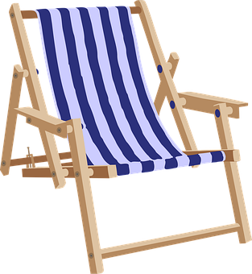
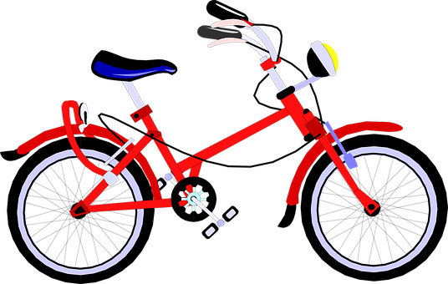
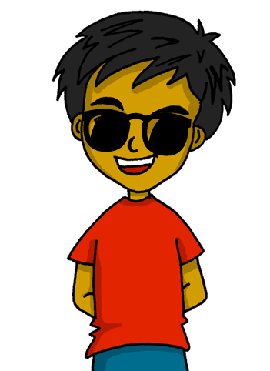
Expressing likes and saying what I and others do
Mi
amarillo
Follow ups 1-5
Notes:
Artwork by Steve Clarke. All additional pictures selected are available under a Creative Commons license, no attribution required.
The frequency rankings for words that occur in this PowerPoint which have been previously introduced in the resources are given in the SOW (excel document) and in the resources that first introduced and formally re-visited those words.
For any other words that occur incidentally in this PowerPoint, frequency rankings will be provided in the notes field wherever possible.
Phonics: Source: helado [3024]
Vocabulary: escuchar [281] hablar [90] [n/a] lugar [144] música [380] famoso [997] típico [1934] 4
Revisit 1: calor [1852] frío [1307] miedo [755] sueño [460]
Revisit 2: hay [haber 13] cuántos [580] cuántas [580]
Frequency of unknown words and cognates:
almohada [4267] cohete [>5000] encuesta [2077] hospital [1050] humano [243] moneda [1577] ruta [1845] verano [1139] su [12]
Source: Davies, M. & Davies, K. (2018). A frequency dictionary of Spanish: Core vocabulary for learners (2nd ed.). Routledge: London

Slide 2
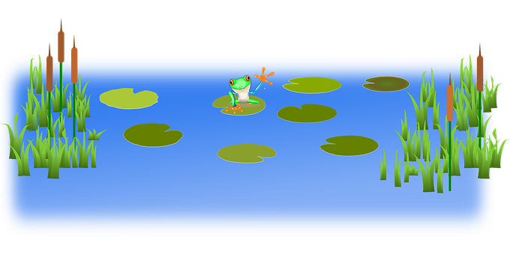
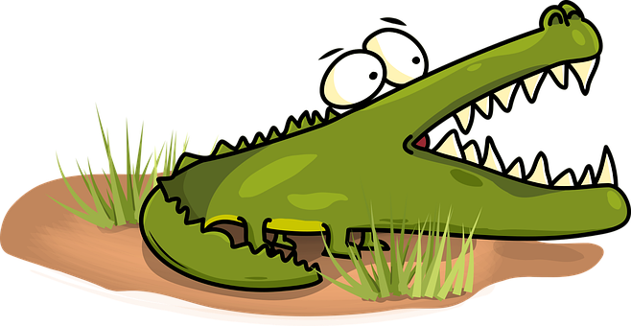
Follow up 1:
cuidado = be careful correctamente = correctly
caer = to fall
[h]
¡Cuidado con el cocodrilo!
hablar
Pronuncia las palabras correctamente para no caer al agua.
Turno 1: Persona A
Turno 2: Persona B
ahí
helado
húmedo
humano
zanahoria
almohada
horror
hablar
hospital
ahora
hoy
Notes:
Timing: 5 minutes
Aim: to practise knowledge of [h] to known and unknown words.
Procedure:
Click to bring up the instruction.
Pupils work in pairs to practise pronunciation. They can choose where to start and have one minute to pronounce all the words correctly (silent h) to avoid being eaten by the crocodile.
Divide the class in A & B and click to indicate it’s ‘persona A’’s turn.
Click to bring up Persona B’s turn.
cuidado [1822] correctamente [4173] caer [251]

Slide 3
Follow up 2
Escribe nueve palabras en inglés.
¡Bingo!
¿Tienes 3? Responde ‘línea’
palabras
¿Tienes 9? Responde ‘bingo’
comer
aprender
responder
amar
montar
escuchar
línea
bingo
buscar
hablar
pasear
hacer
tocar
leer
Notes:
Timing: 5 minutes
Aim: to practise written comprehension of this week’s new language.
Procedure: 1. Pupils choose any 9 of the words from the Spanish table and write them into their grid in English..
2. Teacher then calls out the Spanish for any of the 16 words in the table in whichever order.
3. Pupils call ‘línea’ when they have any three in a row (vertical, horizontal, or diagonal) and then ‘bingo’ again for the first full house.

Slide 4
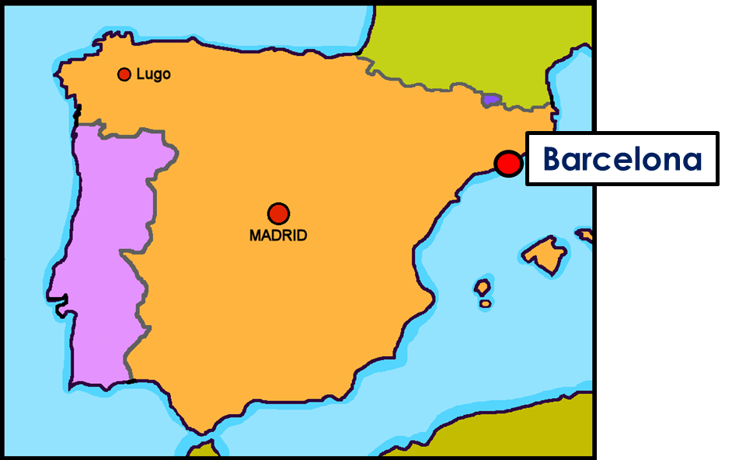
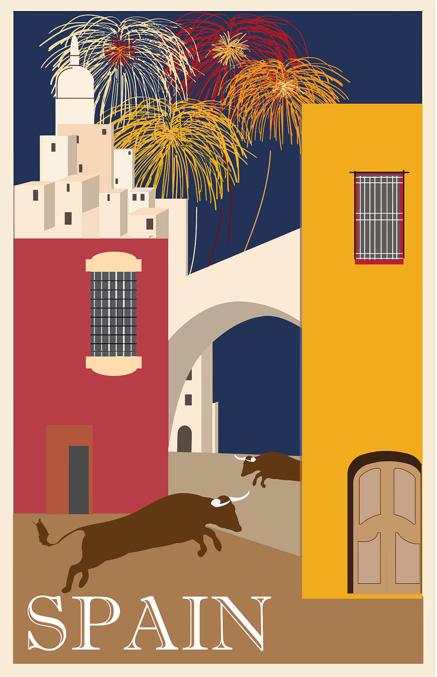
Follow up 3:
¿Dónde está Quique?
[1/5]
hablar
to play (an instrument)
to talk
to listen
to eat
to read
I
You
s/he
El Parque Güell en Barcelona.
Notes:
Timing: 5 minutes
Aim: to correctly use 1^{st,} 2nd and 3rd person singular verbs in oral production.
Procedure:
Pupils select a pronoun on the vertical axis with verb along the horizontal axis.
They translate the short verb phrase (e.g. I – to talk = hablo) to identify the square where they think Quique is.
Click on the square to reveal what is beneath.
Note: pupils might benefit from revisiting the infinitive verbs again before starting the activity. (i.e., enseñar, ver, practicar, comer, caminar).
(!) Quique is hidden behind…
I play= toco

Slide 5
Follow up 3:
¿Dónde está Quique?
[2/5]
hablar
to go for a walk
to visit
to relax
to learn
to do/make
I
You
s/he
El Parque Güell en Barcelona.
Notes:
(!) Quique is hidden behind…
S/he relaxes = descansas

Slide 6
Follow up 3:
¿Dónde está Quique?
[3/5]
hablar
to listen
to hate
to ride
to eat
to reply (to)
I
You
s/he
El Parque Güell en Barcelona.
Notes:
(!) Quique is hidden behind…
S/he eats = come

Slide 7
Follow up 3:
¿Dónde está Quique?
[4/5]
hablar
to play (an
instrument)
to talk
to listen
to eat
to read
I
You
s/he
El Parque Güell en Barcelona.
Notes:
(!) Quique is hidden behind…
S/he listens = escucha

Slide 8
Follow up 3:
¿Dónde está Quique?
[5/5]
hablar
to go for a walk
to visit
to relax
to learn
to do/make
I
You
s/he
El Parque Güell en Barcelona.
Notes:
(!) Quique is hidden behind…
You make= haces

Slide 9
Follow up 4
(la) encuesta = a survey
Pregunta y completa la encuesta*.
hablar
A: ¿Descansas?
B: Sí, descanso.
to relax | to ride a bike | to go for a walk | to read | to do a drawing | to play an instrument | to visit a museum | to eat | to reply to messages
B: No, no monto en bici.
A: ¿Montas en bici?
Notes:
Timing: 8 minutes
Aim: to practise oral production and comprehension of –ar and –er verbs in 1st and 2nd person singular.
Read the title.
Tell students they are going to conduct a survey in the class about popular holiday activities.
Click to bring key speech bubbles to model the dialogue. A ¿Descansas? and click to bring B’s sample answer and follow up question. Click to model how to use the survey sheet.
Tell students they have 5 minutes to ask as many students in the class. Teachers should check that pupils are answering in full sentences.
NB. Some pupils might benefit from writing their response beforehand. Teachers can give a couple of minutes to do this after modelling the exchange.
Frequency of unknown words and cognates:
encuesta [2077]
Source: Davies, M. & Davies, K. (2018). A frequency dictionary of Spanish: Core vocabulary for learners (2nd ed.). Routledge: London

Slide 10
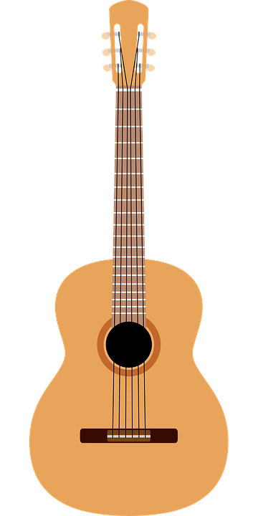
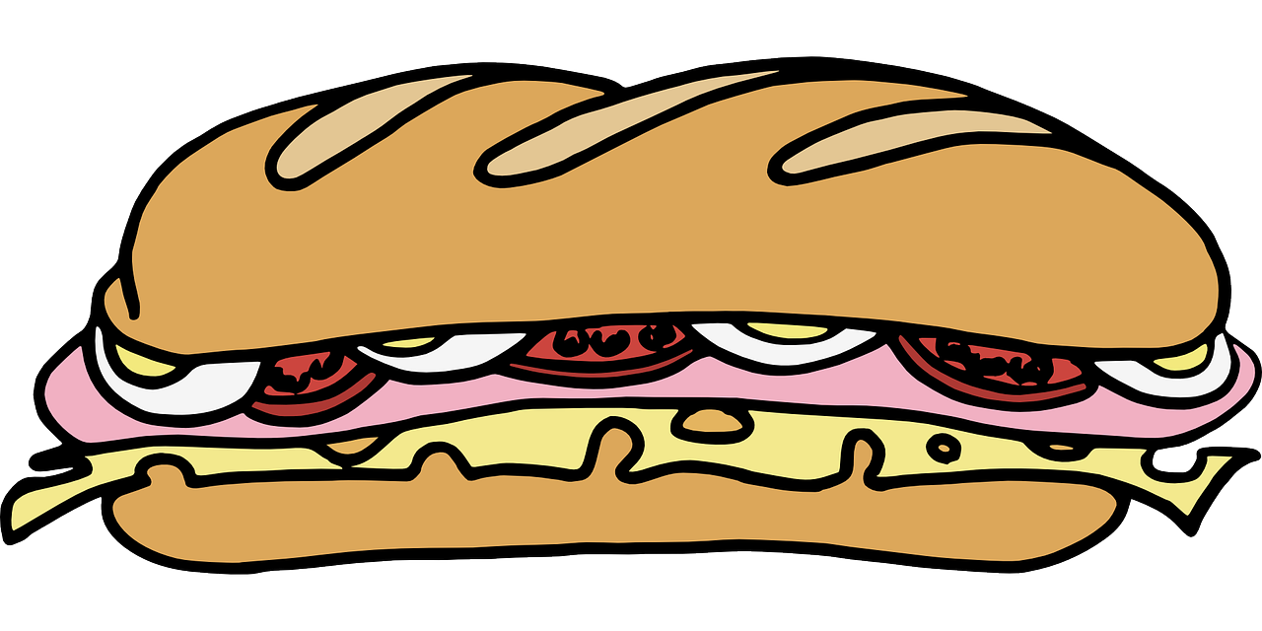
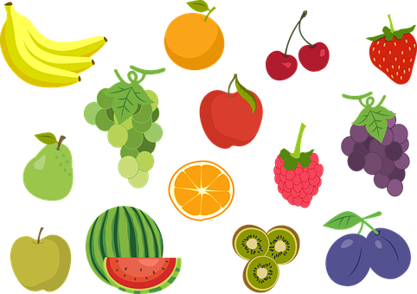
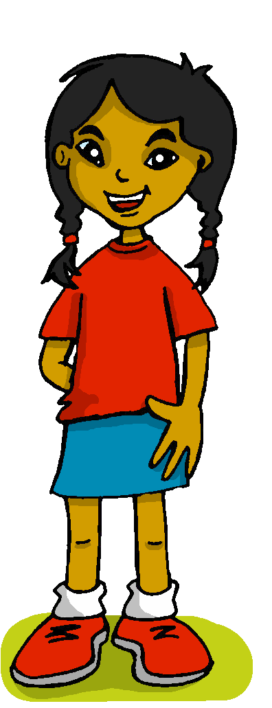
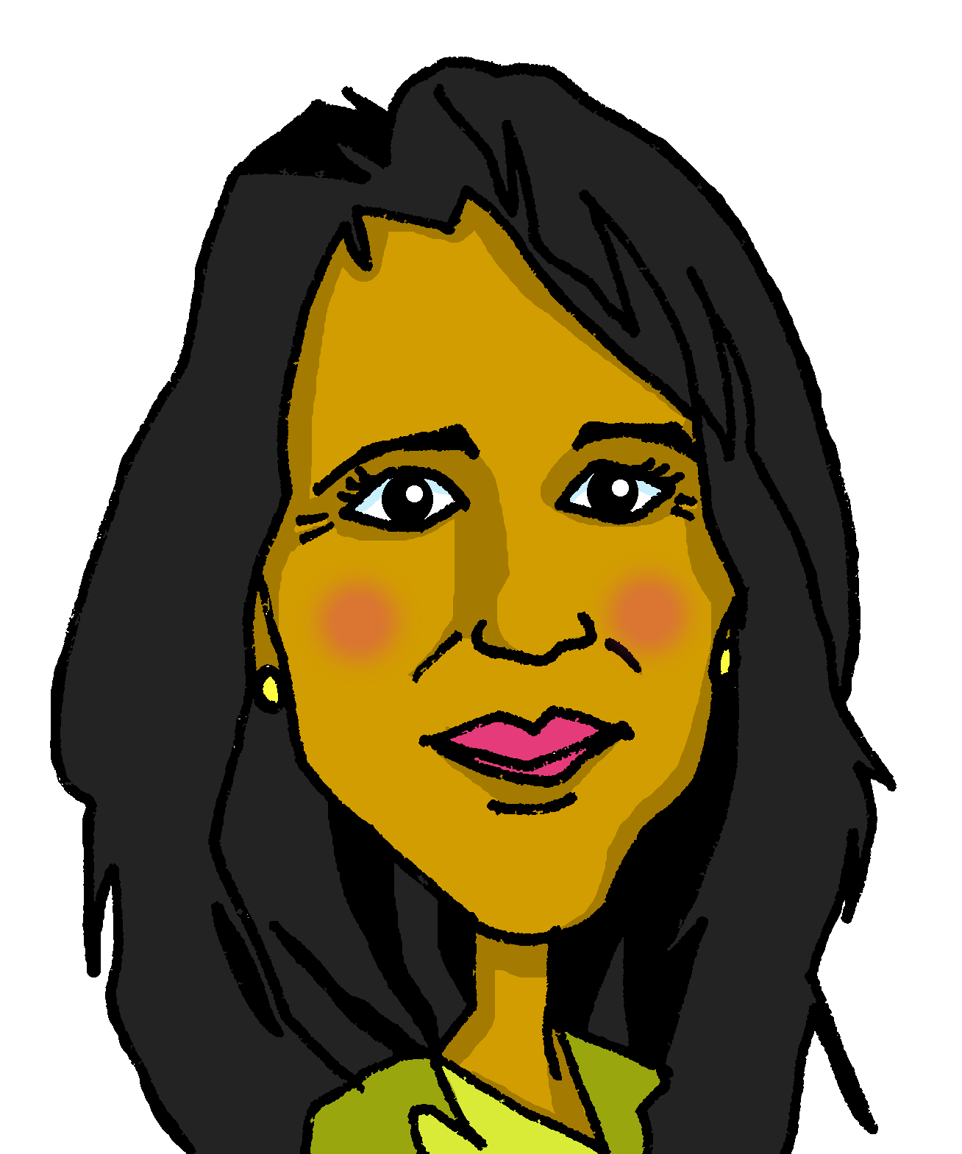
Follow up 5:
Quique describe un día de verano 🌞.
📝 Escribe seis frases.
el verano = (the) summer
escribir
música
vocabulario
información
una fiesta
una revista
un libro
un dibujo
un bocadillo
una naranja
unas palabras
un instrumento
en español
en inglés
la cama
la habitación
la cocina
casa
el parque
la mañana
la tarde
con
por
en
(look for)
(read)
(play an instrument)
(eat)
(learn)
(eat)
(go for a walk)
(visit)
(go for a walk)
(talk)
(learn)
(listen)
[tú]
(talk)
[yo]
(relax)
[ella]
(do)
Notes:
Timing: 5-7 minutes
Aim: to practise more independent written production of singular persons of –ar, -er verbs, drawing on a variety of previously taught vocabulary.
Procedure:
Pupils write sentences using the third person singular and plural of –AR and –ER verbs to describe (with 6 sentences) any of the activities that Sofía, Quique and Pedro do in Summer.
The clouds show what Quique, Sofía and Elena do. This encourages pupils to practise the singular persons of the verbs introduced this year.
Encourage pupils to extend their sentences with extra details. Model an example with them.
[Yo] + [eat] = como un bocabdillo por la mañana.
Note: Teachers can add a list of verbs to the slide to help pupils, if needed. E.g.
buscar, leer, tocar, comer, pasear, aprender, hablar, visitar, hacer, descansar, escuchar
Frequency of unknown words and cognates:
verano [1139]
Source: Davies, M. & Davies, K. (2018). A frequency dictionary of Spanish: Core vocabulary for learners (2nd ed.). Routledge: London

Slide 11
Follow up extra [a]:
Escribe en inglés 📝: Can you get at least 15 points?
 | hay | unas | unos
 | cuando | ¿cuántas? | ¿cuántos?
 | el frío | tengo | el sueño
 | el calor | tiene | el miedo
 | la música | el lugar | famoso
 | escuchar | hablar | típico
vocabulario
there is /are
some (f.)
some (m.)
x3
when
¿how many? (f.)
¿how many? (m.)
I have
(the) sleepiness
(the) cold
x2
(the) heat
s/he, it has
(the) fear
(the) music
(the) place
famous
x1
to listen
to talk
typical
Notes:
Timing: 5 minutes
Aim: to practise written production of vocabulary from this week and this week’s revisited sets.
Procedure: 1. Give pupils a blank grid. They fill in the English meanings of any of the words they know, trying to reach 15 points in total.
Note: The most recently learnt and practised words are pink, words from the first revisit are green and those from the second revisit are blue, thus more points are awarded for them, to recognise that memories fade and more effort (heavy lifting!) is needed to retrieve them.

Slide 12
follow up extra [b]:
escribe en español 📝: can you get at least 15 points?
 | when | how many? (m.) | some (m.)
 | how many? (f.) | some (f.) | There is / are
 | (the) fear | (the) cold | I have
 | s/he, it has | (the) sleepiness | (the) heat
 | (the) place | famous (f.) | typical (m.)
 | (the) music | to listen, listening | to talk, talking
cuando
¿cuántos?
unos
vocabulario
x3
¿cuántas?
unas
hay
el miedo
tengo
el frío
x2
tiene
el sueño
el calor
el lugar
famosa
típico
x1
la música
escuchar
hablar
Notes:
Timing: 5 minutes
Aim: to practise written production of vocabulary from this week and this week’s revisited sets.
Procedure: 1. Give pupils a blank grid. They fill in the Spanish meanings of any of the words they know, trying to reach 15 points in total.
Note: The most recently learnt and practised words are pink, words from the first revisit are green and those from the second revisit are blue, thus more points are awarded for them, to recognise that memories fade and more effort (heavy lifting!) is needed to retrieve them.

Slide 13
¡adiós!
amarillo

Slide 14
Handout: Follow up extra [a]
Escribe en inglés 📝: Can you get at least 15 points?
 | hay | unas | unos
 | cuando | ¿cuántas? | ¿cuántos?
 | el frío | tengo | el sueño
 | el calor | tiene | el miedo
 | la música | el lugar | famoso
 | escuchar | hablar | típico
vocabulario
x3
x2
x1
Notes:
Timing: 5 minutes
Aim: to practise written comprehension of vocabulary from this week and this week’s revisited sets.
Procedure: 1. Give pupils a blank grid. They fill in the English meanings of any of the words they know, trying to reach 15 points in total.
Note: The most recently learnt and practised words are pink, words from the first revisit are green and those from the second revisit are blue, thus more points are awarded for them, to recognise that memories fade and more effort (heavy lifting!) is needed to retrieve them.

Slide 15
Handout: Follow extra [b]
Escribe en español 📝: Can you get at least 15 points?
vocabulario
 | when | how many? (m.) | some (m.)
 | how many? (f.) | some (f.) | there is / are
 | (the) fear | (the) cold | I have
 | s/he, it has | (the) sleepiness | (the) heat
 | (the) place | famous (f.) | typical (m.)
 | (the) music | to listen, listening | to talk, talking
x3
x2
x1
Notes:
Timing: 5 minutes
Aim: to practise written production of vocabulary from this week and this week’s revisited sets.
Procedure: 1. Give pupils a blank grid. They fill in the Spanish meanings of any of the words they know, trying to reach 15 points in total.
Note: The most recently learnt and practised words are pink, words from the first revisit are green and those from the second revisit are blue, thus more points are awarded for them, to recognise that memories fade and more effort (heavy lifting!) is needed to retrieve them.

