Slide 1
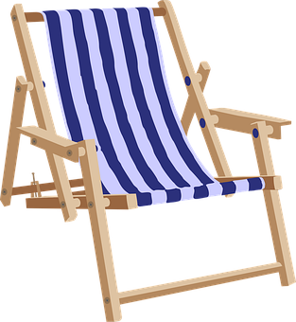
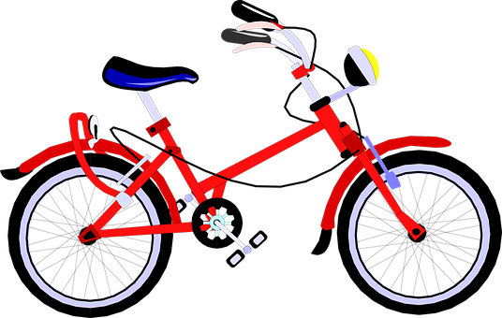
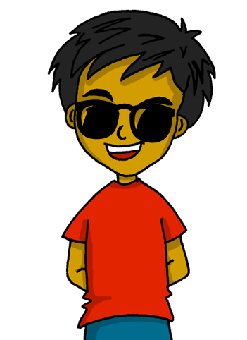
Expressing likes and saying what I and others do
Mi
amarillo
Follow ups 1-5
Notes:
Artwork by Steve Clarke. All additional pictures selected are available under a Creative Commons license, no attribution required.
The frequency rankings for words that occur in this PowerPoint which have been previously introduced in the resources are given in the SOW (excel document) and in the resources that first introduced and formally re-visited those words.
For any other words that occur incidentally in this PowerPoint, frequency rankings will be provided in the notes field wherever possible.
Phonics: Source: ver [38] abuela [783] Cluster: bajar [484] buscar [179] subir [410] abeja [>5000] avispa [>5000] banco [728] bus [3709] vaca [2775] vela [2247] viento [814]
Vocabulary: buscar [179] organizar [1053] tocar [327] cocina [1214] cada [107] luego [150]
Revisit 1: ciudad [178] color [358] fiesta [796] persona [108] mi [37] tu [53] preferido [n/a]
Revisit 2: tiene [19] unos [6] unas [6] boca [465] cabeza [265] dedo [465] ojo [169] oreja [2095] pie [365]
Frequency of unknown words:
bajar [484] subir [410] traducir [2037] padres [>5000] rima [>5000] tabla [2139]
Source: Davies, M. & Davies, K. (2018). A frequency dictionary of Spanish: Core vocabulary for learners (2nd ed.). Routledge: London

Slide 2
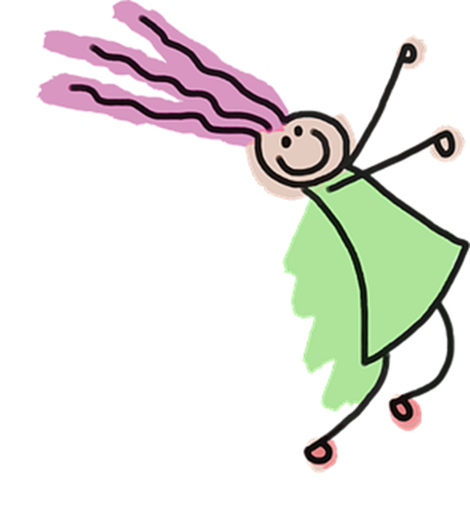
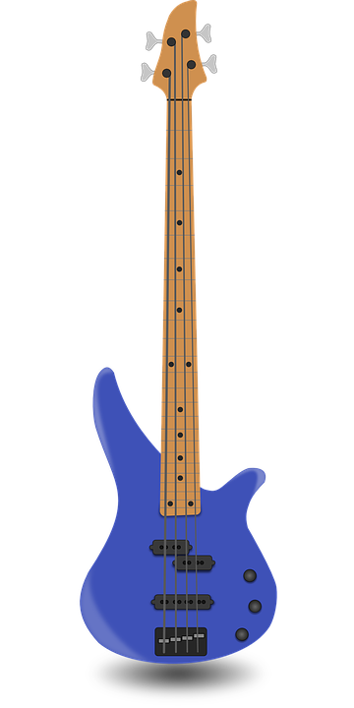
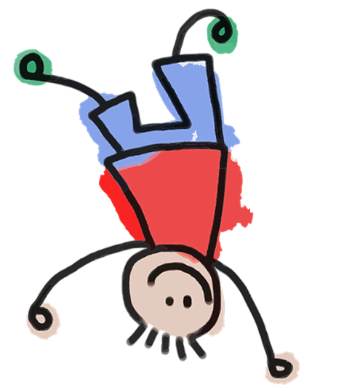
Follow up 1:
[v] [b]
Escucha y lee la rima.
hablar
Practica con tu compañero/a.
30 seg.
Sube y baja el balancín
Con Belén y un delfín.
Baja y sube el balancín
con Valentín el veloz
tocando el bajo y el violín
[fast]
0
[playing]
(la) rima – rhyme
INICIO
Notes:
Timing: 5 minutes
Aim: to practise knowledge of [b] [v] to known and unknown words.
Procedure: 1. Read the instruction
2. Click to bring up each verse of the rhyme and encourage pupils to repeat chorally. Meaning is supported by the pictures accompanying each verse. Repeat x5 to complete the rhyme.
3. At this stage, teachers can ask pupils if they remember the difference between [b] and [v]. ¿El sonido es diferente? The answer is of course no!
4. Click to bring further instruction and give pupils 30 seconds to practise in pairs (click ‘inicio’ to start the timer).
Frequency of unknown words:
rima [>5000]
Source: Davies, M. & Davies, K. (2018). A frequency dictionary of Spanish: Core vocabulary for learners (2nd ed.). Routledge: London

Slide 3
Follow up 2:
¿Qué palabra es?
siem | la tar | lue | ca
to | la co | el cam | orga
po | pre | de | cina
car | nizar | go | da
palabras
60s
b
then, after
g
h
d
each
a
c
f
pm
always
to organise
i
to play
START
Notes:
Timing: 5 minutes
Aim: to present and practise written comprehension and read aloud of three items of previously taught vocabulary that we revisit this week and the four new words.
Procedure: 1. Pupils work in pairs to match up the syllables in order to say the Spanish words introduced and practised in the previous slide. Draw their attention to pictures a-i to help them.
2. Elicit answers from pupils. Answers appear on click (a to i).
3. Optional: Click to make the pictures disappear and elicit the Spanish word for a-i.

Slide 4
Follow up 3 :
Las actividades en verano 🌞
Lee las frases y traduce.
leer
 | __ stroll around ______________.
 | ____ play ______________.
 | ____ read an ___________ ___________.
 | ____ organise ___ ______ in the garden.
 | ___ visit _____________.
 | ___ ride your _____ in the ________.
 | ___ relax ______ day.
E
I
the countryside
[E] Paseo por el campo.
1
S/he
s
an instrument
[1] Toca un instrumento.
S/he
s
interesting
[2] Lee un libro interesante.
2
book
[3] Organizas una fiesta en el jardín.
You
a party
3
[4] Visito a mi familia.
4
I
my family
[5] Montas en bici por la tarde.
5
You
bike
afternoon
[6] Descansa cada día.
6
She
es
each
Notes:
Timing: 7 minutes
Aim: to practise written recognition of AR & -ER verbs (I, you, s/he); to practise comprehension of new and previously taught vocabulary
Procedure:
Pupils read the sentence and translate the sentences, writing the appropriate pronoun and vocabulary item in the gaps provided.
Click to reveal answers.

Slide 5
Follow up 4: Habla en español
(la) tabla – table
padres – parents
traduce = s/he translates
Escribe cinco frases en inglés con las palabras de la tabla*.
hablar
Tu compañero/a traduce la frase al español.
1 minuto
yo tú él ella | organizo organiza toca tocas busco buscas aprendo aprende lee lees visito Visita | un una el la las mi mis | fiesta revista vocabulario habitación noticias casa museo Instrumento | con | la mis mis tu tus | amigo amiga amigos hermano hermana madre padre padres* familia | en por cada | la tarde sábado domingo jueves la cocina casa la plaza clase el parque la ciudad el campo la montaña
0
INICIO
Notes:
Timing: 5 minutes Aim: to practise written comprehension and spoken production using vocabulary and grammar from this week to communicate a range of messages about free time activities.
Procedure:
Both pupils write 5 sentences (in English) made up of words with equivalent meanings from the table.
They swap sentences.
Partner A tries to say all B’s sentences in Spanish within 60 seconds (without or without using the support).
Then Partner B tries to say all A’s sentences in Spanish within 60 seconds.
Adaptions: 1. Teachers could give English sentences to pupils (a couple of words at a time) and pupils write them using mini whiteboards.
2. Teachers could ask questions in Spanish for pupils to answer (either chorally, or individually) – e.g., ¿Qué haces? ¿Qué organizas? ¿Con quién? ¿Cuándo organizas…? ¿Dónde lees…?
Frequency of unknown words:
traducir [2037] padres [>5000] tabla [2139]
Source: Davies, M. & Davies, K. (2018). A frequency dictionary of Spanish: Core vocabulary for learners (2nd ed.). Routledge: London

Slide 6
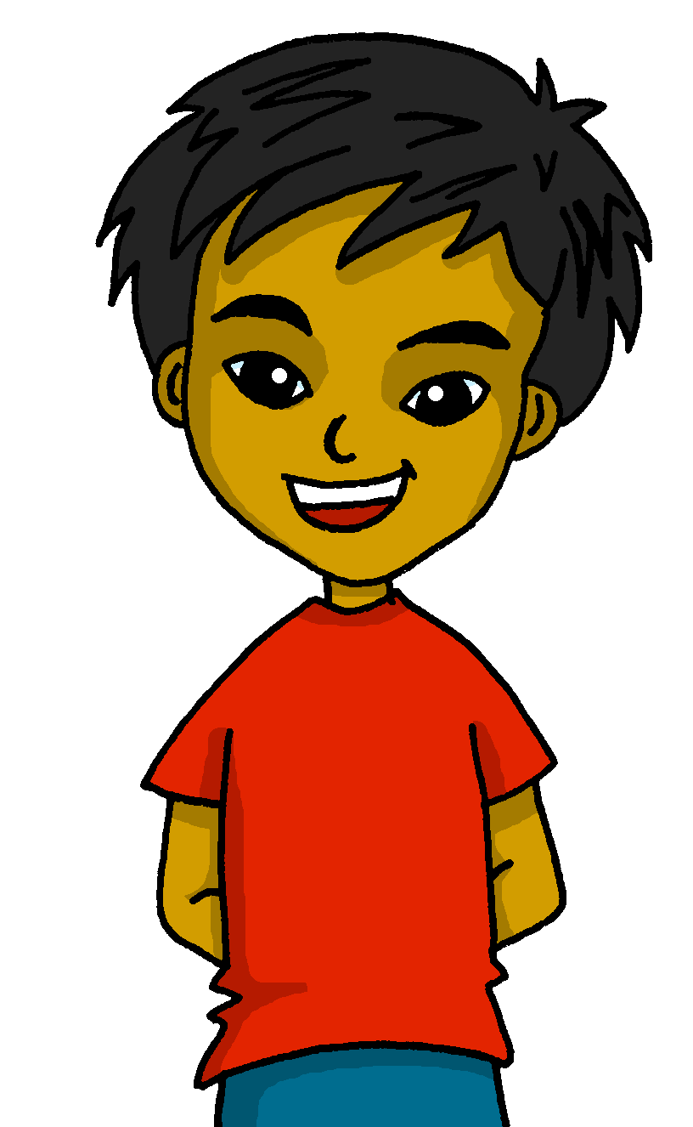
Follow up 5:
Translate do you visit as ‘you visit’. Remember! To turn a statement into a yes/no question, make your voice go up at the end.
Escribe la información de Quique.
escribir
🔗
pero
y
Y también
también
tú él ella | organizo organiza toca tocas busco buscas aprendo aprende lee lees visito Visita | un una el la las mi mis | fiesta revista vocabulario habitación noticias casa museo instrumento | con | la mis mis tu tus | amigo amiga amigos hermano hermana madre papá padres* familia | en por cada | la tarde sábado domingo jueves la cocina casa la plaza clase el parque la ciudad el campo la montaña
Remember to use pronouns make it clear who we are talking about.
Organizo mi habitación con mi hermana cada día
She reads a magazine with dad in the afternoon.
I organise my room with my sister every day
Ella lee una revista con papá por la tarde
¿y Tú? ¿Visitas un museo con tu familia cada sábado?
¿and you? Do you visit a museum with your family each Saturday?
and
y
Notes:
Timing: 10 minutes
Aim: to practise written production using vocabulary and grammar from this week to communicate a range of messages about free time activities.
Procedure:
Read the instruction and ensure pupils understand they are translating what Quique is saying.
Click x2 to bring the two call outs to remind pupils about using pronouns for emphasis as well as how to form questions in Spanish.
Do number 1 with pupils orally to model the task.
Click to reveal the answer.
Give pupils time to work on the three translations. They can do this in their exercise books or mini whiteboards. Lower proficiency pupils might benefit from working on mini whiteboard, with teachers guiding step by step the translation.
ALTERNATIVE FOR HIGHER PROFICIENCY LEARNERS – NEXT SLIDE.

Slide 7
Follow up 5:
🔗
pero
y
luego
¿Qué haces en verano 🌞?
Now use a connective, for example ‘but’
escribir
Start by saying what you do. Make sure you use the right ending to mean ‘I’.
yo tú él Ella Mi ______ | organizo organiza toca tocas busco buscas aprendo aprende lee lees visito Visita | un una el la las mi mis | fiesta revista vocabulario habitación noticias casa museo Instrumento 💡 | con | la mis mis tu tus | amigo amiga amigos hermano hermana madre padre padres* familia 💡 | en por cada | la tarde sábado domingo jueves la cocina casa la plaza clase el parque la ciudad el campo la montaña 💡
and give information about what someone else you know does in summer.
Check your ending again ☺
Organizo una fiesta con mis amigos en casa
pero
You can add more information, too.
mi amigo toca un instrumento cada día.
Luego
descansa en la habitación.
Notes:
ALTERNATIVE TO THE PREVIOUS WRITING TASK FOR HIGHER PROFICIENCY LEARNERS (or it could be a follow on activity, time-allowing)
Aim: to practise more independent writing production key –ar and –er verbs in 1st, 2nd, and 3rd person singular at sentence level; to use connectives to produce longer sentences.
Timing: 10 minutes
Procedure:
Click to bring up the call outs and model a response.

Slide 8
Follow up extra [a]:
Escribe en inglés 📝: Can you get at least 15 points?
 | el ojo | unas | tiene
 | unos | la cabeza | el pie
 | el color | tu | la fiesta
 | la ciudad | mi | preferida
 | organizar | la cocina | tocar
 | buscar | cada | luego
eye
some (f.)
s/he, it has
vocabulario
x3
some (m.)
head
foot
colour
your
party, festival
x2
city
my
preferred (f., s.)
to organise
kitchen
to pla, playing
x1
to search
each
then, after
Notes:
Timing: 5 minutes
Aim: to practise written production of vocabulary from this week and this week’s revisited sets.
Procedure: 1. Give pupils a blank grid. They fill in the English meanings of any of the words they know, trying to reach 15 points in total.
Note: The most recently learnt and practised words are pink, words from the first revisit are green and those from the second revisit are blue, thus more points are awarded for them, to recognise that memories fade and more effort (heavy lifting!) is needed to retrieve them.

Slide 9
follow up extra [b]:
escribe en español 📝: can you get at least 15 points?
 | (the) foot | (the) head | some (m.)
 | some (f.) | (the) eye | s/he, it has
 | your | (the) party, festival | (the) city
 | my | preferred (f.) | (the) colour
 | each | to organise | to play
 | (the) kitchen | then | to search
vocabulario
el pie
la cabeza
unos
x3
unas
el ojo
tiene
tu
la fiesta
la ciudad
x2
mi
preferida
el color
cada
organizar
tocar
x1
la cocina
luego
buscar
Notes:
Timing: 5 minutes
Aim: to practise written production of vocabulary from this week and this week’s revisited sets.
Procedure: 1. Give pupils a blank grid. They fill in the Spanish meanings of any of the words they know, trying to reach 15 points in total.
Note: The most recently learnt and practised words are pink, words from the first revisit are green and those from the second revisit are blue, thus more points are awarded for them, to recognise that memories fade and more effort (heavy lifting!) is needed to retrieve them.

Slide 10
¡adiós!
amarillo

Slide 11
Handout: Follow up extra [a]
Escribe en inglés 📝: Can you get at least 15 points?
 | el ojo | unas | tiene
 | unos | la cabeza | el pie
 | el color | tu | la fiesta
 | la ciudad | mi | preferida
 | organizar | la cocina | tocar
 | buscar | cada | luego
vocabulario
x3
x2
x1
Notes:
Timing: 5 minutes
Aim: to practise written comprehension of vocabulary from this week and this week’s revisited sets.
Procedure: 1. Give pupils a blank grid. They fill in the English meanings of any of the words they know, trying to reach 15 points in total.
Note: The most recently learnt and practised words are pink, words from the first revisit are green and those from the second revisit are blue, thus more points are awarded for them, to recognise that memories fade and more effort (heavy lifting!) is needed to retrieve them.

Slide 12
Handout: Follow extra [b]
Escribe en español 📝: Can you get at least 15 points?
 | (the) foot | (the) head | some (m.)
 | some (f.) | (the) eye | s/he, it has
 | your | (the) party, festival | (the) city
 | my | preferred (f.) | (the) colour
 | each | to organise | to play
 | (the) kitchen | then | to search
vocabulario
x3
x2
x1
Notes:
Timing: 5 minutes
Aim: to practise written production of vocabulary from this week and this week’s revisited sets.
Procedure: 1. Give pupils a blank grid. They fill in the Spanish meanings of any of the words they know, trying to reach 15 points in total.
Note: The most recently learnt and practised words are pink, words from the first revisit are green and those from the second revisit are blue, thus more points are awarded for them, to recognise that memories fade and more effort (heavy lifting!) is needed to retrieve them.

