Slide 1
español, con Quique

Slide 2
Saying what I and others do
amarillo
Los meses del año
SSC [ga] [go] [gu] [ge] [gi]
Notes:
Artwork by Steve Clarke. All additional pictures selected are available under a Creative Commons license, no attribution required.
The frequency rankings for words that occur in this PowerPoint which have been previously introduced in the resources are given in the SOW (excel document) and in the resources that first introduced and formally re-visited those words.
For any other words that occur incidentally in this PowerPoint, frequency rankings will be provided in the notes field wherever possible.
Phonics: revisit SSC [ga] [go] [gu] [ge] [gi]
Vocabulary: cumpleaños [3372] mes [288] enero [1173] febrero [1419] marzo [1231] abril [1064] mayo [909] junio [1035] julio [659] agosto [931] septiembre [1150] octubre [1242] noviembre [1434] diciembre [1165] cuándo [138] mi [37] tu [53] en [5]
Revisit 1: hay [haber 13] cuántos [580] cuántas [580]
Revisit 2: montar [1446] pasear [1741] bicicleta [3684] estadio [2581] madre [226], padre [162] ciudad [178] el [1] la [1] de2 [2] por1 [15]
Frequency of unknown words and cognates:
preguntar [219] repetir [512]
Source: Davies, M. & Davies, K. (2018). A frequency dictionary of Spanish: Core vocabulary for learners (2nd ed.). Routledge: London
Source: Davies, M. & Davies, K. (2018). A frequency dictionary of Spanish: Core vocabulary for learners (2nd ed.). Routledge: London

Slide 3
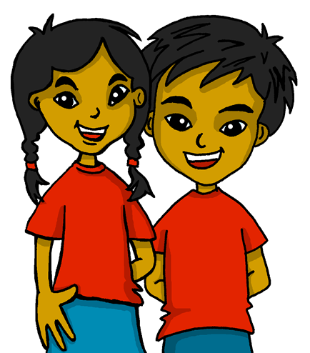
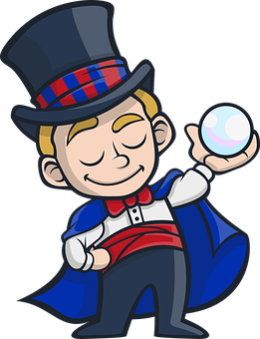
[A] Escucha y escribe.
[ga] [go] [gu] [ge] [gi]
pronunciar
45
guardia
gema
algo
gemelos
girasol
aguacate
mago
gelatina
0
[B] Practica con tu compañero/a.
INICIO
Notes:
Timing: 5 minutes
Aim: To revisit SSC [ga] [go] [gu] [ge] [gi]
Procedure:
Pupils write 1-8 and either [ga] [go] [gu] [ge] [gi]
Click on the pictures to listen.
Click again to reveal the answers.
Click inicio for pupils to pronounce all of the words.
Click on each image again to hear the word, if desired.
Transcript: guardia
gema
algo
gemelos
girasol
aguacate
mago
gelatina
Frequency of unknown words:
algo [110] aguacate [>5000] guardia [1654] gema [>5000] gemelo [>5000] gelatina [>5000] girasol [>5000] mago [4573]

Slide 4
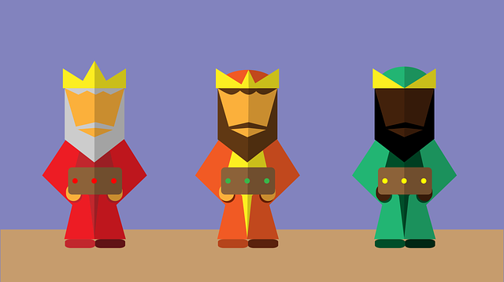
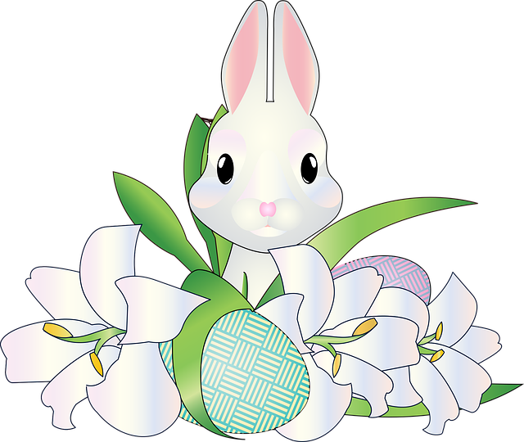
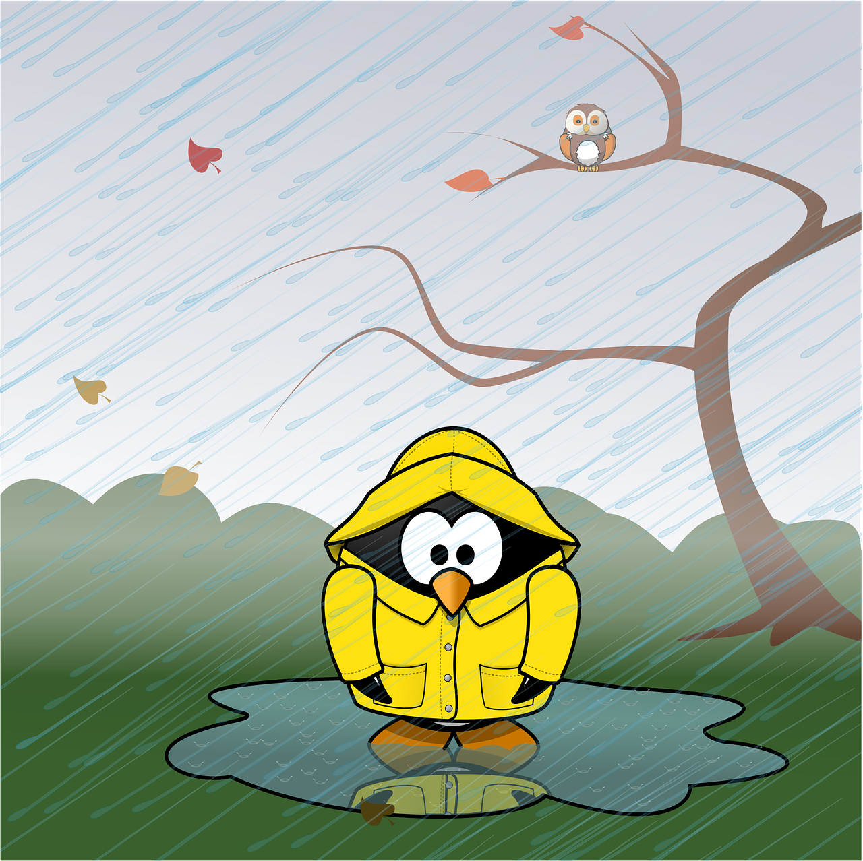
vocabulario
En España, el día del padre es en marzo.
En España, el día de
la madre es en mayo.
Escucha y repite.
enero
febrero
marzo
abril
mayo
junio
julio
agosto
septiembre
octubre
noviembre
diciembre
repite – repeat
Notes:
Timing: 5 minutes
Aim: to introduce key vocabulary for this week.
Procedure: 1.Teacher introduces items one by one (picture, word) & pupils practise pronunciation aloud.
Alternatively, pupils work in pairs, reading the Spanish words out loud and looking at the English meanings (1 minute). 2
NB. Further rounds of learning can be facilitated by one pupil turning away from the board, and his/her partner asking him/her the meanings (‘Cómo se dice X en inglés/español?’). This activity can work from L2 → L1 or L1 → L2.
Frequency of unknown words and cognates:
repetir [512]
Source: Davies, M. & Davies, K. (2018). A frequency dictionary of Spanish: Core vocabulary for learners (2nd ed.). Routledge: London

Slide 5
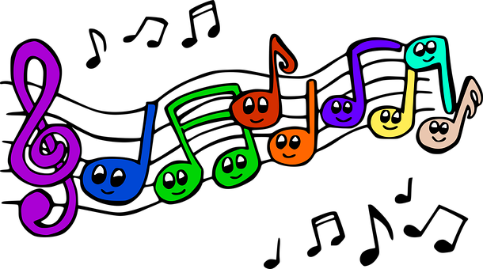
escuchar
Canta 🎤 .
¡y cantar!
escuchar
‘Estos son los meses del año.’ = ‘These are the months of the year.’
Notes:
Timing: 5 minutes
Aim: to revisit months in a song
Procedure:
Read and clarify the instruction.
Listen once for pupils to appreciate and become familiar with the rhythm
Listen one more time and encourage pupils to sing along
Frequency of unknown words: canta [717]
Source: Davies, M. & Davies, K. (2018). A frequency dictionary of Spanish: Core vocabulary for learners (2nd ed.). Routledge: London
Video source:
https://www.youtube.com/watch?v=Jwy3LeAn_n0&ab_channel=El%C3%81rboldelEspa%C3%B1ol-CancionesInfantilesYM%C3%A1s

Slide 6
hablar
¿Qué mes* es hoy, clase?
(el) mes = month
enero
marzo
febrero
February
Notes:
Timing: 5 minutes (12 slides)
Aim: to recap the 12 new vocabulary items for this lesson.
Procedure:
Click to bring the question.
Read the 3 options & elicit correct translation from students.
Frequency of unknown words and cognates:
mes [288]
Source: Davies, M. & Davies, K. (2018). A frequency dictionary of Spanish: Core vocabulary for learners (2nd ed.). Routledge: London

Slide 7
hablar
¿Qué mes* es hoy, clase?
(el) mes = month
junio
marzo
abril
April
Notes:
Timing: 5 minutes (12 slides)
Aim: to recap the 12 new vocabulary items for this lesson.
Procedure:
Click to bring the question.
Read the 3 options & elicit correct translation from students.
Frequency of unknown words and cognates:
mes [288]
Source: Davies, M. & Davies, K. (2018). A frequency dictionary of Spanish: Core vocabulary for learners (2nd ed.). Routledge: London

Slide 8
hablar
¿Qué mes* es hoy, clase?
(el) mes = month
agosto
julio
junio
July
Notes:
Timing: 5 minutes (12 slides)
Aim: to recap the 12 new vocabulary items for this lesson.
Procedure:
Click to bring the question.
Read the 3 options & elicit correct translation from students.
Frequency of unknown words and cognates:
mes [288]
Source: Davies, M. & Davies, K. (2018). A frequency dictionary of Spanish: Core vocabulary for learners (2nd ed.). Routledge: London

Slide 9
hablar
¿Qué mes* es hoy, clase?
(el) mes = month
agosto
julio
junio
June
Notes:
Timing: 5 minutes (12 slides)
Aim: to recap the 12 new vocabulary items for this lesson.
Procedure:
Click to bring the question.
Read the 3 options & elicit correct translation from students.
Frequency of unknown words and cognates:
mes [288]
Source: Davies, M. & Davies, K. (2018). A frequency dictionary of Spanish: Core vocabulary for learners (2nd ed.). Routledge: London

Slide 10
hablar
¿Qué mes* es hoy, clase?
(el) mes = month
enero
marzo
noviembre
March
Notes:
Timing: 5 minutes (12 slides)
Aim: to recap the 12 new vocabulary items for this lesson.
Procedure:
Click to bring the question.
Read the 3 options & elicit correct translation from students.
Frequency of unknown words and cognates:
mes [288]
Source: Davies, M. & Davies, K. (2018). A frequency dictionary of Spanish: Core vocabulary for learners (2nd ed.). Routledge: London

Slide 11
hablar
¿Qué mes* es hoy, clase?
(el) mes = month
enero
abril
marzo
January
Notes:
Timing: 5 minutes (12 slides)
Aim: to recap the 12 new vocabulary items for this lesson.
Procedure:
Click to bring the question.
Read the 3 options & elicit correct translation from students.
Frequency of unknown words and cognates:
mes [288]
Source: Davies, M. & Davies, K. (2018). A frequency dictionary of Spanish: Core vocabulary for learners (2nd ed.). Routledge: London

Slide 12
hablar
¿Qué mes* es hoy, clase?
(el) mes = month
marzo
mayo
junio
May
Notes:
Timing: 5 minutes (12 slides)
Aim: to recap the 12 new vocabulary items for this lesson.
Procedure:
Click to bring the question.
Read the 3 options & elicit correct translation from students.
Frequency of unknown words and cognates:
mes [288]
Source: Davies, M. & Davies, K. (2018). A frequency dictionary of Spanish: Core vocabulary for learners (2nd ed.). Routledge: London

Slide 13
hablar
¿Qué mes* es hoy, clase?
(el) mes = month
noviembre
septiembre
octubre
November
Notes:
Timing: 5 minutes (12 slides)
Aim: to recap the 12 new vocabulary items for this lesson.
Procedure:
Click to bring the question.
Read the 3 options & elicit correct translation from students.
Frequency of unknown words and cognates:
mes [288]
Source: Davies, M. & Davies, K. (2018). A frequency dictionary of Spanish: Core vocabulary for learners (2nd ed.). Routledge: London

Slide 14
hablar
¿Qué mes* es hoy, clase?
(el) mes = month
septiembre
diciembre
octubre
December
Notes:
Timing: 5 minutes (12 slides)
Aim: to recap the 12 new vocabulary items for this lesson.
Procedure:
Click to bring the question.
Read the 3 options & elicit correct translation from students.
Frequency of unknown words and cognates:
mes [288]
Source: Davies, M. & Davies, K. (2018). A frequency dictionary of Spanish: Core vocabulary for learners (2nd ed.). Routledge: London

Slide 15
hablar
¿Qué mes* es hoy, clase?
(el) mes = month
septiembre
noviembre
octubre
October
Notes:
Timing: 5 minutes (12 slides)
Aim: to recap the 12 new vocabulary items for this lesson.
Procedure:
Click to bring the question.
Read the 3 options & elicit correct translation from students.
Frequency of unknown words and cognates:
mes [288]
Source: Davies, M. & Davies, K. (2018). A frequency dictionary of Spanish: Core vocabulary for learners (2nd ed.). Routledge: London

Slide 16
hablar
¿Qué mes* es hoy, clase?
(el) mes = month
julio
agosto
mayo
August
Notes:
Timing: 5 minutes (12 slides)
Aim: to recap the 12 new vocabulary items for this lesson.
Procedure:
Click to bring the question.
Read the 3 options & elicit correct translation from students.
Frequency of unknown words and cognates:
mes [288]
Source: Davies, M. & Davies, K. (2018). A frequency dictionary of Spanish: Core vocabulary for learners (2nd ed.). Routledge: London

Slide 17
hablar
¿Qué mes* es hoy, clase?
(el) mes = month
enero
julio
septiembre
September
Notes:
Timing: 5 minutes (12 slides)
Aim: to recap the 12 new vocabulary items for this lesson.
Procedure:
Click to bring the question.
Read the 3 options & elicit correct translation from students.
Frequency of unknown words and cognates:
mes [288]
Source: Davies, M. & Davies, K. (2018). A frequency dictionary of Spanish: Core vocabulary for learners (2nd ed.). Routledge: London

Slide 18
escuchar
Escucha: ¿Qué mes* es?
(el) mes = month
 | diciembre | octubre | noviembre | septiembre
 | marzo | febrero | enero | junio
 | agosto | septiembre | mayo | abril
 | mayo | julio | abril | marzo
 | enero | noviembre | marzo | octubre
 | abril | mayo | junio | enero
E
1
2
3
4
5
Which months are not mentioned?
_______
______
April
June
July
________
September
December
____________
____________
____________
October
Notes:
Timing: 5 minutes
Aim: to practise aural comprehension of the vocabulary (months) in basic, short sentences. Note: this activity does not practise the grammar as the 3rd person ‘es’ is used throughout. Irregular verb forms (such as es) are learnt as individual vocabulary items.
Procedure:
Read the title and click to bring up the instructions Spanish.
Do the example (E) with them and read the options. (Note: some learners will benefit from being able to circle the words on the sheet).
Click to bring up the animated answers and elicit the English meanings from pupils in whole class feedback.
Transcript:
E. Es noviembre.
Es febrero.
Es agosto.
Es mayo.
Es marzo.
Es enero.
Frequency of unknown words and cognates:
mes [288]
Source: Davies, M. & Davies, K. (2018). A frequency dictionary of Spanish: Core vocabulary for learners (2nd ed.). Routledge: London

Slide 19
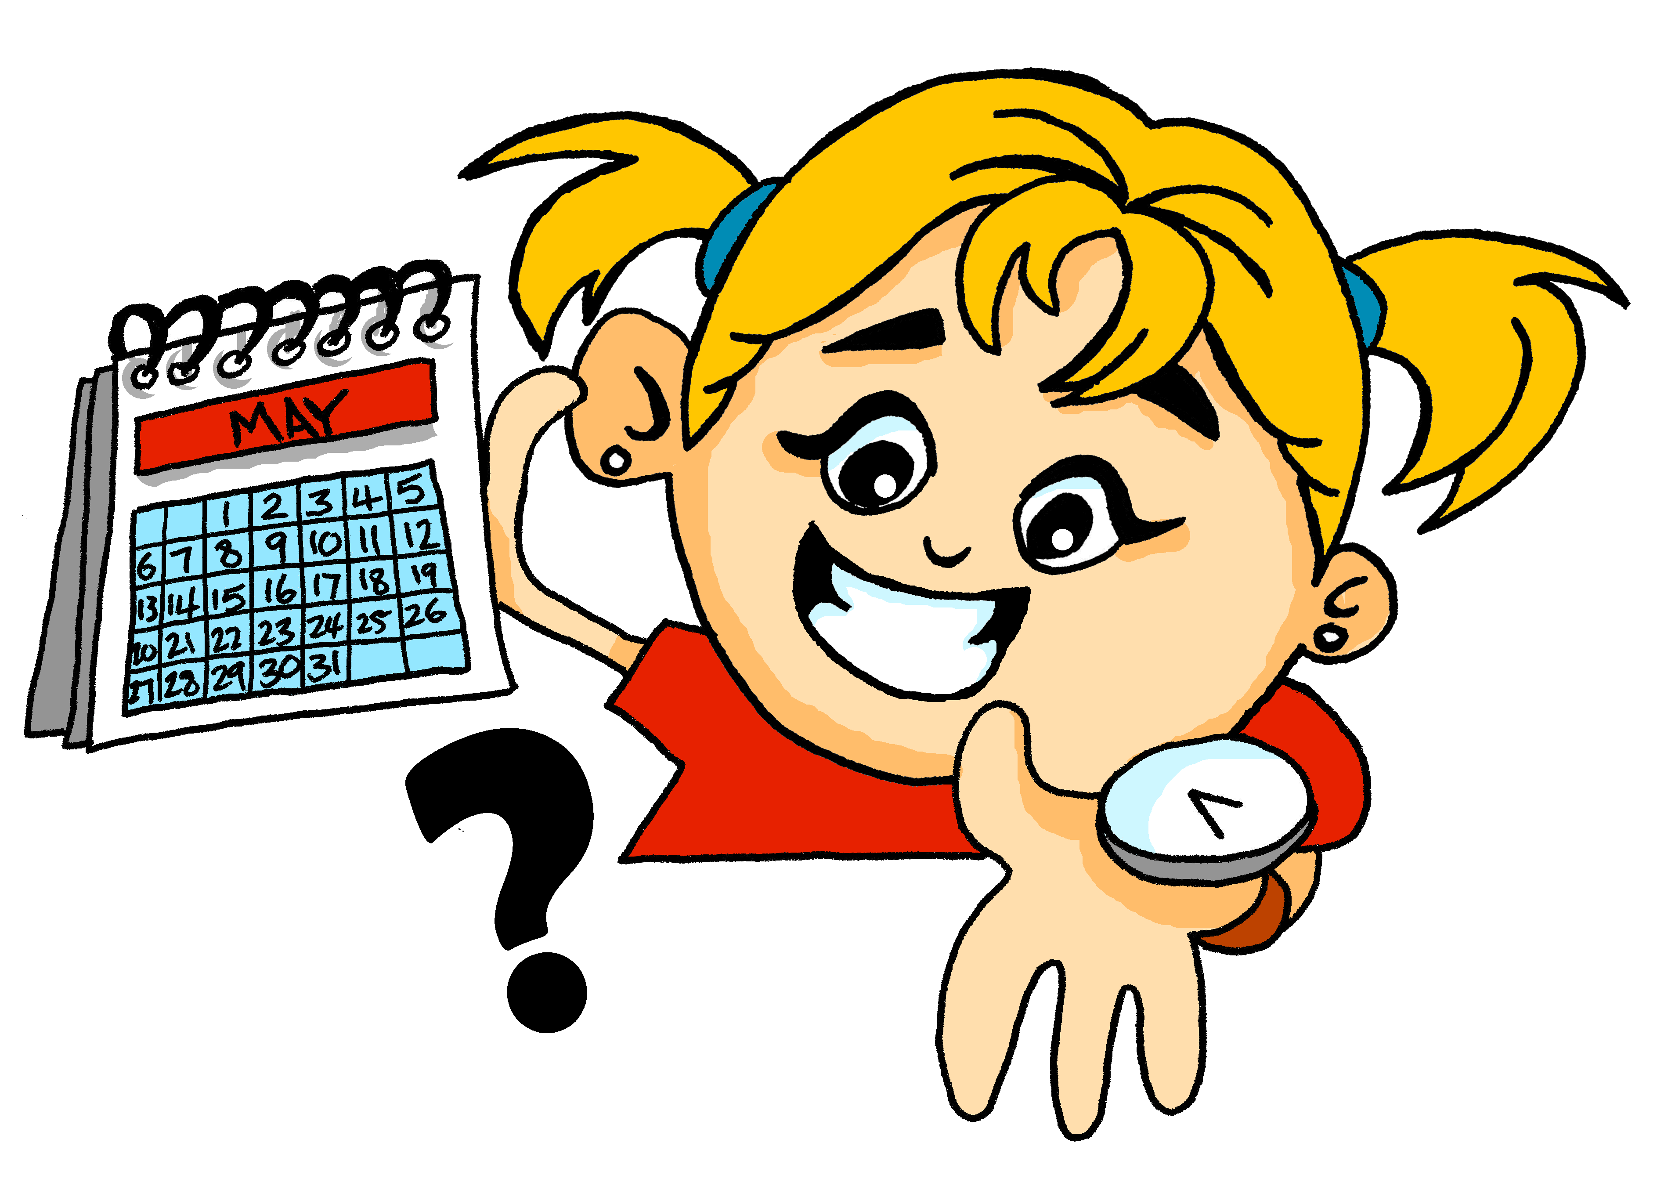
pronunciar
¿Cuándo?
when?
¿Cuándo es tu cumpleaños?
[When is your birthday?]
Rachel Hawkes / Emma Marsden
Notes:
Timing: 1 minute
Aim: to present the question word ¿cuándo?
Procedure:
Pupils listen and repeat the key question word (include gesture if possible)
Display the word and get pupils to repeat one more time.
Elicit English meaning.
Reveal the sentence and elicit English translation from pupils.
Gesture: turn to look at left wrist where a watch might be worn and tap it twice, in time with the two syllables of cuán-do.

Slide 20
Using ‘es’ with days of the week
[ser]
We use ser when talking about what month it is.
To say ‘it is’ and ‘is’ + month of the year, we use es.
Por ejemplo:
Es mayo.
It is May.
Notes:
Time: 1 minutes Aim: to learn about the use of ‘ser’ when taking about what month it is.
Note: this is a specific use of ser that doesn’t follow the rules learnt so far for using ser (traits, origin). However, it is congruent with the notion of essential characteristic or trait in the sense that December is always December (for the length of the 31 day period of one month). It doesn’t unexpectedly change its mood or state and become January.
Procedure: 1. Teachers present the new information. It is animated to allow for a paced, interactive delivery. 2. Elicit the English translation for the examples.

Slide 21
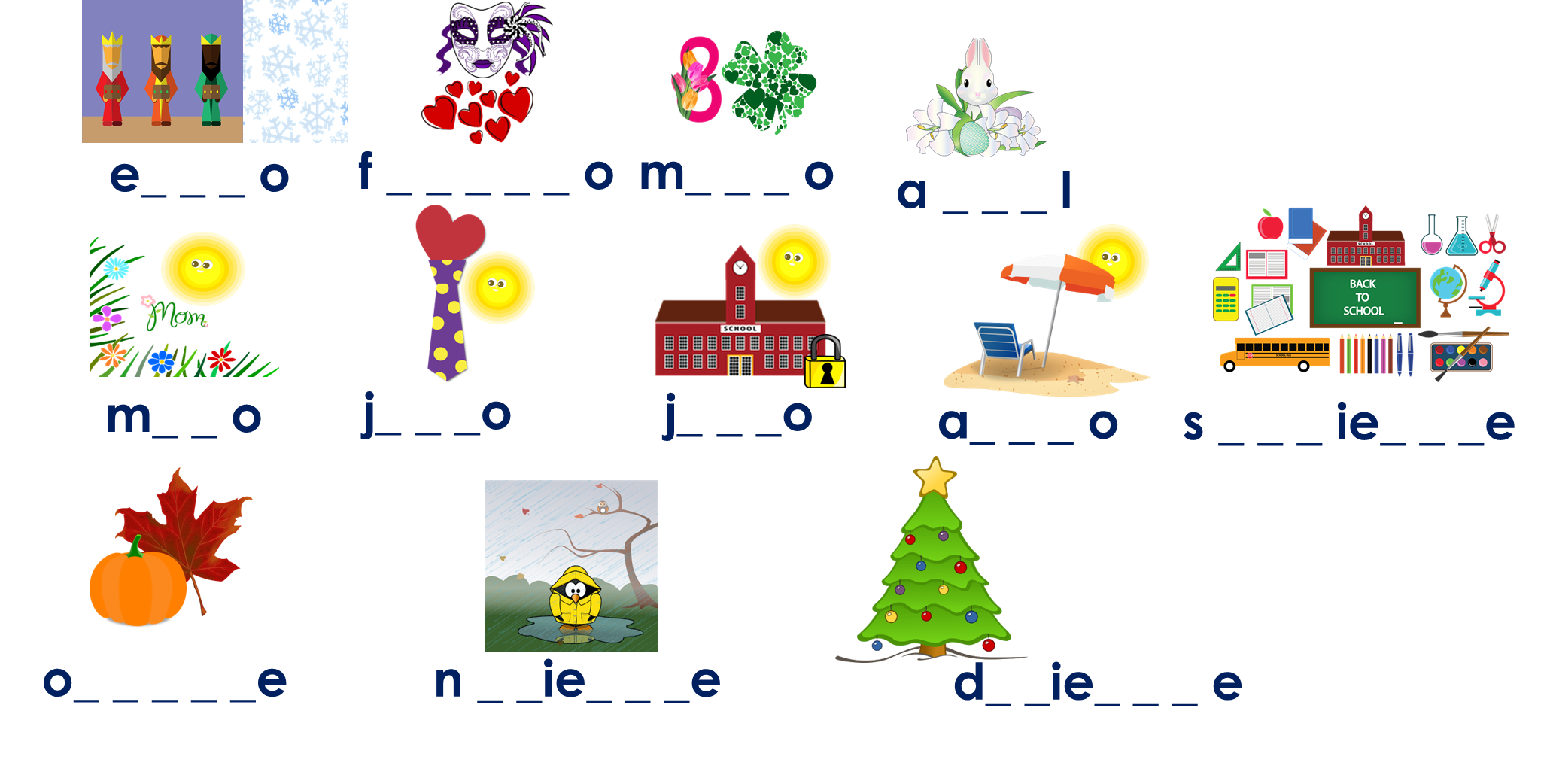
hablar
Pregunta* y responde en clase.
pregunta – ask
¿Cuándo es tu cumpleaños?
1 minuto
Mi cumpleaños es en ______.
0
INICIO
Notes:
Timing: 4 minutes (2 slides – 1 optional to recap months if needed)
Aim: to use the vocabulary introduced in the lesson orally.
Procedure:
Read the question and check for understanding.
Click to bring up the answer and check understanding.
Elicit answers from some pupils to model the exchange.
Click inicio to start the timer. Pupils can work in pairs / small groups or circulate around the classroom asking as many peers as possible.
NB. Teachers can restart the timer to do several rounds of pair work, group work, whole-class.
Frequency of unknown words and cognates:
preguntar [219]
Source: Davies, M. & Davies, K. (2018). A frequency dictionary of Spanish: Core vocabulary for learners (2nd ed.). Routledge: London

Slide 22
vocabulario
Escucha y repite.
e_ _ _ o
f _ _ _ _ _ o
m_ _ _ o
a _ _ _ l
m_ _ o
j_ _ _o
j_ _ _o
a_ _ _ o
s _ _ _ ie_ _ _e
o_ _ _ _ _e
n _ _ie_ _ _e
d_ _ie_ _ _ e
repite – repeat
Notes:
[EXTRA SLIDE FOR CONSLIDATION]
Timing: 2 minutes
Aim: to practise oral recall of the vocabulary for this week.
Procedure: Teacher introduces items one by one (picture, gapped prompt) & pupils recall the word, saying it aloud, chorally.

Slide 23
¡adiós!
amarillo

