Slide 1
español, con Quique

Slide 2
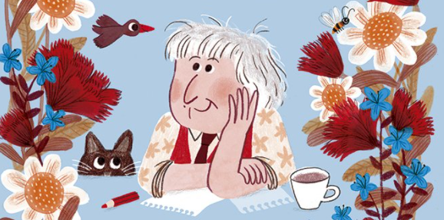
Saying what I and others do
amarillo
- hay + months of the year
- plural indefinite articles
- SSC [revisit]
Notes:
Artwork by Steve Clarke. All additional pictures selected are available under a Creative Commons license, no attribution required.
The frequency rankings for words that occur in this PowerPoint which have been previously introduced in the resources are given in the SOW (excel document) and in the resources that first introduced and formally re-visited those words.
For any other words that occur incidentally in this PowerPoint, frequency rankings will be provided in the notes field wherever possible.
SSC: [j] ojo [169] rojo [534] pájaro [1607] jueves [1650] jirafa [>5000]
Vocabulary: medio [395] nube [1499] río [496] arriba [690] abajo [788]
Revisit 1: un [6] dos [64] tres [134] cuatro [241] cinco [284] seis [438] siete [603] ocho [641] nueve [991] diez [449] once [1700] doce [1138]
Revisit 2: buscar [179] crear [239] presentar [235] usar [317] información [326] país [109] importante [171] divertido [2465] interesante [616]
Frequency of unknown words and cognates glossed: poema [1430] poetisa [>5000] verso [2336]
Source: Davies, M. & Davies, K. (2018). A frequency dictionary of Spanish: Core vocabulary for learners (2nd ed.). Routledge: London
Marta Altés, ‘El libro de Gloria Fuertes para niñas y niños’, Blackie Books. https://blackiebooks.org/catalogo/el-libro-de-gloria-fuertes-para-ninas-y-ninos/

Slide 3
[j]
ojo
pronunciar
Notes:
Timing: 1 minute
Aim: To introduce SSC [j]
Procedure:
Introduce and elicit the pronunciation of the individual SSC [j] and then the source word ‘ojo’ (with gesture, if using).
Click to bring the picture and get pupils to repeat (with gesture, if using).
Pupils to practise in pairs.
Gesture suggestion: point at your eye

Slide 4
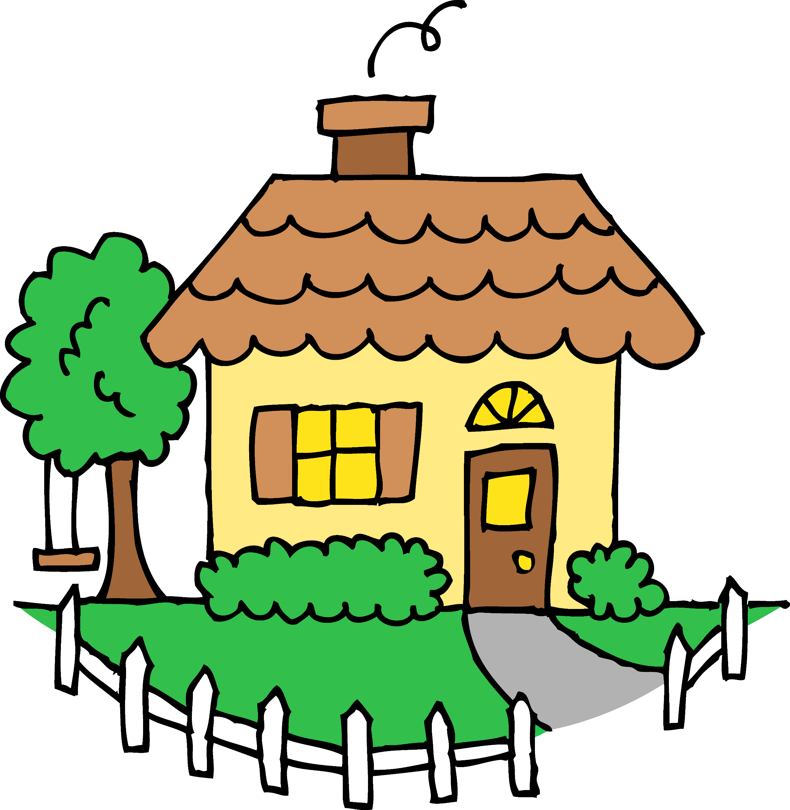
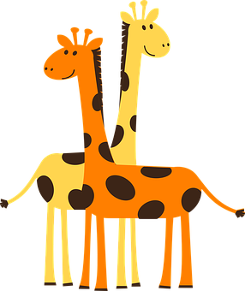
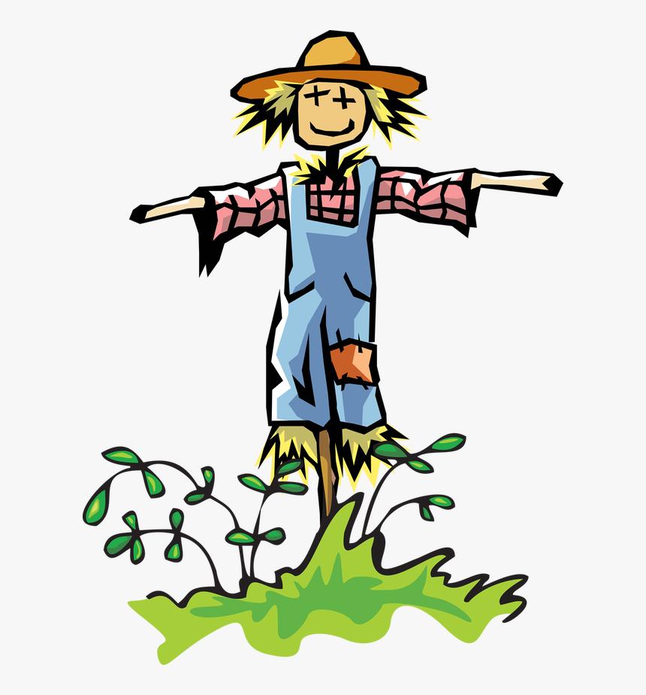
pronunciar
¡A practicar!
cangrejo
conejo
tejado
45 segundos
jueves
Thurs
jirafas
pájaro
rojo
espantapájaros
INICIO
Notes:
Timing: 2 minutes
Aim: to practise reading aloud [j] in mainly unknown words (pictures provided to support meaning).
Procedure:
Read the explanation and ensure pupils understand the task.
Start the timer.
Pupils do whole-class choral practice, i.e. all speaking simultaneously.
Frequency of unknown words and cognates: cangrejo [>5000] conejo [4728] espantapájaros [>5000] jirafa [>5000] pájaro [1607] tejado [>5000]
Source: Davies, M. & Davies, K. (2018). A frequency dictionary of Spanish: Core vocabulary for learners (2nd ed.). Routledge: London

Slide 5
Leer y hablar
Gloria Fuertes: Unos poemas
(el) poema = poems
(la) poetisa = female poet
leer
El título es ‘Paisajes para que los pintes’.
En inglés el título es ‘Landscapes for you to paint.’.
Gloria Fuertes es una poetisa de España.
Notes:
Timing: 2 minutes
Aim: To reintroduce ‘Gloria Fuertes’, the author of the poems, and the name of the collection of poems.
Procedure:
Teachers click to present the information.
Frequency of unknown words and cognates: poema [1430] poetisa [>5000]
Source: Davies, M. & Davies, K. (2018). A frequency dictionary of Spanish: Core vocabulary for learners (2nd ed.). Routledge: London

Slide 6
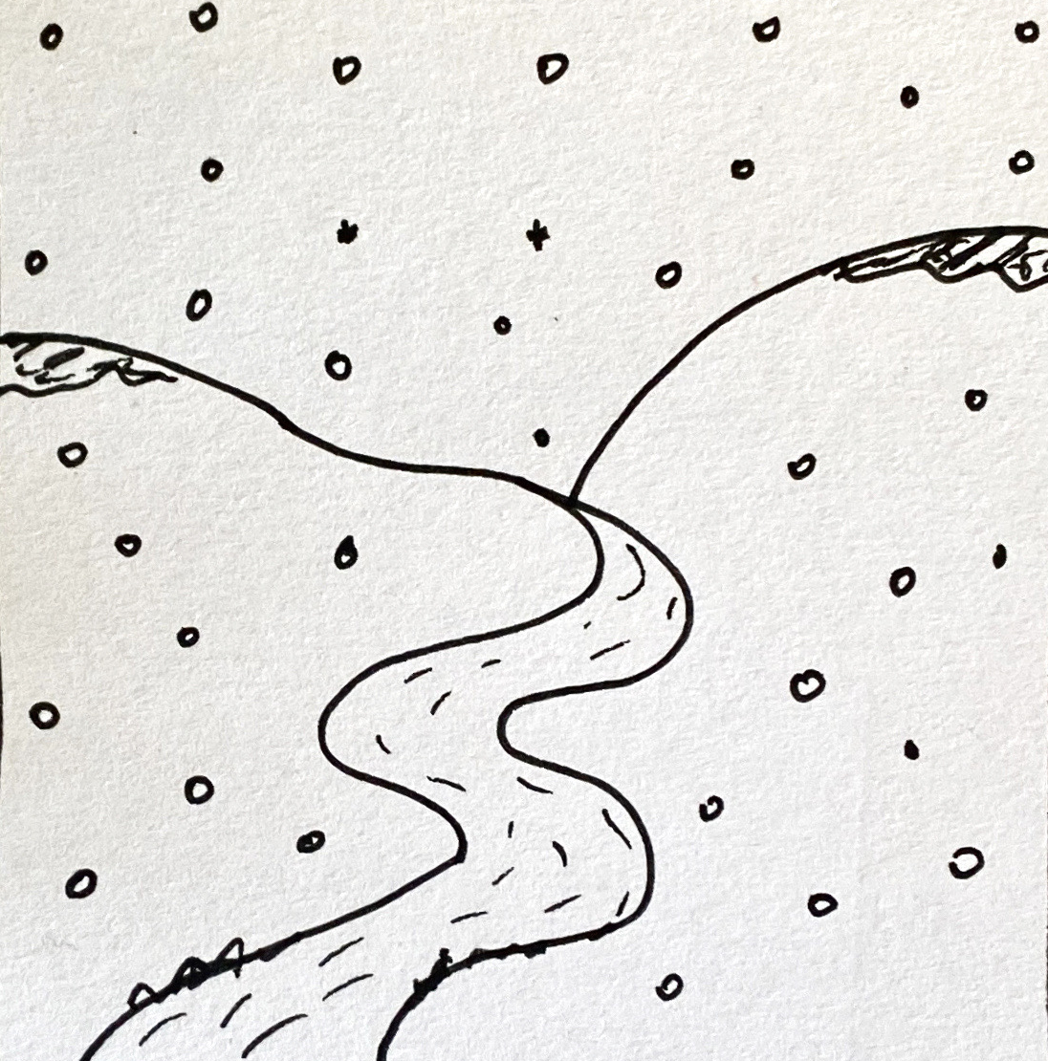
Leer y hablar
Lee el poema. [1/2]
vocabulario
leer
La nieve,
el frío,
y en el medio,
un río
below
snow
a river
middle
cold
abajo
la nieve
un río
el medio
el frío
Notes:
Timing: 10 minutes (two slides)
Aim: to introduce vocabulary with a longer text; to introduce two of the short poems. [2 slides]
Procedure:
Click to hear the short poem. Pupils follow along with the text.
Give pupils 2-3 minutes with a partner to find the Spanish meanings for the 6 English words.
Elicit Spanish responses chorally, prompting with the English, e.g., ‘sun?’ ‘sol’, muy bien. ☺ Note: click on each English word to reveal the Spanish translation.
Pupils could be asked to read the text aloud in pairs, taking it in turns to read alternate sentences.
Click the text box to hear the full text again, if desired.
Move to the next slide and repeat steps 1-5.
Frequency of unknown words and cognates: nieve [3175] frío [1020]
Source: Davies, M. & Davies, K. (2018). A frequency dictionary of Spanish: Core vocabulary for learners (2nd ed.). Routledge: London

Slide 7
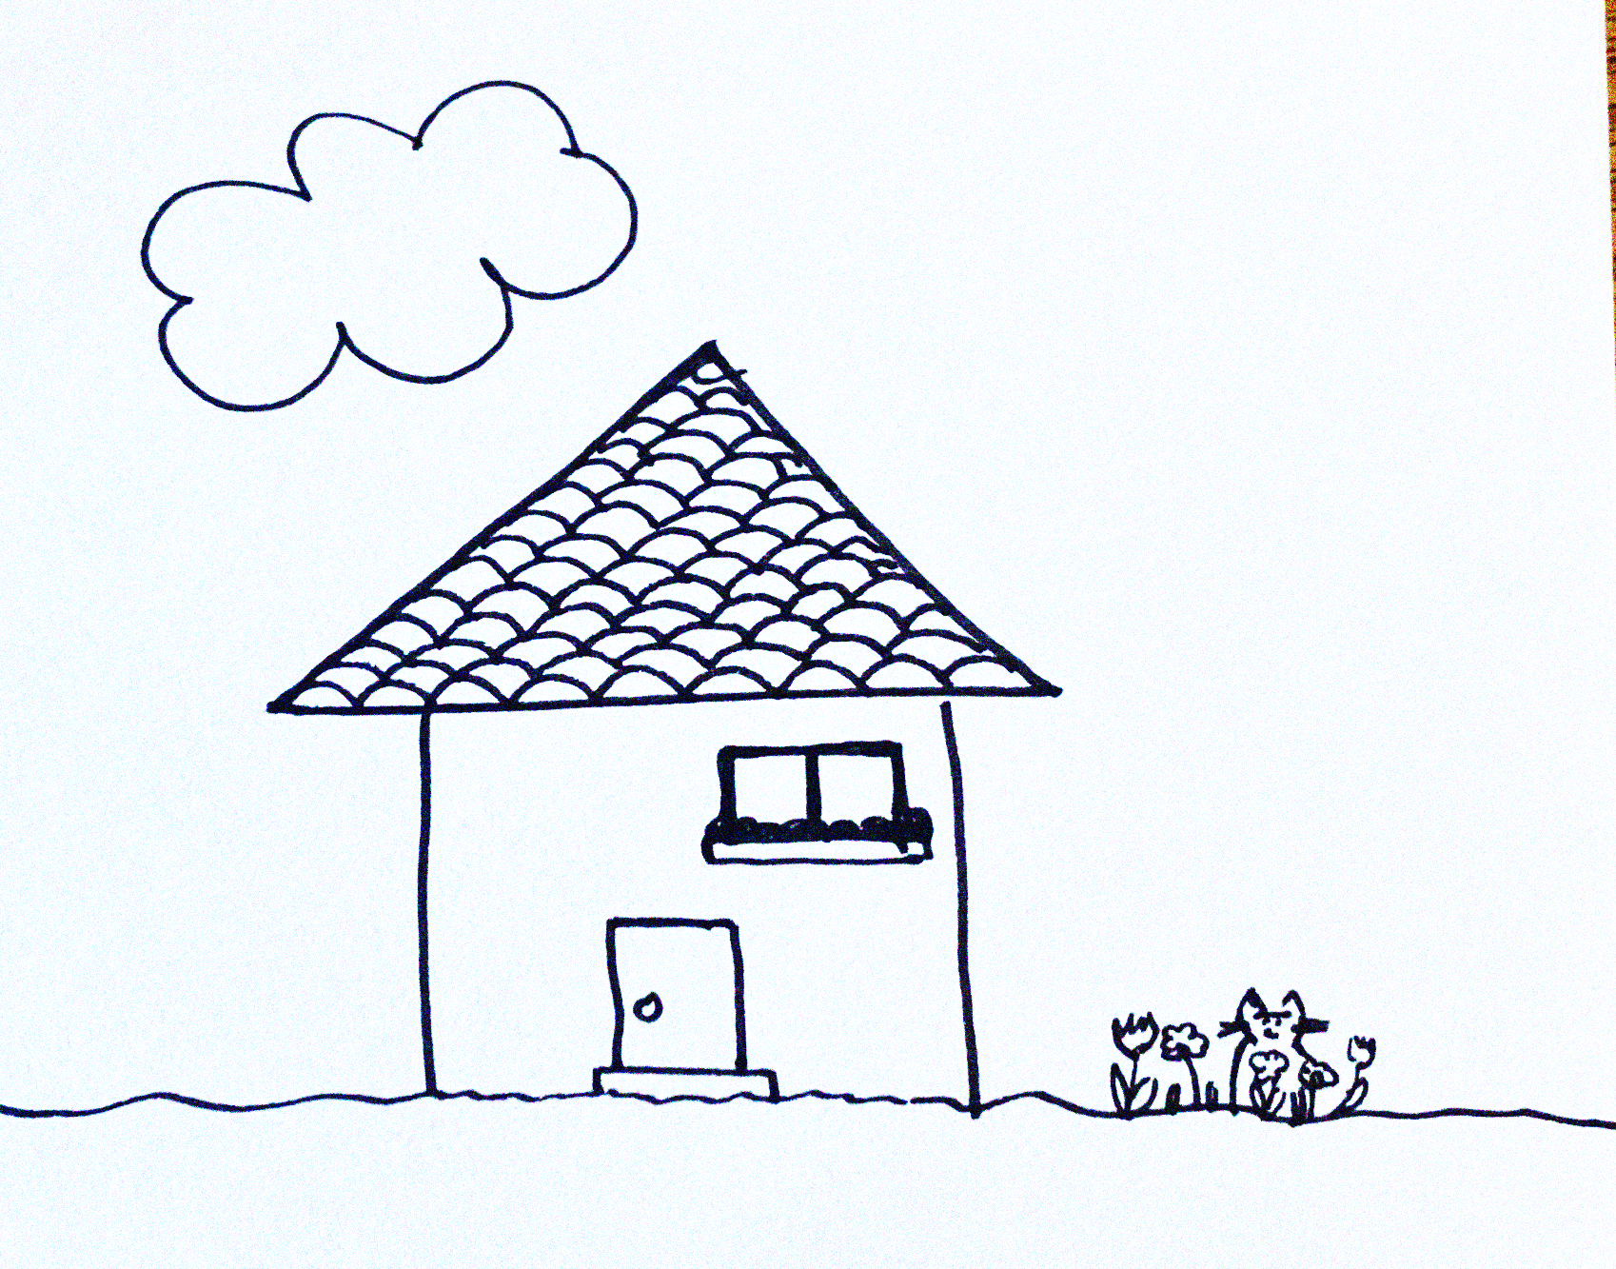
Leer y hablar
Lee el poema. [2/2]
vocabulario
leer
La nube arriba
el gato abajo
en el medio una casa
con un tejado
below
a tile roof
a cat
above
middle
cloud
abajo
un tejado
un gato
arriba
el medio
la nube
Notes:
Procedure:
Click to hear the short poem. Pupils follow along with the text.
Give pupils 2-3 minutes with a partner to find the Spanish meanings for the 6 English words.
Elicit Spanish responses chorally, prompting with the English, e.g., ‘sun?’ ‘sol’, muy bien. ☺ Note: click on each English word to reveal the Spanish translation.
Pupils could be asked to read the text aloud in pairs, taking it in turns to read alternate sentences.
Click the text box to hear the full text again, if desired.
Frequency of unknown words and cognates: casa [106] gato [1728] tejado [>5000]
Source: Davies, M. & Davies, K. (2018). A frequency dictionary of Spanish: Core vocabulary for learners (2nd ed.). Routledge: London

Slide 8
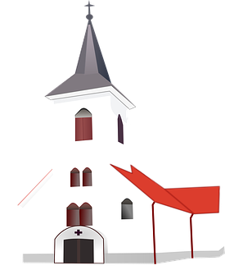
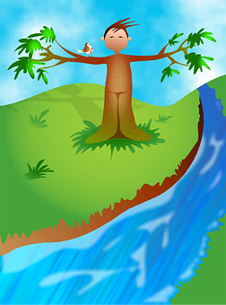
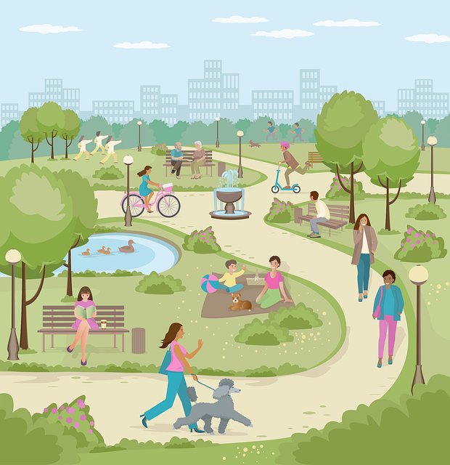
Definite and indefinite articles
[‘a/an & ‘the’]
We have learned that to say a (or an) in Spanish before a noun, you use un or una, depending on whether the noun is masculine or feminine.
To say the before a singular noun, you use ‘el’ or ‘la’.
Nouns that end in –e can be masculine or feminine!
Many masculine nouns in –o whereas feminine nouns often end in –a.
Masculine
Feminine
río
iglesia
a church
una
the church
un
a river
la
el
the river
un
parque
the cloud
el
the park
a cloud
a park
una
nube
la
Notes:
Timing: 4 minutes
Aim: to revisit and contrast definite and indefinite articles.
Procedure:
Present the reminder about indefinite articles.
Click to present two masculine nouns and elicit the indefinite article and then the English meanings.
Click to present two feminine nouns and elicit the indefinite article and then the English meanings.
Click to bring up the reminder about definite article.
Repeat steps 2 and 3.
Click to bring up the callout about masculine and feminine noun endings.

Slide 9
escuchar
Escucha el verso*.
el verso = verse
¿Menciona un / una, o ‘el / la?
¿Dónde está? Marca ✅
Marca ✅
 | a/an | the
Escribe 📝
above | below | in the middle
E
campo
E
1
río
1
2
nube
2
3
estadio
3
4
museo
4
5
plaza
5
Notes:
Timing: 7 minutes
Aim: to practise aural recognition of definite vs. indefinite article and 3 newly introduced vocab items (arriba, abajo, medio); to practise transcription of previously introduced nouns.
Procedure:
Read the title and click to bring up the instructions in Spanish.
Do the example (E) and encourage pupils to write down the Spanish word second time they listen to it.
Click to bring up answers.
Click to bring up part two. This time pupils will hear the noun accompanied by the position (arriba, abajo, medio). They need to identify which one is mentioned for each verse.
Click to bring up answers. Elicit Spanish word from pupils for further practice.
Transcript 1:
E. El campo
1. Un río
2. La nube
3. El estadio
4. Un museo
5. Una plaza
Transcript 2:
E. El campo abajo
Un río en el medio
La nube abajo
El estadio en el medio
Un museo arriba
Una plaza abajo
Frequency of unknown words and cognates: verso [2336]
Source: Davies, M. & Davies, K. (2018). A frequency dictionary of Spanish: Core vocabulary for learners (2nd ed.). Routledge: London

Slide 10
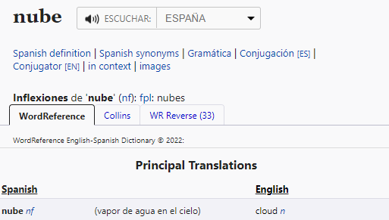
Using reference materials
[understanding symbols]
All dictionaries have symbols with useful information about the type of word, (e.g., noun, adjective) and noun gender (masculine or feminine).
www.wordreference.com
n = noun
m = masculine
f = feminine
Nouns that end in –e could be masculine or feminine, so let’s use a dictionary to figure out the gender.
This can help us find out the grammatical gender of a noun.
feminine
______ nube [the cloud]
la
Ejemplo: nube
una
______ nube [a cloud]
Notes:
Timing: 3 minutes
Aim: to introduce pupils to reference skills – understanding codes in a dictionary in order to find out the gender of a noun.
Procedure:
1. Teachers click to present the information on the slide.
2. Pupils can volunteer the articles.

Slide 11
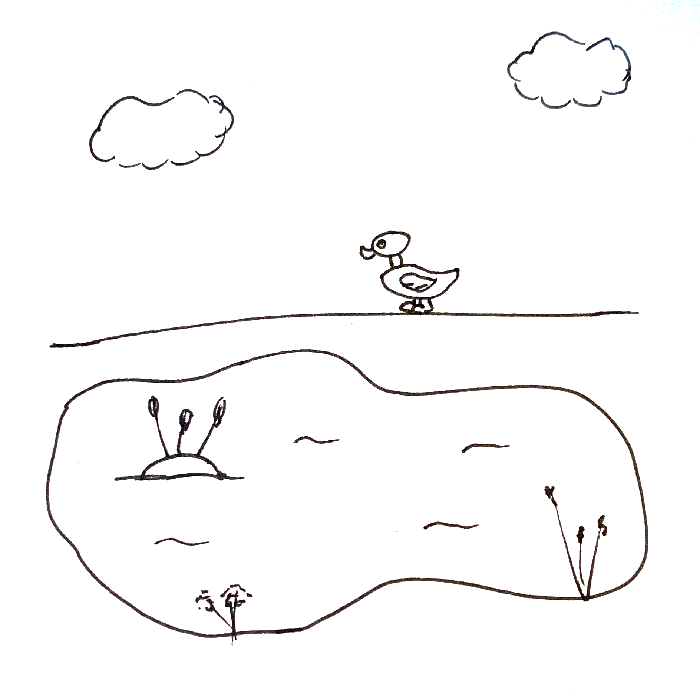
Leer y hablar
Lee el poema*
el poema = poem
¿Qué artículo es? [1/5]
hablar
leer
el | la
un | una
lago (nm) = lake
cielo (nm) = sky
pato (nm) = duck
___cielo
____ lago
y, en el medio, ___ pato.
el
[the sun]
el
[the sea]
un
[and, in the middle, a duck]
Notes:
Timing: 7 minutes [5 slides]
Aim: To use gender codes in order to be able to use the correct definite and indefinite articles with unknown nouns.
Procedure:
Teachers read the instruction and clarify the meaning of artículo.
Teachers draw pupils’ attention to the codes for each of the nouns (frío, nieve, río).
3. Pupils work in pairs to read the poem aloud, selecting the correct translation for ‘the’ or ‘a/an’.
4. Teacher elicits answers from pupils.
5. Click the picture to hear the full text for the poem, if desired.
6. Pupils can read aloud again (whole class) to practise SSC knowledge, time allowing.
Frequency of unknown words and cognates: cielo [620] pato [4857] poema [1430] lago [2151]
Source: Davies, M. & Davies, K. (2018). A frequency dictionary of Spanish: Core vocabulary for learners (2nd ed.). Routledge: London

Slide 12
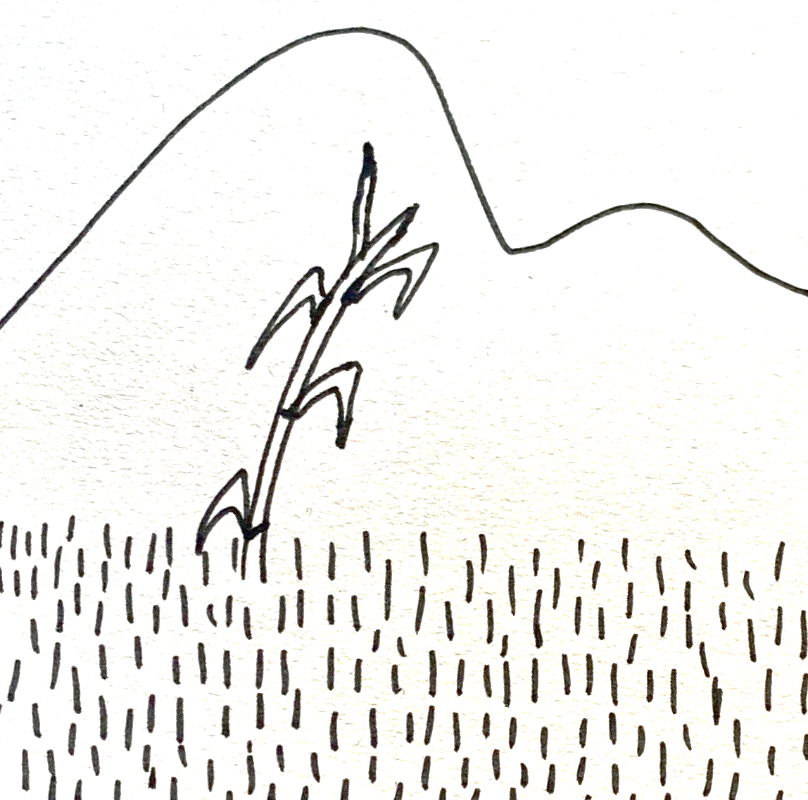
Leer y hablar
Lee el poema*
el poema = poem
¿Qué artículo es? [2/5]
hablar
leer
el | la
un | una
caña (nf) = cane
prado (nm) = meadow
____ prado,
____ montaña,
y, en el medio, ___ caña.
el
[the meadow]
la
[the mountain]
una
[and, in the middle, a cane]
Notes:
[2/5]
Frequency of unknown words and cognates: caña [2837] prado [3614] poema [1430]
Source: Davies, M. & Davies, K. (2018). A frequency dictionary of Spanish: Core vocabulary for learners (2nd ed.). Routledge: London

Slide 13
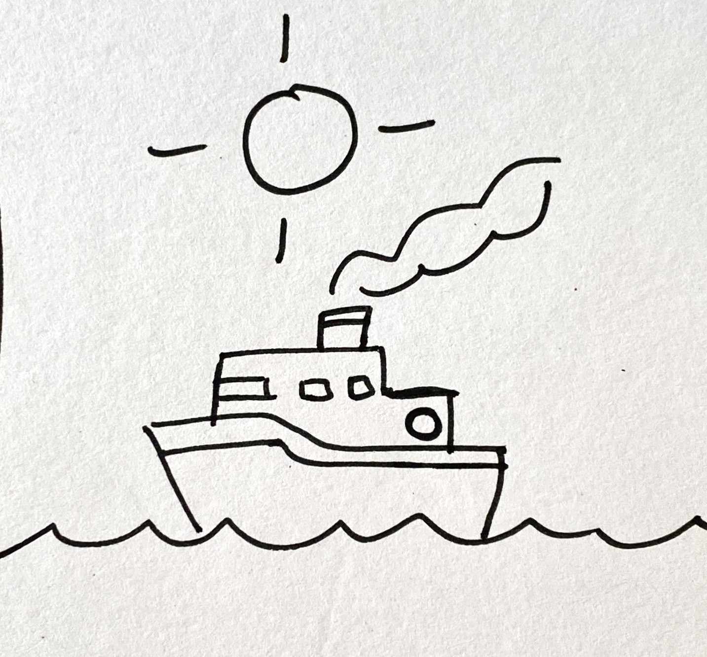
Leer y hablar
Lee el poema*
el poema = poem
¿Qué artículo es? [3/5]
hablar
leer
el | la
un | una
barco (nm) = boat
sol (nm) = sun
mar (nm) = sea
___sol arriba
____ mar abajo
y, en el medio, ___ barco.
el
[the sun above]
el
[the sea below]
un
[and, in the middle, a boat]
Notes:
[3/5]
Frequency of unknown words and cognates: mar [480] poema [1430] sol [383]
Source: Davies, M. & Davies, K. (2018). A frequency dictionary of Spanish: Core vocabulary for learners (2nd ed.). Routledge: London

Slide 14
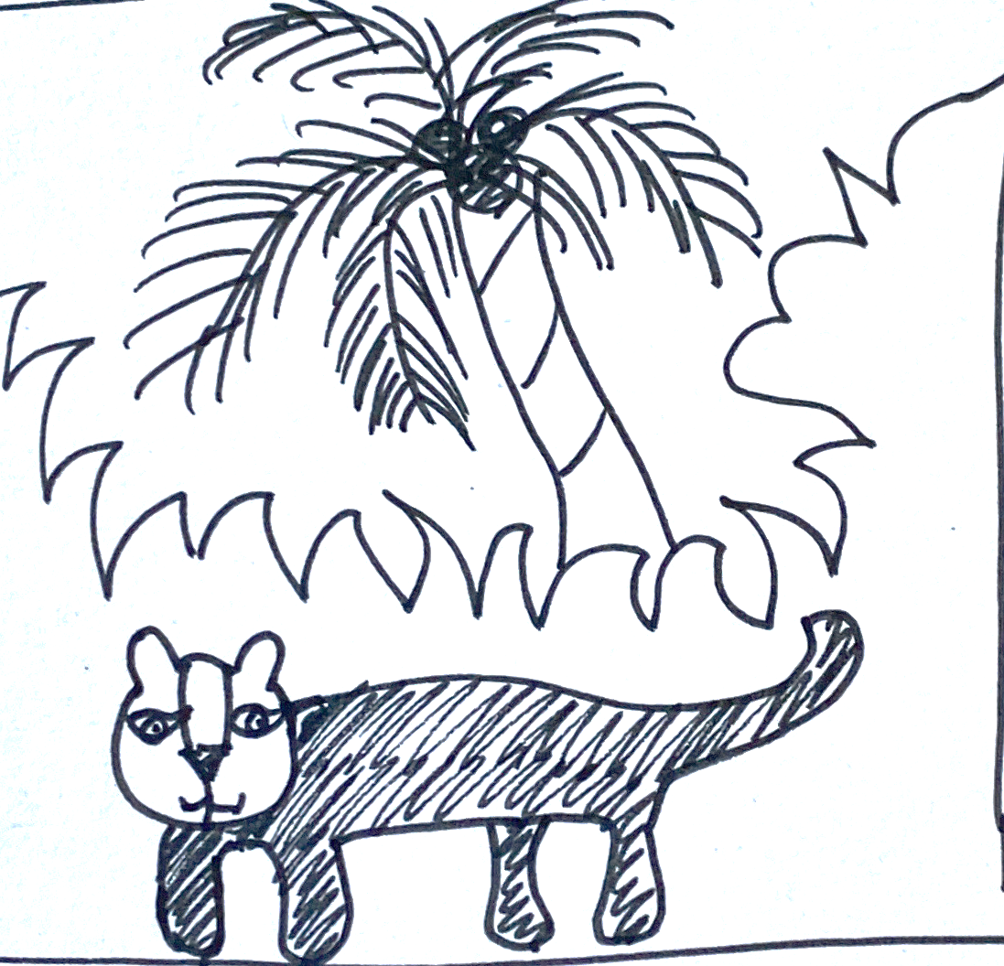
Leer y hablar
Lee el poema*
el poema = poem
¿Qué artículo es? [4/5]
hablar
leer
el | la
un | una
palmera (nf) = palm tree
pantera (nf) = panther
selva (nm) = jungle
la
[the jungle]
____ selva,
___ palmera,
y, en el medio, ___ pantera.
la
[the palm tree]
una
middle
[and, in the _______, a panther]
Notes:
[4/5]
Frequency of unknown words and cognates: palmera [4780] pantera [>5000] poema [1430] selva [2768]
Source: Davies, M. & Davies, K. (2018). A frequency dictionary of Spanish: Core vocabulary for learners (2nd ed.). Routledge: London

Slide 15
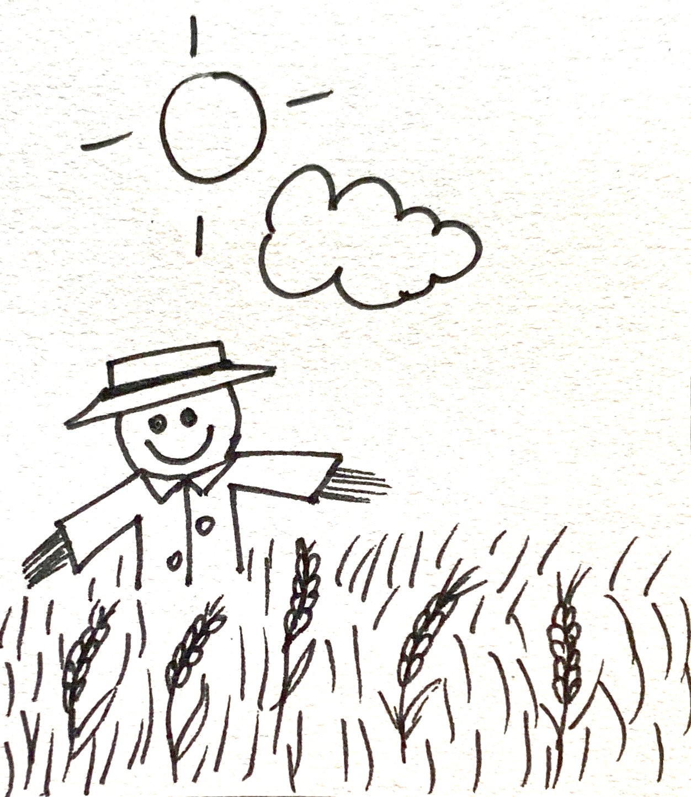
Leer y hablar
Lee el poema*
el poema = poem
¿Qué artículo es? [5/5]
hablar
leer
el | la
un | una
espantapájaros (nm)
= scarecrow
trigo (nm) = wheat
sol (nm) = sun
el
above
[the sun _______]
____ sol arriba,
___ nube abajo,
y, en el medio, ___ trigo
y ____ espantapájaros.
la
below
[the cloud _______]
el
middle
[and, in the _______, the wheat]
un
[and a scarecrow]
Notes:
[5/5]
Frequency of unknown words and cognates: espantapájaros [>5000] poema [1430] sol [383] trigo [3975]
Source: Davies, M. & Davies, K. (2018). A frequency dictionary of Spanish: Core vocabulary for learners (2nd ed.). Routledge: London

Slide 16
¡adiós!
amarillo

