Slide 1
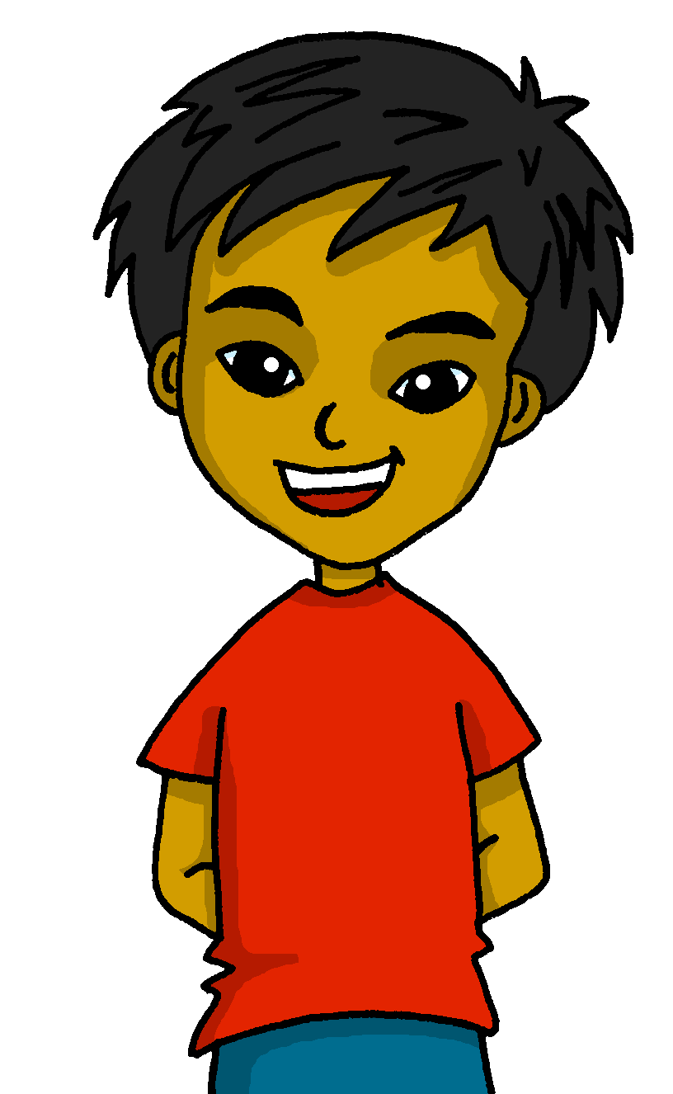
Un poema
Mi
Un poema
amarillo
Follow ups 1-5
Term 3 Week 12
Notes:
Artwork by Steve Clarke. All additional pictures selected are available under a Creative Commons license, no attribution required.
The frequency rankings for words that occur in this PowerPoint which have been previously introduced in the resources are given in the SOW (excel document) and in the resources that first introduced and formally re-visited those words.
For any other words that occur incidentally in this PowerPoint, frequency rankings will be provided in the notes field wherever possible.
Vocabulary: N/A
Revisit 1: amar [700] odiar [2211] las [1] los [1] calor [1852] clase [320] cumpleaños [3372] español [262] fiesta [796] frío [1307] libro [230] lunes [1370] museo [1114] tarde [392] verde [812] difícil [374] fácil [584]
Revisit 2: medio [395] nube [1499] río [496] arriba [690] abajo [788]
Frequency of unknown words and cognates:
brazo [470] corazón [475] carbón [3331] mar [480] oso [4449] poema [1430] tarjeta [1958] voz [252] alegre [2081] bonito [891] curioso [1811] mayor [154] primero [82] rápida [870] su [12] como [20]
Source: Davies, M. & Davies, K. (2018). A frequency dictionary of Spanish: Core vocabulary for learners (2nd ed.). Routledge: London
Source: Davies, M. & Davies, K. (2018). A frequency dictionary of Spanish: Core vocabulary for learners (2nd ed.). Routledge: London

Slide 2
Follow up 1:
Con tu compañero/a, lee
La pantera es negra como el carbón.
Cuando tiene miedo o frío,
su color no es diferente,
pero es rápid como un avión 🛫.
La pantera es única y especial.
El flamenco es blanco primero
y cuando es mayor,
es rosa como una flor.
Como la pantera,
el flamenco, es único y especial
La ballena azul
es grande como un autobús 🚌.
Porque es enorme y vive en el mar 🌊
La ballena azul es única y especial.
El pulpo es curioso como un oso 🐻
y con sus ocho brazos 💪
Y tres corazones 💗
El pulpo también es único y especial.
hablar
leer
con voz alegre 😊
con voz triste 🙁
lento 🐌
[1 minuto]
rápido 🌠
en voz baja 🤫
con voz de abeja 🐝
(la) voz – voice
alegre – happy, lively
en voz baja - quietly
INICIO
Notes:
Timing: 5 minutes
Aim: Speaking and pronunciation practice, involving some ‘acting’ of tones
Procedure:
Read the instruction and bring up the first animation: ‘con voz alegre’.
Students the poem together with each of the tones provided.
NB. Depending on time
Teachers clarify the meaning of each tone and allow pupils to practise in pairs choosing one, two or three different tones.
Teachers allocate time to practise each tone individually.
Frequency of unknown words and cognates:
voz [252] alegre [2081]
Source: Davies, M. & Davies, K. (2018). A frequency dictionary of Spanish: Core vocabulary for learners (2nd ed.). Routledge: London

Slide 3
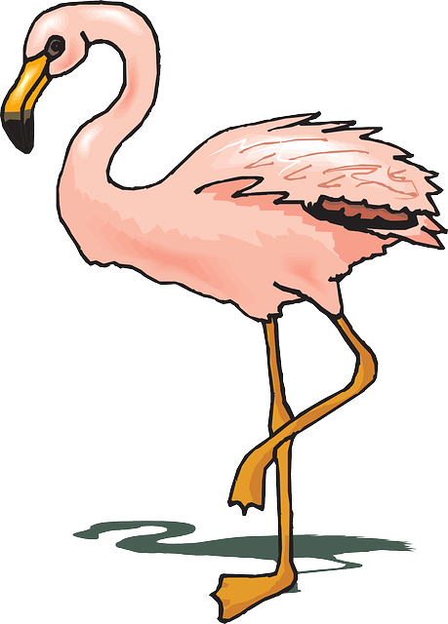
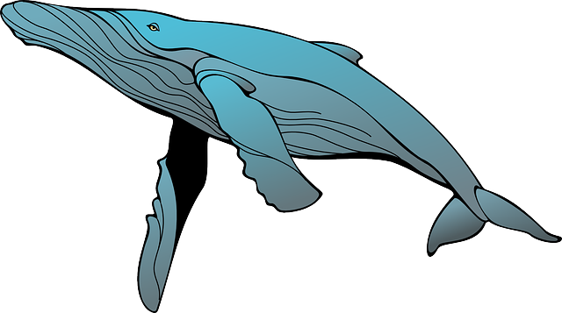
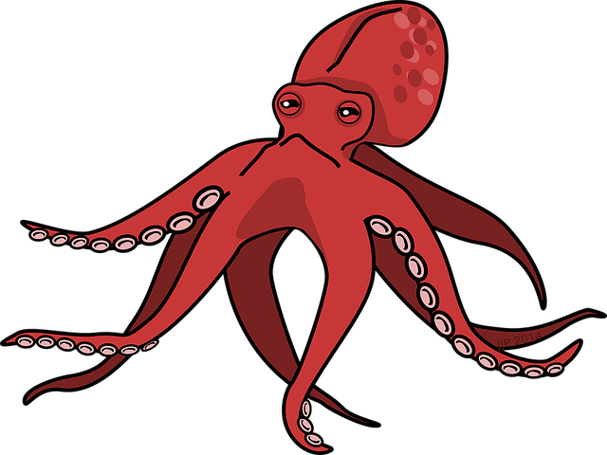
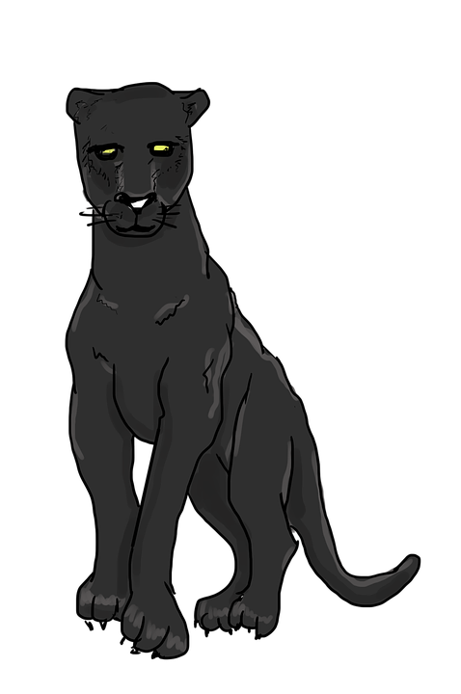
Follow up 2:
¿Cuántos animales hay?
un
flamenco
Hay …
leer
hablar
dos
ballenas
tres
pulpos
flamenco
cuatro
panteras
pantera
cinco
flamencos
pulpo
seis
pulpos
ballena
siete
ballenas
ocho
panteras
nueve
flamencos
diez
pulpos
Notes:
Timing: 5 minutes
Aim: guided production of numbers with the vocabulary for the week.
Procedure:
Elicit the number and the animal from pupils, ensuring the use the plural form.

Slide 4
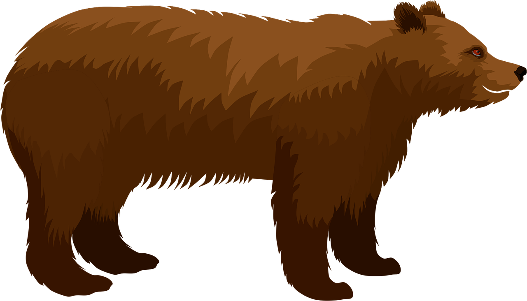
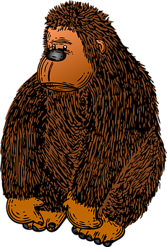
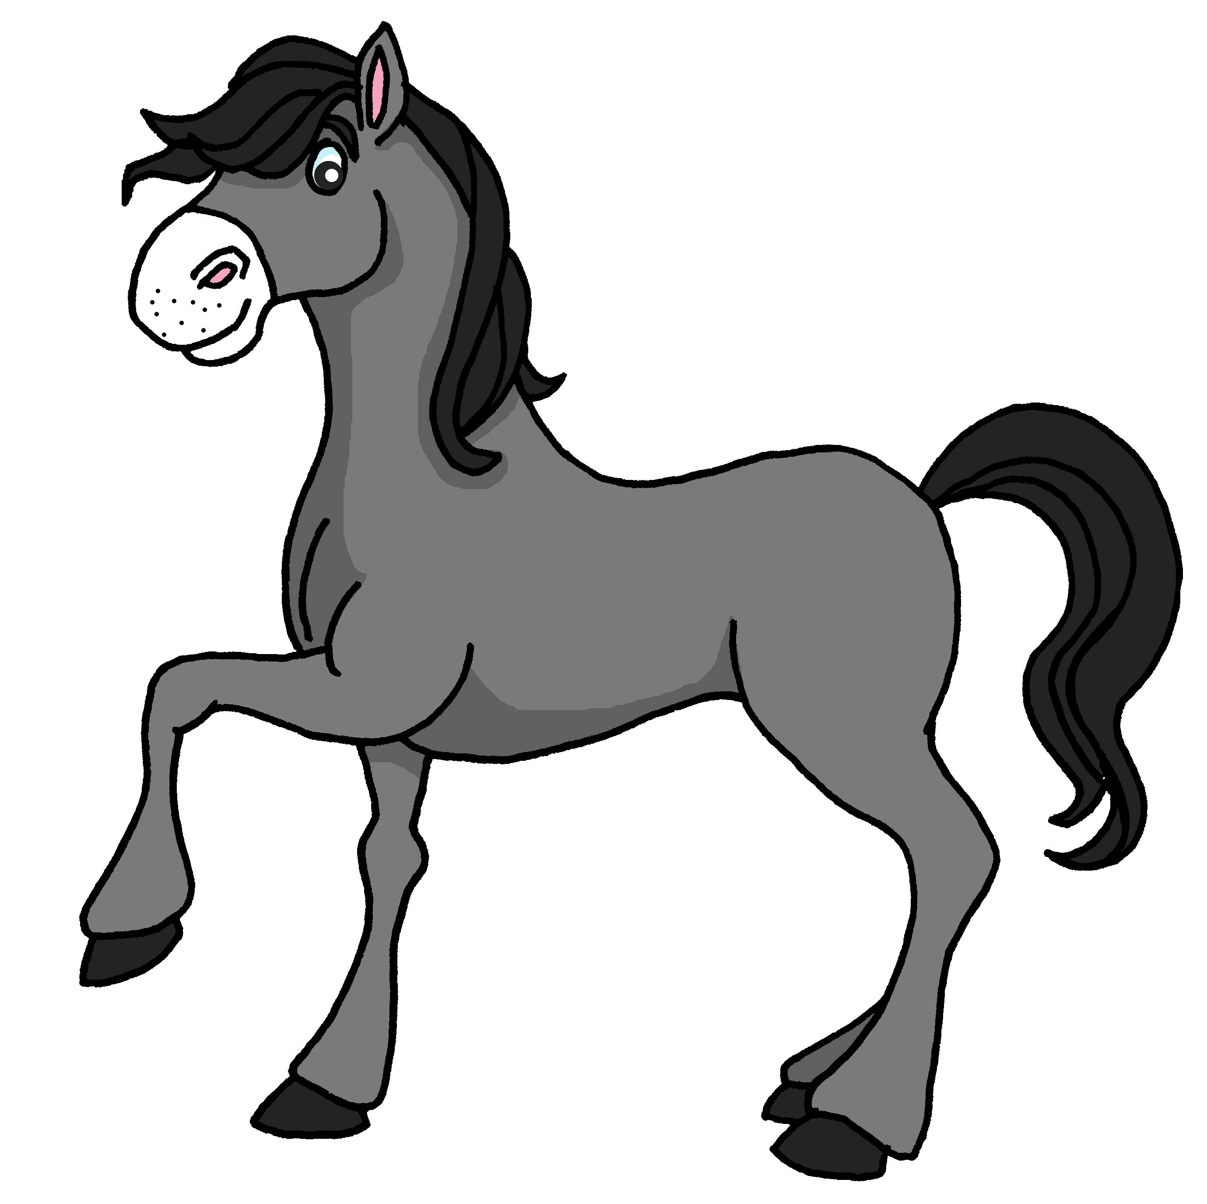
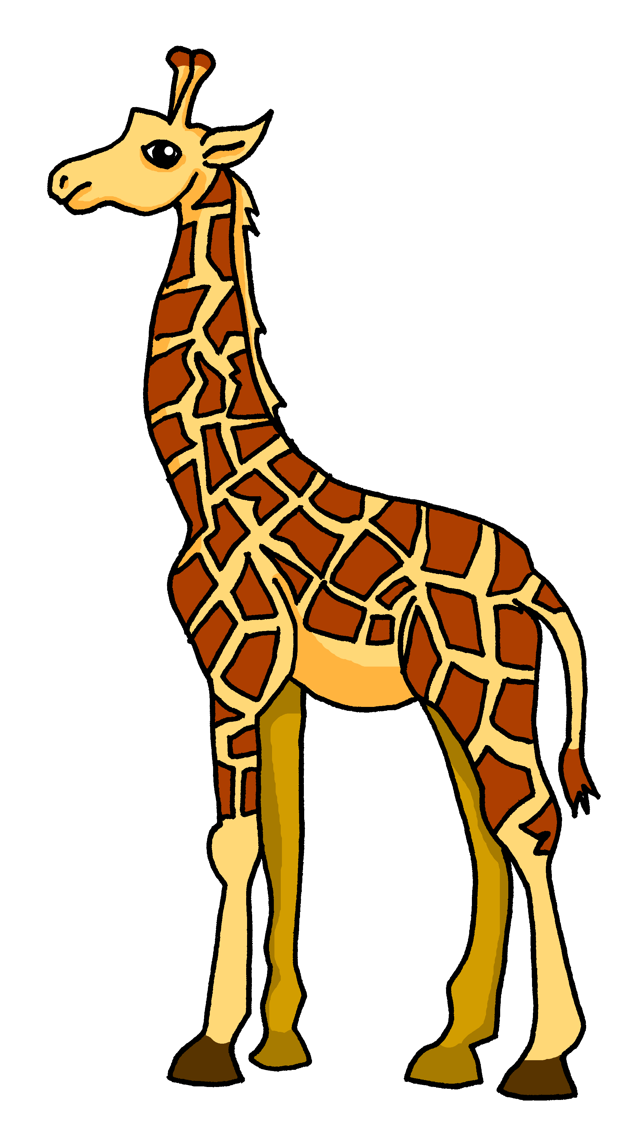
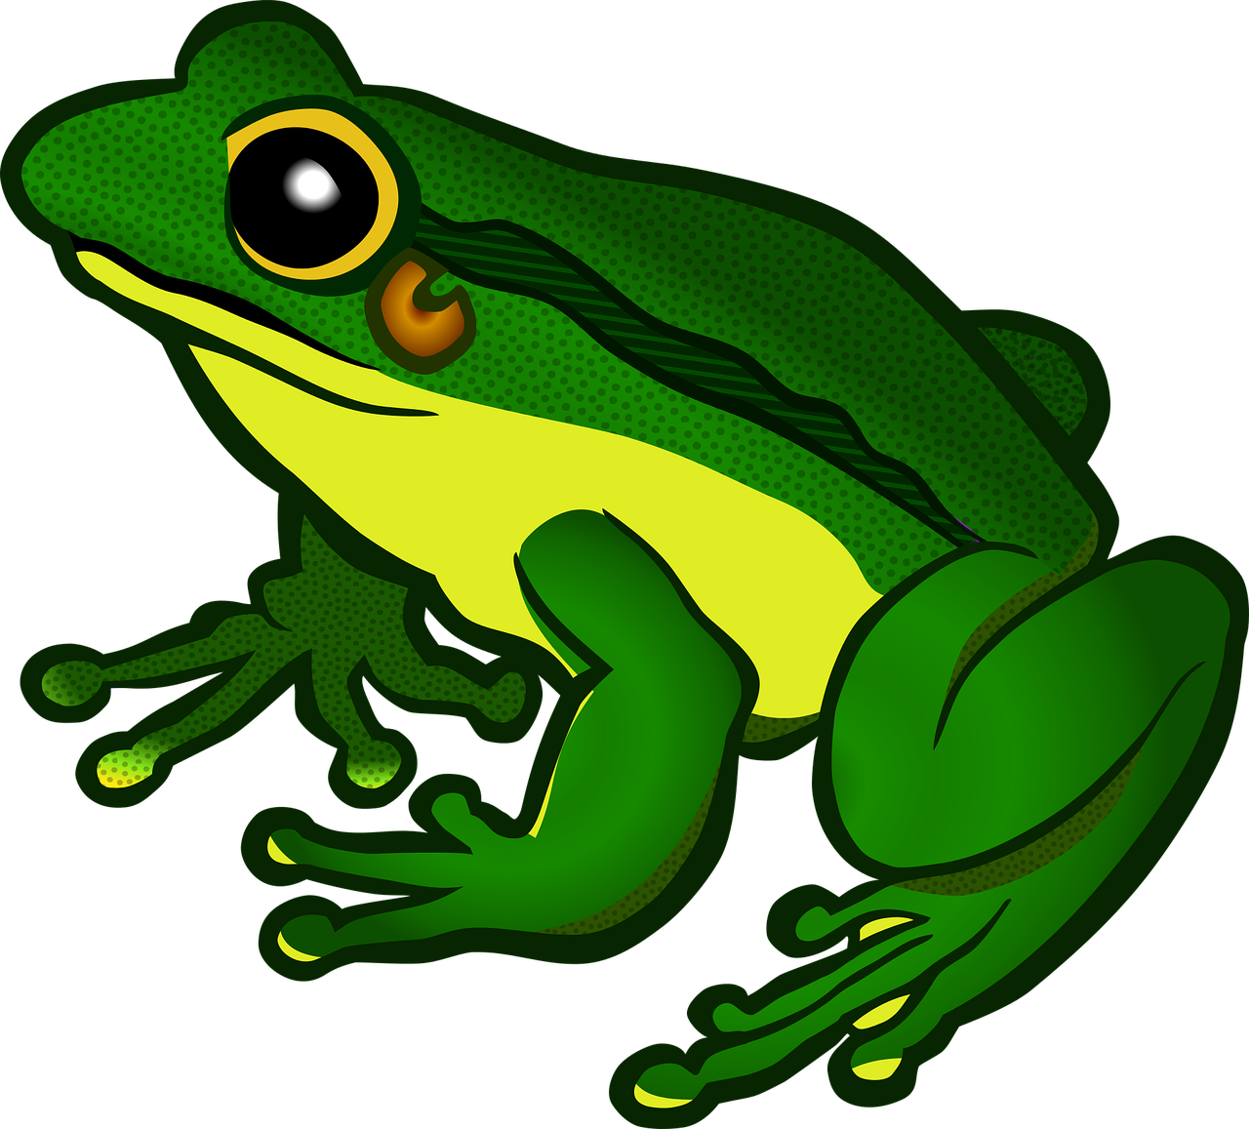
Follow up 3:
Escribe los adjetivos en español.
El oso es curioso.
La tortuga es vieja.
El tigre es activo y grande.
La cebra es blanca y negra.
El gorila es fuerte.
El caballo es rápido.
La jirafa es alta.
La rana es verde.
[curious]
escribir
1
¿Cuál es tu animal preferido?
2
[old]
3
[active and big]
4
[black and white]
Mi animal preferido es el tigre.
5
[strong]
6
[fast]
7
[tall]
rápido - fast
8
[green]
Notes:
Timing: 7 minutes
Aim: to practise written production of previously taught adjectives.
Procedure:
Remind pupils that Spanish adjectives sometimes change their endings to match the noun (in this case, the animal) that they describe, but that adjectives already ending in ‘e’ do not change.
Pupils might work on mini whiteboards to allow teachers to check answers one by one, providing feedback after each.
If pupils need more support with the task, teachers could move the English text boxes to the right to reveal the initial 1-2 letters of each adjective.
Elicit full sentences from pupils when checking answers (this could be done chorally) and if desired, click to hear each full sentence.
Clarify the meaning of speech bubbles and practise the pronunciation.
If time allows, ask pupils to tell you their favourite animal.
Frequency of unknown words and cognates:
rápido [870]
Source: Davies, M. & Davies, K. (2018). A frequency dictionary of Spanish: Core vocabulary for learners (2nd ed.). Routledge: London

Slide 5
Follow up 4:
Lee el poema. ¡De memoria! 🧠
__________ es __________ como el carbón.
Cuando tiene __________ o __________,
su color no es __________,
pero es __________ como un avión 🛫.
__________ es __________ y __________.
__________ es __________ primero
y cuando es mayor,
es __________ como __________.
Como __________,
__________, es __________ y __________
__________ __________
es __________ como un autobús 🚌.
Porque es enorme y vive en el mar 🌊
__________ __________ es __________ y __________.
__________ es __________ como un oso 🐻
y con sus __________ brazos 💪
Y __________ corazones 💗
__________ también es __________ y __________.
hablar
f_ _ m _ _ c _
p_ _ t _ _ _
p_ _ p _
b_ ll _ _ _
rápido – fast
curioso = curious
Notes:
Timing: 5 minutes
Aim: speaking exercise using pictures to practice articles and nouns.
NB. There is an alternative task with more support. This could be done instead of this task or before this task (next slide).
Procedure:
Students do a read aloud, aided by the picture prompts.
Frequency of unknown words and cognates:
curioso [1811] rápido [870]
Source: Davies, M. & Davies, K. (2018). A frequency dictionary of Spanish: Core vocabulary for learners (2nd ed.). Routledge: London

Slide 6
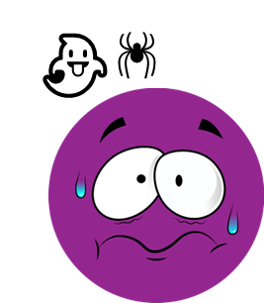
Follow up 4:
Lee el poema. ¡De memoria! 🧠
__________ es __________ como el carbón.
Cuando tiene __________ o __________,
su color no es __________,
pero es __________ como un avión 🛫.
__________ es __________ y __________.
__________ es __________ primero
y cuando es mayor,
es __________ como __________.
Como __________,
__________, es __________ y __________
__________ __________
es __________ como un autobús 🚌.
Porque es enorme y vive en el mar 🌊
__________ __________ es __________ y__________.
__________ es __________ como un oso 🐻
y con sus __________ brazos 💪
Y __________ corazones 💗
__________ también es __________ y __________.
hablar
[different]
[fast]
[unique]
[special]
flamenco
[white]
pantera
pulpo
[unique]
[special]
ballena
[big]
[unique]
[special]
[curious]
[8]
rápido – fast
curioso = curious
[3]
[unique]
[special]
Notes:
Timing: 5 minutes
Aim: speaking exercise using pictures to practice articles and nouns.
This is an alternative task with more support. This could be done instead of this task or before this task (next slide).
Procedure:
Students do a read aloud, aided by the picture prompts.

Slide 7
Follow up 4:
Las respuestas
La pantera
negra
__________ es __________ como el carbón.
Cuando tiene __________ o __________,
su color no es __________,
pero es __________ como un avión 🛫.
__________ es __________ y __________.
__________ es __________ primero
y cuando es mayor,
es __________ como __________.
Como __________,
__________, es __________ y __________
__________ __________
es __________ como un autobús 🚌.
Porque es enorme y vive en el mar 🌊
__________ __________ es __________ y __________.
__________ es __________ como un oso 🐻
y con sus __________ brazos 💪
Y __________ corazones 💗
__________ también es __________ y __________.
hablar
frío
miedo
diferente
rápida
La pantera
única
especial
f_ _ m _ _ c _
El flamenco
blanco
p_ _ t _ _ _
rosa
una flor
la pantera
p_ _ p _
el flamenco
único
especial
b_ ll _ _ _
La ballena
azul
grande
La ballena
azul
única
especial
El pulpo
curioso
ocho
rápido – fast
curioso = curious
tres
el pulpo
único
especial
Notes:
Slide to the answers.

Slide 8
follow up 5a:
Escribe en inglés 📝: can you get at least 15 points?
 | verde | el medio | la nube
 | arriba | abajo | el río
 | odiar | fácil | el frío
 | amar | los | el calor
 | cuando | también | pero
 | blanco | negra | es
vocabulario
green
(the) middle
(the) cloud
x3
above
below
(the) river
to hate
easy
(the) cold
x2
to love, loving
the (m, pl)
(the) heat
when
also
but
x1
white (m)
black (f)
It is (trait)
Notes:
Timing: 5 minutes
Aim: to practise written production of vocabulary from this week and this week’s revisited sets.
Procedure: 1. Give pupils a blank grid. They fill in the English meanings of any of the words they know, trying to reach 15 points in total.
Note: The most recently learnt and practised words are pink, words from the first revisit are green and those from the second revisit are blue, thus more points are awarded for them, to recognise that memories fade and more effort (heavy lifting!) is needed to retrieve them.

Slide 9
follow up 5b:
Escribe en español 📝: can you get at least 15 points?
 | (the) river | (the) cloud | (the) middle
 | below | green | above
 | to love | to hate, hating | easy
 | (the) heat | the (f.) | (the) cold
 | also | when | it is (trait)
 | black (m) | but | white (f)
vocabulario
el río
la nube
el medio
x3
abajo
verde
arriba
amar
odiar
fácil
x2
el calor
las
el frío
también
cuando
es
x1
negro
pero
blanca
Notes:
Timing: 5 minutes
Aim: to practise written production of vocabulary from this week and this week’s revisited sets.
Procedure: 1. Give pupils a blank grid. They fill in the Spanish meanings of any of the words they know, trying to reach 15 points in total.
Note: The most recently learnt and practised words are pink, words from the first revisit are green and those from the second revisit are blue, thus more points are awarded for them, to recognise that memories fade and more effort (heavy lifting!) is needed to retrieve them.

Slide 10
¡adiós!
amarillo

Slide 11
follow up 2b:
Follow up Extra 1a: Handout
Escribe en inglés 📝: can you get at least 15 points?
 | verde | el medio | la nube
 | arriba | abajo | el río
 | odiar | fácil | el frío
 | amar | los | el calor
 | cuando | también | pero
 | blanco | negra | es
vocabulario
x3
x2
x1
Notes:
HANDOUT 5

Slide 12
follow up 2b:
Follow up extra 1b: Handout
Escribe en español 📝: can you get at least 15 points?
 | (the) river | (the) cloud | (the) middle
 | below | green | above
 | to love | to hate, hating | easy
 | (the) heat | the (f.) | (the) cold
 | also | when | it is (trait)
 | black (m) | but | white (f)
vocabulario
x3
x2
x1
Notes:
HANDOUT 5

