Slide 1
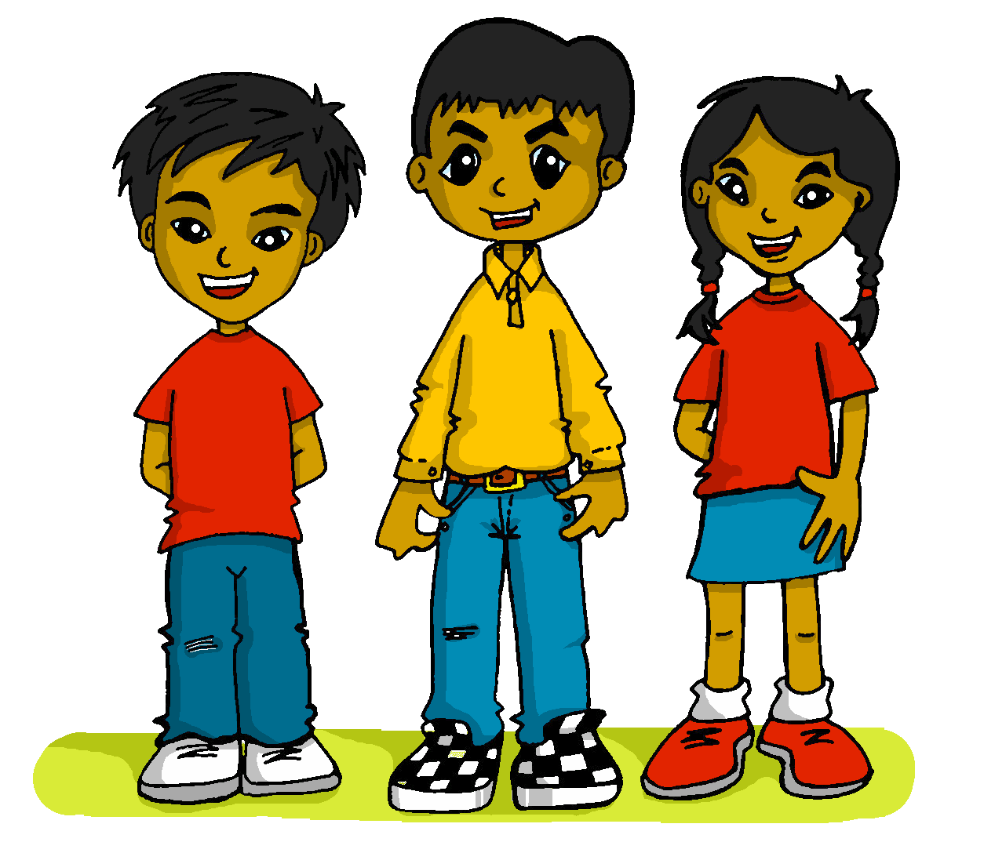
español, con Quique

Slide 2
What do I know now?
amarillo
- Knowledge quiz
Notes:
Artwork by Steve Clarke. All additional pictures selected are available under a Creative Commons license, no attribution required.
The frequency rankings for words that occur in this PowerPoint which have been previously introduced in the resources are given in the SOW (excel document) and in the resources that first introduced and formally re-visited those words.
For any other words that occur incidentally in this PowerPoint, frequency rankings will be provided in the notes field wherever possible.
This lesson includes an assessment of the vocabulary and grammar knowledge from the first two terms of this year’s course. There is a phonics assessment in Week 11. Note: there are no follow up activities this week, but there is an Easter activity at the end of the quiz. This could be used in a follow up slot, more than once, during this week, as appropriate. The quiz can be completed on paper with pupils writing numbered answers. Alternatively there is a word document for printing. There is an answer sheet for teachers. Alternatively, answers are provided on slides for pupils to correct their own or a partner’s.
Source: Davies, M. & Davies, K. (2018). A frequency dictionary of Spanish: Core vocabulary for learners (2nd ed.). Routledge: London

Slide 3
escuchar
Vocabulary
At home, Nina speaks Aymara, a language spoken by Aymara people of Peru and Bolivia. She is learning Spanish at school, like you. Help Nina by answering the questions in this quiz.
A For each question, put a cross (x) under the English meaning that matches what you hear.
You will hear each Spanish word twice. Choose one correct answer only.
 | A | B | C | D
1. | when | July | one | June
 | ☐ | ☐ | ☐ | ☐
2. | sqaure | country | dad | park
 | ☐ | ☐ | ☐ | ☐
3. | fear | middle | very | Tuesday
 | ☐ | ☐ | ☐ | ☐
1
2
3
Notes:
Timing: 20-25 minutes (all assessment slides)
Aim: to practise aural comprehension of vocabulary taught in this year’s course.
Procedure:
1. Click the audio buttons to play each item. (The words are recorded twice with a pause to allow pupils to process the information).
2. Pupils can either write 1C, etc.. or if they have the assessment on a print out they can put a X in the correct box.
3. After items 1-3, continue to the next slide to complete the remainder of the task.
Transcript:
1. junio…..junio
2. país…..país
3. miedo…..miedo
4. campo…..campo
5. calor…..calor
6. mes…..mes

Slide 4
escuchar
Vocabulary
A For each question, put a cross (x) under the English meaning that matches what you hear.
You will hear each Spanish word twice. Choose one correct answer only.
 | A | B | C | D
4. | city | how many | countryside | four
 | ☐ | ☐ | ☐ | ☐
5. | bed | heat, warmth | head | colour
 | ☐ | ☐ | ☐ | ☐
6. | May | my | March | month
 | ☐ | ☐ | ☐ | ☐
4
5
6
Notes:
[Continued]
Transcript:
1. junio…..junio
2. país…..país
3. miedo…..miedo
4. campo…..campo
5. calor…..calor
6. mes…..mes

Slide 5
escuchar
Vocabulary
B For each question, put a cross (x) under the type of word you hear. You will hear each Spanish word twice. Choose one correct answer only.
This word is a good example of …
 | A | B | C | D
Ej. | an question ☐ | physical description ☐ | an activity ☐ | an object ☐
1. | an object ☐ | a month ☐ | a number ☐ | an activity ☐
2. | physical description ☐ | an object ☐ | a person ☐ | a location ☐
3. | a question ☐ | a number ☐ | a location ☐ | a day of the week ☐
4. | a feeling or state ☐ | an object ☐ | a person ☐ | a location ☐
 | a month ☐ | physical description ☐ | an activity ☐ | an object ☐
1
2
3
4
5
6
Notes:
Procedure:
1. Click the audio buttons to play each item. (The words are recorded twice with a pause to allow pupils to process the information).
2. Pupils can either write 1C, etc.. or if they have the assessment on a print out they can put a X in the correct box.
3. When complete, continue to the next task.
Transcript:
alto…..alto
diciembre…..diciembre
hoja…..hoja
cuándo…..cuándo
hermana…..hermana
pasear…..pasear

Slide 6
escuchar
Grammar
C Put a cross (x) next to the person or people that the sentence is about. You will hear each Spanish sentence twice.
1. | I | ☐ | you | ☐ | he/she | ☐
2. | I | ☐ | you | ☐ | he/she | ☐
3. | I | ☐ | you | ☐ | he/she | ☐
4. | I | ☐ | you | ☐ | he/she | ☐
5. | I | ☐ | you | ☐ | he/she | ☐
 | I | ☐ | you | ☐ | he/she | ☐
1
2
3
4
5
6
Notes:
Procedure:
1. Click the audio buttons to play each item. (The words are recorded twice with a pause to allow pupils to process the information).
2. Pupils can either write 1C, etc.. or if they have the assessment on a print out they can put a X in the correct box.
3. When complete, continue to the reading.
Transcript:
1. Comes un bocadillo…. Comes un bocadillo.
2. Toca un instrumento…. Toca un instrument.
3. Visito el museo.... Visito el museo.
4. Escuchas la música.... Escuchas la música.
5. Odio las tardes.... Odio las tardes.
6. Lee una revista.... Lee una revista.

Slide 7
leer
A Translate the underlined Spanish word(s) to complete each English sentence.
1. ¿Cuándo es? ¿Febrero, marzo? ________ is it? __________, _______?
2. Organiza una fiesta. S/he ___ ______________ a _________.
3. Está en el medio de la cocina. She is in the ____________ of the ___________.
4. ¡Buenos días, mamá! _________ ____________, mum!
5. El río es grande. The _________ is ____________,
6. Veo la nube y es negra. I see the _________ and it is __________.
7. Tengo frío. I am _____________ .
8. Mi trabajo es muy difícil. _____ __________ is _______ ________.
9. Luego escucho música arriba. _________ I _________ to music __________.
10. Y también descanso en mi habitación. _______ I _______ ____________ in my room.
Notes:
Aim: to practise written recall of previously taught vocabulary.
Procedure:
Ensure that the task is clear.
Pupils could write 1 – 10 and the individual English word meanings (or they could fill in if they have printed assessment sheets).

Slide 8
escribir
B Translate the underlined English words to complete the Spanish sentence.
1. It is an incredible place. Es un __________ increíble. (write one word)
2. Is white a colour? ¿ El _________ es un ___________? (write two words)
3. You are down below. Estás _________. (write one word)
4. Speaking Spanish is easy. ___________ español es ___________. (write two words)
5. Being famous is impossible. __________ _________ es imposible. (write two words)
6. It is your favourite thing. Es ______ ____________ preferida. (write two words)
7. There are eight teachers. Hay ________ profesoras. (write one word)
8. The animal is weak. El animal es ___________. (write one word)
9. The person is strong. La _____________ es ____________. (write two words)
10. My birthday is in August. Mi __________________ es en ________. (write two words)
Total marks available for vocabulary: 38
Notes:
Aim: to practise written production of previously taught vocabulary.
Procedure:
Ensure that the task is clear.
Pupils could write 1 – 10 and the individual English word meanings (or they could fill in if they have printed assessment sheets).

Slide 9
leer
Grammar
Aymara grammar is very different from Spanish. Help Nina with her Spanish grammar by answering the questions in this part of the quiz.
A
i) Put a [X] next to the person each sentence refers to. ii) Write the Spanish pronoun for I or you or he, she for each sentence, too.
Pronoun
Pronoun
1 | ☐ I ☐ you _{[singular]} ☐ she, he, it | Organizas una fiesta. |  |  | 4 | ☐ I ☐ you _{[singular]} ☐ she, he, it | Habla inglés.
2 | ☐ I ☐ you _{[singular]} ☐ she, he, it | Pasea por la ciudad. |  |  | 5 | ☐ I ☐ you _{[singular]} ☐ she, he, it | Aprendes cada día.
3 | ☐ I ☐ you _{[singular]} ☐ she, he, it | Monto a caballo. |  |  | 6 | ☐ I ☐ you _{[singular]} ☐ she, he, it | Estás aquí.
Notes:
Aim: to practise written recall of previously taught grammar.
Procedure:
Ensure that the task is clear.
Pupils could write the correct English pronouns (or they could fill in if they have printed assessment sheets).

Slide 10
leer
Grammar
B Put a (X) next to the word that completes the sentence.
1. | El hermano __________ pesado hoy. The boy is tiresome today. | ☐ hay | ☐ es | ☐ está | ☐ tiene
2. | La chica _________ sueño. The girl is tired. | ☐ hay | ☐ es | ☐ está | ☐ tiene
3. | _________ un mensaje allí. There is a message there. | ☐ hay | ☐ es | ☐ está | ☐ tiene
4. | El piano __________ un instrumento viejo. The piano is an old instrument. | ☐ hay | ☐ es | ☐ está | ☐ tiene

Slide 11
leer
Grammar
C Write the words in each box in the correct order.
1. | enero un típico | Correct order:_________________________________________
2. | planta verde una | Correct order:_________________________________________
D Put a (X) next to the words that could finish this sentence. Remember the personal ‘a’.
1. Busco a... | a) una noticia. | ☐
 | b) mi madre. | ☐
2. Ama... | a) mi papá. | ☐
 | b) el estadio. | ☐
Notes:
Aim: to practise written recall of previously taught grammar.
Procedure:
Ensure that the task is clear.
Pupils could write the correct English pronouns (or they could fill in if they have printed assessment sheets).

Slide 12
escribir
E Write the Spanish word for ‘a’ or ‘some’. 1. _______ dedo (m) 2. _______ boca (f) 3. _______ ejercicios (mpl) 4. _______ cartas (fpl)
F Write the Spanish word for ‘the’.
1. ________ naranja. (f) 2. ________ domingo. (m) 3. ¿ ________ orejas? (fpl) 4. ¿ ________ barcos? (mpl)
Total marks available for grammar: 28
Notes:
Aim: to practise written production of previously taught grammar
Procedure:
Ensure that the task is clear.
Pupils could write the answers only (or they could fill in if they have printed assessment sheets).

Slide 13
What do I know now?
amarillo
- Knowledge quiz
Notes:
Artwork by Steve Clarke. All additional pictures selected are available under a Creative Commons license, no attribution required.
The frequency rankings for words that occur in this PowerPoint which have been previously introduced in the resources are given in the SOW (excel document) and in the resources that first introduced and formally re-visited those words.
For any other words that occur incidentally in this PowerPoint, frequency rankings will be provided in the notes field wherever possible.
This lesson includes an assessment of the vocabulary and grammar knowledge from the first two terms of this year’s course. There is a phonics assessment in Week 11. Note: there are no follow up activities this week, but there is an Easter activity at the end of the quiz. This could be used in a follow up slot, more than once, during this week, as appropriate. The quiz can be completed on paper with pupils writing numbered answers. Alternatively there is a word document for printing. There is an answer sheet for teachers. Alternatively, answers are provided on slides for pupils to correct their own or a partner’s.
Source: Davies, M. & Davies, K. (2018). A frequency dictionary of Spanish: Core vocabulary for learners (2nd ed.). Routledge: London

Slide 14
escuchar
Vocabulary
At home, Nina speaks Aymara, a language spoken by Aymara people of Peru and Bolivia. She is learning Spanish at school, like you. Help Nina by answering the questions in this quiz.
A For each question, put a cross (x) under the English meaning that matches what you hear.
You will hear each Spanish word twice. Choose one correct answer only.
 | A | B | C | D
1. | when | July | one | June
 | ☐ | ☐ | ☐ | ☐
2. | sqaure | country | dad | park
 | ☐ | ☐ | ☐ | ☐
3. | fear | middle | very | Tuesday
 | ☐ | ☐ | ☐ | ☐
1
2
3
Notes:
Timing: 20-25 minutes (all assessment slides)
Aim: to practise aural comprehension of vocabulary taught in this year’s course.
Procedure:
1. Click the audio buttons to play each item. (The words are recorded twice with a pause to allow pupils to process the information).
2. Pupils can either write 1C, etc.. or if they have the assessment on a print out they can put a X in the correct box.
3. After items 1-3, continue to the next slide to complete the remainder of the task.
Transcript:
1. junio…..junio
2. país…..país
3. miedo…..miedo
4. campo…..campo
5. calor…..calor
6. mes…..mes

Slide 15
escuchar
Vocabulary
A For each question, put a cross (x) under the English meaning that matches what you hear.
You will hear each Spanish word twice. Choose one correct answer only.
 | A | B | C | D
4. | city | how many | countryside | four
 | ☐ | ☐ | ☐ | ☐
5. | bed | heat, warmth | head | colour
 | ☐ | ☐ | ☐ | ☐
6. | May | my | March | month
 | ☐ | ☐ | ☐ | ☐
4
5
6
Notes:
[Continued]
Transcript:
1. junio…..junio
2. país…..país
3. miedo…..miedo
4. campo…..campo
5. calor…..calor
6. mes…..mes

Slide 16
escuchar
Vocabulary
B For each question, put a cross (x) under the type of word you hear. You will hear each Spanish word twice. Choose one correct answer only.
This word is a good example of …
 | A | B | C | D
Ej. | an question ☐ | physical description ☐ | an activity ☐ | an object ☐
1. | an object ☐ | a month ☐ | a number ☐ | an activity ☐
2. | physical description ☐ | an object ☐ | a person ☐ | a location ☐
3. | a question ☐ | a number ☐ | a location ☐ | a day of the week ☐
4. | a feeling or state ☐ | an object ☐ | a person ☐ | a location ☐
 | a month ☐ | physical description ☐ | an activity ☐ | an object ☐
1
2
3
4
5
6
Notes:
Procedure:
1. Click the audio buttons to play each item. (The words are recorded twice with a pause to allow pupils to process the information).
2. Pupils can either write 1C, etc.. or if they have the assessment on a print out they can put a X in the correct box.
3. When complete, continue to the next task.
Transcript:
alto…..alto
diciembre…..diciembre
hoja…..hoja
cuándo…..cuándo
hermana…..hermana
pasear…..pasear

Slide 17
escuchar
Grammar
C Put a cross (x) next to the person or people that the sentence is about. You will hear each Spanish sentence twice.
1. | I | ☐ | you | ☐ | he/she | ☐
2. | I | ☐ | you | ☐ | he/she | ☐
3. | I | ☐ | you | ☐ | he/she | ☐
4. | I | ☐ | you | ☐ | he/she | ☐
5. | I | ☐ | you | ☐ | he/she | ☐
 | I | ☐ | you | ☐ | he/she | ☐
1
2
3
4
5
6
Notes:
Procedure:
1. Click the audio buttons to play each item. (The words are recorded twice with a pause to allow pupils to process the information).
2. Pupils can either write 1C, etc.. or if they have the assessment on a print out they can put a X in the correct box.
3. When complete, continue to the reading.
Transcript:
1. Comes un bocadillo.
2. Toca un instrumento.
3. Visito el museo.
4. Escuchas la música.
5. Odio las tardes.
6. Lee una revista.

Slide 18
leer
A Translate the underlined Spanish word(s) to complete each English sentence.
1. ¿Cuándo es? ¿Febrero, marzo? ________ is it? __________, _______?
2. Organiza una fiesta. S/he ___ ______________ a _________.
3. Está en el medio de la cocina. She is in the ____________ of the ___________.
4. ¡Buenos días, mamá! _________ ____________, mum!
5. El río es grande. The _________ is ____________,
6. Veo la nube y es negra. I see the _________ and it is __________.
7. Tengo frío. I am _____________ .
8. Mi trabajo es muy difícil. _____ __________ is _______ ________.
9. Luego escucho música arriba. _________ I _________ to music __________.
10. Y también descanso en mi habitación. _______ I _______ ____________ in my room.
When
February March
is organising
party
middle
kitchen
Good morning
river
big, large
cloud
black
cold
My work
very difficult
Then/Later
listen
up above/upstairs
And
also relax
Notes:
Aim: to practise written recall of previously taught vocabulary.
Procedure:
Ensure that the task is clear.
Pupils could write 1 – 10 and the individual English word meanings (or they could fill in if they have printed assessment sheets).

Slide 19
escribir
B Translate the underlined English words to complete the Spanish sentence.
1. It is an incredible place. Es un __________ increíble. (write one word)
2. Is white a colour? ¿ El _________ es un ___________? (write two words)
3. You are down below. Estás _________. (write one word)
4. Speaking Spanish is easy. ___________ español es ___________. (write two words)
5. Being famous is impossible. __________ _________ es imposible. (write two words)
6. It is your favourite thing. Es ______ ____________ preferida. (write two words)
7. There are eight teachers. Hay ________ profesoras. (write one word)
8. The animal is weak now. El animal está ___________ ahora. (write one word)
9. The person is strong. La _____________ es ____________. (write two words)
10. My birthday is in August. Mi __________________ es en ________. (write two words)
lugar
blanco
color
abajo
Hablar
fácil
Ser famoso
tu cosa
ocho
débil
persona
fuerte
cumpleaños
agosto
Total marks available for vocabulary: 38
Notes:
Aim: to practise written production of previously taught vocabulary.
Procedure:
Ensure that the task is clear.
Pupils could write 1 – 10 and the individual English word meanings (or they could fill in if they have printed assessment sheets).

Slide 20
leer
Grammar
Aymara grammar is very different from Spanish. Help Nina with her Spanish grammar by answering the questions in this part of the quiz.
A
i) Put a [X] next to the person each sentence refers to. ii) Write the Spanish pronoun for I or you or he, she for each sentence, too.
Pronoun
Pronoun
1 | ☐ I ☐ you _{[singular]} ☐ she, he, it | Organizas una fiesta. |  |  | 4 | ☐ I ☐ you _{[singular]} ☐ she, he, it | Habla inglés.
2 | ☐ I ☐ you _{[singular]} ☐ she, he, it | Pasea por la ciudad. |  |  | 5 | ☐ I ☐ you _{[singular]} ☐ she, he, it | Aprendes cada día.
3 | ☐ I ☐ you _{[singular]} ☐ she, he, it | Monto a caballo. |  |  | 6 | ☐ I ☐ you _{[singular]} ☐ she, he, it | Estás aquí.
Notes:
Aim: to practise written recall of previously taught grammar.
Procedure:
Ensure that the task is clear.
Pupils could write the correct English pronouns (or they could fill in if they have printed assessment sheets).

Slide 21
leer
Grammar
B Put a (X) next to the word that completes the sentence.
1. | El hermano __________ pesado hoy. The boy is tiresome today. | ☐ hay | ☐ es | ☐ está | ☐ tiene
2. | La chica _________ sueño. The girl is tired. | ☐ hay | ☐ es | ☐ está | ☐ tiene
3. | _________ un mensaje allí. There is a message there. | ☐ hay | ☐ es | ☐ está | ☐ tiene
4. | El piano __________ un instrumento viejo. The piano is an old instrument. | ☐ hay | ☐ es | ☐ está | ☐ tiene

Slide 22
leer
Grammar
C Write the words in each box in the correct order.
1. | enero un típico | Correct order:_________________________________________
2. | planta verde una | Correct order:_________________________________________
un enero típico
una planta verde
D Put a (X) next to the words that could finish this sentence. Remember the personal ‘a’.
1. Busco a... | a) una noticia. | ☐
 | b) mi madre. | ☐
2. Amas... | a) mi papá. | ☐
 | b) el estadio. | ☐
Notes:
Aim: to practise written recall of previously taught grammar.
Procedure:
Ensure that the task is clear.
Pupils could write the correct English pronouns (or they could fill in if they have printed assessment sheets).

Slide 23
escribir
E Write the Spanish word for ‘a’ or ‘some’. 1. _______ dedo (m) 2. _______ boca (f) 3. _______ ejercicios (mpl) 4. _______ cartas (fpl)
F Write the Spanish word for ‘the’.
1. ________ naranja. (f) 2. ________ domingo. (m) 3. ¿ ________ orejas? (fpl) 4. ¿ ________ barcos? (mpl)
un
una
unos
unas
la
el
las
los
Total marks available for grammar: 28
Notes:
Aim: to practise written production of previously taught grammar
Procedure:
Ensure that the task is clear.
Pupils could write the answers only (or they could fill in if they have printed assessment sheets).

