Slide 1
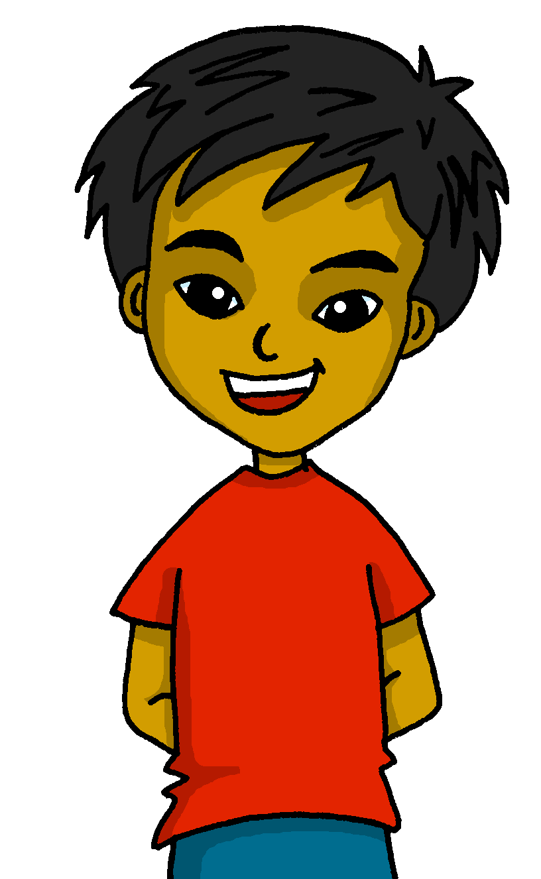
español, con Quique

Slide 2
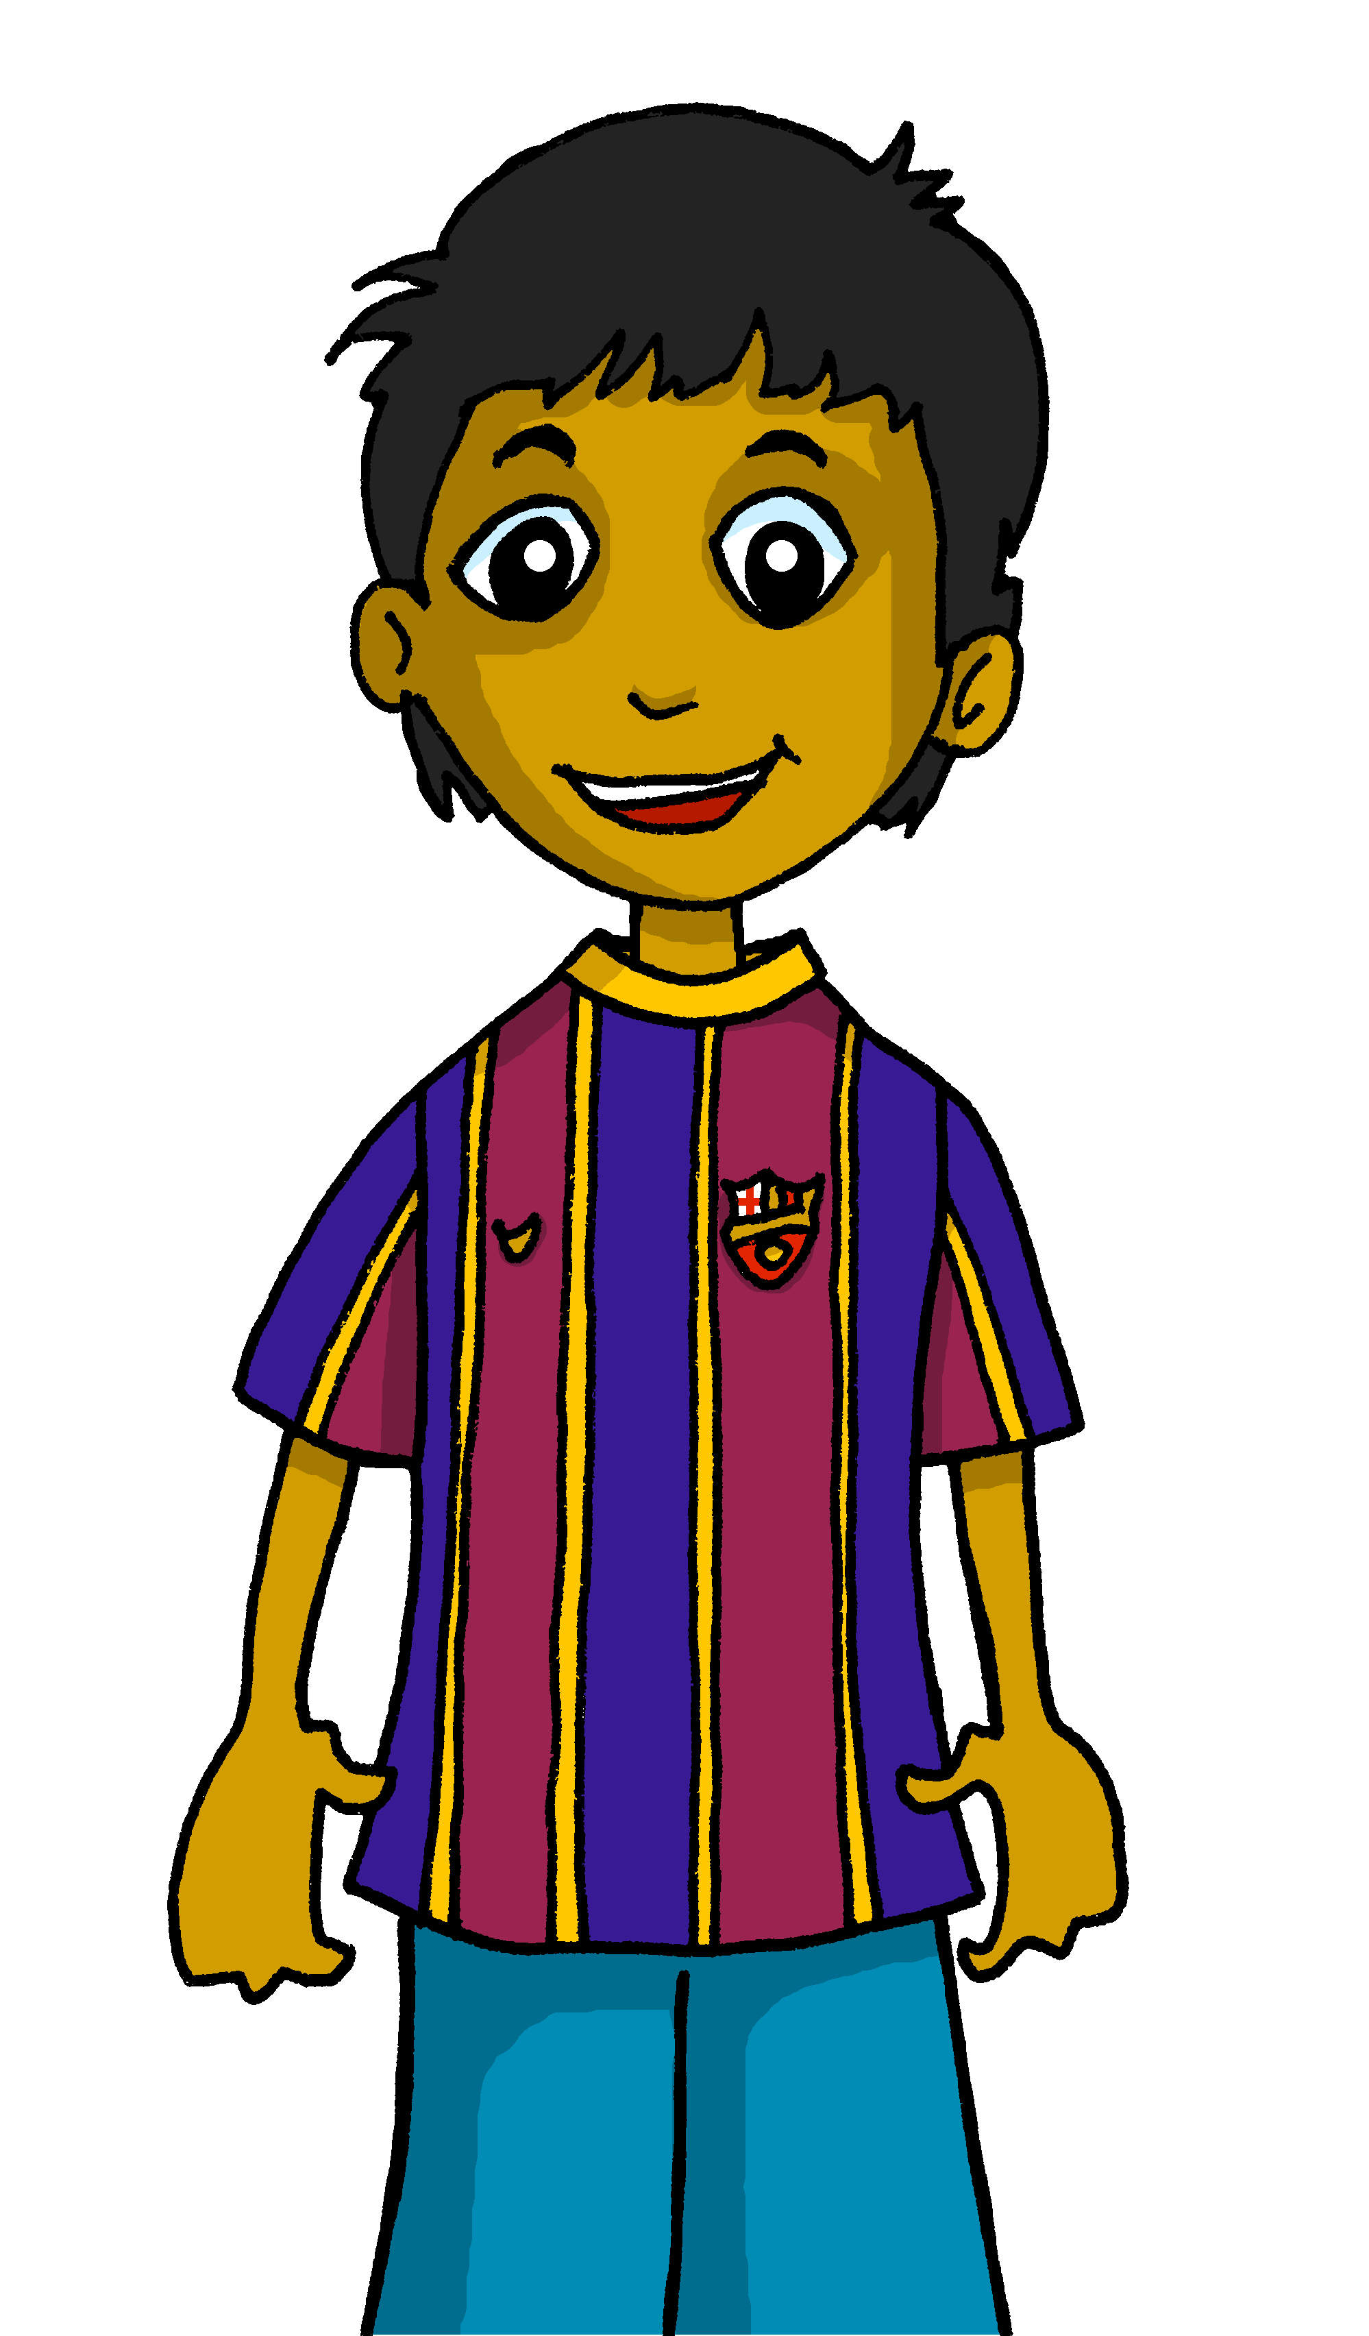
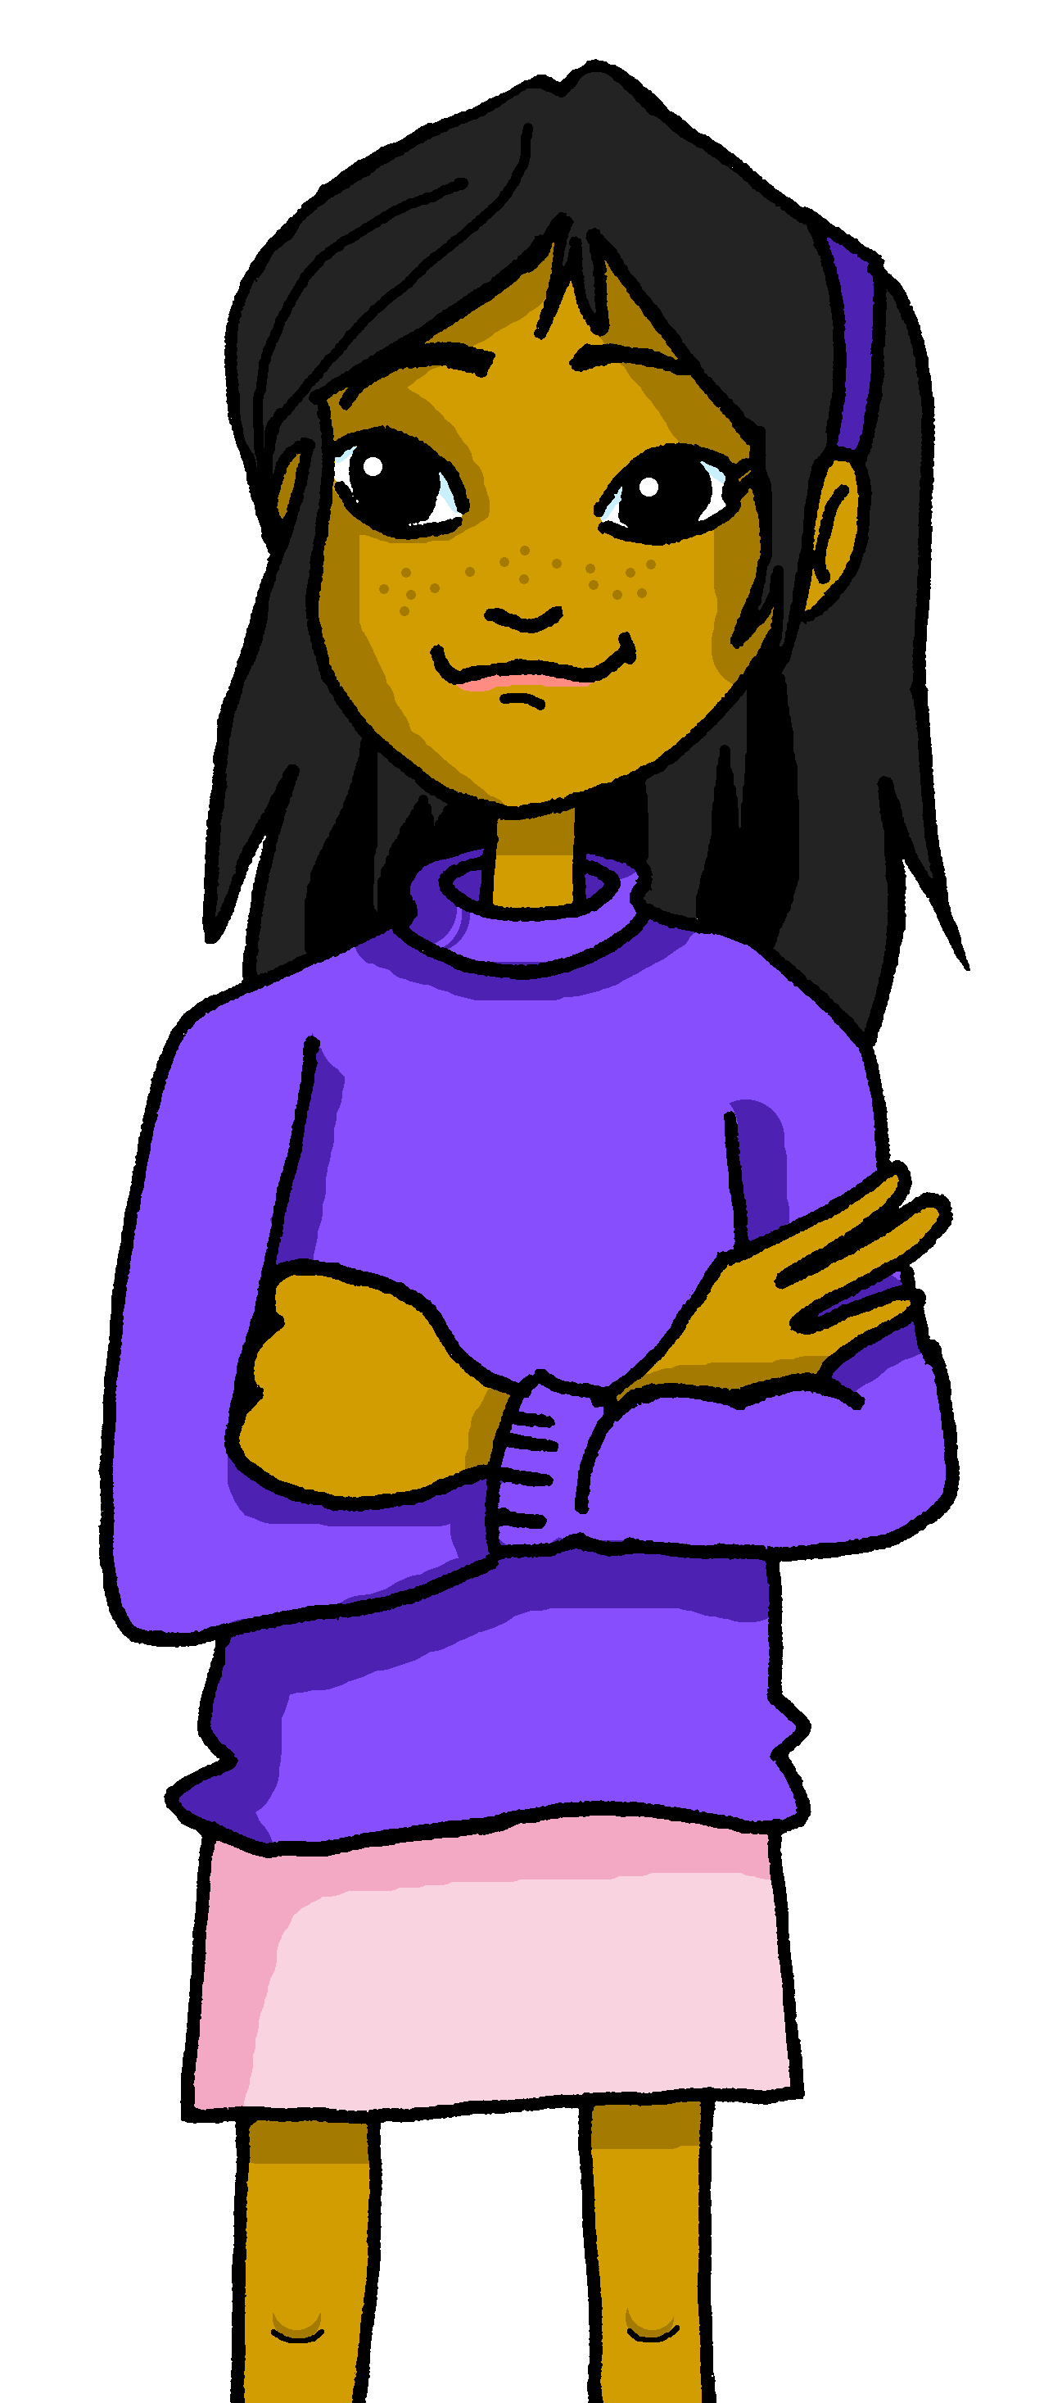
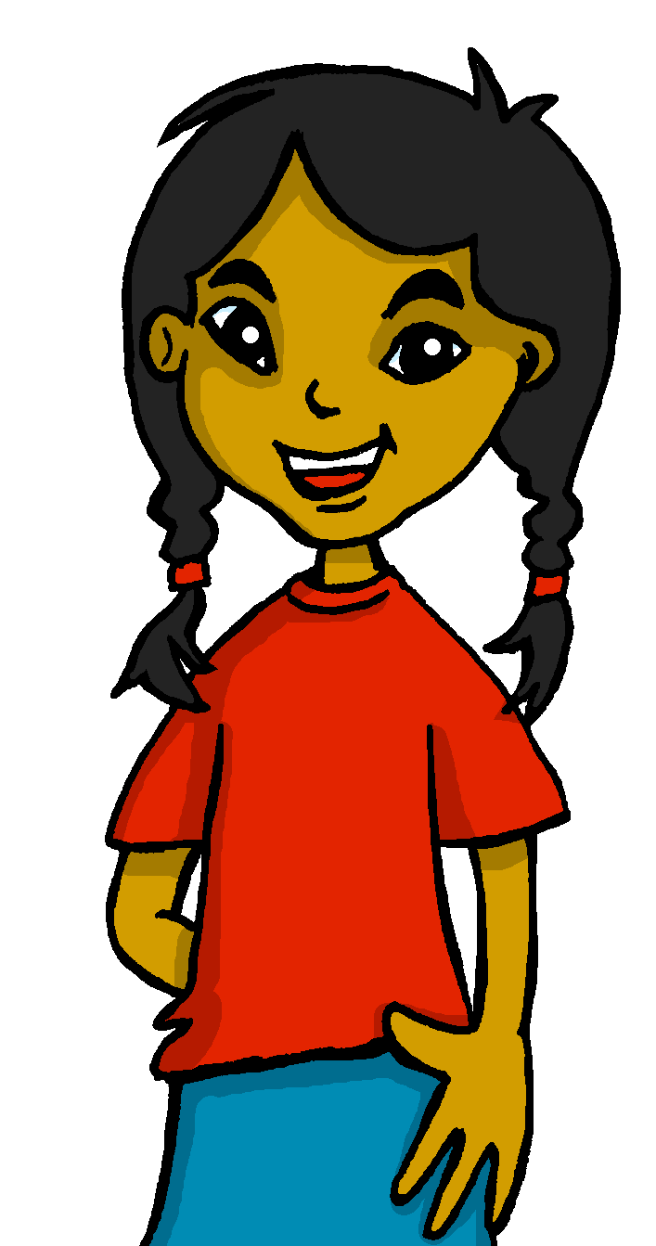
Saying what I and others do
Mi comida
- Infinitives: -er verbs, I, you, s/he
- SSC [que]
amarillo
Notes:
Artwork by Steve Clarke. All additional pictures selected are available under a Creative Commons license, no attribution required.
The frequency rankings for words that occur in this PowerPoint which have been previously introduced in the resources are given in the SOW (excel document) and in the resources that first introduced and formally re-visited those words.
For any other words that occur incidentally in this PowerPoint, frequency rankings will be provided in the notes field wherever possible.
SSC: que [2325]
Vocabulary: comer [347] hacer, hago, hace [26] responder (a) [464] actividad [344] bocadillo [>5000] ejercicio [1162] naranja [2924] ordenador [2624]
Glossed words: escribir [198]
Source: Davies, M. & Davies, K. (2018). A frequency dictionary of Spanish: Core vocabulary for learners (2nd ed.). Routledge: London

Slide 3
[que]
paquete
pronunciar
Notes:
Timing: 1 minute
Aim: to introduce SSC [que]
Procedure:
To elicit the pronunciation of the individual SSC [que]
Click to bring up the picture and get students to repeat (with gesture, if using).
Gesture suggestion : with both hands, draw the shape of a rectangle in 3 moves (top, sides, bottom).

Slide 4
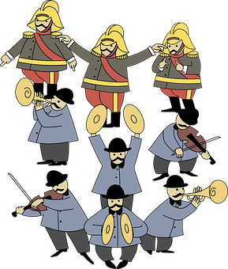
escuchar
Escucha. ¿Es ‘ca’, ‘co’ o ‘que’?
E
1
que
____so
bo___
ca
4
que
ra____ta
2
3
or_____sta
que
____beza
ca
Notes:
Timing: 5 minutes
Aim: to recognise [que] with two previously learnt SSCs: ‘CA’ and ‘CO’. All of these SSCs share the /k/ phoneme.
Procedure:
Read the instruction and do the example [E] with pupils. Pupils to write the correct SSCs [ca], [co] or [que].
Do items1-4.
Go through answers by eliciting the Spanish word from pupils, and click to bring up answers.
Give pupils 1 minute to work in pairs to practise pronunciation.
Transcript:
E queso
1 boca
2 orquesta
3 cabeza
4 raqueta
Frequency of unknown words: boca [465] cabeza [365] orquesta [] queso [3187] raqueta []
Source: Davies, M. & Davies, K. (2018). A frequency dictionary of Spanish: Core vocabulary for learners (2nd ed.). Routledge: London

Slide 5
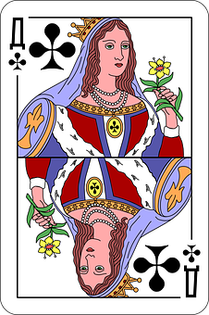
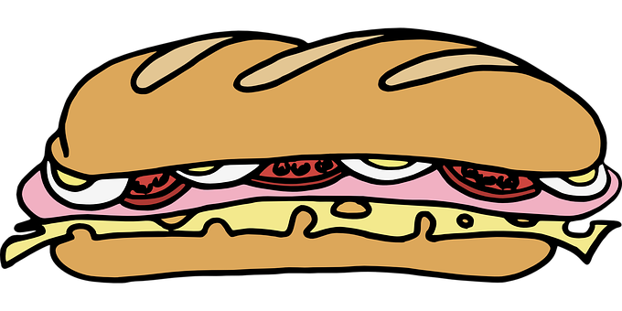
vocabulario
¿Cómo es en español?
exercise
responder a
el ejercicio
activity
la carta
la actividad
la
c_ _ t_
el
_ j _ _ c_ c_ _
la
a_ t_ v _ d _ _
r_ _ p_ _ d_ _ _
to do, make
el ordenador
to eat, eating
computer
message
sandwich
to reply
to do, make
activity
computer
card
activity
orange
hacer
orange
message
exercise
to reply, replying
exercise
to do, make
to eat, eating
card
sandwich
el
o_ d _ _ _ d _ _
h _ _ _ r
comer
el bocadillo
la naranja
el mensaje
c _ m _ _
el b_c_d_ ll_
la n_ r _ _ j _
el m_ _ s_ j _
Notes:
Timing: 5 minutes
Aim: to present and practise written comprehension and read aloud of previously taught vocabulary and new words for this week.
Procedure: 1. Click for an English item. Elicit pronunciation of the Spanish from pupils.
2. Click to cover the Spanish word with a picture.
3. Continue with the remaining items.
4. Optional at this stage: elicit the Spanish from pupils, (Note: the gapped versions of the Spanish appear and then English prompts reappear on each mouse click).

Slide 6
Knowing who does what
⚠ We don’t need pronouns because the verb ending tells us who is doing the action.
[–er verbs: ‘I’ versus ‘you’]
We know to mean ‘I’ and ‘you’ with a verb, the verb ending changes.
To mean ‘I’ with a verb, we remove –er and add -o.
To mean ‘you’ with a verb, we remove –er and add –es.
(to eat)
Ejemplo: comer
I
You
Como un bocadillo.
Comes fruta.
I eat a sandwich.
You eat fruit.
Notes:
Timing: 3 minutes
Aim: to introduce 2nd person singular for –er verbs, building on the 1st person singular (introduced in term 2 week 5).
Procedure:
Click through the animations to present the new information.
Elicit English translations for the Spanish examples provided.

Slide 7
escuchar
Quique habla con Sofía.
[1/6]
Escucha y escribe* 📝A o B.
escribe = write
E
A
→
B
Escucha y escribe el verbo. ¿Qué imagen es correcta?
Aprendo
a
b
c
______________________
Notes:
Timing: 7 minutes [6 slides in total: Slide 1/6]
Aim: to practise aural recognition of 1st and 2nd person of –er verbs (singular)
Procedure:
Read the title and click on each instruction to hear it in Spanish. Pupils need to identify to which person each statement refers to (I / YOU), They can write A or B.
Do the example (E).
Now click once more to bring up part 2. Pupils listen again to the same statement, write down the verb in Spanish and identify the picture that corresponds to the extra information in the sentence.
Click to bring up the written form of the verb and identify the correct letter/picture.
Transcript
E. Aprendo inglés.
Lees una revista.
Como fruta.
Haces un ejercicio.
Comes un bocadillo.
Leo un mensaje de mi amigo.
Frequency of unknown words: escribir [198]
Source: Davies, M. & Davies, K. (2018). A frequency dictionary of Spanish: Core vocabulary for learners (2nd ed.). Routledge: London

Slide 8
escuchar
Quique habla con Sofía.
[2/6]
Escucha y escribe* 📝A o B.
escribe = write
A
→
1
B
Escucha y escribe el verbo. ¿Qué imagen es correcta?
Lees
a
b
c
______________________
Notes:
[2/6]
Transcript
Lees una revista.

Slide 9
escuchar
Quique habla con Sofía.
[3/6]
Escucha y escribe* 📝A o B.
escribe = write
2
A
→
B
Escucha y escribe el verbo. ¿Qué imagen es correcta?
Como
a
b
c
______________________
Notes:
[3/6]
Transcript
2. Como fruta.

Slide 10
escuchar
Quique habla con Sofía.
[4/6]
Escucha y escribe* 📝A o B.
escribe = write
A
→
3
B
Escucha y escribe el verbo. ¿Qué imagen es correcta?
Haces
a
b
c
_______________
Notes:
[4/6]
Transcript
3. Haces un ejercicio.

Slide 11
escuchar
Quique habla con Sofía.
[5/6]
Escucha y escribe* 📝A o B.
escribe = write
A
→
4
B
Escucha y escribe el verbo. ¿Qué imagen es correcta?
Comes
a
b
c
_______________
Notes:
[5/6]
Transcript
4. Comes un bocadillo.

Slide 12
escuchar
Quique habla con Sofía.
[6/6]
Escucha y escribe* 📝A o B.
escribe = write
5
A
→
B
Escucha y escribe el verbo. ¿Qué imagen es correcta?
Leo
a
b
c
_______________
Notes:
[6/6]
Transcript:
5. Leo un mensaje de mi amigo.

Slide 13
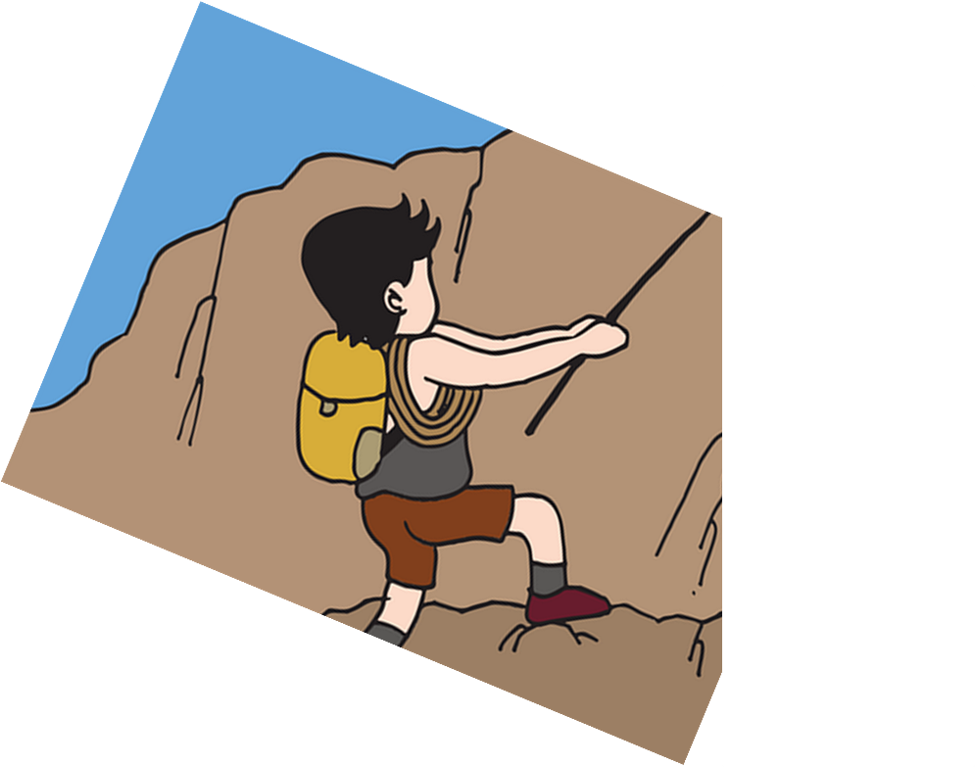
leer
Lee la frase. ¿Qué es en inglés?
[1/6]
(la) frase = phrase, sentence
Como una naranja.
(piece of) fruit
apple
orange
pencil
5
4
the
an
a
3
eat
reply
learn
read
2
I
You
1
Notes:
Timing: 5 minutes [6 slides, 6 items] Slide 1/6
Aim: to practise comprehension of 1st and 2nd person singular of –er verbs, key vocabulary & definite and indefinite articles in reading.
Procedure:
Tell students they need to use the words, starting from the bottom, to climb up the mountain (so that they translate the sentence!).
Ask students to work in pairs to practise first.
Click to trigger the timer (15 seconds per sentence).
Ask a volunteer from a pair to say the Spanish sentence out loud and the English translation.
Click on the purple textbox to hear the Spanish audio.
Repeat with the next 5 sentences (there are 6 in total).
ANSWERS
1. Como una naranja.
2. Aprendes una palabra nueva.
3. Respondo a mi hermana.
4. Haces una actividad.
5. Leo un libro divertido.
6. Respondes a un mensaje en el ordenador.
Frequency of unknown words: frase [1036]
Source: Davies, M. & Davies, K. (2018). A frequency dictionary of Spanish: Core vocabulary for learners (2nd ed.). Routledge: London

Slide 14
leer
Lee la frase. ¿Qué es en inglés?
[2/6]
(la) frase = phrase, sentence
Aprendes una palabra nueva.
book
word
sandwich
message
weird
old
new
incredible
5
4
a
the
an
3
read
learn
do
reply
2
I
You
1
Notes:
[2/6]
Transcript:
Aprendes una palabra nueva.

Slide 15
leer
Lee la frase. ¿Qué es en inglés?
[3/6]
(la) frase = phrase, sentence
Respondo a mi hermana.
message
word
brother
sister
the
a
my
5
4
to
3
do
read
reply
reply
2
You
I
1
Notes:
[3/6]
Transcript:
Respondo a mi hermana.

Slide 16
leer
Lee la frase. ¿Qué es en inglés?
[4/6]
(la) frase = phrase, sentence
Haces una actividad.
bed
drawing
thing
activity
5
4
a
the
an
3
read
learn
do
reply
2
I
You
1
Notes:
[4/6]
Transcript:
Haces una actividad.

Slide 17
leer
Lee la frase. ¿Qué es en inglés?
[5/6]
(la) frase = phrase, sentence
Leo un libro divertido
text
news item
book
magazine
new
fun
old
important
5
4
an
the
a
3
make
do
read
reply
2
You
I
1
Notes:
[5/6]
Transcript:
Leo un libro divertido.

Slide 18
leer
Lee la frase. ¿Qué es en inglés?
[6/6]
(la) frase = phrase, sentence
Respondes a un mensaje en el ordenador.
room
park
computer
a
the
an
5
on
letter
activity
idea
message
4
an
the
a
3
reply to
make
read
learn
2
You
I
1
Notes:
[6/6]
Transcript:
Respondes a un mensaje en el ordenador.

Slide 19
¡adiós!
amarillo

