Slide 1
español, con Quique

Slide 2
Saying what I and others do
Por la tarde
-ar verbs: I vs. S/he
- SSC [ga] [go] [gu]
amarillo
pm
Notes:
Artwork by Steve Clarke. All additional pictures selected are available under a Creative Commons license, no attribution required.
The frequency rankings for words that occur in this PowerPoint which have been previously introduced in the resources are given in the SOW (excel document) and in the resources that first introduced and formally re-visited those words.
For any other words that occur incidentally in this PowerPoint, frequency rankings will be provided in the notes field wherever possible.
SSC: ganar [295] lago [2151] gusano [4217]
Vocabulary: descansar [1749] campo [342] habitación [1069] tarde [392] por² [15]
Revisit 1: buscar [179] crear [239] presentar [235] pronunciar [1990] usar [317] información [326] país [109] importante [171] divertido [2465] interesante [616]
Revisit 2: eres [7] (recycle adjectives) de1 [2] Inglaterra [n/a] España [n/a] Perú [n/a]
Glossed words: mandar [588]
Source: Davies, M. & Davies, K. (2018). A frequency dictionary of Spanish: Core vocabulary for learners (2nd ed.). Routledge: London

Slide 3
[ga]
ganar
pronunciar
[go]
lago
[gu]
gusano
Notes:
Timing: 1 minute
Aim: To revisit SSC [ga] [go] [gu]
Procedure:
To recap and elicit the pronunciation of the individual SSC [ga] [go] [gu]
Click to bring the picture & get students to repeat (with gesture, if using).
Gesture suggestion for ganar: lift your fist up in two goes.
Gesture suggestion for lago: rowing – two movements
Gesture suggestion for gusano: with index finger, lift up and down three times.

Slide 4
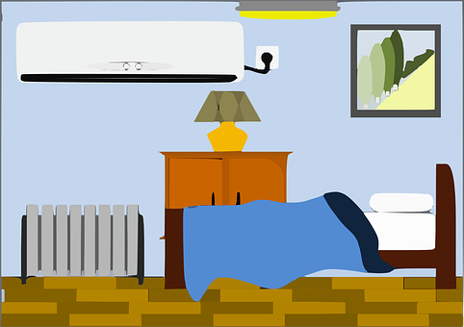
vocabulario
el campo
[countryside]
[to relax, relaxing]
la habitación
descansar
[room]
⚠ Use por for in with times of day: e.g. por la mañana (in the morning)
pm
la tarde
por
[in (times of day) through, around, along]
[afternoon]
Notes:
[1/3]
Timing: 4 minutes
Aim: to introduce new vocabulary.
Procedure 1. Pupils either work by themselves or in pairs, reading out the words and recapping their English meaning (1 minute). 2. Then, in the next slide, students try to recall the English orally (chorally), looking at the Spanish (1 minute). 3. Then, in the following slide, they to recall the Spanish meanings orally (again, chorally), looking at the English (1 minute).
Notes:
Note that images/words won’t disappear and appear in this activity as in previous resources.

Slide 5
vocabulario
c_ _nt_ _s_ d_
countryside
el campo
r_ _ m
la habitación
room
to relax, relaxing
a_ t _ r n _ _ _
t_ r_l_ _, r_l_ x_ _ _
afternoon
la tarde
descansar
in (times of day)
i_ (t_ _ _ _ o_ d_ _)
por
Notes:
[2/3]
Procedure: 1. Students try to recall the English orally (chorally), looking at the Spanish (1 minute). 2. Elicit answers and click to reveal
3. Then, in the following slide, they to recall the Spanish meanings orally (again, chorally), looking at the English (1 minute).

Slide 6
vocabulario
countryside
el campo
_ _ c_ m_ _
la habitación
room
_ _ h_ b_ t_ c_ _ n
to relax, relaxing
descansar
afternoon
la tarde
d_ sc _ _ s _
l_ t_ _ d _
in (times of day)
p_ _
por
Notes:
[2/3]
Procedure: 1. Students recall the Spanish meanings orally (again, chorally), looking at the English (1 minute)
2. Click to reveal the answers.

Slide 7
Knowing who does what
⚠ We don’t need pronouns because the verb ending tells us who is doing the action.
[–ar verbs: ‘I’ versus ‘s/he, it’]
To mean ‘I’ with a verb, we remove –ar and add -o.
To mean ‘you’ with a verb, we remove –ar and add –as.
I
you
Descanso en la habitación.
Descansas en el parque.
I relax in the room.
You relax in the park.
Notes:
Timing: 3 minutes
Aim: to introduce 2nd person singular for –ar verbs.
Procedure:
Click through the animations to present the new information.
Elicit English translations for the Spanish examples provided.

Slide 8
escuchar
Quique habla con Sofía.
¿Qué información comprendes?
Marca ✅❌
¿Quién es?
mi = my
Marca ✅❌
 | Quique (I) | Sofía (you)
object | place | person
En inglés
E
(with) my sister
1
in the countryside
2
(by) bike
3
in the room
information
4
(with) my father
5
(around) the park
Notes:
Timing: 7 minutes
Aim: to practise aural recognition of 1st and 2nd person of –ar verbs (singular); to practise comprehension of vocabulary in short sentences.
Procedure:
Read the title and click to bring up the instructions in Spanish. Pupils need to identify to which person each statement refers to (I / YOU)
Do the example (E).
Click to bring up the answers.
Pupils listen again to understand more information from each sentence. Pupils can either write 1A/B/C, etc.. or if they have the printout they can put an X or tick.
in the correct box. Some pupils can also write the key words in English.
Click to bring up answers (tick and English words) and get pupils to check their answers.
Transcript:
E. Descanso con mi hermana.
Paseo por el campo.
Montas en Bicicleta.
Descansas en la habitación.
Busco Información con mi padre.
Paseas por el parque.
NB. If pupils find part 2 of the task particularly challenging, you could adapt it and make it more accessible by:
Adding pictures and getting pupils to label.
Giving pupils English words and they number / label them.

Slide 9
Multiple meanings of ‘por’
[prepositions]
The preposition por is often used with verbs of movement.
We translate por in different ways in English:
Ejemplo:
Paseo por la ciudad.
Paseo por el campo.
I go for a walk around the city.
I go for a walk in the countryside.
We also use ‘por’ to mean ‘in’ with ‘morning’ and ‘evening’:
Ejemplo:
Visito la iglesia por la mañana.
I visit the church in the morning.
Notes:
Timing: 2 minutes
Aim: to introduce two key prepositions en & por.
Procedure:
Click to bring up the explanation.
Elicit English for the Spanish examples.

Slide 10
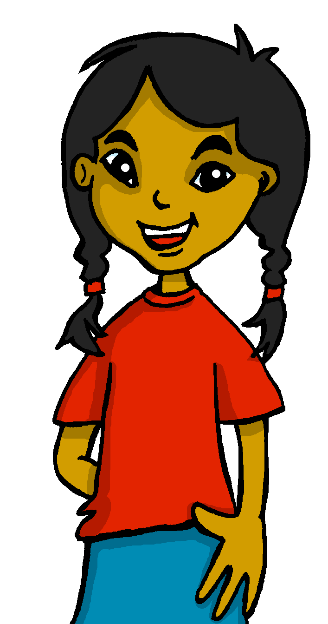
leer
Quique y Sofía mandan* mensajes.
||/\
/||||
/||/\
/||/
Lee ¿Qué es en inglés?
escuchar
Quique
Escucha: ¿’en’ o ‘por’?
E
Visitas la iglesia por la tarde.
||/\
/||/\
/|||
||/\
Sofía
 | in | around
1
Montas en bici por
la ciudad.
2
Presento información
en clase.
E
Quique
||/\
/||/\
/|||
||/\
3
||/\
/||/\
/|||
|/|||\
Sofía
1
Descanso en mi habitción.
4
Quique
||/\
2
/||/\
/|||
|/|||\
Usas la bici en el parque.
5
||/\
Sofía
3
/||/\
/|||
|/|||\
Paseas por el campo.
4
6
Quique
||/\
/||/\
/|||
|/|||\
Descansas por la tarde.
5
mandan = they send
mi = my
6
Notes:
Timing: 8 minutes (2 slides)
Aim: to practise written comprehension of t 1st & 3rd person singular verb endings with a range of regular –ar verbs; multiple translation of ‘por’
Procedure:
Read the title & click to explain the context of the task. Pupils to listen and annotate whether it’s ‘en’ or ‘por’ (NB. Some pupils could attempt this task prior to listening. Note that both ‘en’ and ‘por’ could work for #4.
Click through the animations to bring up answers.
Pupils to read the sentences aloud again and the decide the correct translation of ‘en’ and ‘por’. (next task focuses on comprehension at sentence level, including the person of the verb).
Move to slide 2.
Transcript: Visitas la iglesia por la tarde.
Montas en bici por la ciudad.
Presento información en clase.
Descanso en mi habitción.
Usas la bici en el parque.
Paseas por el campo.
Descansas por la tarde.
mandar [588]

Slide 11
leer
Escribe las frases en inglés .
escuchar
Quique
E
Visitas la iglesia por la tarde.
 | ____ visit the church __ the __________.
 | ____ _____ your bike _______ the city.
 | ___ present ___________ in class.
 | ____ relax _____ my __________.
 | __ _____ ____ ______ ________ the park.
 | ___ __ __ _ ____ __ the countryside.
 | ___ ________ _____ ____ _____________.
1
Sofía
E
You
in
afternoon
Montas en bici por
la ciudad.
2
Presento información
en clase.
ride
Quique
1
You
around
3
Sofía
Descanso en mi habitción.
⚠ In English we say ‘your’ but Spanish uses the definite article ‘the’
2
I
information
4
Quique
Usas la bici en el parque.
3
I
in
room
5
Sofía
Paseas por el campo.
4
You use
your
in/around
bike
6
Quique
You
go
for
a
in
Descansas por la tarde.
5
walk
relax
in
You
afternoon
6
the
Notes:
Aim: to practise written comprehension of t 1st & 3rd person singular verb endings with a range of regular –ar verbs; multiple translation of ‘por’
Procedure:
(slide 2). Read the instruction (traduce las frases al inglés).
Pupils to complete the translation task.
Click through the animations to bring up answers.
Click the audio buttons to listen again, if desired.
Optional extension: 1. Click again to remove the Spanish texts.
2. Elicit Spanish sentences from pupils from the English prompts.
3. Click the audio buttons to listen and check, if required.

Slide 12
hablar
¡Habla! Lee la frase en español
[1/4]
You do not need all of the words!
You use a word in class.
15
Usas una palabra en clase.
S
uso
un
una
en
por
usas
palabra
mensaje
clase
0
INICIO
Notes:
Time: 5 minutes
(Slide 1/4)
Aim: to practise oral sentence building. Targeted features: 1st & 2nd person singular; prepositions Procedure:
1. Click for English sentence and Spanish prompt words. 2. Click inicio to start the timer.
3. Pupils select from the words given to create and say the sentence out loud before the time elapses. 4. Click for the Spanish sentence to appear.

Slide 13
hablar
¡Habla! Lee la frase en español
[2/4]
You do not need all of the words!
I go for a walk in (around) the countryside.
15
Paseo por el campo.
S
por
el
paseo
en
por
paseas
un
campo
ciudad
0
INICIO
Notes:
Time: 5 minutes
(Slide 2/4)

Slide 14
hablar
¡Habla! Lee la frase en español
[3/4]
You do not need all of the words!
You search for a book in the afternoon.
15
Buscas un libro por la tarde.
S
por
libro
la
tarde
en
buscas
un
busco
el
0
INICIO
Notes:
Time: 5 minutes
(Slide 2/4)

Slide 15
hablar
¡Habla! Lee la frase en español
[4/4]
You do not need all of the words!
I relax in the park with my father in the afternoon.
15
Descanso en el parque con mi padre por la tarde.
S
mi
descanso
la
padre
descansas
en
por
con
parque
tarde
el
una
0
INICIO
Notes:
Time: 5 minutes
(Slide 2/4)

Slide 16
¡adiós!
amarillo

