Slide 1
Saying what I and others do
amarillo
Follow ups 1-5
Notes:
Artwork by Steve Clarke. All additional pictures selected are available under a Creative Commons license, no attribution required.
The frequency rankings for words that occur in this PowerPoint which have been previously introduced in the resources are given in the SOW (excel document) and in the resources that first introduced and formally re-visited those words.
For any other words that occur incidentally in this PowerPoint, frequency rankings will be provided in the notes field wherever possible.
SSC: l source: libro [230] ll source: llamar [122]
Vocabulary: visitar [792] iglesia [437] mamá [675] museo [1114] papá [865] parque [1354] plaza [806] con [14] Revisit 1: tienes [19] hoja [916] idea [247] lápiz [3740] mensaje [847] palabra [192] regla [1380] Revisit 2: feliz [908] imposible [1418] increíble [1642] ¿dónde? [161]
Glossed: sobre [62] viaje [519] trabajo [152] solo [181] inglés [583] voz [252] leer [209] grabar [1560]
Source: Davies, M. & Davies, K. (2018). A frequency dictionary of Spanish: Core vocabulary for learners (2nd ed.). Routledge: London

Slide 2
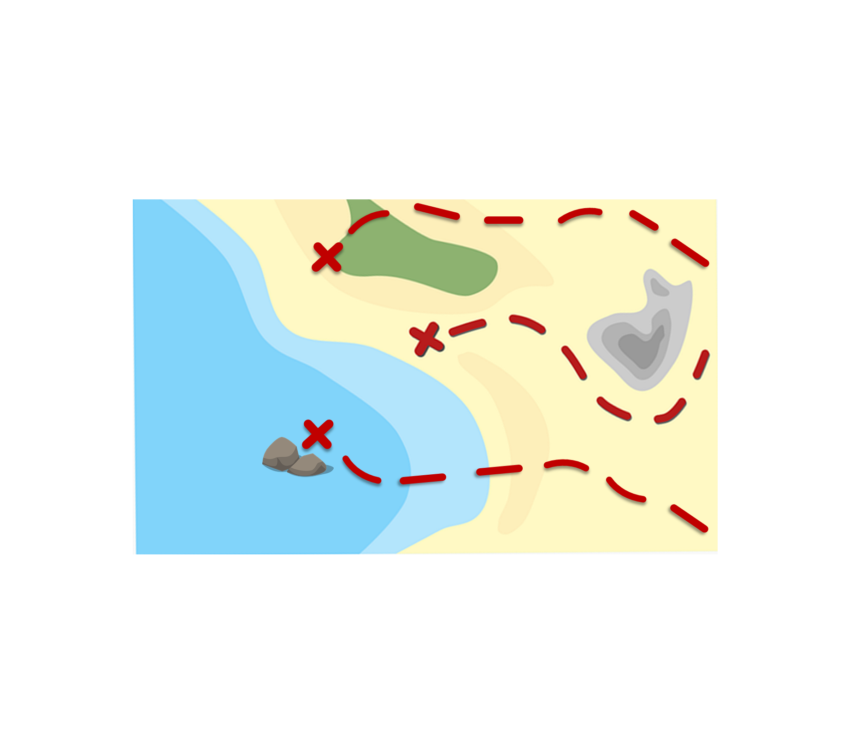
Follow up 1:
[l] libro
La ruta de las monedas
[ll] llamar
Pronuncia las palabras y colecciona monedas.
Turno 1: Persona A
Turno 2: Persona B
libro
lobo
collar
60
grillo
llamar
amarillo
medalla
color
ballena
camello
lavar
llave
llave
calle
loro
llover
0
sol
pollo
INICIO
Notes:
Timing: 5 minutes
Aim: To practise the pronunciation of Spanish words with the SSC [l] and [ll].
Procedure:
Pupils work in pairs to practise pronunciation. They can choose where to start and have one minute to collect as many coins as possible.
Divide the class in A & B and click to indicate it’s ‘persona A’’s turn.
Pupil A starts from either ‘Amarillo, ‘camello’ or ‘pollo’, and follows the path to pronounce the words and collect the corresponding coins.
Click to bring up Persona B’s turn.

Slide 3
Follow up 2:
Knowing who does what
⚠ We don’t need pronouns because the verb ending tells us who is doing the action.
[–ar verbs: ‘I’ versus ‘s/he, it’]
In Spanish, the words for ‘I’ and ‘s/he’ (pronouns) are often unnecessary.
To mean ‘I’ with a verb, we remove –ar and add -o.
To mean ‘s/he, it’ with a verb, we remove –ar and add –a.
Ejemplo: buscar
I
s/he, it
Busco un museo.
Busca una plaza.
I search for a museum.
S/he searches for a museum.
Notes:
Timing: 8 minutes (two slides)
Aim: to recap 1st and 3rd person singular forms of –ar verbs.
Procedure:
Click through the animations to present the new information.
Elicit English translations for the Spanish examples provided.

Slide 4
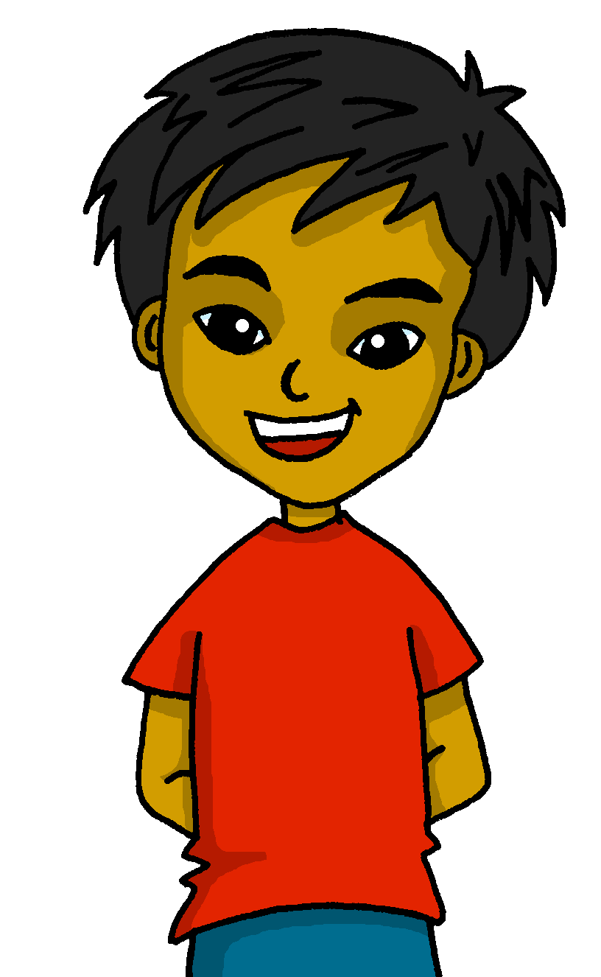
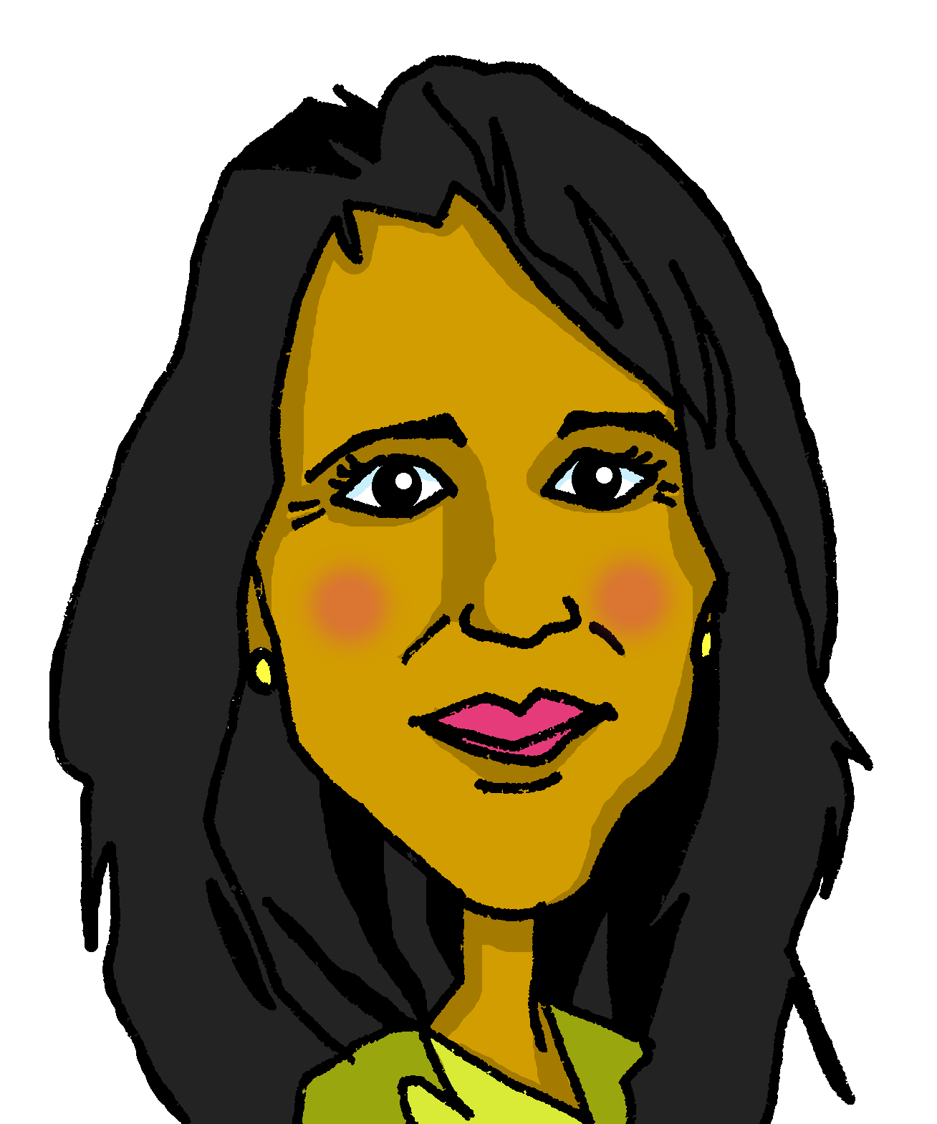
Follow up 2:
Lee las frases.
Quique escribe 📝 sobre* el fin de semana. Mamá Elena está de viaje* con el trabajo*.
Marca ✅la opción correcta
¿Es divertido, importante, interesante o raro?
leer
Quique (I) | Elena (she)
solo = only
inglés = English
sobre = about
viaje = trip
trabajo = work
Busco un libro en el parque.
Presenta información.
Uso mi barco en el parque.
Visito una plaza nueva.
Usa solo* inglés.
Visita un museo importante.
Busca ideas en un libro.
1
[R]
2
[Im]
3
[R]
4
[In]
5
[R]
Es…
6
[In/D]
7
[In]
¡No! Es..
Notes:
Aim: to practise written comprehension of 1st and 3rd persons singular of –AR verbs and vocabulary from this week.
Timing: 8 minutes
Procedure:
Read the instructions in Spanish. Clarify meaning.
Model the task using the first item.
Pupils decide which each of the sentences refers to (Quique talking about himself (I) or about his mum, Elena (she).
Click to correct the answers. If desired, click the green buttons to hear the sentence audio.
Click again to bring up a supplementary comprehension task. The aim of the activity is to prompt pupils to think about the meaning of the sentences. Pupils read the sentences again and decide what they think about each task / activity.
Click to bring up some possible answers. These are not definitive and pupils may want to suggest differently!
sobre [62] viaje [519] trabajo [152] solo [181] inglés [583]

Slide 5
Follow up 3:
Escucha y escribe 📝.
[1/5]
escuchar y escribir
1. _____ un animal con papel.
Crea
I
s/he
3
2
1
¡escribe!
Notes:
[1/5] Timing: 5 minutes (5 slides)
Aim: to practise aural comprehension of this week’s new language, connecting sound with meaning.
Procedure:
Click to play the audio.
Click to count down 3 -2 – 1. When the word ‘escribe’ appears bottom right, pupils can try to write the missing verb.
Note: pupils can be challenged to write the full sentence from memory by turning away from the board.
Click to reveal the missing verb.
Click again to bring up two pronoun options.
Elicit the answer from pupils and click to reveal the answer tick.
Transcript:
Crea un animal con papel.

Slide 6
Follow up 3:
Escucha y escribe 📝.
[2/5]
escuchar y escribir
1. _____ una plaza importante.
Visito
I
s/he
3
2
1
¡escribe!
Notes:
[2/5] Timing: 5 minutes (5 slides)
Aim: to practise aural comprehension of this week’s new language, connecting sound with meaning.
Procedure:
Click to play the audio.
Click to count down 3 -2 – 1. When the word ‘escribe’ appears bottom right, pupils can try to write the missing verb.
Note: pupils can be challenged to write the full sentence from memory by turning away from the board.
Click to reveal the missing verb.
Click again to bring up two pronoun options.
Elicit the answer from pupils and click to reveal the answer tick.
Transcript:
Visito una plaza importante.

Slide 7
Follow up 3:
Escucha y escribe 📝.
[3/5]
escuchar y escribir
1. _____ una cosa en mi bolsa.
Busco
I
s/he
3
2
1
¡escribe!
Notes:
[3/5] Timing: 5 minutes (5 slides)
Aim: to practise aural comprehension of this week’s new language, connecting sound with meaning.
Procedure:
Click to play the audio.
Click to count down 3 -2 – 1. When the word ‘escribe’ appears bottom right, pupils can try to write the missing verb.
Note: pupils can be challenged to write the full sentence from memory by turning away from the board.
Click to reveal the missing verb.
Click again to bring up two pronoun options.
Elicit the answer from pupils and click to reveal the answer tick.
Transcript:
Busco una cosa en mi bolsa.

Slide 8
Follow up 3:
Escucha y escribe 📝.
[4/5]
escuchar y escribir
1. ____ una palabra nueva.
Usa
I
s/he
3
2
1
¡escribe!
Notes:
[4/5] Timing: 5 minutes (5 slides)
Aim: to practise aural comprehension of this week’s new language, connecting sound with meaning.
Procedure:
Click to play the audio.
Click to count down 3 -2 – 1. When the word ‘escribe’ appears bottom right, pupils can try to write the missing verb.
Note: pupils can be challenged to write the full sentence from memory by turning away from the board.
Click to reveal the missing verb.
Click again to bring up two pronoun options.
Elicit the answer from pupils and click to reveal the answer tick.
Transcript:
Usa una palabra nueva.

Slide 9
Follow up 3:
Escucha y escribe 📝.
[5/5]
escuchar y escribir
1. ________ información interesante.
Presenta
I
s/he
3
2
1
¡escribe!
Notes:
[5/5] Timing: 5 minutes (5 slides)
Aim: to practise aural comprehension of this week’s new language, connecting sound with meaning.
Procedure:
Click to play the audio.
Click to count down 3 -2 – 1. When the word ‘escribe’ appears bottom right, pupils can try to write the missing verb.
Note: pupils can be challenged to write the full sentence from memory by turning away from the board.
Click to reveal the missing verb.
Click again to bring up two pronoun options.
Elicit the answer from pupils and click to reveal the answer tick.
Transcript:
Presenta información interesante.

Slide 10
Follow up 4:
Quique no tiene voz* [1/5]
Lee y graba* la frase. ¡Usa las palabras!
leer
hablar
Quique has lost his voice but wants to send a voice message to mum while she’s away, saying what he does at the weekend, but also what Sofía does. Can you help him?
¡No tengo voz!
¡Ojo! ⚠ Una palabra es extra.
⚠ Remember: adjectives usually come after the noun.
20
1. I visit a fun park.
visito
divertido
un
visita
parque
mamá
?
Visito
un
parque
divertido.
Quique
(la) voz = voice
lee = read
graba = record
0
INICIO
Notes:
Timing: 5 mins [5 slides in total] [1/5]
Aim: to practise scaffolded spoken production of this week’s key language.
Procedure:
Teacher reads the title of the task and elicits English translation from students.
Click to bring up Spanish instructions and read out loud. Ensure that meanings are clear.
Click to start the timer.
Pupils work in pairs to translate orally and say the sentence aloud in Spanish within the five-second time limit.
Elicit answers from students (either chorally or from individuals).
Click on the blue speaker icon on the phone to bring up the answer.
voz [252] leer [209] grabar [1560]

Slide 11
Follow up 4:
Quique no tiene voz* [2/5]
Lee y graba* la frase. ¡Usa las palabras!
leer
hablar
¡Ojo! ⚠ Dos palabras extra.
¡No tengo voz!
20
2. She uses a weird instrument.
una
instrumento
un
uso
usa
raro
mamá
?
Usa
un
instrumento
raro.
Quique
⚠ Remember: adjectives come after the noun.
(la) voz = voice
lee = read
graba = record
0
INICIO
Notes:
[2/5]

Slide 12
Follow up 4:
Quique no tiene voz* [3/5]
Lee y graba* la frase. ¡Usa las palabras!
leer
hablar
¡Ojo! ⚠ Una palabra extra.
¡No tengo voz!
60
3. I create a drawing on paper.
una
dibujo
en
creo
crea
papel
mamá
?
Creo
un
dibujo
en papel.
Quique
(la) voz = voice
lee = read
graba = record
0
INICIO
Notes:
[3/5]

Slide 13
Follow up 4:
¡No tengo voz!
Quique no tiene voz* [4/5]
Lee y graba* la frase. ¡Usa las palabras!
leer
hablar
¡Ojo! ⚠ Dos palabras extra.
⚠ and they agree (match) the noun they are describing.
60
4. I visit an old park.
un
visito
viejo
vieja
parque
mamá
?
Visito
un
parque
viejo.
Quique
⚠ Remember: adjectives come after the noun.
(la) voz = voice
lee = read
graba = record
0
INICIO
Notes:
[4/5]

Slide 14
Follow up 4:
¡No tengo voz!
Quique no tiene voz* [5/5]
Lee y graba* la frase. ¡Usa las palabras!
leer
hablar
¡Ojo! ⚠ Dos palabras extra.
⚠ and they agree (match) the noun they are describing.
60
5. She searches for a new plant.
busca
busco
nuevo
planta
una
nueva
mamá
?
Busca
una
planta
nueva.
Quique
⚠ Remember: adjectives come after the noun.
(la) voz = voice
lee = read
graba = record
0
INICIO
Notes:
[5/5]

Slide 15
Follow up 5:
Escribe 5 frases en español.
información
una iglesia
un museo
un parque
una plaza
una palabra
una idea
una hoja
un mensaje
un instrumento
una cosa
una planta
un libro
una regla
escribir
[I search] [S/he searches] [I create] [S/he creates] [I present] [S/he presents] [I use] S/he uses] [I visit] [S/he visits]
Notes:
Timing: 8 minutes
Aim: to practise written production of new 1st and 3rd person verb forms and written comprehension of previously taught vocabulary.
Procedure: 1. Pupils write five sentences using five different verb forms, translating from English into Spanish, and then selecting appropriate sentence endings from the Spanish items in the yellow box on the right. 2. Pupils read each other their sentences and the listening partners interprets into English.

Slide 16
Follow up extra:
Escribe en español: Can you get at least 15 points?
 | important | where? | impossible
 | a ruler | incredible | happy
 | a sheet, leaf | a pencil | an idea
 | you have | a message | a word
 | to visit | a church | a museum
 | a park | a square | with
vocabulario
vocabulario
importante
¿dónde?
imposible
x3
una regla
increíble
feliz
una hoja
un lápiz
una idea
x2
tienes
un mensaje
una palabra
visitar
una iglesia
un museo
x1
un parque
una plaza
con
Notes:
Timing: 6 minutes
Aim: to practise written production of vocabulary for this week and previous weeks.
Procedure:
1. Pupils need to write the Spanish for as many words as possible, aiming to get at least 15 points (but more if possible).
2. Click for Spanish answers.

Slide 17
Handout: Follow up extra:
Follow up extra:
Escribe en español: Can you get at least 15 points?
 | happy | where? | impossible
 | a ruler | incredible | happy
 | a sheet, leaf | a pencil | an idea
 | you have | a message | a word
 | to visit | a church | un museum
 | a park | a square | with
vocabulario
vocabulario
x3
x2
x1
Notes:
Timing: 6 minutes
Aim: to practise written production of vocabulary for this week and previous weeks.
Procedure:
1. Pupils need to write the Spanish for as many words as possible, aiming to get at least 15 points (but more if possible).
2. Click for Spanish answers.

