Slide 1
español, con Quique

Slide 2
Saying what I and others do
amarillo
- Infinitives: -ar verbs
- SSC [l]
Notes:
Artwork by Steve Clarke. All additional pictures selected are available under a Creative Commons license, no attribution required.
The frequency rankings for words that occur in this PowerPoint which have been previously introduced in the resources are given in the SOW (excel document) and in the resources that first introduced and formally re-visited those words.
For any other words that occur incidentally in this PowerPoint, frequency rankings will be provided in the notes field wherever possible.
SSC: libro [1477]
Vocabulary: buscar [179] crear [239] presentar [235] usar [317] información [326] país [109] importante [171] divertido [2465] interesante [616]
Revisit 1: tiene [19] dibujo [1726] hermano [333] hermana [3409] mesa [525] perro [888] profesor, profesora [501] puerta [274]
Revisit 2: clase [320] [en clase] cómodo [2237] pesado [2166] positivo [1188] ahora [81]
Glossed words: peligro [1170] abierto [654]
Source: Davies, M. & Davies, K. (2018). A frequency dictionary of Spanish: Core vocabulary for learners (2nd ed.). Routledge: London

Slide 3
pronunciar
[l]
libro
Notes:
Timing: 1 minute
Aim: To introduce SSC [l]
Procedure:
Introduce and elicit the pronunciation of the individual SSC [l] and then the source word ‘libro’ (with gesture, if using).
Click to bring the picture & get students to repeat (with gesture, if using).
Gesture suggestion: use two hands to pretend to open a book

Slide 4
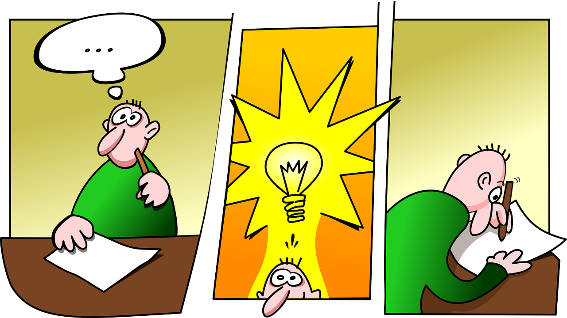
vocabulario
Vocabulario
buscar
presentar
[to present, presenting]
[to look for, looking for]
[to use, using]
crear
usar
[to create, creating]
Notes:
Timing: 3 minutes (one slide)
Aim: to introduce key vocabulary for the of Spanish club (a range of infinitive verbs)
Procedure: 1. Pupils either work in pairs, reading the Spanish words out loud and looking at the English meanings (1 minute). 2. Then the teacher removes the English words or pictures (one by one) and pupils try to recall the English orally (chorally), looking at the Spanish (1 minute). 3. Then the Spanish meanings are removed (one by one) and pupils try to recall them orally (again, chorally), looking at the English (1 minute) 4. Further rounds of learning can be facilitated by one pupil turning away from the board, and his/her partner asking him/her the meanings (‘Cómo se dice X en español?’). This activity can work from L2 → L1 or L1 → L2.

Slide 5
vocabulario
Vocabulario
importante
interesante
un país
presentar
información
usar
buscar
divertido
to use, using
to look for, looking for
fun
to present, presenting
a country
information
important
interesting
Notes:
Timing: 3 minutes
Aim: to revisit infinitive verbs, introduce nouns & adjectives
Procedure: 1. Elicit pronunciation from pupils for the Spanish words
2. Click for an English prompt.
3. Elicit the Spanish word from pupils. 4. Continue until all 8 items have been seen and heard.

Slide 6
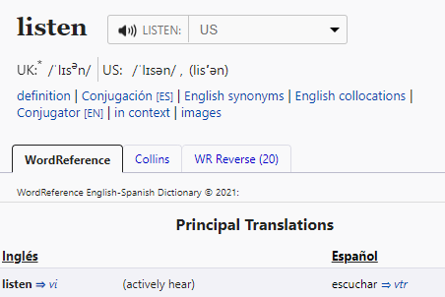
Infinitives: -ar verbs
The infinitive form of a verb is the form you see in a dictionary.
[to ______]
The infinitive often describes the general meaning of the verb.
In English, this is often written ‘to + verb’.
Ejemplo
Es interesante buscar información.
It’s interesting to look for information.
You can also begin a sentence with the infinitive:
In this case, the Spanish infinitive is translate with the –ing form of the verb.
Ejemplo
Buscar información es interesante.
Looking for information is interesting.
Notes:
Timing: 3 minutes
Aim: to introduce the notion of infinitive verbs with –ar verbs.
Procedure:
Click through the animations to present the new information.
Elicit English translations for the Spanish examples provided.
https://www.wordreference.com/es/translation.asp?tranword=listen

Slide 7
escuchar
En el club de español
Escucha las instrucciones del señor Valero.
¿Dónde está el infinitivo?
Escucha otra vez y escribe.
Marca
at the beginning | at the end
infinitivo en español
adjetivo en inglés
E
usar
important
1
buscar
interesting
2
presentar
fun
3
usar
important
4
buscar
incredible
5
crear
fun
Notes:
Timing: 7 minutes
Aim: to practice aural recognition of the infinitive verbs and the two position in a sentence.
Procedure:
Read the context and click to bring up further instruction.
Pupils write 1-5 in their books
Click to listen to the example. Pupils tick whether they can hear the infinitive verb at the beginning of the sentence, or at the end.
Do the example with them. Play once and focus their attention to the –ar ending.
Play 1-5.
Go through answers for 1-5 part 1 (identifying the position of the infinitive)
Click to bring part 2 of the task (listening out for infinitive)
Pupils to listen one more time and write down the infinitive – most able pupils can also write the adjective in English.
Transcript:
Ej. Es importante usar español.
Buscar información es interesante.
Es divertido presentar vocabulario.
Usar un cuaderno es importante.
Es increíble buscar información de un país.
Es divertido crear un dibujo.

Slide 8
leer
Quique escribe.
After a term attending the Spanish club, Quique writes.
E
Es interesante buscar información de España.
Completa las frases ✍.
to
look for
[E] It is interesting ____ _________ information about Spain.
[1] _____________ a drawing is fun.
[2] It is important ____ _____ Spanish.
[3] _____________ information in class is _____________.
[4] ____________ a word is important.
[5] It is _____________ to present a Spanish animal.
1
Crear un dibujo es divertido.
Creating
2
Es importante usar español.
to
use
Presentar información en clase es divertido.
3
Presenting
fun
4
Buscar una palabra es importante.
Looking for
interesting
5
Es intersante presentar un animal español.
Notes:
Timing: 7 minutes
Aim: to practise written comprehension of key adjectives and –ar verbs, including both possible translation into English (to __ / ing)
Procedure:
Read the title & click to explain the context of the task (Sofía reflects on what she’s learned in lessons).
Click to bring further instructions in Spanish (complete las frases en español).
Do [E] with them to model the task. Remind students about the translation of the infinitive form of the verb in Spanish.
Students complete 1-5.
Click through the animations to bring up answers.
Ej. Es interesante buscar información de España.
Crear un dibujo es divertido.
Es importante usar español.
Presentar información en clase es divertido.
Buscar una palabra es importante.
Es intersante presentar un animal español.

Slide 9
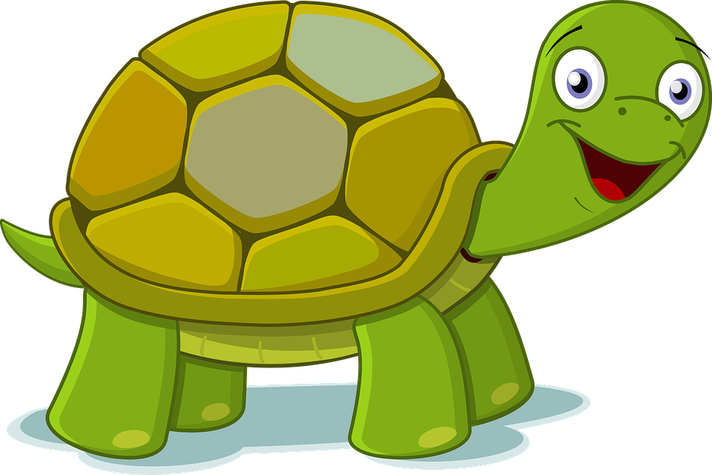
hablar
En el club de español
Una puerta está abierta: ¡Irene está en peligro! [1/6]
leer
Read the sentence aloud with your partner before Irene gets to the door.
Lee en español 📢 [1/6].
Es importante [to use] español en clase.
usar
buscar
crear
abierto = open/opened
peligro = danger
Notes:
Timing: 5 mins [5 slides in total] [1/6]
Aim: to use infinitive verbs with ‘es’ in guided oral production; to develop awareness of the translation of the gerund and infinitive forms into Spanish (infinitive verbs).
Procedure:
Teacher reads the title of the and elicits English translation from students.
Click to bring up Spanish instruction and read out loud.
Pupils work in pairs to say the sentence aloud in Spanish. Encourage most able to translate it too.
Once Irene disappears, the infinitive is removed from the board & 3 options are provided.
Elicit answers from students.

Slide 10
hablar
Lee en español 📢 [2/6].
leer
Es divertido [to look for] information.
usar
buscar
presentar
Notes:
[2/6]

Slide 11
hablar
Lee en español 📢 [3/6].
leer
Es divertido [to look for] vocabulario nuevo.
usar
crear
buscar
Notes:
[3/6]

Slide 12
hablar
Lee en español 📢 [4/6].
leer
[Presenting] información de España es divertido.
usar
presentar
buscar
Notes:
[4/6]

Slide 13
hablar
Lee en español 📢 [5/6].
leer
[Looking for] información de un país es increíble.
crear
presentar
buscar
Notes:
[5/6]

Slide 14
hablar
Lee en español 📢 [6/6].
leer
[Creating] un dibujo animado* es divertido.
presentar
crear
buscar
el dibujo animado - cartoon
Notes:
[6/6]

Slide 15
¡adiós!
amarillo

