Slide 1
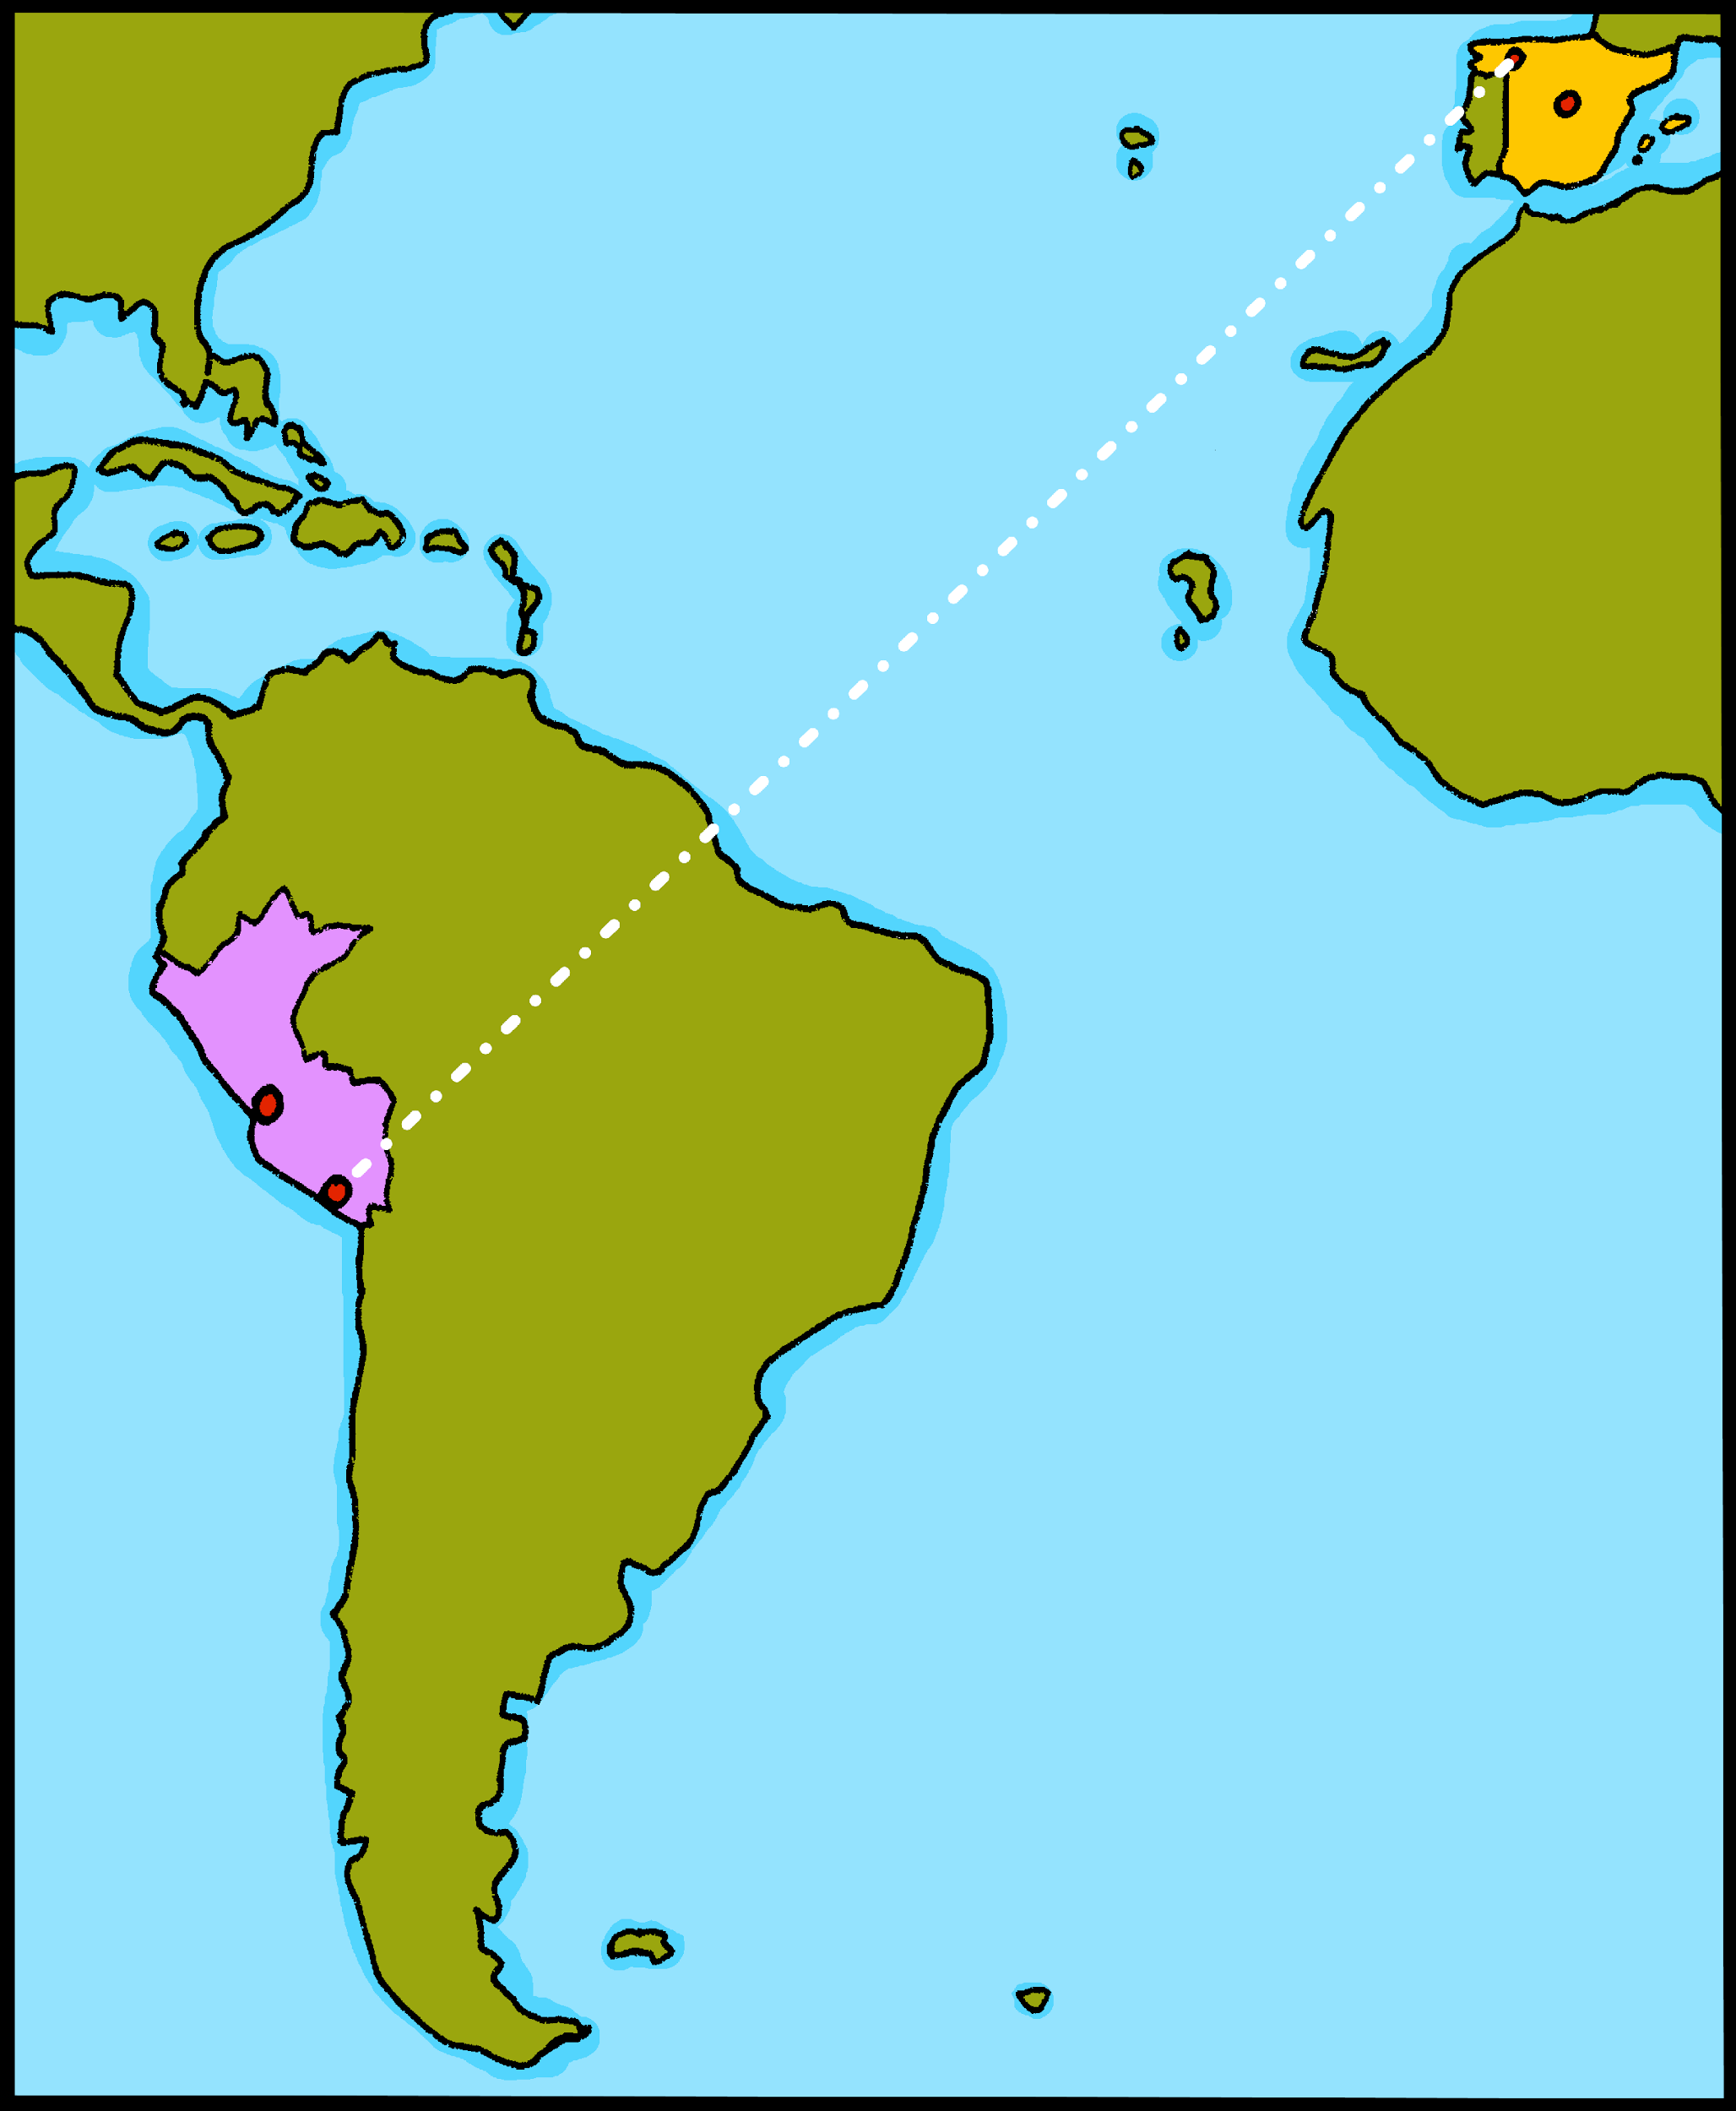
¡hola!

Slide 2
Describing me and others
amarillo
Revisit ‘estar’
Adjective agreement (o → a ; -e & -z).
SSC [a] [o] [u]
Notes:
Artwork by Steve Clarke. Pronoun pictures from NCELP (www.ncelp.org). All additional pictures selected from Pixabay and are available under a Creative Commons license, no attribution required.
Frequency of new vocabulary:
feliz [908] imposible [1418] increíble [1642] ¿dónde? [161]+ revisiting week 2-4 adjectives
Source: Davies, M. and Davies, K. (2018). A frequency dictionary of Spanish: Core vocabulary for learners (2nd ed.). Routledge: London
The frequency rankings for words that occur in this PowerPoint which have been previously introduced in these resources are given in the SOW and in the resources that first introduced and formally re-visited those words.
For any other words that occur incidentally in this PowerPoint, frequency rankings will be provided in the notes field wherever possible.
Source: Davies, M. & Davies, K. (2018). A frequency dictionary of Spanish: Core vocabulary for learners (2nd ed.). Routledge: London

Slide 3
[o]
dos
pronunciar
[a]
casa
universo
[u]
Notes:
Timing: 2 minutes
Aim: To practise SSC [a] [o] [u].
Procedure:
Click to trigger [o] and get students to repeat – this is also a great opportunity to check whether they remember the source word.
Click to trigger the word [dos] and source word & get students to repeat.
Repeat the process with [a] and [u].
Once all the source words are on display, click to trigger first picture [casa] – ask students to pronounce the word that matches the picture. Repeat 2 more times to go through all the source words.
For further practice, students work in pairs. One student uses a gesture, the partners elicits the source word.

Slide 4
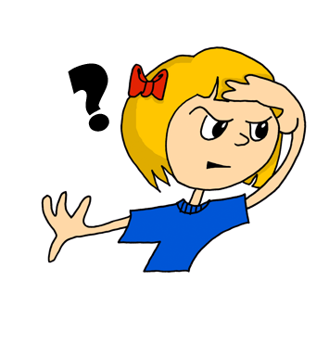
¿dónde?
pronunciar
where?
¿Dónde está?
[Where is s/he, it?]
Rachel Hawkes / Emma Marsden
Notes:
Timing: 2 minutes
Aim: To present question word ¿dónde?
Procedure:
Pupils listen and repeat the key question word (include gesture if possible)
Display the word and get them to repeat one more time.
Elicit English meaning.
Reveal the sentence.
Note: more practice of understanding and responding to dónde can be done in class, with the teacher asking ‘Dónde está (Jack)?’ and students pointing ‘Allí’, and then the teacher can contrast two questions – Cómo está and Dónde está so that pupils need to focus on the difference in meaning between the two, and respond appropriately, using suitable adjectives and adverbs.

Slide 5
hablar
Pregunta a tu compañero en español: Where is (Paolo)? He is in (Peru).
Paolo
Mariana
Salome
Lucas
60
[Perú]
[Ecuador]
[Colombia]
[España]
Nicolas
Nuria
Paula
Carolina
S
[Colombia]
[España]
[Ecuador]
[Perú]
Bruno
Eduardo
Samuel
Mario
0
[España]
[Perú]
[Colombia]
[Ecuador]
INICIO
Notes:
Timing: 4 minutes
Aim: to practise application of phonics knowledge in read aloud of people names; to practise spoken production of Dónde está…? Está en…
Procedure:
Pupils work in pairs, asking and answering questions. Where is XXX? S/he is in XXX.
They race against the timer, trying to ask and answer about all places in one minute.

Slide 6
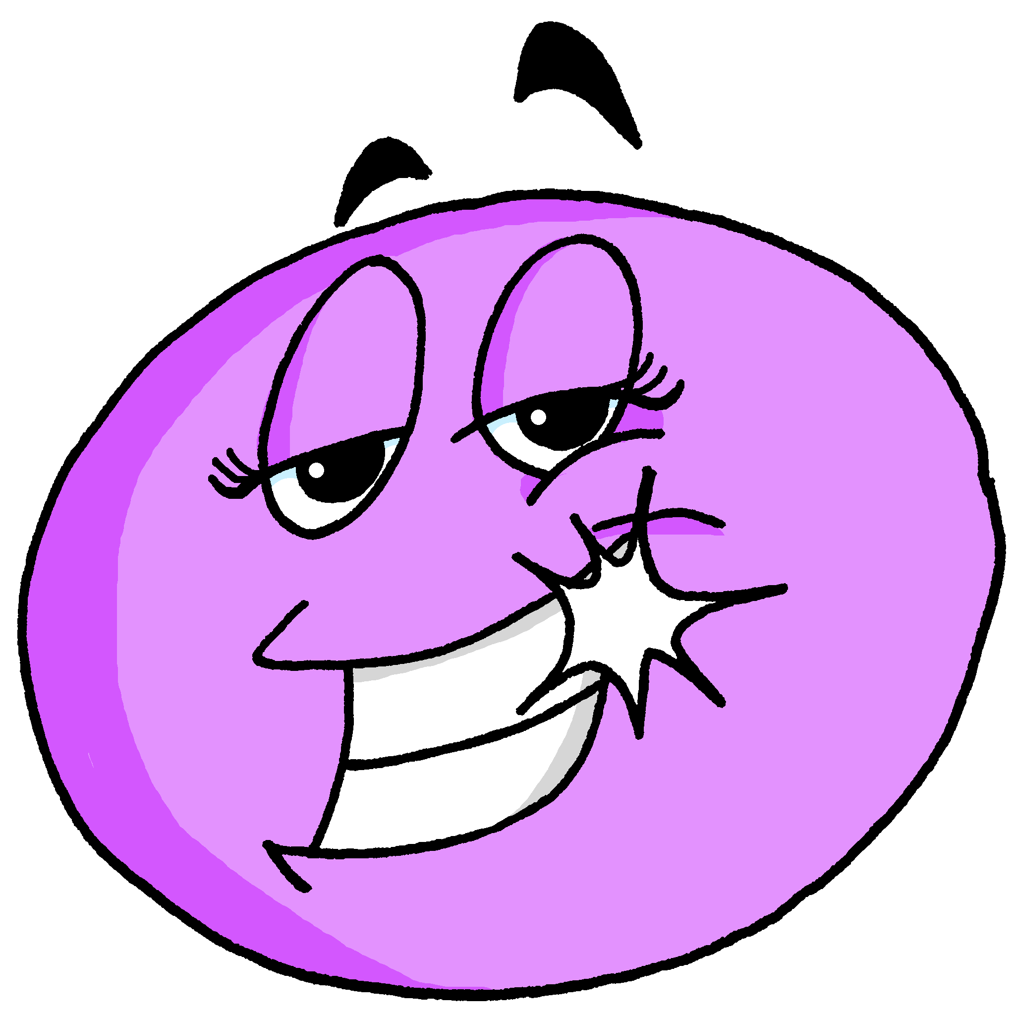
vocabulario
imposible
increíble
feliz
Notes:
Timing: 2 minutes
Aim: to introduce 3 new items of vocabulary.
Procedure:
Click to trigger the picture. Say the Spanish word and get students to repeat.
Click again to bring up the word and get students to repeat one more time. Elicit English meaning.
Repeat with the other two adjectives.
NB. Students haven’t learned ssc [z] yet so this will need extra practice.

Slide 7
vocabulario
positivo
preparado
imposible
Notes:
Timing: 3 minutes (5 slides)
Aim: To embed the meaning of the new words.
Procedure:
Read the three Spanish words out loud to model pronunciation. Elicit the right answer from students.
2. Repeat with the 4 four slides.

Slide 8
vocabulario
feliz
pesado
negativo

Slide 9
vocabulario
cómodo
increíble
imposible

Slide 10
vocabulario
enfermo
feliz
perdido

Slide 11
vocabulario
imposible
pesado
increíble

Slide 12
vocabulario
imposible
_mpo_ib_e
increíble
in_r_íb_ _
f_l_z
feliz
Notes:
Timing: 2 minutes
Aim: to recall the 3 new items of vocabulary.
Procedure:
Click to trigger the clues for the Spanish word and elicit word from a student.
Click to bring up the Spanish word. The next image will automatically appear.
Click to trigger the clues for the Spanish word and elicit word from a student.
Roll back the animations and repeat the process.

Slide 13
leer
Lee: ¿Dónde está el intruso?
sano | enfermo
Ej
hoy
positivo
1
 | pesada | perdida
cómoda
2
¿cómo? |  | ¿dónde?
sano
3
activa | pesada
preparado
4
hoy |  | ahora
enferma
5
perdido | activo
el intruso = intruder → odd one out
Notes:
Timing: 5 minutes
Aim: To revisit week 2-4 vocabulary and encourage students to notice patterns.
Procedure:
Ask students to work in pairs to spot the odd-one-out in each series of words. They need to be ready to give a reason.
Do the example with them (ejemplo). Read the words out loud and ask for a volunteer. The odd one out is “hoy” because “sano” & “enfermo” are both adjectives (& end in –o – are masculine), whereas “hoy” means “today” and is an adverb. Check that students remember that “hoy” is “today”.
Elicit students’ responses. Answers are animated – click to bring the answer (the font of the odd-one-out changes to pink on click).

Slide 14
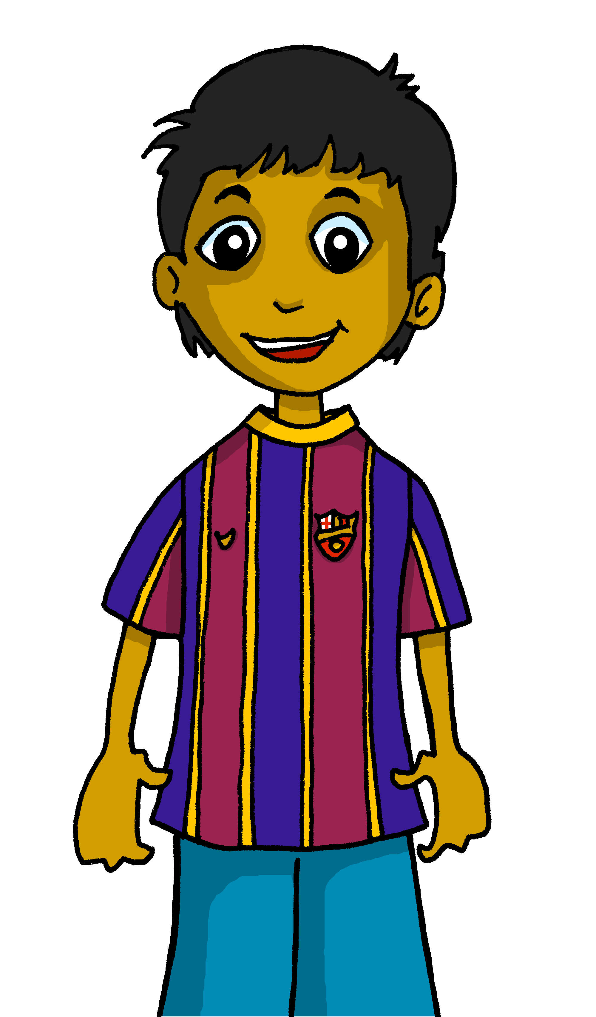
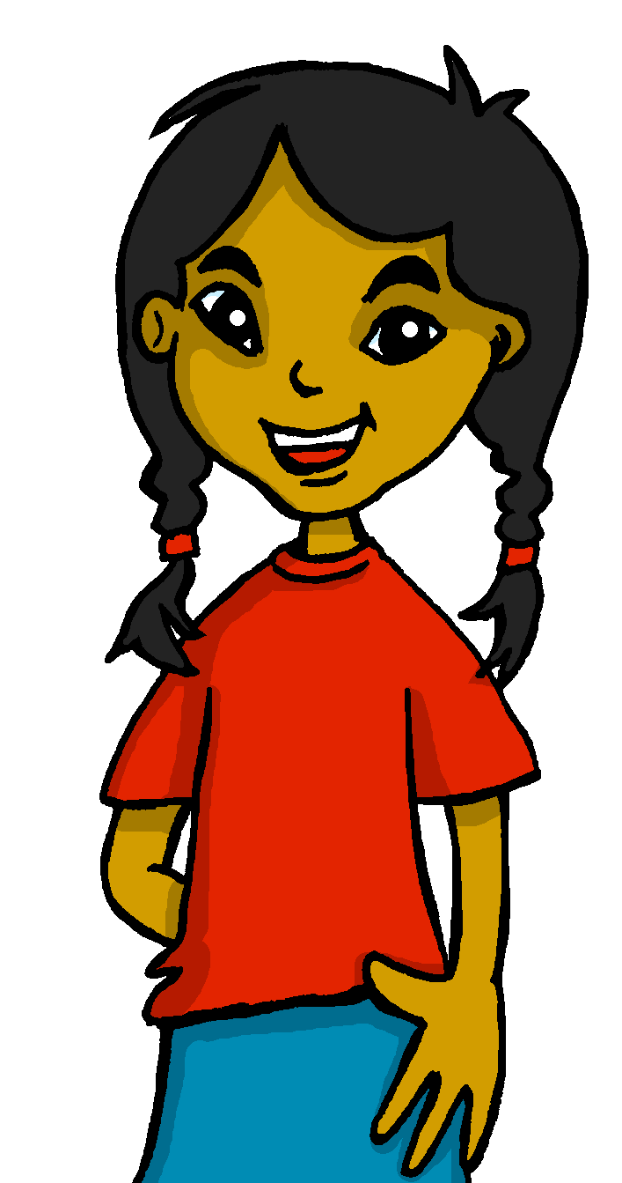
Gender agreement with adjectives
Remember, some adjectives change to match the gender (male or female) of the noun they describe.
As you know, masculine adjectives that end in ‘o’ change to an ‘a’ when the person or animal being described is female.
Rubén está contento.
Sofía está contenta.
Rubén is pleased.
Sofía is pleased.
Notes:
Timing: 2 minutes (two slides)
Aim: to recap the knowledge about adjectives ending in –o.
Procedure:
Click through the animations.
Elicit the English translations for the examples from students.

Slide 15
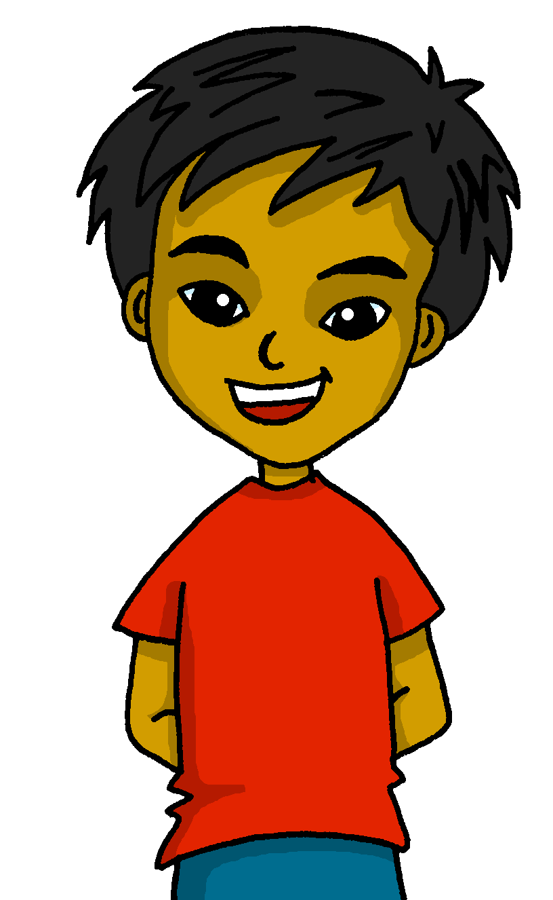
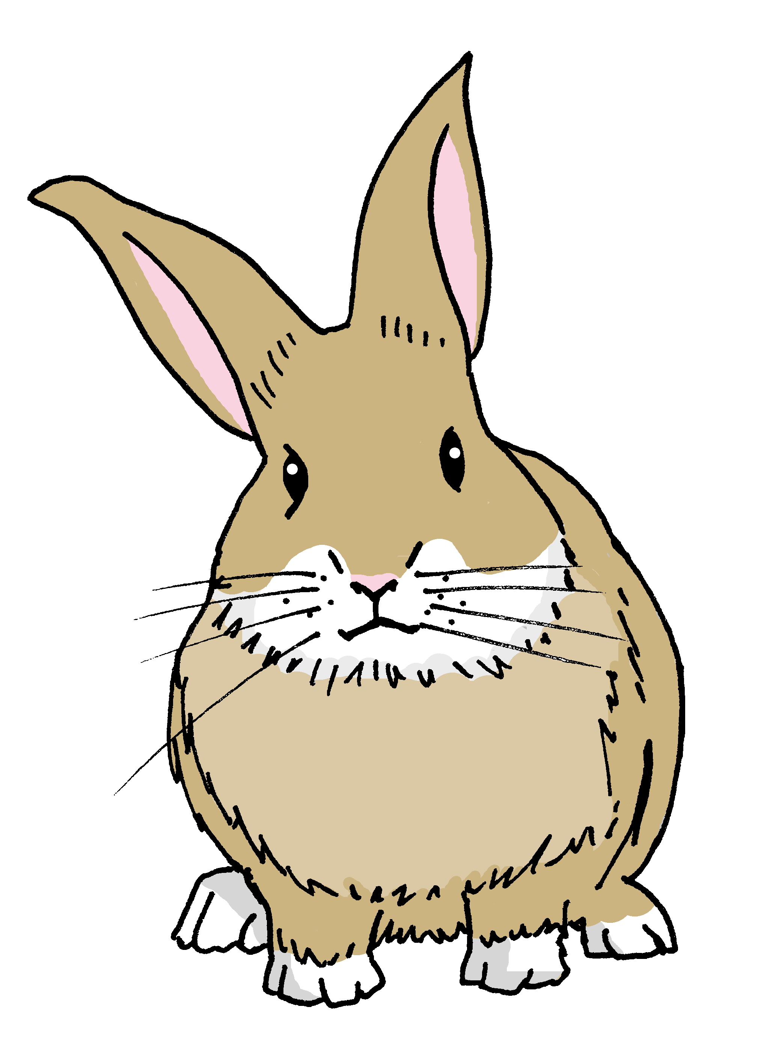
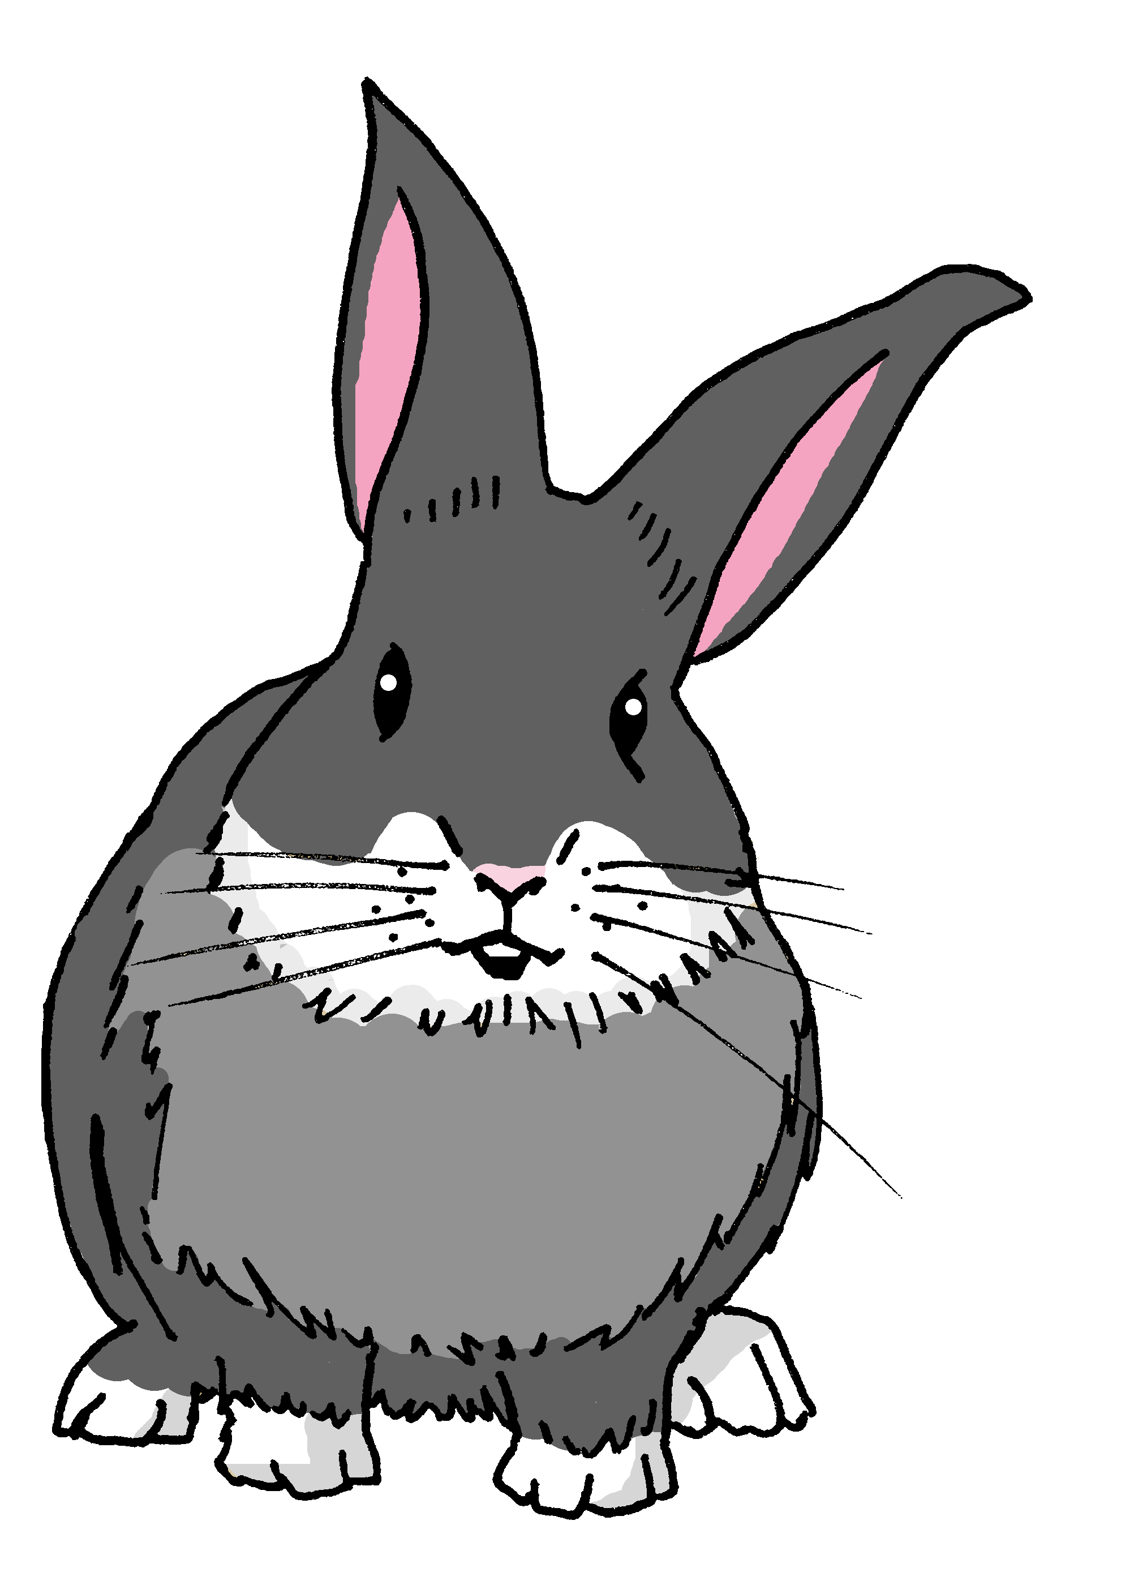
Gender agreement with adjectives
When an adjective ends in –e or -z it can describe a female and male person or animal. It does not change.
Quique está increíble.
Pancho está feliz.
Quique is (feeling) incredible.
Pancho is (feeling) happy.
Sofía está increíble.
Manchita está feliz.
Sofía is (feeling) incredible.
Manchita is (feeling) happy.
Notes:
Aim: to present new information about adjectives ending in –e or –z.
Procedure:
Click through the animations.
Elicit the English translations for the examples from students.

Slide 16
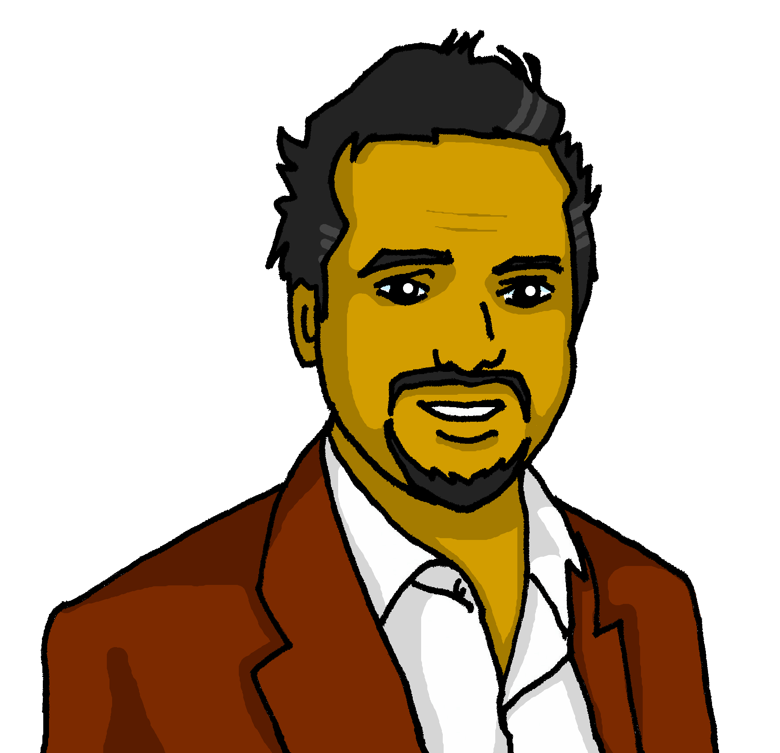
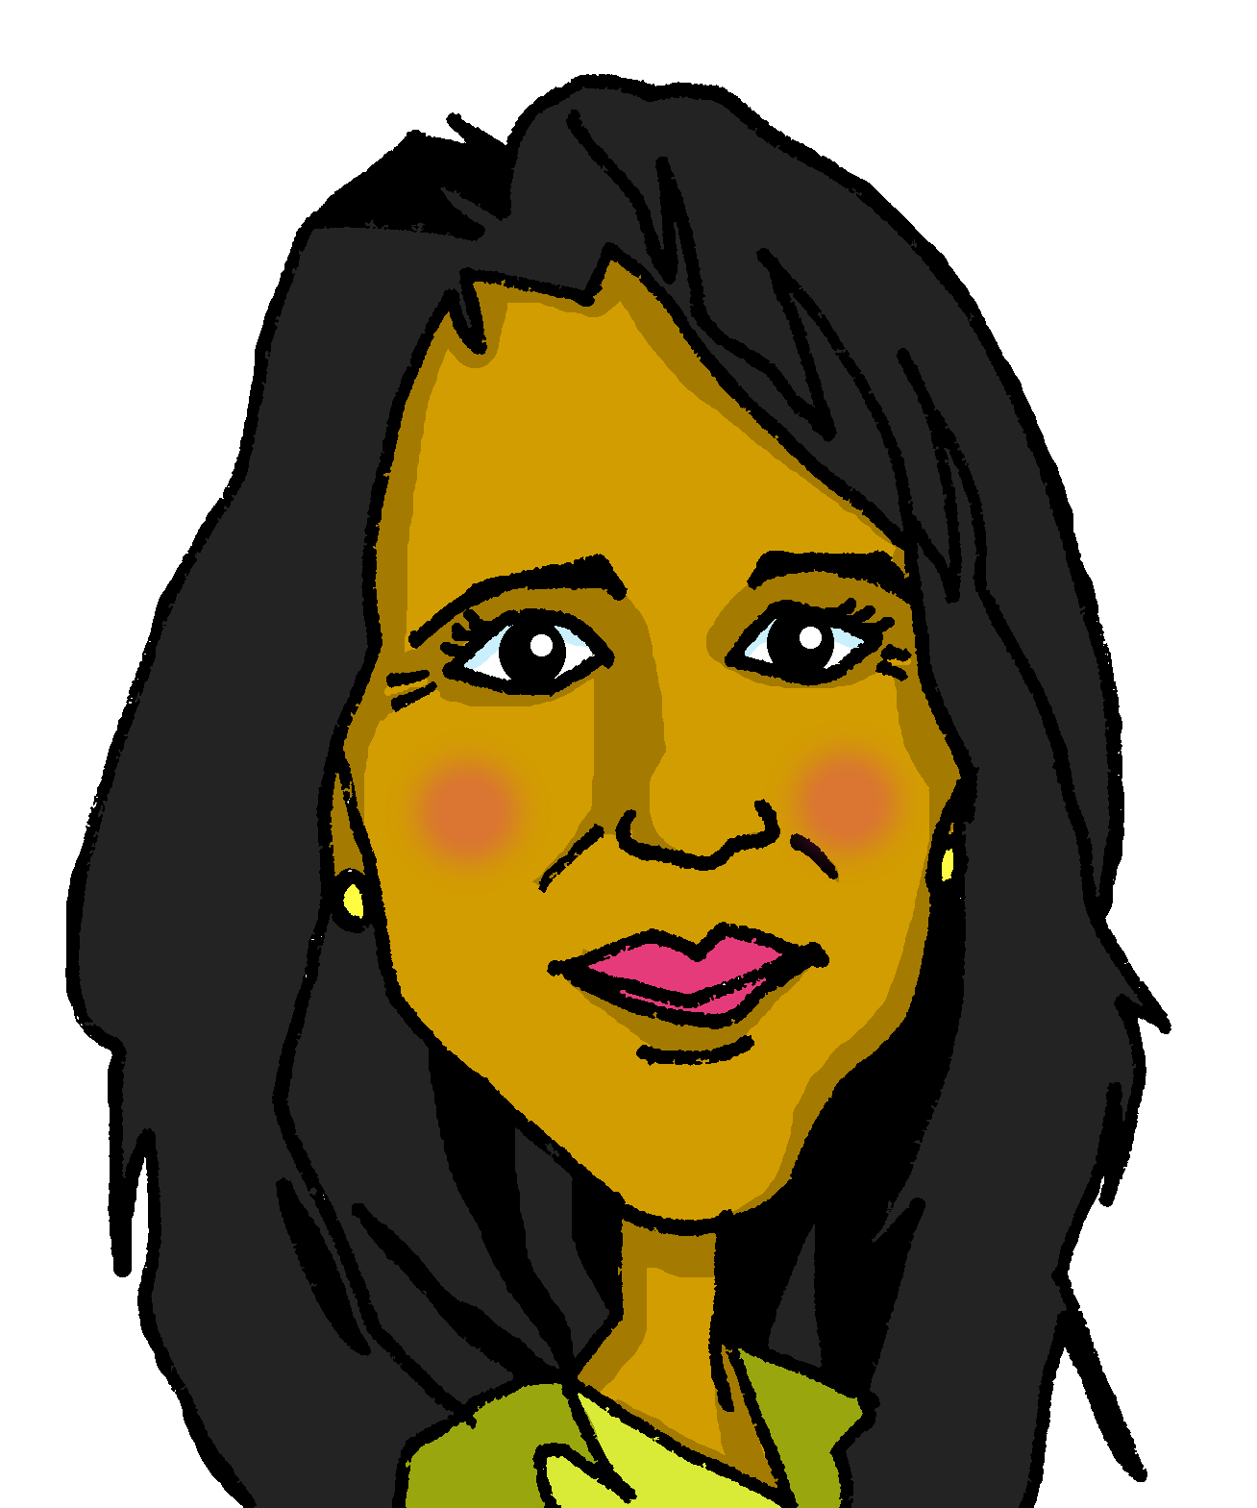
leer
Lee: ¿Quién?
In her diary, Sofía has described how her parents are feeling today.
¡Ay ay ay! She’s spilled hot chocolate on it so we can’t see who she’s describing. Elena or Pedro? Or could it be either?
¿Elena, Pedro o los dos?
Papá hoy está imposible.
Escribe
Papá está pesado.
adjetivo | Elena | Pedro | los dos | inglés
Mamá está activa.
imposible
impossible
pesado
annoying
Mamá está feliz aquí.
activa
active
Mamá está sana hoy.
feliz
happy
Papá está increíble ahora.
sana
healthy
increíble
incredible
Notes:
Timing: 8 minutes
Aim: to practise understanding of regular adjective agreement.
Procedure:
1. Read the task title in Spanish & click x2 to trigger the English.
2. Ask students to write down the adjective & the person it refers to (Elena, Pedro or los dos). Encourage them to write down the English meaning too.
3. The answers are animated – click x2 to bring the adjective and the tick, then click again to reveal the name in the diary. For those statements that could be both, you can ask students to guess who they think it is (Elena or Pedro?!).
4. Click one more time for the English translation.

Slide 17
¡adiós!
amarillo

