Slide 1
Describing me and others
amarillo
Follow ups 1-5
Notes:
Artwork by Steve Clarke. Pronoun pictures from NCELP (www.ncelp.org). All additional pictures selected from Pixabay and are available under a Creative Commons license, no attribution required.
Frequency of new vocabulary:
feliz [908] imposible [1418] increíble [1642] ¿dónde? [161]+ revisiting week 2-4 adjectives
Source: Davies, M. and Davies, K. (2018). A frequency dictionary of Spanish: Core vocabulary for learners (2nd ed.). Routledge: London
The frequency rankings for words that occur in this PowerPoint which have been previously introduced in these resources are given in the SOW and in the resources that first introduced and formally re-visited those words.
For any other words that occur incidentally in this PowerPoint, frequency rankings will be provided in the notes field wherever possible.
Source: Davies, M. & Davies, K. (2018). A frequency dictionary of Spanish: Core vocabulary for learners (2nd ed.). Routledge: London

Slide 2
Follow up 1
Escribe en inglés: Can you get at least 15 points?
 | está | aquí | cómodo
 | sano | ¿cómo? | allí
 | ¡Buenos días! | perdido | ¡Buenas tardes!
 | sí | hoy | estás
 | increíble | ¿dónde? | ahora
 | estoy | feliz | positivo
 | pesado | en clase | imposible
s/he, it is
here
comfortable
x3
healthy
how?
there
Good morning!
lost
now
x2
yes
today
you are
incredible
where?
now
I am
happy
positive
x1
annoying
in class
impossible
Notes:
Timing: 5 minutes
Aim: to practise written comprehension of vocabulary for this week and previous weeks.
Procedure:
1. Pupils need to write the English for as many words as possible, aiming to get at least 15 points (but more if possible).
2. Click for English answers.

Slide 3
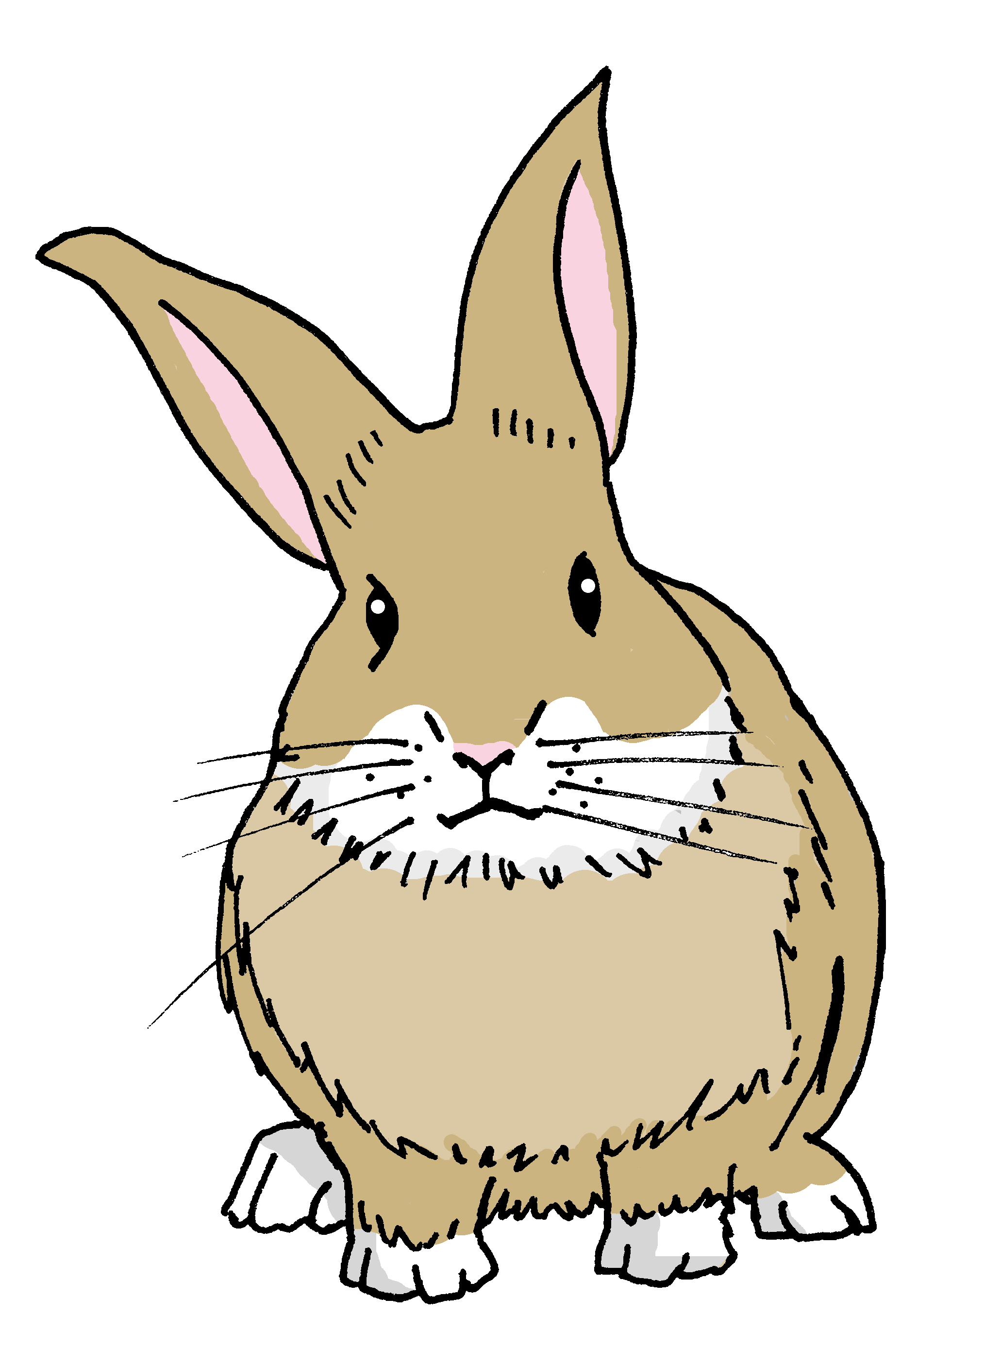
Follow up 2
Yes/no questions
Remember! In Spanish, change a statement into a question by raising your voice at the end:
Statement
⚠ Spanish uses two question marks – the one at the front is upside down!
Estás feliz.
You are happy.
Question
¿Estás feliz?
Are you happy?
Notes:
Timing: 2 minutes
Aim: to formally introduce yes / no questions = raising intonation to form questions.
Procedure:
Read the grammar explanation.
Elicit English translation for the Spanish examples provided.

Slide 4
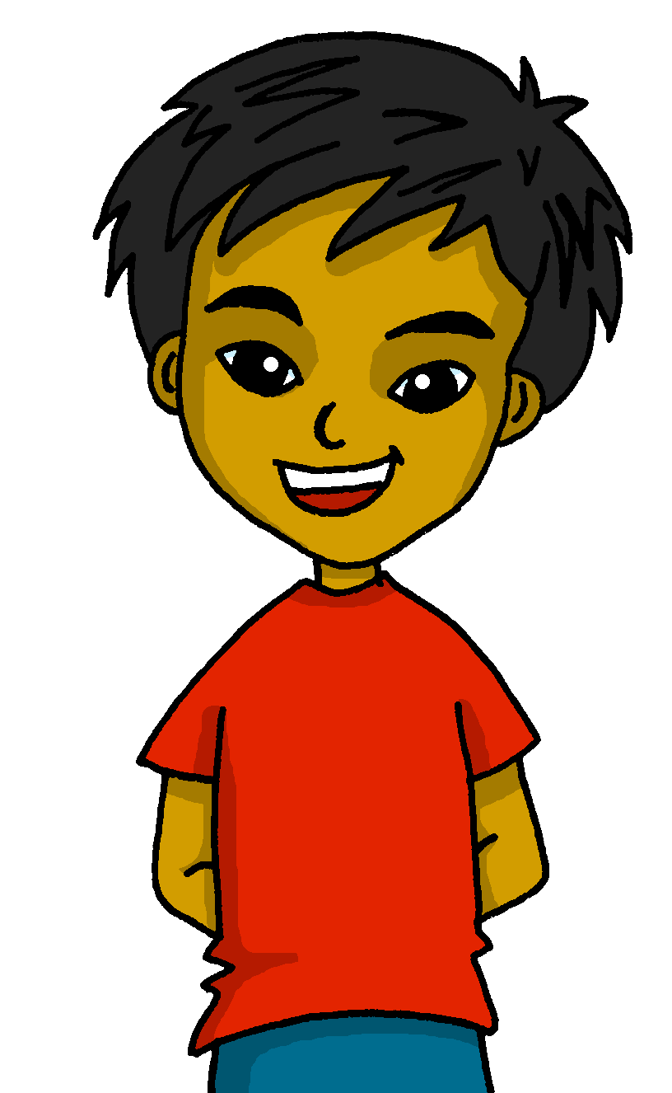
Follow up 2
Una encuesta: Quique is doing a survey in class.
Is he asking someone or reporting results to Señora Mora?
escuchar
Escribe
Escribe Ask o Report.
 | Asking someone | Reporting back to Sr. Mora
¿Estás feliz?
Ej
Está imposible.
1
¿Estás enfermo?
2
¡Está negativo!
¿Estás sano?
¿Estás negativo?
3
Está increíble.
4
¿Estás positivo?
una encuesta - a survey
5
Notes:
Time: 5 minutes
Aim: to practise aural comprehension of questions and statements by paying attention to raised intonation.
Procedure:
1. Read the title and instructions.
2. Click to trigger the Spanish instructions. (!) Remind students that when giving a statement, the intonation will be flat and when asking a question they will hear raised intonation.
4. Students could be asked to write what they hear during the second listening. The challenge icon appears on second click.
5. Answers are animated – first click brings up the tick and second click brings up what was said.
Transcript
¿Estás feliz?
Está imposible
¿Estás enfermo?
¿Estás sano?
Está increíble
¿Estás positivo?

Slide 5
Follow up 3
¿Cómo estás? Escribe 2 frases.
escribir
1. Estoy perdida.
2. Estoy imposible.
activo activa (active)
preparado preparada (ready)
sano sana (healthy)
cómodo cómoda (comfortable)
positivo positiva (positive)
pesado pesada (annoying)
enfermo enferma (ill)
perdido perdida (lost)
imposible (impossible)
increíble (incredible)
feliz* (sad)
⚠ Don’t forget to use the correct ending for the adjective!
Notes:
Time: 5 minutes
Aim: to write two sentences using estoy + adjective in the correct form in order to prepare for the speaking task.
Procedure:
Read the title and instructions.
Click to bring the examples & elicit English translation.
Click to bring reminder re adjectival agreement.
Click to bring up the known adjectives with masculine / feminine forms.
Ask pupils to choose two adjectives how they want to describe how they are feeling today and to look at them very carefully.
Ask them to write them on their own arm.
Then click to make the table disappear.
Ask students to write down their two sentences (with the correct adjective agreement).
Teacher circulates to check their writing.
Note: This follow up prepares students also for the speaking activity in Follow up 4.

Slide 6
Follow up 4
- ¿Cómo estás?
1. Estoy perdida.
Una encuesta
2. Estoy imposible.
= a survey
hablar
X
X
happy
incredible
comfortable
positive
ready
impossible
annoying
negative
lost
Notes:
Time: 5 minutes
Aim: to use “estoy” + correct adjective agreement in oral production; to process the English meaning of a range of adjectives.
Procedure:
Read the title.
Tell students they are going to conduct a survey in the class on how they are feeling.
Click to bring key question ¿Cómo estás? & sample answer examples (‘Estoy perdida’ & ‘estoy imposible’). This will make it clear to students that they should use the answers they have prepared. Click x2 to model how to use the survey sheet.
Tell students they have 5 minutes to ask as many students in the class. They should aim to ask and answer the questions, from memory, by the end of the survey.
! Encourage students to attempt to answer the question from memory

Slide 7
Una encuesta
- ¿Cómo estás?
Estoy ……
= a survey
hablar
happy | incredible | comfortable | positive | ready | Impossible | annoying | negative | lost
Notes:
Template slide for survey – print in A5

Slide 8
Follow up 5
Escribe en español: Can you get at least 15 points?
 | Good morning | s/he, it is (state) | Good afternoon
 | there | here | how?
 | lost | healthy | ill
 | comfortable | today | yes
 | happy | incredible | impossible
 | you are (state) | annoying | I am (state)
 | in class | positive | where?
Buenos días
está
Buenas tardes
x3
allí
aquí
¿cómo?
perdido|perdida
sano|sana
enfermo|enferma
x2
cómodo|cómoda
hoy
sí
feliz
increíble
imposible
x1
estás
pesado|pesada
estoy
en clase
positivo|positiva
¿dónde?
Notes:
Timing: 5 minutes
Aim: to practise written production of vocabulary for this week and previous weeks.
Procedure:
1. Pupils need to write the Spanish for as many words as possible, aiming to get at least 15 points (but more if possible).
2. Click for Spanish answers.

