Slide 1
Describing me and others
amarillo
Follow ups 1-5
Notes:
Artwork by Steve Clarke. Pronoun pictures from NCELP (www.ncelp.org). All additional pictures selected from Pixabay and are available under a Creative Commons license, no attribution required.
Frequency of new vocabulary and phonics:
Phonics: [i] source word: idea [247]
Vocabulary: clase [320] [en clase] cómodo [2237] pesado [2166] positivo [1188] ahora [81] Source: Davies, M. and Davies, K. (2018). A frequency dictionary of Spanish: Core vocabulary for learners (2nd ed.). Routledge: London
The frequency rankings for words that occur in this PowerPoint which have been previously introduced in these resources are given in the SOW and in the resources that first introduced and formally re-visited those words.
For any other words that occur incidentally in this PowerPoint, frequency rankings will be provided in the notes field wherever possible.

Slide 2
Follow up 1:
[e]
elefante
[i]
idea
Listen to these Spanish speakers introduce themselves. What are their names? Fill the gaps with [e] or [i].
Remember that proper nouns start with a capital letter!
These are all popular surnames in Spain!
E
R o m e r o
_
1
G i l
_
2
T o r r e s
_
3
I g l e s i a s
_
_
4
G a r r i d o
_
5
O r t e g a
_
Notes:
Timing: 5 minutes
Aim: to practise aural comprehension and written production of the SSC [e] and [i].
Procedure:
Click to bring up the prompts.
Click on E to hear the ejemplo (example). Students write down the missing letters and volunteer the name.
Click for answer.
Continue with items 1-5.
Transcript [ejemplo] Romero [1] Gil [2] Torres [3] Iglesias
[4] Garrido
[5] Ortega

Slide 3
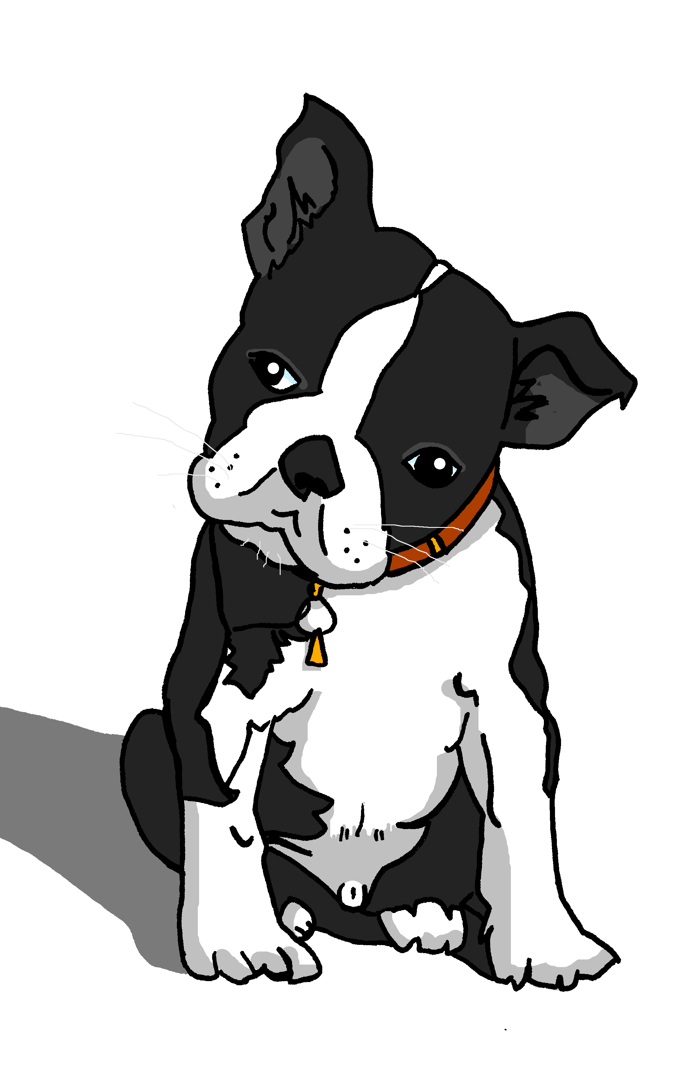
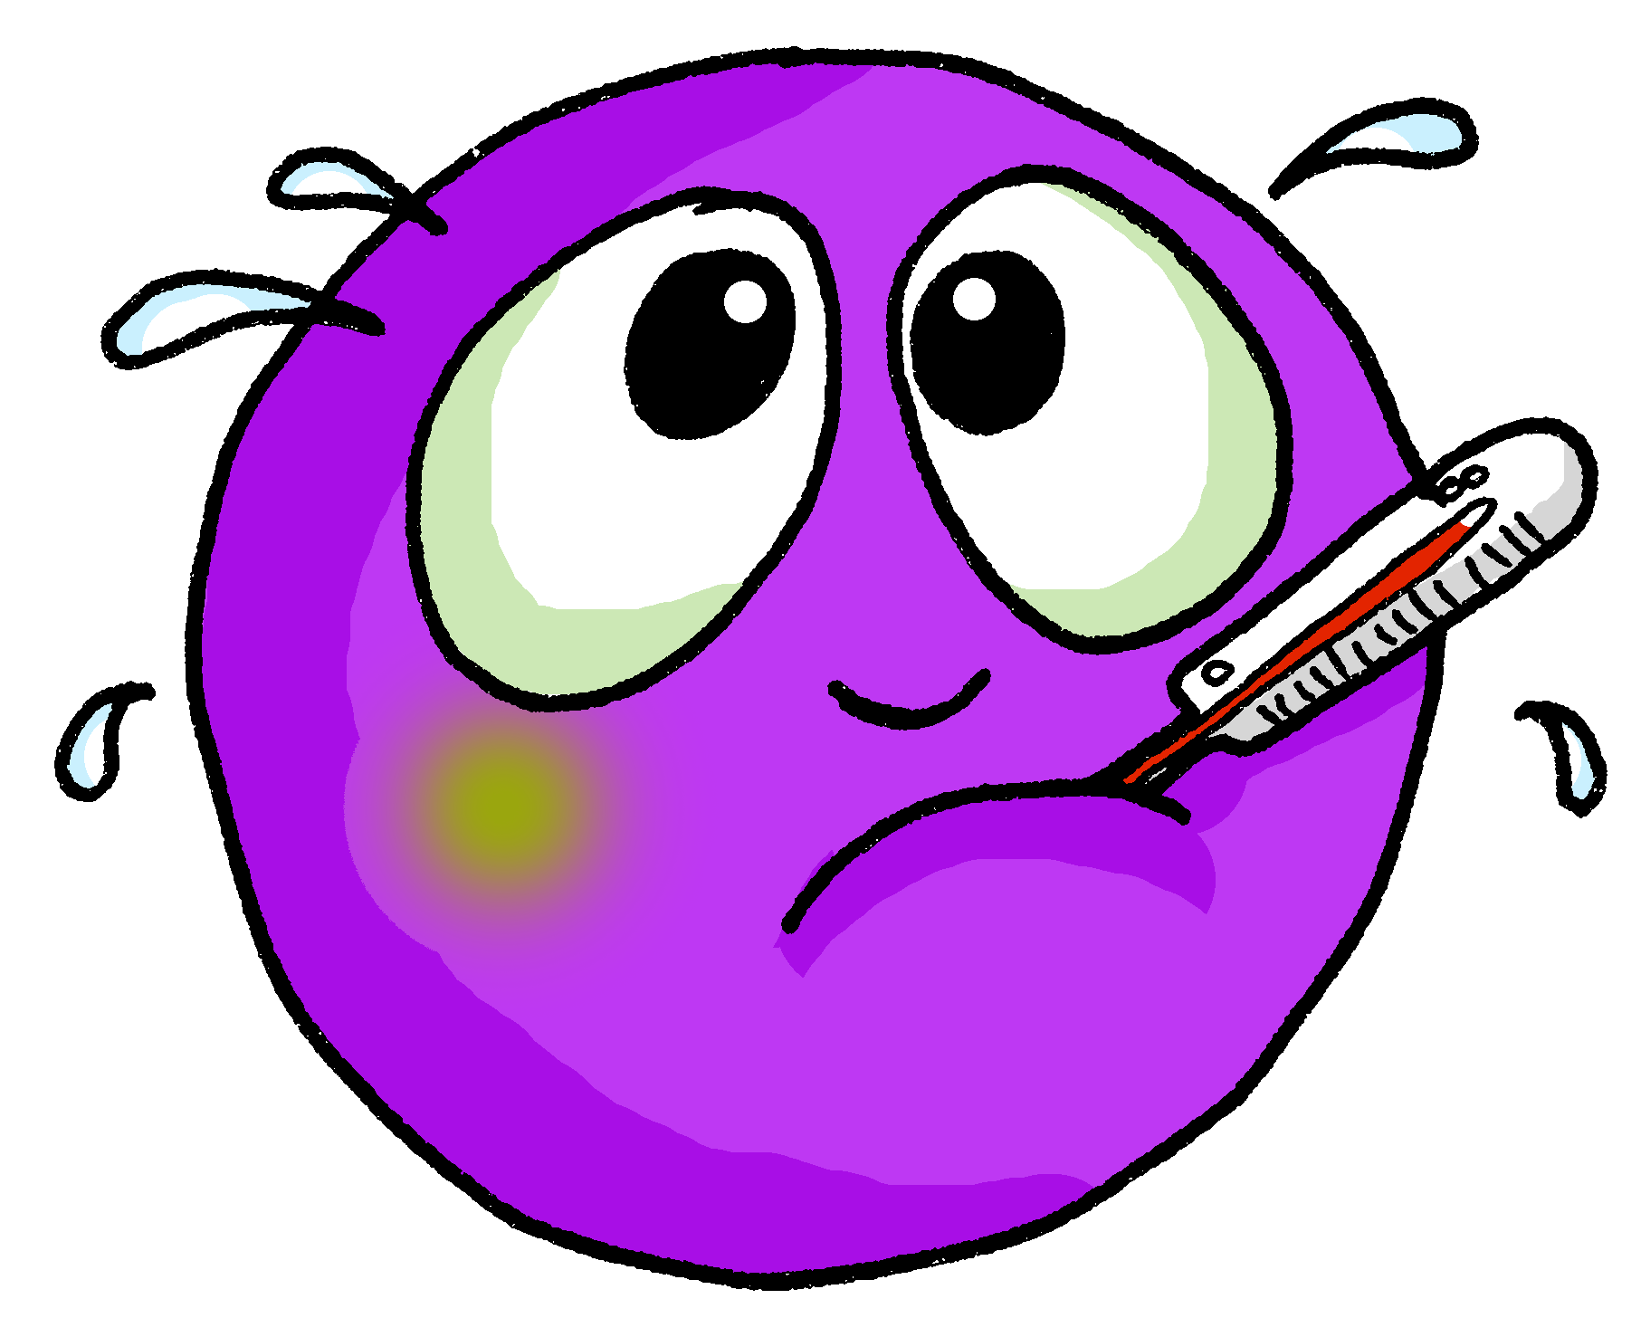
Follow up 2:
Sometimes we refer to people by name in a sentence:
Santi is sick today.
In Spanish, we often don’t need to use the pronoun:
Santi está enfermo hoy.
Here we use the pronoun he because we don’t need to repeat Santi.
He is tired sick today.
⚠ This means that está can mean is and he is, she is, it is.
Está enfermo hoy.
[is]
[He is]

Slide 4
Follow up 2:
Lee las frases.
Pedro está en allí. ________ ________ __________.
El señor Valero está en clase. Está preparado. ________ _____ ___ _______. _______ ________.
¿Rita? No, está en casa. ______ ? ___ _________ _____ ______.
¿Cómo está Martín? Está curioso hoy. _____ ______ _______? ______ _______________ ________.
¿Belén está nerviosa? No, está tranquila. ___ __________ _________? ____ ________ _______.
Write the English meaning of está for each sentence:
leer
Pedro
is
there
Mr Valero
is
in
class
He is
ready
Rita
No,
she is
at
home
How
is
Martin
He is
feeling curious
today
Is
Belén
nervous
No
she is
calm
Notes:
Procedure:
Pupils write 1 – 5 and the English translation of está as best fits each sentence.
Click to trigger answers.
Note: The rest of the English translations are provided to enable pupils focus all their attention on the different meanings of está.

Slide 5
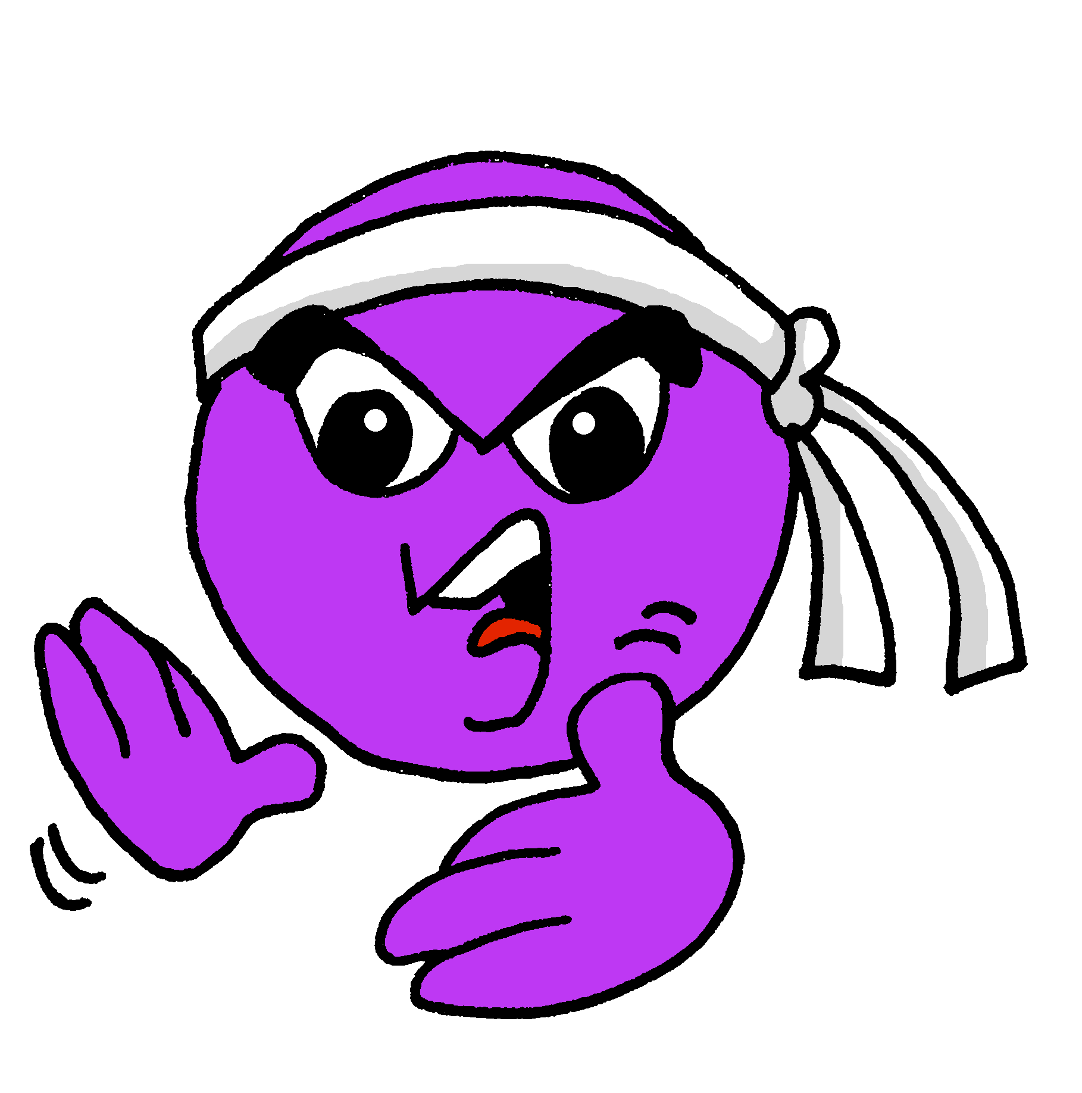
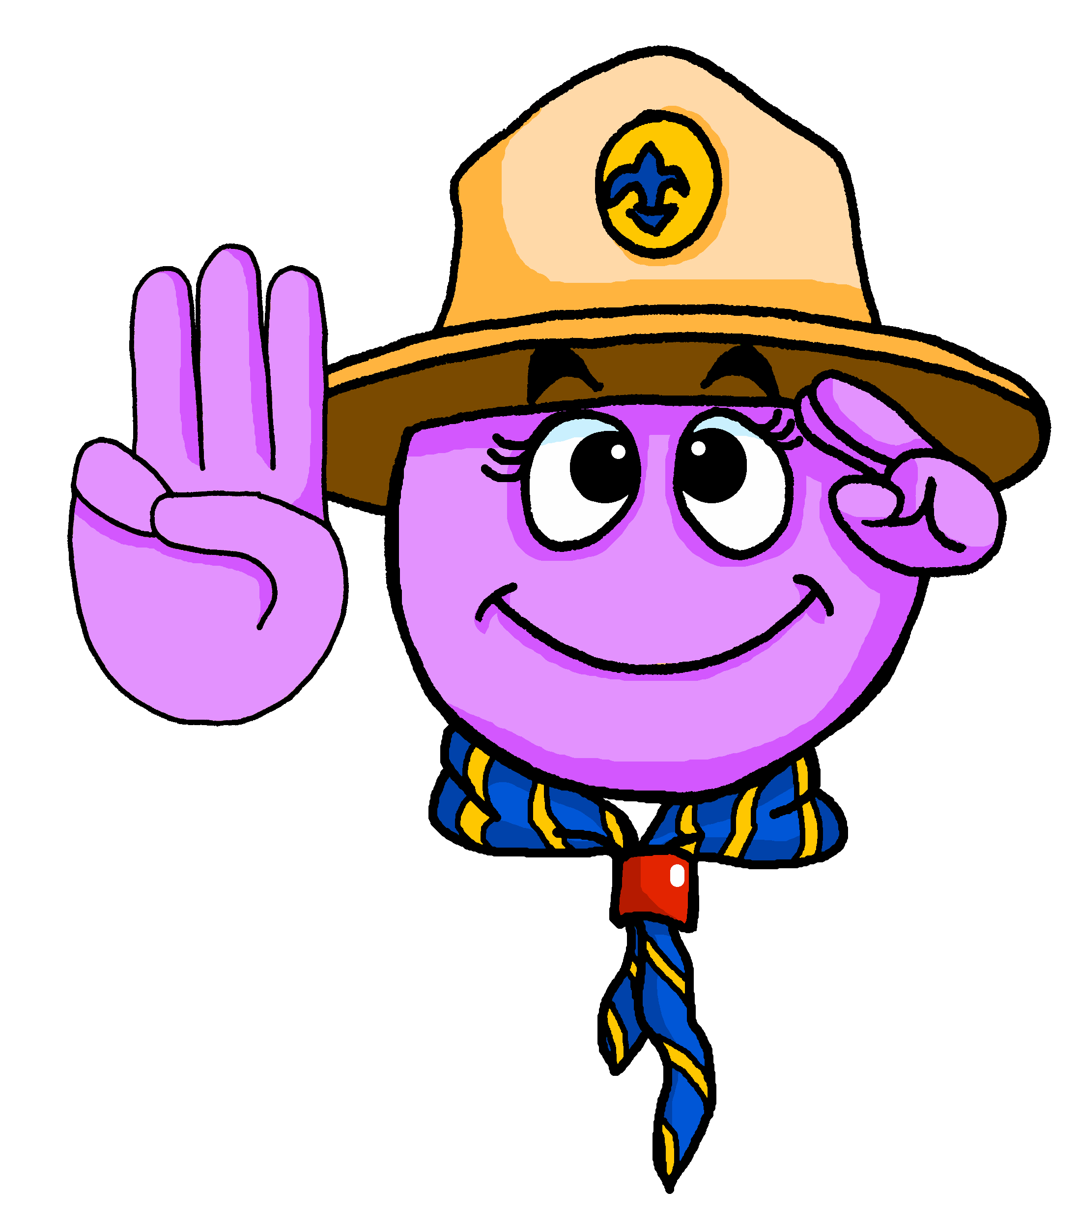
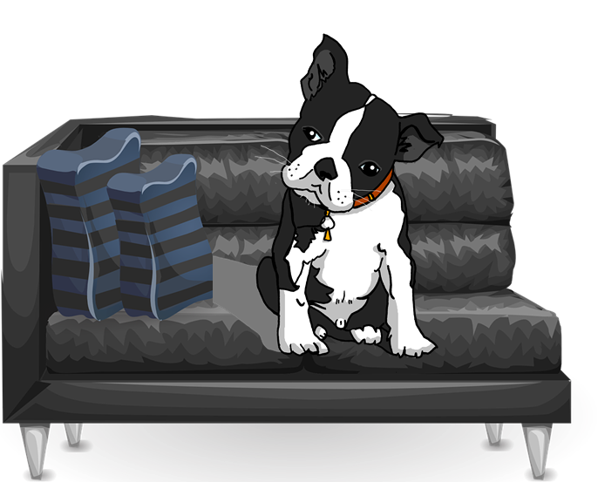
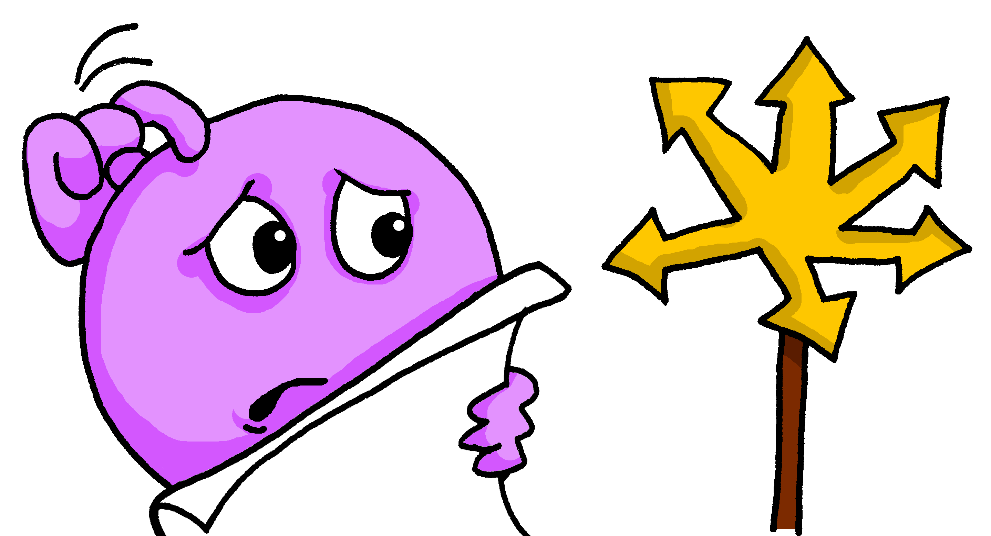
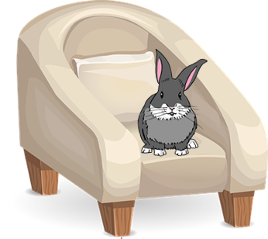
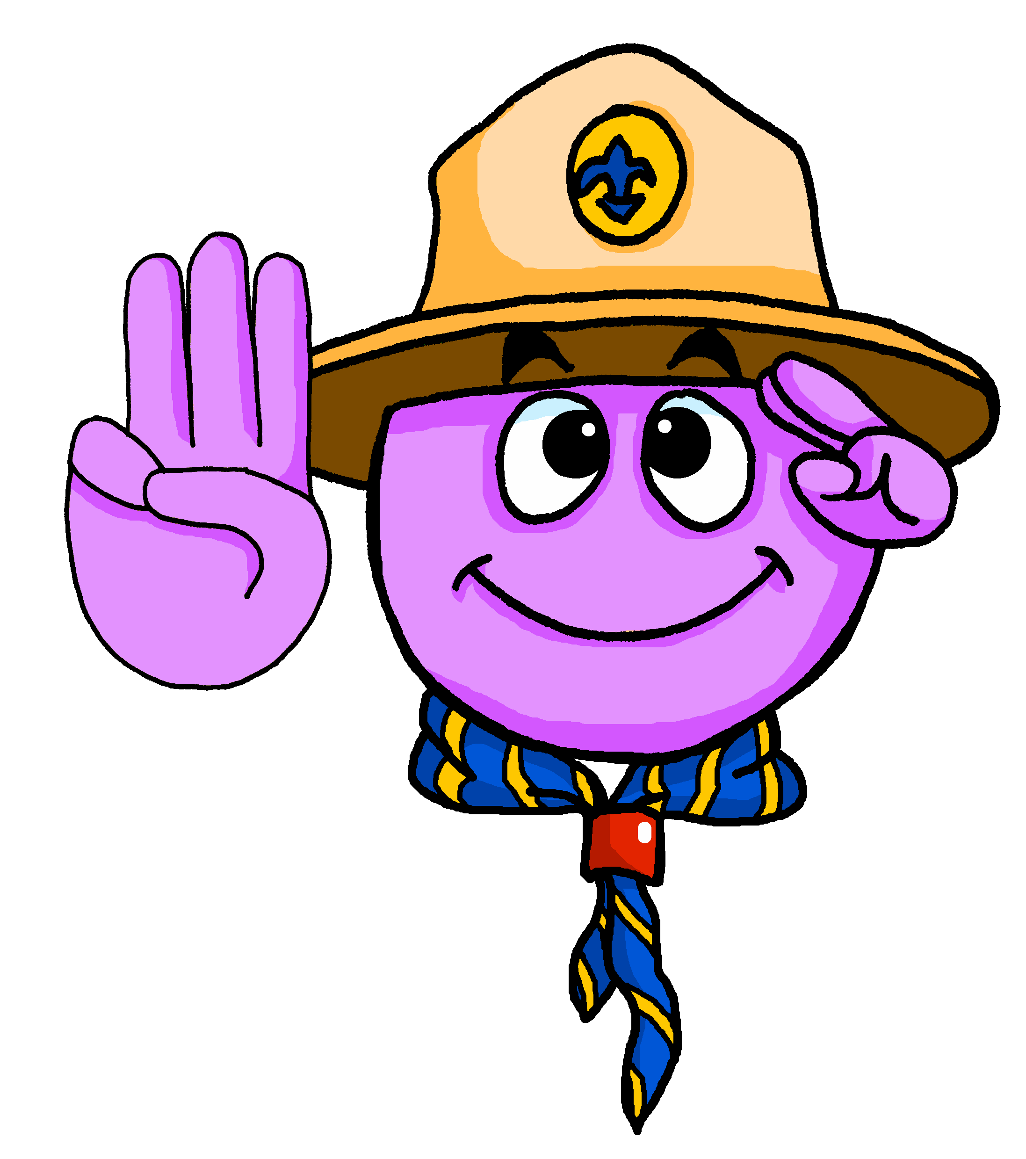
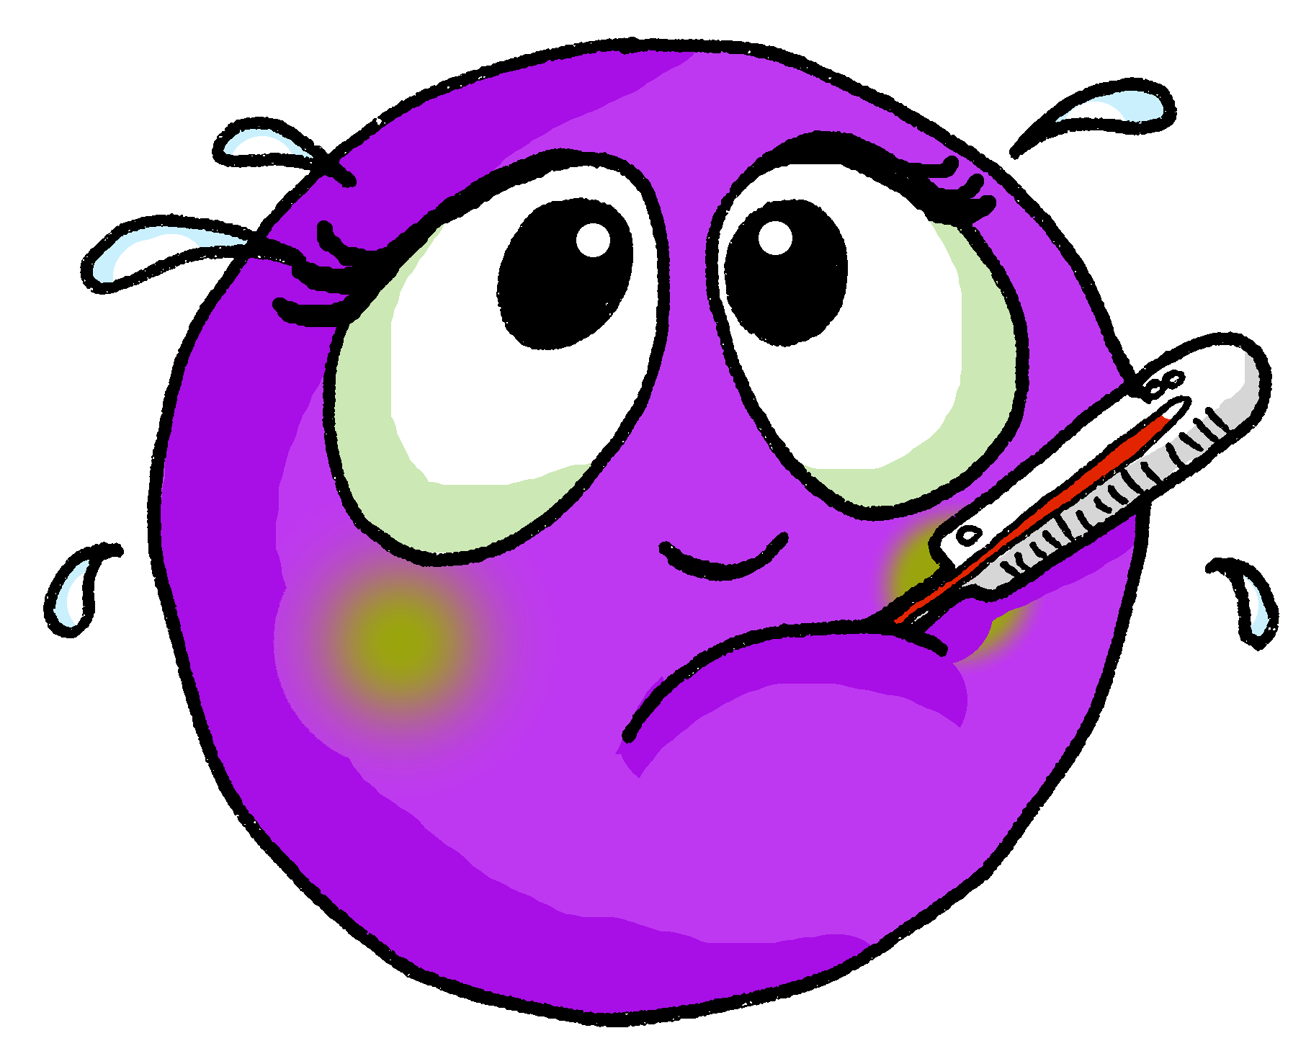
Follow up 3:
Describe a la persona.
cómodo | cómoda
preparado | preparada
positivo | positiva
activo | activa
perdido | Perdida
enfermo | enferma
hablar
60
S
0
INICIO
Notes:
Timing: 5 minutes
Aim: to practise oral production of known adjectives with correct gender agreement.
Procedure: 1. Start the timer. Click for image.
2. Students say the adjective that describes the image, with the correct ending. 3. Explain that the emojis with longer eyelashes require feminine adjective agreement. 4. A list of adjectives is provided to support production at this stage. The task can be repeated 2-3 times, and the words can be removed, as appropriate, to challenge full recall.

Slide 6
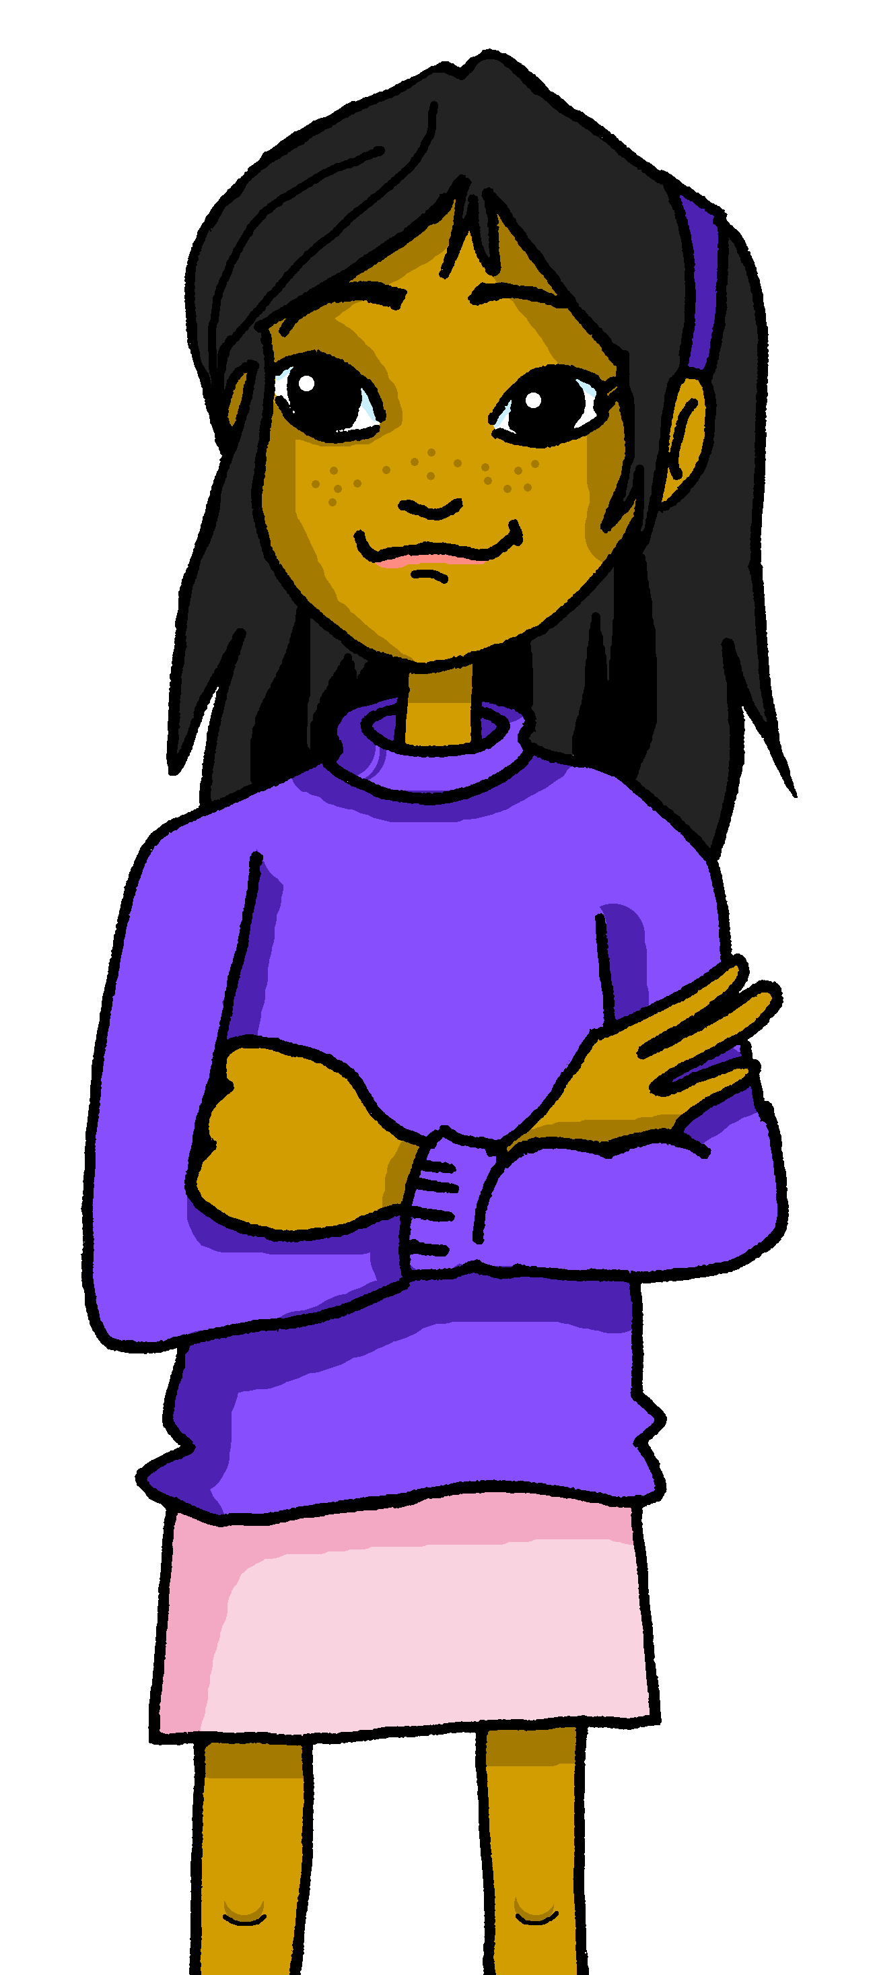
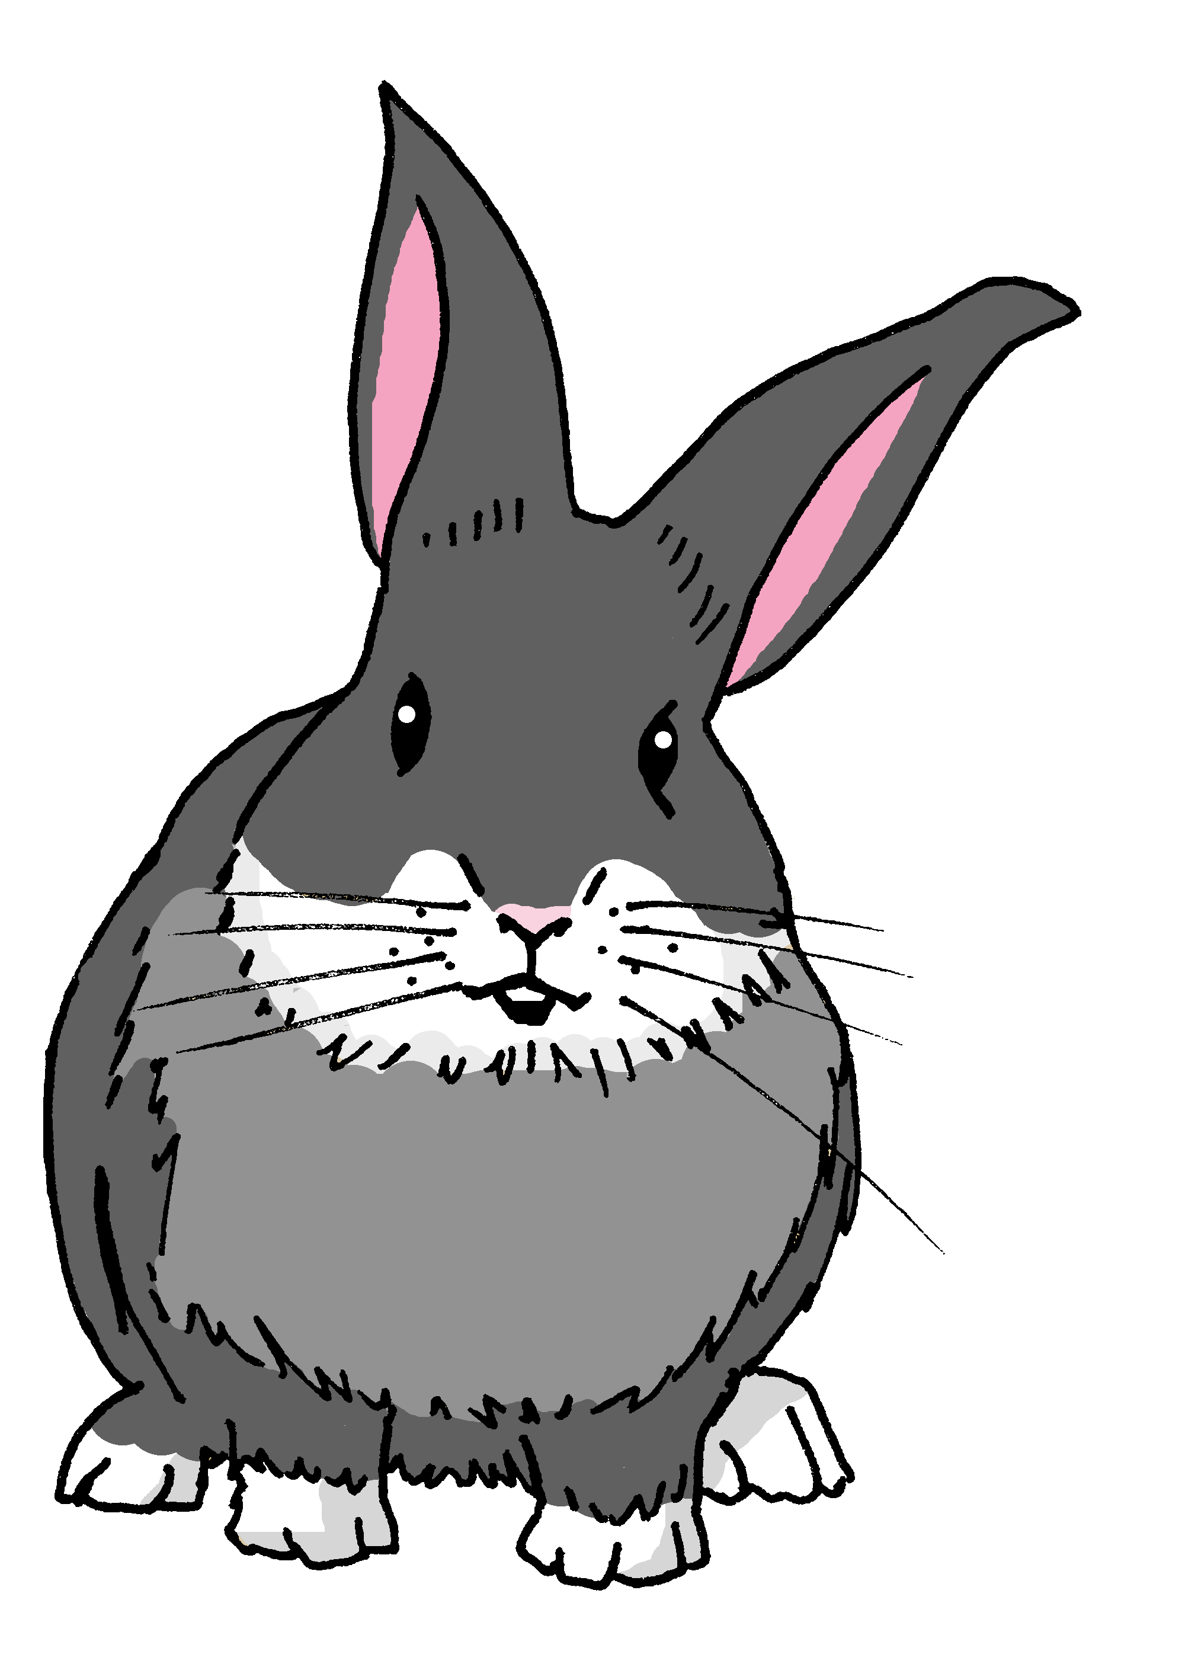
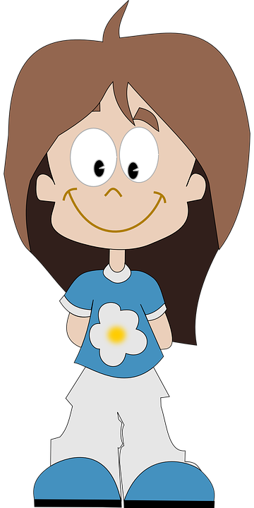
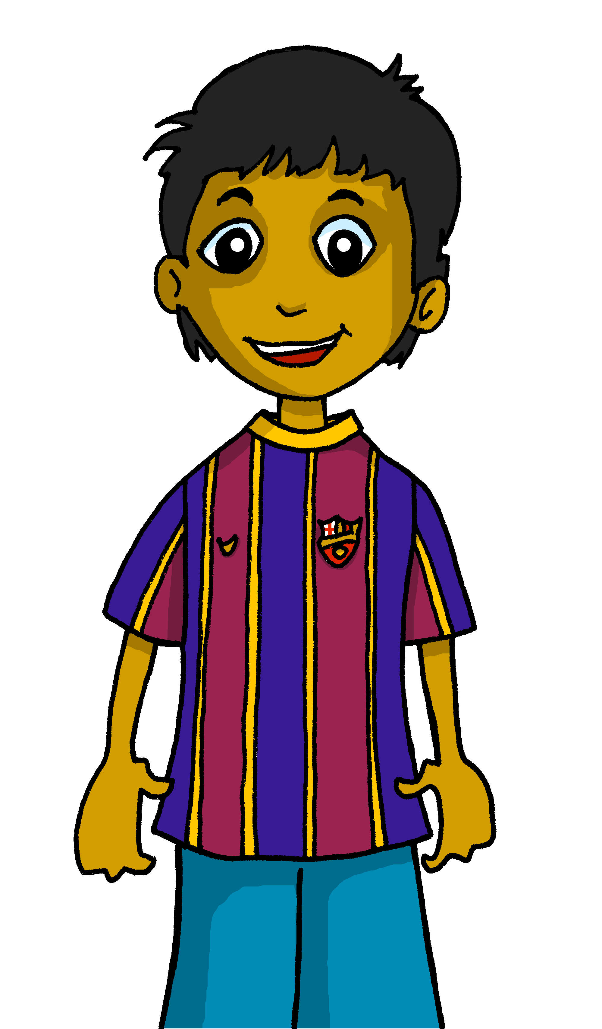
Follow up 4:

Escribe.
escribir
Manchita está enferma hoy.
4. Ángela is comfortable in class.
1. Manchita is ill today.
Ángela está cómoda en clase
Santi está pesado en casa.
2. Santi is annoying at home.
Úrsula está preparada ahora.
5. Úrsula is ready now.
Rubén está positivo ahora.
3. Rubén is feeling positive now.
¿Cómo estás hoy en clase?
________________________
[I am…]
Notes:
Timing: 8-10 minutes
Aim: to use the correct form of the adjective in written production.
Procedure:
Tell students to translate sentences 1-5, paying careful attention to the correct form of the adjective. Draw students’ attention to the translation of “is” (she/he/it IS). If needed, recap adjectives before starting attempting the sentences in full. o
Challenge students to write a sentence about how they are feeling today, using the correct form of “estar”.

Slide 7
Follow up 5:
Escribe en español.
Can you get at least 15 points?
 | Good afternoon | absent | there
 | I am | where? | here
 | How? | active | class
 | healthy | calm/quiet | prepared
 | today | ill | active
 | you are | annoying | s/he is
 | in class | comfortable | now
x3
x2
x1
vocabulario
Notes:
Timing: 5 minutes
Aim: to practise written production of vocabulary from last week and this week.
Procedure: 1. Give pupils a blank grid. They fill in the Spanish meanings of any of the words they know, trying to reach 15 points in total.
Note: The most recently learnt and practised words are pink, words from the previous week are green and those from two weeks ago are blue, thus more points are awarded for them, to recognise that memories fade and more effort (heavy lifting!) is needed to retrieve them.

