Slide 1
Describing me and others
amarillo
Follow ups 1-5 Week 3
Notes:
Artwork by Steve Clarke. Pronoun pictures from NCELP (www.ncelp.org). All additional pictures selected from Pixabay and are available under a Creative Commons license, no attribution required.
Frequency of new vocabulary and phonics:
Phonics: [u] source word: universe [1603]
Vocabulary: estás [21] ¿dónde? [161] sí [45] no [11] en1 [5] ¡Buenos días! [103/65] ¡Buenas tardes! [103/392] Source: Davies, M. and Davies, K. (2018). A frequency dictionary of Spanish: Core vocabulary for learners (2nd ed.). Routledge: London
The frequency rankings for words that occur in this PowerPoint which have been previously introduced in these resources are given in the SOW and in the resources that first introduced and formally re-visited those words.
For any other words that occur incidentally in this PowerPoint, frequency rankings will be provided in the notes field wherever possible.

Slide 2
Follow up 1:
elefante
[e]
A Escucha.
B Escucha. Escribe [e], [o] o [a].
2
‘Elefante’ is number ________.
E
e v e n t o
_
_
_
1
2
1
e c o
_
_
2
e l e m e n t o
_
_
_
_
3
3
e n e m i g o
_
_
_
4
e s c a p a r
_
_
_
5
e s c a l e r a
_
_
_
_
Notes:
Timing: 5 minutes
Aim: to practise aural comprehension and transcription of the SSC [e], [o] and [a].
Procedure:
Click to bring up the prompts.
Click on each audio symbol to listen to the words.
Click for the number answer.
Click to bring up task B.
Click on sound button to hear a cognate word.
Pupils write down the missing letters.
Click to reveal answers.
Elicit or give the meanings. Explain that many Spanish and English words are similar.
Transcript Part A: [1] restaurante [2] elefante [3] diamante
Part B:
evento (event) eco (echo) element (element) enemigo (enemy) escaper (escape) escalera (stairs – like escalator) Frequency of unknown vocabulary: evento [1517] eco [2461] elemento [537] enemigo [1066] escapar [899] escalera [1789]
Source: Davies, M. and Davies, K. (2018). A frequency dictionary of Spanish: Core vocabulary for learners (2nd ed.). Routledge: London

Slide 3
Follow up 2:
Sometimes we refer to people by name in a sentence:
Eduardo is here.
In Spanish, we often don’t need to use the pronoun.
Eduardo está aquí.
Here we use the pronoun he because we don’t need to repeat Emanuel.
He is ready.
⚠ This means that está can mean is and he is, she is, it is.
Está preparado.
[is]
[He is]
Notes:
Timing: 5 minutes (two slides)
Aim: to draw attention to pronouns in English and Spanish and the multiple meanings of ‘está’ (is, he is, she is, it is).
Procedure:
Click to present the information.
Ensure students’ understanding of the key term ‘pronoun’.

Slide 4
Follow up 2:
Lee las frases.
Elena está en clase. ________ ________ ___ __________.
Emanuel está en casa. Está enfermo. ________ _____ ___ _______. _______ ________.
¿Eva? No, está ausente. ______ ? ___ _________ __________.
¿Cómo está Edgar? Está activo hoy. _____ ______ _______? ______ _________ ________.
¿ Enrique está enfermo? No, está sano. ___ __________ _________? ____ ________ _______.
Write the English meaning of está for each sentence:
leer
Elena
is
in
class
Emanuel
is
at
home
He is
ill.
Eva
No,
she is
absent
How
is
Edgar
He is
active
today
Is
Enrique
ill
No
he is
healthy
Notes:
Procedure:
Pupils write 1 – 5 and the English translation of está as best fits each sentence.
Click to trigger answers.
Note: The rest of the English translations are provided to enable pupils focus all their attention on the different meanings of está.

Slide 5
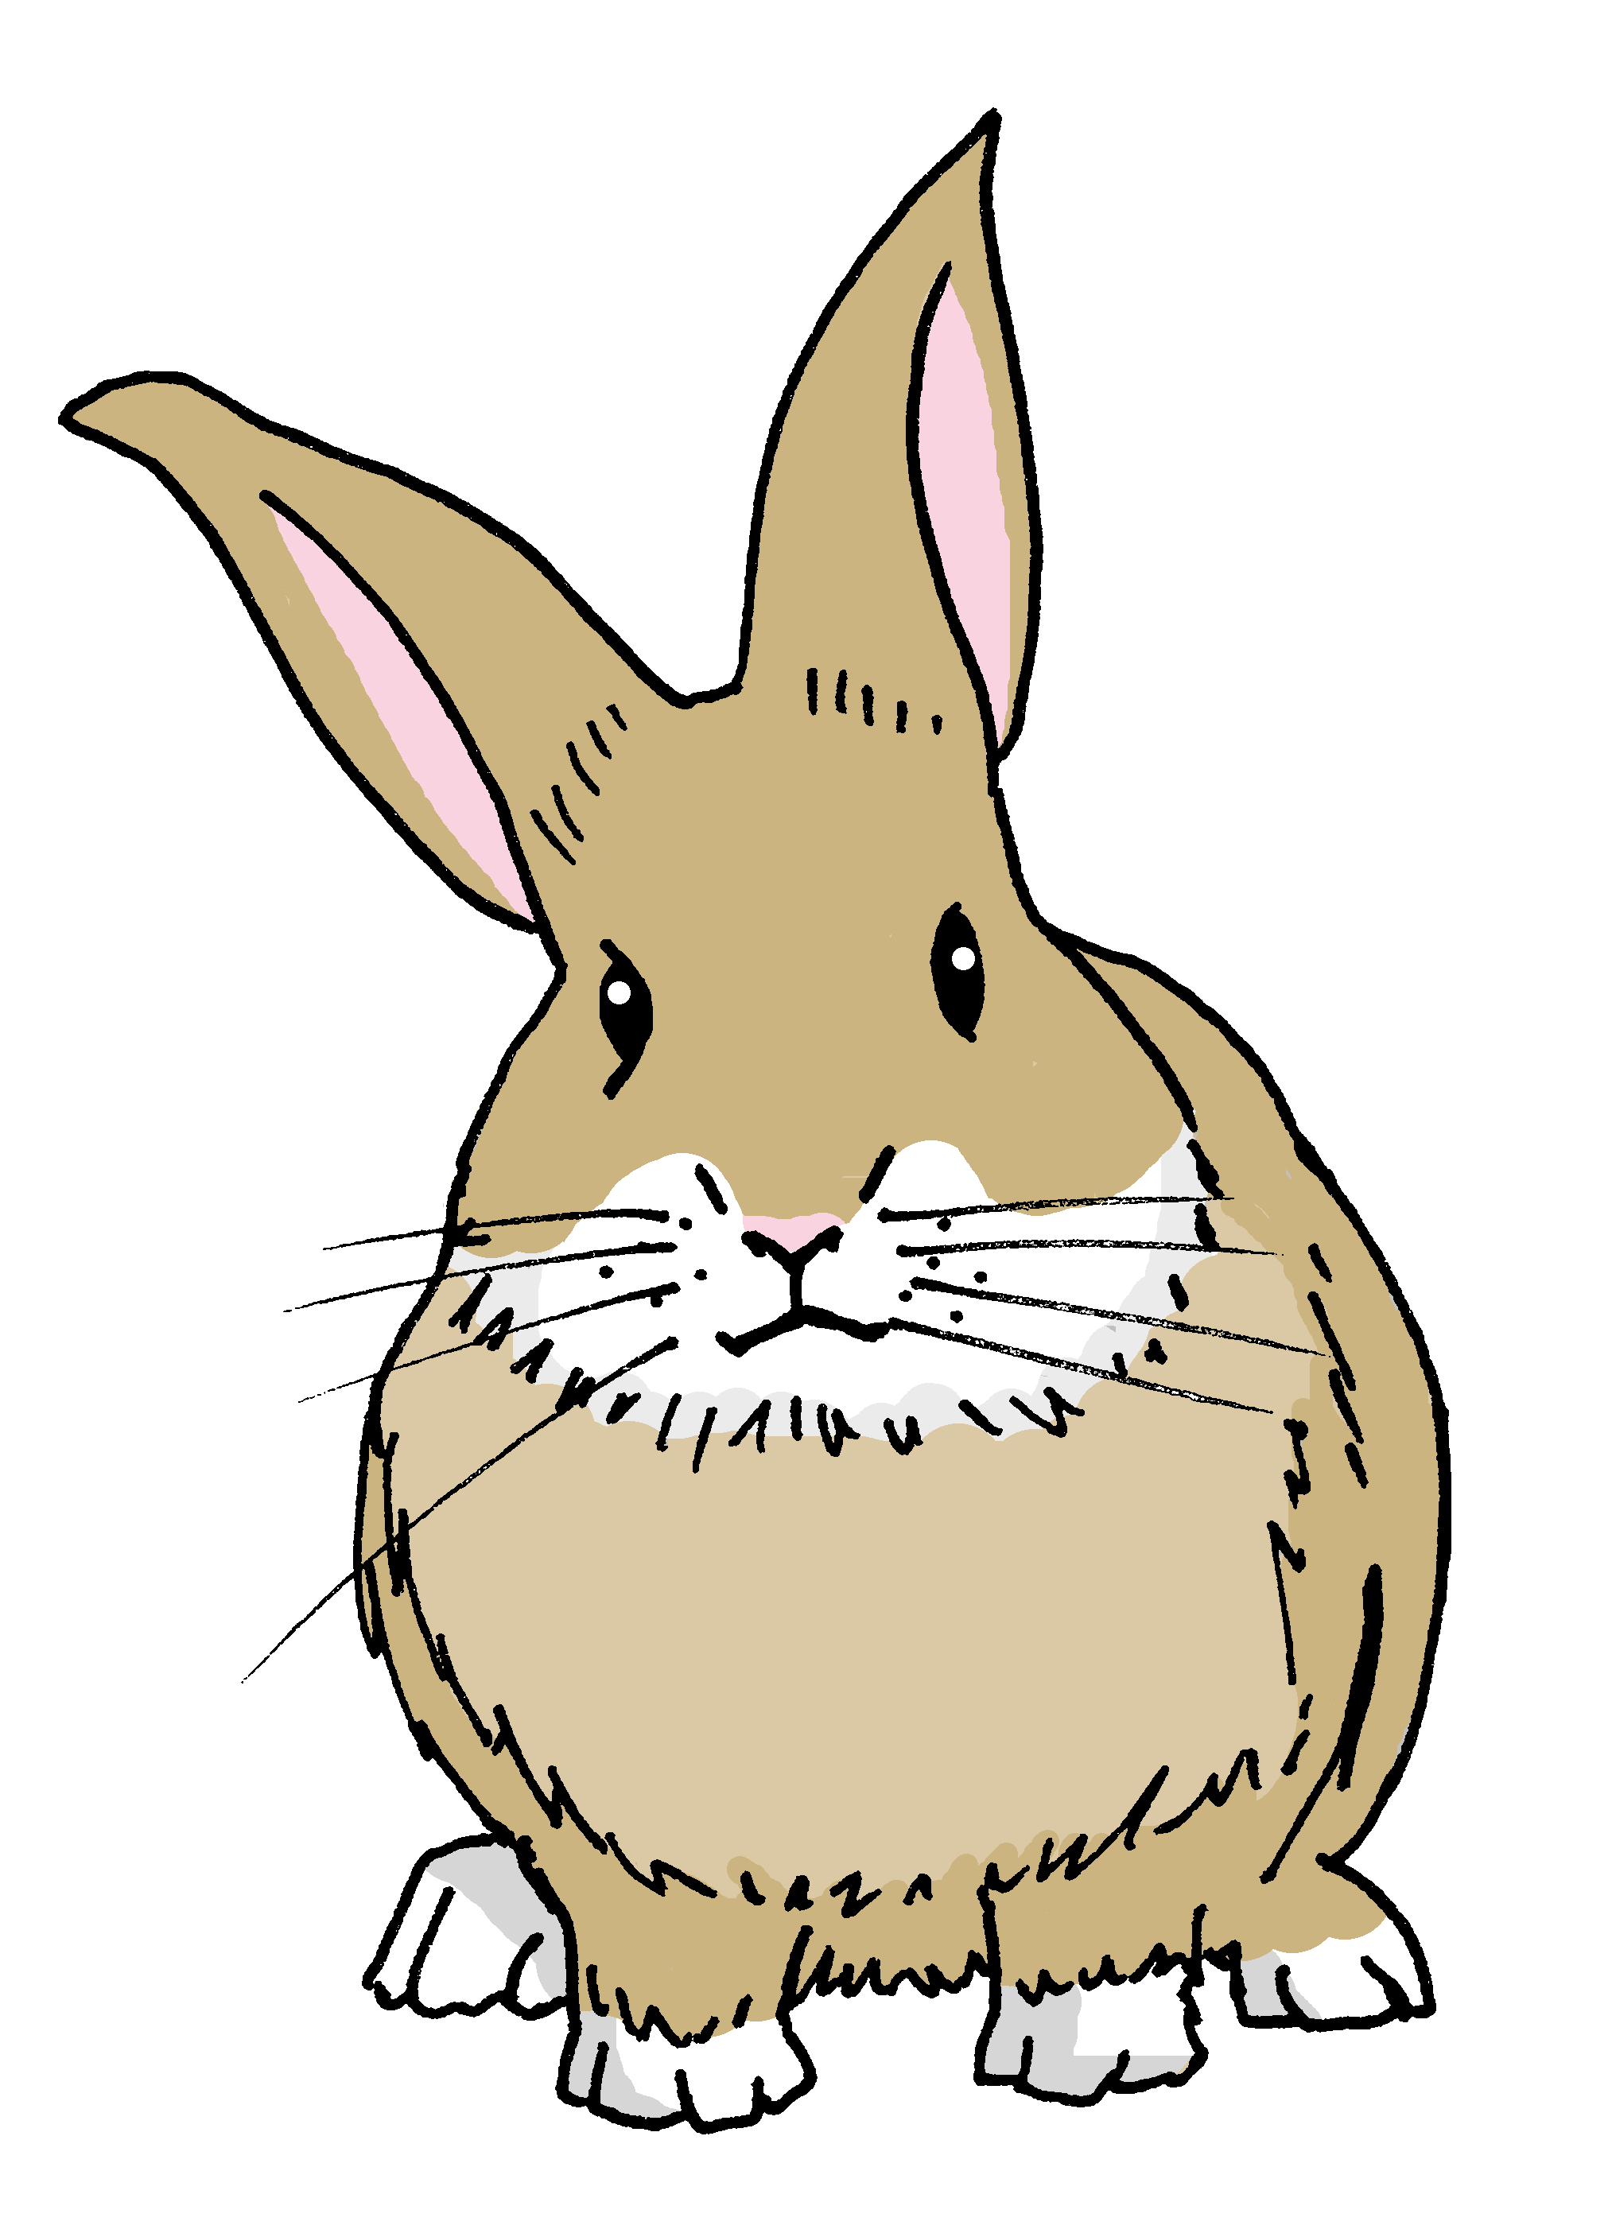
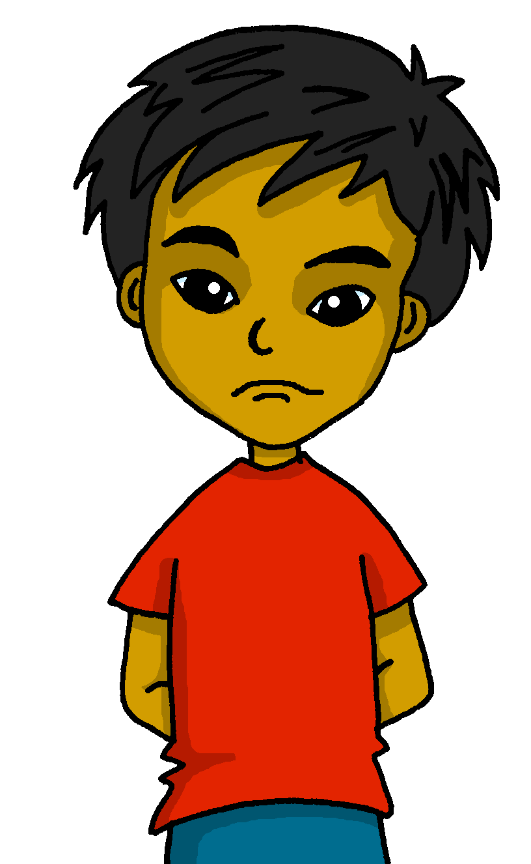
Follow up 3:
Escucha. Escribe en inglés.
hablar
E
Pancho está perdido.
Pancho is lost.
1
¿Estás activo?
Are you active?
2
Estoy enfermo.
I am ill.
3
Estás preparado.
You are ready.
4
Está sano.
He is healthy.
5
Quique está allí.
Quique is there.
Notes:
Timing: 10 minutes (can be split into two five minute sessions)
Aim: to practise aural comprehension of this week’s vocabulary and structures.
Procedure:
1. Pupils write 1-6.
2. Click to play audio.
3. Pupils write the English meaning.
4. Give item by item feedback.
Transcript: E. Pancho está perdido. 1. ¿estás activo? 2. Estoy enfermo. 3. Estás preparado. 4. Está sano. 5. Quique está allí.

Slide 6
Escribe en inglés: Can you get at least15 points?
 | aquí | allí | estoy
 | hola | presente | ausente
 | sí | España | ¿dónde?
 | en | Buenos días | Buenas tardes
 | enfermo | estás | hoy
 | está | ¿cómo? | serio
 | preparado | sano | activo
x3
x2
x1
Notes:
Timing: 5 minutes
Aim: to practise written comprehension of vocabulary from last week and this week.
Procedure: 1. Give pupils a blank grid. They fill in the English meanings of any of the words they know, trying to reach 15 points in total.
Note: The most recently learnt and practised words are pink, words from the previous week are green and those from two weeks ago are blue, thus more points are awarded for them, to recognise that memories fade and more effort (heavy lifting!) is needed to retrieve them.

Slide 7
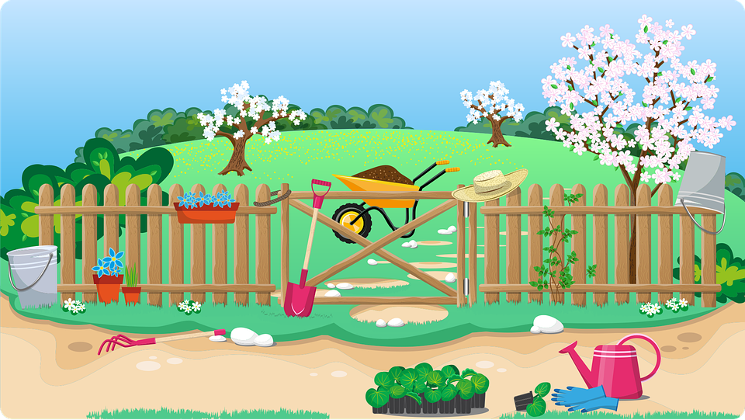
Follow up 4:
lost
ready
ill
active
healthy
¿Dónde está Pancho?
hablar
I am
You are
Estás activo.
He is
Notes:
Timing: 5 minutes
Aim: to correctly use the verbs ‘estoy’, ‘está’ and ‘estás’ in oral production, together with newly learnt vocabulary items.
Procedure:
Pupils select a verb form on the vertical axis with an adjective along the horizontal axis.
They translate the short sentence to identify the square where they think Pancho is.
Click on the square to reveal what is beneath.
Note: pupils might benefit from revisiting the adjectives again before starting the activity.
(!) Pancho is hidden behind….
You are active / Estás activo.

Slide 8
lost
ready
ill
active
healthy
hablar
I am
Estoy enfermo.
You are
He is
Notes:
Pancho is hidden behind… I am ill. / Estoy enfermo.

Slide 9
lost
ready
ill
active
healthy
I am
Estoy sano.
You are
He is
Notes:
Pancho is hidden behind… I am healthy / Estoy sano.

Slide 10
Follow up 5:

Find the difference. Change the Spanish sentence to match the English sentence.


escribir
1 _____________________________
Estoy en la clase.
4 _____________________________
Estás
Está activo hoy.
Estoy
(You are in the classroom).
(I am active today.).


Está preparado.
2 _____________________________
Está en España.
enfermo.
5 _____________________________
¿
?
(He is ill.)
(Is s/he in Spain?)


3 _____________________________
Elena ¿estás aquí?
6 _____________________________
allí?
¿Cómo está hoy?.
estás
(Elena, are you there?
(How are you today?
Notes:
Timing: 5 minutes
Aim: to practise written word meaning recognition and correct written production.
Procedure: 1. Pupils read the English and the Spanish and find one difference. 2. They need to change the Spanish to match the English. 3. Click to provide the answers to each sentence.

