Slide 1
español, con Sofía
¡Feliz Navidad!

Slide 2
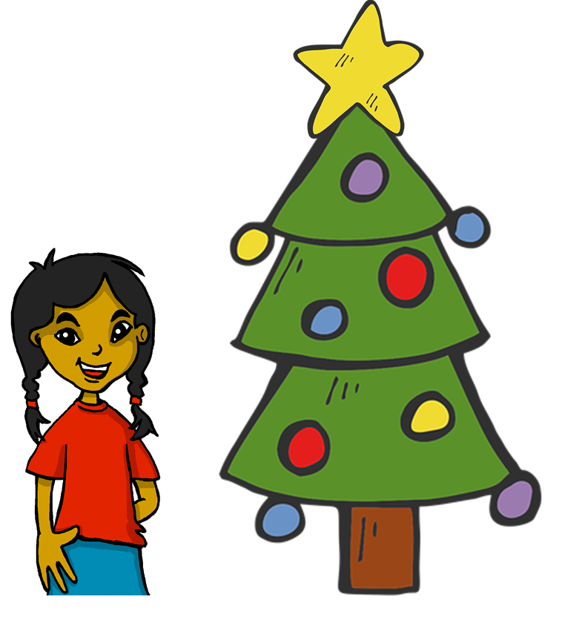
Describing me and others
amarillo
Phonics
Christmas
Notes:
Artwork by Steve Clarke. All additional pictures selected are available under a Creative Commons license, no attribution required.
The frequency rankings for words that occur in this PowerPoint which have been previously introduced in the resources are given in the SOW (excel document) and in the resources that first introduced and formally re-visited those words.
For any other words that occur incidentally in this PowerPoint, frequency rankings will be provided in the notes field wherever possible.
This week starts with the transcription part of the phonics assessment. Note that all remaining activities for this week are included within this PPT. Activities have been designed so that pupils complete them independently and then a nominated pupil can click to provide the answers. The tasks can be used flexibly throughout the week, to allow the teacher to listen to individual pupils completing the read aloud part of the phonics assessment.
Source: Davies, M. & Davies, K. (2018). A frequency dictionary of Spanish: Core vocabulary for learners (2nd ed.). Routledge: London

Slide 3
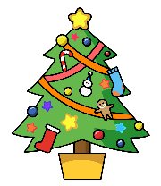
escuchar
¡Feliz Navidad!
Listen and fill the gaps with the correct letter or letters.
 | Names
1 | __ lan
2 | __ steban
3 | __ livia
4 | __ __ ro
5 | __ sabel
6 | __ oe
7 | __ __ nstanza
8 | __ __ leste
9 | __ rsula
10 | __ __ milo
Notes:
Note: Awaiting audio for Camilo Phonics assessment transcription
Timing: 5 minutes
Aim: to assess knowledge of the phonics that pupils have been taught in weeks 1-12 in a listen and transcribe task.
Procedure:
1. Explain that pupils will first listen and fill the gaps with the letters they hear to complete the list of 10 Spanish names. 2. Complete this stage with pupils. Click on each audio button once to hear the names. They are recorded twice with a pause in between for processing. 3. Then move to the next slide.
Transcript:
1. Alan | Alan 2. Esteban | Esteban
3. Olivia | Olivia 4. Ciro | Ciro 5. Isabel | Isabel 6. Zoe | Zoe 7. Constanza | Constanza 8. Celeste | Celeste 9. Úrsula | Úrsula 10. Camilo | Camilo

Slide 4
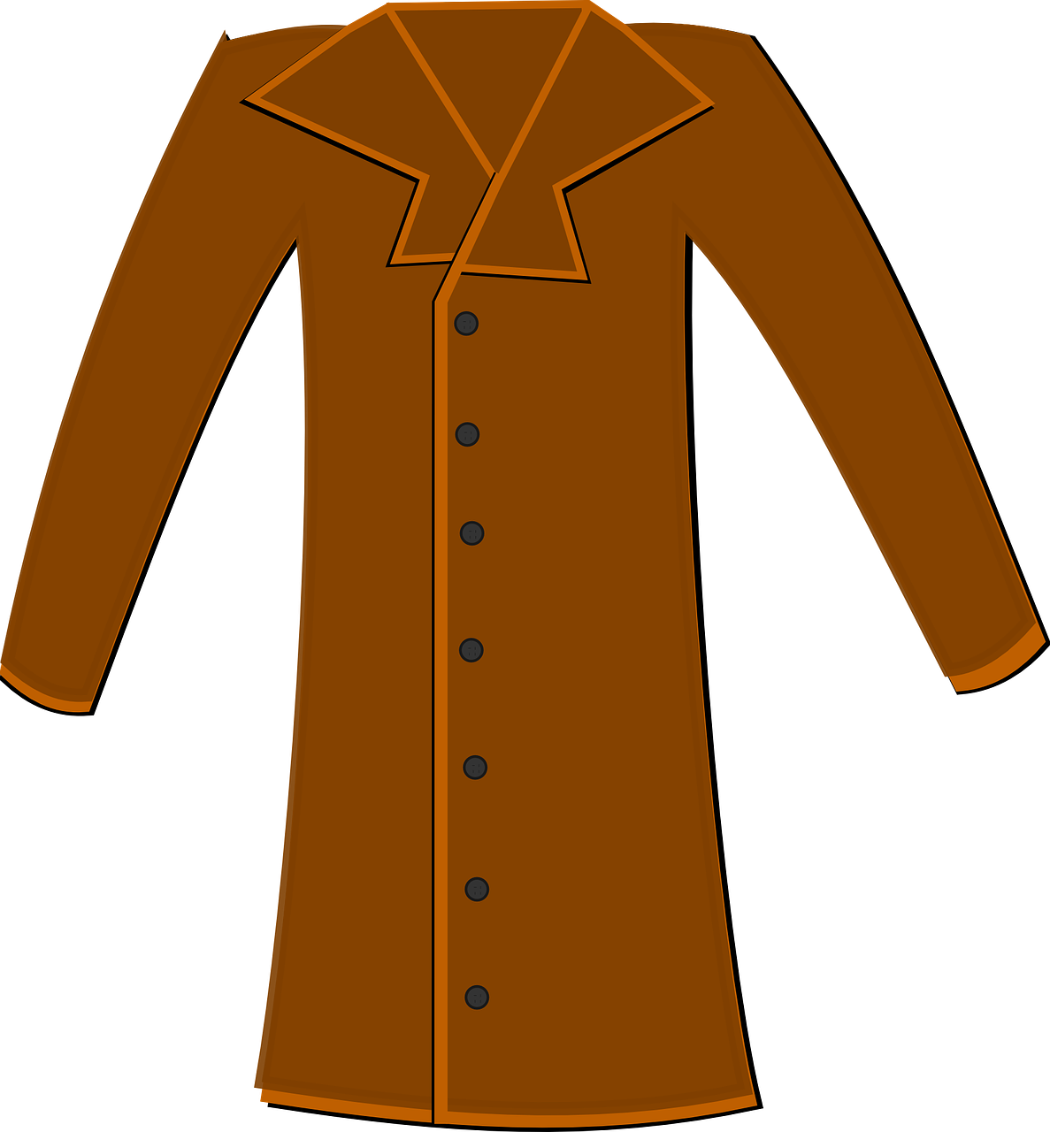
pronunciar
¡Feliz Navidad!
Read aloud the Spanish name and the Christmas present with the same initial sound.
You have not learnt these words so use what you know about how to pronounce Spanish.
abrigo
[a]
Asún
Notes:
Phonics assessment model slide Prior preparation: either print out one set of phonics slides and cut in half or print out individual copies of the pupil version of the phonics quiz; in addition, print out sufficient pupil feedback sheets to have one per pupil as you can mark pupil answers here and give them the sheet as feedback.
Timing: 1 minute
Aim: to introduce the phonics quiz to pupils and model an example.
Procedure:
Explain to pupils that they are going to read aloud the names they transcribed and pronounce the Christmas present with the same initial sound.
Explain that you will listen to each pupil individually during the lessen (during the week) and that during this time, the class will do some other Christmas activities.
3. Click to bring up the SSC, the name and the present item.
4. Elicit the item and the name.
5. Click the words to hear them pronounced.
Note:
there are no follow up lessons this week, so it would be possible to continue the speaking assessments in the follow up time during this week, as needed.
if preferred, and the resources are available, pupils could record their answers (e.g. on computer or ipad) though this would involve the teacher listening back to assess them.
Frequency of unknown words:
abrigo [3827] Source: Davies, M. & Davies, K. (2018). A frequency dictionary of Spanish: Core vocabulary for learners (2nd ed.). Routledge: London
4

Slide 5
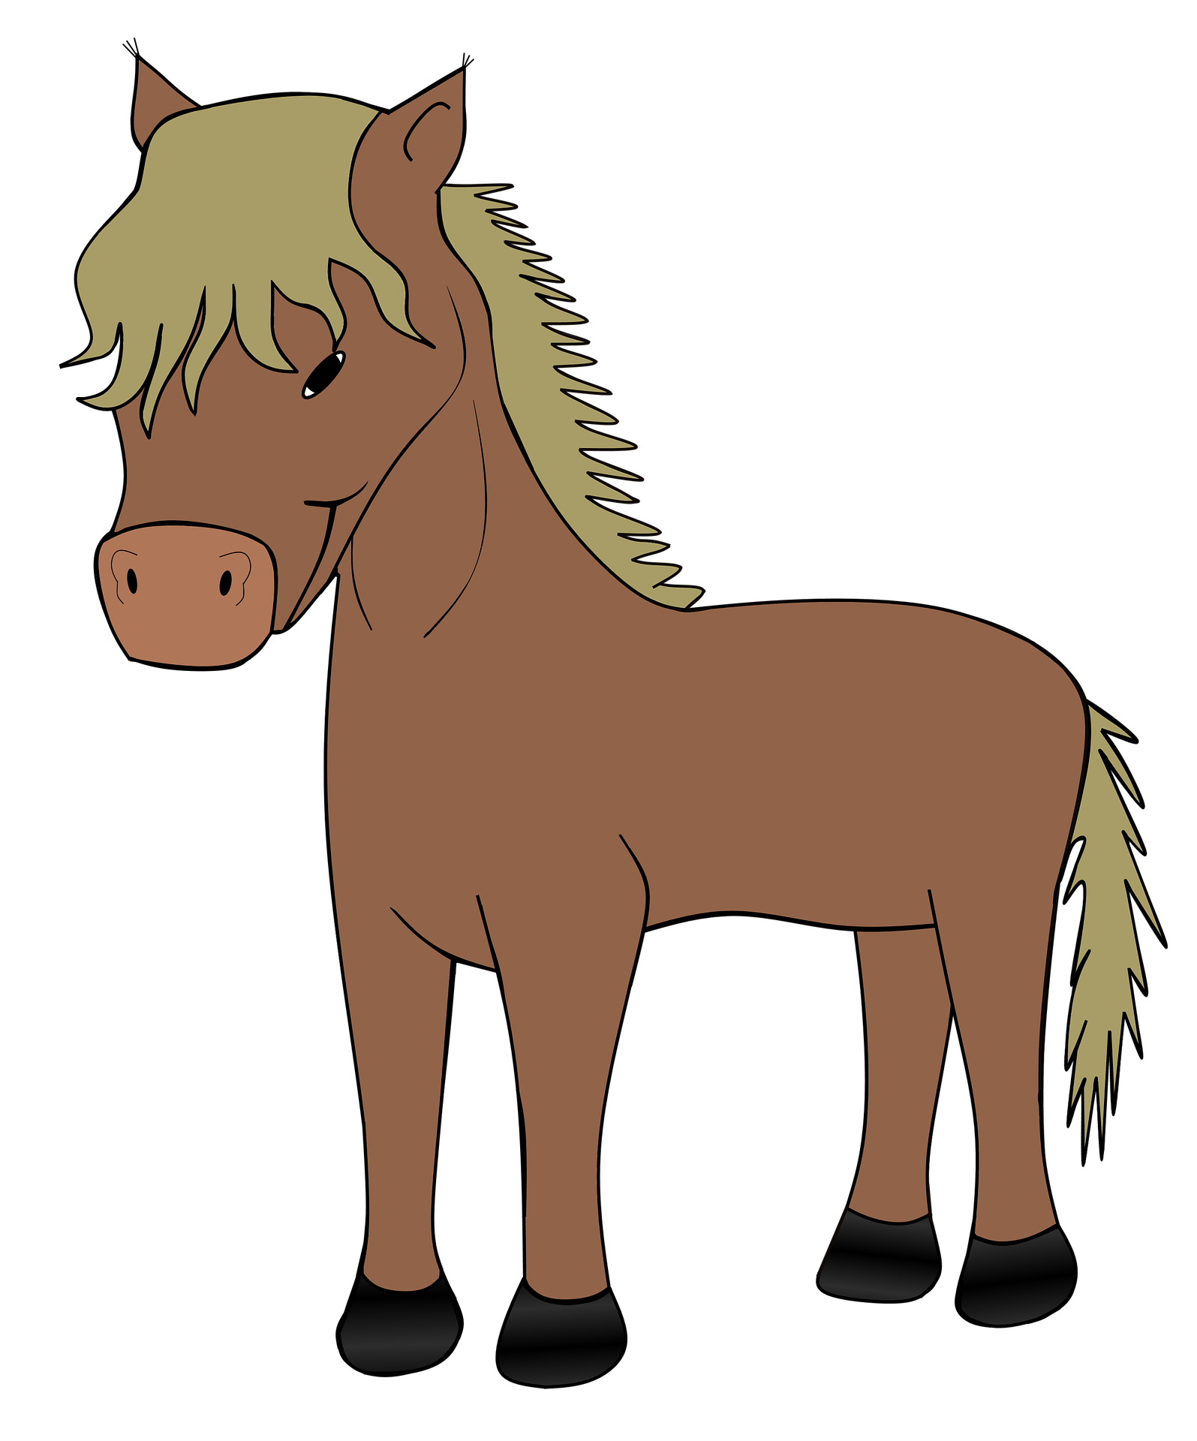
pronunciar
[a]
[e]
pronunciar
abanico
establo
Alan
Esteban
Notes:
Timing: 1 minute per pupil
Aim: to assess pupils’ ability to read aloud the SSC taught this term. Procedure: 1. Give out the independent task that pupils will work on during the lesson. 2. Listen to individual pupils reading the words aloud. Mark in real time.
3. If desired, teachers can listen to the audio versions in preparation.
Note:
there are no follow up lessons this week, so it would be possible to continue the speaking assessments in the follow up time during this week, as needed.
if preferred, and the resources are available, pupils could record their answers (e.g. on computer or ipad) though this would involve the teacher listening back to assess them.
Frequency of unknown words: abanico [>5000] establo [>5000]
Source: Davies, M. & Davies, K. (2018). A frequency dictionary of Spanish: Core vocabulary for learners (2nd ed.). Routledge: London
5

Slide 6
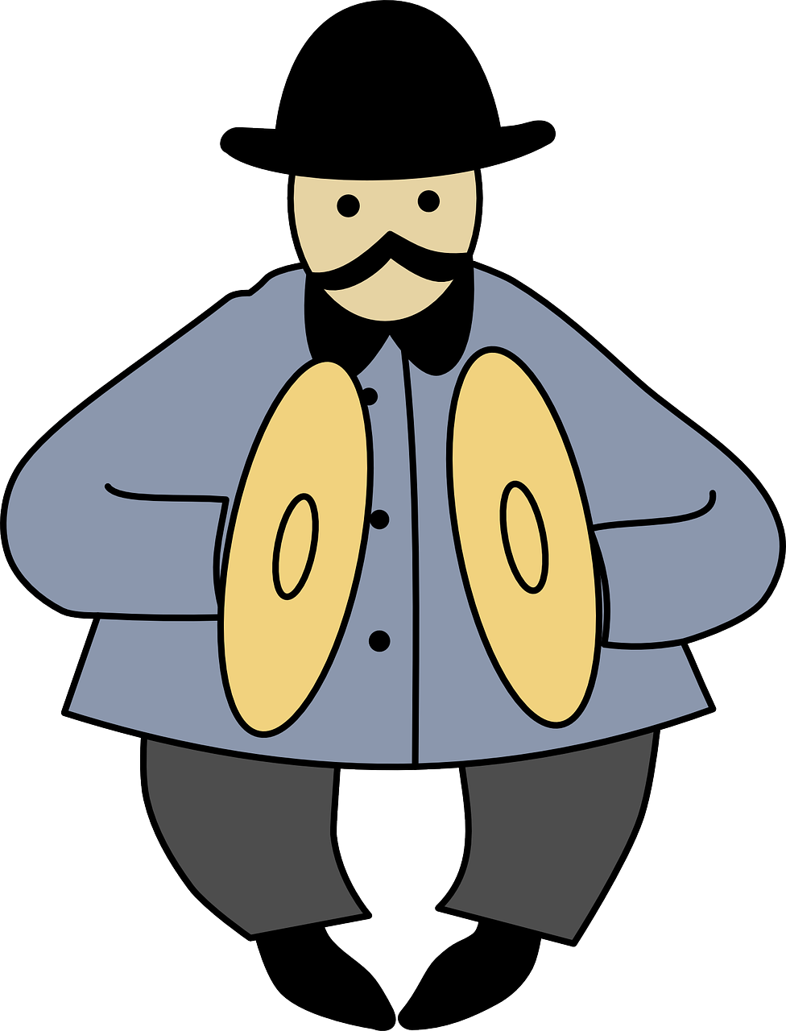
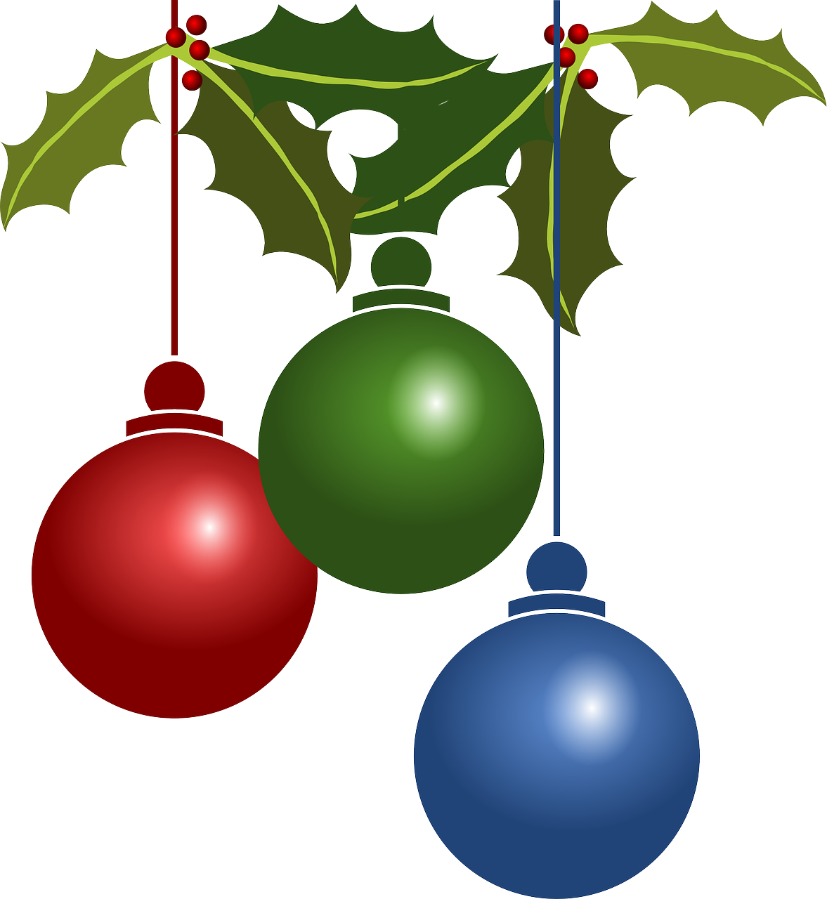
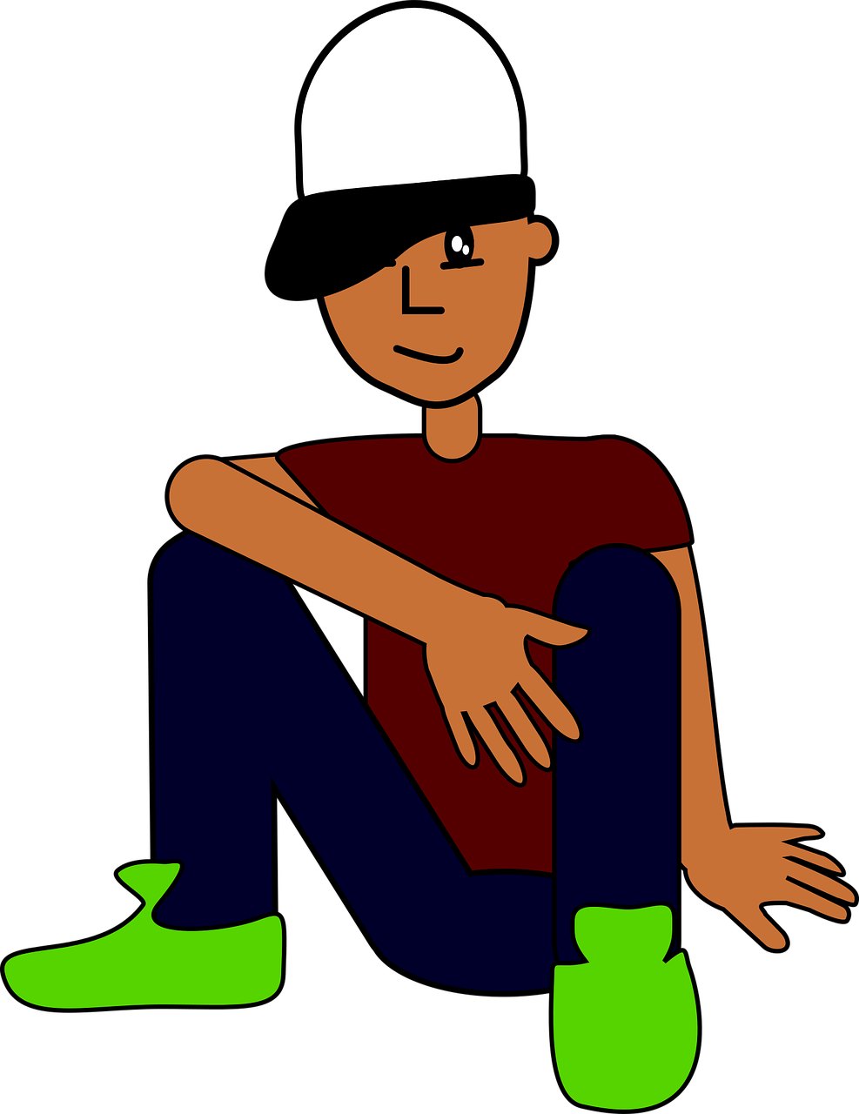
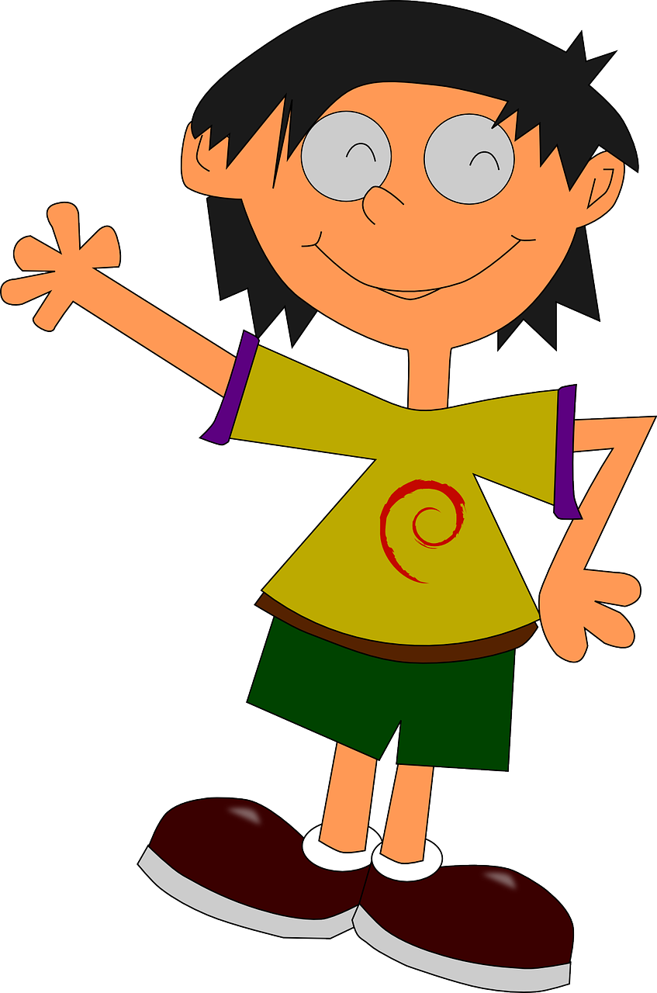
pronunciar
[o]
[ci]
pronunciar
ornamento
címbalos
Olivia
Ciro
Notes:
Frequency of unknown words: címbalo [>5000] ornamento [>5000]
Source: Davies, M. & Davies, K. (2018). A frequency dictionary of Spanish: Core vocabulary for learners (2nd ed.). Routledge: London
6

Slide 7
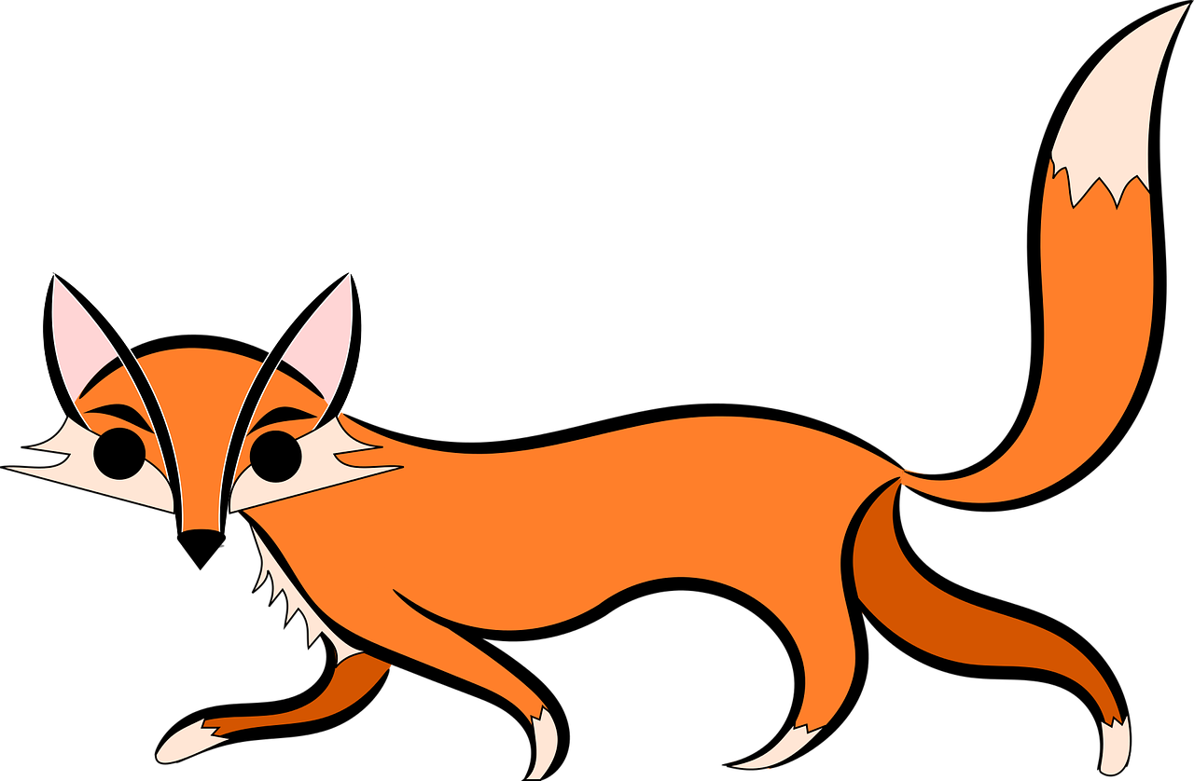
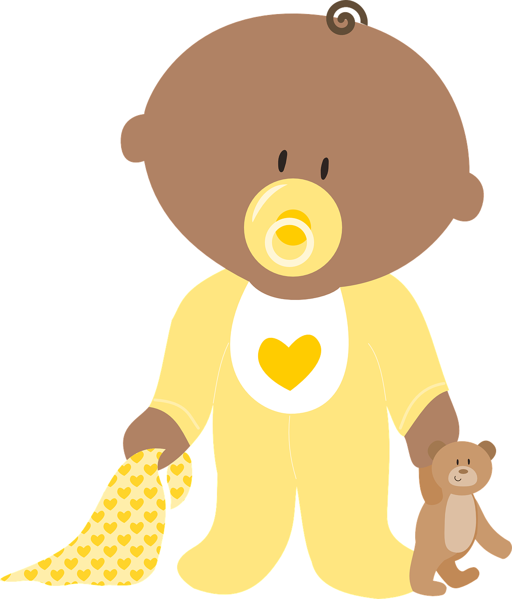
pronunciar
[i]
[z]
pronunciar
imán
zorro
Isabel
Zoe
Notes:
Frequency of unknown words: imán [>5000] zorro [>5000]
Source: Davies, M. & Davies, K. (2018). A frequency dictionary of Spanish: Core vocabulary for learners (2nd ed.). Routledge: London
7

Slide 8
pronunciar
[co]
[ce]
pronunciar
consola
cerdo
Constanza
Celeste
Notes:
Frequency of unknown words: consola [4996] cerdo [3720]
Source: Davies, M. & Davies, K. (2018). A frequency dictionary of Spanish: Core vocabulary for learners (2nd ed.). Routledge: London
8

Slide 9
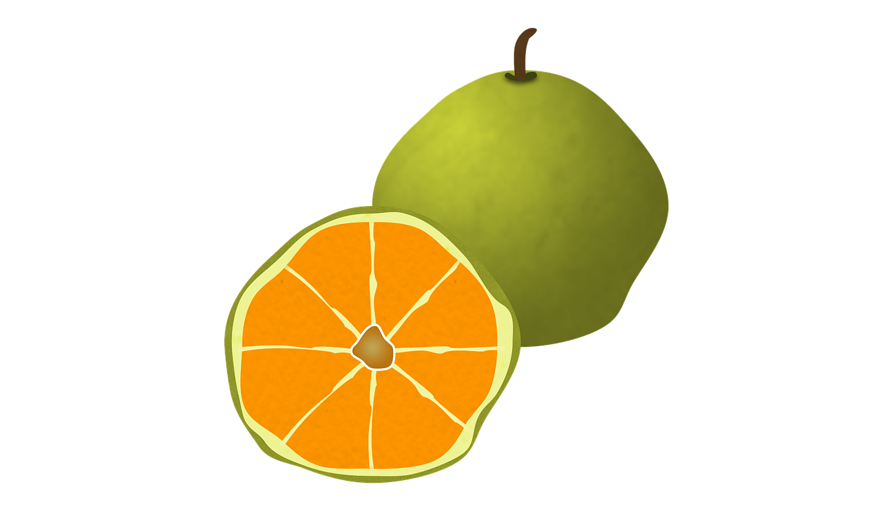
pronunciar
[u]
[ca]
pronunciar
ugli
camisa
Úrsula
Camilo
Notes:
Frequency of unknown words: ugli [>5000] camisa [1873]
Source: Davies, M. & Davies, K. (2018). A frequency dictionary of Spanish: Core vocabulary for learners (2nd ed.). Routledge: London
9

Slide 10
leer
El Roscón de Reyes
¡Es un donut gigante 😮!
A ‘Roscón de Reyes’ is a traditional Spanish brioche-like sweet bread eaten the night before or morning of Reyes or King’s Day (6th January).
Hidden inside, there are a small toy and a small dried kidney bean. The person who finds the small toy will be crowned king for the day and the lucky person who finds the bean has the honour of paying for the whole cake!
el haba
el juguete
Notes:
Timing: 10 minutes
Aim: to learn about a typical food eaten to celebrate el día de los Reyes Magos; to practise spoken recall of singular persons of tener and nouns from weeks 9, 10, 11 and 12.
Procedure: 1. Read the text in English explaining what the Roscón de Reyes is. 2. Tell pupils that they are going to have the chance to practise hiding and finding the bean and the toy.
Image attribution: https://www.hornazart.com/roscones.html

Slide 11
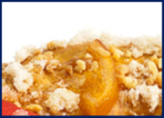
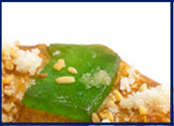
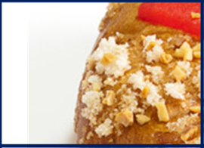
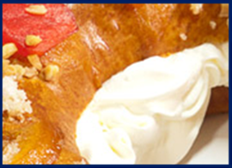
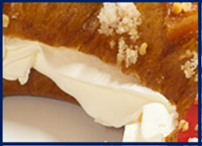
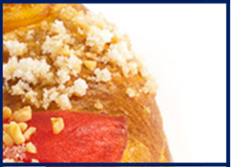
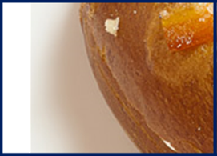
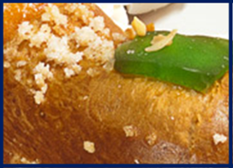
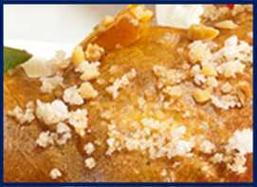
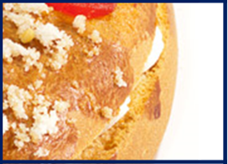
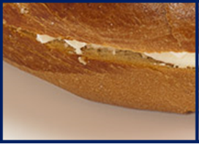
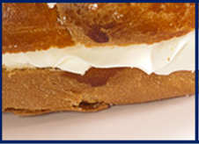
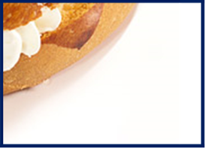
hablar
El Roscón de Reyes [1]
a (female) teacher
a message
a book
a sister
Do you have…?
s/he, it has
you have
I have
Notes:
Teacher-led version of the task (if needed, to model the activity) Aim: to practise spoken production of singular persons of tener and nouns from this term. Procedure: 1. Pupils ask a question or make a statement. E.g. Tienes una hermana. (You have a sister.) 2. Teacher clicks the square to reveal what is underneath. 3. Pupils continue to ask produce utterances until both the both and the king have been located. 4.
You have + exercise book = bean [tienes un cuaderno]
You have + a present = king [tengo un regalo]
A= nouns from week 9
B = nouns from week 10
C = nouns from week 11
D = nouns from week 12
Image attribution: https://www.hornazart.com/roscones.html

Slide 12
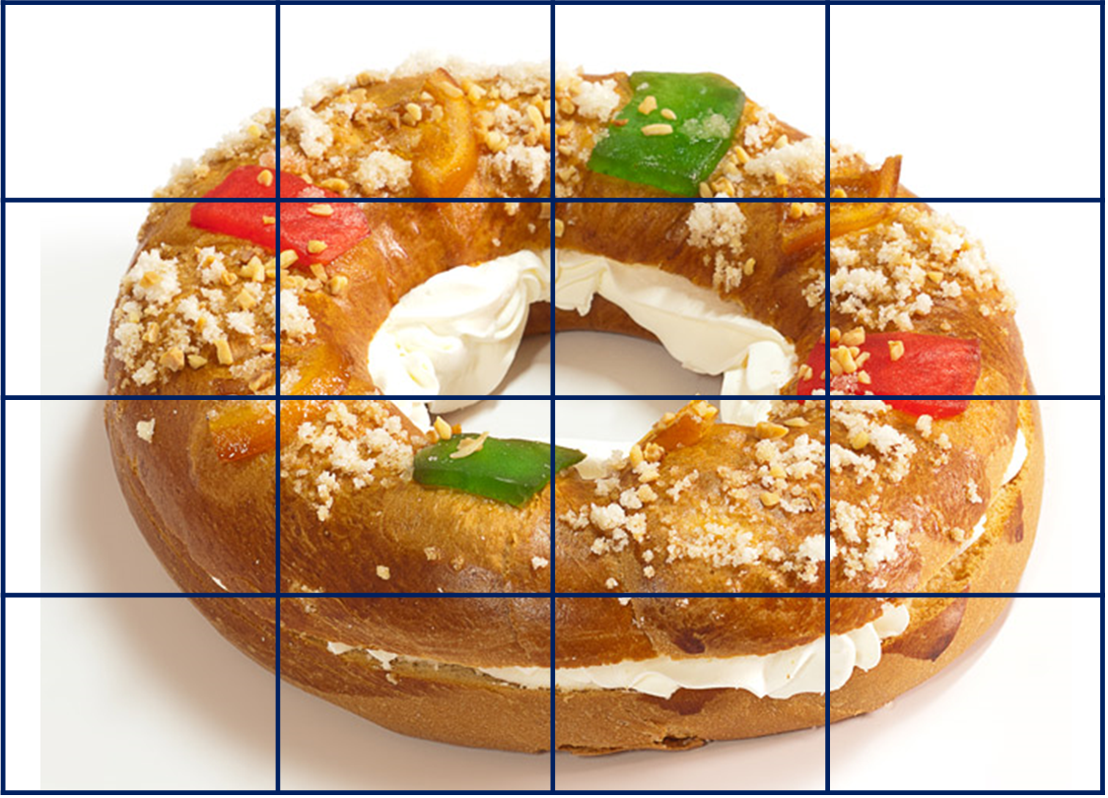
hablar
El Roscón de Reyes
En tu roscón, dibuja ✍ y esconde* el haba y el juguete.
a
b
c
d
1
2
3
el haba
el juguete
4
*esconde: hide
Notes:
Procedure: 1. Display this slide. 2. Pupils collect their handout and secretly draw their bean and toy in their selected cells.
3. They then play in pairs, trying to be the first to find the bean and the king.
4. See the next slide for the hand out which offers the chance to practise all of the nouns from this half-term.
Image attribution: https://www.hornazart.com/roscones.html

Slide 13
handout
El Roscón de Reyes
1 | Do you have? | ¿Tienes…?
2 | s/he, it has | Tiene…
3 | You have | Tienes…
4 | I have | Tengo…
a
b
c
d
a |  | b
English | Spanish | English | Spanish
a boat | un barco | a drawing | un dibujo
a bag | una bolsa | a brother | un hermano
a horse | un caballo | a sister | una hermana
a bed | una cama | a table | una mesa
a book | un libro | a dog | un perro
a plant | una planta | a door | una puerta
1
2
c |  | d
English | Spanish | English | Spanish
a sheet | una hoja | an animal | un animal
an idea | una idea | a thing | una cosa
a pencil | un lápiz | an instrument | un instrumento
a message | un mensaje | a male teacher | un profesor
a word | una palabra
a ruler | una regla | a female teacher | una profesora
3
4
Notes:
Pupil handout
Note: in this version of the game, pupils can say any noun from a, b, c or d when targeting these coordinates. This gives the opportunity to practise saying/reading aloud more vocabulary.
A= nouns from week 9
B = nouns from week 10
C = nouns from week 11
D = nouns from week 12 (plus profesor/a from week 10)
Image attribution: https://www.hornazart.com/roscones.html

Slide 14
hablar
El Roscón de Reyes [2]
a (female) teacher
a message
a book
a sister
Do you have…?
s/he, it has
you have
I have
Notes:
Optional additional round of the teacher-led version of the game
I have have + a question = bean [tengo una pregunta]
S/he has + a female friend = king [tiene una amiga]
A= nouns from week 9
B = nouns from week 10
C = nouns from week 11
D = nouns from week 12
Image attribution: https://www.hornazart.com/roscones.html

Slide 15
¡adiós!
amarillo

Slide 16
a |  | b |  | c |  | d
English | Spanish | English | Spanish | English | Spanish | English | Spanish
a boat | un barco | a drawing | un dibujo | a sheet | una hoja | an animal | un animal
a bag | una bolsa | a brother | un hermano | an idea | una idea | a thing | una cosa
a horse | un caballo | a sister | una hermana | a pencil | un lápiz | an instrument | un instrumento
a bed | una cama | a table | una mesa | a message | un mensaje | a male teacher | un profesor
a book | un libro | a dog | un perro | a word | una palabra | a female teacher | una profesora
a plant | una planta | a door | una puerta | a ruler | una regla
Notes:
A list of the Spanish and English vocabulary for additional support, if needed.

Slide 17
¡Feliz Navidad!
Pupil name: ___________________________________
Total score: _____ / 20
Listen and fill the gaps with the correct letter or letters.
 | Name | Present | SSC [sound-symbol correspondence] | p/ x
1 | Alan | abanico | a
2 | Esteban | establo | e
3 | Olivia | ornamento | co
4 | Ciro | címbalos | ce
5 | Isabel | imán | i
6 | Zoe | zorro | z
7 | Constanza | consola | o
8 | Celeste | cerdo | ci
9 | Úrsula | ugli | u
10 | Camilo | camisa | ca
 | Names
1 | __ lan
2 | __ steban
3 | __ livia
4 | __ __ ro
5 | __ sabel
6 | __ oe
7 | __ __nstanza
8 | __ __ leste
9 | __ rsula
10 | __ __ milo
abanico
establo
ornamento
címbalos
imán
zorro
consola
cerdo
Note: 1] Each item offers two opportunities to assess the same SSC, but only one SSC is assessed per item (e.g. ‘abanico’ only assesses for ‘a’, not for ‘i’ or ‘co’. 2] Teachers award one point for the SSC in each word (max. 2 points per item).
ugli
camisa
Read aloud the Spanish name and the Christmas present with the same initial sound. You have not learnt these words so use what you know about how to pronounce Spanish.
Notes:
This is for the teacher. The right hand side is the marksheet for each pupil, the left hand side is the pupil version.
The audio has both the names and the items for teachers to check against.

Slide 18
Pupil name: ___________________________________
Total score: _____ / 20
Pupil name: ___________________________________
Total score: _____ / 20
 | Name | Present | SSC [sound-symbol correspondence] | p/ x
1 | Alan | abanico | a
2 | Esteban | establo | e
3 | Olivia | ornamento | co
4 | Ciro | címbalos | ce
5 | Isabel | imán | i
6 | Zoe | zorro | z
7 | Constanza | consola | o
8 | Celeste | cerdo | ci
9 | Úrsula | ugli | u
10 | Camilo | camisa | ca
 | Name | Present | SSC [sound-symbol correspondence] | p/ x
1 | Alan | abanico | a
2 | Esteban | establo | e
3 | Olivia | ornamento | co
4 | Ciro | címbalos | ce
5 | Isabel | imán | i
6 | Zoe | zorro | z
7 | Constanza | consola | o
8 | Celeste | cerdo | ci
9 | Úrsula | ugli | u
10 | Camilo | camisa | ca
Note: 1] Each item offers two opportunities to assess the same SSC, but only one SSC is assessed per item (e.g. ‘abanico’ only assesses for ‘a’, not for ‘i’ or ‘co’. 2] Teachers award one point for the SSC in each word (max. 2 points per item).
Note: 1] Each item offers two opportunities to assess the same SSC, but only one SSC is assessed per item (e.g. ‘abanico’ only assesses for ‘a’, not for ‘i’ or ‘co’. 2] Teachers award one point for the SSC in each word (max. 2 points per item).
Notes:
This is two copies of the marksheet for each pupil.

Slide 19
¡Feliz Navidad!
¡Feliz Navidad!
Listen and fill the gaps with the correct letter or letters.
Listen and fill the gaps with the correct letter or letters.
 | Names
1 | __ lan
2 | __ steban
3 | __ livia
4 | __ __ ro
5 | __ sabel
6 | __ oe
7 | __ __nstanza
8 | __ __ leste
9 | __ rsula
10 | __ __ milo
 | Names
1 | __ lan
2 | __ steban
3 | __ livia
4 | __ __ ro
5 | __ sabel
6 | __ oe
7 | __ __nstanza
8 | __ __ leste
9 | __ rsula
10 | __ __ milo
abanico
establo
abanico
establo
ornamento
címbalos
ornamento
címbalos
imán
zorro
imán
zorro
consola
cerdo
consola
cerdo
ugli
camisa
ugli
camisa
Read aloud the Spanish name and the Christmas present with the same initial sound. You have not learnt these words so use what you know about how to pronounce Spanish.
Read aloud the Spanish name and the Christmas present with the same initial sound. You have not learnt these words so use what you know about how to pronounce Spanish.
Notes:
This is two copies of the pupil phonics quiz.

