Slide 1
Saying what I and others have
amarillo
Follow ups 1-5
Notes:
Artwork by Steve Clarke. All additional pictures selected are available under a Creative Commons license, no attribution required.
The frequency rankings for words that occur in this PowerPoint which have been previously introduced in the resources are given in the SOW (excel document) and in the resources that first introduced and formally re-visited those words.
For any other words that occur incidentally in this PowerPoint, frequency rankings will be provided in the notes field wherever possible.
Vocabulary: animal [322] cosa [69] instrumento [1042] papel [393] raro [1005] nuevo [94] viejo [225]
Revisit 1tener [19] tengo [19] barco [1384] caballo [907] cama [609] camisa [1873] libro [230] planta [768] silla [1271] zapato [1477] un [6] una [6]
Revisit 2: activo [1278] enfermo [1092] perdido [1899] preparado [2092] sano [1961] hoy [167] ¿cómo? [151]
SSC: zapato [1477]
Glossed words:
adivinar [2201]
Source: Davies, M. & Davies, K. (2018). A frequency dictionary of Spanish: Core vocabulary for learners (2nd ed.). Routledge: London

Slide 2
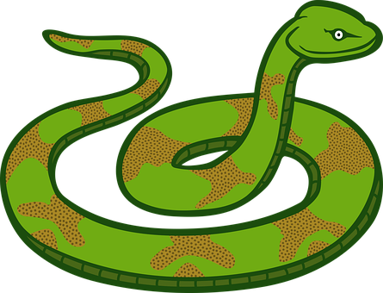
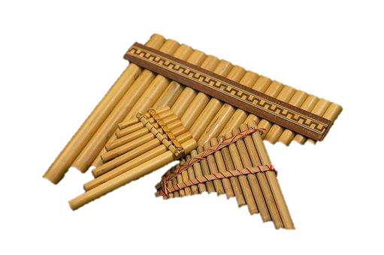
Follow up 1
[z] zapato
[z] sounds the same as [c] in front of [e] [i]
A Escucha. ¿Qué sonido es?
Marca
Sounds like ‘s’ in snake
Sounds like ‘th’ in ‘Theo’
B Escribe una ciudad*.
Tu compañero/a adivina*.
 | s | z
 |  |  | co _ _
 |  |  | _ _ mpoña
 |  |  | pe _ _
 |  |  | _ _ eco
 |  |  | ro _ _ l
 |  |  | _ _ mbomba
¿Tienes [____] ?
Do you have…?
E
s a
[thing]
peso
zampoña
1
za
cosa
2
so
zona
rosal
zueco
3
zu
zambomba
zapato
4
sa
5
za
adivina = guess
Notes:
Timing: 5 minutes
Aim: to develop phonological awareness of [z] in contrast with [s]
Procedure:
Click to bring up the instruction.
Click to bring table and do example together (E).
Students tick and/or write the correct sound [s] [z]
Teachers can ask pupils to identify the two instruments. They have seen ‘la zampoña’ in rojo t3 w9. It’s a wind instrument traditional from the Andean highlands (countries such as Peru, Argentina, Bolivia, Chile, Ecuador, and Colombia). It is considered one of the most important and representative instruments of the Andean culture. Teachers can ask ¿Qué es la zampoña? ‘un instrument’, muy bien ☺ . ¿De dónde es? ¿De España? ¿De Perú…? ‘Zambomba’ is new so teachers should highlight that it’s an instrument of friction typical from Andalusia, Spain.
Part B
Click to bring up reminder of [z] [ce] [ci] sound correlation & instructions.
Partner A writes down one city, partner B tries to guess by asking ‘¿tienes…? + one of the cities on the board.
Teachers circulate to listen to pupils’ pronunciation and praise/correct as necessary.
Transcript [EJ] cosa
[1] zampoña
[2] peso
[3] zueco
[4] rosal
[5] zambomba
Zambomba’s picture from https://www.unionmusical.es/618242-zambomba-samba-6191-zambomba-extragrande-30-x-22-cm.html
adivinar [2201]

Slide 3
Follow up 2:
Vocabulario
¡Excelente! 🤗
vocabulario
un animal
nueva
raro
tiene
tengo
una
odd,weird (m)
paper
a / an (f)
a thing
an animal
new (f)
I have
a book
s/he has
do you have
happy
old (m)
un libro
¿tienes…?
papel
feliz
viejo
una cosa
Notes:
Timing: 5 minutes
Aim: to practise written comprehension and spoken pronunciation of vocabulary for this week and the revisited weeks.
Procedure:
1. Click for English prompt. Pupils need to locate the correct Spanish word and pronounce it, chorally.
2. Click for target word to be highlighted. 3. Repeat for all 12 items.

Slide 4
Follow up 3:
Organiza los adjetivos y completa las tres frases.
leer
The ending changes when the noun is masculine/feminine
The ending is the same for a masculine/feminine noun
raro
feliz
enfermo
sana
imposible
preparada
increíble
-o
- When referring to a singular masculine noun, these adjectives end in _______
- When referring to a singular feminine noun, these adjectives end in ____
- Adjectives ending in ______ or –z have the same ending for a masculine/feminine noun.
-a
-e
Notes:
Timing: 5 minutes
Aim: to revisit the rule for regular gender adjectival agreement.
Procedure:
1. Read the instruction in Spanish.
2. Pupils have to arrange the adjectives in the two different categories (all previously introduced, including Week 12 new items - raro, feliz). 3. Once the words are arranged, ask them to complete the rule.

Slide 5
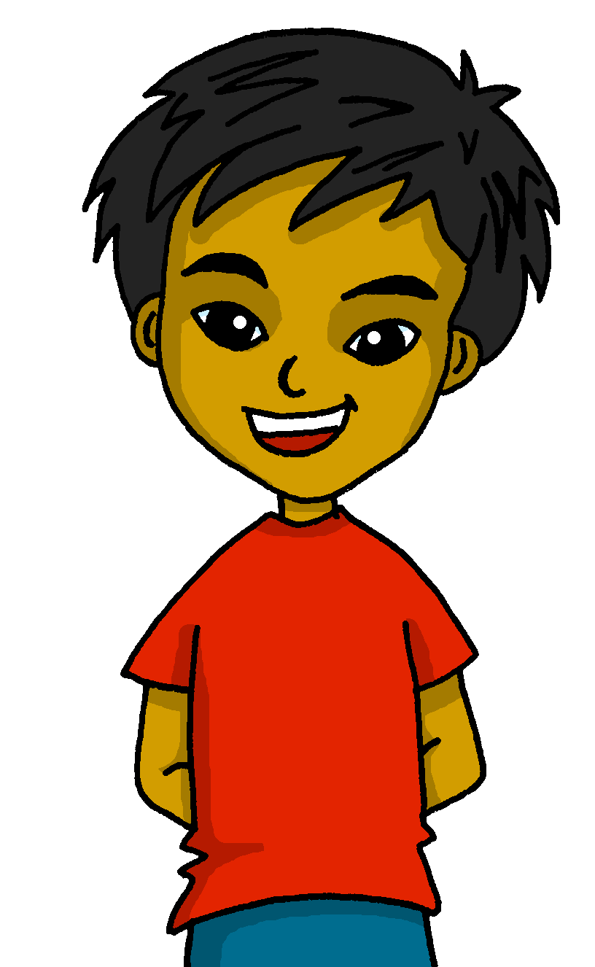
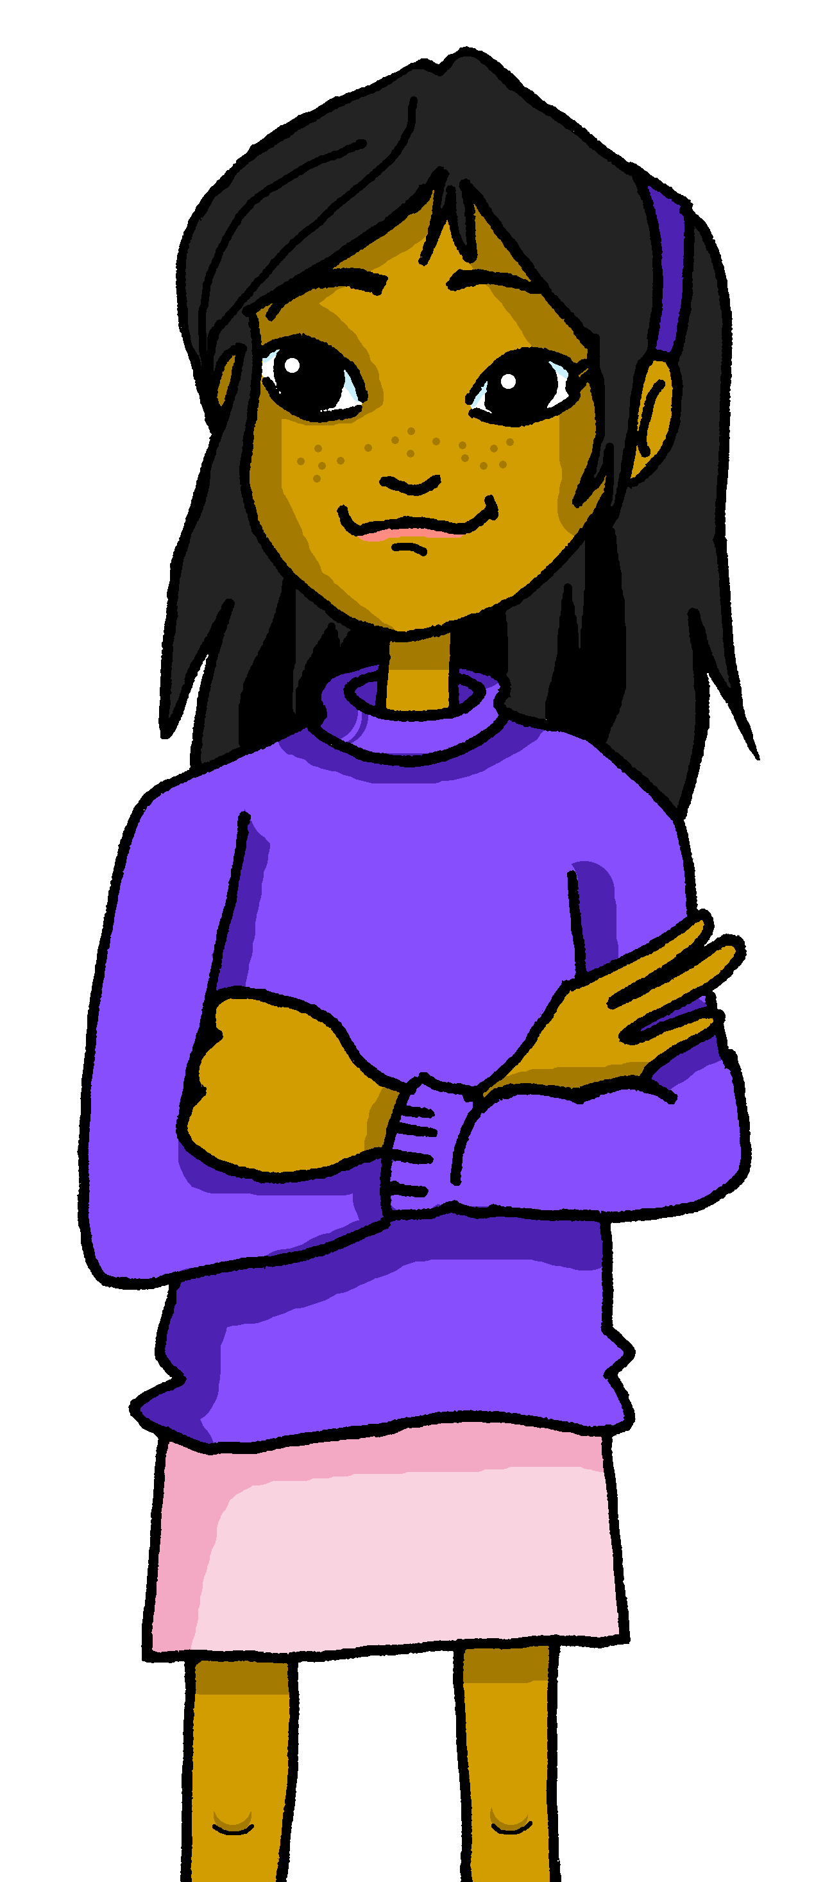
Yes/no questions
Remember! Turn a statement into a yes/no question by making your voice go up at the end.
Tengo un lápiz.
I have a pencil.
¿Tengo un lápiz?
Do I have a pencil?
Remember how to say ‘you have’:
Tienes una idea.
You have an idea.
Ask someone else ‘do you have?’ using tienes and making your voice go up.
¿Tienes un libro?
Do you have a book?
Notes:
Do this recap slide before Follow up 4.
Timing: 2 minutes
Aim: to recap tienes and raised intonation questions.
Procedure:
1. Click to bring up each new part of the explanation.
2. Elicit the English for the Spanish examples after each animated question mark.

Slide 6
Follow up 4:
Habla
Say the Spanish sentence. [1/5]
You do not need all of the words!
hablar
Do I have an old book?
15
¿Tengo un libro viejo?
S
una
un
tienes
cuaderno
viejo
tengo
vieja
libro
0
INICIO
Notes:
Time: 6-8 minutes (5 slides)
Aim: to practise oral sentence building. Targeted features: postnominal regular gender agreement | revisit tengo / tienes / tiene | raised intonation questions. Procedure:
1. Click for English sentence and Spanish prompt words. 2. Click inicio to start the timer.
3. Pupils select from the words given to create and say the sentence out loud before the time elapses. 4. Click for the Spanish sentence to appear.

Slide 7
Follow up 4:
Habla
Say the Spanish sentence. [2/5]
You do not need all of the words!
hablar
You have a healthy brother.
15
Tienes un hermano sano.
S
una
tiene
tienes
sano
enfermo
sana
hermana
un
hermano
0
INICIO
Notes:
Time: 6-8 minutes (5 slides)
Aim: to practise oral sentence building. Targeted features: postnominal regular gender agreement | revisit tengo / tienes / tiene | raised intonation questions. Procedure:
1. Click for English sentence and Spanish prompt words. 2. Click inicio to start the timer.
3. Pupils select from the words given to create and say the sentence out loud before the time elapses. 4. Click for the Spanish sentence to appear.

Slide 8
Follow up 4:
Habla
Say the Spanish sentence. [3/5]
You do not need all of the words!
hablar
She has happy dog.
15
Tiene un perro feliz.
S
feliz
perro
tienes
activo
tengo
triste
una
un
tiene
0
INICIO
Notes:
Time: 6-8 minutes (5 slides)
Aim: to practise oral sentence building. Targeted features: postnominal regular gender agreement | revisit tengo / tienes / tiene | raised intonation questions. Procedure:
1. Click for English sentence and Spanish prompt words. 2. Click inicio to start the timer.
3. Pupils select from the words given to create and say the sentence out loud before the time elapses. 4. Click for the Spanish sentence to appear.

Slide 9
Follow up 4:
Habla
Say the Spanish sentence. [4/5]
You do not need all of the words!
hablar
Do you have a sick plant?
15
¿Tienes una planta enferma?
S
sano
planta
pelota
una
activo
sana
enferma
tienes
un
enfermo
tiene
0
INICIO
Notes:
Time: 6-8 minutes (5 slides)
Aim: to practise oral sentence building. Targeted features: postnominal regular gender agreement | revisit tengo / tienes / tiene | raised intonation questions. Procedure:
1. Click for English sentence and Spanish prompt words. 2. Click inicio to start the timer.
3. Pupils select from the words given to create and say the sentence out loud before the time elapses. 4. Click for the Spanish sentence to appear.

Slide 10
Follow up 4:
Habla
Say the Spanish sentence. [5/5]
You do not need all of the words!
hablar
Does s/he have a new bike?
15
¿Tiene una bici nueva?
S
barco
bici
tienes
lento
tengo
lenta
nuevo
una
un
tiene
nueva
0
INICIO
Notes:
Time: 6-8 minutes (5 slides)
Aim: to practise oral sentence building. Targeted features: postnominal regular gender agreement | revisit tengo / tienes / tiene | raised intonation questions. Procedure:
1. Click for English sentence and Spanish prompt words. 2. Click inicio to start the timer.
3. Pupils select from the words given to create and say the sentence out loud before the time elapses. 4. Click for the Spanish sentence to appear.

Slide 11
Follow up 5a:
Escribe en inglés: Can you get at least 15 points?
 | perdido | enferma | hoy
 | sano | preparada | how?
 | tener | un barco | un libro
 | tengo | una | una silla
 | una cosa | raro | nuevo
 | un animal | viejo | un instrumento
 | papel | tiene | tienes
lost (m)
Sick, ill (f)
today
vocabulario
vocabulario
x3
healthy (m)
ready (f)
¿cómo?
to have, having
a boat
a book
x2
I have
a /an (feminine)
a chair
a thing
weird, odd
new
an animal
old
an instrument
x1
paper
s/he has
you have
Notes:
Timing: 5 minutes
Aim: to practise written production of vocabulary for this week and previous weeks.
Procedure:
1. Pupils need to write the Spanish for as many words as possible, aiming to get at least 15 points (but more if possible).
2. Click for Spanish answers.

Slide 12
Follow up 5b:
Escribe en español: Can you get at least 15 points?
 | lost | today | How?
 | ready | healthy | ill, sick
 | I have | a book | a boat
 | to have, having | a chair | a/an (feminine)
 | an animal | a thing | you have
 | paper | new | odd, weird
 | an instrument | old | s/he has
perdido
hoy
¿Cómo?
vocabulario
vocabulario
x3
preparada
sano
enferma
tengo
un libro
un barco
x2
tener
una silla
una
un animal
una cosa
tienes
papel
nuevo
raro
x1
un instrumento
viejo
tiene
Notes:
Timing: 6 minutes
Aim: to practise written production of vocabulary for this week and previous weeks.
Procedure:
1. Pupils need to write the Spanish for as many words as possible, aiming to get at least 15 points (but more if possible).
2. Click for Spanish answers.

Slide 13
Handout 5a
Escribe en inglés: Can you get at least 15 points?
 | perdido | enferma | hoy
 | sano | preparada | how?
 | tener | un barco | un libro
 | tengo | una | una silla
 | una cosa | raro | nuevo
 | un animal | viejo | un instrumento
 | papel | tiene | tienes
vocabulario
vocabulario
x3
x2
x1
Notes:
HANDOUT

Slide 14
Handout 5b:
Escribe en español: Can you get at least 15 points?
 | lost | today | How?
 | ready | healthy | ill, sick
 | I have | a book | a boat
 | to have, having | a chair | a/an (feminine)
 | an animal | a thing | you have
 | paper | new | odd, weird
 | an instrument | old | s/he has
vocabulario
vocabulario
x3
x2
x1
Notes:
HANDOUT

