Slide 1
español, con Quique

Slide 2
Describing me and others
amarillo
- tener: 1st & 3rd person singular (I, you)
- SSC [ce] [ci]
Notes:
Artwork by Steve Clarke. All additional pictures selected are available under a Creative Commons license, no attribution required.
The frequency rankings for words that occur in this PowerPoint which have been previously introduced in the resources are given in the SOW (excel document) and in the resources that first introduced and formally re-visited those words.
For any other words that occur incidentally in this PowerPoint, frequency rankings will be provided in the notes field wherever possible.
SSC: decir [32] centro [317]
Cluster: cerca [1042] celebrar [886] dulce [1861] cero [1731] cocina [1214]
Vocabulary: tienes [19] hoja [916] idea [247] lápiz [3740] mensaje [847] palabra [192] regla [1380]
Revisit 1: qué [50] día [65] lunes [1370] martes [3101] miércoles [1816] jueves [1650] viernes [1259] sábado [1179] domingo [693]
Revisit 2: estás [21] sí [45] no [11] en1 [5] ¡Buenos días! [103/65] ¡Buenas tardes! [103/392]
Glossed words: adivinar [2201] caer [251] estuche [>5000] cuidado [1822] correctamente [4173]
Source: Davies, M. & Davies, K. (2018). A frequency dictionary of Spanish: Core vocabulary for learners (2nd ed.). Routledge: London

Slide 3
pronunciar
[ci]
decir
[to say, tell]
[ce]
centro
Notes:
Timing: 1 minute
Aim: to revisit SSC [ce] and [ci]
Procedure:
Present and elicit the pronunciation of the individual SSC [ci] and then the source word ‘decir’ (with gesture, if using).
Click to bring up the picture and get students to repeat (with gesture, if using).
Present and elicit the pronunciation of the individual SSC [ce] and then the source word ‘centro’ (with gesture, if using).
Suggested gestures: i) For ‘centre’, pupils can bring their two index fingers together to touch as per the image where arrows converge in a central point.
ii) British sign language for ‘say’ is to lift the right index finger to mouth and then direct it quickly away from the body (as though tracing the trajectory of a string of words coming out of the mouth towards a listener in front). For a video, see here: https://www.signbsl.com/sign/say

Slide 4
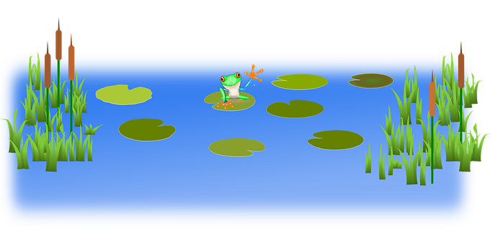
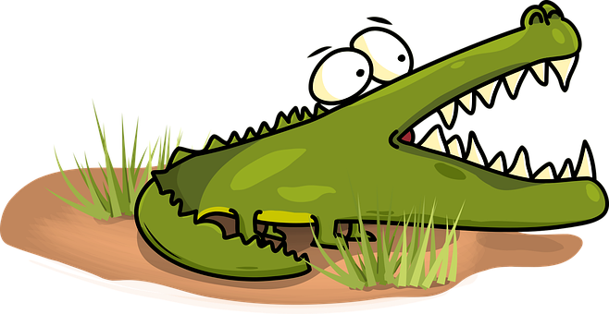
hablar
¡Cuidado con el cocodrilo!
cuidado = be careful correctamente = correctly
caer = to fall
[ce]
[ci]
Pronuncia las palabras correctamente para no caer al agua.
Turno 1: Persona A
Turno 2: Persona B
30
centro
dulce
noticia
habitación
S
cocina
cielo
ciudad
oficina
0
cine
celebrar
cero
INICIO
Notes:
Timing: 5 minutes
Aim: to practise knowledge of [ce] [ci] to known and unknown words.
Procedure:
Click to bring up the instruction.
Pupils work in pairs to practise pronunciation. They can choose where to start and have 30 seconds to pronounce all the words correctly to avoid being eaten by the crocodile.
Divide the class in A & B and click to indicate it’s ‘persona A’’s turn.
Click to bring up Persona B’s turn.
Click on the words to hear them pronounced, as required.
cuidado [1822] correctamente [4173] caer [251]

Slide 5
vocabulario
¿Cómo es en español?
una palabra
un mensaje
una regla
un lápiz
un
dibujo
una puerta
una
hoja
una idea
a pencil
a message
a sheet
a door
a ruler
an idea
a word
a drawing
Notes:
Timing: 5 minutes
Aim: to revisit words from previous weeks and introduce six new nouns for this week.
Procedure: 1. Click for an English prompt.
2. Elicit the Spanish word from pupils. 3. Continue until all 8 items have been seen and heard.
Note: The new words are also illustrated with a picture; previously learnt words are not illustrated.

Slide 6
leer
(el) estuche = pencil case
¿Es ‘un’ o ‘una’?
¿Es posible [P] o imposible [I] ?
Escribe 1 – 7 y [P] o [I].
1
Tengo un perro.
Tengo una hermana.
Tengo un libro.
Tengo una hoja.
Tengo un lápiz.
Tengo una regla.
Tengo un mensaje.
[P]
2
[I]
3
[I]
En mi estuche…
4
[I]
5
[P]
6
[P]
7
[P]
Notes:
Timing: 5 minutes
Aim: to practise connection of the correct singular indefinite article with the corresponding noun; in addition, to practise written comprehension of the new vocabulary for this week.
Procedure:
Explain that Quique has written a list of things she has but split her hot chocolate on it. Elicit the full sentences from pupils (chorally), including the missing articles. E.g. Teacher: uno. Pupils: Tengo un perro. Click each time to reveal the correct article, after pupils have spoken.
Click to bring up and title and instructions. Read the title – ‘¿Es posible o imposible?’ Ensure that pupils understand the title. These two words are new for this week.
Explain that this is a list of what Quique says she has in her pencil case, but is she being sensible or joking? Is what he says possible or impossible?
Do [1] with them to model the task.
Paying attention to the word meaning and comparing it to what they can see would fit into the pencil case, pupils write [I] or [P].
Elicit posible or imposible from pupils. Click to reveal the answers. Where it is posible, a 2nd click moves the item into the pencil case.
estuche [>5000]

Slide 7
Tener: tienes
[to have | having]: you have
We have already seen the verb tener means ‘to have’.
I
you
To mean I have, use ‘tengo’.
For ‘you have’, use ‘tienes’.
Tengo un caballo.
¡Tienes un caballo!
Tengo un perro, Santi.
Tengo un perro.
¡Tienes un caballo!
I have a (male) dog.
¡You have a horse!
Notes:
Timing: 2 minutes
Aim: to introduce 2nd person singular of tener: ‘tienes’
Procedure:
Present the information about tener (to have).
Elicit English translations for the Spanish examples provided.

Slide 8
Yes/no questions
Remember! Turn a statement into a yes/no question by making your voice go up at the end.
Tengo un lápiz.
I have a pencil.
¿Tengo un lápiz?
Do I have a pencil?
Remember how to say ‘you have’:
Tienes una idea.
You have an idea.
Ask someone else ‘do you have?’ using tienes and making your voice go up.
¿Tienes un libro?
Do you have a book?
Notes:
Timing: 2 minutes
Aim: to recap tienes and raised intonation questions.
Procedure:
1. Click to bring up each new part of the explanation.
2. Elicit the English for the Spanish examples after each animated question mark.

Slide 9
escuchar
Escucha. Quique habla.
Is he asking himself or Ángela?
¿Qué es? Escribe.
Marca
Do I have…? | Do you have…? | en inglés
E
a plant
1
a brother
2
a drawing
3
a message
4
a word
5
a (female) teacher
6
a sheet
Notes:
Timing: 6 minutes
Aim: to practise aural comprehension of singular and plural nouns and differentiate between tengo and tienes, connecting these with their meanings in yes/no questions.
Procedure:
Pupils write 1-6 in their books and I and you.
Click to listen to the example. Pupils decide whether question means do I have or do you have.
Click to listen again. Pupils write the meaning of the noun in English.
Complete the task with items 1-6, listening once for the verb.
Click to correct.
Listen again to understand the nouns.
Click to reveal noun answers.
Transcript:
Ej. ¿Tengo una planta?
1. ¿Tienes un hermano?
2. ¿Tengo un dibujo?
3. ¿Tienes un mensaje?
4. ¿Tengo una palabra?
5. ¿Tienes una profesora?
6. ¿Tienes una hoja?

Slide 10
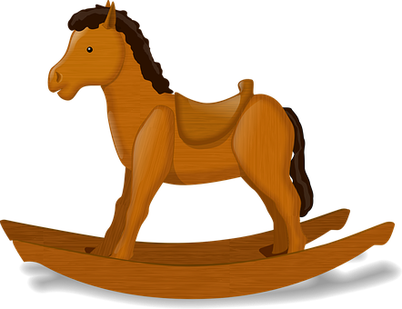
hablar
(el) compañero/a = male/female partner
adivina = s/he guesses
Escribe un número (1-4) en secreto.
Tu compañero/a adivina:
‘Do you have…..?’
1
2
un | caballo
 | mensaje
 | libro
 | lápiz
 | perro
 | barco
3
4
una | palabra
 | hoja
 | puerta
 | regla
 | planta
Notes:
Timing: 5 minutes
Aim: to practise oral production tengo, tienes, the six new nouns from this week and previously taught nouns.
Procedure: 1. Pupil A chooses (in secret) a pencil case. 2. Pupil B asks questions to guess which pencil case A has chosen. 3. When B correctly guesses, pupils swap and repeat the task. Note: for more able groups / pupils, teachers could remove or partially obscure the vocabulary support, either before the first round, or for subsequent rounds, to increase the challenge.
adivinar [2201] compañero [551]

Slide 11
¡adiós!
amarillo

