Slide 1
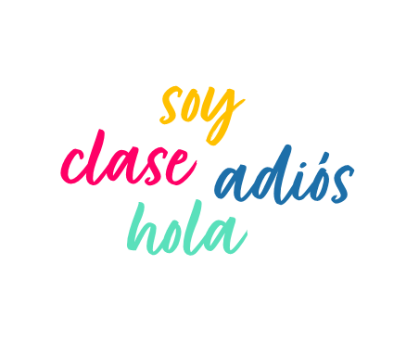
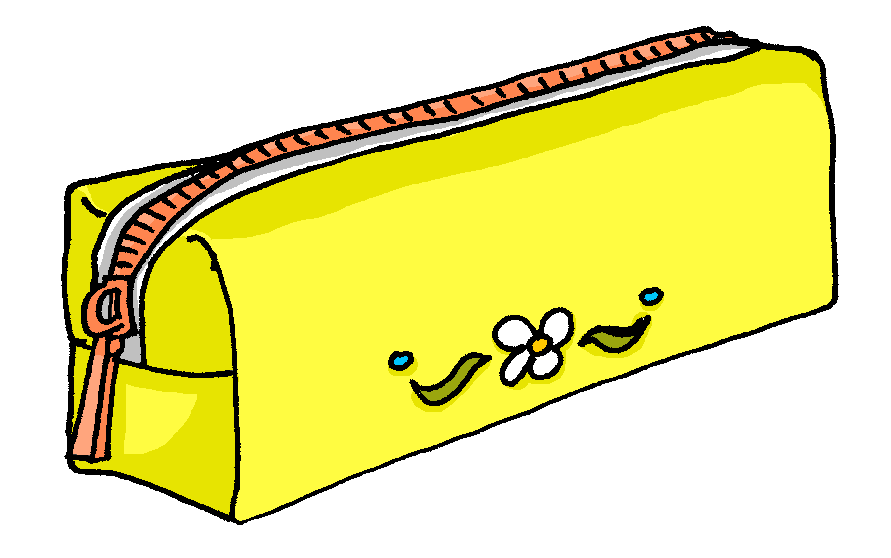
Saying what I and others have
amarillo
Follow ups 1-5
Notes:
Artwork by Steve Clarke. All additional pictures selected are available under a Creative Commons license, no attribution required.
The frequency rankings for words that occur in this PowerPoint which have been previously introduced in the resources are given in the SOW (excel document) and in the resources that first introduced and formally re-visited those words.
For any other words that occur incidentally in this PowerPoint, frequency rankings will be provided in the notes field wherever possible.
SSC: decir [32] centro [317]
Cluster: cerca [1042] celebrar [886] dulce [1861] cero [1731] cocina [1214]
Vocabulary: tienes [19] hoja [916] idea [247] lápiz [3740] mensaje [847] palabra [192] regla [1380]
Revisit 1: qué [50] día [65] lunes [1370] martes [3101] miércoles [1816] jueves [1650] viernes [1259] sábado [1179] domingo [693]
Revisit 2: estás [21] sí [45] no [11] en1 [5] ¡Buenos días! [103/65] ¡Buenas tardes! [103/392]
Glossed words: adivinar [2201] caer [251] corregir [2351] cuidado [1822] correctamente [4173]
Source: Davies, M. & Davies, K. (2018). A frequency dictionary of Spanish: Core vocabulary for learners (2nd ed.). Routledge: London

Slide 2
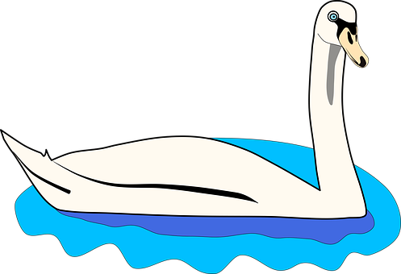
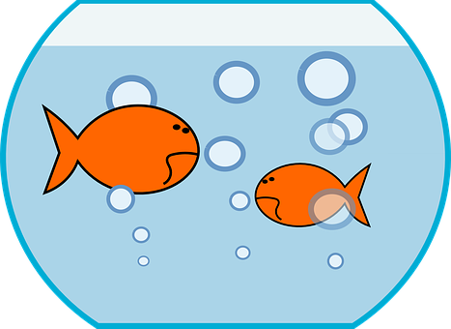
Follow up 1
Marca
pronunciar
Escucha. ¿Qué sonido es?
 | ce | ci
 |  |  | _ _ sne
 |  |  | _ _ elo
 |  |  | _ _ leste
 |  |  | _ _ en
 |  |  | pe_ _ s
 |  |  | co _ _ nero
 |  |  | impa _ _ ente
Practica con tu compañero/a.
El cisne está en el lago
bajo un cielo soleado
el agua es celeste
y cien peces huyen
del co cinero impaciente
60
E
c i
the swan is in the lake
1
c i
c e
under a sunny sky
2
[sky-blue]
S
3
c i
100
the water is sky-blue
4
c e
and hundreds of fish run away
5
c i
6
c i
from the impatient cook
0
😤
INICIO
Notes:
Timing: 5 minutes
Aim: to develop phonological awareness of [ce] [ci] in a read aloud task.
Procedure:
Click to bring up the instruction.
Click to bring up table and do example together (E).
Students tick and/or write the correct sound [ce] [ci]
Click to reveal answers and elicit pupils’ pronunciation of each word.
Click to bring up Part B and read instructions.
Click to bring up the poem.
Allow pupils to practise in pairs.
Click on the text to listen to it.
Practise one more time as a whole class.
Transcript Part A: [EJ] cisne
[1] cielo
[2] celeste [3] cien
[4] peces
[5] cocinero
[6] impaciente
Transcript Part B: El cisne está en el lago
bajo un cielo soleado
el agua es celestele
y cien peces huyen
del cocinero impaciente

Slide 3
Follow up 2:
Escribe 1 – 10 y las palabras en inglés.
leer
mensaje | regla | barco | botella | palabra | idea | hermana | cama | caballo | lápiz
word for ‘a/an’
word for ‘a/an’
en inglés
en inglés
1
2
3
4
5
idea
una
message
un
6
7
8
9
10
ruler
una
sister
una
boat
un
bed
una
bottle
una
horse
un
word
una
pencil
un
Notes:
Timing: 5 minutes
Aim: to practise written comprehension of new vocabulary and its correct association with the appropriate indefinite article (word for ‘a/an’).
Procedure:
1. Read the instruction in Spanish.
2. Pupils are to write down the English meanings of the nouns (in order as they appear from the left on the ‘tickertape’). Note: the tickertape is set to repeat until the next mouse click. Pupils may need to see as many as 3 – 4 repetitions to get all of the words.
3. Pupils can volunteer the answers orally. Written answers appear on clicks. 4. Teacher clicks to bring up the 2nd prompt ‘word for ‘a/an’’.
5. Pupils write in the indefinite articles.
6. Elicit and click to reveal answers.

Slide 4
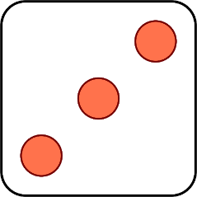
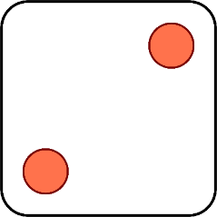
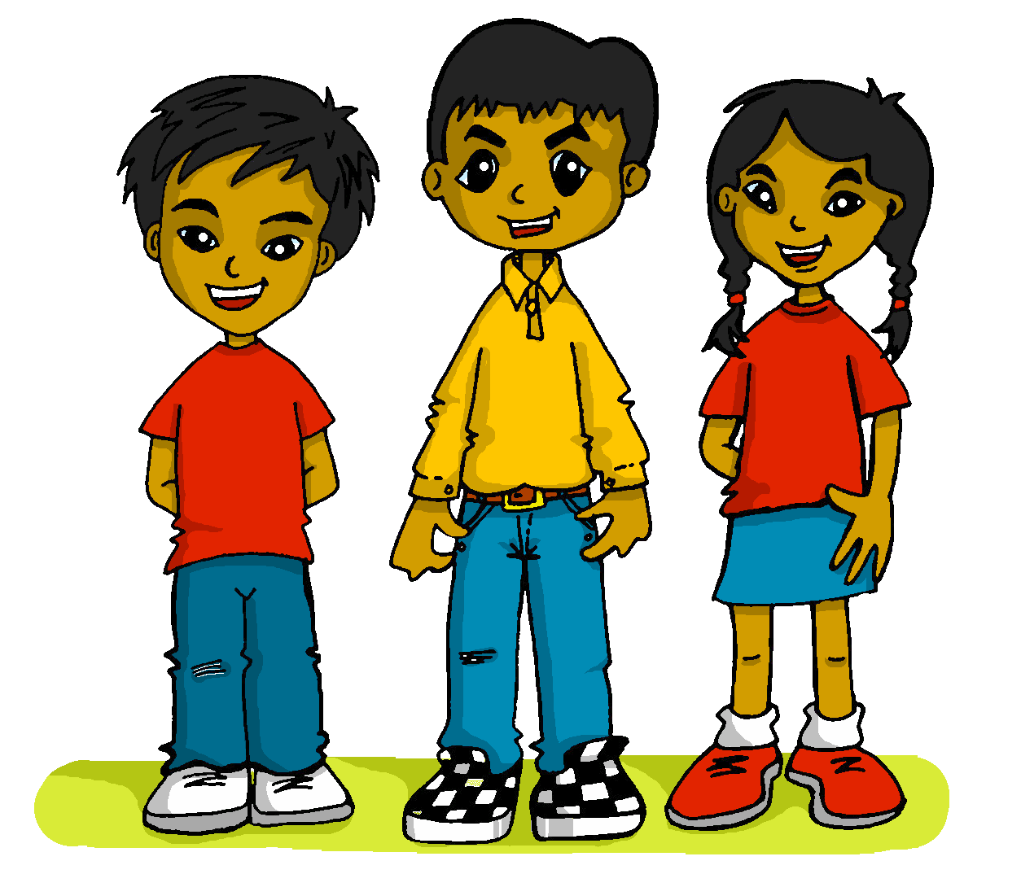
Follow up 3
Con tu compañero/a, habla en español.
Quique, Luis and Sofía are playing a game. What do they have to say each time in Spanish?
hablar
¿Tienes una regla?
Tengo una palabra.
Tienes un mensaje.
¿Tengo un lápiz?
¿Tiene una hoja?
Tiene una idea.
1 | I have…
2 | You have…
3 | She has…
4 | Do I have…?
5 | Do you have…?
6 | Does he have…?
1 | a pencil
2 | a message
3 | a word
4 | a ruler
5 | an idea
6 | a sheet
Notes:
Timing: 5 minutes
Aim: to practise oral production of three parts of tener (question and answer) and the six new nouns from this week.
Procedure: 1. Click to ‘roll’ the dice.
2. Pupils translate the verbs and nouns whose numbers correspond to the respective dice to make a short sentence. They say the answer chorally.
3. Click to reveal the correct sentence.
4. Repeat until all six combinations have been said.

Slide 5
Follow up 4
una hoja
Persona A: Round 1
hablar
Persona B: Round 1
1. ___ _____ a sheet.
 | Which verb?
1
I have
Tengo…
Tienes…
Person A says: una hoja
Tengo una hoja.
Person B hears ‘hoja’ and replies with the full sentence, using either tengo or tienes.
Person A writes the missing sentence beginning in English.
Notes:
Timing: 2 minutes (plus 7 minutes for the task)
Aim: to model the speaking task.
Procedure:
1. Click to model each step and explain it. 2. Then give out the handouts. (two slides at the end of the presentation)

Slide 6
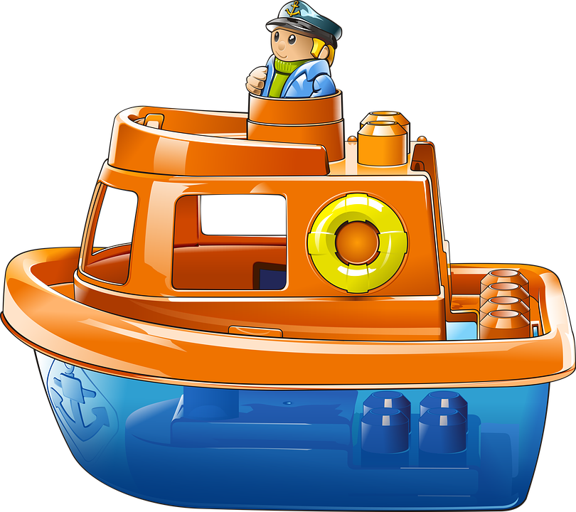
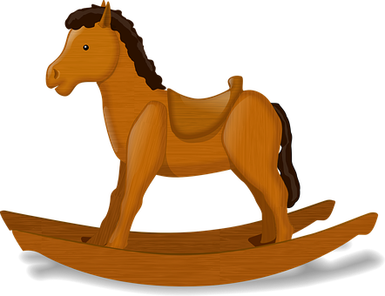
Follow up 4:
Es correcto? ✅
Persona A: Round 1
hablar
Persona B: Round 1
1. ___ _______ a sheet.
2. ___ _______ a pencil.
3. ___ _______ a boat.
4. ___ _______ a horse.
5. ___ _______ a word.
I have
una hoja
1
2
3
4
5
Tengo…
Tienes…
I have
un lápiz
Tengo una hoja.
You have
un barco
Tengo un lápiz.
Tienes un barco.
You have
un caballo
Tienes un caballo.
I have
una palabra
Tengo una palabra.
Notes:
DO NOT DISPLAY DURING THE TASK Timing: 1 minute
Aim: to give feedback to all pupils on Round 1.
Procedure:
Elicit the half sentence for number 1 from A pupils. Click to reveal.
Elicit the corresponding full sentence for number 1 from B pupils.
Click to confirm the full sentence in Spanish and A’s sentence beginning in English.
Continue for items 2 – 5.
Then go to the next slide to give feedback on Round 2.
corregir [2351]

Slide 7
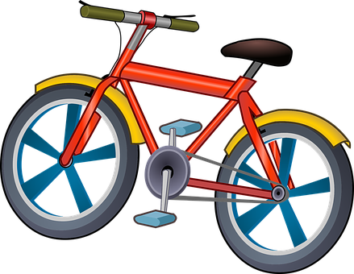
Follow up 4:
Es correcto? ✅
Persona B: Round 2
Persona A: Round 2
hablar
1
2
3
4
5
1. ___ _______ a dog.
2. ___ _______ a (female) teacher.
3. ___ _______ an idea.
4. ___ _______ a bottle.
5. ___ _______ a ruler.
Tengo…
Tienes…
You have
un perro
Tienes un perro.
You have
una profesora
Tienes una profesora.
I have
una idea
Tengo una idea.
You have
una botella
Tienes una botella.
I have
una regla
Tengo una regla.
Notes:
DO NOT DISPLAY DURING THE TASK Timing: 1 minute
Aim: to give feedback to all pupils on Round 2.
Procedure:
Elicit the half sentence for number 1 from A pupils. Click to reveal.
Elicit the corresponding full sentence for number 1 from B pupils.
Click to confirm the full sentence in Spanish and A’s sentence beginning in English.
Continue for items 2 – 5.
corregir [2351]

Slide 8
Follow up 5a:
Escribe en inglés: Can you get at least 15 points?
 | estás | ¡Buenas tardes! | ¡Buenos días!
 | viernes | lunes | en
 | jueves | sábado | miércoles
 | ¿qué? | un día | martes
 | una hoja | un lápiz | tengo
 | una palabra | un mensaje | una regla
 | tienes | una idea | tiene
you are (state)
Good afternoon
Good morning
vocabulario
x3
Friday
Monday
in
Thursday
Saturday
Wednesday
x2
what
a day
Tuesday
a sheet
a pencil
I have
a word
a message
a ruler
x1
you have
an idea
he/she/it has
Notes:
Timing: 6 minutes
Aim: to practise written comprehension of vocabulary from last week and this week.
Procedure: 1. Give pupils a blank grid. They fill in the English meanings of any of the words they know, trying to reach 15 points in total.
Note: The most recently learnt and practised words are pink, words from the previous week are green and those from two weeks ago are blue, thus more points are awarded for them, to recognise that memories fade and more effort (heavy lifting!) is needed to retrieve them.

Slide 9
Follow up 5b:
Escribe en español: Can you get at least 15 points?
 | Monday | Good afternoon | Good morning
 | You are (state) | Friday | in
 | Tuesday | Wednesday | Thursday
 | a day | What? | Saturday
 | I have | a message | a pencil
 | a ruler | You have | an idea
 | a word | a sheet | a/an (feminine)
lunes
Buenas tardes!
¡Buenos días!
vocabulario
x3
estás
viernes
en
martes
miércoles
jueves
x2
¿qué?
un día
sábado
tengo
un mensaje
un lápiz
una regla
tienes
una idea
x1
una palabra
una hoja
tienes
Notes:
Timing: 6 minutes
Aim: to practise written production of vocabulary for this week and previous weeks.
Procedure:
1. Pupils need to write the Spanish for as many words as possible, aiming to get at least 15 points (but more if possible).
2. Click for Spanish answers.

Slide 10
Follow up 5a:
Escribe en inglés: Can you get at least 15 points?
 | estás | ¡Buenas tardes! | ¡Buenos días!
 | viernes | lunes | en
 | jueves | sábado | miércoles
 | ¿qué? | un día | martes
 | una hoja | un lápiz | tengo
 | una palabra | un mensaje | una regla
 | tienes | una idea | tiene
vocabulario
x3
x2
x1
Notes:
Timing: 6 minutes
Aim: to practise written comprehension of vocabulary from last week and this week.
Procedure: 1. Give pupils a blank grid. They fill in the English meanings of any of the words they know, trying to reach 15 points in total.
Note: The most recently learnt and practised words are pink, words from the previous week are green and those from two weeks ago are blue, thus more points are awarded for them, to recognise that memories fade and more effort (heavy lifting!) is needed to retrieve them.

Slide 11
Follow up 5b:
Escribe en español: Can you get at least 15 points?
 | Monday | Good afternoon | Good morning
 | You are (state) | Friday | in
 | Tuesday | Wednesday | Thursday
 | A day | What? | Saturday
 | I have | A message | A pencil
 | A ruler | He/she/it has | An idea
 | A word | A sheet | You have
vocabulario
x3
x2
x1
Notes:
Timing: 6 minutes
Aim: to practise written comprehension of vocabulary from last week and this week.
Procedure: 1. Give pupils a blank grid. They fill in the English meanings of any of the words they know, trying to reach 15 points in total.
Note: The most recently learnt and practised words are pink, words from the previous week are green and those from two weeks ago are blue, thus more points are awarded for them, to recognise that memories fade and more effort (heavy lifting!) is needed to retrieve them.

Slide 12
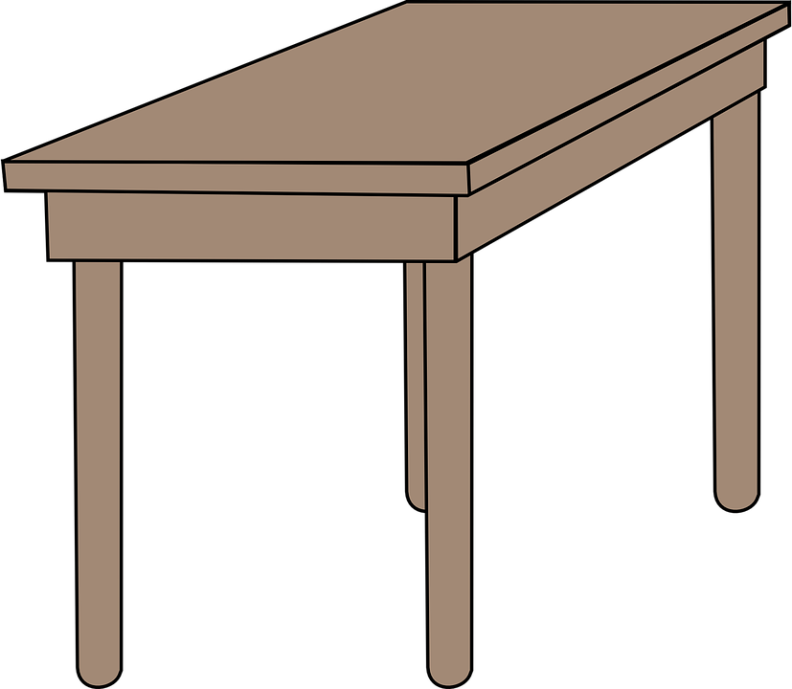
handout
¡A hablar!
hablar
Persona A: Round 1
Persona A: Round 2
1. ___ _______ a sheet.
2. ___ _______ a pencil.
3. ___ _______ a boat.
4. ___ _______ a horse
5. ___ _______ a word.
1
2
3
4
5
Tengo…
Tienes…
Notes:
Person A handout

Slide 13
Handout
¡A hablar!
hablar
Persona B: Round 1
Persona B: Round 2
1
2
3
4
5
1. ___ _______ a dog.
2. ___ _______ a (female) teacher.
3. ___ _______ an idea.
4. ___ _______ a bottle.
5. ___ _______ a ruler.
Tengo…
Tienes…
Notes:
Person B handout

