Slide 1
español, con Quique

Slide 2
Describing me and others
amarillo
- tener’: 1st & 3rd person singular
- SSC [ci]
Notes:
Artwork by Steve Clarke. All additional pictures selected are available under a Creative Commons license, no attribution required.
The frequency rankings for words that occur in this PowerPoint which have been previously introduced in the resources are given in the SOW (excel document) and in the resources that first introduced and formally re-visited those words.
For any other words that occur incidentally in this PowerPoint, frequency rankings will be provided in the notes field wherever possible.
Phonics: [ci] decir [32]
Vocabulary: tiene [19] dibujo [1726] hermano [333] hermana [3409] mesa [525] perro [888] profesor, profesora [501] puerta [274]
Revisit 1: eres [7] (recycle adjectives) de1 [2] Inglaterra [n/a] España [n/a] Perú [n/a]
Revisit 2: estar [21] estoy [21] está [21] presente [1114] ausente [>5000] aquí [130] allí [197] hola [1245]
Glossed words: el [1] la [1] palabra [192] posible [427]
Source: Davies, M. & Davies, K. (2018). A frequency dictionary of Spanish: Core vocabulary for learners (2nd ed.). Routledge: London

Slide 3
pronunciar
[ci]
decir
Notes:
Timing: 1 minute
Aim: To introduce SSC [ci]
Procedure:
Introduce and elicit the pronunciation of the individual SSC [ce] and then the source word ‘centro’ (with gesture, if using).
Click to bring the picture & get students to repeat (with gesture, if using).

Slide 4
pronunciar
Con tu compañero/a, pronuncia:
5
cinco
paciencia
12
cielo
cine
S
cocina
ciudad
diciembre
0
INICIO
Notes:
Timing: 3 minutes
Aim: To develop phonological awareness of [ci]
Procedure:
In pairs, pupils have to pronounce the words themselves and apply their SSC knowledge of [ci]
Teacher gives feedback and pupils listen and repeat. Click on the words to hear the audio, as required.
Partner A sits with their back to the board whilst partner B reads aloud the first four words that appear in animation. Partner A writes the word. Partner then swap roles for the remaining three words. They can check their spellings when they turn back to face the board. Teachers should circulate to listen to students’ pronunciation and praise/correct as necessary.
Finally, click inicio for pupils to try to say all the words in 12 seconds.

Slide 5
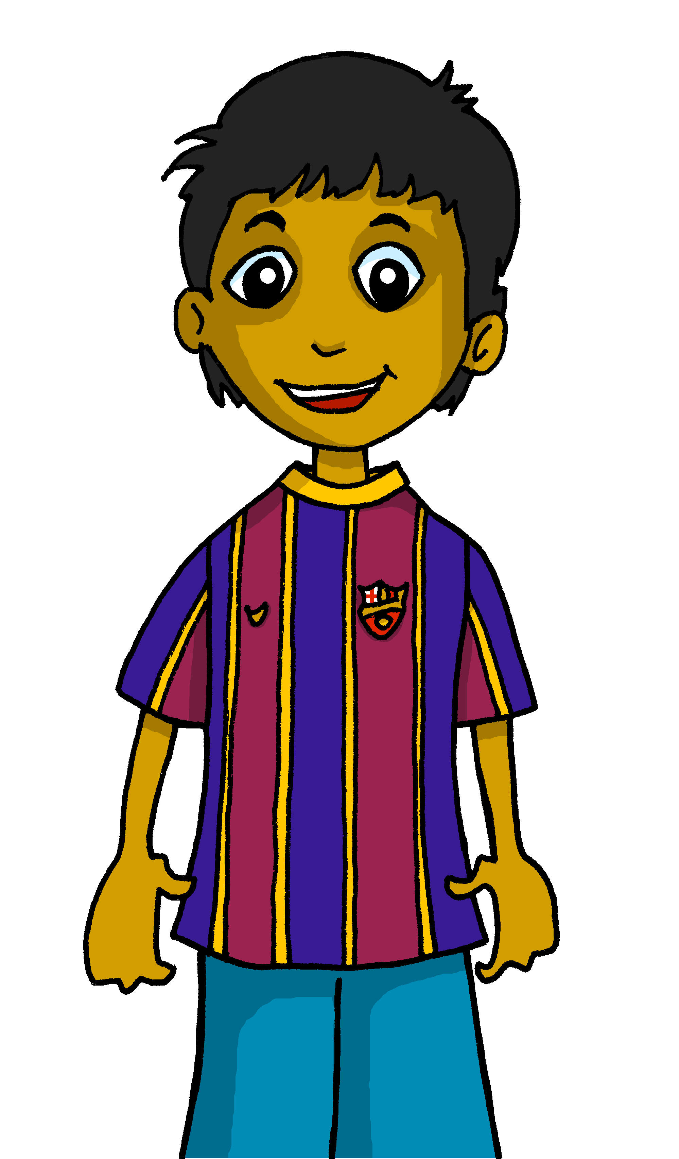
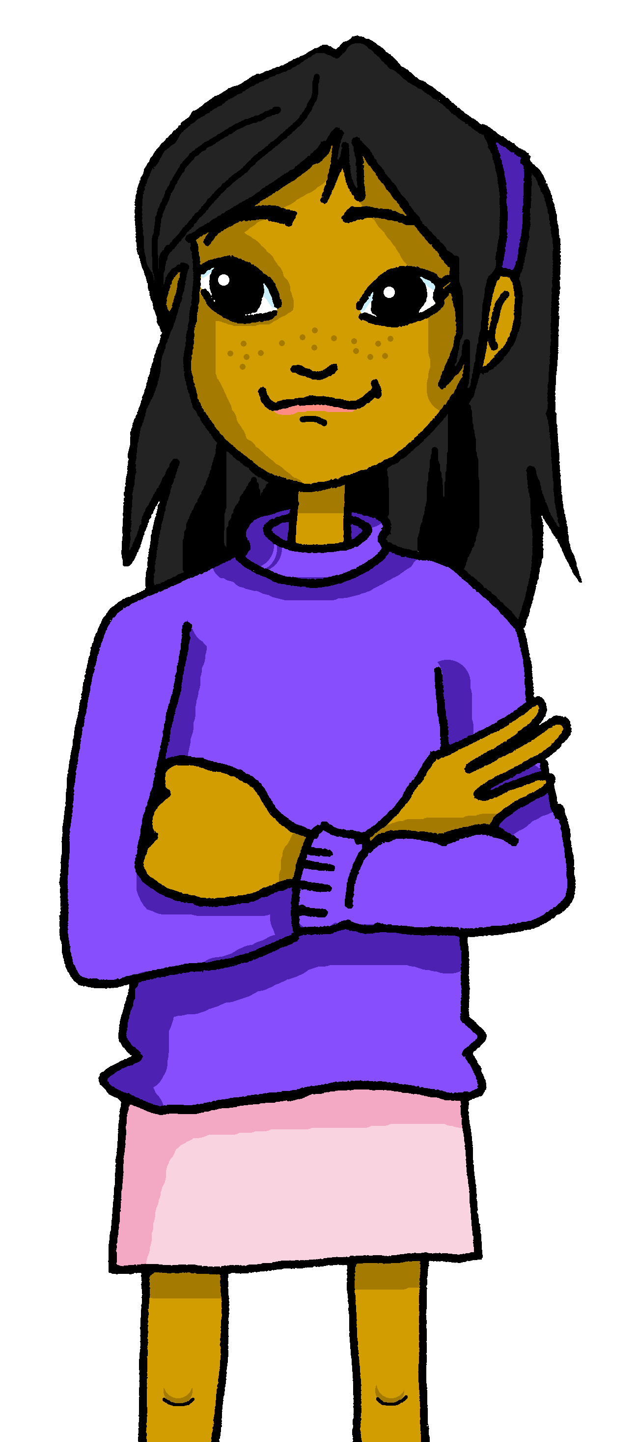
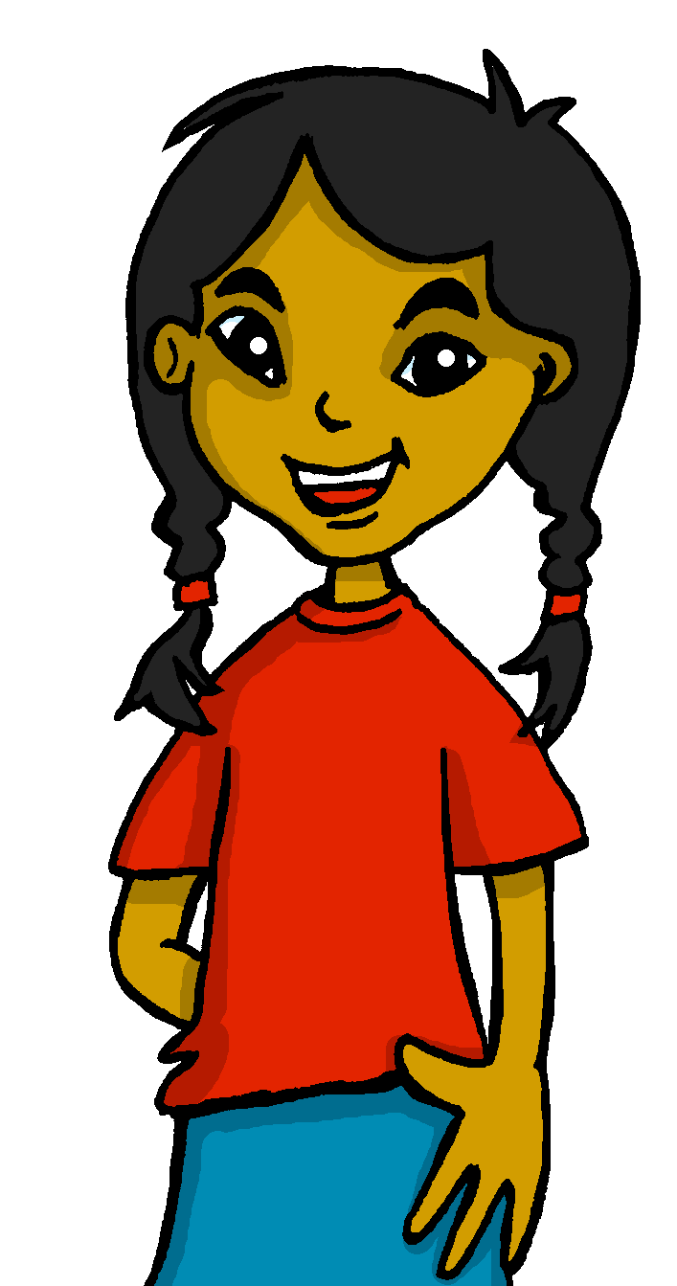
Tener: I have & s/he, it has
[to have | having]
We have already seen the verb tener means ‘to have’.
I
S/he, it
To refer to I, we use ‘tengo’.
To refer to s/he or it, we use ‘tiene’.
Mi amigo es Rubén.
Mi amiga es Elena.
Tengo un amigo.
Sofía tiene una amiga.
I have a (male) friend.
Sofía has a (female) friend.
She has a (female) friend.
Notes:
Timing: 3 minutes
Aim: to revisit 1st and 3rd person singular of ‘tener’.
Procedure:
Read the grammar explanation on tener (to have).
Elicit English translation for the Spanish examples provided.

Slide 6
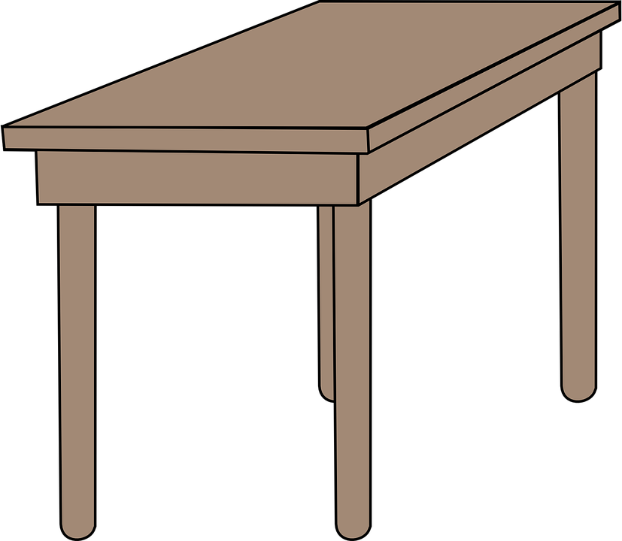
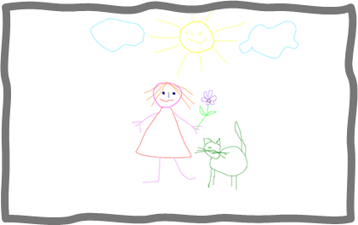
leer
Max, un amigo de Inglaterra
Quique has a penpal friend, Max.
He is learning Spanish.
Max and Quique are learning about Spain and English schools in lessons.
To refer to a female teacher, we say ‘una profesora’.
En clase tengo…
una mesa
un dibujo
un profesor
una puerta
Notes:
Timing: 3 minutes
Aim: to introduce Max, a new character & 3 new items of vocabulary.
Procedure:
Click x2 to bring up text in English and clarify who Max is
Click to bring up speech bubble – explain to pupils that Max is telling Quique what his classroom is like
Introduce x4 new items of vocabulary: 1) get students to repeat the word 2) bring up the picture

Slide 7
leer
En clase
¿Quién tiene el objeto?
el = the
la = the
(la) palabra = word
Escribe la palabra.
E
E Tiene un profesor.
Quique (I) | Max (he)
1
1 Tiene un perro.
2 Tengo una hermana.
2
hermana
profesor
3 Tengo una cama.
3
cama
perro
4
4 Tiene una puerta.
mesa
puerta
5
5 Tengo una mesa.
6
6 Tiene un caballo.
caballo
Notes:
Timing: 5 minutes
Aim: to practise reading comprehension of ‘tiene’ and ‘tengo’.
Procedure:
Read the title
Click x2 to bring up context and clarify – Quique writes about what he has and Max has.
Click x1 to bring up instruction in Spanish – draw their attention to the meaning of ‘palabra’
Paying attention to the verb, pupils write the Spanish word for the object in the correct column.
Do [E] with them.
Next slide focuses on meaning.
el/la [1] palabra [192]

Slide 8
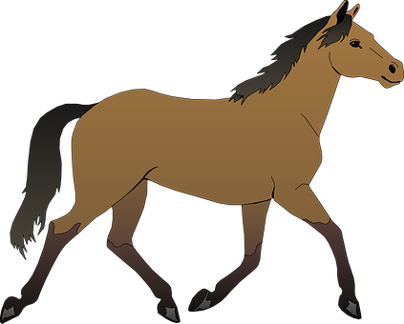
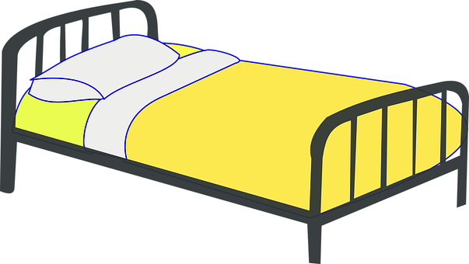
leer
En clase
posible = possible
¿Qué objeto es? Escribe la letra (a, b, c…)
hablar
Lee las frases. ¿Es posible?
¿Es imposible?
c
¡Reacciona 🤔!
E Tiene un profesor.
A
B
e
‘Tiene un profesor’
¡Es posible!
1 Tiene un perro.
b
2 Tengo una hermana.
g
3 Tengo una cama.
a
b
d
4 Tiene una puerta.
f
d
5 Tengo una mesa.
f
e
6 Tiene un caballo.
g
a
c
Notes:
Timing: 4 minutes
Aim: to practise reading comprehension of both newly introduced and revisited vocabulary & apply logic to the statements.
Procedure:
Focus on meaning – pupils to match the sentence with the correct picture(s).
Go through the answers
Click x2 to bring up instruction – speaking activity.
Click x2 to bring up speech bubbles and model the conversation.
Pupil take turns to read statements 1-6 and react to them according to whether they are logical in this context (classroom).
Posible [427]

Slide 9
escuchar
En clase
Escribe la palabra en inglés.
Quique habla. ¿Quién tiene el objeto?
Marca
 | Quique (I) | Max (he) | objeto
E
pen
1
drawing
2
female teacher
3
plant
(la) palabra = (the) word (el) objeto = (the) object
4
table
Notes:
Timing: 4 minutes
Aim: to practise aural comprehension of ‘tengo’ & ‘tiene’.
Procedure:
Read the title & click to bring up the instructions in Spanish.
Do the example (E).
Click to bring up instruction for the challenge. Encourage most able pupils to write down in English the object.
Click to bring up animation / answers.
5. Listen x1 and ask pupils to write down the English word for the objects mentioned.
6. Click to bring up animation / answers.
Transcript
Ej. Tengo un boli.
Tiene un dibujo.
Tengo una profesora.
Tiene una planta.
Tengo una mesa.
El/la [1] palabra [192]

Slide 10
vocabulario
Escribe en inglés: Can you get at least 15 points?
 | hola | estoy | presente
 | aquí | estar | allí
 | España | eres | de
 | preparada | cómodo | Inglaterra
 | un perro | una mesa | tengo
 | una profesora | una puerta | un dibujo
 | tiene | una hermana | un profesor
hello
I am (state)
present
x3
here
to be, being (state)
there
Spain
you are (trait)
from
x2
ready (f)
comfortable (m)
England
a dog
a table
I have
a female teacher
a door
a drawing
x1
s/he has
a sister
a male teacher
Notes:
Timing: 6 minutes
Aim: to practise written comprehension of vocabulary from last week and this week.
Procedure: 1. Give pupils a blank grid. They fill in the English meanings of any of the words they know, trying to reach 15 points in total.
Note: The most recently learnt and practised words are pink, words from the previous week are green and those from two weeks ago are blue, thus more points are awarded for them, to recognise that memories fade and more effort (heavy lifting!) is needed to retrieve them.

Slide 11
¡adiós!
amarillo

Slide 12
Handout
Escribe en inglés: Can you get at least 15 points?
 | hola | estoy | presente
 | aquí | estar | allí
 | España | eres | de
 | preparada | cómodo | Inglaterra
 | un perro | una mesa | tengo
 | una profesora | una puerta | un dibujo
 | tiene | una hermana | un profesor
vocabulario
x3
x2
x1
Notes:
Timing: 6 minutes
Aim: to practise written comprehension of vocabulary from last week and this week.
Procedure: 1. Give pupils a blank grid. They fill in the English meanings of any of the words they know, trying to reach 15 points in total.
Note: The most recently learnt and practised words are pink, words from the previous week are green and those from two weeks ago are blue, thus more points are awarded for them, to recognise that memories fade and more effort (heavy lifting!) is needed to retrieve them.

