Slide 1
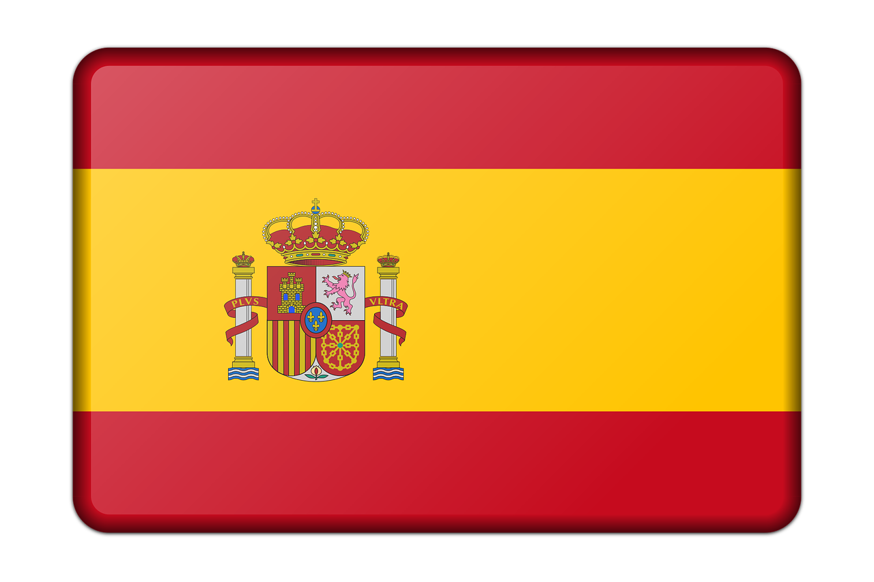
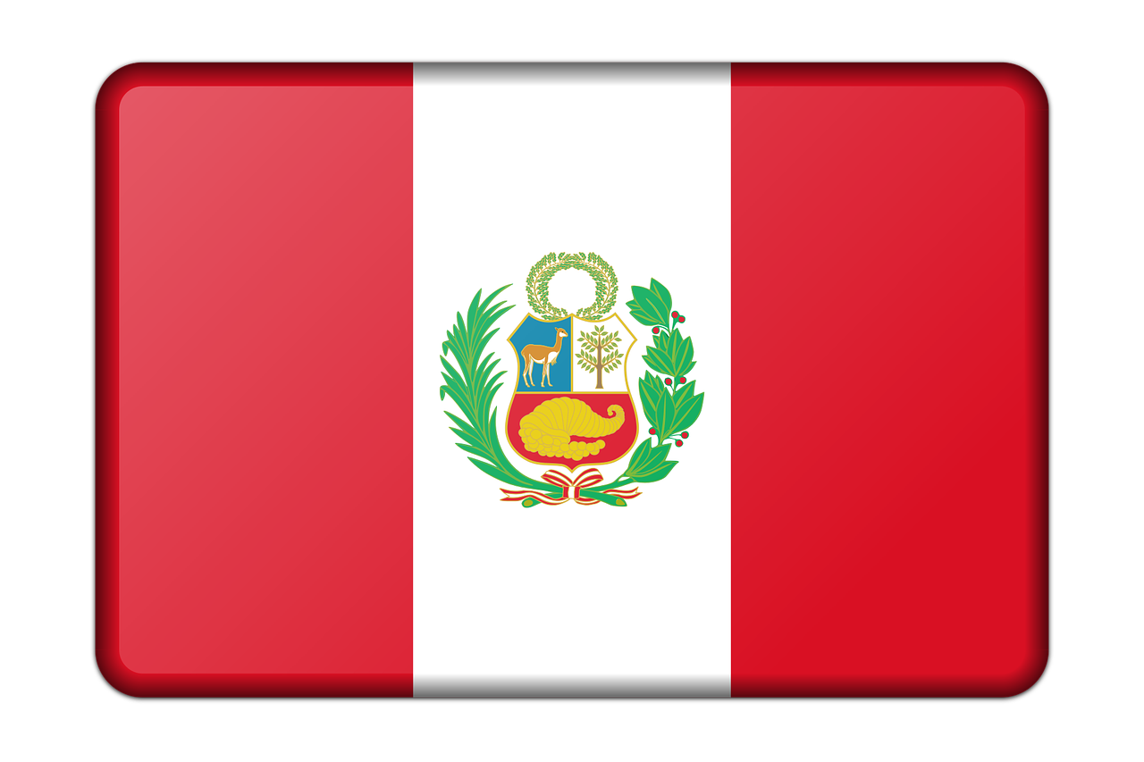
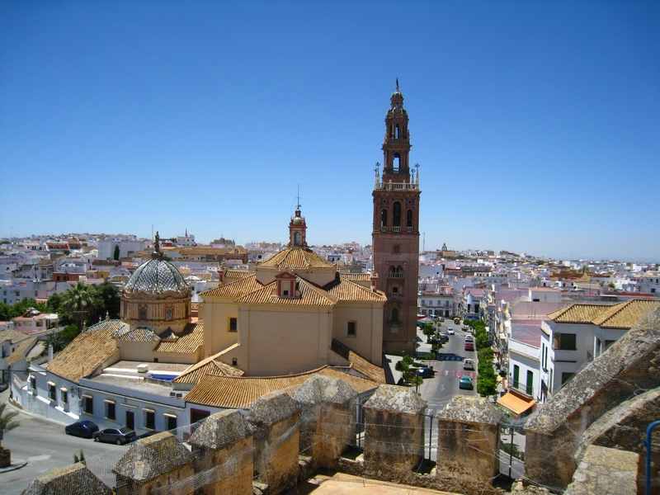
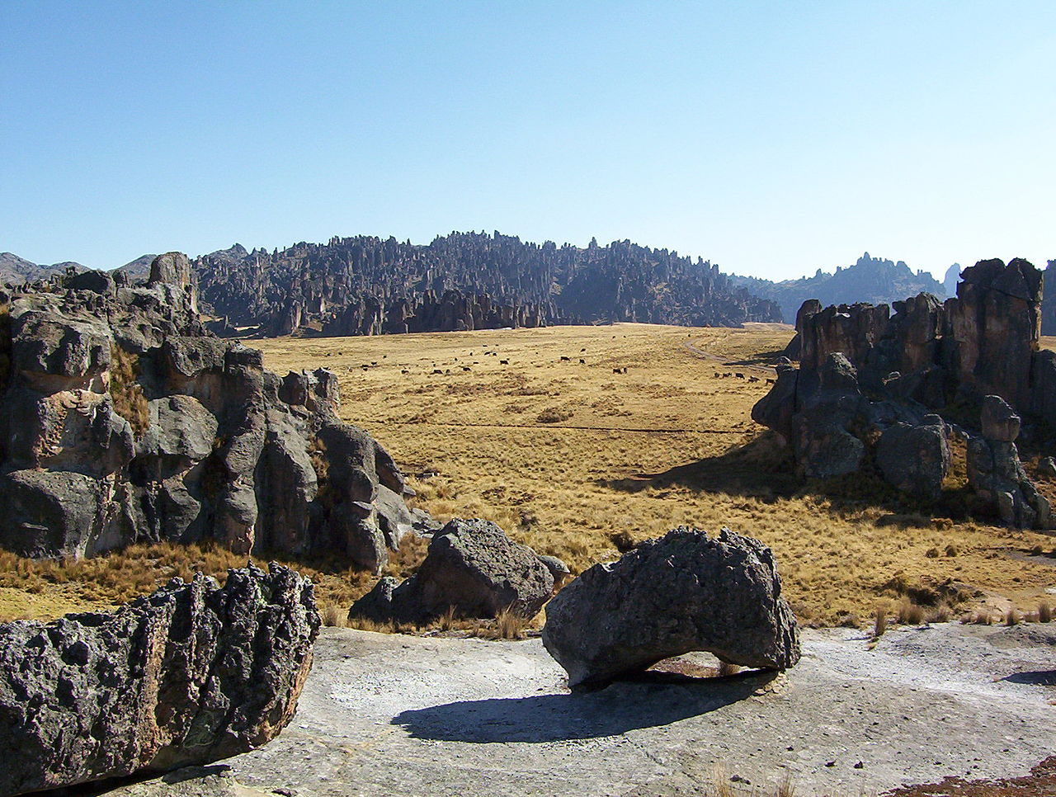
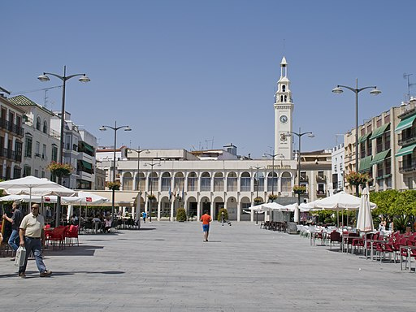
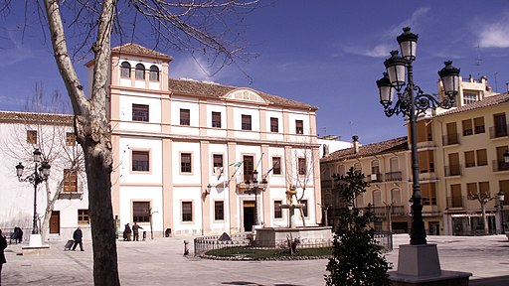
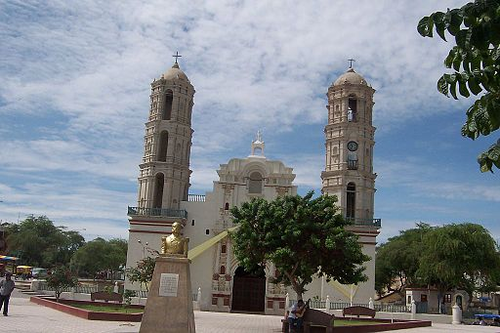
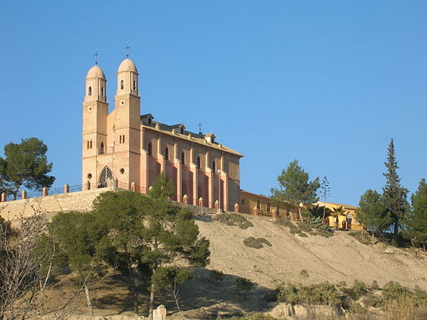
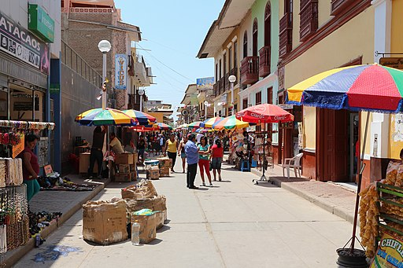
España y Perú Read aloud the Spanish name of each place.
España y Perú Read aloud the Spanish name of each place.
You have not learnt these words so just use what you know about how to pronounce Spanish. ☺
Concentrate on the underlined letters.
You have not learnt these words so just use what you know about how to pronounce Spanish. ☺
Concentrate on the underlined letters.
1 | 2 | 3
4 | 5 | 6
1 | 2 | 3
4 | 5 | 6
Carmona
Pasco
Cusco
Carmona
Pasco
Cusco
Lucena
Algeciras
Baza
Lucena
Algeciras
Baza
7 | 8 | 9 | 10
7 | 8 | 9 | 10
Sechura
Cieza
Sicuani
Catacaos
Sechura
Cieza
Sicuani
Catacaos
For numbers 8, 9 and 10 write the number of syllables in each word here: 8. [___] 9. [___] 10. [___]
For numbers 8, 9 and 10 write the number of syllables in each word here: 8. [___] 9. [___] 10. [___]
Notes:
Pupil handout To copy and cut in half
Information source: https://en.wikipedia.org/wiki/List_of_cities_in_Peru Image attribution: Carmona - Pufacz, Public domain, via Wikimedia Commons Pasco - [Bernd Wolniczak], CC BY-SA 4.0 via Wikimedia Commons Cusco - Peruwikila, CC BY-SA 3.0 <via Wikimedia Commons Lucena - lberto Cabello from Vitoria-Gasteiz, Spain, CC BY 2.0 via Wikimedia Commons Algeciras - Paolichy, CC BY-SA 4.0 via Wikimedia Commons Baza - Rimantas Lazdynas, CC BY-SA 3.0 via Wikimedia Commons Sechura - No machine-readable author provided. Alfredobi assumed (based on copyright claims)., Public domain, via Wikimedia Commons Cieza - No machine-readable author provided. Lionni assumed (based on copyright claims)., Public domain, via Wikimedia Commons Sicuani - Ant.rios2013, CC BY-SA 4.0 via Wikimedia Commons
Catacaos - Bernard Gagnon, CC BY-SA 3.0, via Wikimedia Commons
Links to licences:
https://creativecommons.org/licenses/by/2.0 https://creativecommons.org/licenses/by-sa/3.0 https://creativecommons.org/licenses/by-sa/4.0

